Slide 1
Identifying Features Impacting Healthcare Videos on Youtube Using Face Recognition Methods and BERT Model
By
Jahnavi Chadalavada
Computer Science Department University of Central Missouri Lees Summit, MO, USA

Slide 2
Motivation
Recent research in Information Systems (IS) suggests that there is an increasing usage towards videos to administer self – health.Studies suggest that one in three US adults use the Internet to diagnose or learn about a health concern. However, such access to health information online could exacerbate the disparities in health information availability and use.
Even though social media offers an excellent conduit for encouraging patients to increase their knowledge on health literacy, there is a significant challenge in producing fair and transparent recommendations that address the needs of every user.
we need a fair and bias-minimizing approach that ensures recommendations are not skewed against a particular demographic group or set of ideas.
Hence there is need to understand which features has more impact on views of healthcare videos.

Slide 3
Objectives
This project is an empirical valuation, considering YouTube videos as the primary dataset, and trying to identify features influencing video engagement.
Diabetes-related videos are collected from YouTube and their metadata using YouTube Data API.Around 350 videos are collected using most relevant search words related to diabetes.
YouTube Videos are Converted into frames and using OpenCv.
Extract gender,age and race information using DeepFace framework.
Retrieve medical information using BERTopic.
Run ML algorithms to identify which feature has more influence on view count of videos.

Slide 4
Related work
YouTube for Patient Education: A Deep Learning Approach for Understanding Medical Knowledge from User-Generated Videos [1].
Identifying content unaware features influencing popularity of videos on YouTube: A study based on seven regions [2].
Hyperextended lightface: A facial attribute analysis framework [6].

Slide 5
Problem Statement
To produce fair and transparent recommendations of healthcare videos.we need to understand the biases associated with demographic characters of actors/presenters and medical information in the healthcare videos on youtube.
Hence the need to understand which features impact views of healthcare videos is very high.

Slide 6
Proposed Solution
Project structure has three main steps as below.
Data Collection
The primary source for data is YouTube.YouTube API is used to extract data from the YouTube.Videos are downloaded using youtube video downloaders.
Data preprocessing
To extract facial attributes first we need to convert videos into frames.OpenCV (Open Source Computer Vision Library) library is used to convert videos into frames.
To extract facial attributes DeepFace is used.DeepFace is a popular open-source face recognition and facial attribute analysis library that is built on top of Keras,TensorFlow, and OpenCV.
Perform Topic Modelling to extract medical information from video subtitles using BerTopic [4].Bertopic is a topic modeling algorithm that uses a pre-trained BERT (Bidirectional Encoder Representations from Transformers) language model to encode text data and cluster similar documents into topics.

Slide 7
Data analysing using Machine learning techniques.
Knowing which features are important in a machine learning model is essential for understanding how the model is making its predictions and for optimizing the model’s performance.
One of the simplest methods to assess the importance of features is by analyzing the coefficients of the model.
Many machine learning algorithms, such as logistic regression,decision trees, random forests, and gradient boosting models, provide feature importance scores that indicate how much each feature contributes to the model’s performance. These scores can be used to identify the most important features in the data.For example, in scikit-learn, you can use the feature importances attribute of a trained tree-based model to retrieve the feature importance scores.

Slide 8
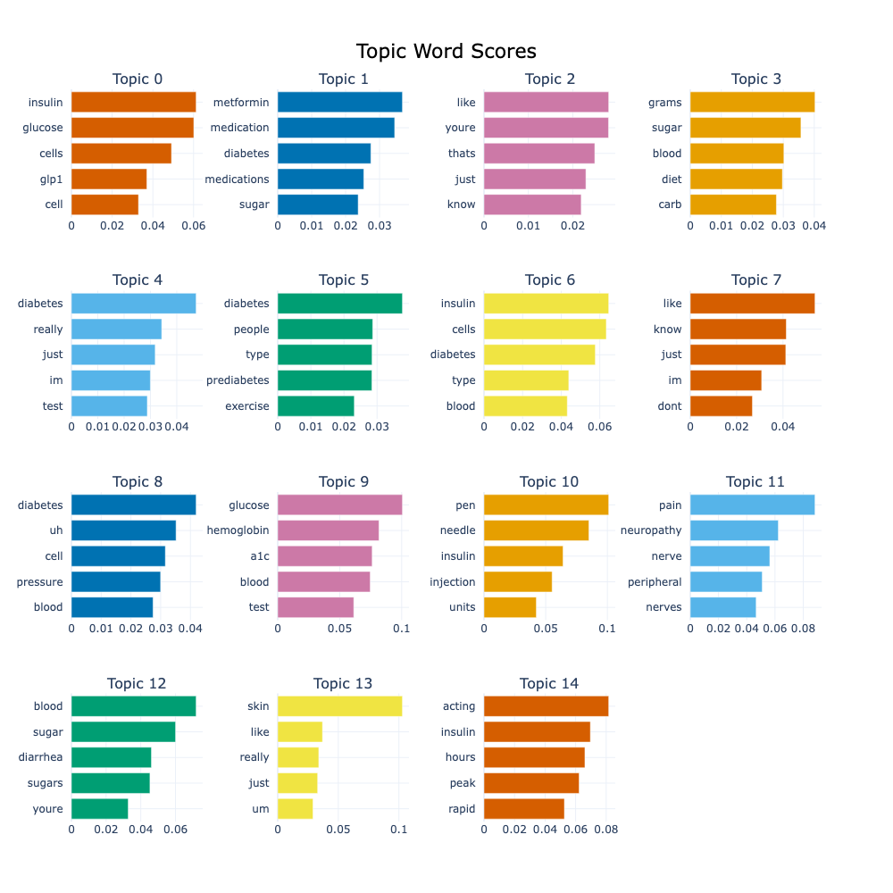
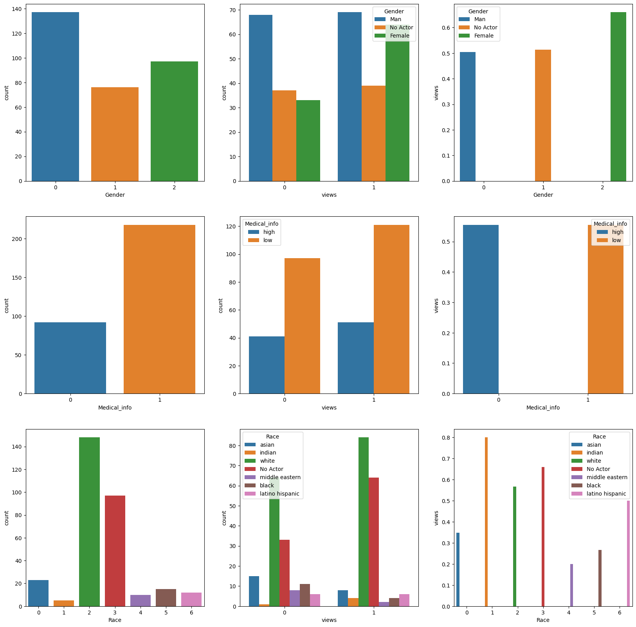
Results

Slide 9
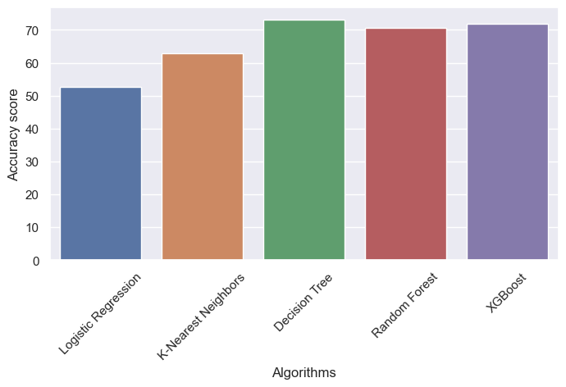
Results

Slide 10
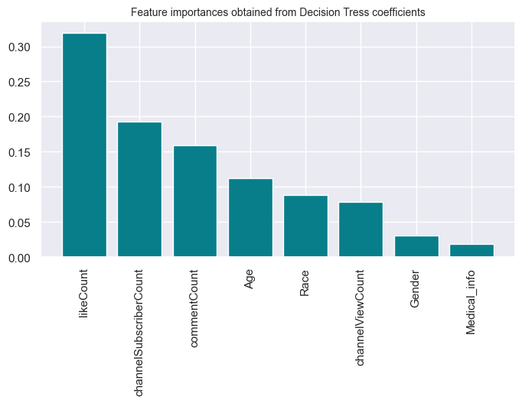
Results

Slide 11
References
Liu, X., B. Zhang, A. Susarla, R. Padman, “YouTube for Patient Education: A Deep Learning Approach for Understanding Medical Knowledge from User-Generated Videos,” 2018 KDD Workshop on Machine Learning for Medicine and Healthcare, London, UK, August 2018
Halim, Z., Hussain, S., & Ali, R. H. (2022). Identifying content unaware features influencing popularity of videos on youtube: A study based on seven regions. Expert Systems with Applications, 206, 117836.
Ladhak, F., Durmus, E., Cardie, C., & McKeown, K. (2020). WikiLingua: A new benchmark dataset for cross-lingual abstractive summarization. arXiv preprint arXiv:2010.03093.
Liu, C., Wang, D., Liu, C., Jiang, J., Wang, X., Chen, H., ... & Zhang, X. (2020). What is the meaning of health literacy? A systematic review and qualitative synthesis. Family medicine and community health, 8(2).
Pitoura, E., Stefanidis, K., & Koutrika, G. (2022). Fairness in rankings and recommendations: an overview. The VLDB Journal, 1-28.
Serengil, S. I., & Ozpinar, A. (2021, October). Hyperextended lightface: A facial attribute analysis framework. In 2021 International Conference on Engineering and Emerging Technologies (ICEET) (pp. 1-4). IEEE.
Thelwall, M., & Foster, D. (2021). Male or female gender-polarized YouTube videos are less viewed. Journal of the Association for Information Science and Technology, 72(12), 1545-1557.
Krishna Pothugunta, Xiao Liu, Anjana Susarla, Rema Padman.On Curating Responsible and Representative Healthcare Video Recommendations for Patient Education and Health Literacy: An Augmented Intelligence Approach (https://doi.org/10.48550/arXiv.2207.07915)

Slide 12
Thank You

