Slide 1

H e l l o

Slide 2
show

Slide 3
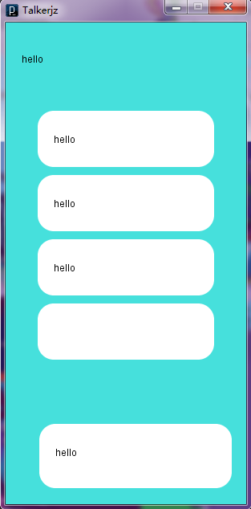
Talkerjz

Slide 4
collect

Slide 5



Slide 6
Analyse

Slide 7
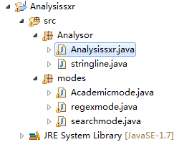
Analysissxr

Slide 8
Dream
For own
personality

Slide 9
Bye

