Slide 1
Python Testing with Pytest
VegasPy August 2023
Jak Crow
github.com/jxcrw/vegaspy-pytest
Notes:
- Story time ☺

Slide 2
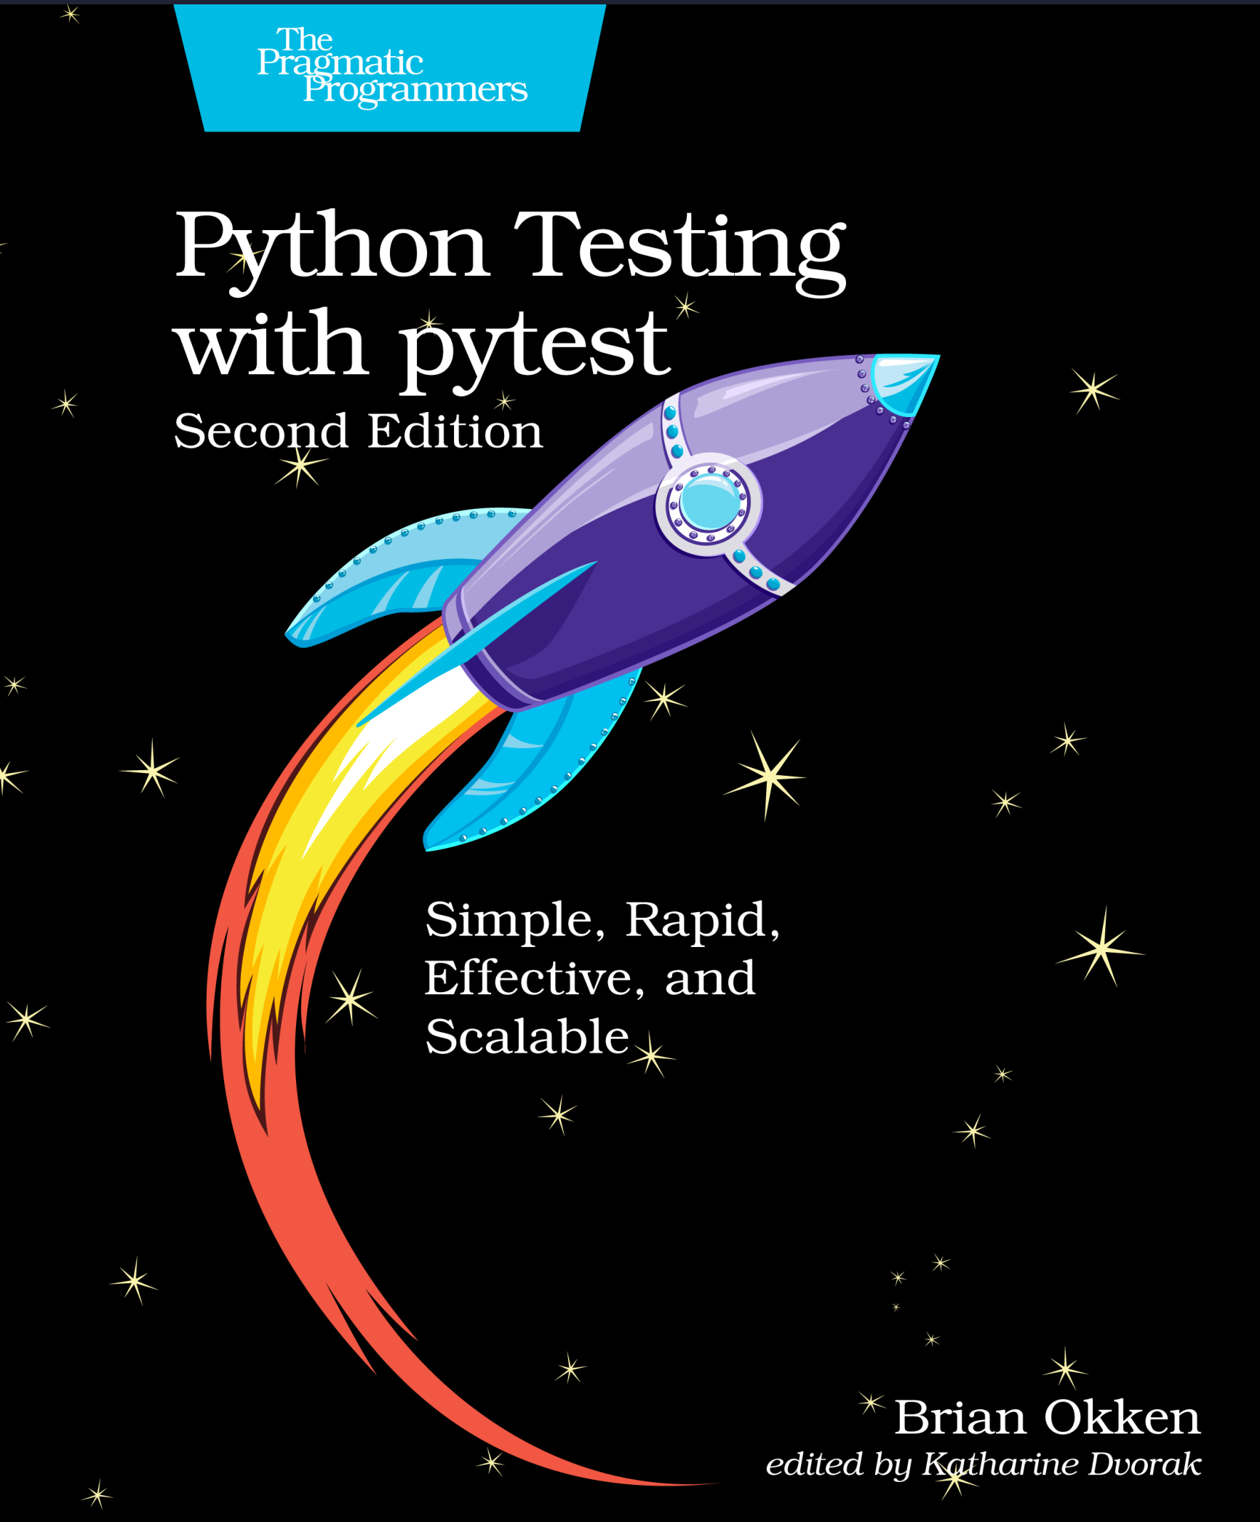
Credit Where It’s Due
Fast reading, excellent content
Learn by testing real app

Slide 3
Why pytest?
Simplicity: tests are super easy to write (and read!).
Almost zero cognitive overhead (just assert!).
Runs tests written for unittest/nose.
Integrates with CI/CD + IDEs + automation tools.
Extendable with custom + third-party plugins.
Large, active open-source dev community.
Shut up and show us some code nerd. 🤓
Notes:
Overview of python testing space.
test_0_hello_pytest.py
Not even an import required.
Test functions must start with “test_”.
Test files must start with “test_” or end with “_test”.
Override `assert` keyword.
Show running test in terminal.
Show running with –v option.
Can specify test dirs, files, classes, functions, patterns, etc.
test_1_lib_pytest.py + test_1_lib_unittest.py
Just show quick comparison of pytest vs unittest.

Slide 4
Cards App Demo
Super simple task (card) management app.
Noteworthy packages: rich, typer, tinydb.

Slide 5
Structuring Test Functions
Common pattern: arrange-act-assert/given-when-then.
Anti-pattern: arrange-act-assert-act-assert... .
Doesn't focus on testing a single behavior.
Hard to determine original intent in future.
Notes:
Arrange – set up data/environment to do something.
Act – do something.
Assert – test for expected result/behavior.
Show example:
navi\python\pytest-okken\cards\src\test_card.py::test_to_dict().

Slide 6
Fixtures
Functions that run before or after tests (setup/teardown).
Prep data, network resources, app state, etc.
Strong fixturing support in pytest 💪
Notes:
Example: test_2_hello_fixture.py
Show running with --setup-show.
Then add scope=“module” to fixture decorator.
Example: navi\python\pytest-okken\cards\src\test_db.py
Scope scaffolding to maintain test order independence.
Be careful with this.
Multiple fixtures per test.
Show --fixtures flag to find where tests live.

Slide 7
Parameterization
Use a single test function to test many test cases.
Function parameterization.
Fixture parameterization.
Complex parameterization pytest_generate_tests().
Notes:
Example: navi\python\pytest-okken\cards\src\test_db.py → parameterization section

Slide 8
Markers
Used to indicate that a test is special in some way, or as tags/labels.
Built-in and custom (@pytest.mark.<custom_marker>)
Built-in Marker | Description
@pytest.mark.skip() | Skips a test, with an optional reason.
@pytest.mark.skipif() | Skips test if any of the conditions are True.
@pytest.mark.xfail() | Indicates that a test is expected to fail.
@pytest.mark.parametrize() | Test function parameterization.
@pytest.mark.usefixtures() | Indicates that a test needs all the specified fixtures.
@pytest.mark.filterwarnings() | Adds a warning filter to the given test.
Notes:
Just show quick examples: navi\python\pytest-okken\cards\src\test_card_markers.py
Custom markers provide another level of organization, but necessary?

Slide 9
Test Coverage
Doesn’t tell you whether test suite is good, just how much app code you hit.
Can inspect coverage with Coverage.py and pytest-cov.
`pytest --cov="dir"`
`pytest --cov="dir" --cov-report=html`
Beware of coverage-driven development.

Slide 10
Testing Strategies
Totally architecture-dependent. User-visible features usually a good place to start.
Consider: security, performance, loading, input validation, etc.
Test by app layer (UI/API/DB/etc.).
Here, UI/DB are thin to isolate dependencies, and so that testing API gives more bang for buck.
Test by category:
Recent - new features/fixes/refactors/etc.
Core - things that must work for product to be useful.
Risk - perhaps like third-party code .
Problematic - things that frequently break or get bug reports.
Expertise - features/algos only understood by a few people.
Initial test cases:
Happy path
Interesting input sets
Interesting starting states
Interesting ending states
Possible error states
Write explicit strategy and list cases before writing test code.
Document bugfixes with tests.
Test enough to sleep soundly at night.

Slide 11
Other Topics
Pytest config files
Mocking
CI with tox
Plugins
Advanced parameterization 🤯

Slide 12
That’s All :)
Questions/comments/feedback
Repo: github.com/jxcrw/vegaspy-pytest
Moar repo: github.com/jxcrw/navi/python/pytest-okken
VegasPy Discord: discord.gg/STFMeZ2W

Slide 13
Title
Note
Another note

