Slide 1
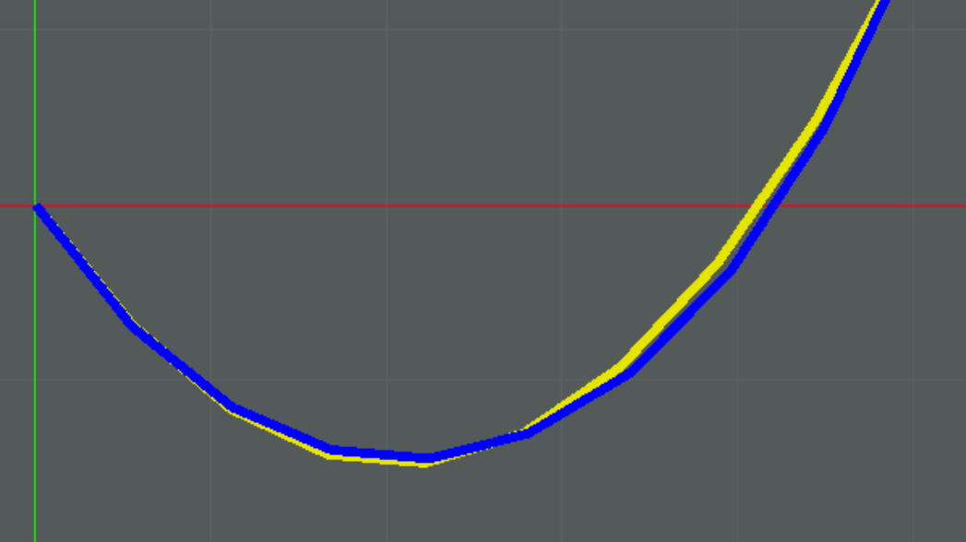

Godot Cable Models
Sponsor:
Los Alamos National Laboratory
Instructor: Pauline Wade
Mentor: David Mascarenas

Slide 2
Project Conception.
New Hanford Dry Retrieval Effort
Use of cleaning machinery in dangerous waste tanks.
Cable management takes engineer time.
Inefficient operation.
How might the problem be improved upon?
Simulate deformation of cables for future applications.

Slide 3
Algorithms Considered.
Finite Element Deformation
Used by engineers for precise accurate solutions.
Implicitly solved system
Truss elements, non-linear solving
Mass-Spring Evaluation
Used by animators as a naïve and/or efficient solution.
Explicit numerical simulation using a Semi-implicit Euler method.
Very fast, easy implementation, good enough for certain purposes.

Slide 4
Application.
Godot 4
Game Engine
Open source
Used for user interface and visual elements
Run Demo!
Notes:
Useful scene for viewing structure.
Show mass spring.
Redefine some parameters.
Add external lateral force. Observe motion.
Alter mass.
Examine statistics panel. Mention time analysis.
Look as results and future work.

Slide 5
Project Evaluation
User Testing
Five engineers and researchers from Los Alamos
Likert Scale responses
Open ended feedback.
Internal Checks for Stability
Many subcomponents require testing.
Basic input robustness tests.

Slide 6
Results and Future Work.
Important Features
3D implementation
Beter UI controls
Collision and friction consideration.
Decision Making Processes
Detecting cable crossing
Detecting bad tensions

Slide 7
Thank you for your consideration
Thomas Holt, Computer Science, Class of 2025
Mustafa Tekin, Computer Science, Class of 2025
John Mo, Computer Science, Class of 2025
Jordan Daryanani, Computer Science, Class of 2025
Jonathan Zhao, Computer Science, Class of 2025

