Slide 1
Creative Component Update
Jason Xie
Date: 01/28/2026

Slide 2
Overview
Learning HQC
Focusing on recent polynomial multiplication and sampling

Slide 3
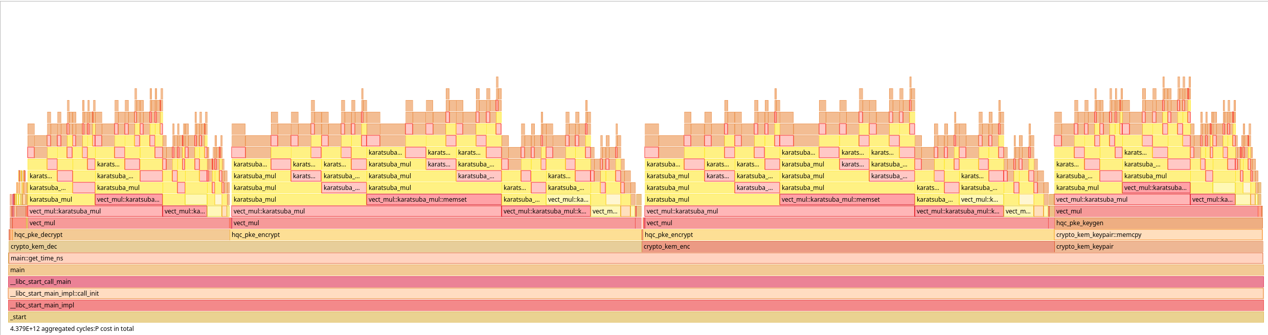
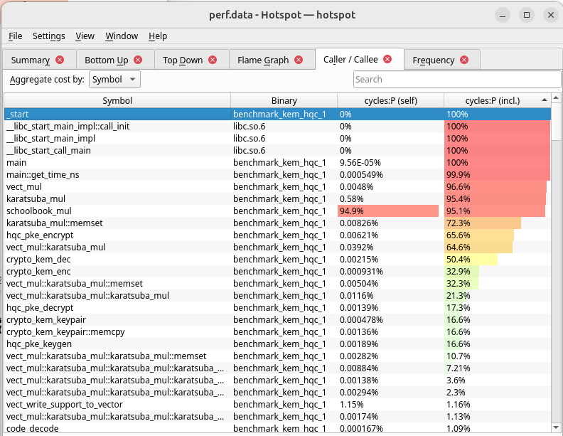
HQC-1 perf
Using Linux perf, we can see very clearly that the vector multiplication dominates all three functions
In other papers that provided similar metrics, but with different multipliers, the vector multiplication function still dominates the scheme

Slide 4
Recent approaches
Shift-and-add
Featured in earliest hardware implementations
Relies on sparsity?
Subject to recent side-channel attacks
Karatsuba and Toom-Cook
Featured in most recent official software implementation of HQC
Dense solvers that are generally inefficient on hardware
Suffers at larger vector lengths
Additive FFT
Complex hardware implementation
Hardware can be structurally similar to NTT (lattice)

Slide 5

Polynomial Multiplier
Non-exhaustive list of publications with optimizations or hardware implementations of polynomial multipliers

Slide 6
Other considerations
Relative to sparse solvers
Specification notes that multiplications should be performed “without taking account the sparsity” to avoid leakage
“Cyber-agility”
Relative papers cite motive that system ability to switch between schemes are important to applications
As noted, Additive FFT approaches like FAFFT are structurally similar to NTT multipliers and were subjects to accelerators targeting both lattice and code schemes

Slide 7
Short-term Tasks
Narrow down topic
Finish reading through existing hardware implementations publications for HQC
Finish reading recent sparse multiplier implementation
Finish reading KS+CRT and FAFFT paper
Gain better understanding of binary polynomial multiplication relative to HQC

Slide 8
Longer-term Tasks
Narrow down a topic

Slide 9

Binary Poly multiplication for HQC
Multiplication is done over $𝔽_{2} \left[x\right]/(x_{n}−1)$
$𝔽_{2} \left[x\right]$: Polynomials with coefficients that are either 1 or 0
Two polynomials are equal if they differ by a multiple of $(x^{n}−1)$
$c\left(x\right)=a\left(x\right)⋅b\left(x\right) mod (x^{n}−1)$

