Slide 1
Creative Component Update
Jason Xie
Date: 12/18/2025 -> 01/21/2026

Slide 2
Overview
Learning Falcon
Went through existing specifications
Played around with existing implementation
Learning HQC
Went through existing specifications
Looked through existing testbenches
Finished reading some earlier hardware implementations (Just trying to gain a better intuition of some of the operations)

Slide 3
HQC (FIPS-207) Motivation
4th round NIST selected HQC for FIPS-207
Believed it was a good backup for a general encryption standard to Kyber (ML-KEM) in case Lattice-based approaches prove vulnerable
So far, the only code-based standard to be selected
Limitations – per specifications:
Low encryption rates, so larger plaintexts -> increased parameters
Generally less efficient implementations compared to lattice-based KEMs

Slide 4
HQC in a nutshell
Key generation
Produces a public key pair and a secret key pair
Public key consists of a random polynomial and computed polynomial
Secret key consists of two sparse polynomials
Encapsulation
Given the public key, provides a derived shared secret key and cipher text
The cipher text contains encrypted noise under the public key, the random noise hashed (usually by SHAKE 256), and a salt string
Decapsulation
Given the secret key and KEM, returns a pass or fail
I’ve documented a more detailed breakdown on the functions’ algorithms in my Obsidian vault for future reference

Slide 5
HQC Bottlenecks and Limitations
Polynomial multiplication
Per the papers I’ve read, this is the most obvious computational bottleneck
Playing around with Linux Perf, we can see this clearly as well
All KEM and PKE functions are dominated by this operation
Most of the implementation papers from IACR alone are focused on improving this aspect
Known attacks on existing hardware implementations
Original and some existing hardware implementations are susceptible to side channel attacks
Some of these have already been “solved”, but I’d like to keep them in mind as provided solutions have some PPA trade-offs

Slide 6
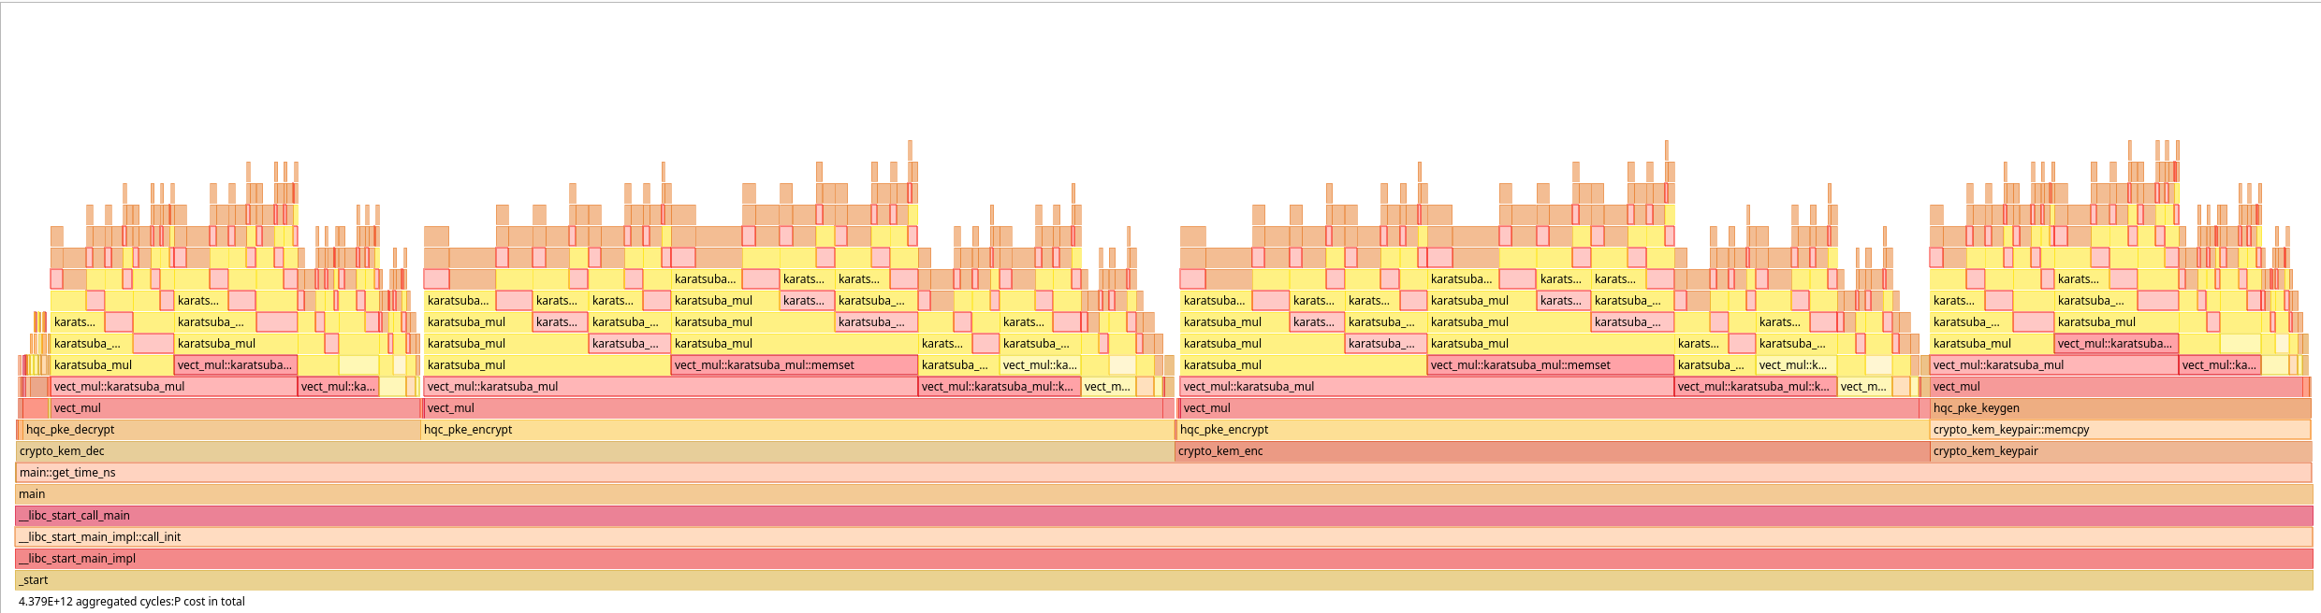
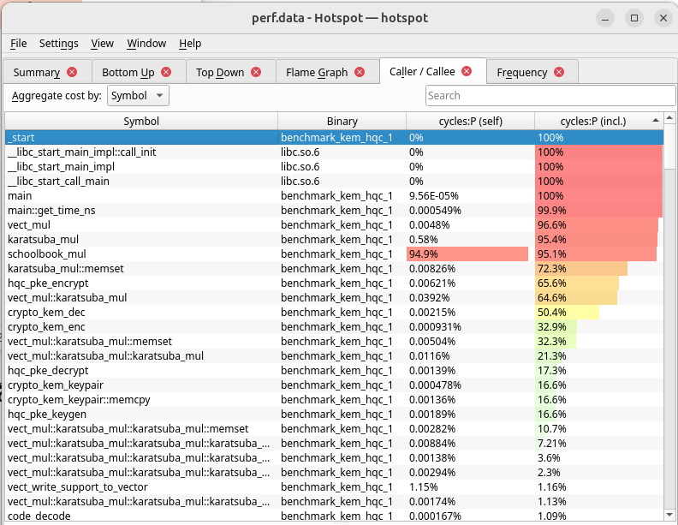
HQC-1 perf
Using Linux perf, we can see very clearly that the vector multiplication dominates all three functions
In other papers that provided similar metrics, but with different multipliers, the vector multiplication function still dominates the scheme

Slide 7
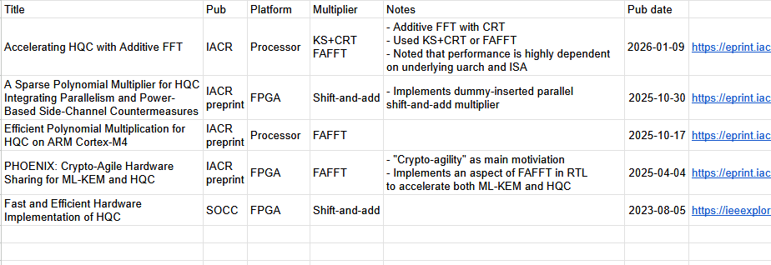
Polynomial Multiplier
Non-exhaustive list of publications with optimizations or hardware implementations of polynomial multipliers

Slide 8
Polynomial Multiplier
Official HQC implementation uses Toom-Karatsuba (TK)
FFT based multipliers
Frobenius Additive Fast Fourier Transform
Implemented on processor and RTL
Generally better for long mult instructions for processors than TK
Kronecker Segmentation + Chinese Remainder Theorem
Implemented on processor
Generally better for short mult instructions for processors than TK
Shift-add multipliers
Common in hardware implementations due to efficiency compared to TK
Implemented on processor and RTL
Naïve implementations subject to power side-channel attacks

Slide 9
Polynomial Multiplier
For processor and embedded platforms, it was noted that the best multiplier depends greatly on μArch and ISA
“Cyber agility” or the ability to switch between schemes was also a topic of another paper
Ie; since the FAFFT multiplier was similar to the NTT operation in ML-KEM (Kyber), the system could switch between schemes with low overhead

Slide 10
Key Recovery by Timing Side Channel Attacks
There have been a couple demonstrations by papers published on ITAR where the secret key could be recovered via timing attacks
These attacks could be mitigated by constant time implementations or masked implementations
In ITAR, there are three papers that speak on masked implementations, but I haven’t read them yet
It might be worth noting these papers are a bit older and this particular attack hasn’t been mentioned in most of the newer papers

Slide 11
Key Recovery by Power Analysis
Correlation Power Analysis (CPA) was first found in a paper attacking a BIKE FPGA implementation with a shift-and-add multiplier
Found that the sequential and index-driven nature of multiplier produced intermediate values in traces which allowed for key recovery
One solution was to insert dummies by duplicating some values during multiplication
This effectively introduces some noise in the traces and masks memory access, making key recovery by CPA much more difficult
Increase in PPA, but enables parallelism passively and protection from CPA

Slide 12
Message Recovery by RM Leakage
Last week, a preprint was released exposing a leakage point in the Reed Muller encoding process
By exploiting the bit-to-word expansion in the encoder, the full 128-bit message can be recovered
I haven’t finished reading this yet – but I felt this paper was notable as it’s the first attack on the encoder I’ve seen

Slide 13
Topic bank
Acceleration or optimization of polynomial multiplier?
Improve “cyber agility” for existing multipliers
Ie; explore reusability of parallel shift-add multiplier with dummies for NTT and Lattice based schemes (Like Kyber)
Implement or explore implementations of existing processor multipliers on RTL
Ie; KS+CRT multiplier
Explore multipliers used in other code-based scheme implementations
Ie; BIKE and Classic McEliece implementations

Slide 14
Short-term Tasks
Narrow down topic
Finish reading through existing hardware implementations publications for HQC published by ITAR
Exhaust publications regarding known attacks on existing hardware implementations
Finish reading RM leakage paper
Finish reading paper for masked implementation

Slide 15
Longer-term Tasks
Narrow down a topic

