Slide 1

Xoptfoil
AirfoilEditor

Slide 2
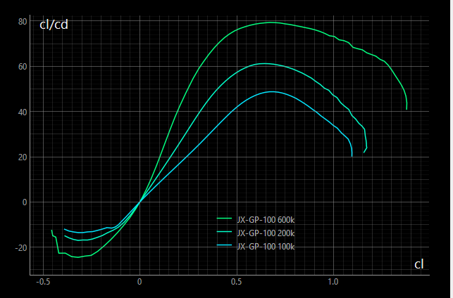
AirfoilEditor
Worker
Xfoil Polars
Xfoil

Slide 3
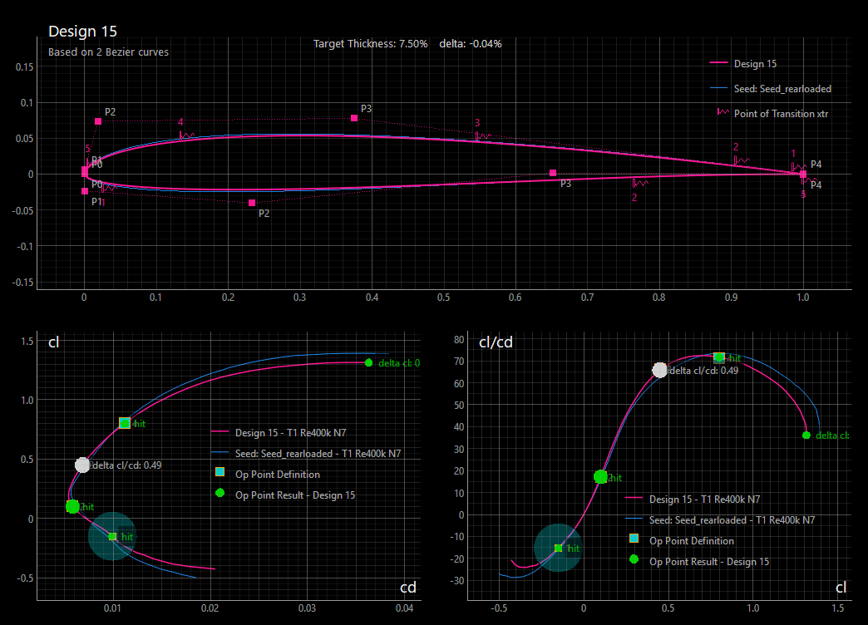
AirfoilEditor Optimization Mode
Input Data
Final Airfoil
Runtime
Info
Xoptfoil2
Xfoil

Slide 4
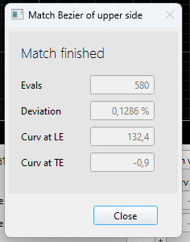
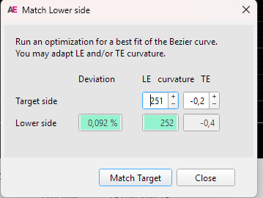
Match Bezier
Match Bezier
 | Deviation |  | LE curvature TE
Upper side
Target side
Weighting
Curvature at LE of target airfoil differs at upper and lower side. A new value is proposed and can be adapted
 | Deviation |  | LE curvature TE
Target side
Weight
Upper side
Curvature at LE of target airfoil differs at upper and lower side. A new value is proposed and can be adapted
0,34%
178
2,1
221
0,2
221
0,2
2,5
2,5
0,34%
178
2,1
Match Target
Close
Match Target
Close
Run an optimization for a best fit of the of lower side Bezier curve.
Targets of Match |  | Actual values
[ ] Achieve LE curvature
[ ] Limit TE curvature
[X] Minimize Deviation
221
178
0,2
2,1
0,34%

Slide 5

Merge Aifoils
Curvature at LE of target airfoil differs at upper and of target airfoil differs at upper and lower side. A new value is
Airfoil 1
Blended
Airfoil 2
MG 06 norm
34%
JX-GT-15
Close

