Slide 1

AirfoilEditor
PlanformCreator2

Slide 2

PlanformCreator2

Slide 3


Slide 4
Panelled Geometry,
Airfoils
Xflr5
Idea!
PlanformCreator2
FLZ
Improvement
CAD

Slide 5
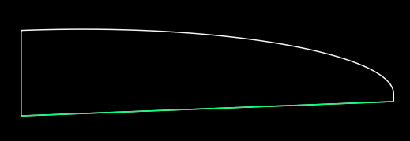
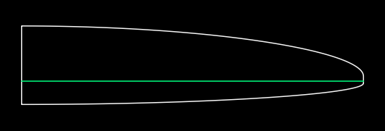
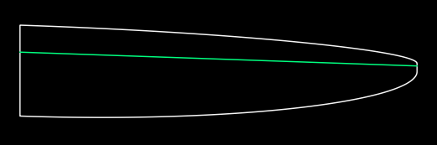

Slide 6
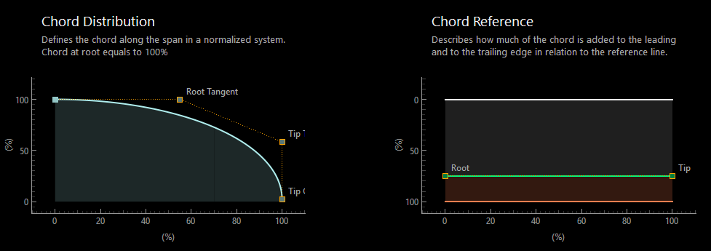

Slide 7
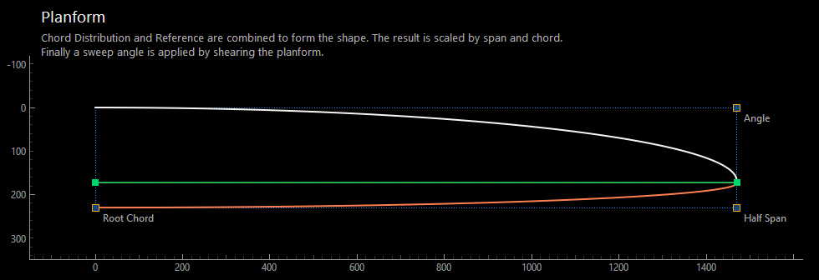

Slide 8


Slide 9


Slide 10


Slide 11


Slide 12



Hinge line equals Reference line
Seperate hinge line definition
Hinge line with a kink

Slide 13


Slide 14


Slide 15


sub-elliptical
over elliptical

Slide 16
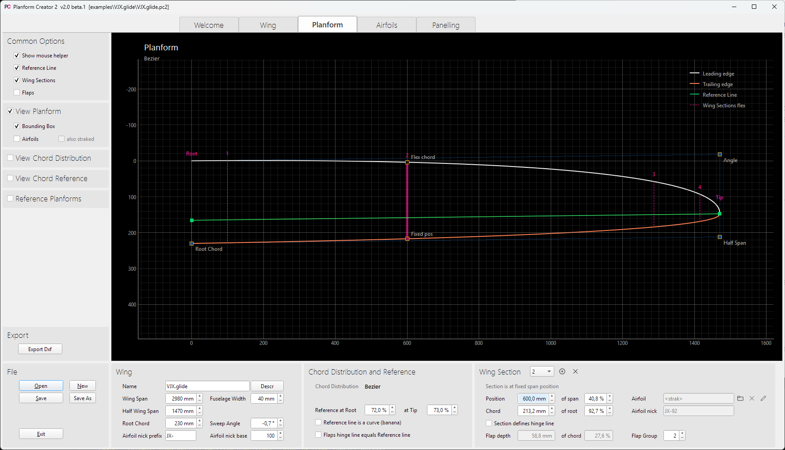
Main Views
Diagram Settings
Actions
Planform Paramter

Slide 17
Main Views
Diagram Settings
Actions
Planform Parameters

