Slide 1
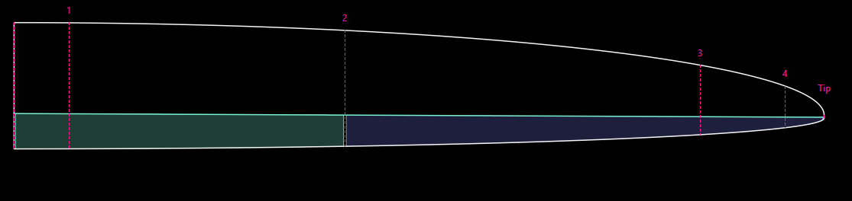
PlanformCreator2

Slide 2

AirfoilEditor
PlanformCreator2

Slide 3
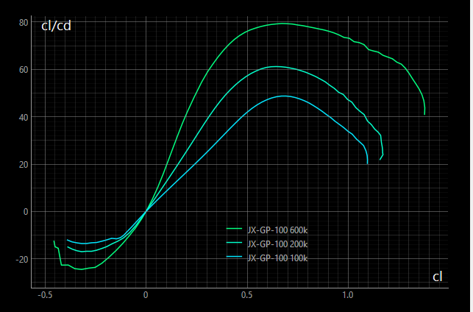
Planform Design
Performance Analysis
Panelled Geometry,
Airfoils
Xflr5
Idea!
PlanformCreator2
FLZ
Improvement
CAD
PlanformCreator2
Worker
Xfoil Polars
Xfoil

Slide 4
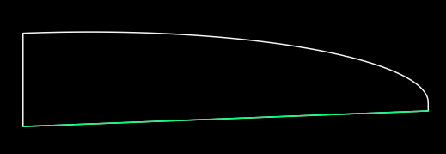
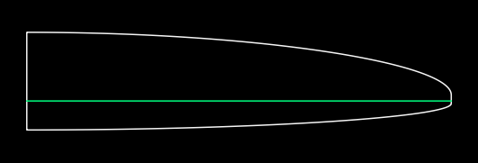
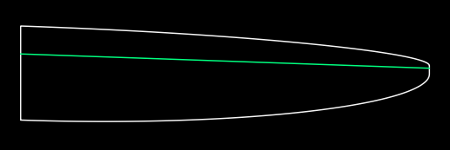

Slide 5
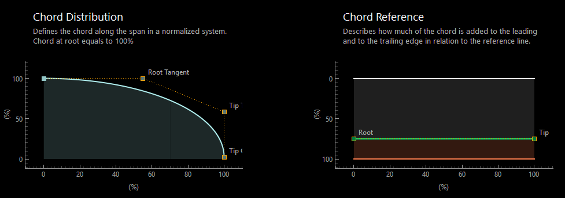

Slide 6
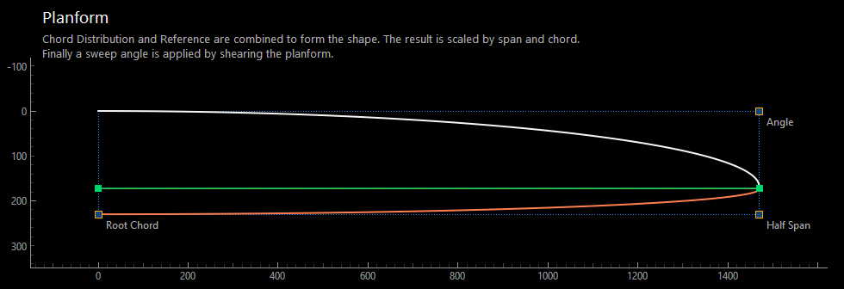

Slide 7
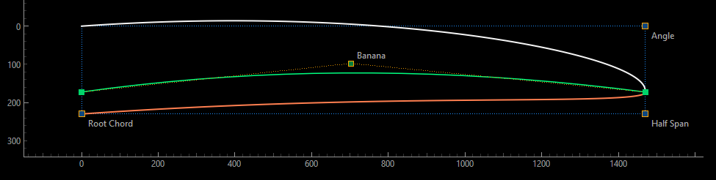

Slide 8
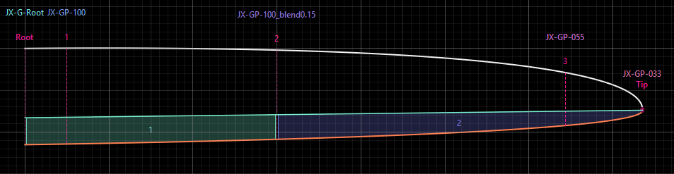

Slide 9
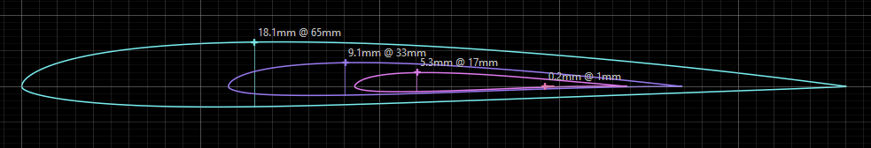

Slide 10
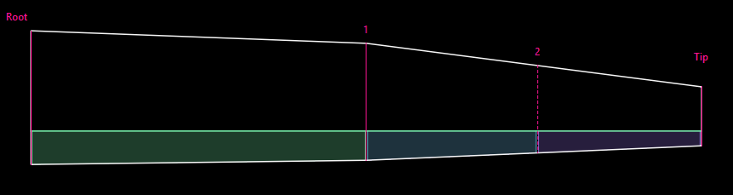

Slide 11
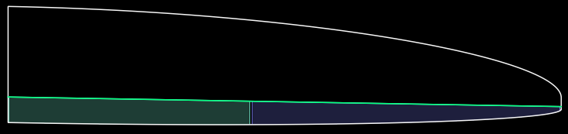
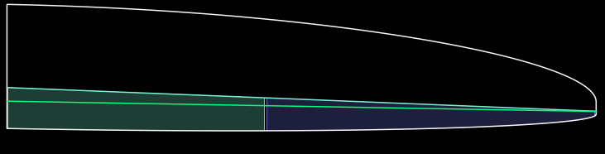
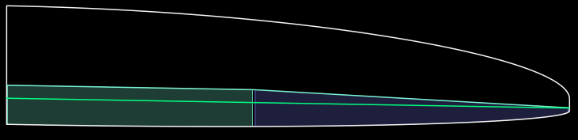
Hinge line equals Reference line
Seperate hinge line definition
Hinge line with a kink

Slide 12
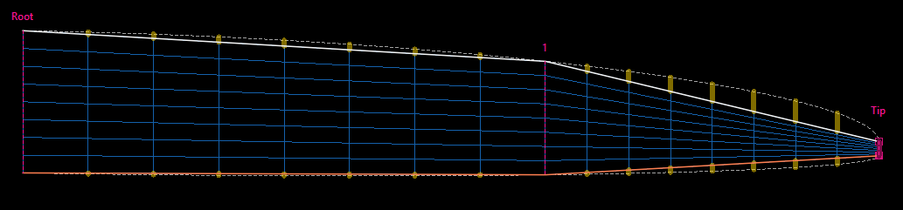

Slide 13
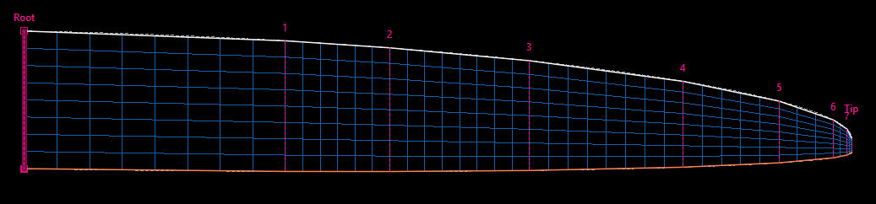

Slide 14
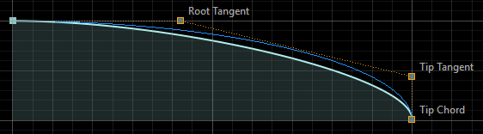
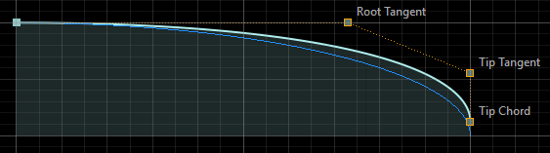
sub-elliptical
over elliptical

Slide 15
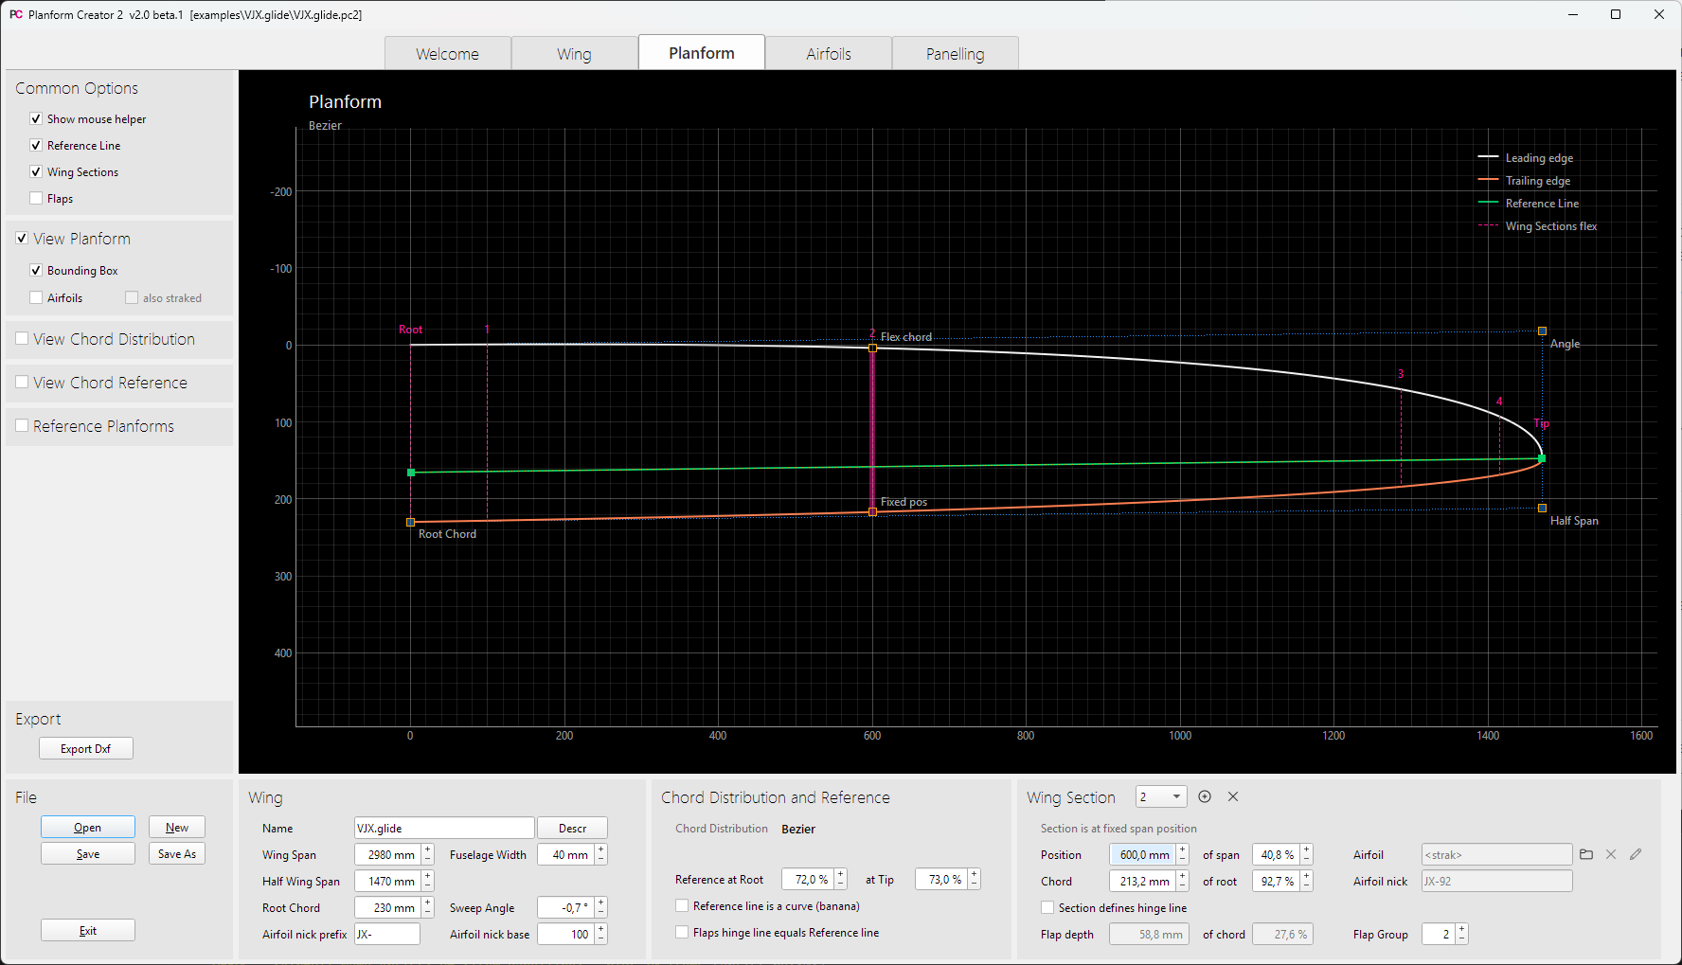
Main Views
Diagram Settings
Actions
Planform Parameters

Slide 16
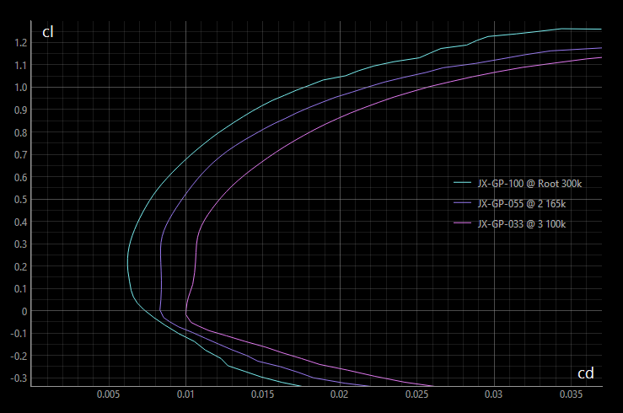
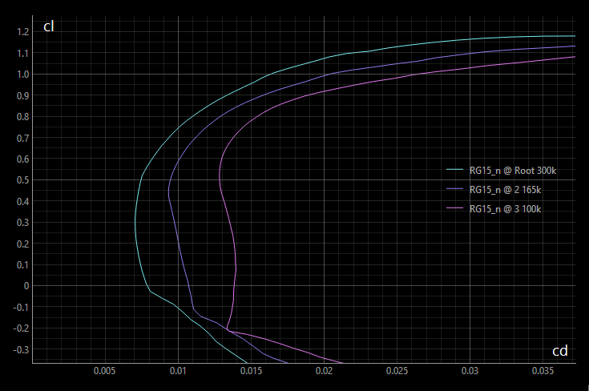
Airfoil strak
Single airfoil
towards tip collapse of section polar due to bubbles
all sections try their best at lower Re numbers

Slide 17
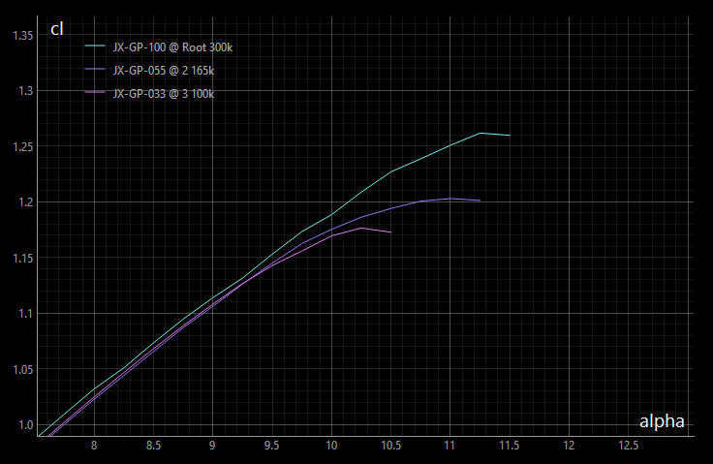
alpha_max at the wing sections
cl
Thermal Airfoil
Race Airfoil
cl_max
+
Flat Plate
+
dcl
+
dalpha
alpha_max
-3°
-1,5°
0°
alpha
Airfoil alpha0

Slide 18
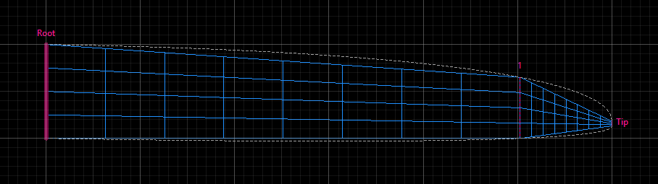
Initial paneling

Slide 19
Bad
(1) Too much deviation
Critical
(3) Tip chord
Ok
(2) Number of Panels

Slide 20
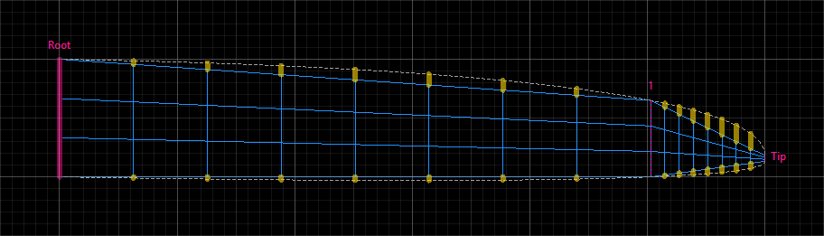
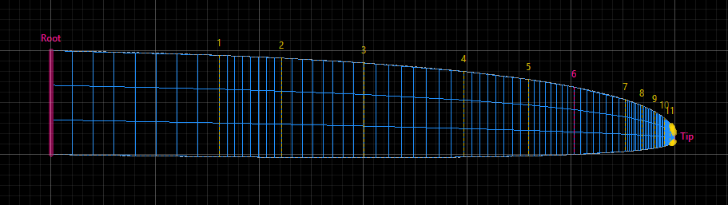
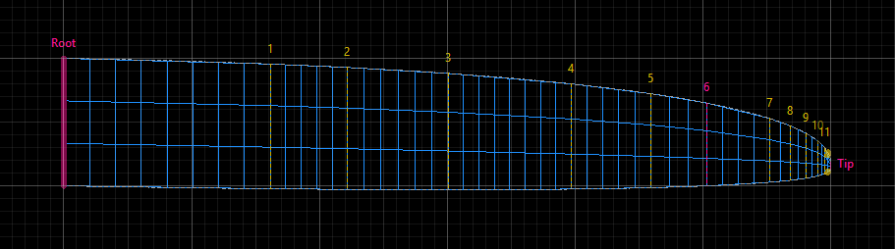
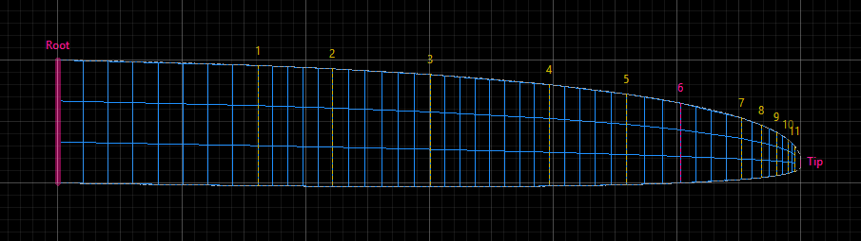
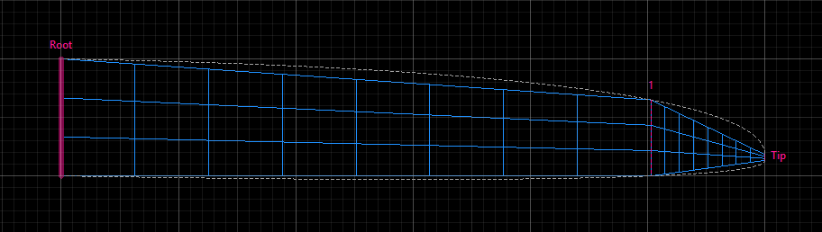
Initial paneling with high deviation to planform
Auto insertion of helper sections
Minimum panel width applied
Minimum tip chord applied
Ready for Analysis

Slide 21
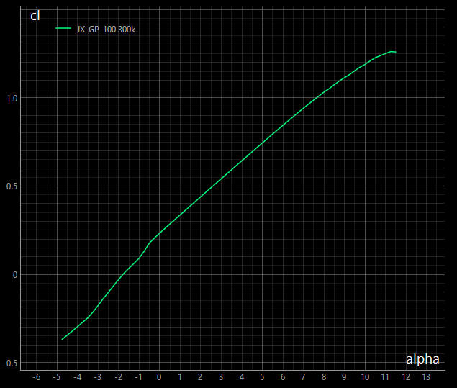
inviscid
dcl/dalpha = 0.11
alpha0
airfoil
Determination of
alpha0 for VLM
alpha0
VLM

Slide 23
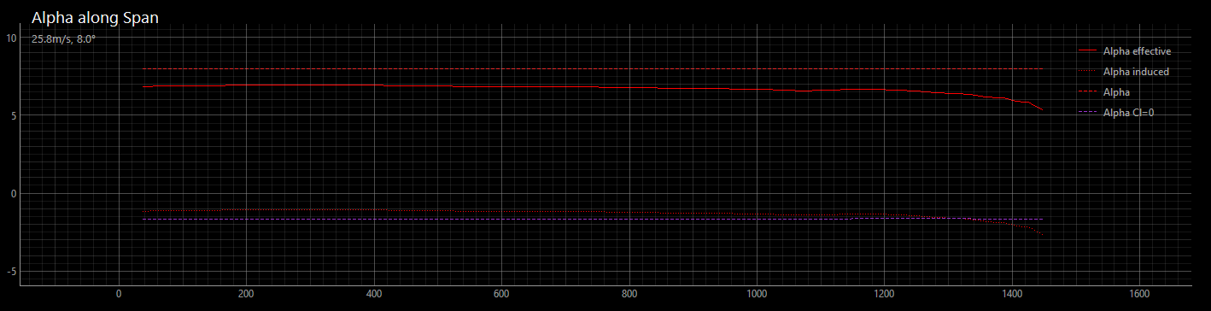
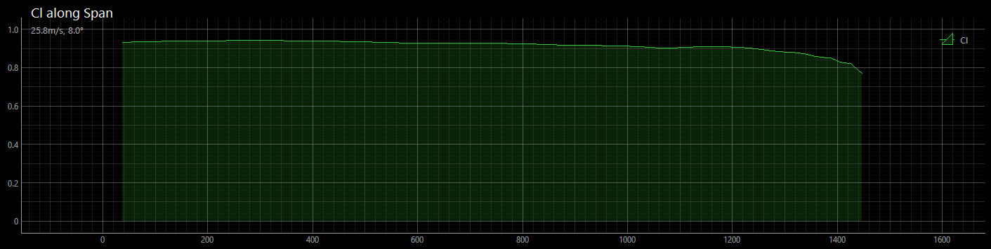
VLM Results – linear

Slide 24
airfoil cl_max
Linear Determination of
alpha max
alpha max

Slide 25
Non-Linear Determination of
alpha0
airfoil eff
New alpha0 of VLM
Start

Slide 26
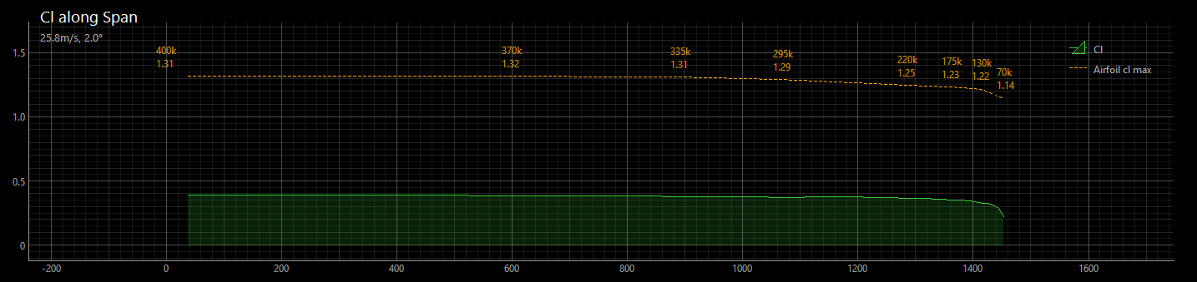
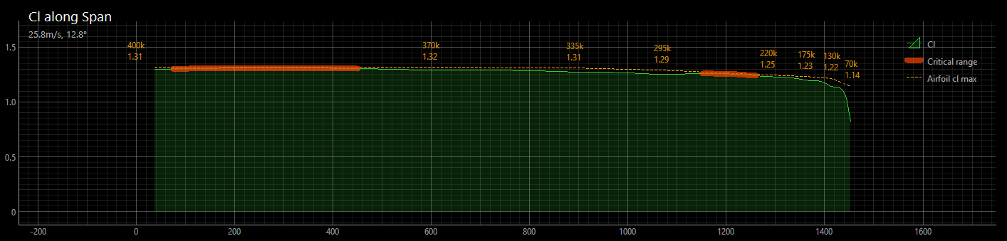
alpha = 2°
alpha set to max

Slide 27
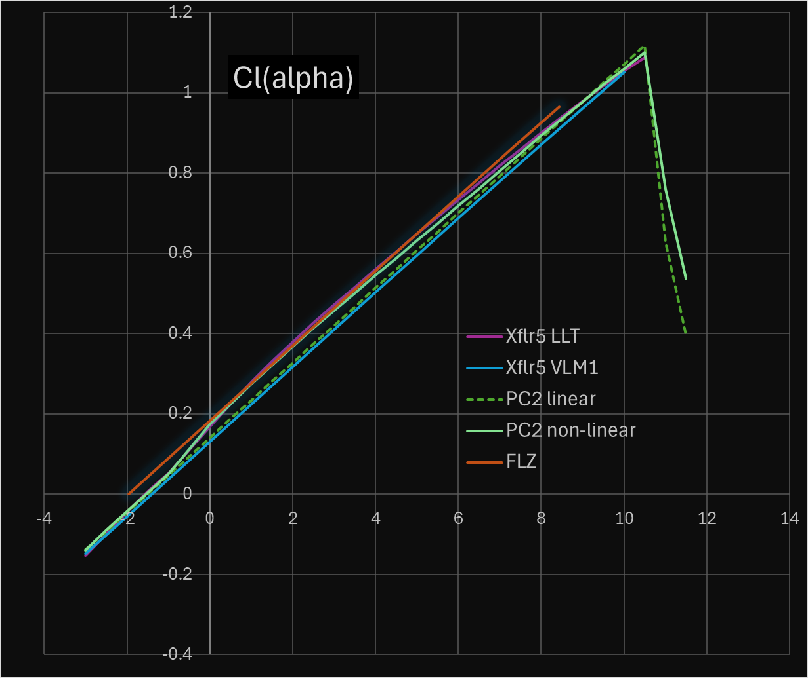
alpha = 2°

Slide 28
