Slide 1

Xoptfoil
AirfoilEditor

Slide 2
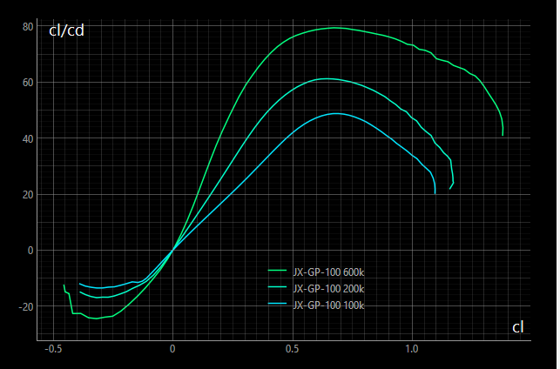
AirfoilEditor
Worker
Xfoil Polars
Xfoil

Slide 3
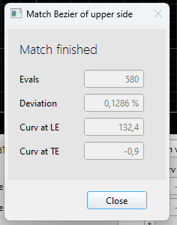
Match Upper side
Matching Upper side / 590 iterations
Current
Target
Weight
Current
Target
Weight
Deviation
0,34%
1,0
Deviation
0,34%
1,0
Curvature LE
178
221
2,5
Curvature LE
178
221
2,5
Curvature TE
2,1
0,2
1,0
Curvature TE
2,1
0,2
1,0
Match Target
Curvature at LE of target airfoil differs at upper and lower side. A new value is propsed and can be adapted.
Close
Close
Match Upper Side
Matching Upper Side
Match Upper Side finished
Current
Target
Weight
Current
Target
Weight
Current
Target
Weight
Deviation
0,34%
1,0
Deviation
0,34%
1,0
Deviation
0,34%
1,0
Curvature LE
178
221
2,5
Curvature LE
178
221
2,5
Curvature LE
178
221
2,5
Curvature TE
2,1
0,2
1,0
Curvature TE
2,1
0,2
1,0
Curvature TE
2,1
0,2
1,0
Curvature at LE of target airfoil differs at upper and lower side. A new value is propsed and can be adapted.
590 Iterations
Within 590 Iterations
Match Target
Close
Stop
Close
Match Target
Close

Slide 4
Match Bezier
Match Bezier
 | Deviation |  | LE curvature TE
Upper side
Target side
Weighting
Curvature at LE of target airfoil differs at upper and lower side. A new value is proposed and can be adapted
 | Deviation |  | LE curvature TE
Target side
Weight
Upper side
Curvature at LE of target airfoil differs at upper and lower side. A new value is proposed and can be adapted
0,34%
178
2,1
221
0,2
221
0,2
2,5
2,5
0,34%
178
2,1
Match Target
Close
Match Target
Close

Slide 5

Merge Aifoils
Curvature at LE of target airfoil differs at upper and of target airfoil differs at upper and lower side. A new value is
MG 06 blended
MG 06 norm
34%
JX-GT-15
Thickness
7.82% @ 43,1%
7.82% @ 43,1%
7.82% @ 43,1%
Camber
7.82% @ 43,1%
7.82% @ 43,1%
7.82% @ 43,1%
Close

Slide 6
Merge Aifoils
Curvature at LE of target airfoil differs at upper and of target airfoil differs at upper and lower side. A new value is
Airfoil 1
Blended
Airfoil 2
MG 06 norm
34%
JX-GT-15
Close

