Slide 2
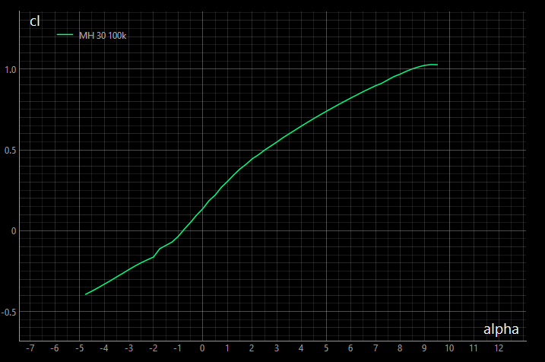
alpha_cl0
„inviscid“
alpha_cl0
viscous

Slide 3
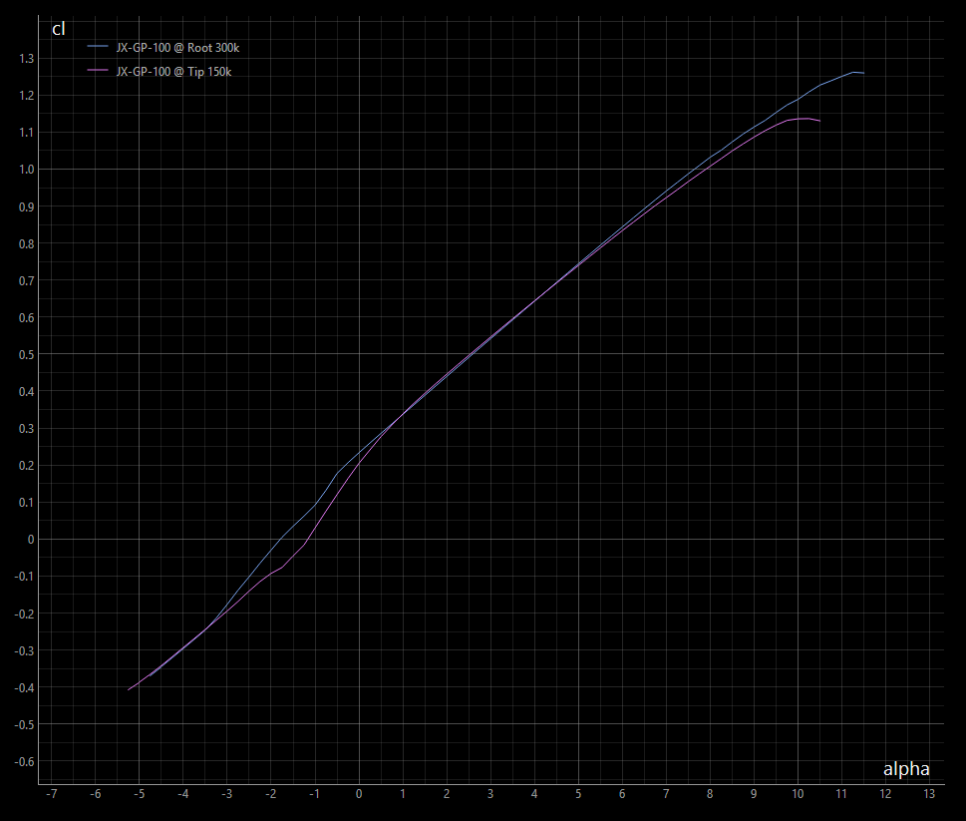
Inviscid
rad: dcl/dalpha = 2pi = 6.283
degree: dcl/dalpha = 2pi**2 / 180 = 0.110
Find alpha0
alpha = 0 degrees
cl = 0.110 * (alpha - alpha0)
→
alpha0 = alpha - cl / 0.11
= 0.0 - 0.23 / 0.11
= -2.09
inviscid
zero camber
cl (alpha=0) = 0.23
alpha0
0 degrees
= -2.09

Slide 4
cl = 0.110 * (alpha - alpha0)
→
alpha0 = alpha - cl / 0.11
= 5.0 - 0.74 / 0.11
= -1.73
Find alpha0
alpha = 5 degrees
cl (alpha=5) = 0.74
inviscid
zero camber
dcl/dalpha = 0.11
alpha0
5 degrees
= -1.73
alpha
5 degress

