Slide 1
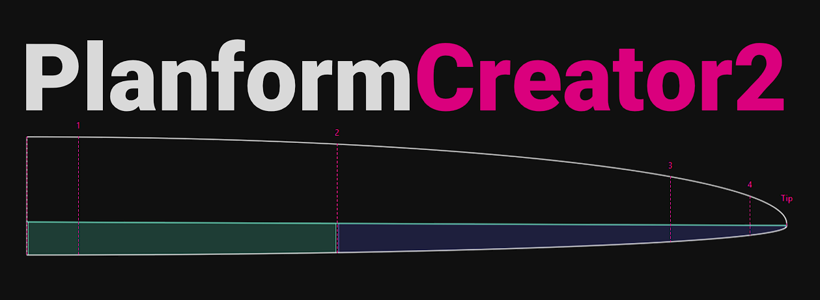
Implementation of Wing Aerodynamics
Draft
Jochen Günzel, February 2025

Slide 2
Intention
The purpose of this little document is
to describe the chosen numerical approach to implement wing aerodynamics into the app PlanformCreator2
verify the results with Xflr5 and FLZ_vortex
give a preview on the current user interface implementation
base for a more detailed documentation on GitHub and RC-Network
Acknowledgement
Special thanks to Arne Voß of DLR / Göttingen for his implementation of VLM and providing the source code on GitHub – and especially for patiently taking me by the hand when doing my first trials with VLM

Slide 3
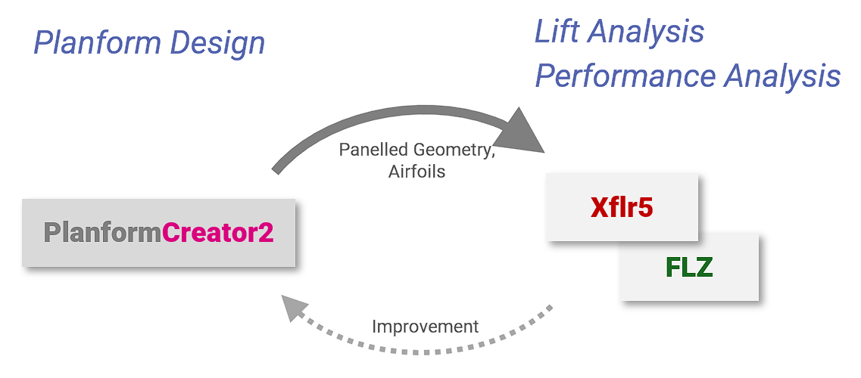
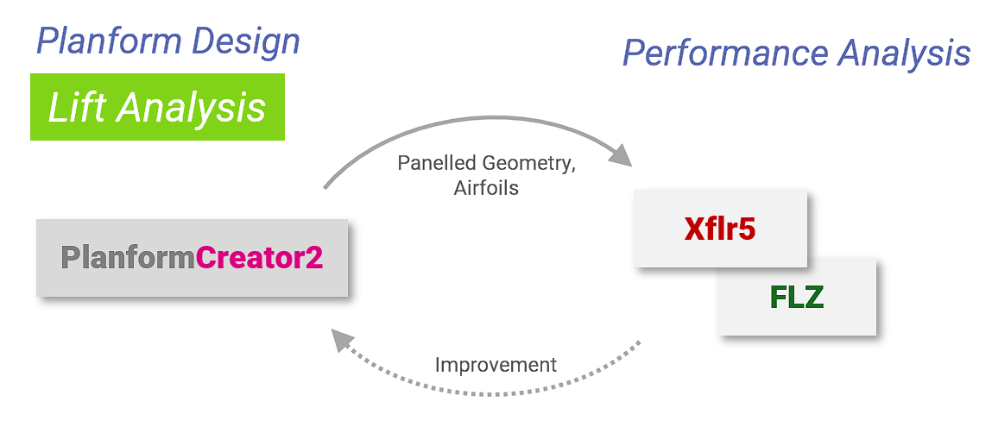
Objectives
To date, the app PlanformCreator2 has focused exclusively onto geometric design of a wing's planform. Although aerodynamic aspects were always in view by focusing on the chord distribution along the wingspan, no direct aerodynamic properties could be used to support the planform design process.
An important goal of planform design is to achieve a good-natured wing regarding stall - at the same time good performance through minimized induced drag.
Up to now the user had to iterate with an external tool like Xfl5 or FLZ_vortex to analyze especially lift along the wingspan.
The extension described here, shall allow to assess the lift distribution along wingspan and the check if the local lift exceeds the maximum lift the airfoil can provide.

Slide 4
Objectives
Non-objectives
As the app does not want to compete with the powerful existing apps for wing analysis, drag either of the airfoil or induced drag is considered in the analysis. Therefore, no statements about the wings aerodynamic performance can be made.
No Drag
No Performance
Implementation Goals
Just like to current app, the implementation of wing aerodynamics should allow for an interactive, playful approach to planform design.
Therefore, it would be highly desirable if the aerodynamic calculations would be performed in “real time” allowing to change the geometry and watching the effect on lift distribution at the same time
Easy to Use
Real-Time

Slide 5
Approach
Basic Approach
Calculate the list distribution along wingspan. To check if the wing fails at a certain segment of the wing, increase the angle of attack until the local lift coefficient Cl exceeds the maximum lift coefficient cl_max of the airfoil at this position.
To keep it simple and fast, only a T1-Polar (constant speed) is supported for the wing analysis.
Steps needed
For this various extensions had to be made for PlanformCreator2:
Integrate airfoil polar generation based on Xfoil
Mesh resp. panel generation of the wing
VLM lift calculation
Join 2D airfoil polars and 3D wing aero data - either
linear – assuming inviscid dcl/dalpha – or
non-linear taking viscous effects into account
Verify the results with Xflr5 and FLZ_vortex

Slide 6
Planform Design
Lift Analysis
Planform Design
Performance Analysis
Performance Analysis
Lift Analysis
Panelled Geometry,
Airfoils
Panelled Geometry,
Airfoils
Xflr5
Xflr5
PlanformCreator2
PlanformCreator2
FLZ
FLZ
Improvement
Improvement
6

Slide 7
1. Airfoil Polars
…

Slide 8
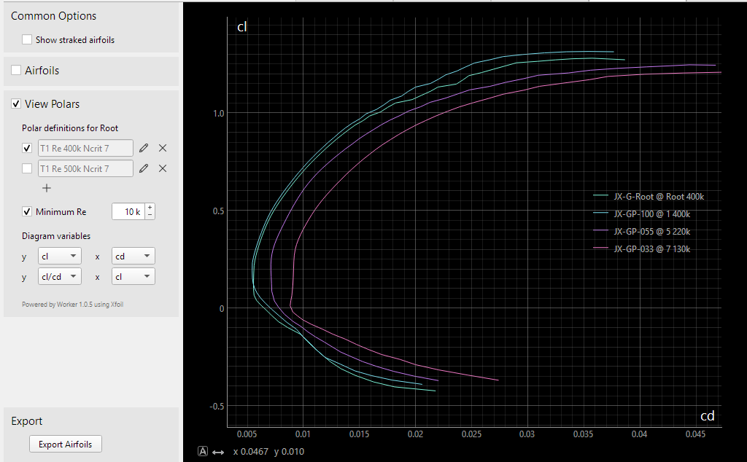
Airfoil Polar Generation
To get 2D airfoil data a lot of modules could be used from the AirfoilEditor. Xfoil is encapsulated by the Worker tool of the Xoptfoil2 project and runs as a background task.
Features:
Up to 5 polars can be defined for the root wing section
Automatic generation of all Re number adapted polars for all wing sections
‘Auto Range’ to ensure the complete alpha range from cl_min to cl_max is covered by the polar
The polars along wingspan can already be helpful to have a first assessment of the airfoil ‘strak’ especially towards tip with its lower Re numbers.
The approach of PlanformCreator2 is different from Xflr5. In Xflr5 the polar for a certain Re number is interpolated from a previously generated polar set of the airfoil at a section – while PC2 a polar is always generated for the Re number needed at this section.
Remark: Polar generation is implemented as being ‘lazy’ meaning the polar is only generated if a polar is requested by the user or for further calculation. If the chord distribution of the wing is changed, the Re number at the wing sections will change - the current polar becomes invalid and will be re-created at request. Generated polars of an airfoil are cached in the file system.

Slide 9
2. Panel Generation
…

Slide 10
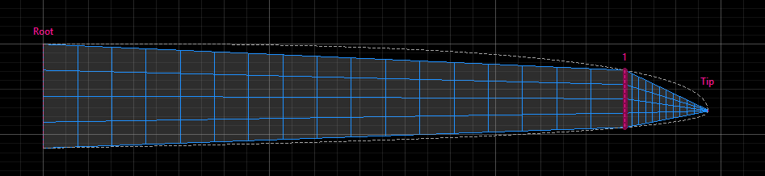
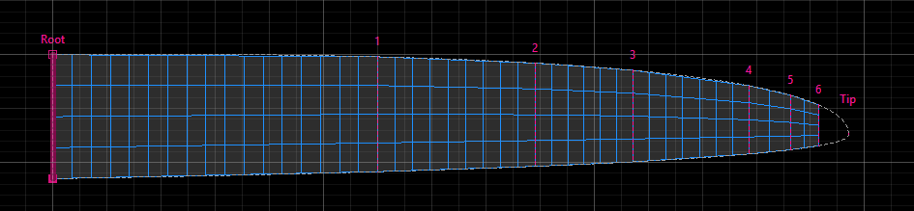
Panel Generation
The already existing mesh generation for the export to Xflr5 and FLZ_vortex was revised for ease of use and generation of the panels needed for VLM calculation.
After the initial definition of the number of x and y-panels of a section, a mesh optimization can be applied based on the parameters:
Minimum chord at tip – this will cut the tip to ensure a Re number which leads to meaningful Xfoil results
Minimum panel width – the number of y panels per section will be adapted to achieve a uniform panel width along span
Minimum chord deviation to planform – additional wing sections will be inserted automatically until the deviation of the section trapezoids to the original planform is below the defined threshold
As for airfoil polar generation, panel generation is ‘lazy’: A new mesh is initialized each time the planform is changed by the user.
Initial paneling
Auto optimized paneling
A short look ahead: As already described in theory the results of a VLM calculation does not improve if the number of panels in x direction is increased. For non swept wings, 2 x-panels are sufficient (already 1 x-panel leads to 95% result), for swept wings 3 x-panels are fine to achieve the desired results.

Slide 11
3. VLM Calculation
…

Slide 12
Lift along Span
Possible Approaches
A little investigation was made to find the right approach for determining the lift distribution along wingspan. Main criteria were
Fast calculation to allow real time analysis
Possibility to integrate 2D airfoil polar data
so-called to use Python implementation.
The first approach of taking LLT (lifting line theory) was discarded as LLT is limited to little swept wings. Therefore, a VLM (vortice lattice method) approach came into focus.
Panel Aero On GitHub
Luckily, there is a fine, compact VLM implementation available on GitHub called ‘Panel Aero’ written by Arne Voß / DLR.
‘Panel Aero’ is initially supplied with the geometry mesh data of the wing and creates out this the so-called influence matrix which describes the influence of a (all) panel on all other panels.
As the influence matrix is only depended on the wing’s geometry it is constant for different speeds and angle of attack thus allowing very fast calculation of a panels Cp value for various AOA or speed.
Having the Cp value of all panels, it is straight forward to calculate lift per panel, per panel stripe or for the complete wing for a desired operating point.
The Cl value at an y station is derived from the lift value per panel stripe. The effective angle of attack alpha _{eff} and the induced angle alpha _{ind} can be directly derived from Cl.

Slide 13
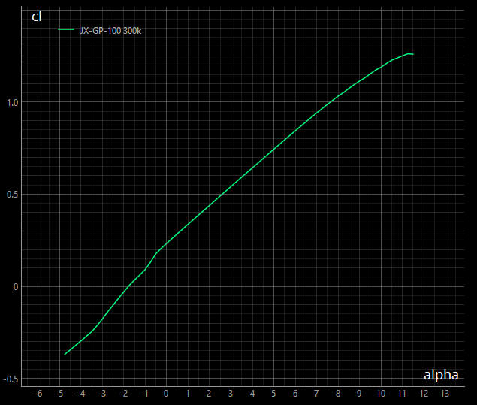
Remarks on VLM
As VLM is part of the inviscid “world” a wing is / can be idealized by a flat plate, which is divided into trapezoidal panels.
Camber of an airfoil is mapped to an additional angle of the “flat plate” which is added to the angle of attack of the wing in the VLM calculation.
This additional “camber angle” equals to alpha0 (alpha at cl=0.0), which either can be determined from
a numerical approximation based on the airfoils camber line – or
from the airfoil polar
For this implementation, the second variant was chosen.
Starting from this alpha0 VLM calculates the cl value for a new alpha with the inviscid gradient of dcl/dalpha = 2π ( equals 0.11 in degrees)
This will become important, when 2D airfoil data is combined with 3D VLM data.
inviscid
dcl/dalpha = 0.11
Determination of
alpha _{camber} for VLM
alpha0
airfoil
alpha _{camber}
VLM
Xflr5 also determines alpha0 from the airfoil polar (interpolation). For a LLT based calculation, the same value as shown in the diagram is taken, for VLM a corrected, smaller value is taken (I didn’t have a look in the source code for this).
FLZ_vortex calculates alpha0 of an airfoil with the numerical approximation based on the camber line. This it also the reason, why FLZ_vortex allows to enter a manual value for alpha0 to overwrite the approximated value (viscous effects)

Slide 14
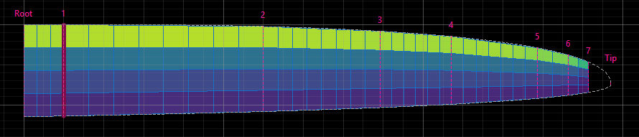
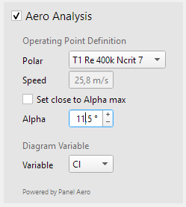
VLM implemented
The integration of the ‘Panel Aero’ module was straight forward.
The calculation speed of ‘Panel Aero’ is excellent: Building the influence matrix for the wing shown in the diagram with 144 panels takes about 100ms.
The subsequent aerodynamic calculation per operating point runs in about 5ms.
This allows the desired interactive approach of planform geometric design and aerodynamic assessment.
An attempt was made to limit the additional input needed for the aerodynamic analysis to a very minimum.
The user chooses on of the already defined polars for the root wing section, selects alpha – that’s it.
A special function ‘Set close to alpha max’ will find alpha short before stall automatically (this will be discussed later in the context of Cl_max)

Slide 15
4. Join 2D and 3D Aero
…

Slide 16
Linear Approach
The question to answer is:
At which y station does the local Cl (evaluated from VLM) reach cl_max, which the airfoil can provide at most?
Most straightforward is a linear approach:
Local Cl is taken and checked, if it is greater than cl_max of the airfoil polar at this y-station. Whereas cl_max of a panel stripe is an interpolation of cl_max of the airfoil polar at the sections to the left and right.
The associated alpha_max is the local effective angle of attack. With
alpha = alpha _{eff} + alpha _{ind}
you get the final geometric angle of attack of the wing.
Linear Determination of
alpha _{max}
airfoil cl_max
inviscid dcl/dalpha
alpha max
It is obvious that alpha_max calculated with the linear approach is a pessimistic value. As can be seen in the diagram the airfoil would deliver less lift at this point, at the same time allowing a higher angle until its cl_max is reached.
So the calculated alpha_max value will be smaller than the real alpha_max (what ever it is…).
We could end at this point as the initial question was “A whicht y_station does the wing fail?”. The corresponding alpha is not in the focus. But some kind of “spirit of research” claims a more exact answer, which led to a non-linear approach …
alpha eff

Slide 17
Non-Linear Approach
To get a more exact result based on the data available we have to tell VLM that the viscous lift of the airfoil is different from the assumed lift based on inviscid dcl/dalpha – in other words: We must handle the difference between the red straight line and the green airfoil polar in the diagram.
The implemented procedure for each panel stripe is as follows:
Based on the evaluated alpha _{eff} get current cl of airfoil.
alpha _{camber} = alpha _{eff} - cl / 2π
gives a new initial alpha _{camber} d for another VLM calculation.
Loop until the change in total Lift becomes small.
We have thus introduced a small viscous loop over the VLM calculation.
It turned out that this viscous loop converges very fast. Typically, within 1 to 4 iterations the change of total Lift is less than 1%. As the VLM aero calculation for an operating point is very fast, the viscous loop doesn’t slow down the overall calculation noticeable.
Regarding the alpha_max evaluation, the non-linear approach typically leads to 0,5% - 1% higher angles than the linear approach.
The effect is higher for lower Re numbers with a more curved dcl/dalpha polar of an airfoil.
Core procedure of the viscous loop
Non-Linear Determination of
alpha _{camber}
airfoil cl
inviscid dcl/dalpha
alpha _{eff}
New alpha _{camber} VLM
Start
alpha eff

Slide 18
5. Comparing Results
with Xflr5 and FLZ_vortex

Slide 19
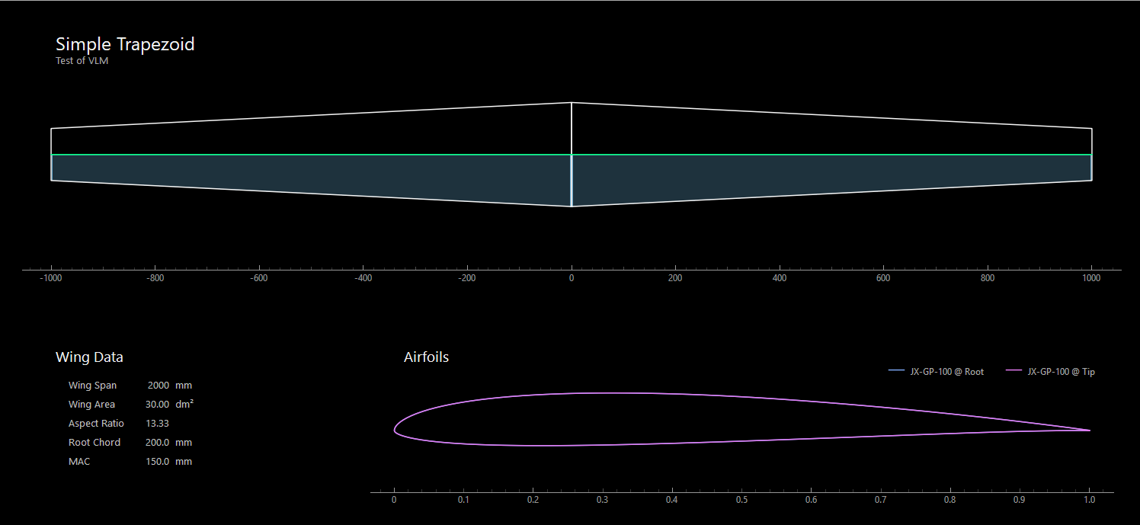
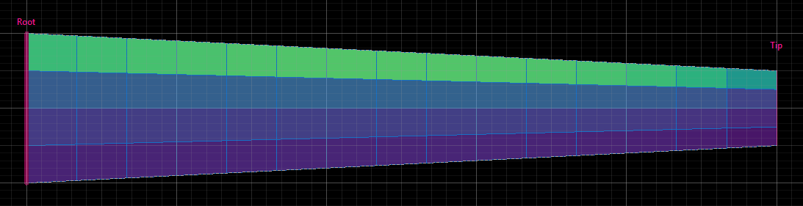
Comparsion to Xfl5 and FLZ_vortex
To assess the results of the implementation basic planforms like rectangle, trapezoid, non-swept, swept were taken, which all showed similar results regarding the differences between the apps.
In this example a simple trapezoidal planform is used.
The Cl(alpha) polar of the wing is calculated in
PC2 with viscous loop,
Xflr5 with LLT and VLM
FLZ_vortex with VLM (the polar has to be assembled manually as the app is based on a T2 polar (constant lift).
The panel mesh is the same for all applications.

Slide 20
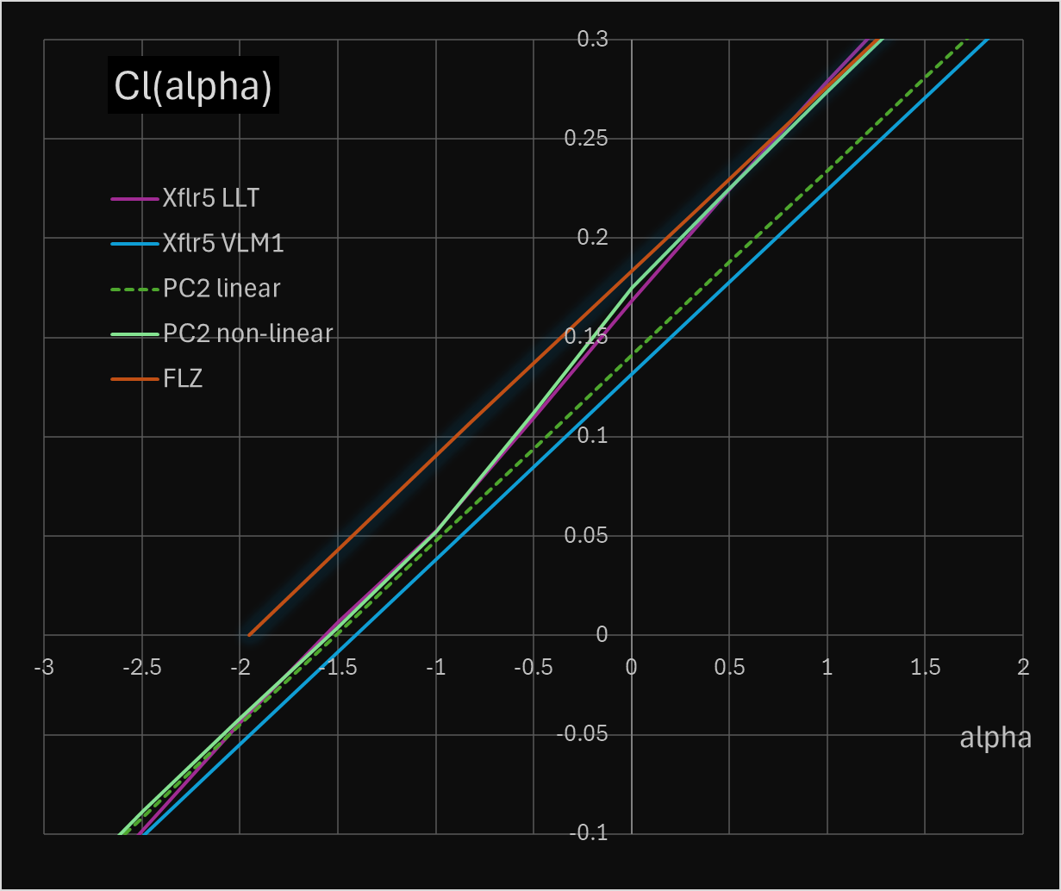
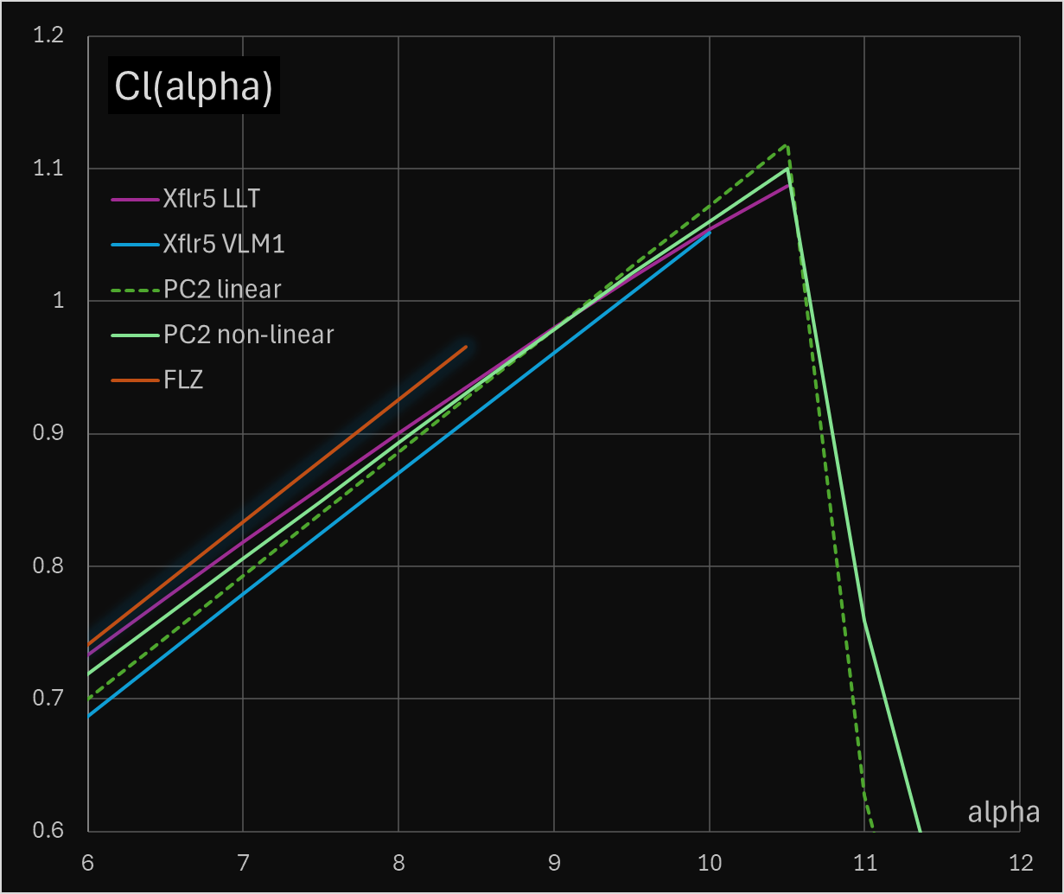
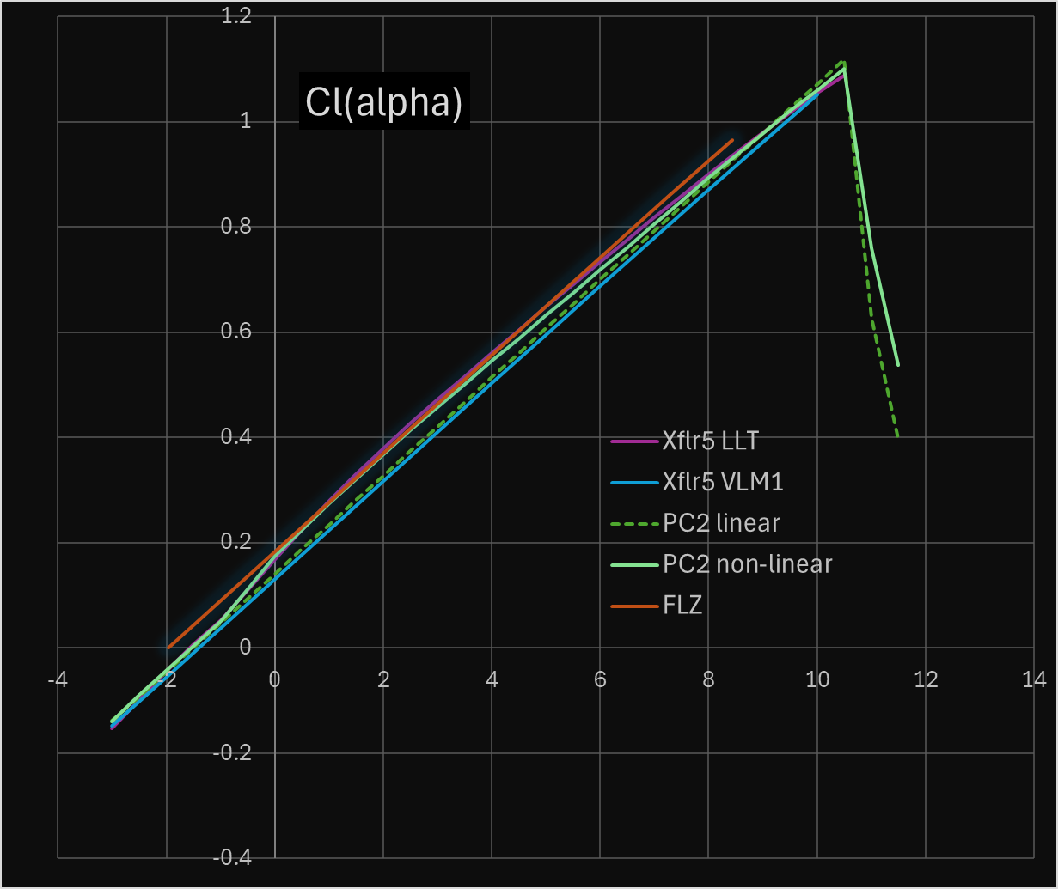
Comparsion to Xfl5 and FLZ_vortex
Zoom
Overall, promising results.
Both linear and non-linear implementations are quite close to Xflr5 and FLZ_vortex.
The non-linear polar is slightly curved and follows the airfoil polar dampened.
PC2 non-lin alpha0 based on airfoil polar, non-linear approach, very close to Xflr5 LLT
PC2 linear alpha0 based on airfoil polar, linear approach, quite close to Xflr5 VLM
Xlfr5 LLT alpha0 based on airfoil polar, non-linear approach, wing polar follows airfoil polar
Xlfr5 VLM corrected alpha0 based on airfoil polar, linear approach, smallest Cl (alpha)
FLZ quite high alpha0 due to numerical approximation (?) , linear approach, highest Cl(alpha)
PC2 non-lin curved towards Cl_max, very close to Xflr5 LLT, continues beyond cl_max (partial CL fail supported)
PC2 linear highest Cl_max, alpha_max same as non-linear continues beyond cl_max (partial CL fail supported)
Xlfr5 LLT curved towards Cl_max, very close to PC2 non-linear stops at Cl_max (one stripe fails -> wing fails)
Xlfr5 VLM smaller Cl_max and alpha_max stops at Cl_max (one stripe fails -> wing fails)
FLZ smallest Cl_max and alpha_max, probably because of numerical estimation of airfoils cl_max

Slide 21
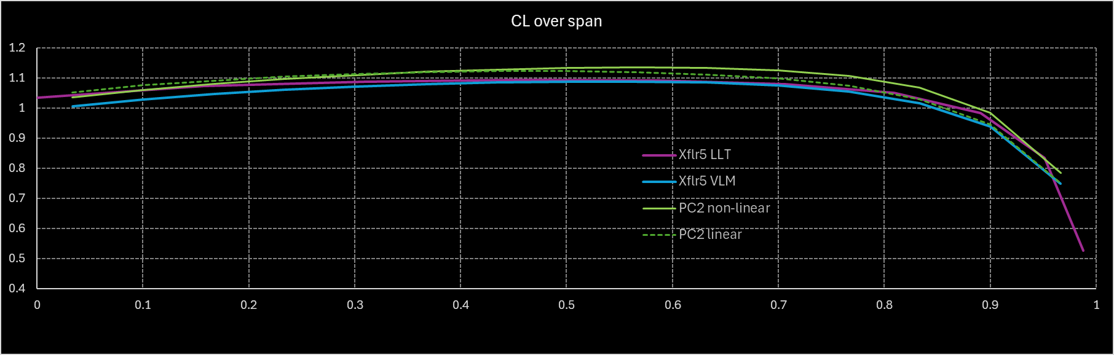
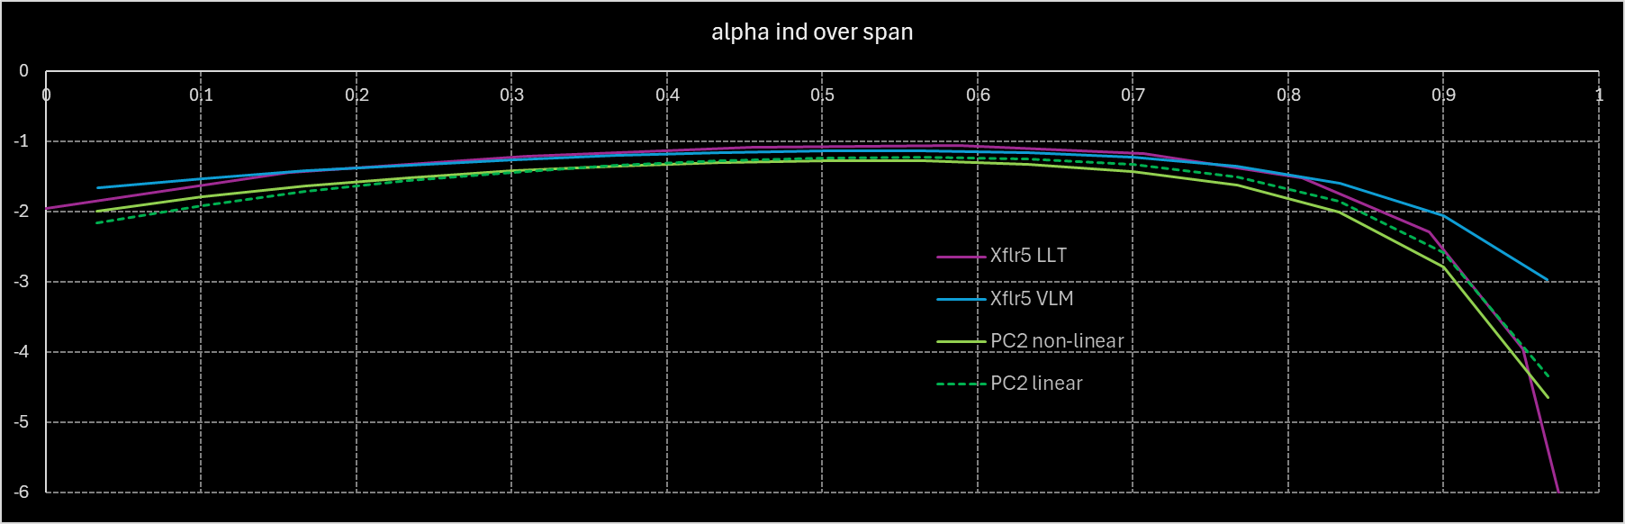
Comparsion to Xfl5 and FLZ_vortex
Cl along span
As excepted PC2 linear follows quite closely Xlfr5 VLM. Due to higher alpha0 the Cl curve is shifted towards higher Cl.
The slightly different Cl course of PC2 non-linear and Xlfr5 LLT indicates that there is a different implementation of the “viscous loop” in PC2 and Xflr5. (further investigation needed?)
alpha induced along span
Because local Cl and alpha _{induced} are directly coupled via alpha0 the findings for Cl apply to alpha _{induced} .

Slide 22
5. Real Example in PlanformCreator2
…

Slide 23
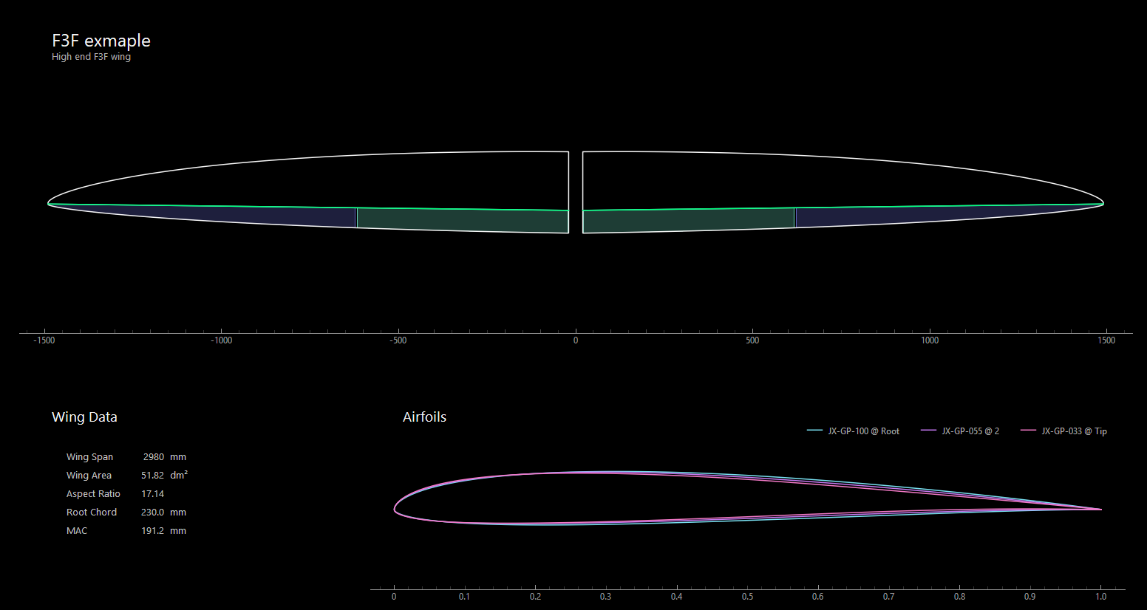
Example F3F - 1
Task
This wing should be improved as it shows critical stall behavior with a tendency to wing drop (de: abschmieren).

Slide 24
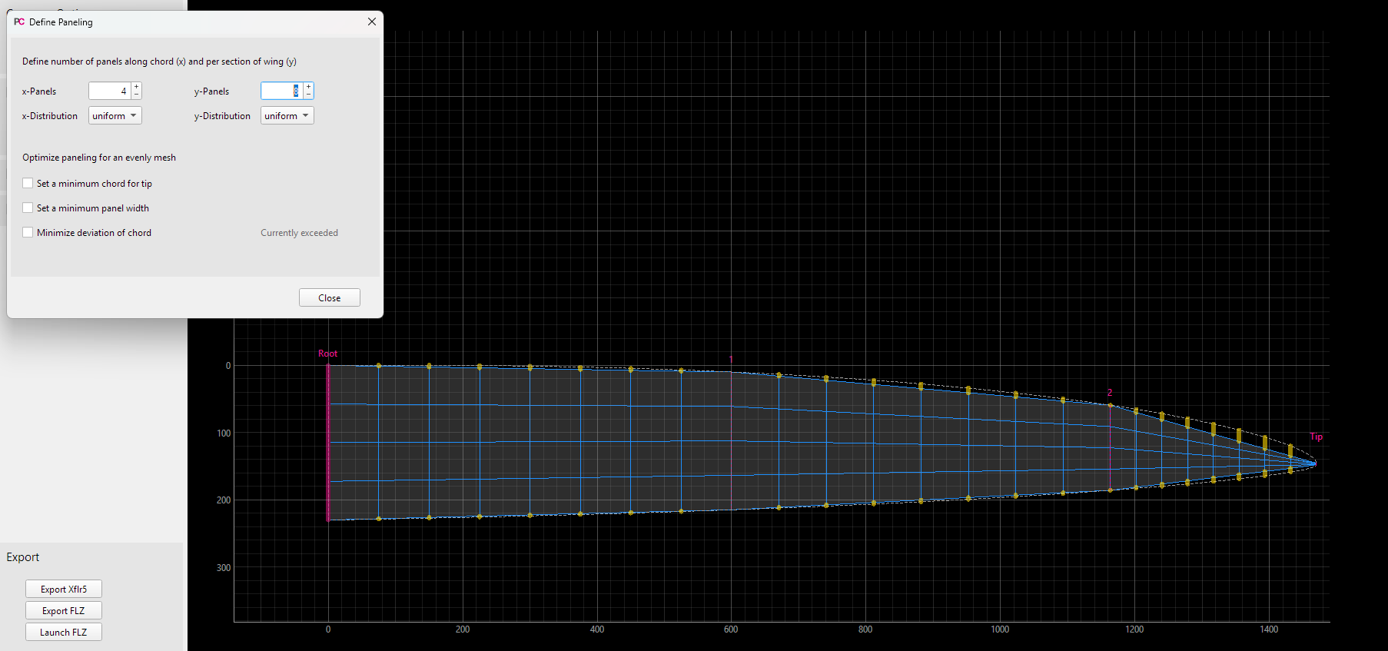
Example F3F - 1
Paneling
Before paneling optimization, the deviation of paneled planform to the original planform is quite high.
So the optimization settings are applied…

Slide 25
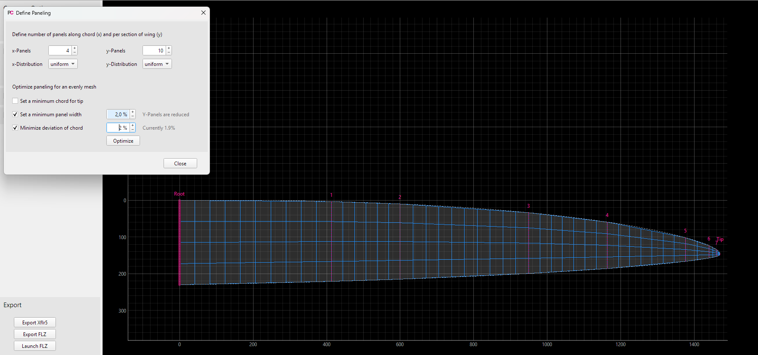
Example F3F - 2
Paneling optimized
Panel distribution now looks better and is sufficient for aero analysis.

Slide 26
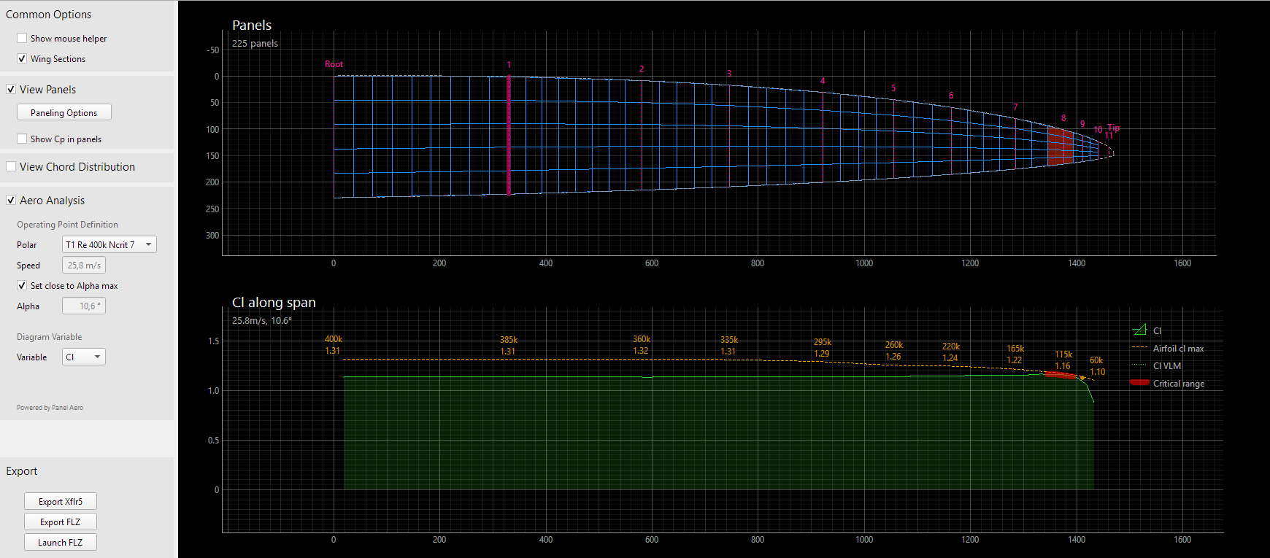
Example F3F - 3
Aero Analysis
VLM analysis are automatically started with opening the “Aero Analysis” panel.
With the option “Set close to alpha_max” the maximum AoA before a part of the wing stalls, is searched.
The Cl along span distribution indicates the critical part of the wing with a red line.
In the panels view the causing panel stripes are also marked red.

Slide 27
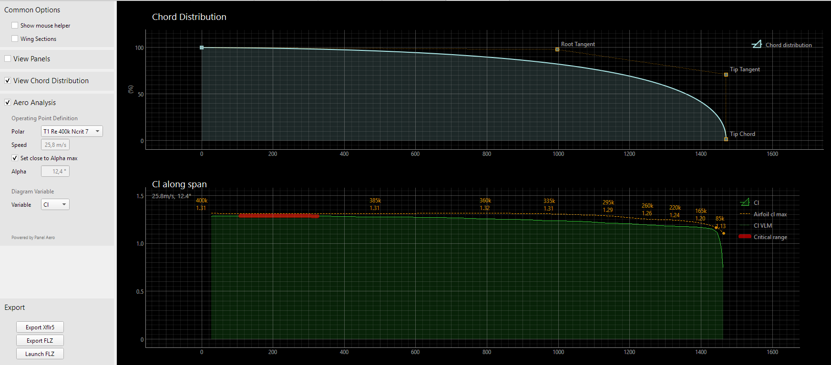
Example F3F - 4
Planform Modification
With “View Chod Distribution” the Bezier curve defining the chord is displayed.
By moving the tip tangent control point with the mouse, the chord in the tip area is made fuller.
This will move the critical wing area towards root. In addition, alpha_max increased from 10.6° to 12.4°.
Mission completed! 😉

Slide 28
This was the short tour through the VLM wing aero extension of PlanformCreator2 v3.
Thank you for sticking it out this far!
Any feedback is greatly appreciated.
Jochen

