Slide 1
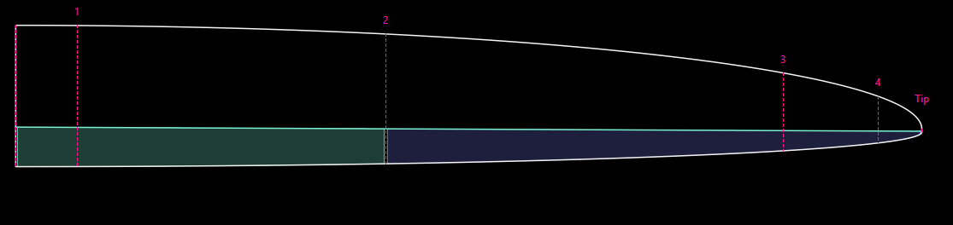
PlanformCreator2

Slide 2

AirfoilEditor
PlanformCreator2

Slide 3
Panelled Geometry,
Airfoils
Xflr5
Idea!
PlanformCreator2
FLZ
Improvement
CAD
Planform Design
Performance Analysis
Panelled Geometry,
Airfoils
Xflr5
Idea!
PlanformCreator2
FLZ
Improvement
CAD
Lift Analysis

Slide 4
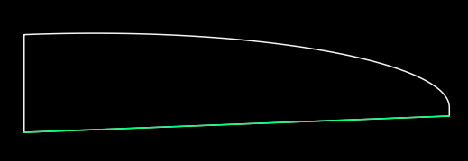
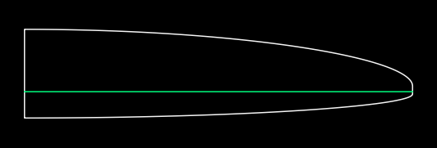
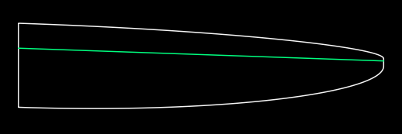

Slide 5
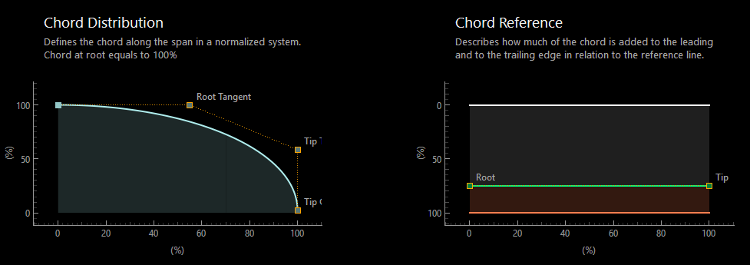

Slide 6
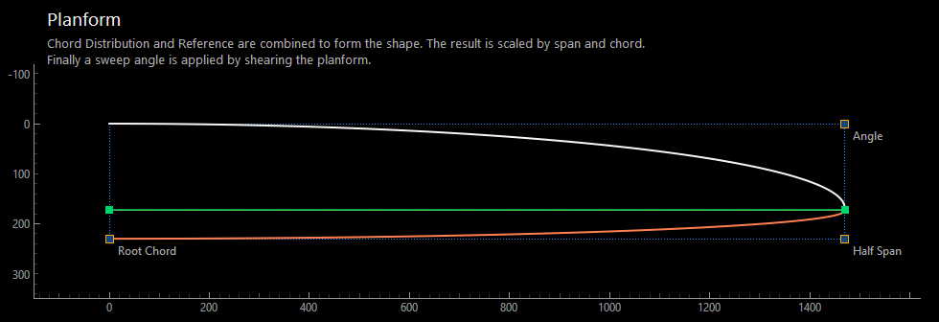

Slide 7
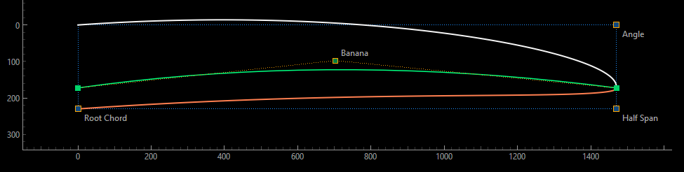

Slide 8
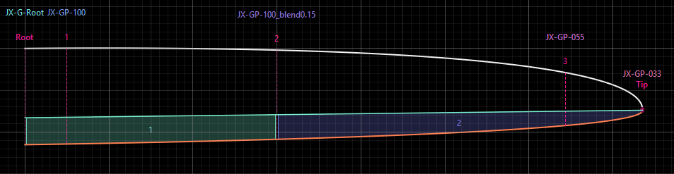

Slide 9
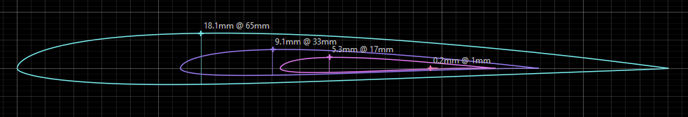

Slide 10
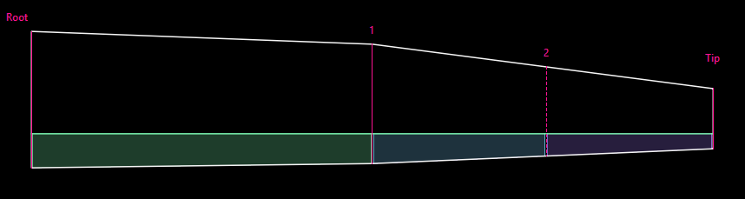

Slide 11
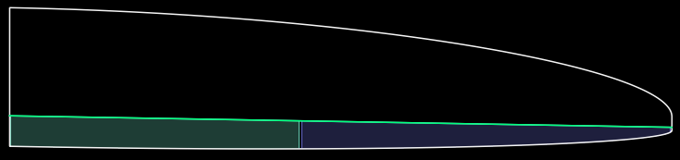
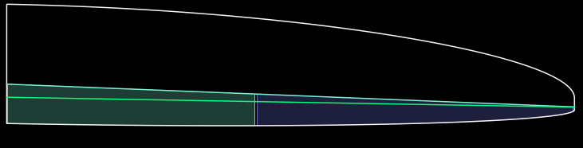
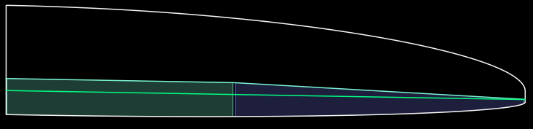
Hinge line equals Reference line
Seperate hinge line definition
Hinge line with a kink

Slide 12
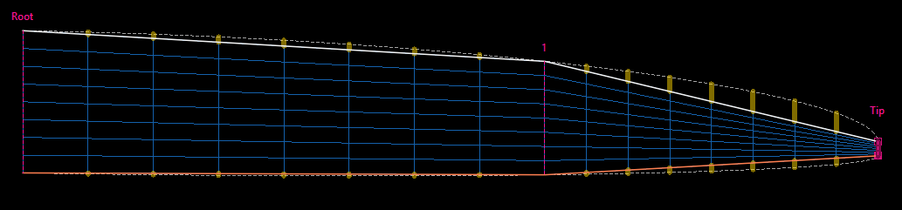

Slide 13
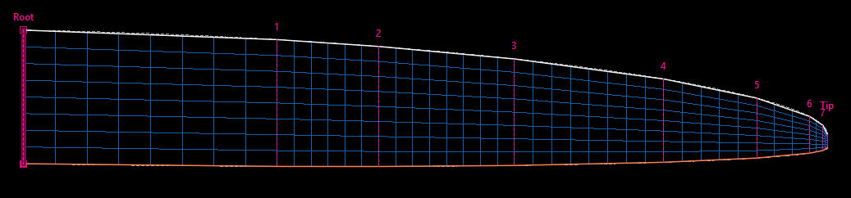

Slide 14
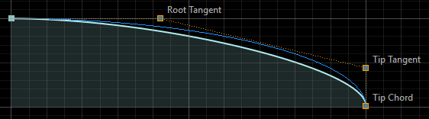
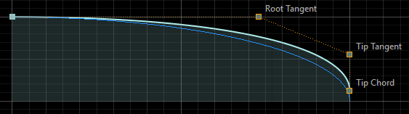
sub-elliptical
over elliptical

Slide 15
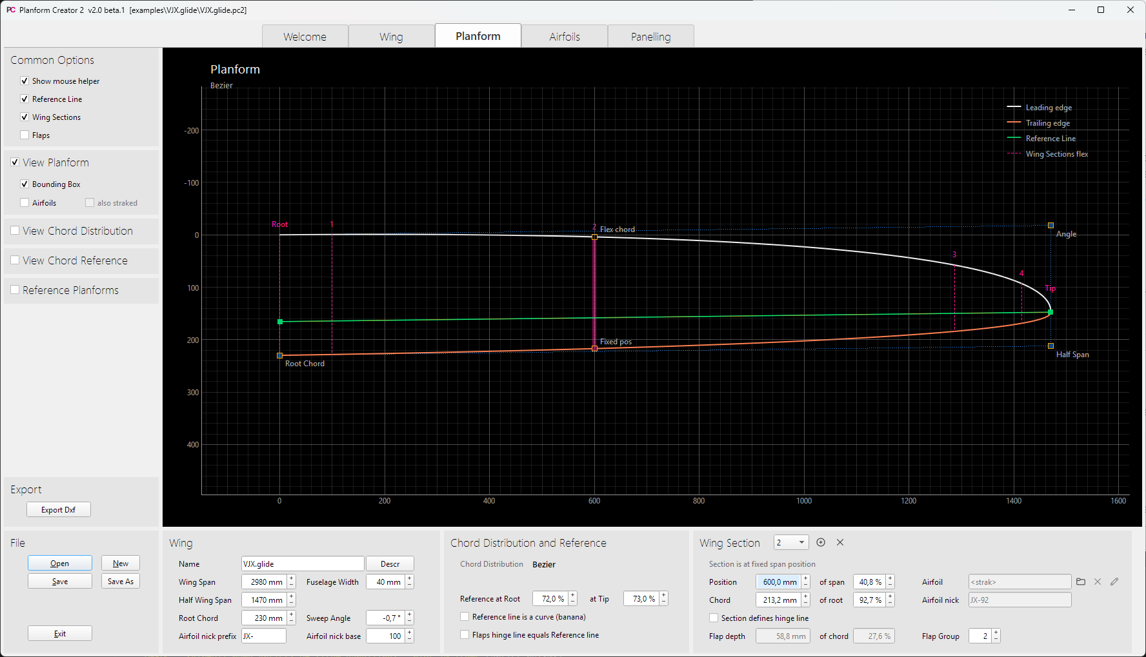
Main Views
Diagram Settings
Actions
Planform Paramter

Slide 16
Main Views
Diagram Settings
Actions
Planform Parameters

Slide 17
