Slide 1
Xflr5 meets Xoptfoil-JX
X5optfoil
catches
Thoughts on implementing an airfoil optimization into Xflr5 based on Xoptfoil-JX
Jochen Günzel / Mathias Boese 2021

Slide 2
Timetable

Slide 3
0. Proof of concept
1. MVP
2. First Version
Integrate parts of Xoptfoil-JX into xflr5.
Show airfoil optimization could be a cool feature in xflr5
Build a fully functional optimization with Xflr5 focusing on a specific use cases.
Allows to get feedback from the „community“
Transfer all the rest functionlity from Xoptfoil-JX to Xflr5 (RiP Xoptfoil-JX)
Allow production optimization in a limited domain

Slide 4
0.0 Ramp up
Make plan, prepare development
Setup QT
Xflr5 source control
Build, run, debug
Xflr5
André : Sourceforge permissions for Matthias
Xoptfoil-JX

Slide 5
0.1 Spike solution (Durchstich)
Make an principle airfoil optimization up and running using a basic file based interface between Xflr5 and Xoptfoil-JX
optimize_foil.cpp
use PSO frame
…
Xflr5
use HH shape functions
Print results
Create the skeleton of PSO, Hicks-Henne based airfoil optimization based Andrés example implemantation
use Create airfoils
Proxy to Xevalfoil
foils
objectives
Xevalfoil.exe
use aero objective f.
aero objective function
Xoptfoil-JX
use define op points
define op points
Build a very stripped version of Xoptfoil-JX which holds the evaluation of the objective function
(aero and geometric)

Slide 6
0.2 Take over control
Move the input of all parameters needed for optimization to xflr5
optimize_foil.cpp
…
Xflr5
…
Manuel entry of
op_point definition
Op_points
foils
objectives
Xevalfoil.exe
use aero objective f.
Xoptfoil-JX
define op points

Slide 7
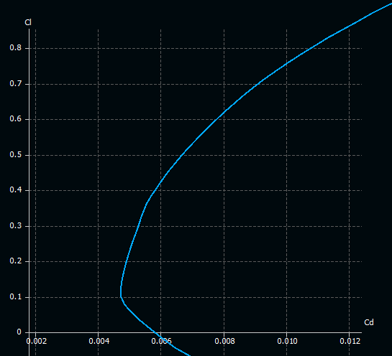
0.3 UX prototyp
Implement a first, basic version of a graphical definition of optimization targets e.g. „Modify a polar of an existing airfoil“
optimize_foil.cpp
Select airfoil and polar
Xflr5
Modify polar by spline
Create op Point
Show results in polar
Xevalfoil.exe
…
Xoptfoil-JX

Slide 8
Visions

Slide 9
Design Scribbles

