Slide 1
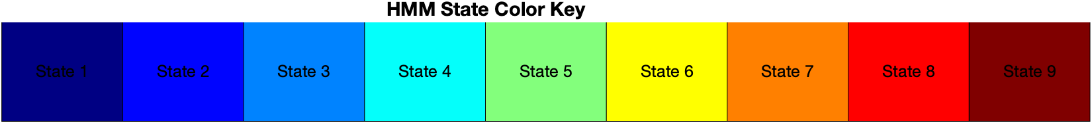
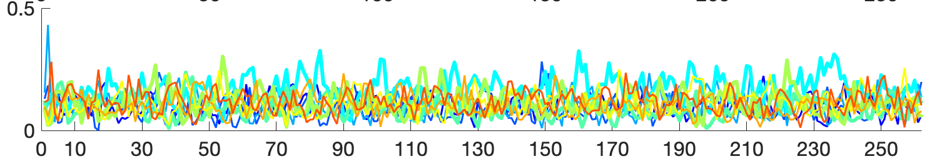
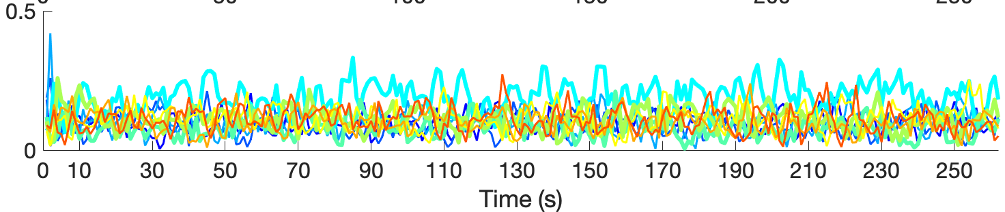
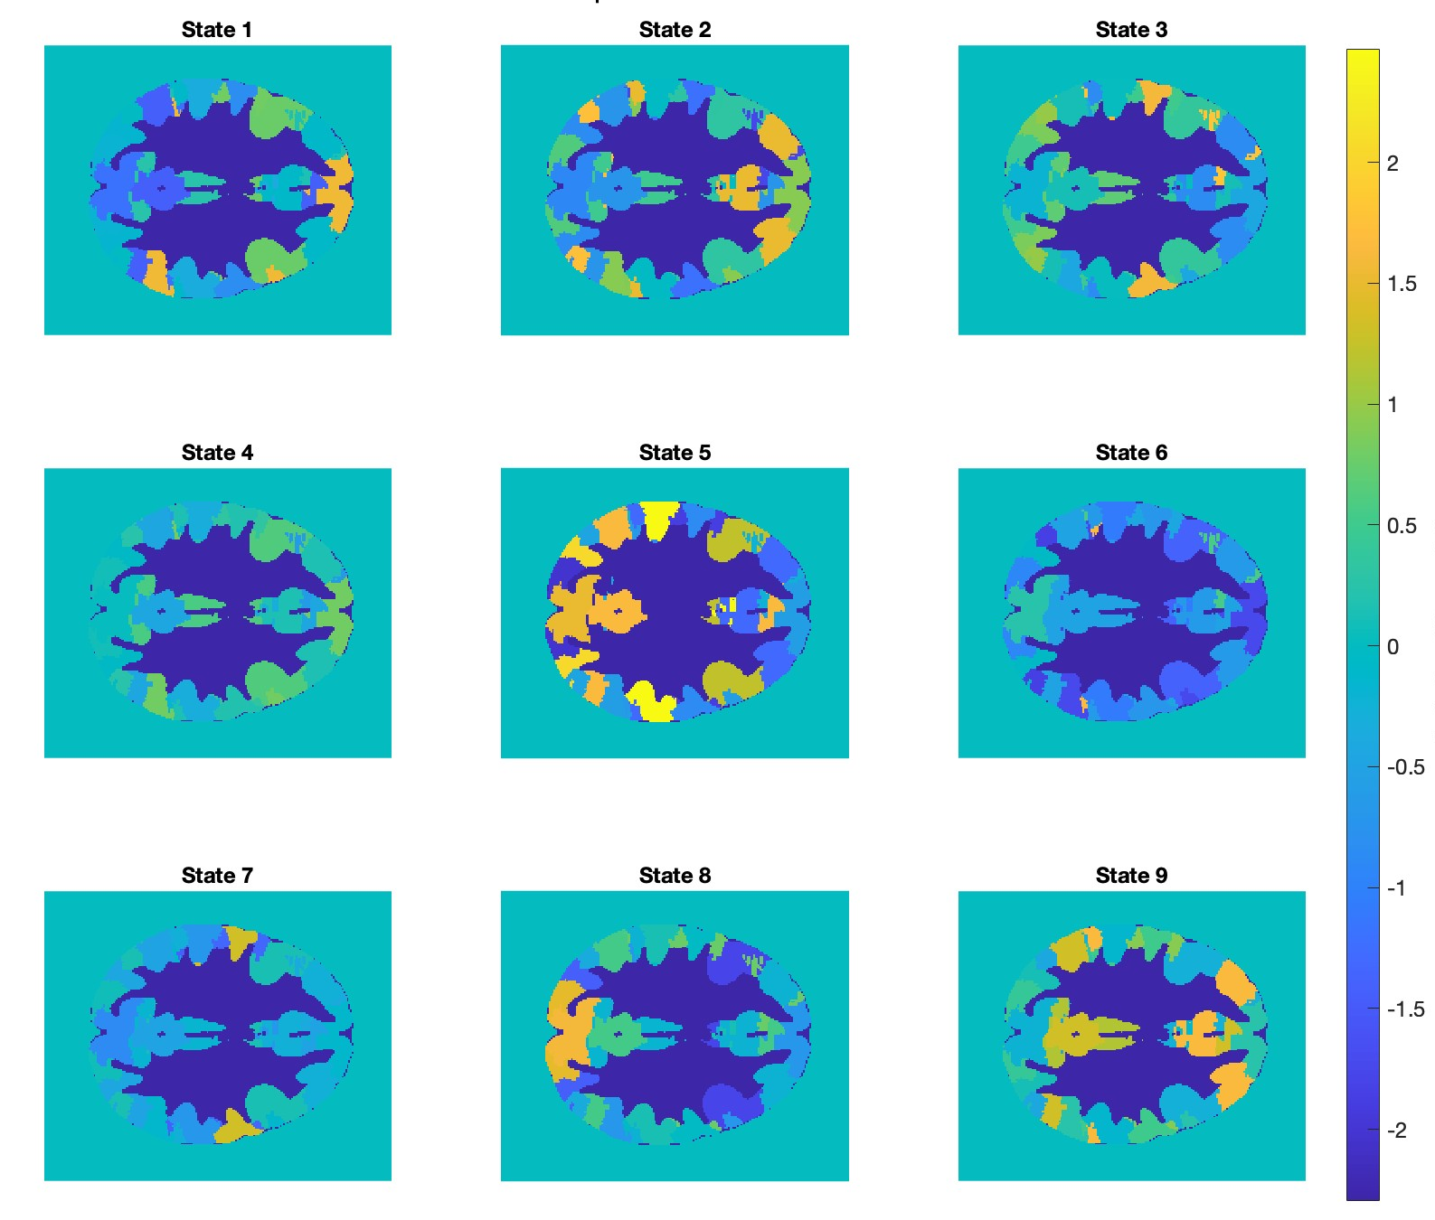
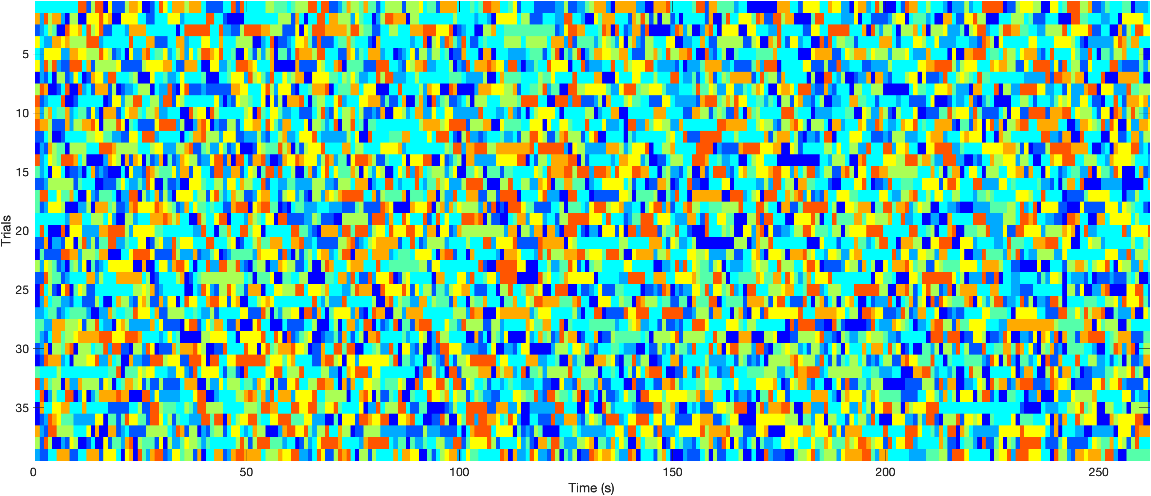
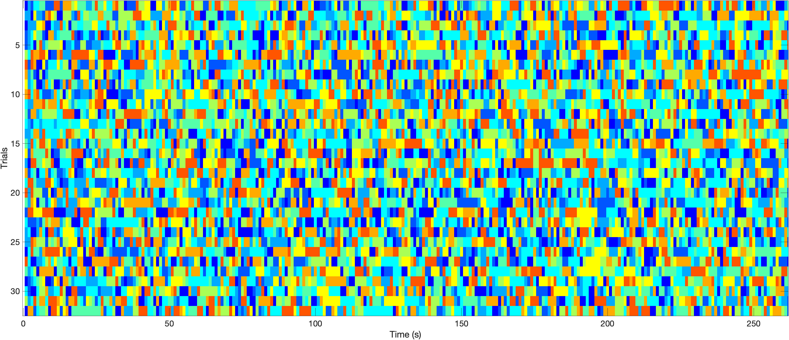
Functional Connectivity during Emotional Video viewing with Psychotic diagnoses
Li, Judy. X.^{1,2,4}, Jeganathan, Jayson ¹, Sonkusare, Saurabh ², Paton, Bryan ^{3,4,5}, Luchow, Shiami ⁴, Breakspear, Michael ^{3,4}, Wellstein, Katharina .V.^{3,4}
¹ John Hunter Hospital, Hunter New England Local Health District, Australia, ² University of Sydney, Sydney, Australia, ³ University of Newcastle, Newcastle, Australia, ⁴ Hunter Medical Research Institute, Newcastle, Australia, ⁵ Mark Hughes Foundation Centre for Brain Cancer Research, University of Newcastle, NSW, 2308, Australia.
INTRODUCTION
Emotional processing in schizophrenia, which is a key feature of negative symptoms, is poorly understood while negative symptoms form the majority of burden of disease [1]. However, there is an unmet need for effective treatments. Functional neuroimaging, use of natural stimuli, and new connectivity techniques offer a novel way to investigate these symptoms and potentiate treatments. Evidence links negative symptoms to impairment in emotional neurocognitive processes. [2, 3].
Naturalistic stimuli such as video may better exposes individual differences between participants [4]. Naturalistic stimuli are closer to real-world experiences, increasing their ecological validity compared to highly-controlled, experimental tasks [5]. They also offer improved test-retest reliability compared to resting state. There are associations between severity of psychopathology and altered emotional processing of movie clips. [6, 7].
Previous research showed that Hidden Markov models (HMM) may uncover differences in functional-connectivity in participants with mental illness [8, 9].
METHODS
43 participants with a history of diagnosed psychotic illness (CC) and 37 healthy controls (HC) were recruited for this study. CC participants fulfilled the DSM-5 criteria for broadly defined psychotic disorder (including mood disorders with psychotic features, schizophrenia, schizophreniform disorder, and schizoaffective disorder). CCs were recruited from outpatient mental health clinics in Hunter New England Local Health District in NSW, Australia.
Participants viewed a 4-minute video stimulus compiled by Mavadati and Mahoor [10] for the DISFA database (see Table 1). Symptom severity was assessed using the PANSS scale. Functional MRI and heart rate (HR) were recorded during viewing. The fMRI data has previously been preprocessed with fmriprep.
ANALYSIS
Participant data were randomly allocated to either a hold-out dataset (HOD) or a test dataset with 5 CC and HCs in our HOD and 39 CC, 32 HC in our test dataset. We utilized a hidden Markov model (HMM) to identify underlying brain states driven by the stimuli via the OHBM HMM-MAR toolbox [11]. Parameters K (9) and Dirichilet Diag (10) for the HMM-MAR model were determined using cross-validation and free energy computation on a selection of candidate priors with our HOD. We then quantified how much time is spent in each brain state (fractional occupancy [FO], see Figure 1).
We performed t-tests on the FO of the 9 HMM states, and performed the Benjamini-Hochberg procedure for FDR correction (see Table 2).
We then compared the FO of the states that exhibited differences CC and HC in each segment in order to determine which video clip (segment) of the video stimulus elicited the observed differences.
Table 1. Video stimulus description. Each segment represents a video clip that was designed by Mavadati and Mahoor [10] to elicit a target emotion. The authors showed the video clips to participants and measured their facial Action Units (AUs) as a response to the video clips, based on which they showed that the vide-clips elicited AUs related to the target to differing degrees (”%Target emotion occurred”).
Figure 1. Colour key to HMM states, annotated by number.
Segment Number | 1 | 2 | 3 | 4 | 5 | 6 | 7 | 8 | 9
Start (s) | 10 | 25 | 51 | 71 | 82 | 140 | 156 | 194 | 231
Length (s) | 11 | 22 | 16 | 7 | 54 | 12 | 34 | 33 | 41
Target Emotion | Happy | Happy | Surprise | Fear | Disgust | Disgust | Sadness | Sadness | Surprise
% of time target emotion occurred | 67.3 | 52.8 | 9.2 | 6.3 | 23.6 | 5.5 | 5.1 | 1.2 | 11.7
HMM State | p-value | Standard Deviation | Confidence Interval | Adjusted p-value
1 | 0.616714493 | 0.029380785 | [-0.00796, 0.01321] | 0.743445039
2 | 0.40680231 | 0.029972409 | [-0.00635, 0.01526] | 0.610203464
3 | 0.85327787 | 0.024935476 | [-0.00816, 0.18648] | 0.85327787
4 | 0.011454808 | 0.05276286 | [-0.04409, -2.68813] | 0.103093273
5 | 0.033444333 | 0.027101147 | [0.00089, 2.22566] | 0.1504995
6 | 0.241973669 | 0.028741026 | [-0.00431, 1.19286] | 0.544440756
7 | 0.317530437 | 0.033597883 | [-0.01814, -1.01592] | 0.571554787
8 | 0.660840034 | 0.03525043 | [-0.01546, -0.44300] | 0.743445039
9 | 0.124843396 | 0.033135261 | [-0.00271, 1.57745] | 0.374530187
FRACTIONAL OCCUPANCY HC
Mean FO state 4: 0.154. 0.150** 0.178 0.148* 0.172* 0.184 0.183** 0.171 0.175
Mean FO state 5: 0.120*** 0.089. 0.102 0.093 0.084 0.079 0.089* 0.088 0.082
Table 2. Between group p-values for fractional occupancy of each state during video viewing by t test, adjusted via Benjamini-Hochberg procedure for FDR correction
FRACTIONAL OCCUPANCY CC
Mean FO state 4: 0.156. 0.196** 0.182. 0.222* 0.195* 0.202 0.213** 0.165 0.183
Mean FO state 5: 0.074*** 0.790 0.089 0.075 0.091 0.066 0.074* 0.080 0.072
Figure 2 (above). Spatial maps of the 9 HMM states, numbered correspondingly. The colour gradient indicates standardized relative magnitude of activation for the 17 ROIs of the atlas by Yeo et al. [12], with a colour bar on the right for scale.
Figure 3 (right). HMM states with the highest probability of occurring at each point in time for each participant (Trial) grouped into clinical (Top) and control (Bottom). Colour key to states can be found in Figure 2.
RESULTS
We found that CC compared to HC occupied states 4 less and state 5 more compared to other states based on t tests, however these comparisons did not survive multiple comparisons correction.
When relating the FO of state 4 and state 5 to the different video segments, we found that for state 4 these differences occurred predominantly in the video clips targeting the emotions happiness, fear, disgust, and sadness. For state 5 FO differences occurred mainly in video clips targeting happiness and sadness.
We also visualized the brain states to show the relative activation of the 17 ROIs.
CONCLUSION
Studying differences in occupied brain states during an ecologically valid emotional stimulus offers novel insights into the disease. These findings will shed light on new targets for ongoing
investigation and treatment formulation.
In our first preliminary analysis, we found promising indications of differences in functional connectivity during video-viewing which did not pass a false discovery rate correction.
Additionally, our current model does not show any difference in transition probabilities across states. On a conceptual level, this finding is erroneous and points to potential hidden issues in our modelling process.
Further work needs to be conducted to investigate the validity of our preliminary findings. We will revisit our parameters underlying the HMM-MAR, and continue to analyse other outputs (heart rate, switching rate) in correlation with clinical scoring (PANSS).
Here, we find that the main difference in brain state expression arises from happiness, sadness, fear and disgust. Further interpretation of the brain states and correlation with the video segments could be
completed, leading to new direction for further investigation into emotional processing.
REFERENCES
1. Correll, C.U. and N.R. Schooler, Negative symptoms in schizophrenia: a review and clinical guide for recognition, assessment, and treatment. Neuropsychiatric disease and treatment, 2020: p. 519 534.
2. Yao, B. and K. Thakkar, Interoception abnormalities in schizophrenia: A review of preliminary evidence and an integration with Bayesian accounts of psychosis. Neuroscience & Biobehavioral Reviews, 2022. 132: p. 757-773.
3. Wylie, K.P. and J.R. Tregellas, The role of the insula in schizophrenia. Schizophrenia research, 2010. 123(2-3): p. 93- 104.
4. Finn, E.S. and P.A. Bandettini, Movie-watching outperforms rest for functional connectivity-based prediction of behavior. NeuroImage, 2021. 235: p. 117963.
5. Sonkusare, S., M. Breakspear, and C. Guo, Naturalistic Stimuli in Neuroscience: Critically Acclaimed. Trends in Cognitive Sciences, 2019. 23(8): p. 699-714.
6. Li, X., et al., Decreased intersubject synchrony in dynamic valence ratings of sad movie contents in dysphoric individuals. Scientific Reports, 2021. 11(1): p. 14419.
7. Tu, P.-C., et al., Reduced synchronized brain activity in schizophrenia during viewing of comedy movies. Scientific Reports, 2019. 9(1): p. 12738.
8. Ou, J., et al., Characterizing and differentiating brain state dynamics via hidden Markov models. Brain topography, 2015. 28: p. 666-679.
9. Kottaram, A., et al., Brain network dynamics in schizophrenia: Reduced dynamism of the default mode network. Human brain mapping, 2019. 40(7): p. 2212-2228.
Mavadati, S.M., et al., DISFA: A Spontaneous Facial Action Intensity Database. IEEE Transactions on Affective Computing, 2013. 4(2): p. 151-160.
Yeo BT, Krienen FM, Sepulcre J, Sabuncu MR, Lashkari D, Hollinshead M, Roffman JL, Smoller JW, Zöllei L, Polimeni JR, Fischl B, Liu H, Buckner RL. The organization of the human cerebral cortex estimated by intrinsic functional connectivity. J Neurophysiol. 2011. 106(3): p. 1125-65.
12. Vidaurre, D., et al., Spectrally resolved fast transient brain states in electrophysiological data. NeuroImage, 2016. 126: p. 81-95.

