Slide 1
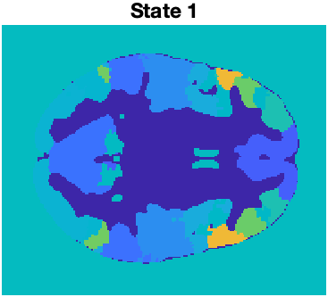
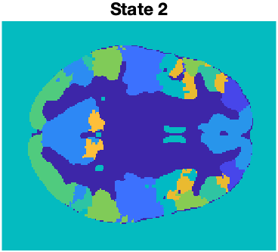
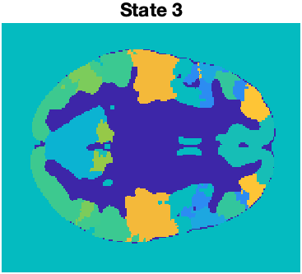
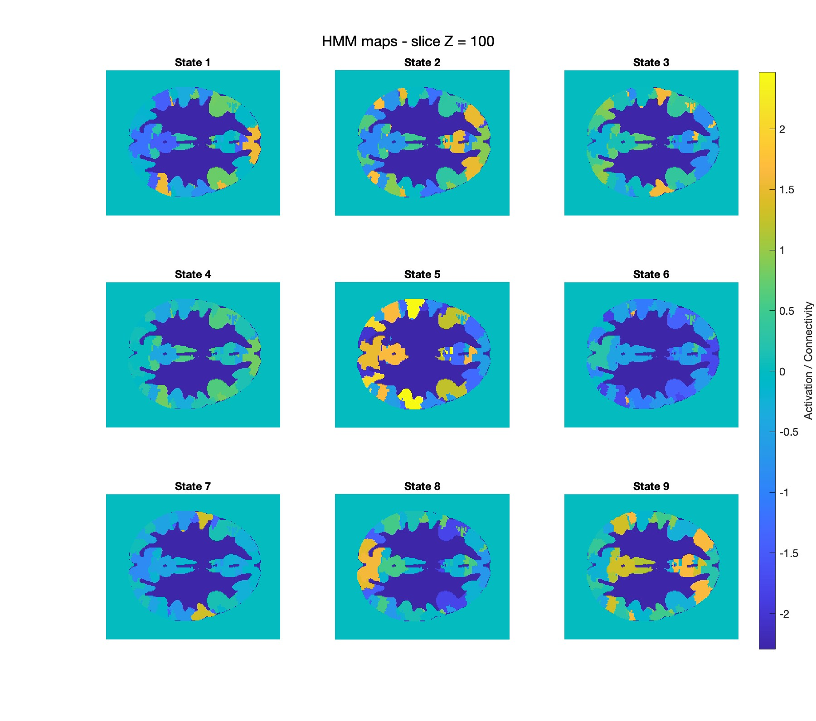
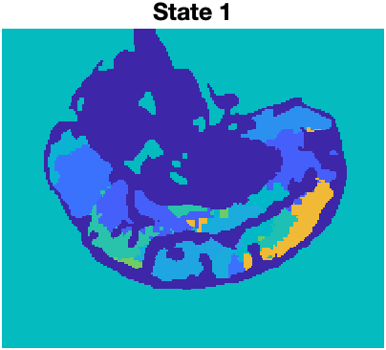
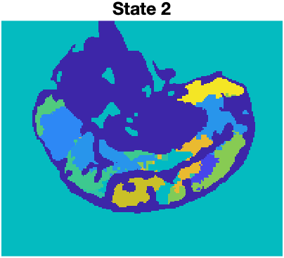
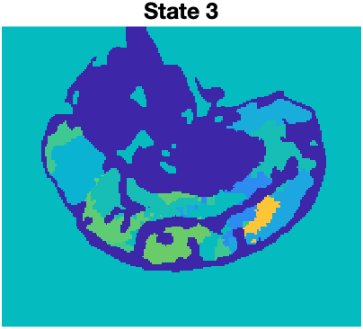
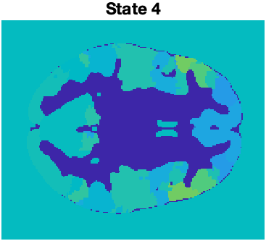
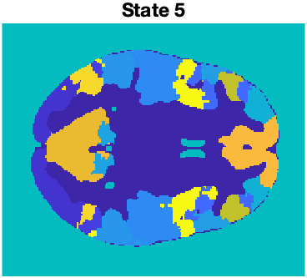
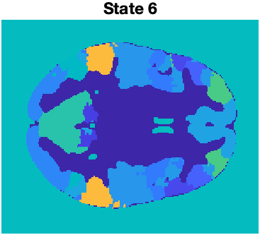
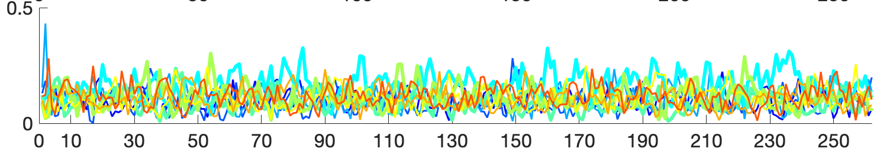
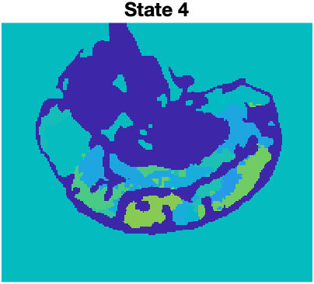
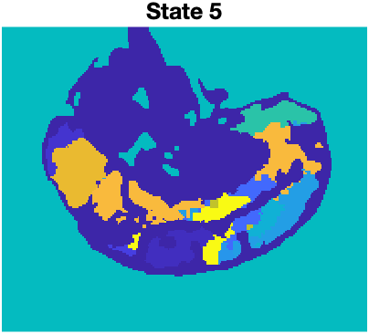
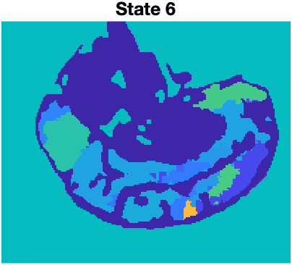
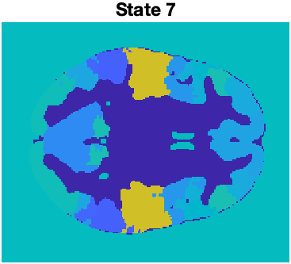
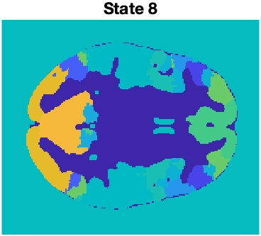
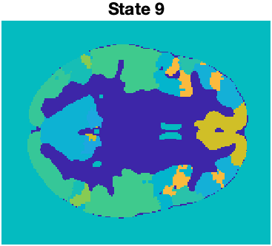
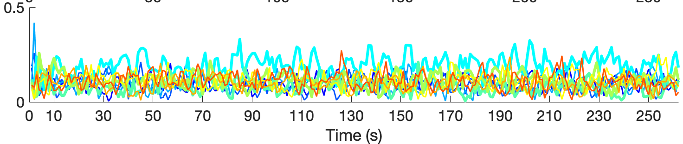
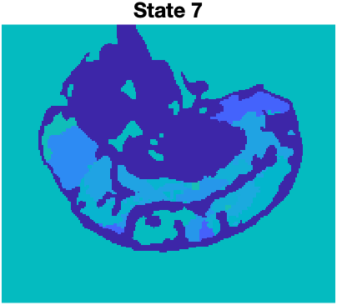
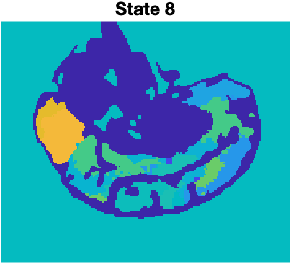
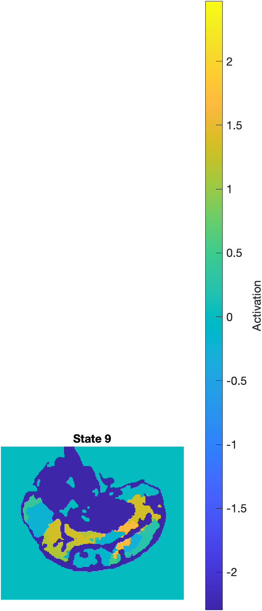
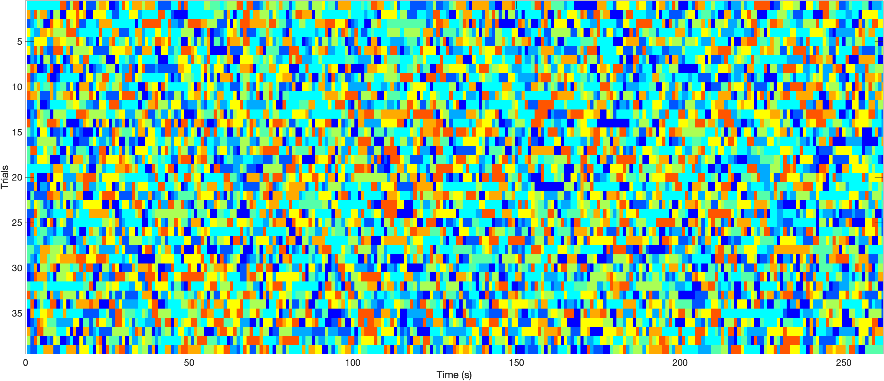
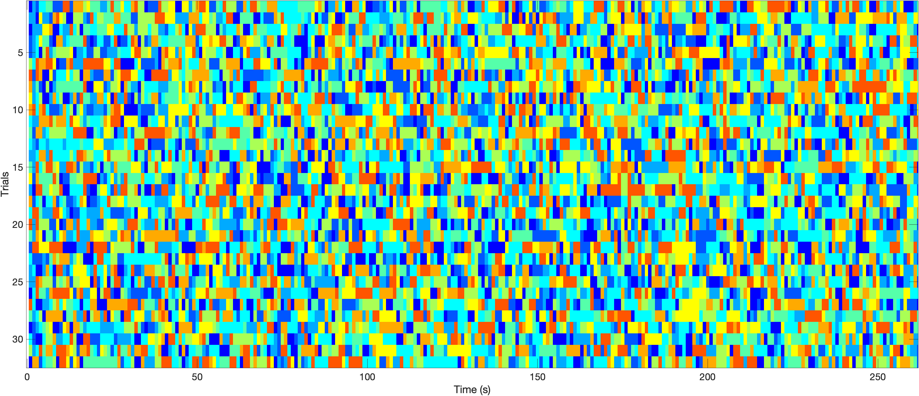
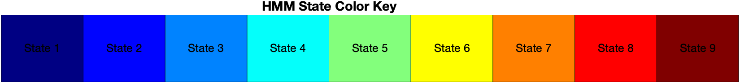



Functional Connectivity of participants with Psychotic disorder during Emotional Video viewing
Li, Judy. X.^{1,2,4}, Jeganathan, Jayson ¹, Sonkusare, Saurabh ², Paton, Bryan ^{3,4,5}, Luchow, Shiami ⁴, Breakspear, Michael ^{3,4}, Wellstein, Katharina .V.^{3,4}
¹ John Hunter Hospital, Hunter New England Local Health District, Australia, ² University of Sydney, Sydney, Australia, ³ University of Newcastle, Newcastle, Australia, ⁴ Hunter Medical Research Institute, Newcastle, Australia, ⁵ Mark Hughes Foundation Centre for Brain Cancer Research, University of Newcastle, NSW, 2308, Australia.
INTRODUCTION
Emotional processing in schizophrenia, which is a key feature of negative symptoms, is poorly understood while negative symptoms form the majority of burden of disease [1]. Functional neuroimaging, use of natural stimuli, and new connectivity techniques offer a novel way to investigate these symptoms and potentiate treatments. Evidence links negative symptoms to impairment in emotional neurocognitive processes [2, 3].
METHODS
43 participants with a history of diagnosed psychotic illness (CC) and 37 healthy controls (HC) were recruited. CC participants fulfilled the DSM-5 criteria for broadly defined psychotic disorder (including mood disorders with psychotic features, schizophrenia, schizophreniform disorder, and schizoaffective disorder).
Participants viewed a 4-minute video stimulus compiled for the DISFA database (see Table 1) by Mavadati and Mahoor [10] . The fMRI data has previously been preprocessed with fmriprep.
Participants were randomly allocated to either a hold-out dataset (HOD; 5CC, 5HC) or a main dataset (39 CC, 32 HC). Analysis was performed using the OHBA HMM-MAR toolbox [11]. Based on cross-validation and free energy computation we identified that K=9 and Dirichilet Diag=10 provided the best fit given our HOD data. We then fit an HMM using these priors to the main dataset and subsequently quantified how much time participants spent in each brain state (fractional occupancy; FO).
We performed t-tests on the FO of the 9 HMM states (see Table 1). We then compared the FO of the states that exhibited differences between CC and HC in each segment in order to determine what video clips of the video stimulus elicited the observed differences.
RESULTS
We found that CC compared to HC occupied states 4 less and state 5 more compared to other states based on t tests, however these comparisons did not survive multiple comparisons correction.
When relating the FO of state 4 and state 5 to the different video segments, we found that for state 4 these differences occurred predominantly in the video clips targeting the emotions happiness, fear, disgust, and sadness. For state 5 FO differences occurred mainly in video clips targeting happiness and sadness.
We also visualized the brain states to show the relative activation of the 17 ROIs.
Table 1. Video stimulus description. Each segment represents a video clip that was designed by Mavadati and Mahoor [10] to elicit a target emotion. The authors showed the video clips to participants and measured their facial Action Units (AUs) as a response to the video clips, based on which they showed that the vide-clips elicited AUs related to the target to differing degrees (”%Target emotion occurred”).
Segment Number | 1 | 2 | 3 | 4 | 5 | 6 | 7 | 8 | 9
Start (s) | 10 | 25 | 51 | 71 | 82 | 140 | 156 | 194 | 231
Length (s) | 11 | 22 | 16 | 7 | 54 | 12 | 34 | 33 | 41
Target Emotion | Happy | Happy | Surprise | Fear | Disgust | Disgust | Sadness | Sadness | Surprise
% of time target emotion occurred | 67.3 | 52.8 | 9.2 | 6.3 | 23.6 | 5.5 | 5.1 | 1.2 | 11.7
a)
FRACTIONAL OCCUPANCY HC
Mean FO state 4: 0.154. 0.150** 0.178 0.148 0.172* 0.184 0.183** 0.171 0.175
Mean FO state 5: 0.120*** 0.089. 0.102 0.093 0.084 0.079 0.089 0.088 0.082
FRACTIONAL OCCUPANCY CC
Mean FO state 4: 0.156. 0.196** 0.182. 0.222 0.195* 0.202 0.213** 0.165 0.183
Mean FO state 5: 0.074*** 0.790 0.089 0.075 0.091 0.066 0.074 0.080 0.072
Figure 1. Spatial maps of the 9 HMM states. The colour gradient indicates standardized relative magnitude of activation for the 17 ROIs of the Yeo et al. [12] atlas.
b)
Table 2. Between group t-tests for fractional occupancy (FO) of each state during video viewing, adjusted p-values corrected with Benjamini-Hochberg procedure for FDR correction
FRACTIONAL OCCUPANCY CC
HMM State | p-value | Standard Deviation | Confidence Interval | Adjusted p-value
1 | 0.616714493 | 0.029380785 | [-0.00796, 0.01321] | 0.743445039
2 | 0.40680231 | 0.029972409 | [-0.00635, 0.01526] | 0.610203464
3 | 0.85327787 | 0.024935476 | [-0.00816, 0.18648] | 0.85327787
4 | 0.011454808 | 0.05276286 | [-0.04409, -2.68813] | 0.103093273
5 | 0.033444333 | 0.027101147 | [0.00089, 2.22566] | 0.1504995
6 | 0.241973669 | 0.028741026 | [-0.00431, 1.19286] | 0.544440756
7 | 0.317530437 | 0.033597883 | [-0.01814, -1.01592] | 0.571554787
8 | 0.660840034 | 0.03525043 | [-0.01546, -0.44300] | 0.743445039
9 | 0.124843396 | 0.033135261 | [-0.00271, 1.57745] | 0.374530187
FRACTIONAL OCCUPANCY HC
CONCLUSIONS
In our first preliminary analysis, we found promising indications of differences in functional connectivity during video-viewing. Difference in expression of brain states 4 and 5 were significant in the segments targeting the following emotions: happiness, sadness, and disgust.
There are several limitations to this first analysis. Firstly, our current model does not show any difference in transition probabilities across states. On a conceptual level, this finding is erroneous and points to potential hidden issues in our modelling process. Secondly, the video stimulus itself does not reliably elicit the emotions the different clips it targets as shown by the original authors’ study. Thus, other dynamics captured by the video stimulus may provide more insight than the different segments. We will revisit our parameters underlying the HMM-MAR, and continue to analyse other outputs (heart rate, switching rate) in correlation with clinical scoring (PANSS).
c)
c)
Figure 2. Fractional Occupancy (FO) of states were plotted against time. a) FO of each state at each point in time. Time spent in states 4 and 5 at each point in time were related to the different movie segments using t-tests and corrected with Benjamini-Hochberg procedure for FDR correction. *p_{corrected}< 0.05, **p_{corrected}< 0.01, ***p_{corrected}< 0.001. b) States with the highest FO at each point in time (x axis) were plotted for each individual (y axis). c) Colour bar showing colour representation of state numbers.
REFERENCES
Correll, C.U. and N.R. Schooler, Negative symptoms in schizophrenia: a review and clinical guide for recognition, assessment, and treatment. Neuropsychiatric disease and treatment, 2020: p. 519 534.
Yao, B. and K. Thakkar, Interoception abnormalities in schizophrenia: A review of preliminary evidence and an integration with Bayesian accounts of psychosis. Neuroscience & Biobehavioral Reviews, 2022. 132: p. 757-773.
Wylie, K.P. and J.R. Tregellas, The role of the insula in schizophrenia. Schizophrenia research, 2010. 123(2-3): p. 93-104.
Finn, E.S. and P.A. Bandettini, Movie-watching outperforms rest for functional connectivity-based prediction of behavior. NeuroImage, 2021. 235: p. 117963.
Sonkusare, S., M. Breakspear, and C. Guo, Naturalistic Stimuli in Neuroscience: Critically Acclaimed. Trends in Cognitive Sciences, 2019. 23(8): p. 699-714.
Li, X., et al., Decreased intersubject synchrony in dynamic valence ratings of sad movie contents in dysphoric individuals. Scientific Reports, 2021. 11(1): p. 14419.
Tu, P.-C., et al., Reduced synchronized brain activity in schizophrenia during viewing of comedy movies. Scientific Reports, 2019. 9(1): p. 12738.
Ou, J., et al., Characterizing and differentiating brain state dynamics via hidden Markov models. Brain topography, 2015. 28: p. 666-679.
Kottaram, A., et al., Brain network dynamics in schizophrenia: Reduced dynamism of the default mode network. Human brain mapping, 2019. 40(7): p. 2212-2228.
Mavadati, S.M., et al., DISFA: A Spontaneous Facial Action Intensity Database. IEEE Transactions on Affective Computing, 2013. 4(2): p. 151-160.
Yeo BT, Krienen FM, Sepulcre J, Sabuncu MR, Lashkari D, Hollinshead M, Roffman JL, Smoller JW, Zöllei L, Polimeni JR, Fischl B, Liu H, Buckner RL. The organization of the human cerebral cortex estimated by intrinsic functional connectivity. J Neurophysiol. 2011. 106(3): p. 1125-65.
Vidaurre, D., et al., Spectrally resolved fast transient brain states in electrophysiological data. NeuroImage, 2016. 126: p. 81-95.
Contact Details (scan)
E: judyxli19@gmail.com

