Slide 1
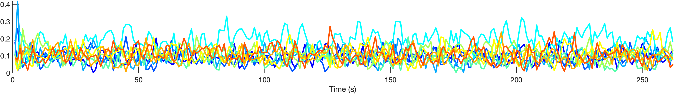
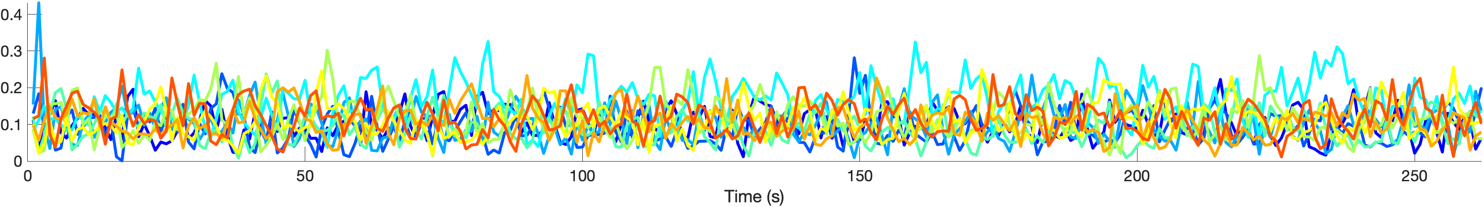
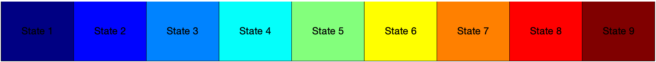
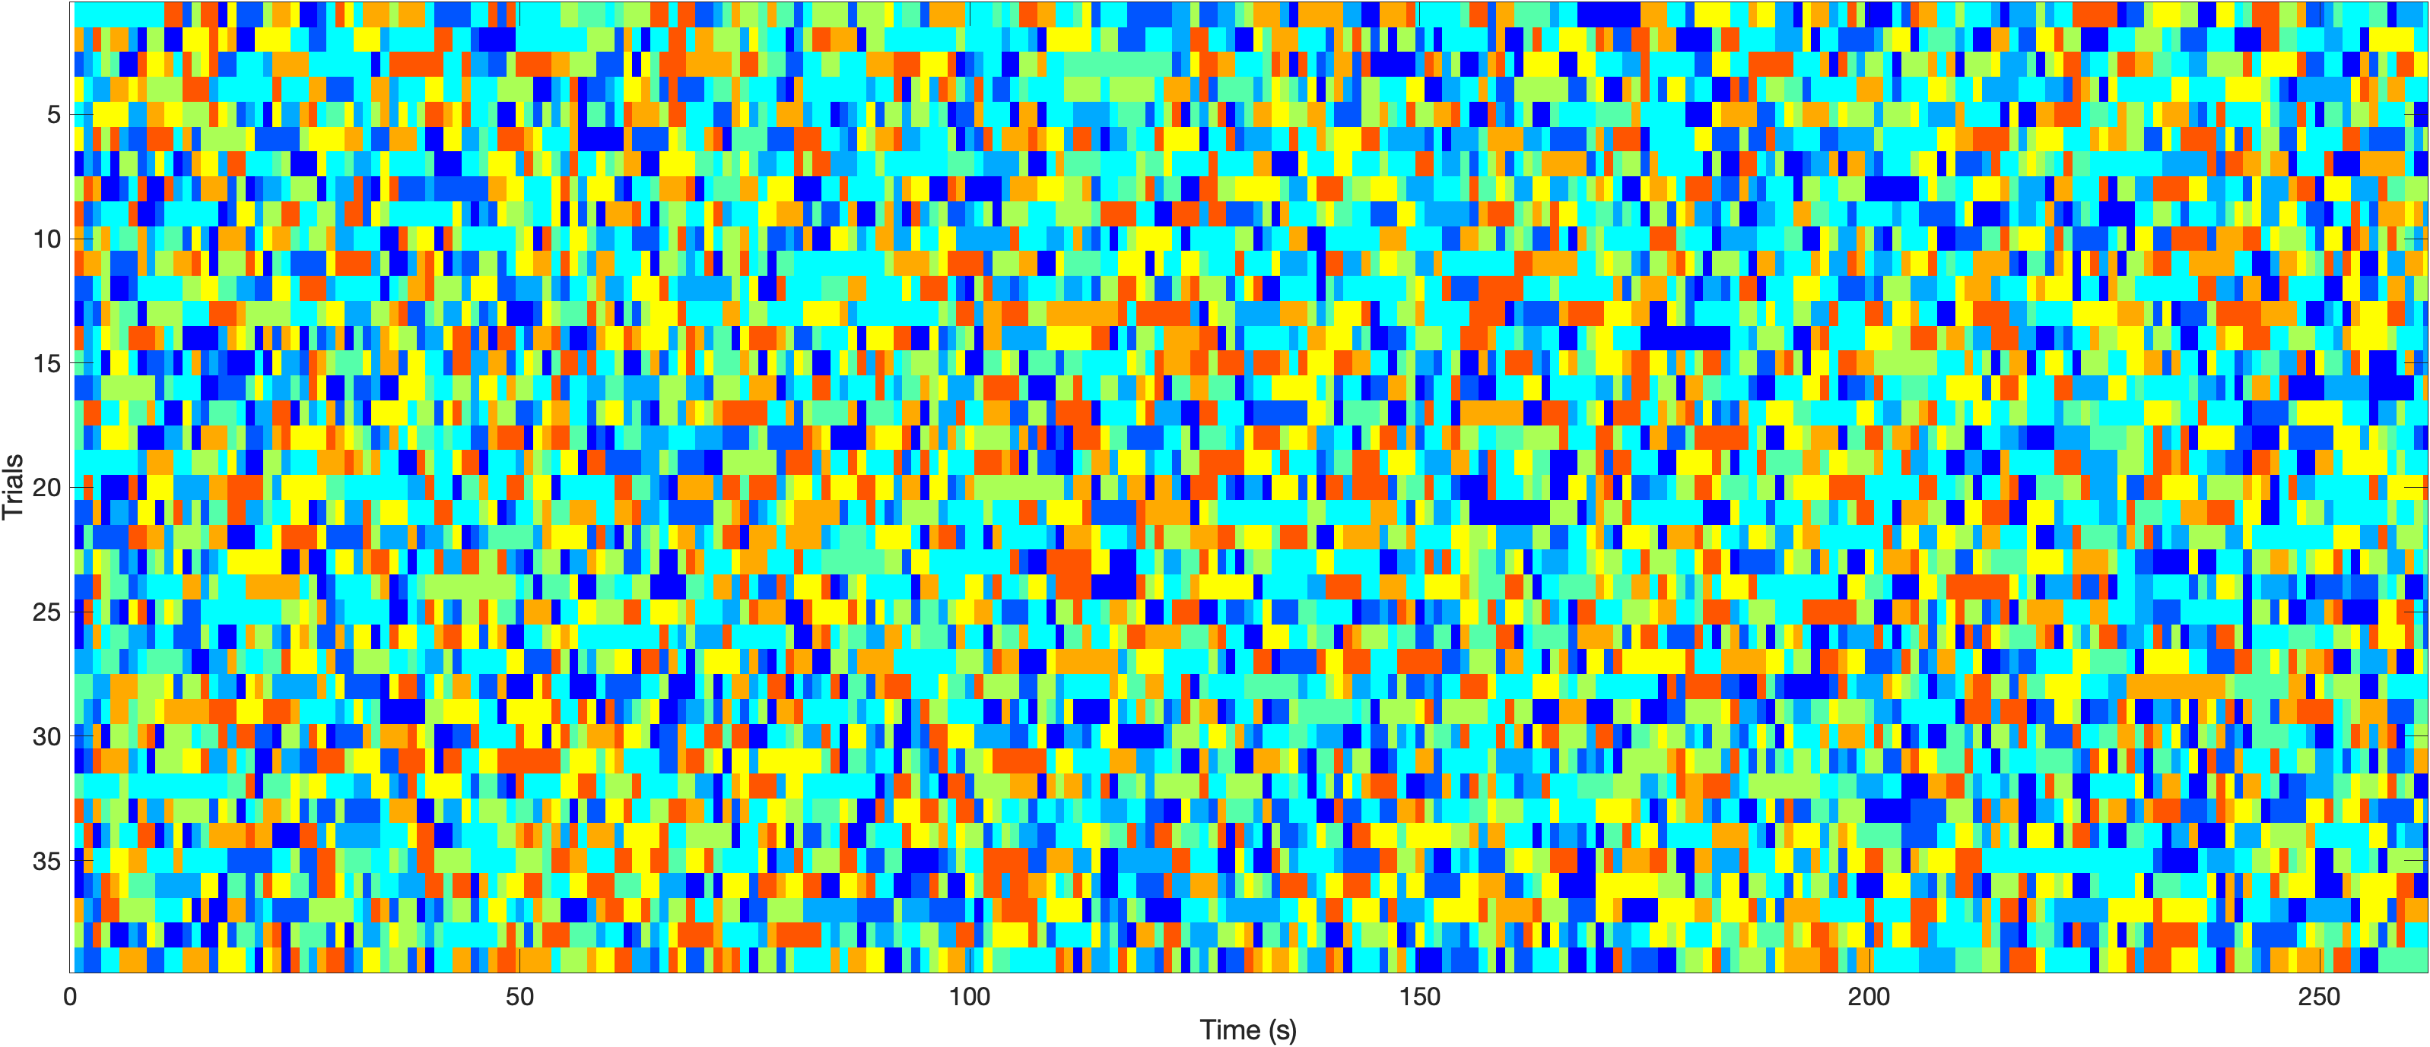
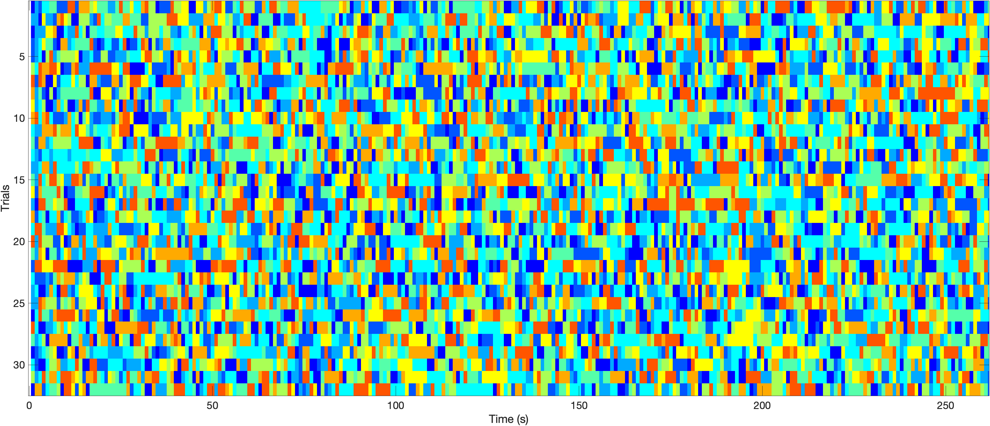
Functional Connectivity during Emotional Video viewing with Psychotic diagnoses
Li, Judy. X.^{1,2,4}, Jeganathan, Jayson ¹, Sonkusare, Saurabh .³, Paton, Bryan .^{3,4,5}, Luchow, Shiami ⁴, Breakspear, Michael .^{3,44}, Wellstein, Katharina .V.^{3,4}
¹ John Hunter Hospital, Hunter New England Local Health District, Australia, ² University of Sydney, Sydney, Australia, ³ University of Newcastle, Newcastle, Australia, ⁴ Hunter Medical Research Institute, Newcastle, Australia, ⁵ Mark Hughes Foundation Centre for Brain Cancer Research, University of Newcastle, NSW, 2308, Australia.
INTRODUCTION
The negative symptoms of schizophrenia are simultaneously poorly understood and form the majority of burden of disease [1]. There is an unmet need for effective treatments, despite urgent demand. Functional neuroimaging, use of natural stimuli and new connectomics techniques offer a novel way to investigate these symptoms and potentiate treatments. Evidence links negative symptoms to impairment in emotional neurocognitive processes. [2, 3].
Naturalistic stimuli such as video in reduced unexplainable variance and better exposes individual differences between participants [4]. Naturalistic stimuli are closer to real-world experiences, increasing their ecological validity compared to highly-controlled, experimental tasks [5]. They also offer improved test-retest reliability compared to resting state . There are associations between severity of psychopathology and altered emotional processing of movie clips. [6, 7].
Hidden Markov models (HMM) can be used on fMRI data in the context of mental illness found significant differences in neurofunctional-connectivity in participants with mental illness [8, 9].
METHODS
43 participants with a history of diagnosed psychotic illness (CC) and 37 healthy controls (HC) were recruited for this study. CC participants fulfilled the DSM-5 criteria for broadly defined psychotic disorder (including mood disorders with psychotic features, schizophrenia, schizophreniform disorder, and schizoaffective disorder). CCs were recruited from outpatient mental health clinics in Hunter New England Local Health District in NSW, Australia.
Participants viewed a 4 minute video stimulus compiled by Mavadati, Mahoor [10] for the DISFA database. Symptom severity was assessed using the PANSS scale. fMRI and heart rate (HR) were recorded during viewing. fMRI data has already kindly been parcellated and archived.
Participant data were randomly allocated to either a hold-out dataset (HOD) or a test dataset with 5 CC and HCs in our HOD and 39 CC, 32 HC in our test dataset. We utilized a hidden Markov model (HMM) to identify underlying brain states driven by the stimuli via the OHBM HMM-MAR toolbox [11]. Parameters K (=9) and Dirichilet Diag (=10) for the HMM-MAR model were determined using cross-validation and free energy computation on a selection of candidate priors with our HOD. We then quantified how much time is spent in each brain state (fractional occupancy [FO]).We performed t tests on the FO of the 9 HMM states, and performed the Benjamini-Hochberg procedure for FDR correction.
RESULTS
We graphed the expression of HMM states during video-viewing below. We found that states 4 and 5 were statistically significant on t tests, but were not significant after FDR. Of note, transition probabilities were equivalent for all states.
SZD
Figure 1. Line graph of probability of each HMM state at each point in time during video viewing. Top graph is clinical group, Bottom graph is control group. Colour key to states can be found in Figure 2.
Table 1. Annotation of video clip watched by participants with segments in chronological order, time stamps, target emotion and % of time target emotion occurred as measured by Facial Action Units [10] .
Seg # | 1 | 2 | 3 | 4 | 5 | 6 | 7 | 8 | 9
Start (s) | 00 | 15 | 41 | 61 | 72 | 130 | 146 | 184 | 221
Length (s) | 11 | 22 | 16 | 7 | 54 | 12 | 34 | 33 | 41
Target Emotion | Happy | Happy | Surprise | Fear | Disgust | Disgust | Sadness | Sadness | Surprise
% of time target emotion occurred | 67.3 | 52.8 | 9.2 | 6.3 | 23.6 | 5.5 | 5.1 | 1.2 | 11.7
Figure 3. Colour key to HMM states, annotated by number.
Table 2. Between group p-values for fractional occupancy of each state during video viewing by t test, adjusted via Benjamini-Hochberg procedure for FDR correction
HMM State | p-value | Standard Deviation | Adjusted p-value
1 | 0.616714493 | 0.029380785 | 0.743445039
2 | 0.40680231 | 0.029972409 | 0.610203464
3 | 0.85327787 | 0.024935476 | 0.85327787
4 | 0.011454808 | 0.05276286 | 0.103093273
5 | 0.033444333 | 0.027101147 | 0.1504995
6 | 0.241973669 | 0.028741026 | 0.544440756
7 | 0.317530437 | 0.033597883 | 0.571554787
8 | 0.660840034 | 0.03525043 | 0.743445039
9 | 0.124843396 | 0.033135261 | 0.374530187
CONCLUSION
Studying differences in occupied brain states during an ecologically valid emotional stimulus offers novel insights into the disease. These findings will shed light on new targets for ongoing investigation and treatment formulation.
In our first preliminary analysis, we found promising indications of differences in functional connectivity during video-viewing which did not pass a false discovery rate correction.
Additionally, our current model does not show any difference in transition probabilities across states. On a conceptual level, this finding is erroneous and points to potential hidden issues in our modelling process.
Further work needs to be conducted to investigate the validity of our preliminary findings. We will revisit our parameters underlying the HMM-MAR, and continue to analyse other outputs (heart rate, switching rate) in correlation with clinical scoring (PANSS).
Figure 3. HMM states with the highest probability of occurring at each point in time for each participant (Trial) grouped into clinical (Top) and control (Bottom). Colour key to states can be found in Figure 2.
REFERENCES
1. Correll, C.U. and N.R. Schooler, Negative symptoms in schizophrenia: a review and clinical guide for recognition, assessment, and treatment. Neuropsychiatric disease and treatment, 2020: p. 519 534.
2. Yao, B. and K. Thakkar, Interoception abnormalities in schizophrenia: A review of preliminary evidence and an integration with Bayesian accounts of psychosis. Neuroscience & Biobehavioral Reviews, 2022. 132: p. 757-773.
3. Wylie, K.P. and J.R. Tregellas, The role of the insula in schizophrenia. Schizophrenia research, 2010. 123(2-3): p. 93-104.
4. Finn, E.S. and P.A. Bandettini, Movie-watching outperforms rest for functional connectivity-based prediction of behavior. NeuroImage, 2021. 235: p. 117963.
5. Sonkusare, S., M. Breakspear, and C. Guo, Naturalistic Stimuli in Neuroscience: Critically Acclaimed. Trends in Cognitive Sciences, 2019. 23(8): p. 699-714.
6. Li, X., et al., Decreased intersubject synchrony in dynamic valence ratings of sad movie contents in dysphoric individuals. Scientific Reports, 2021. 11(1): p. 14419.
7. Tu, P.-C., et al., Reduced synchronized brain activity in schizophrenia during viewing of comedy movies. Scientific Reports, 2019. 9(1): p. 12738.
8. Ou, J., et al., Characterizing and differentiating brain state dynamics via hidden Markov models. Brain topography, 2015. 28: p. 666-679.
9. Kottaram, A., et al., Brain network dynamics in schizophrenia: Reduced dynamism of the default mode network. Human brain mapping, 2019. 40(7): p. 2212-2228.
10. Mavadati, S.M., et al., DISFA: A Spontaneous Facial Action Intensity Database. IEEE Transactions on Affective Computing, 2013. 4(2): p. 151-160.
11. Vidaurre, D., et al., Spectrally resolved fast transient brain states in electrophysiological data. NeuroImage, 2016. 126: p. 81-95.

