Slide 1
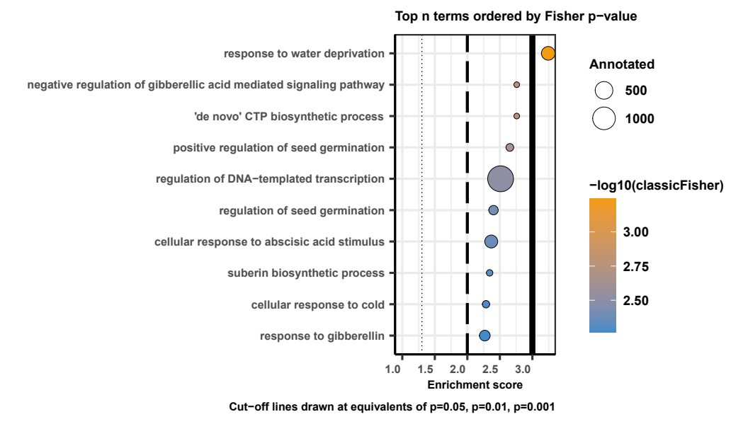
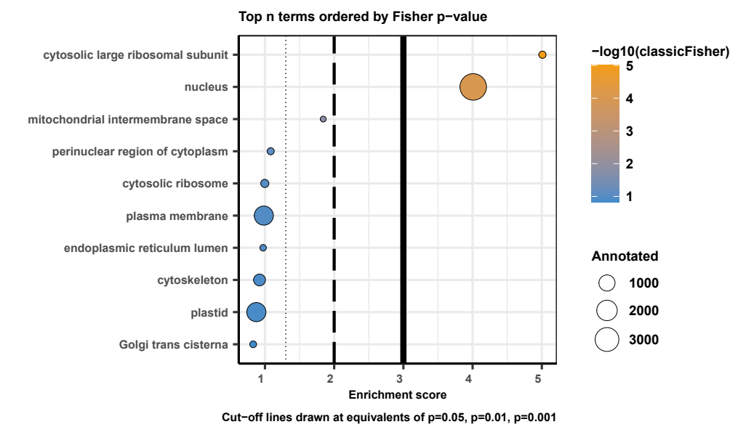
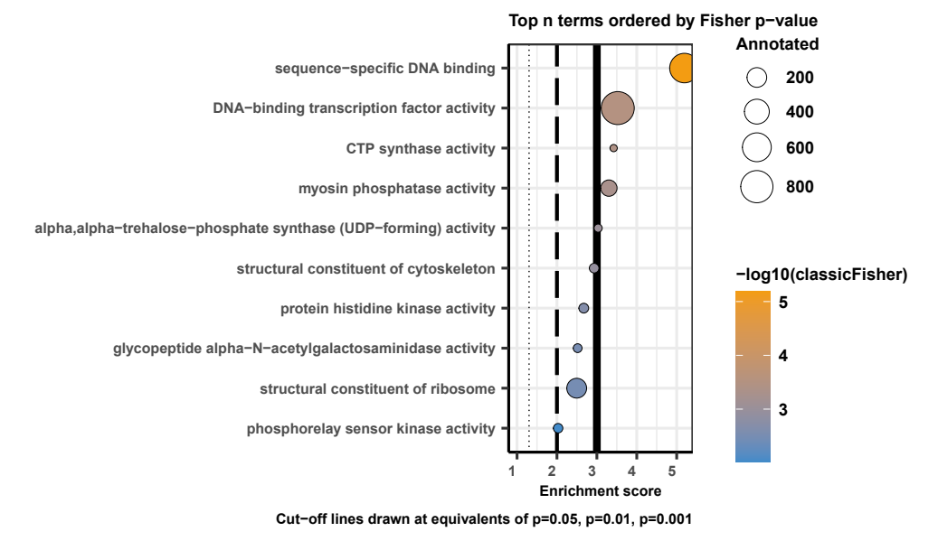
Zm vs Osj, Ta
Expanded and DEG in any species
BP
CC
MF

Slide 2
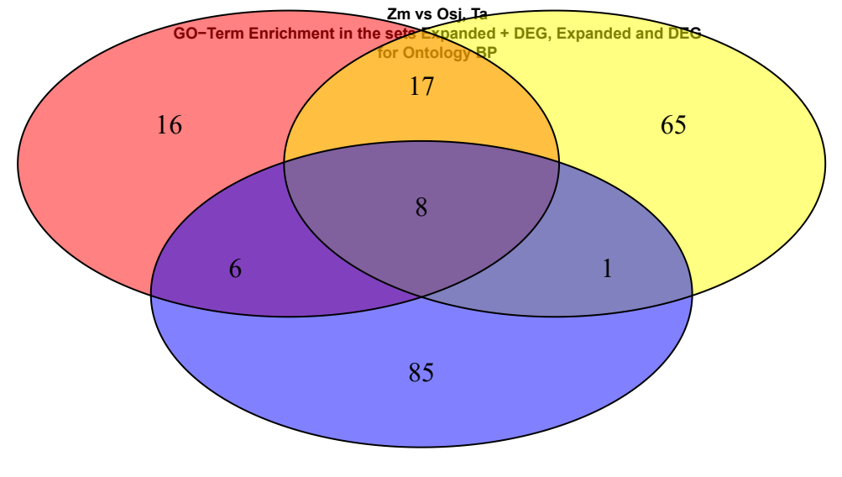



RED: Expanded + DEG
YELLOW: DEG
BLUE: Expanded
"C:\Users\jerem\Desktop\Studium\Nutzpflanzen Master\Masterarbeit\EX_THE000003\EX_THE000003_GOTerm_Comparison.R"

Slide 3
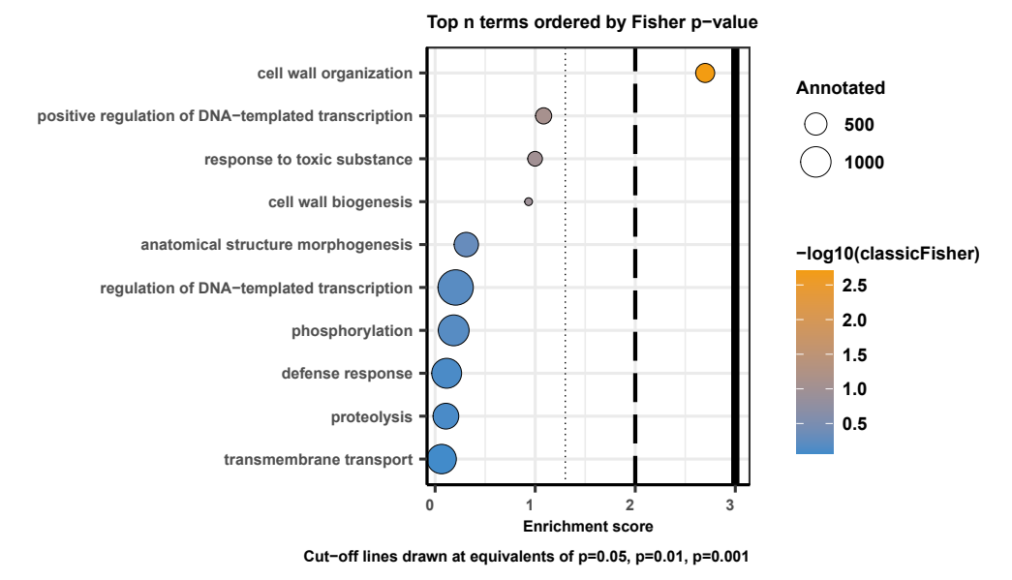
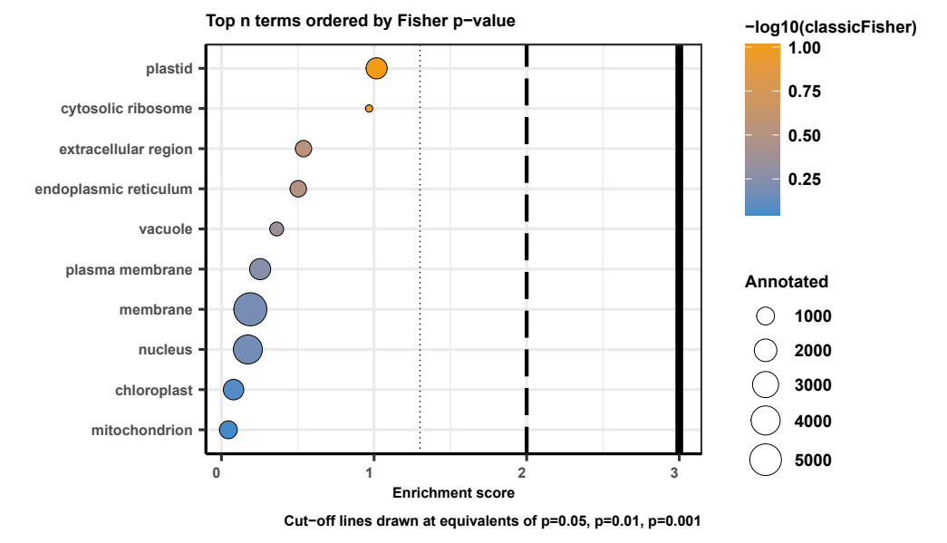
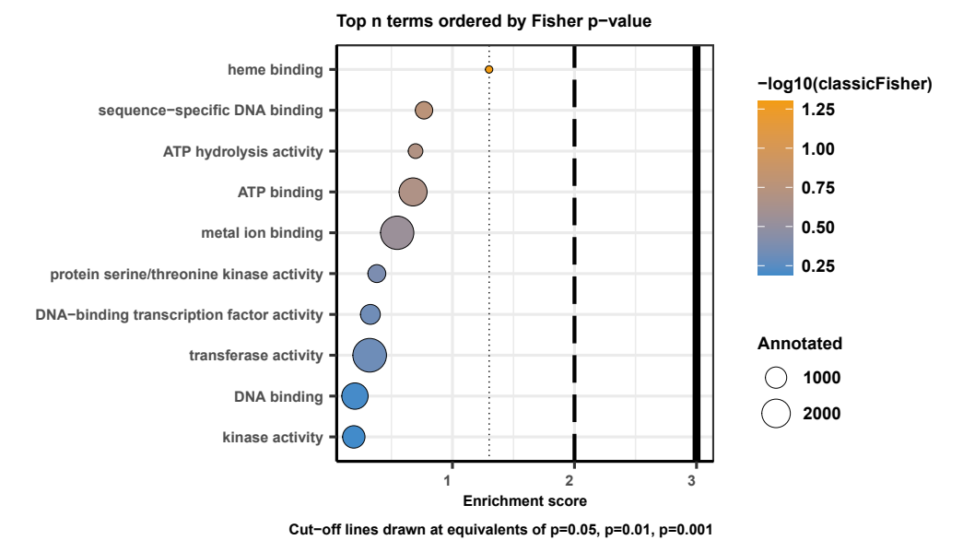
Msi, Sb, Zm vs Osj, Ta
Expanded and DEG in any species
BP
CC
MF

Slide 4
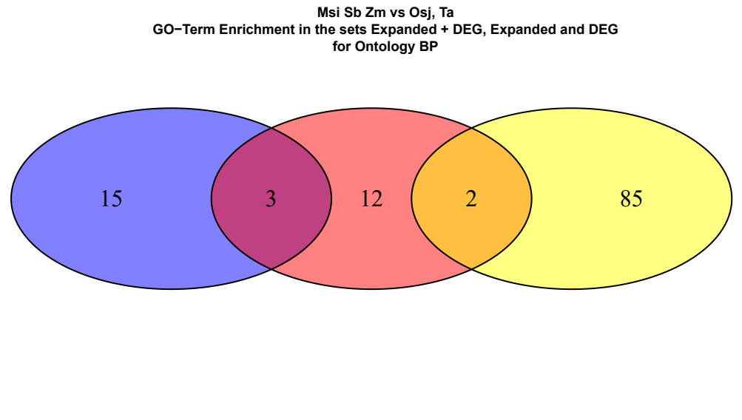

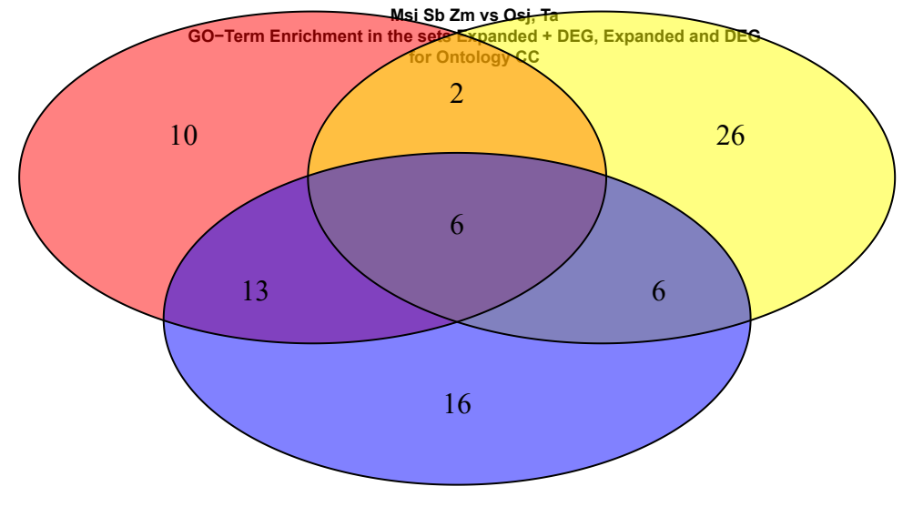

RED: Expanded + DEG
YELLOW: DEG
BLUE: Expanded
"C:\Users\jerem\Desktop\Studium\Nutzpflanzen Master\Masterarbeit\EX_THE000003\EX_THE000003_GOTerm_Comparison.R"

