Slide 1
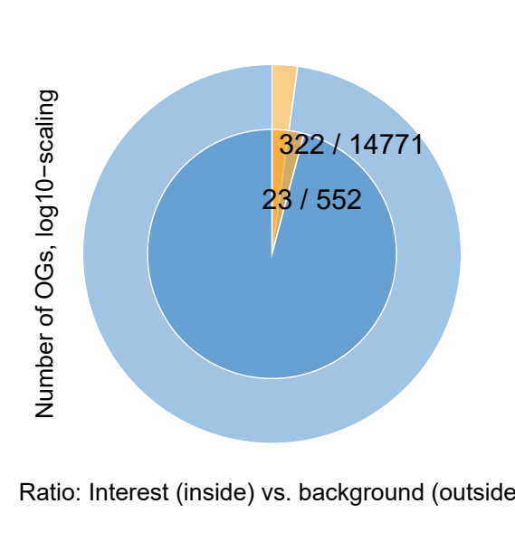
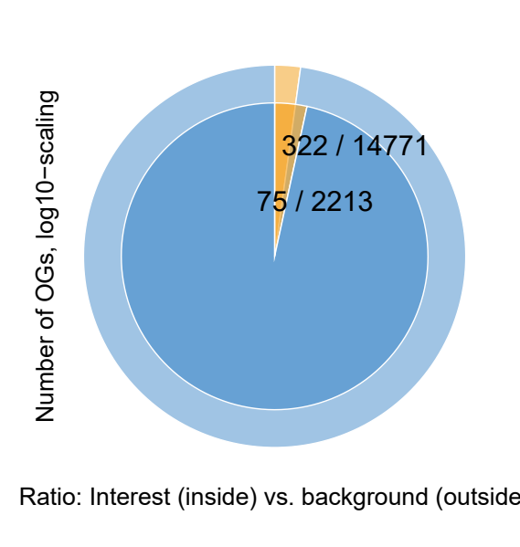

Conserved, hypotheses, Expanded, DEG in any expanded Species
Msi vs...
Osj
Ta
Osj, Ta
p = 0.00231794115180957
p = 4.4995356119966e-05
p = 0.0104383461987447

Slide 2
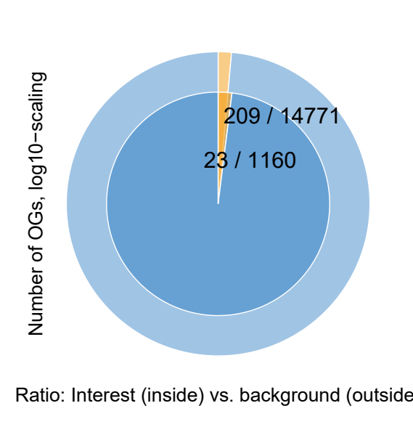


Conserved, hypotheses, Expanded, DEG in any expanded Species
Sb vs...
Osj
Ta
Osj, Ta
p = 0.0625982232485831
p = 0.00570822397491443
p = 0.0640714490595862

Slide 3
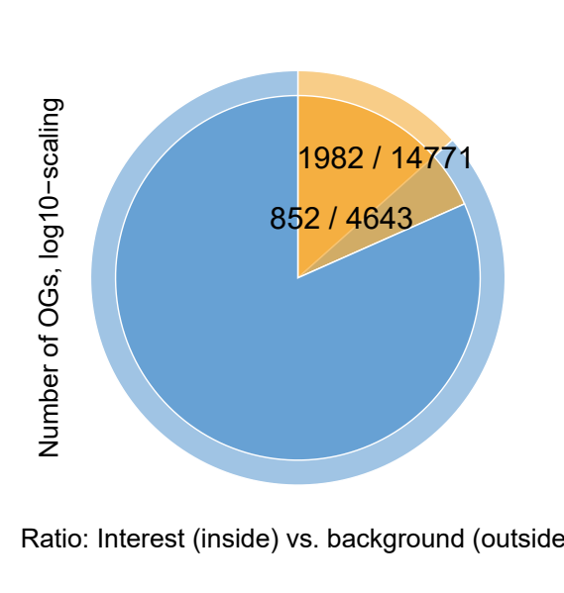
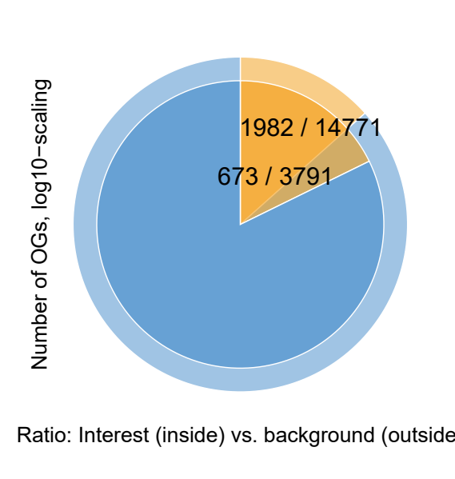
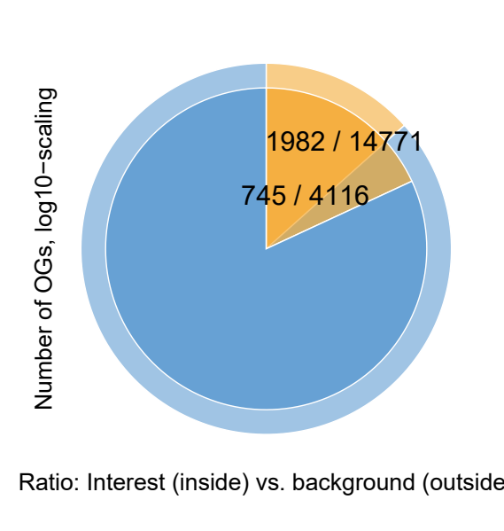
Conserved, hypotheses, Expanded, DEG in any expanded Species
Zm vs...
Osj
Ta
Osj, Ta
p = 2.88931723237232e-24
p = 1.59910785074032e-31
p = 5.25250971986298e-19

Slide 4
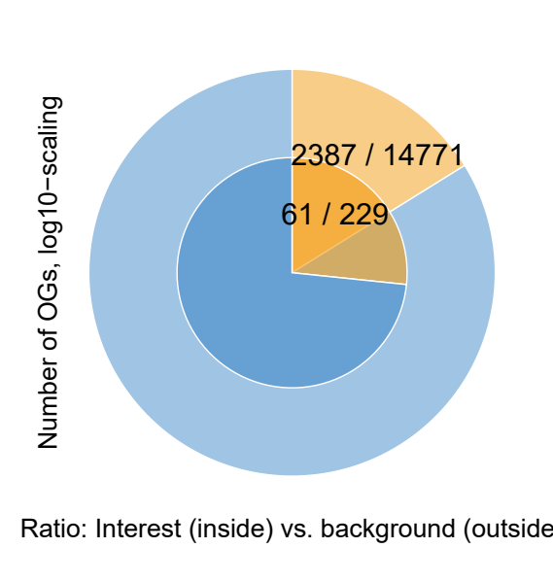
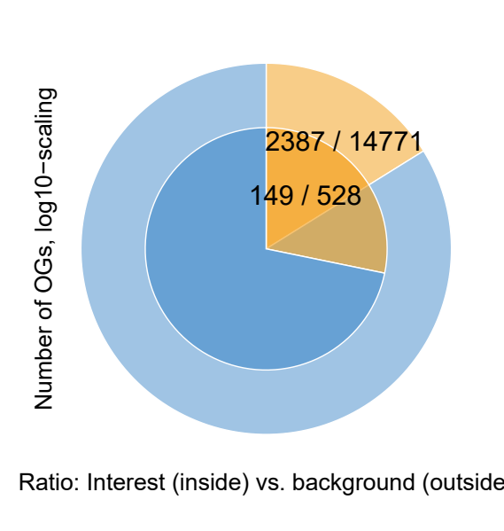

Conserved, hypotheses, Expanded, DEG in any expanded Species
Msi, Sb, Zm vs...
Osj
Ta
Osj, Ta
p = 3.32509922238356e-05
p = 7.94502131504751e-13
p = 4.00030138219779e-05

Slide 5
