Slide 1
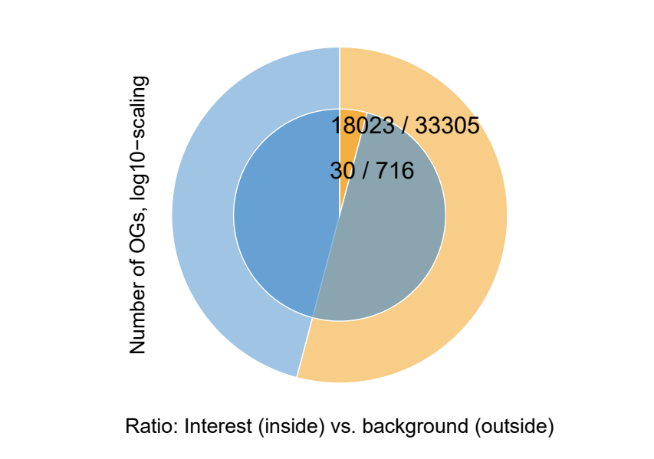
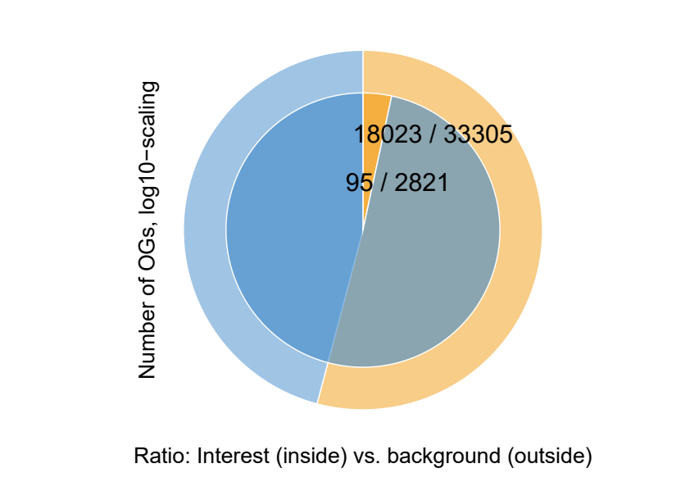
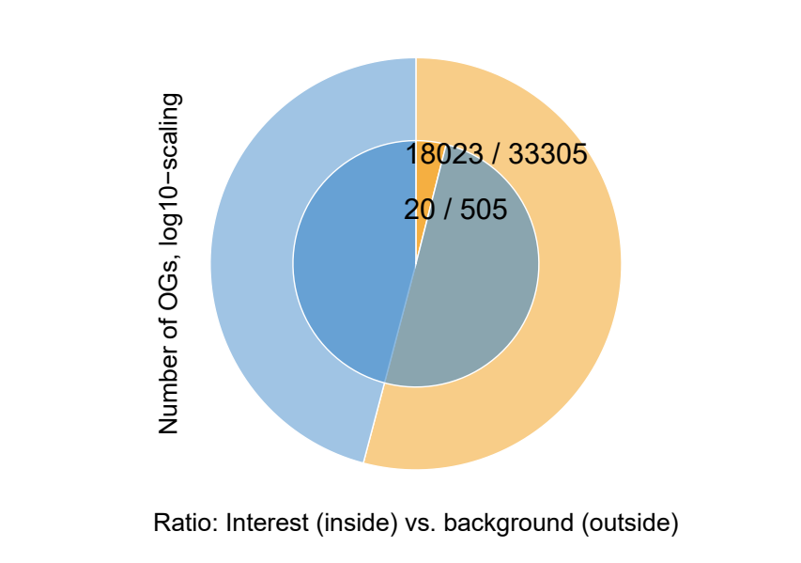
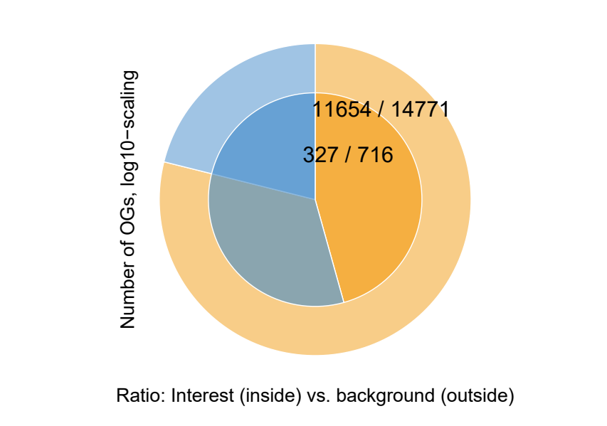
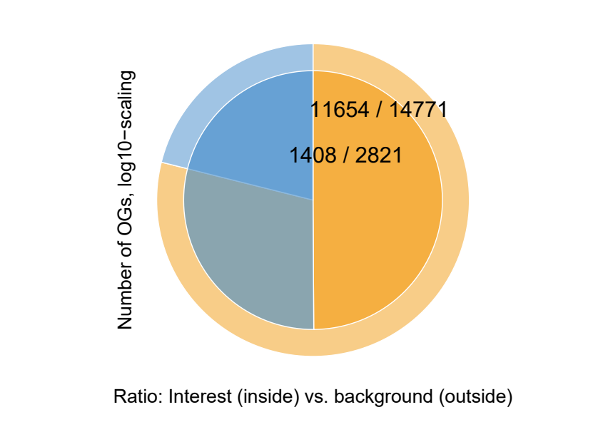
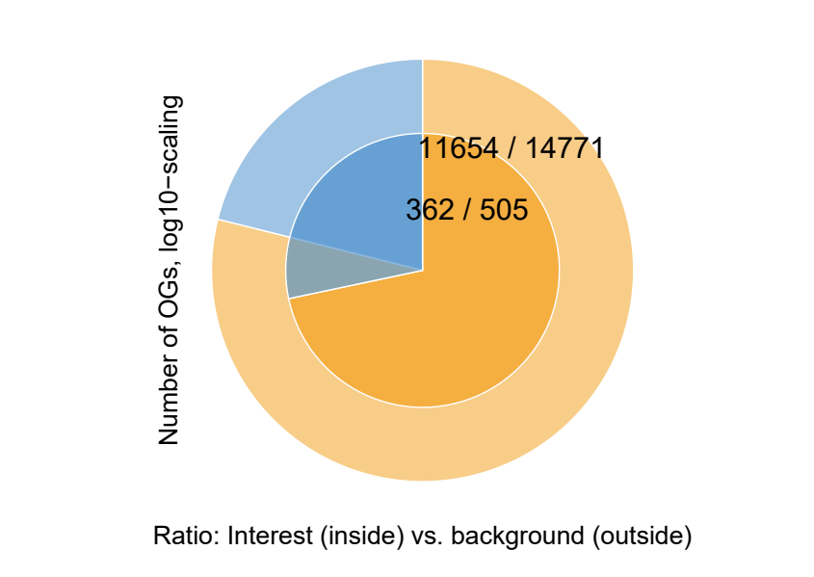
Expandeed; DEG in Any Species
Msi
Expandeed; DEG in Any Species vs BG
vs Osj
vs Ta
vs Osj, Ta
all
conserved

Slide 2
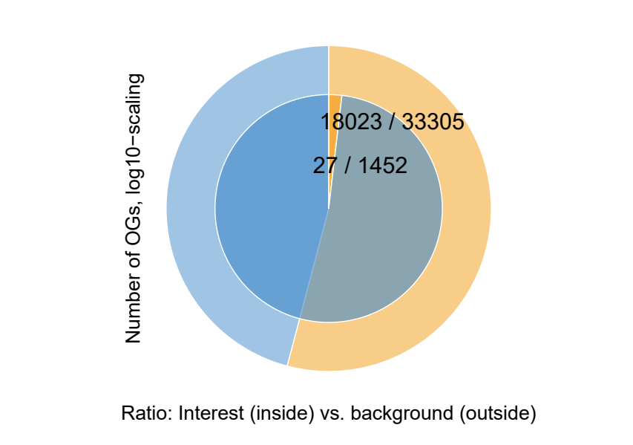
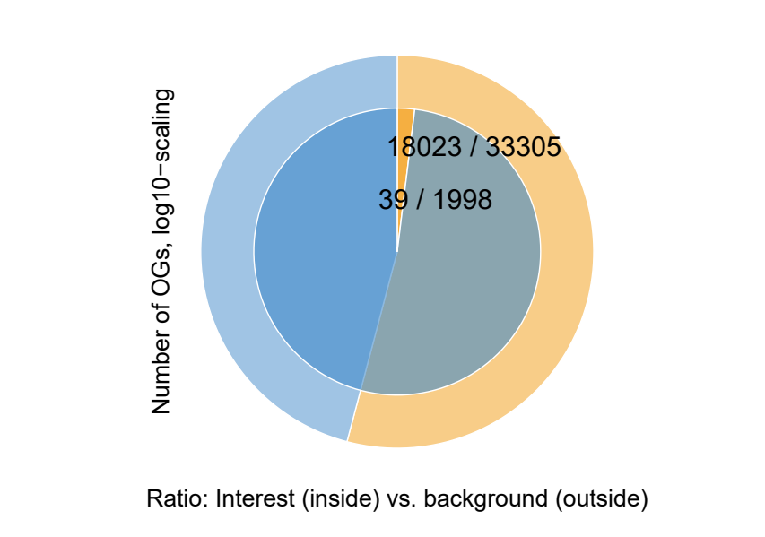
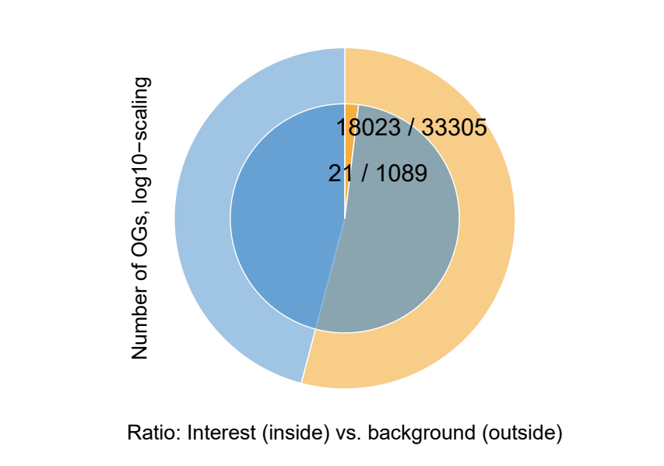
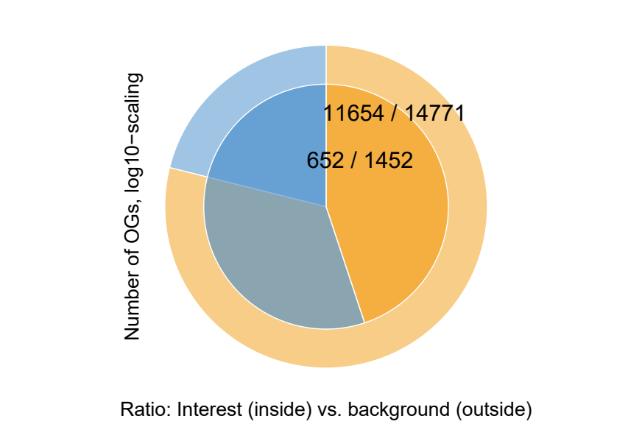
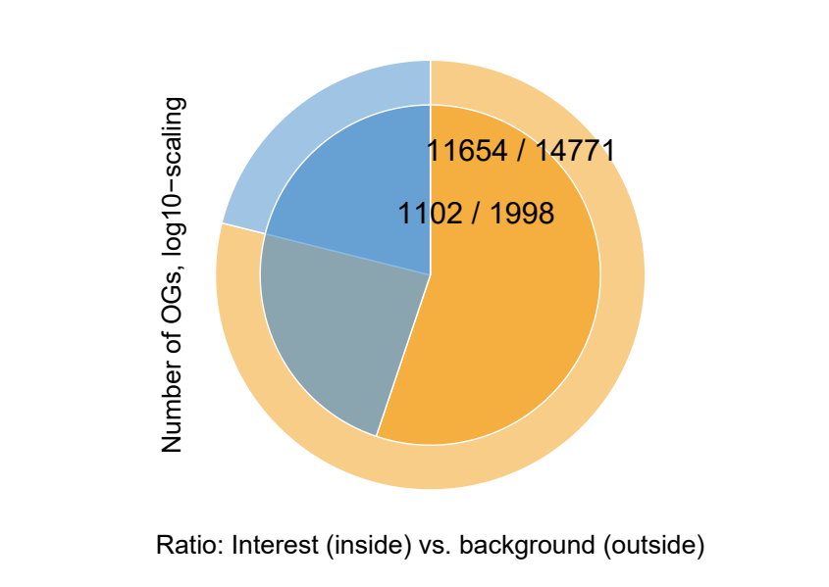
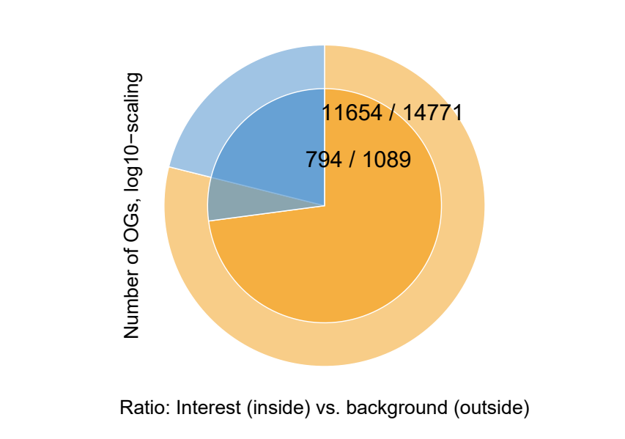
Expandeed; DEG in Any Species vs BG
Sb
vs Osj
vs Ta
vs Osj, Ta
all
conserved

Slide 3
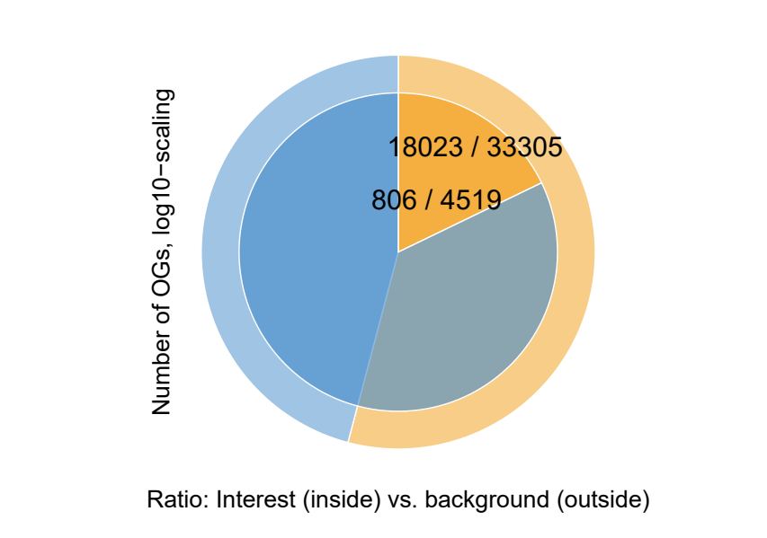
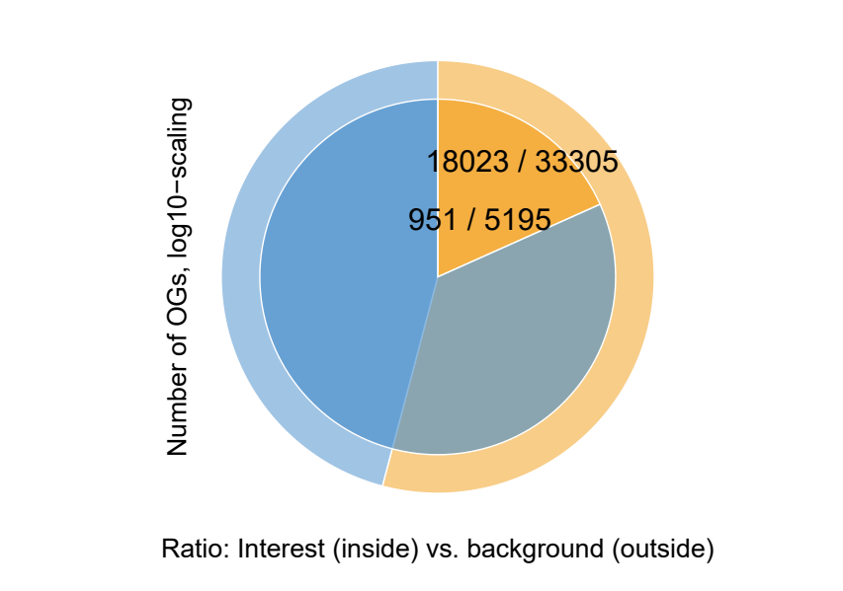
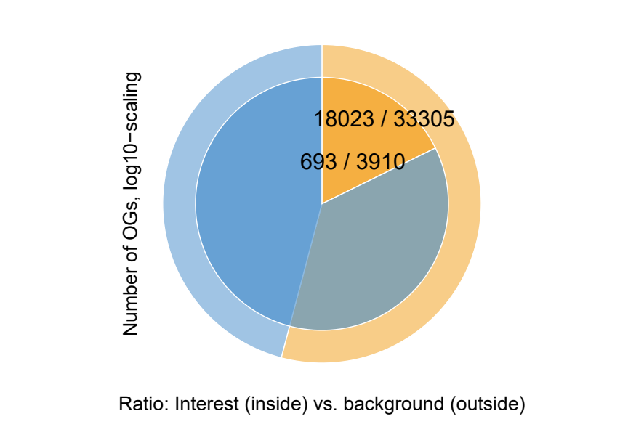
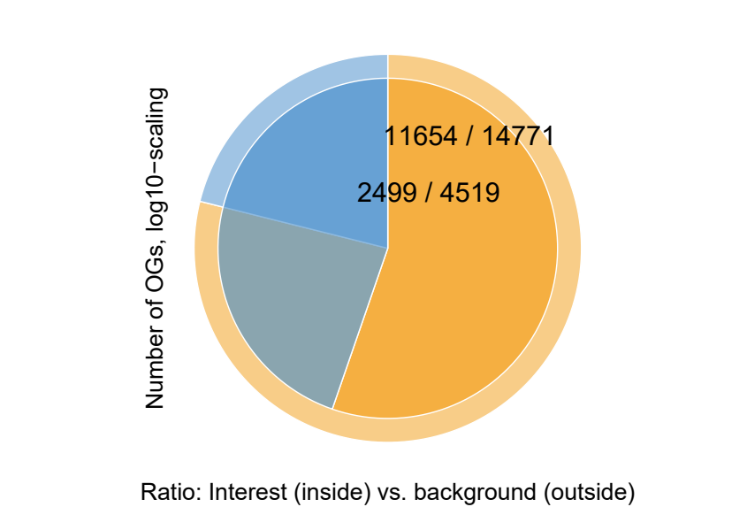
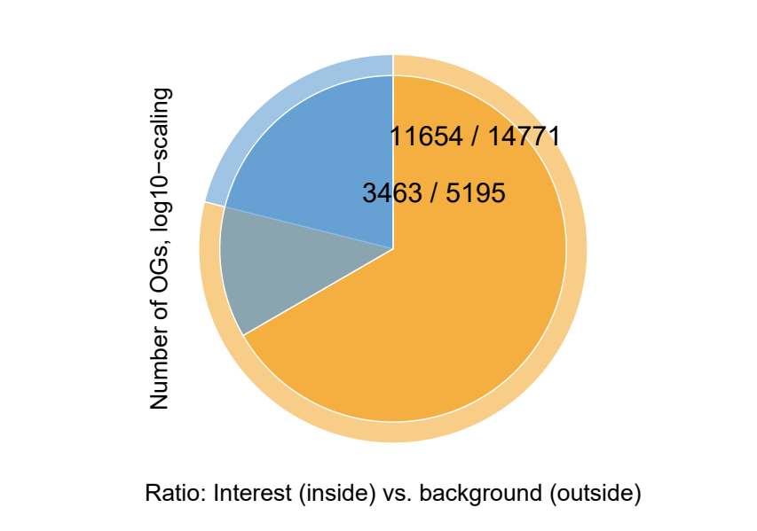
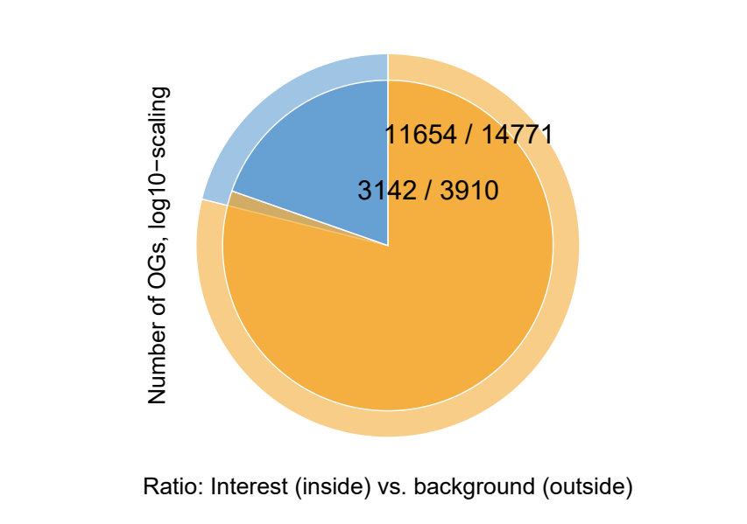
Expandeed; DEG in Any Species vs BG
Zm
vs Osj
vs Ta
vs Osj, Ta
all
conserved

Slide 4
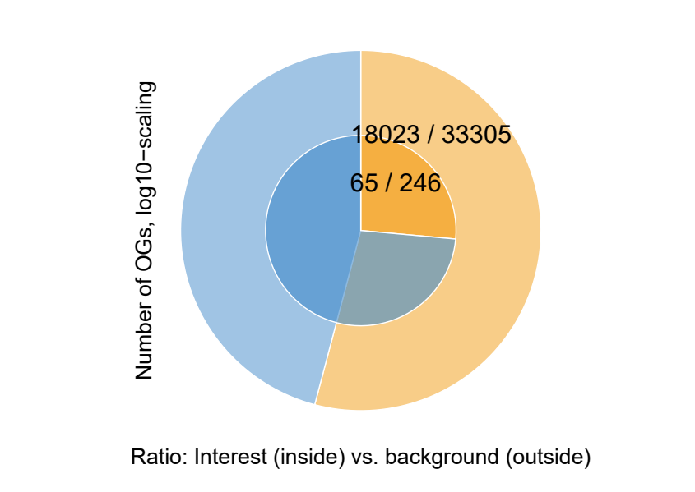
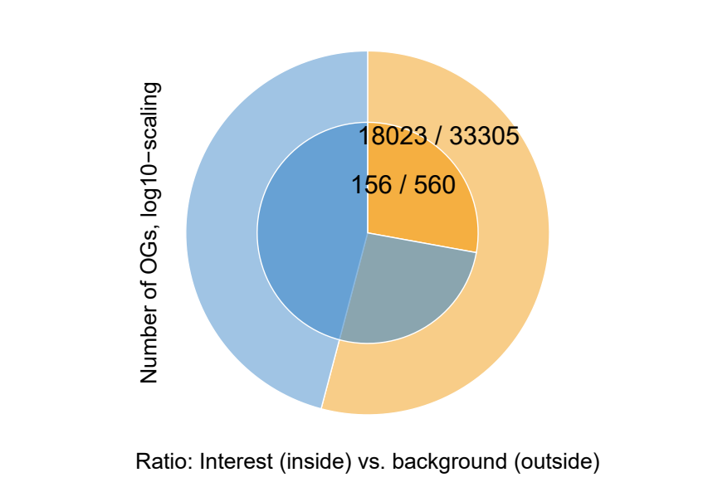
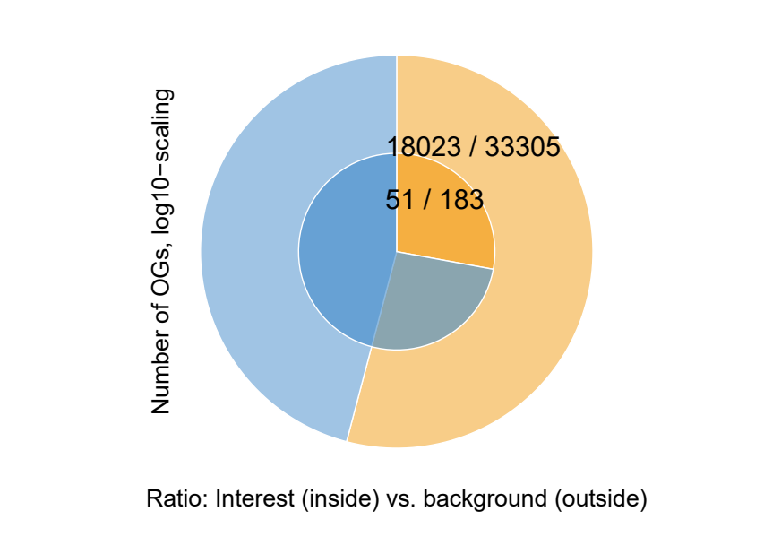
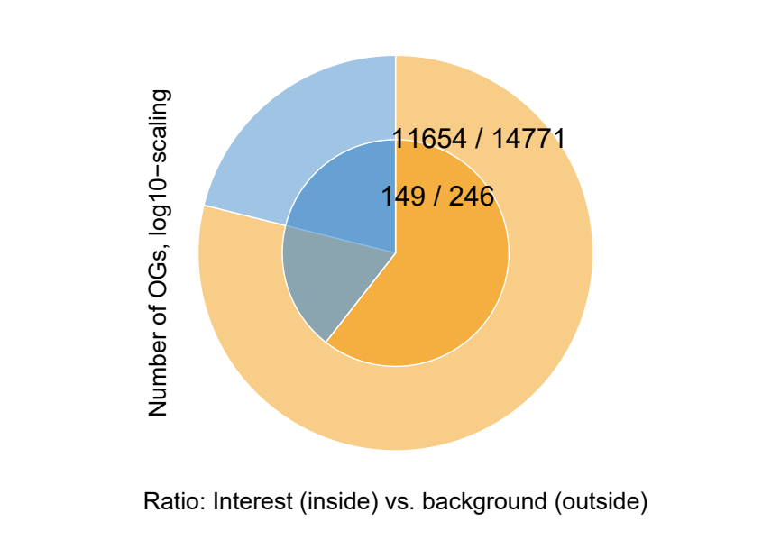
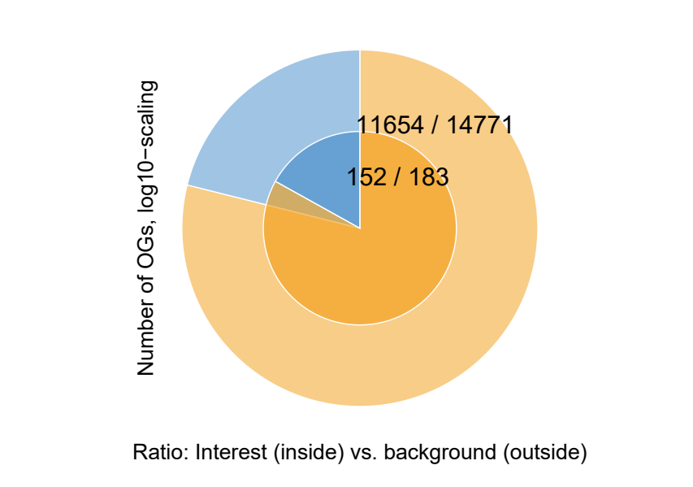
Expandeed; DEG in Any Species vs BG
Msi, Sb, Zm
vs Osj
vs Ta
vs Osj, Ta
all
conserved

Slide 5
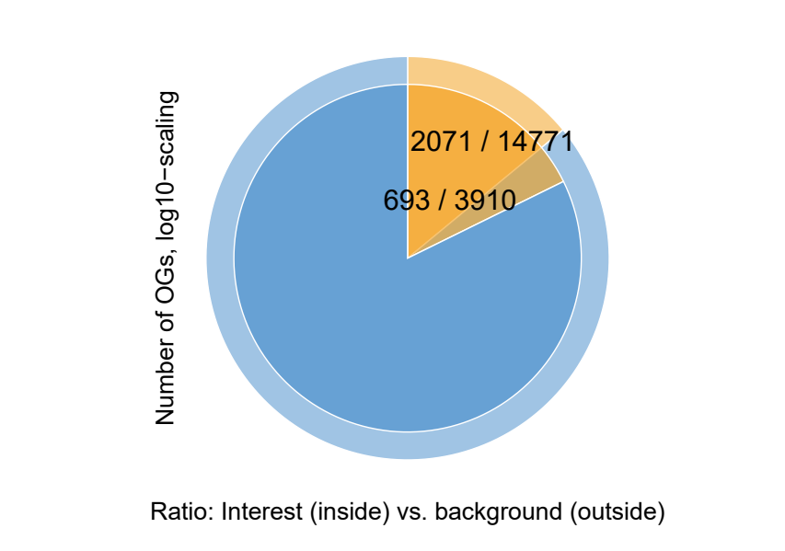
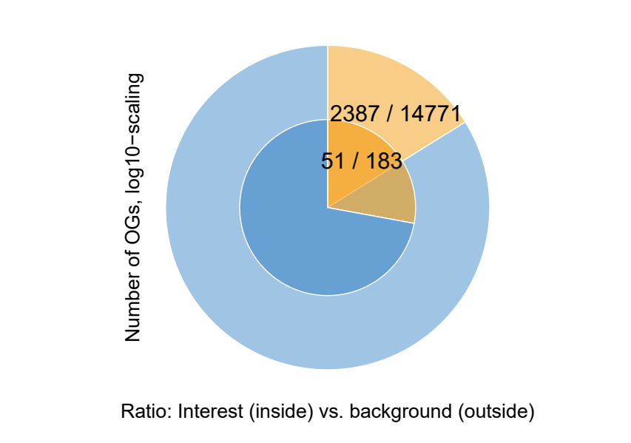
Expanded; DEG in Any Expanded Species vs BG DEG from any Expanded Species
Zm vs Osj, Ta, conserved
Msi, Sb, Zm vs Osj, Ta, conserved

Slide 6
Filter | # HOGs
Mi, Conserved, DEG in any expanded species | 322
So, Conserved, DEG in any expanded species | 209
Zm, Conserved, DEG in any expanded species | 1982
Mi So Zm, Conserved, DEG in any expanded species | 2387
Mi So Zm, Conserved, DEG In all expanded species | 2

Slide 7
Filter | # HOGs
Hypotheses 12, Conserved expanded, DEG in any expanded species | 51
Hypotheses 12, Conserved expanded, DEG in any expanded species only all C3 plants are upregulated | 4
Hypotheses 12, Conserved expanded, DEG in any expanded species no DEG in C3, at least one DEG for each C4 , all C4 Expanded | 0
Hypotheses 12, Conserved expanded, DEG in any expanded species no DEG in C3, DEG in any C4 , all C4 Expanded

Slide 8
Filter | # HOGs
Zm expanded, no DEG in C3, All Zm DEG | 7
At Least One C4 Expanded No DEG in C4 All C3 Upregulated | 162
All C4 Expanded No DEG in C4 All C3 Upregulated | 14
No DEG C3 , All C4 expanded, At least one DEG per C4 plant | 0
Zm expanded, no DEG in C3, only any Zm DEG | 59 completely different than the 51 in hypotheses 12
no DEG in C3, DEG in any C4 , all C4 Expanded | 9
 | go term slim filter 1 go term out from enrichment For each species count HOGs where this species is expanded and make a upset

