Slide 1
Scala.js
A deep dive into using JavaScript in a type safe way.
Justin Maat
@jxm262

Slide 2
Scala.js
Current State of Web Development
Why Scala.js?
How does it work?
Going from Scala to JS
Going from JS to Scala (Façade)

Slide 3
Current State of Web Development
Frameworks and Libraries
React, Vue, ELM, etc..
Immutable.js, Ramda, Rx.js (stream based)
Grunt, Gulp, Brocolli, npm , bower, etc..
Developers demanding more (ES6)
Features:
Promises, tail call optimization, …
Syntax:
async/await, arrow functions, let/const, spread operator, …
Type Safety
TypeScript, Flow, PureScript

Slide 4
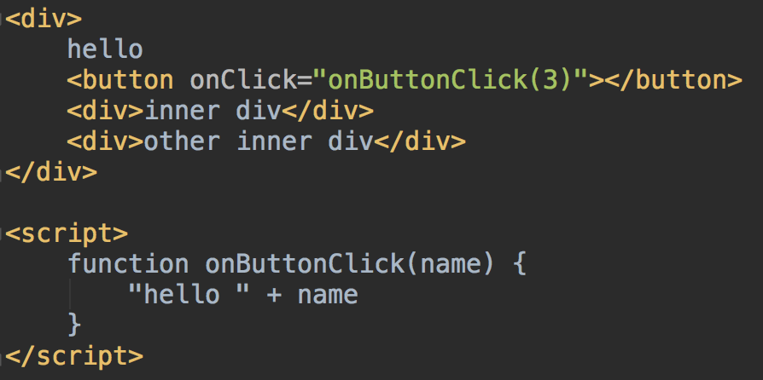
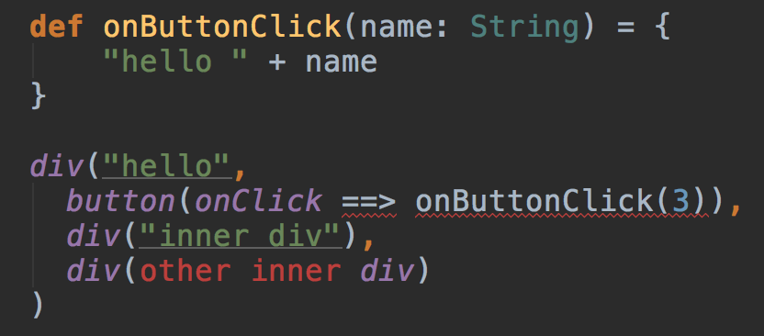
Scala.js?
Compiles Scala code to JS
Runs quickly <2x as slow as native JS
All the cool Scala stuff out of the box!
For comprehensions, Case Classes, Pattern matching, Collections
Type Safety!

Slide 5
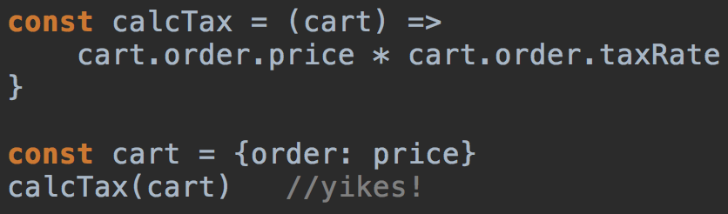
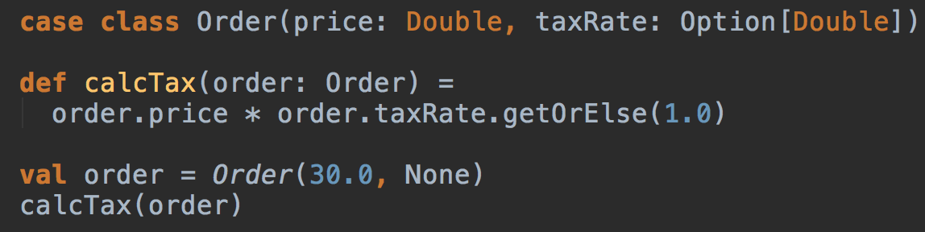
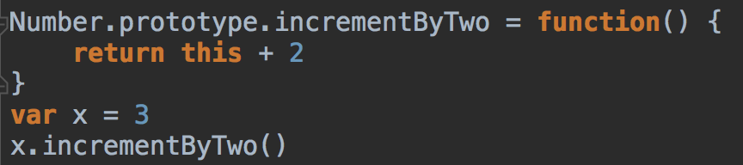
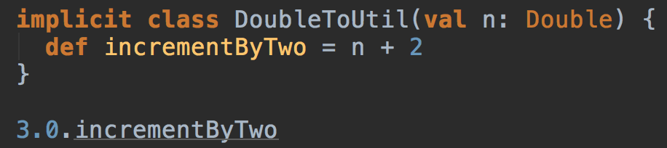
Type Safety
Obviously cool stuff
Less obvious, but even more cool stuff

Slide 6
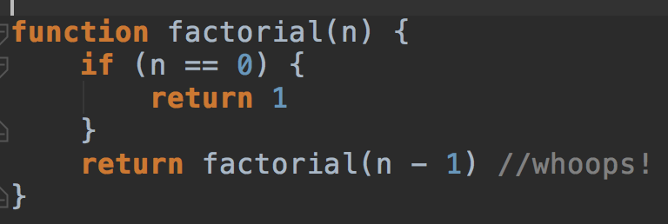
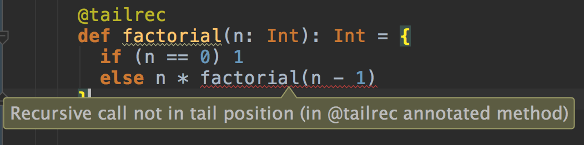
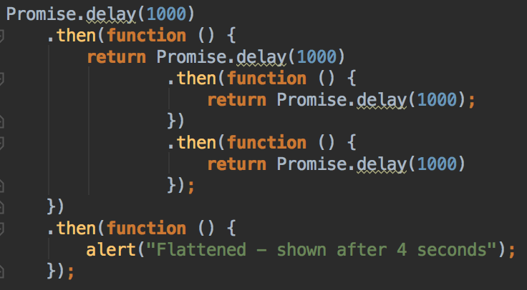

Plays nice with JS
More cool stuff
But has some differences
Hey thanks for the warning!

Slide 7
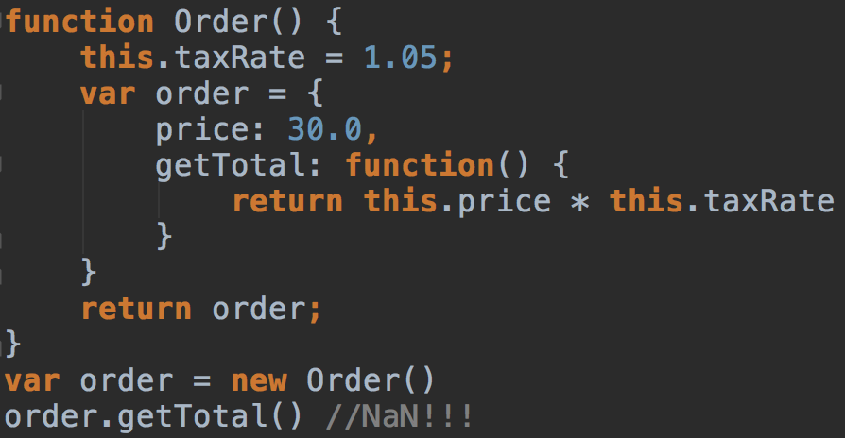
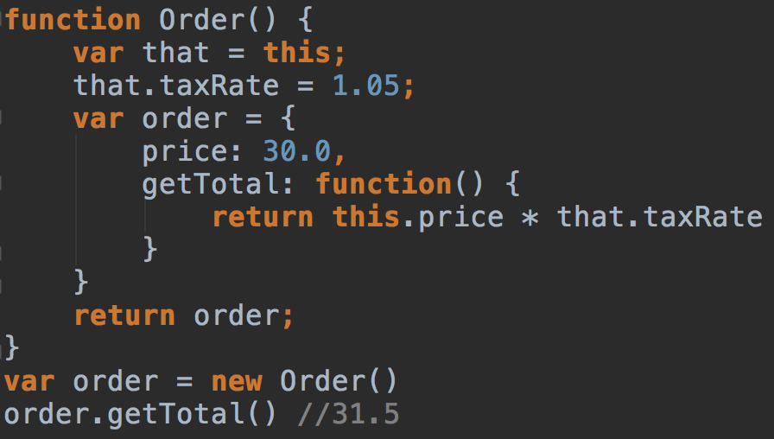
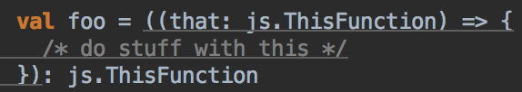
Type Correspondence
Pretty standard stuff
scala.String <=> js.String
Bool, Null, Etc..
Some things don’t map over directly, but it’s pretty easy
UndefOr[T] ⬄ Option wow that’s cool!
js.FunctionN ⬄ scala.FunctionN
js.Dictionary, js.Array, etc..
“this” and that – js.ThisFunctionN

Slide 8
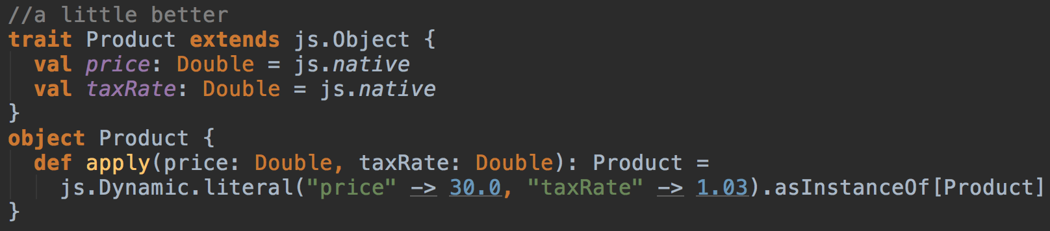
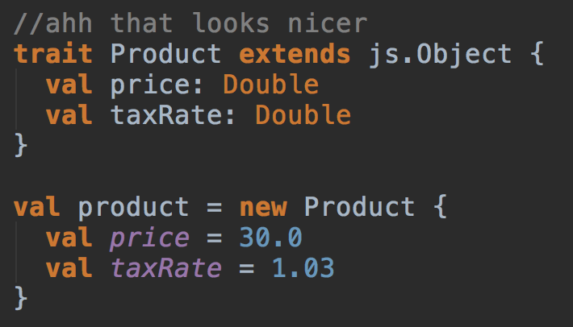
Type Correspondence
js.Dynamic
Very dynamic
Scala Object interface
Anonymous class

Slide 9
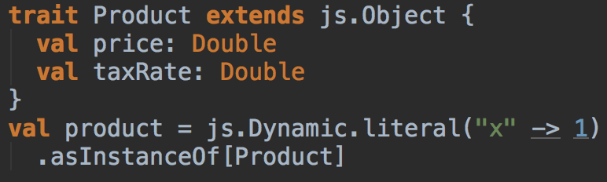
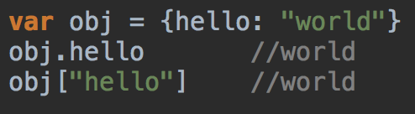
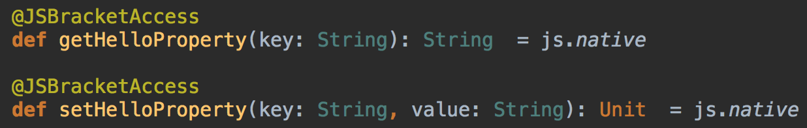
Facades
Usually represent JS api structure using traits.
Must inherit from js.Any (base type) – usually from js.Object
Should use js.native for Native JS types
.asInstanceOf[T]
Type erased, can cast to anything of js.Any
Bracket Access
Uses getters/setters

Slide 10
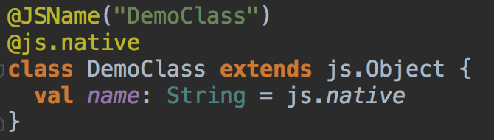
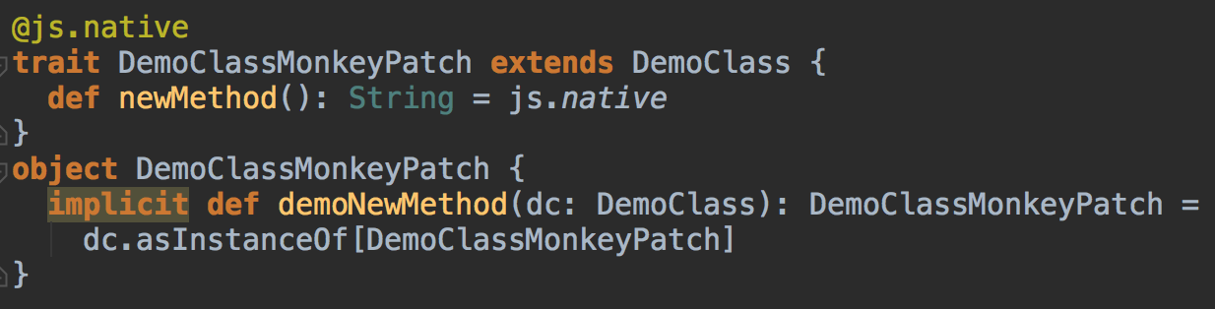
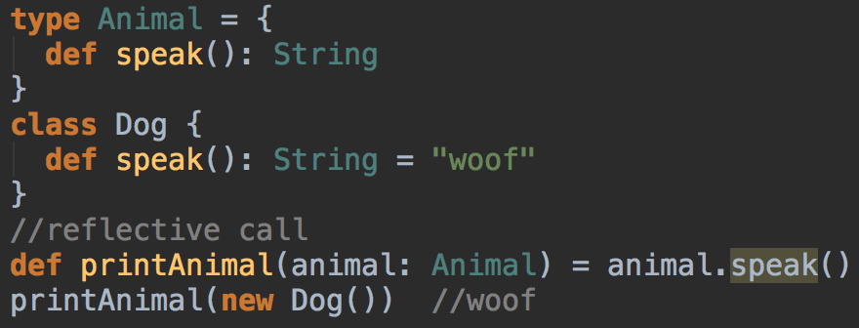
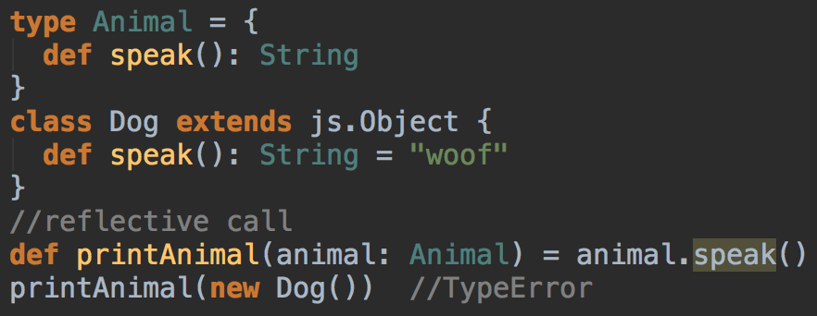
Facades
Native js classes
Monkey patching - (more type safe, yay!)
Avoid scala structural types (kind of duck typing)
Be careful of .asInstanceOf[C]
Has same issue as traits (erasure), can cast to anything

Slide 11
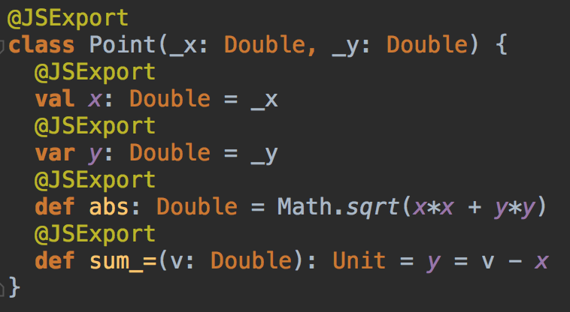
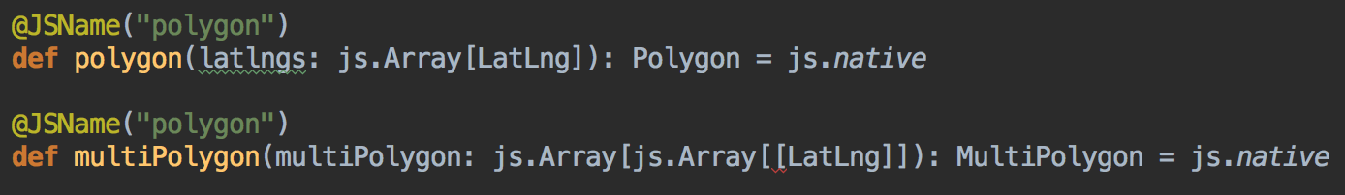
Calling Scala.js from JavaScript
@JSExport
Overloading
@JSExportDescendentObjects / @JSExportAll
_= convenience methods
Type safe and easy to understand

Slide 12
DEMO
MY Notes to Demo - Basics from scalajs to JS
Basics from JS to scala.js
More in depth
-most dynamic, partially type safe, most type safe snippet
-Monkey patching type safety snippet
-Monkey patching (limitations when sharing with outer js code)
-avoiding asInstanceOf (show runtime errors on snippets)
-avoiding structural types (show on snippets errors)
- the “_=“ setter trick
-Anonymous classes coolness
-getting js constructors, js.constructorOf[C] and some syntax sugar
Leaflet
-method overloading
-builder for options (or better way)
-examples of it all working beyond snippets and

Slide 13
MY Notes to Demo - Basics from scalajs to JS
Basics from JS to scala.js
More in depth
-most dynamic, partially type safe, most type safe snippet
-Monkey patching type safety snippet
-Monkey patching (limitations when sharing with outer js code)
-avoiding asInstanceOf (show runtime errors on snippets)
-avoiding structural types (show on snippets errors)
- the “_=“ setter trick
-Anonymous classes coolness
-getting js constructors, js.constructorOf[C] and some syntax sugar
Leaflet
-method overloading
-builder for options (or better way)
-examples of it all working beyond snippets and

