Slide 1
UCSD ECE 268 - Security of Hardware Embedded Systems
Merkle Tree with Post-Quantum Secure Hash
KangarooTwelve and Rescue-Prime
Jeffrey Lee, Henry Tran
June 4th, 2026
Notes:
Presenter: both
Hello, I am Jeffrey
And I am Henry
And we will be presenting on the paper, SoK: A Security Architect’s View of Printed Circuit Board Attacks

Slide 2
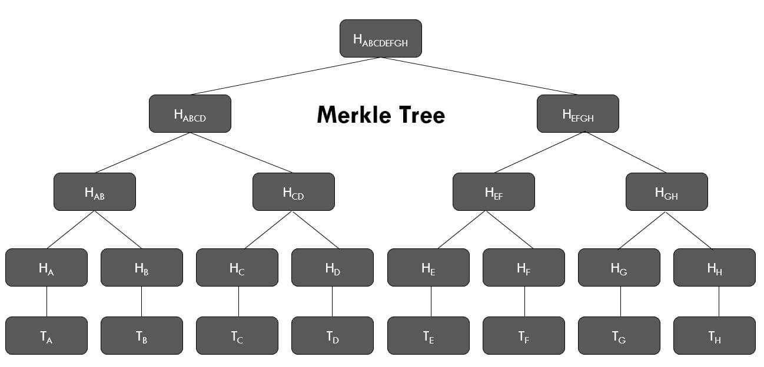
Background & Motivation
Merkle Tree:
Hierarchical cryptographic data structure
Leaves = hash of data
Parents = hash of children
Kangaroo12:
Need for modern standard with high throughput on standard hardware
Based on SHA3 permutation,utilizes relies heavily on operations
Rescue-Prime:
Meant for zero-knowledge proving systems
Operates over large prime fields relying on modular arithmetic and matrix operations
Notes:
Presenter: Henry
<Just read off the slide>

Slide 3
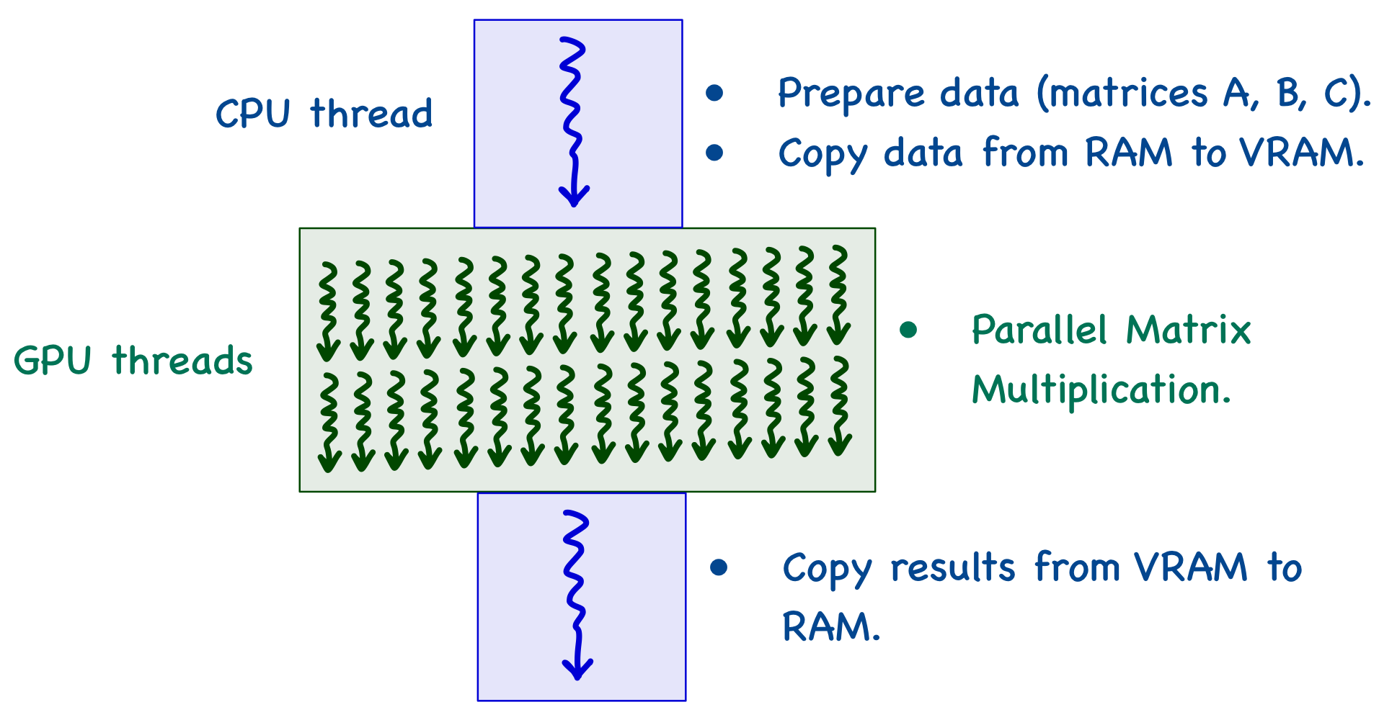
Approach
Merkle Tree: exploit parallelism on GPU by level-batched hashing
KangarooTwelve: parallelize Keccak permutations for chaining values, exploit any optimizations for bitwise operations
Rescue-Prime: can exploit parallelism of matrix multiplication in the MDS Matrix Multiplication layer of the Rescue-XLIX permutations and operations mapped accross a state

Slide 4
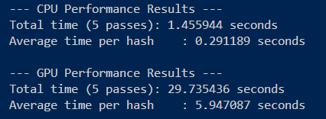
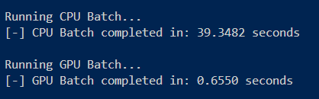
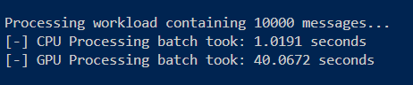
Results, Observations, Next Steps
Sequential hashing data blocks (eg. a single level on Merkle Tree) with GPU-optimized hash functions did not necessarily yield speedup.
Batching across a level yielded drastically improved performance.
KangarooTwelve underperforms significantly on GPU, even when batched.
Next steps: continue work on GPU optimizations on KangarooTwelve
Example with Rescue-Prime Yielding 0.05x speedup (GPU vs CPU)
Example with Rescue-Prime Yielding ~60x speedup! (GPU vs CPU)
Example with KangarooTwelve Yielding ~0.03x speedup (GPU vs CPU)

