Slide 1
Lecture 4: Introduction to Practical Machine Learning
Instructor: Jianfeng(Jeff) Ren

Slide 2
Introduction to OpenCV Summer 2015, Tuesday/Thursday 7:00-9:00pm
Do you want to make your computer react human gestures? Do you want to make your car drive more safety? Do you want to make your home more security? Do you want to build one of the above systems with your hands? Get answers to all these questions and more at the Workshop “OpenCV”!
This class will get you prepared to quickly implement your computer vision related ideas using OpenCV.
Instructor:
Dr. Jianfeng(Jeff) Ren
Multimedia R&D, Qualcomm Inc

Slide 3
Machine Learning
Normal Bayes classifier;
Support vector machine;
Decision Trees;
Boost;
Random Trees;
Expectation Maximization;
Neural Network;

Slide 4
Overview
Intro. to Support Vector Machines (SVM)
Properties of SVM
Applications
Gene Expression Data Classification
Text Categorization if time permits
Discussion

Slide 5
α
Linear Classifiers
x
f
y^{est}
f(x,w,b) = sign(w x + b)
denotes +1
denotes -1
w x + b>0
w x + b=0
How would you classify this data?
w x + b<0

Slide 6
α
Linear Classifiers
x
f
y^{est}
f(x,w,b) = sign(w x + b)
denotes +1
denotes -1
How would you classify this data?

Slide 7
α
Linear Classifiers
x
f
y^{est}
f(x,w,b) = sign(w x + b)
denotes +1
denotes -1
How would you classify this data?

Slide 8
α
Linear Classifiers
x
f
y^{est}
f(x,w,b) = sign(w x + b)
denotes +1
denotes -1
Any of these would be fine..
..but which is best?

Slide 9
α
Linear Classifiers
x
f
y^{est}
f(x,w,b) = sign(w x + b)
denotes +1
denotes -1
How would you classify this data?
Misclassified
to +1 class

Slide 10
α
α
Classifier Margin
Classifier Margin
x
x
f
f
y^{est}
y^{est}
f(x,w,b) = sign(w x + b)
f(x,w,b) = sign(w x + b)
denotes +1
denotes -1
denotes +1
denotes -1
Define the margin of a linear classifier as the width that the boundary could be increased by before hitting a datapoint.
Define the margin of a linear classifier as the width that the boundary could be increased by before hitting a datapoint.

Slide 11
α
Maximum Margin
x
f
y^{est}
Maximizing the margin is good according to intuition and PAC theory
Implies that only support vectors are important; other training examples are ignorable.
Empirically it works very very well.
f(x,w,b) = sign(w x + b)
denotes +1
denotes -1
The maximum margin linear classifier is the linear classifier with the, um, maximum margin.
This is the simplest kind of SVM (Called an LSVM)
Support Vectors are those datapoints that the margin pushes up against
Linear SVM

Slide 12
Linear SVMs: Overview
The classifier is a separating hyperplane.
Most “important” training points are support vectors; they define the hyperplane.
Quadratic optimization algorithms can identify which training points x_{i} are support vectors with non-zero Lagrangian multipliers α_{i}.
Both in the dual formulation of the problem and in the solution training points appear only inside dot products:
Find α₁…α_{N} such that
Q(α) =Σα_{i} - ½ΣΣα_{i}α_{j}y_{i}y_{j}x_{i}^{T}x_{j} is maximized and
(1) Σα_{i}y_{i} = 0
(2) 0 ≤ α_{i} ≤ C for all α_{i}
f(x) = Σα_{i}y_{i}x_{i}^{T}x + b

Slide 13
Linear SVM code (1)

Slide 14
Linear SVM code (2)

Slide 15
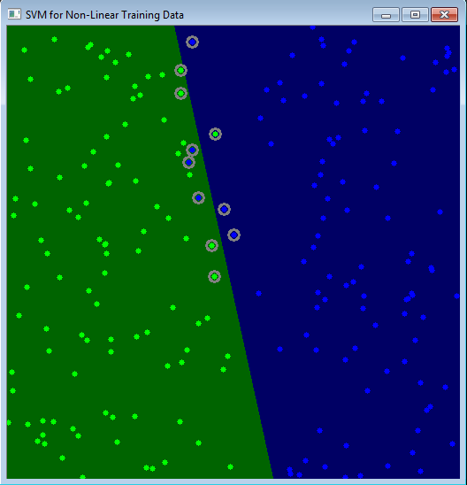
Non Linear SVM

Slide 16
Non-linear SVMs
Datasets that are linearly separable with some noise work out great:
But what are we going to do if the dataset is just too hard?
How about… mapping data to a higher-dimensional space:
0
x
0
x
x²
0
x

Slide 17
Non-linear SVMs: Feature spaces
General idea: the original input space can always be mapped to some higher-dimensional feature space where the training set is separable:
Φ: x → φ(x)

Slide 18
The “Kernel Trick”
The linear classifier relies on dot product between vectors K(x_{i},x_{j})=x_{i}^{T}x_{j}
If every data point is mapped into high-dimensional space via some transformation Φ: x → φ(x), the dot product becomes:
K(x_{i},x_{j})= φ(x_{i}) ^{T}φ(x_{j})
A kernel function is some function that corresponds to an inner product in some expanded feature space.
Example:
2-dimensional vectors x=[x₁ x₂]; let K(x_{i},x_{j})=(1 + x_{i}^{T}x_{j})²,
Need to show that K(x_{i},x_{j})= φ(x_{i}) ^{T}φ(x_{j}):
K(x_{i},x_{j})=(1 + x_{i}^{T}x_{j})²,
= 1+ x_{i1}²x_{j1}² + 2 x_{i1}x_{j1} x_{i2}x_{j2}+ x_{i2}²x_{j2}² + 2x_{i1}x_{j1} + 2x_{i2}x_{j2}
= [1 x_{i1}² √2 x_{i1}x_{i2} x_{i2}² √2x_{i1} √2x_{i2}]^{T} [1 x_{j1}² √2 x_{j1}x_{j2} x_{j2}² √2x_{j1} √2x_{j2}]
= φ(x_{i}) ^{T}φ(x_{j}), where φ(x) = [1 x₁² √2 x₁x₂ x₂² √2x₁ √2x₂]

Slide 19
What Functions are Kernels?
For some functions K(x_{i},x_{j}) checking that
K(x_{i},x_{j})= φ(x_{i}) ^{T}φ(x_{j}) can be cumbersome.
Mercer’s theorem:
Every semi-positive definite symmetric function is a kernel
Semi-positive definite symmetric functions correspond to a semi-positive definite symmetric Gram matrix:
K(x₁,x₁) | K(x₁,x₂) | K(x₁,x₃) | … | K(x₁,x_{N})
K(x₂,x₁) | K(x₂,x₂) | K(x₂,x₃) |  | K(x₂,x_{N})
… | … | … | … | …
K(x_{N},x₁) | K(x_{N},x₂) | K(x_{N},x₃) | … | K(x_{N},x_{N})
K=

Slide 20
Examples of Kernel Functions
Linear: K(x_{i},x_{j})= x_{i} ^{T}x_{j}
Polynomial of power p: K(x_{i},x_{j})= (1+ x_{i} ^{T}x_{j})^{p}
Gaussian (radial-basis function network):
Sigmoid: K(x_{i},x_{j})= tanh(β₀x_{i} ^{T}x_{j} + β₁)

Slide 21
Nonlinear SVM - Overview
SVM locates a separating hyperplane in the feature space and classify points in that space
It does not need to represent the space explicitly, simply by defining a kernel function
The kernel function plays the role of the dot product in the feature space.

Slide 22
Properties of SVM
Flexibility in choosing a similarity function
Sparseness of solution when dealing with large data sets
- only support vectors are used to specify the separating hyperplane
Ability to handle large feature spaces
- complexity does not depend on the dimensionality of the feature space
Overfitting can be controlled by soft margin approach
Nice math property: a simple convex optimization problem which is guaranteed to converge to a single global solution
Feature Selection

Slide 23
SVM Applications
SVM has been used successfully in many real-world problems
- text (and hypertext) categorization
- image classification
- bioinformatics (Protein classification,
Cancer classification)
- hand-written character recognition

