Slide 1

POWDERHOUNDS
Contributors: Anna Sours, Erich Mitchell, TJ Ossola, Spencer Davis, Jason Sheridan, Lisa Caruana, Bailey Taber
Special Thanks: Kevin Lee, Adrienne Tecza and Leah Stucky
An interactive website to help plan your next powder-chasing Colorado vacation utilizing decision tree machine learning and historical weather data.

Slide 2





Project Goal
Create a website that helps users decide where to go in Colorado to find powder throughout the year based on historical snowfall data.
Gather user data on how people are using the website and trip goals.

Slide 3
Decision tree machine learning model
Historical weather data source downloaded from Natural Resources Conservation Services.
A Random Forest Machine Learning model was produced but was too large to be stored on GitHub.
Model and data uploaded to a PostgreSQL database, which also stores user input.

Slide 4

Machine Learning Models
Concatenated data in Jupyter notebook with Pandas.
Ran through multiple Machine Learning models:
Line Regression – 30%
KNN – 69%
Decision Tree – 76%
Neuro network – 82%
Random Forest – 82%

Slide 5



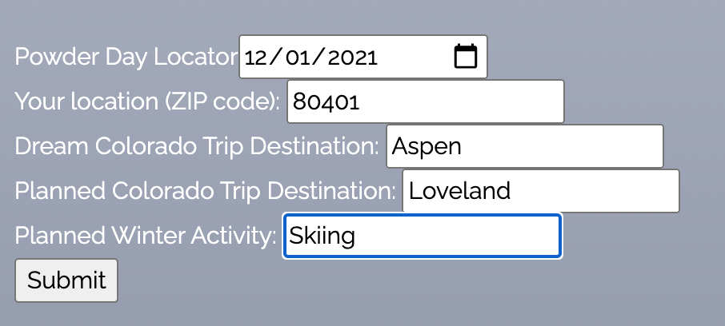


APP.PY
prediction via json
historical data
Query DB
store user data
RIP Heroku “gone too soon”

Slide 6
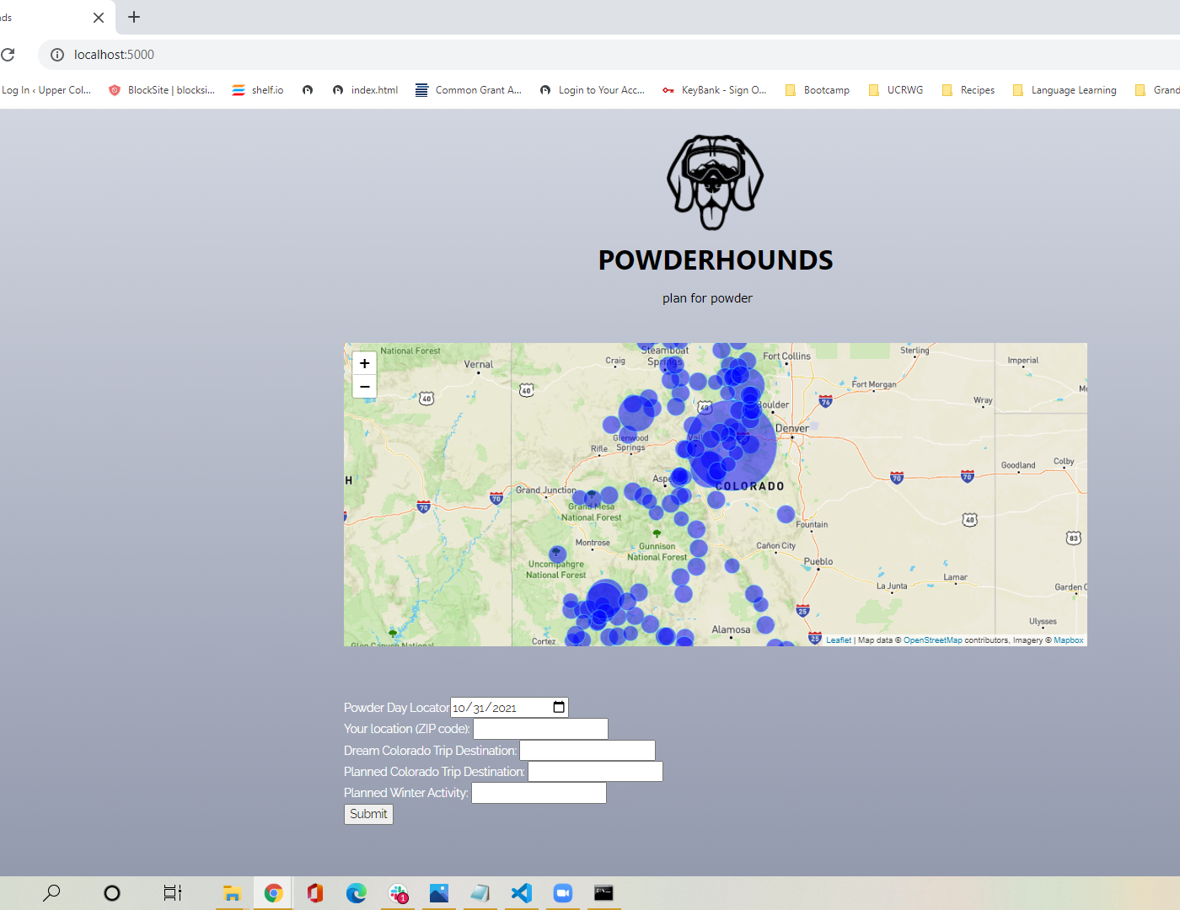
responsive Map
There is a circle for each one of the 115 stations
User selects a planned trip date and the map is populated with data from the ML model predicting snowfall for that date
Circle map that scales with the amount of snow that will be gained
Smaller circles represent melt, reaches a middle point (tipping point) where it becomes snow
Ran into problems with color variations
Larger circles and clusters indicate a good place to go for that week for snowfall

Slide 7
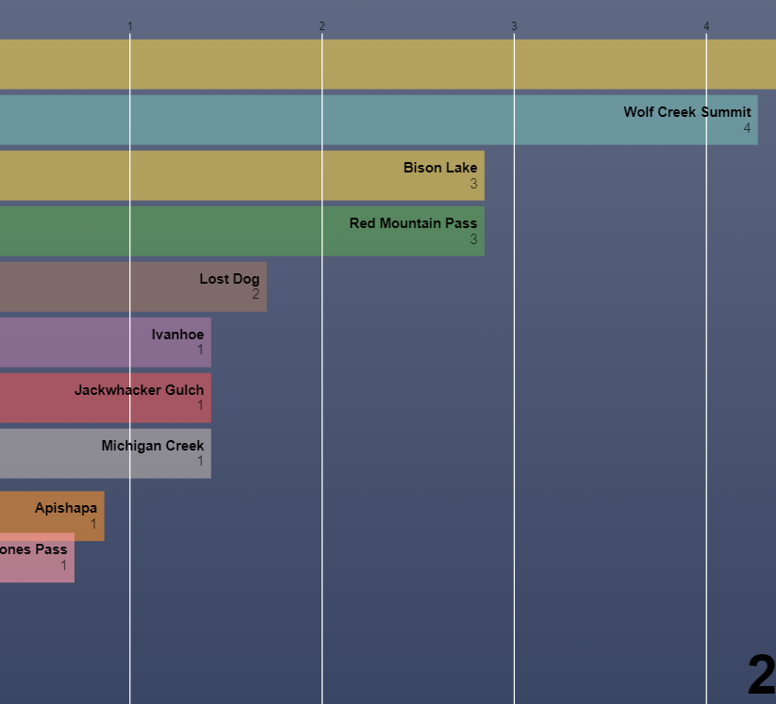
Racing bar chart

Slide 8
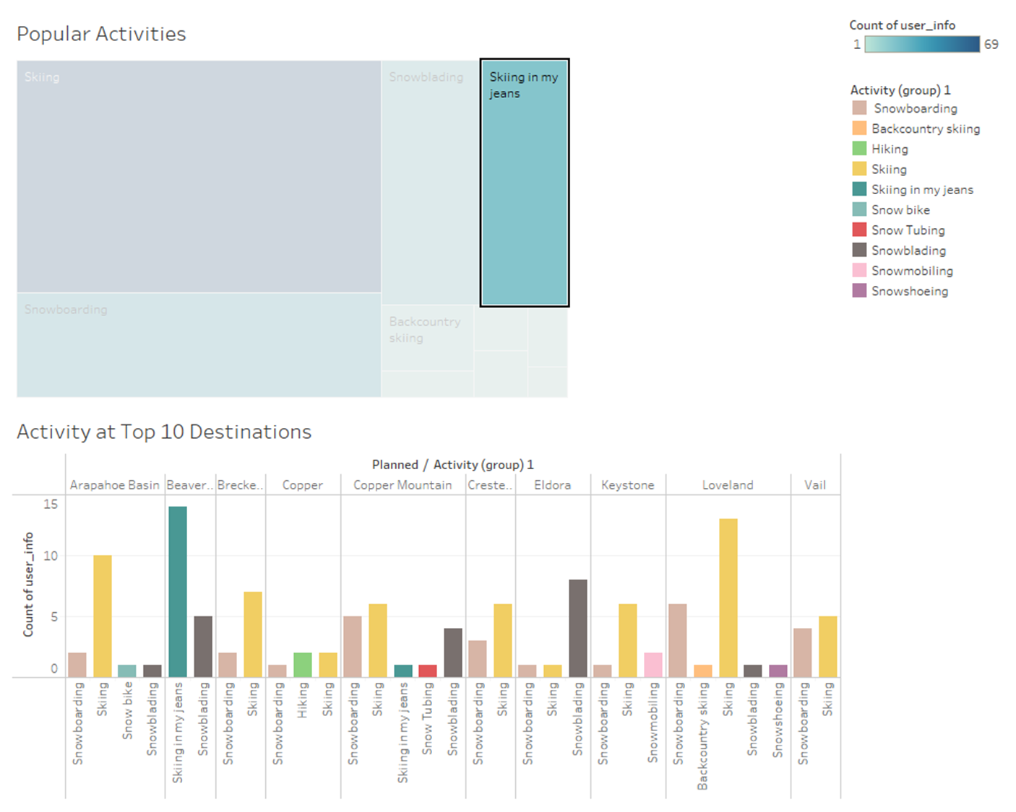
DATA VISUALIZATIONS
One key feature of the website is collecting user data: user location (ZIP code), trip dates, dream Colorado trip, planned Colorado trip and planned winter activity.
The PostgreSQL database was connected to Tableau, which was then used to generate a series of dashboards and charts analyzing user input.

Slide 9



snafus
Issues with transforming and shaping Machine Learning model
Differences in output from different models
Size of data – sharing, importing and hosting
Knowledge of the meteorology
Publishing on Tableau Public required extracting the data – Tableau visualizations do not update with new user input.
Workflow and timeline crunch
Difficulties in having data accessible in workable format
Difficulties in getting data into GeoJSON format and navigating the JSON

Slide 10

Where to from here
Ideally this website should scrape for the most recent snowfall data to add to the database and incorporate analysis based in meteorology
Include a Daily Top Ten snowfall locations bar chart
Include markers for closest ski resorts and places to buy dog treats
Maximize opportunities for advertising and links to partner websites for travel plans; refine user input selections
Use dropdowns for the user input section to retain data integrity (standardized spellings, capitalizations and limit locations/activities)

