Slide 1
Penn State Food Locator
By: Andrew Kyffin, Jake Smith, Luke Leiter

Slide 2
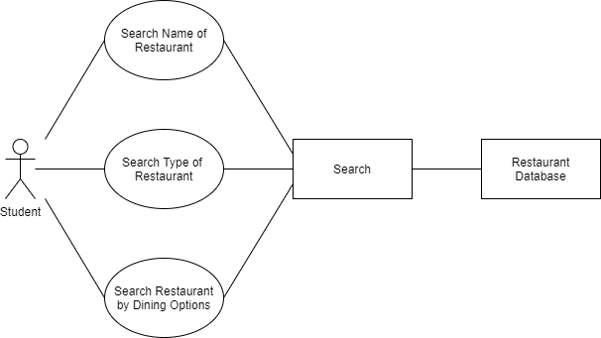
Using the Website
Notes:
Use Cases

Slide 3
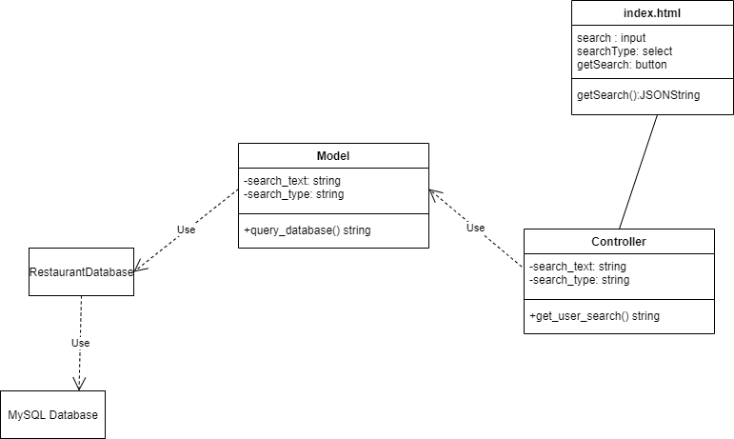
Class Diagram for Restaurant a Search

Slide 4
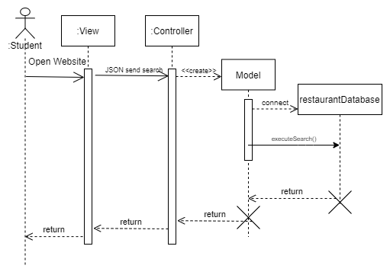
Sequence Diagram for Search

Slide 5
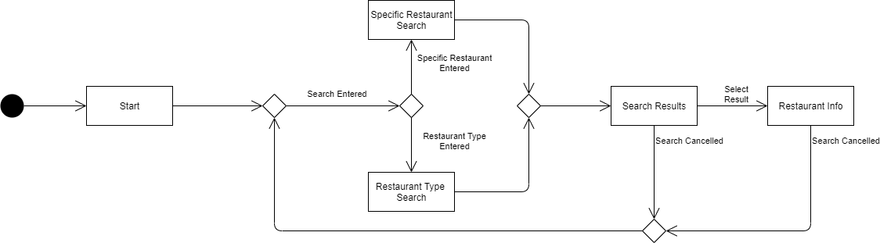
Activity Diagram for a Search

Slide 6
Progress Update
Progress is going smoother than expected:
Model
Writing Queries
View
Very basic website
Refactoring
Controller
Receiving and sending query results

Slide 7
Project Demo

