Slide 1
Chemnitz Cultural Sites App
M.Sc. Web Engineering
Juho Lee 855888
Notes:
Good Afternoon
My name is juho lee from master of web engineering. Before beginning, I’d like to mention that it may be challenging to present everything I’ve prepared within the 10-minute time frame. I appreciate your understanding if I speak a little quickly."

Slide 2
Project Overview
Required Features
Categorized List
Filter & Search
Map & Text View
User Registration & Profile Editing
Add/Remove Favorites
Additional Features
Reviews
Users can contribute to the dataset by submitting proposals
Notes:
First is Project Overview.
I implemented all the features which are mentioned in the project task slides.
As additional features, I implemented two things.
First is Reviews and Second is that the users can suggest to add or modify cultural site in the database

Slide 3
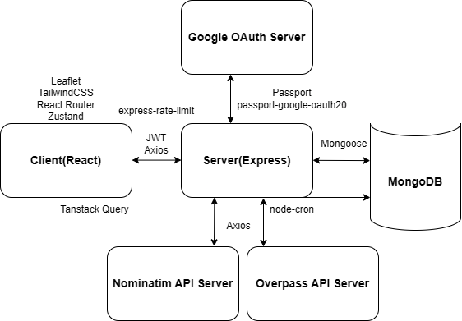
Architecture & Technologies
Notes:
This Figure is an overall architecture and technologies of the app.
The client was built using React, and the server was built using Express.
Basically, I built the app using MERN stack, the main motivation of it was it was the things covered in the uebung.

Slide 4
Development Process
5
2
4
3
1

Slide 5
Challenge & Solution
Synchronization with original data
Prevent Re-registration of Deleted Sites
Handling Many Requests to the Server
=> Scheduled DB Updates with node-cron
=> Add deleted data into excludesourceids collection
Use Tanstack for Data Fetching and State Management
Notes:
First is Project Overview.
I implemented all the features which are mentioned in the project task slides.
As additional features, I implemented two things.
First is Reviews, and Second is that the users can suggest to add or modify cultural site in the database

Slide 6
Limitation & Future Improvement
Unable to process Way and Relation data natively
Currently use query out center; option
Lack of Image Hosting Server
imageUrl field exist in DB, but not used
Every Deletion is a Hard delete
All deletions permanently remove related data without recovery options.
Notes:
First is Project Overview.
I implemented all the features which are mentioned in the project task slides.
As additional features, I implemented two things.
First is Reviews, and Second is that the users can suggest to add or modify cultural site in the database

Slide 7

Live Demo

Slide 8
Q&A
Q&A
?
?
?

