Slide 1
RNN & BPTT
林广和

Slide 2
RNN
Traditional Neural Network
Shortcoming: all inputs (and outputs) are independent of each other
Example: predict the next word in a sentence without context
（缺少前馈神经网络的图）

Slide 3
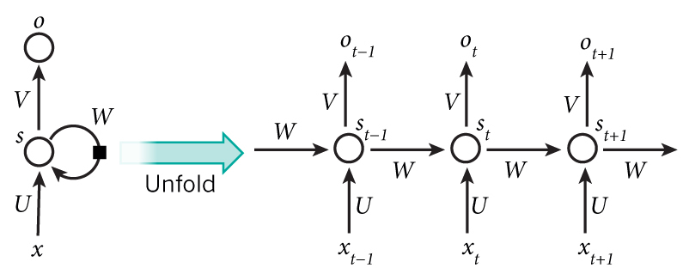
RNN(Recurrent Neural Network)
Recurrent:
perform the same task for every element of a sequence, with the output being depended on the previous computations.
RNNs have a “memory” which captures information about what has been calculated so far.

Slide 4
RNN(Recurrent Neural Network)
Note that:
a RNN shares the same parameters (W,U ,V)
Output may not be necessary.

Slide 5
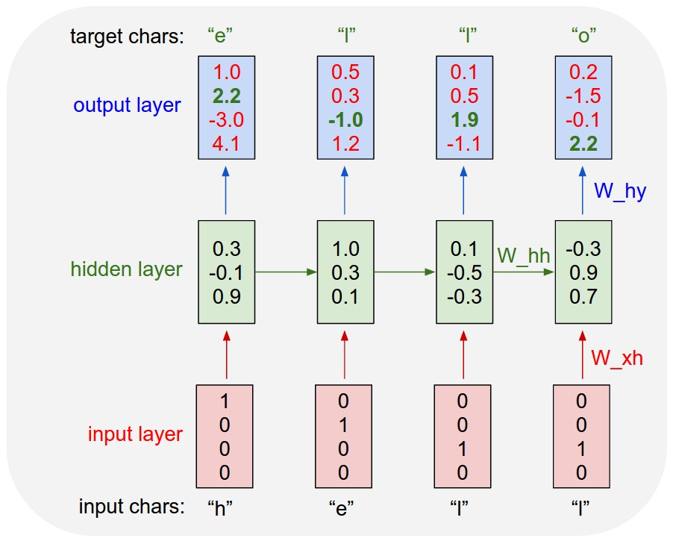
Applications
vocabulary =｛h，e，l，o｝
the training sequence “hello”
1-of-k encoding

Slide 6
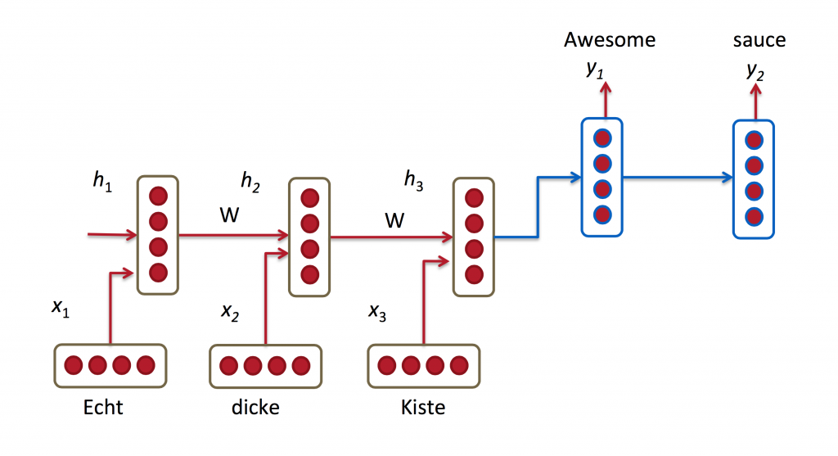
Applications
Language Modeling and Generating Text
Example: Given a sequence of words we want to predict the probability of each word given the previous words.
Machine Translation
Example : German -> English
Speech Recognition

Slide 7
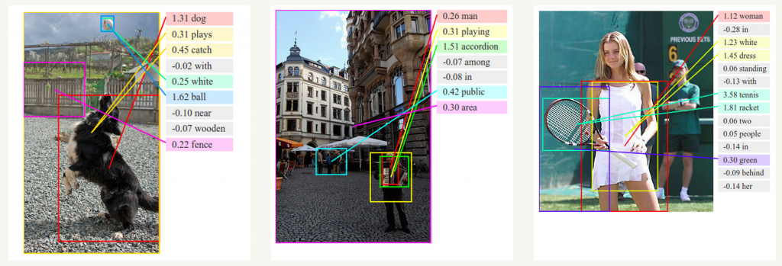
Generating Image Descriptions

Slide 8
Training RNN
Chain Rule
Backpropagation
BPTT(Backpropagation Through Time)

Slide 10
Outline
Introduction
Margin Infused Relaxed Algorithm for CRFs
Bootstrapping with CRFs
Experimental Results & Discussions

Slide 11
Introduction
Named Entity Recognition (NER)
an important problem in natural language processing and has been investigated for many years.
Research Background
There have been a lot of works on this task, especially for major languages such as English, Chinese, etc.
For the Vietnamese language, several authors have attempted to tackle the NER problem using both supervised and semi-supervised methods.
However, previous works for NER in the Vietnamese language mainly used offline supervised learning methods, where all the training data are gathered before a model is trained.

Slide 12
Introduction
One dominant approach for NER in the Vietnamese language
supervised learning with conditional random fields(CRFs)
Attractive semi-supervised learning approaches
Reason: it is expensive to get a large amount of labeled data.
Especially, using bootstrapping methods, Ji and Grishman (2006) were able to improve the performance of existing NER systems.

Slide 13
Introduction
For the Vietnamese language, in supervised learning
Using CRFs 87.90% F₁ score as their highest performance.
Using SVMs 87.75% F₁ score for the task.
In semi-supervised learning
90.14% F₁ score using CRFs with the generalized expectation criteria
95% F₁ score using bootstrapping and rule-based models.

Slide 14
Introduction
Works
Using MIRA to learn CRFs instead of the traditional offline method would increase the performance of our system.
Proposing a set of features that is useful for this task , does not need human work for processing unlabeled data and gives competitive performance.
Using the bootstrapping method on top of the CRF models to gradually increase the number of labeled data.

Slide 15
MIRA for CRFs
Conditional Random Fields
MIRA

Slide 16
CRFs
Probabilistic Graphical Model
Let G = (V, E ) be a graph such that , so that Y is indexed by the vertices of G. The node v represents the random variables Y_{v} ,the edge e E represents the probability dependence between random variables .
v
W
O

Slide 17
CRFs
Markov property
v
W
O

Slide 18
CRFs
Definition. Let G = (V, E ) be a graph such that , so that Y is indexed by the vertices of G. Then (X, Y) is a conditional random field in case, when conditioned on X, the random variables Y_{v} obey the Markov property with respect to the graph: ，where w ∼ v means that w and v are neighbors in G.

Slide 19
CRFs
A linear-chain CRF defines the conditional distribution as :
where
is the normalization constant.

Slide 20
CRFs
Y₁ Y₂ Y_{i} Y_{n}
Linear Chain CRF
obey the Markov property
with respect to the graph:
...
...
X₁ X₂ X_{i} X_{n}
Y₁ Y₂ Y_{i} Y_{n}
....
....
X=(X₁,X₂,...X_{i},X_{n})

Slide 21
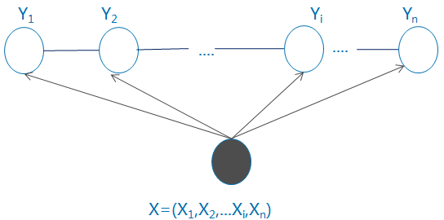
CRFs(Parametric form)
A linear-chain CRF defines the conditional distribution as :
where
is the normalization constant.

Slide 22
CRFs (Vector form)
Let K₁,K₂ be the number of transition and state feature respectively.

Slide 23
CRFs (Vector form)
Let w be weight vector ,F(y , x) represent global feature vector , in other words,

Slide 24
CRFs
A linear-chain CRF defines the conditional distribution as :
where
is the normalization constant.

Slide 25
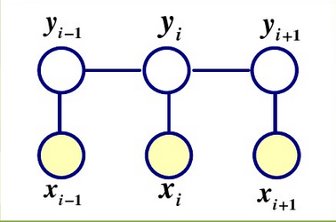
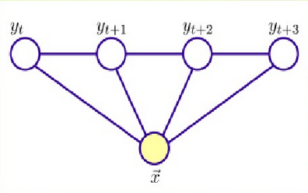
CRFs
Linear –Chain CRF

Slide 26
Training by MIRA
The normal method of training a CRF:
IIS
Quasi-Newton methods such as the L-BFGS algorithm
In this paper , we introduce MIRA to train the model.

Slide 27
Training by MIRA
Online Learning
Perceptron Learning Algorithm(PLA)
PLA(another form)
Multiclass Problem
Error-Set

Slide 28
Training by MIRA
Ultraconservative
MIRA
My confusion

Slide 29

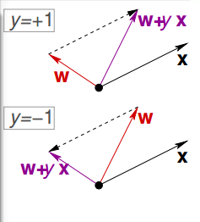
PLA
Algorithm 3 A feature selection step
Output: weight vector w
For t = 0,1,… find a mistake of w_{t} called (try to)correct the mistake by …until no more mistakes return w

Slide 30
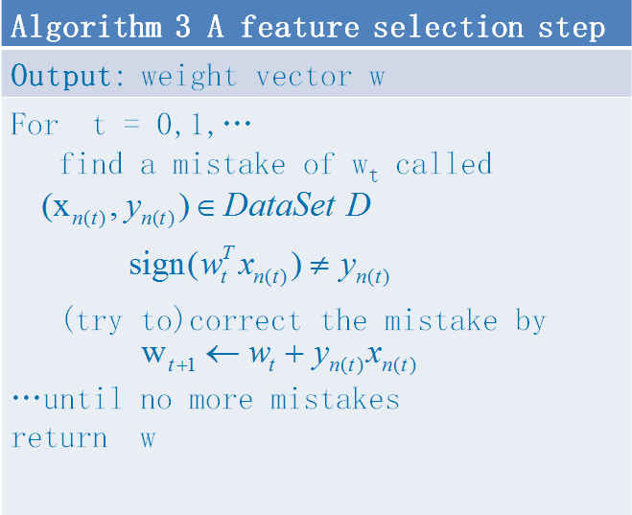
PLA

Slide 31
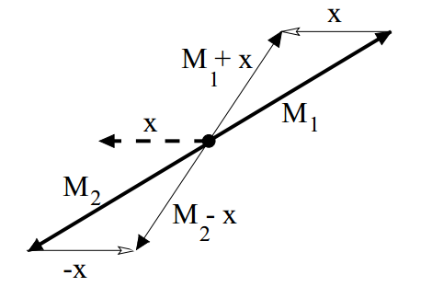
PLA（another form）

Slide 32
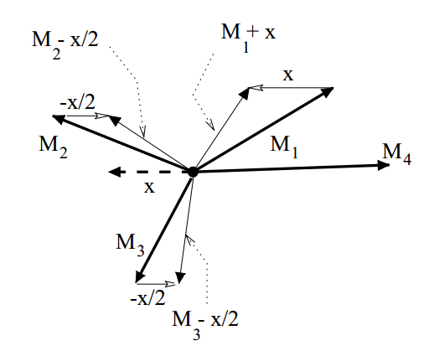
Multiclass Problem

Slide 33
Multiclass Problem

Slide 34
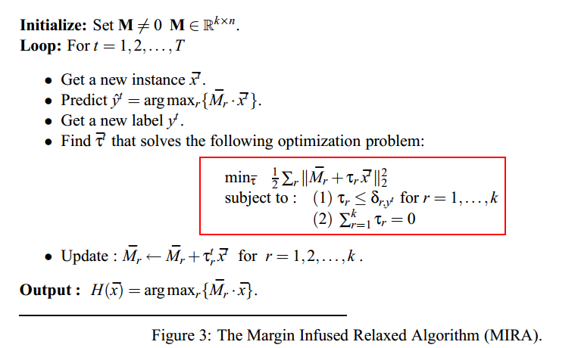
MIRA

Slide 35
MIRA
Algorithm 1 MIRA
INPUT: Training Data ， number of iterations N .
1: 2: for n =1 to N do 3: for t =1 to |D| do 4: 5: 6: 7: end for 8: end for 9: return
s(x, y)is a scoring function and L(y_{t}, y) is a loss function.

Slide 36
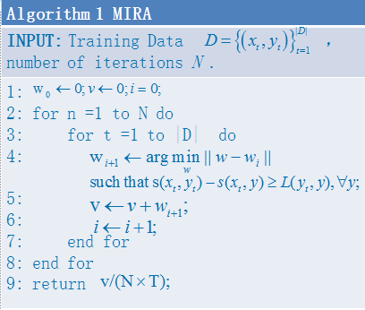
MIRA
s(x, y)is a scoring function and L(y_{t}, y) is a loss function.

Slide 37
Prediction of CRFs
During testing, the label sequence for a new test instance is determined by a Viterbi-like algorithm, which returns the label sequence with the highest probability according to the trained model (Sutton and McCallum, 2006).

Slide 38
Viterbi Algorithm
The Viterbi algorithm is a dynamic programming algorithm for finding the most likely path.
According to ,
where

Slide 39
Viterbi Algorithm
Note: path represents label sequence
which is a local feature vector

Slide 40
Viterbi Algorithm
Algorithm 2 Viterbi Algorithm
INPUT: Feature Vector F(y,x), weight vector w, observation sequence Output: The most likely label sequence
1: Initialize 2: for i=2,3,…,n do 3: 4: 5: end for 6: 7: for i=n-1,n-2,…,1 do 8: 9: end for 10: return

Slide 41
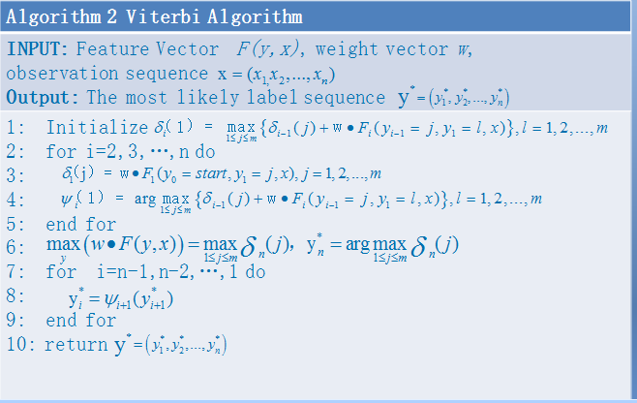
Viterbi Algorithm

Slide 42
Features for CRFs
There are 5 possible tags that we are interested in:
person, organization, location, miscellaneous (proper names), and none.
The none tag indicates that the corresponding word is not a part of any named entity.
For instance, it may be a verb or an adjective.
Three types of features
the identity of words (W) in a window of size 5 and their combinations.

Slide 43
Features for CRFs
Orthographic features (O) in a window of size 5 :
whether a word is in lower case,
whether it has the first letter capitalized
whether all of its letters are capitalized
whether it contains numeric letters or not
The part-of-speech (P) of the word and the combination of W and P to better describe the context of the sentence.

Slide 44
A feature selection step
Algorithm 3 A feature selection step
INPUT: feature Set L, to be verified feature set U, validation set V
1.Add the O₀ and W₀ to L 2.For u in U 3. Build a model with L + u, measure the performance on V 4. If performance increases L=L + u; End U=U/u; 8. End
Note:word identity (W), part-of-speech (P), and orthographic information (O);
The subscripts indicate the position of the features relatively to the current position.

Slide 45
Feature Selection Result
Group | Feature
Single | W₀, W₋₁, W₁, W₋₂, W₂, W_{−1,0}, W_{0,1}, W_{−2,−1}, W_{1,2}, W_{−1,0,1}, W_{−2,−1,0}, W_{0,1,2}, , O₀ , P₋₁, P₀, P₁, P_{−1,0,} P_{0,1}, P_{−2,−1}, P_{1,2}
Complex | W₀P₁, W₀P₀O₀, W₀O₀, W₀W₋₁O₀O₋₁, W₀W₁O₀O₁
Table 1: Features for training the CRFs.

Slide 46
Bootstrapping with CRFs
Difficulty:
the lack of labeled data
One way to address this problem
to gradually create more labeled data with just a small amount of labeled data via semi-supervised learning.
More specifically, we use the bootstrapping method in this paper.

Slide 47
Bootstrapping with CRFs
Algorithm 4 Bootstrapping with CRFs
INPUT: Labeled data set L, unlabeled data set U, number of iterations n, the amount of sentences per round k.
1: for i = 0 to n do 2: Train CRF model Mi on data set L. 3: Use Mi to label U. 4: Choose k labeled sentences X = with highest confidence from U. 5: L ← L ∪ X; U ← U \ X. 6: end for 7: return M_{n}.

Slide 48
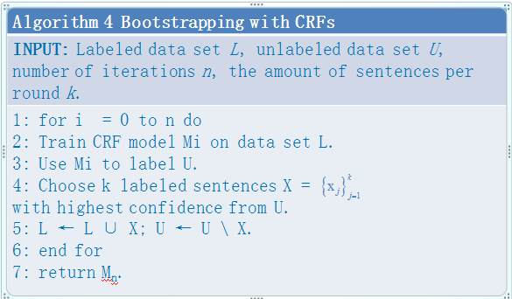
Bootstrapping with CRFs

Slide 49
Experimental Results
Setup
Corpus:1,911 sentences(labeled,411 for testing,1500 for training)
17,500 sentences(unlabeled)
Both data sets are collected from online newspaper articles.
We train 3 initial models using 500, 1000, and 1500 sentences respectively and apply the bootstrapping algorithm to each trained model, with
The maximum number of iterations n is 15. In each iteration, the model selects the top k = 10 highest confidence sentences to add into its training set.
Finally, we compare the results of these models after 5, 10, and 15 rounds of bootstrapping with the initial models.

Slide 50
Experimental Results
Results
Table 2: Results of bootstrapping with different initial training sizes after 0, 5, 10, and 15 rounds of bootstrapping. The bold figures are the best F₁ scores with respect to a training size.
#Data | CRF with MIRA |  |  |  | Normal(offline) CRF
 | 0 | 5 | 10 | 15 | 0 | 5 | 10 | 15
500 | 84.78 | 85.69 | 83.73 | 84.60 | 83.24 | 83.22 | 82.93 | 82.90
1000 | 85.91 | 88.34 | 87.11 | 87.11 | 87.67 | 87.59 | 87.67 | 87.14
1500 | 88.12 | 88.15 | 89.16 | 87.96 | 88.58 | 88.70 | 88.74 | 88.16

Slide 51
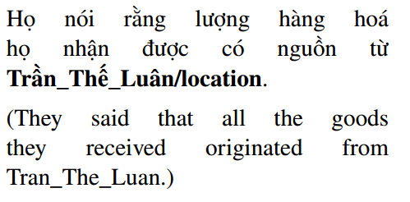
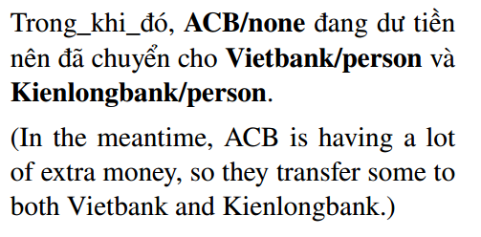
Discussion
The confusion: a person name ,a location name and organization name.
The word“Trần_Thế_Luân” refers to a person name rather than a location name as predicted above.
The model could not recognize “ACB” as an organization name.

Slide 52
References
Koby Crammer and Yoram Singer. 2003. Ultraconservative online algorithms for multiclass problems.Journal of Machine Learning Research, 3:951–991.
John Lafferty, Andrew McCallum, and Fernando C.N.Pereira. 2001. Conditional random fields: Probabilistic models for segmenting and labeling sequence data. In International Conference on Machine Learning (ICML).

