Slide 1
RNN & BPTT
林广和

Slide 2
Reference
BPTT_.pptx (from YangPei)
RECURRENT NEURAL NETWORKS TUTORIAL

Slide 3
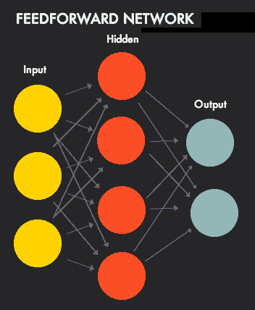
NN
Traditional Neural Network
Shortcoming: all inputs (and outputs) are independent of each other
Example: predict the next word in a sentence without context

Slide 4
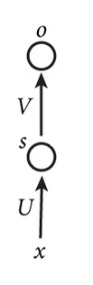
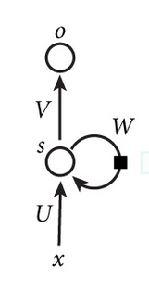
RNN & NN
NN
RNN

Slide 5
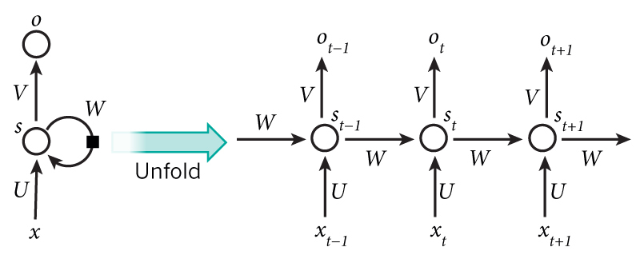
RNN(Recurrent Neural Network)
Recurrent:
perform the same task for every element of a sequence, with the output being depended on the previous computations.
RNNs have a “memory” which captures information about what has been calculated so far.

Slide 6
RNN(Recurrent Neural Network)
Note that:
a RNN shares the same parameters (W,U ,V)

Slide 7
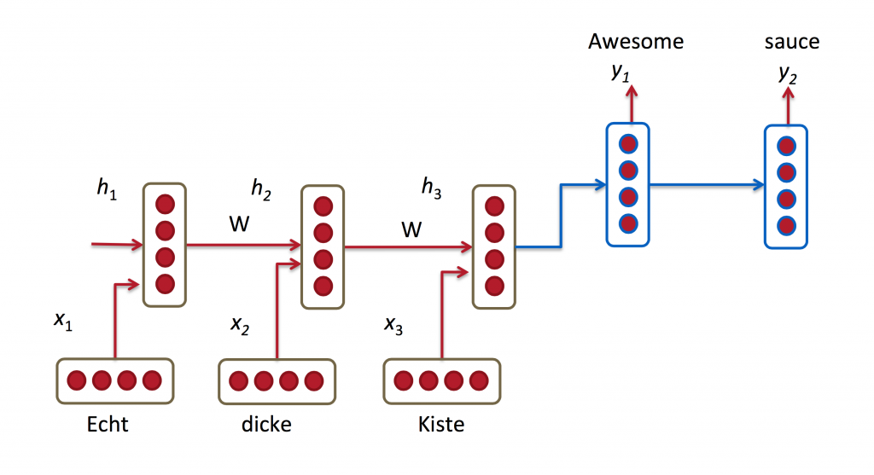
Applications
Language Modeling and Generating Text
Example: Given a sequence of words we want to predict the probability of each word given the previous words.
Machine Translation
Example : German -> English
Speech Recognition

Slide 8
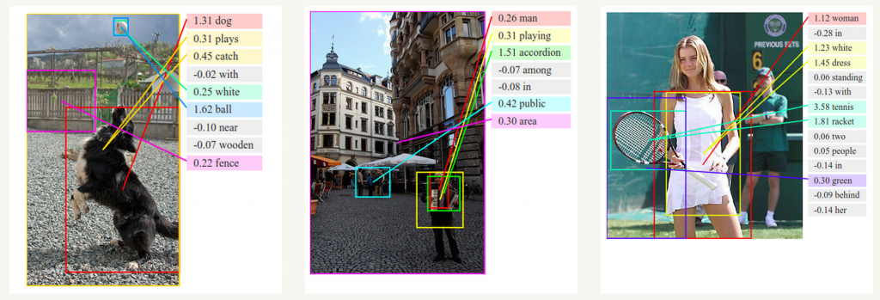
Generating Image Descriptions

Slide 9
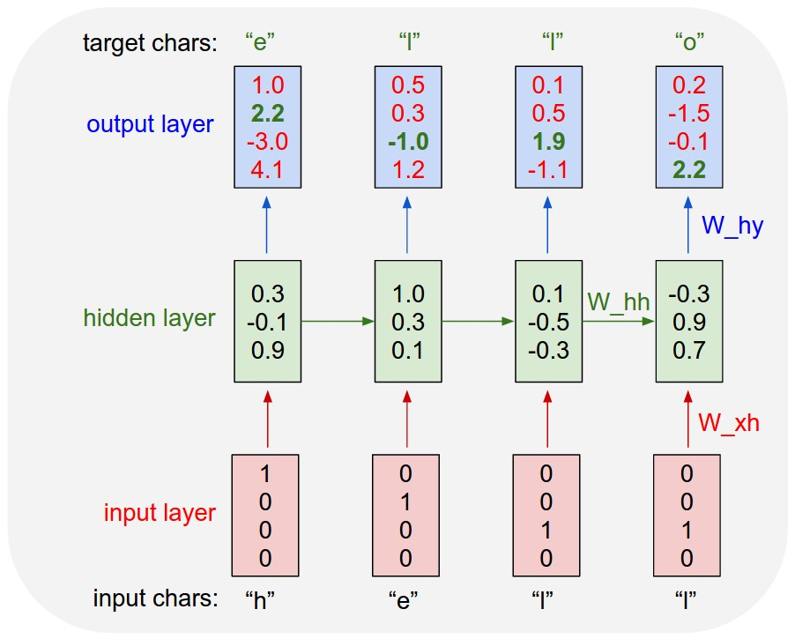
Applications
vocabulary =｛h，e，l，o｝
the training sequence “hello”
1-of-k encoding
t=1
t=2
t=3
t=4

Slide 10
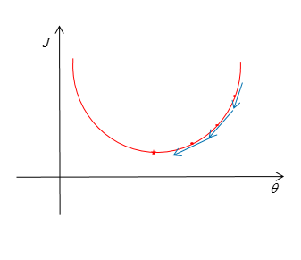
Training RNN
Cost Function
Gradient Descent
NN
BP Algorithm
RNN
Backpropagation Through Time (BPTT)

Slide 11
Training RNN
Chain Rule
Backpropagation
BPTT(Backpropagation Through Time)

Slide 12
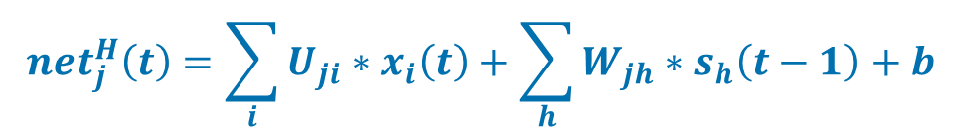

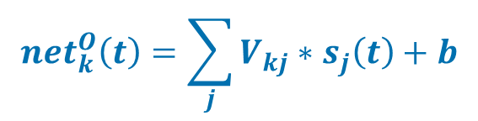

Formulas
$$y_{k}\left(t\right)=g\left({net}_{k}^{o}\left(t\right)\right)$$
k
$${net}_{k}^{O}\left(t\right)=\sum_{j}{V_{kj}∗s_{j}\left(t\right)+b}$$
V
$$s_{j}\left(t\right)=f\left({net}_{j}^{H}\left(t\right)\right)$$
S(t)
j
$${net}_{j}^{H}\left(t\right)=\sum_{i}{U_{ji}∗x_{i}\left(t\right)+\sum_{h}{W_{jh}∗s_{h}\left(t−1\right)+b}}$$
U
W
i
X(t)
S(t-1)
Notes:
如果元素标号没有与求和符号连用，
表示具体的标号，如1,2…，反之，是一个变量

Slide 13
Cross Entropy Loss
One-hot
if

Slide 14
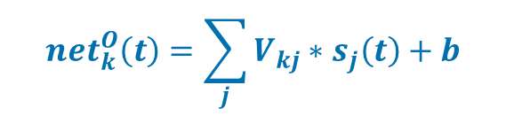
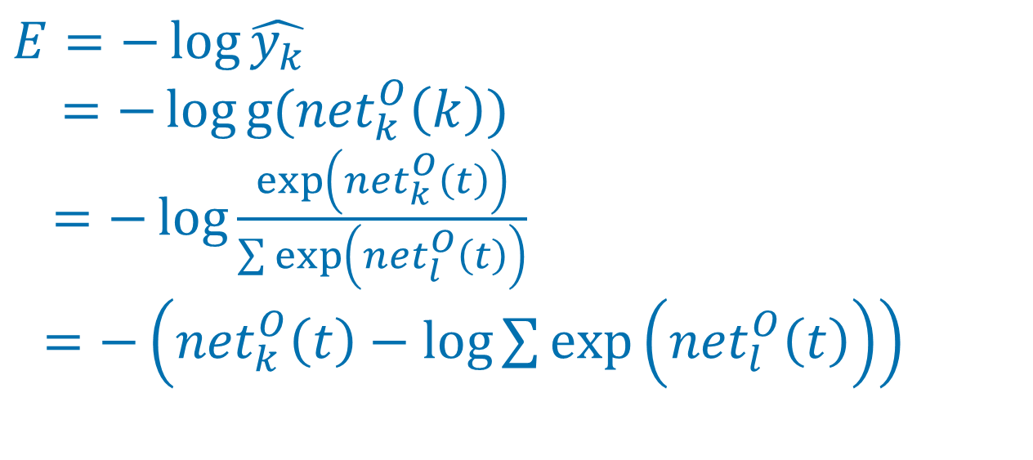

$$y_{k}\left(t\right)=g\left({net}_{k}^{o}\left(t\right)\right)$$
Output Layer
k
$${net}_{k}^{O}\left(t\right)=\sum_{j}{V_{kj}∗s_{j}\left(t\right)+b}$$
$$E=−\log{\hat{y_{k}}}$$
$$=−\log{g({net}_{k}^{O}\left(k\right))}$$
$=−\log{\frac{\exp\left({net}_{k}^{O}\left(t\right)\right)}{\sum{\exp\left({net}_{l}^{O}\left(t\right)\right)}}}$
$=−\left({net}_{k}^{O}\left(t\right)−\log{\sum{\exp\left({net}_{l}^{O}\left(t\right)\right)}}\right)$
Notes:
LGH:提醒杨培将softmax（netok(k)）调整一下

Slide 15

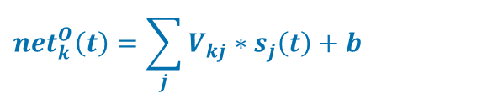

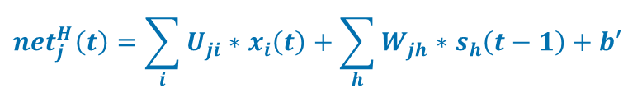

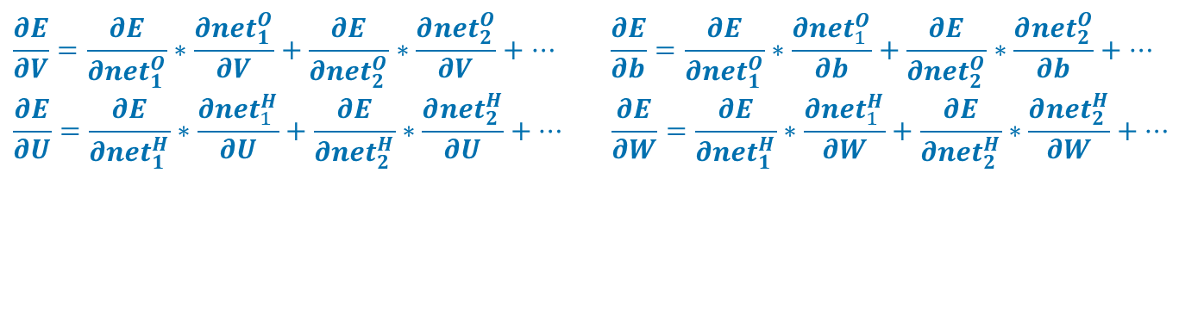
$\frac{∂E}{∂V}$, $\frac{∂E}{∂U}$, $\frac{∂E}{∂W}$
$$E=−\left({net}_{k}^{O}\left(t\right)−\log{\sum{\exp\left({net}_{l}^{O}\left(t\right)\right)}}\right)$$
$$y_{k}\left(t\right)=g\left({net}_{k}^{o}\left(t\right)\right)$$
$${net}_{k}^{O}\left(t\right)=\sum_{j}{V_{kj}∗s_{j}\left(t\right)+b}$$
$$s_{j}\left(t\right)=f\left({net}_{j}^{H}\left(t\right)\right)$$
$${net}_{j}^{H}\left(t\right)=\sum_{i}{U_{ji}∗x_{i}\left(t\right)+\sum_{h}{W_{jh}∗s_{h}\left(t−1\right)+b′}}$$
$$\frac{∂E}{∂V}=\frac{∂E}{∂{net}_{1}^{O}}∗\frac{∂{net}_{1}^{O}}{∂V}+\frac{∂E}{∂{net}_{2}^{O}}∗\frac{∂{net}_{2}^{O}}{∂V}+… \frac{∂E}{∂b}=\frac{∂E}{∂{net}_{1}^{O}}∗\frac{∂{net}_{1}^{O}}{∂b}+\frac{∂E}{∂{net}_{2}^{O}}∗\frac{∂{net}_{2}^{O}}{∂b}+…$$
$$\frac{∂E}{∂U}=\frac{∂E}{∂{net}_{1}^{H}}∗\frac{∂{net}_{1}^{H}}{∂U}+\frac{∂E}{∂{net}_{2}^{H}}∗\frac{∂{net}_{2}^{H}}{∂U}+… \frac{∂E}{∂W}=\frac{∂E}{∂{net}_{1}^{H}}∗\frac{∂{net}_{1}^{H}}{∂W}+\frac{∂E}{∂{net}_{2}^{H}}∗\frac{∂{net}_{2}^{H}}{∂W}+…$$

Slide 16

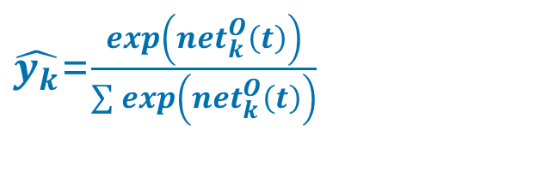
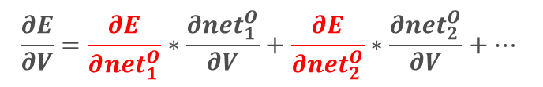
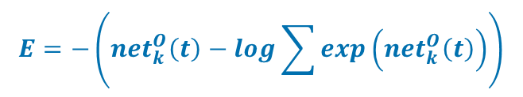
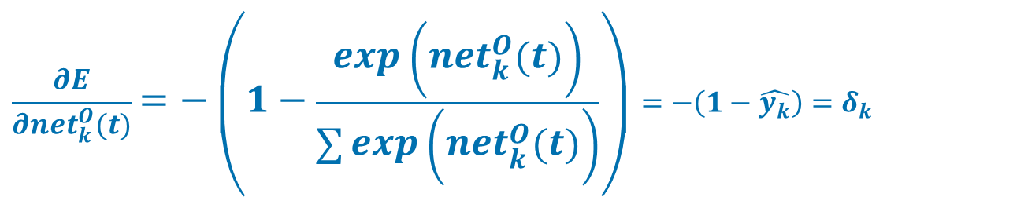
$\frac{∂E}{∂{net}_{k}^{O}(t)}$
$$\frac{∂E}{∂V}=\frac{∂E}{∂{net}_{1}^{O}}∗\frac{∂{net}_{1}^{O}}{∂V}+\frac{∂E}{∂{net}_{2}^{O}}∗\frac{∂{net}_{2}^{O}}{∂V}+…$$
$$E=−\left({net}_{k}^{O}\left(t\right)−\log{\sum{\exp\left({net}_{k}^{O}\left(t\right)\right)}}\right)$$
Output Layer
k
m
$\hat{y_{k}}$=$\frac{exp\left({net}_{k}^{O}\left(t\right)\right)}{\sum{exp\left({net}_{k}^{O}\left(t\right)\right)}}$
$$\frac{∂E}{∂{net}_{k}^{O}(t)}=−\left(1−\frac{exp\left({net}_{k}^{O}\left(t\right)\right)}{\sum{exp\left({net}_{k}^{O}\left(t\right)\right)}}\right)=−\left(1−\hat{y_{k}}\right)=δ_{k}$$
Notes:
此时，为E有贡献的，不仅有netk （此处，k是具体的标号，不是变量），还有不是k的net，这里，为了不缺乏一般性，定义一个m，还有netm等等，为此需要分别求导

Slide 17
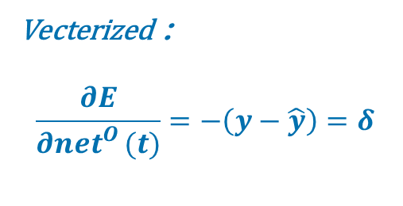
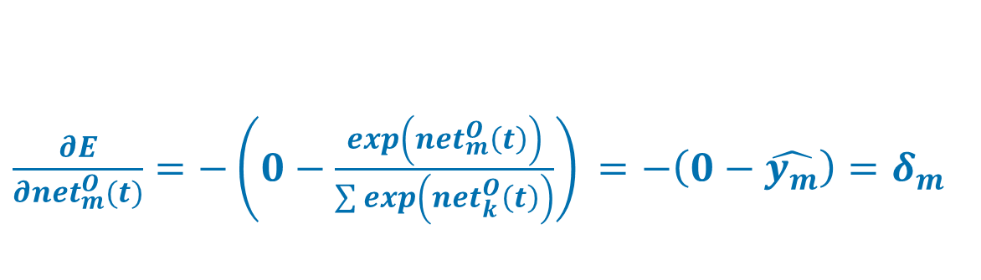

$\frac{∂E}{∂{net}_{m}^{O}(t)}$
$$\frac{∂E}{∂V}=\frac{∂E}{∂{net}_{1}^{O}}∗\frac{∂{net}_{1}^{O}}{∂V}+\frac{∂E}{∂{net}_{2}^{O}}∗\frac{∂{net}_{2}^{O}}{∂V}+…$$
$$E=−\left({net}_{k}^{O}\left(t\right)−\log{\sum{\exp\left({net}_{k}^{O}\left(t\right)\right)}}\right)$$
Output Layer
k
m
$\frac{∂E}{∂{net}_{m}^{O}(t)}=−\left(0−\frac{exp\left({net}_{m}^{O}\left(t\right)\right)}{\sum{exp\left({net}_{k}^{O}\left(t\right)\right)}}\right)$ $=−\left(0−\hat{y_{m}}\right)=δ_{m}$
Vecterized：
$$\frac{∂E}{∂{net}_{}^{O}(t)}=−\left(y−\hat{y}\right)=δ$$
Notes:
此时，为E有贡献的，不仅有netk （此处，k是具体的标号，不是变量），还有不是k的net，这里，为了不缺乏一般性，定义一个m，还有netm等等，为此需要分别求导

Slide 18

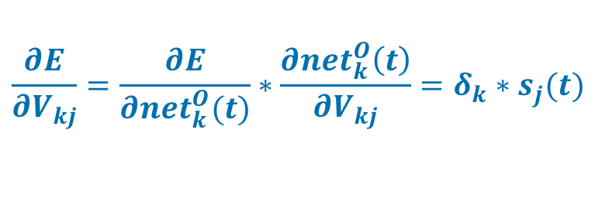

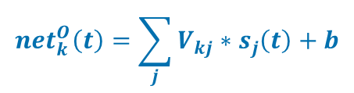
$\frac{∂E}{∂V}$
$$\frac{∂E}{∂VV_{}}=\frac{∂E}{∂{net}_{1}^{O}}∗\frac{∂{net}_{2}^{O}}{∂V}+\frac{∂E}{∂{net}_{2}^{O}}∗\frac{∂{net}_{2}^{O}}{∂V}+… V﷯+…$$
$$\frac{∂E}{∂V_{kj}}=\frac{∂E}{∂{net}_{1}^{O}}∗\frac{∂{net}_{1}^{O}}{∂V_{kj}}+\frac{∂E}{∂{net}_{2}^{O}}∗\frac{∂{net}_{2}^{O}}{∂V_{kj}}+…$$
$$y_{k}\left(t\right)=g\left({net}_{k}^{o}\left(t\right)\right)$$
k
m
$${net}_{k}^{O}\left(t\right)=\sum_{j}{V_{kj}∗s_{j}\left(t\right)+b}$$
j
$\frac{∂{net}_{k}^{O}\left(t\right)}{∂V_{kj}}=s_{j}(t)$ $\frac{∂{net}_{m}^{O}\left(t\right)}{∂V_{kj}}=0$
$$\frac{∂E}{∂V_{kj}}=\frac{∂E}{∂{net}_{k}^{O}(t)}∗\frac{∂{net}_{k}^{O}\left(t\right)}{∂V_{kj}}=δ_{k}∗s_{j}(t)$$
$$\frac{∂E}{∂V}=\left(\hat{y}−y\right)∗s^{T}(t)$$
Notes:
E是有多个neto组成的，而每个neto都含有多个不同的Vkj，而且，每个neto之间的Vkj都是不同的。
所以在求E对Vkj的偏导数时，只需要考虑一个netk，然后对netk求Vkj的偏导数
注意：此时，x是常数，s(t)也是常数，V是变量

Slide 19
E对W求偏导

Slide 20
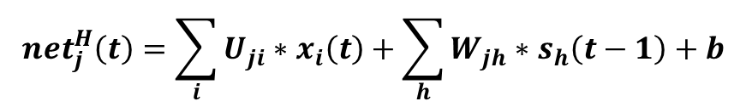
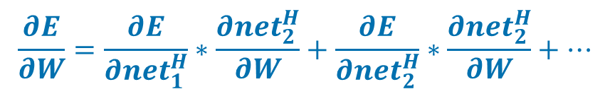




$$\frac{∂E}{∂W}$$
$$\frac{∂E}{∂W}=\frac{∂E}{∂{net}_{1}^{H}}∗\frac{∂{net}_{2}^{H}}{∂W}+\frac{∂E}{∂{net}_{2}^{H}}∗\frac{∂{net}_{2}^{H}}{∂W}+…$$
$$y_{k}\left(t\right)$$
k
$${net}_{k}^{O}\left(t\right)$$
BPTT
V
$$s_{j}\left(t\right)=f\left({net}_{j}^{H}\left(t\right)\right)$$
S(t)
j
$${net}_{j}^{H}\left(t\right)=\sum_{i}{U_{ji}∗x_{i}\left(t\right)+\sum_{h}{W_{jh}∗s_{h}\left(t−1\right)+b}}$$
U
W
i
X(t)
S(t-1)

Slide 21

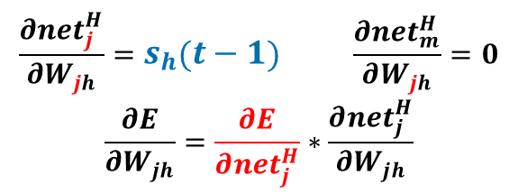
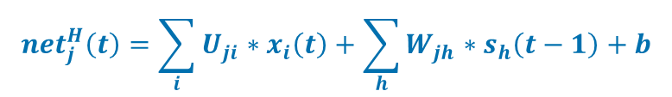

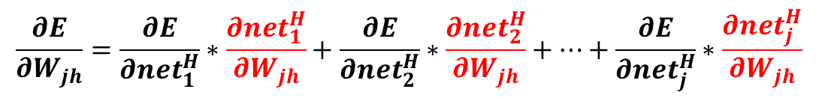
T=1
$$\frac{∂E}{∂W_{jh}}=\frac{∂E}{∂{net}_{1}^{H}}∗\frac{∂{net}_{1}^{H}}{∂W_{jh}}+\frac{∂E}{∂{net}_{2}^{H}}∗\frac{∂{net}_{2}^{H}}{∂W_{jh}}+…+\frac{∂E}{∂{net}_{j}^{H}}∗\frac{∂{net}_{j}^{H}}{∂W_{jh}}$$
$$s_{j}\left(t\right)=f\left({net}_{j}^{H}\left(t\right)\right)$$
j
h
$${net}_{j}^{H}\left(t\right)=\sum_{i}{U_{ji}∗x_{i}\left(t\right)+\sum_{h}{W_{jh}∗s_{h}\left(t−1\right)+b}}$$
j
h
$$\frac{∂{net}_{j}^{H}}{∂W_{jh}}=s_{h}\left(t−1\right) \frac{∂{net}_{m}^{H}}{∂W_{jh}}=0$$
$$\frac{∂E}{∂W_{jh}}=\frac{∂E}{∂{net}_{j}^{H}}∗\frac{∂{net}_{j}^{H}}{∂W_{jh}}$$
=>$\frac{∂E}{∂{net}_{j}^{H}(t)}$
Notes:
E是由net1,2,3,k等组成的，而每个netok又是由s1,2,3,4等组成的，而每个sj又含有对应的netHj，所以，求E对netHj的偏导数将会是多个部分之和

Slide 22
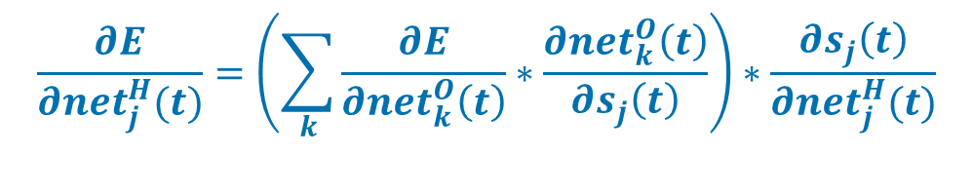


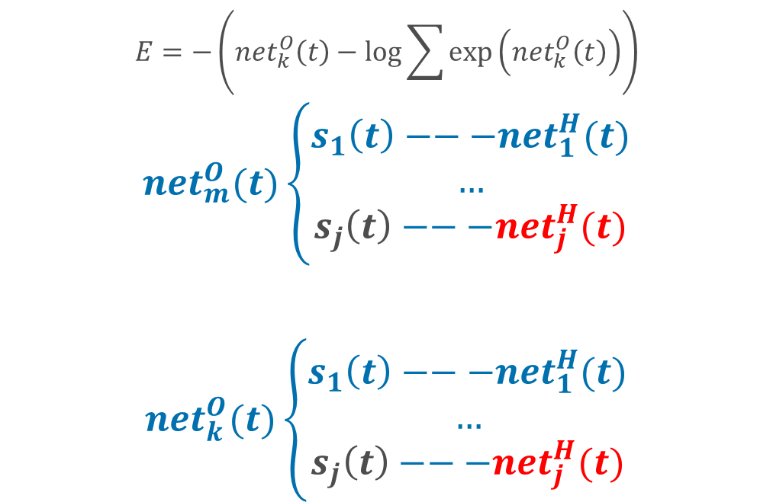



$\frac{∂E}{∂{net}_{j}^{H}(t)}$
$$E=−\left({net}_{k}^{O}\left(t\right)−\log{\sum{\exp\left({net}_{k}^{O}\left(t\right)\right)}}\right)$$
$${net}_{m}^{O}(t)\left\{\begin{aligned}s_{1}\left(t\right)−−−{net}_{1}^{H}(t) \\ … \\ s_{j}\left(t\right)−−−{net}_{j}^{H}(t)\end{aligned}\right.$$
$${net}_{k}^{O}(t)\left\{\begin{aligned}s_{1}\left(t\right)−−−{net}_{1}^{H}(t) \\ … \\ s_{j}\left(t\right)−−−{net}_{j}^{H}(t)\end{aligned}\right.$$
$$y_{k}\left(t\right)$$
k
m
$${net}_{k}^{O}\left(t\right)$$
$$s_{j}\left(t\right)$$
j
$${net}_{j}^{H}\left(t\right)$$
$$\frac{∂E}{∂{net}_{j}^{H}(t)}=\left(\sum_{k}{\frac{∂E}{∂{net}_{k}^{O}\left(t\right)}}∗\frac{∂{net}_{k}^{O}\left(t\right)}{∂s_{j}\left(t\right)}\right)∗\frac{∂s_{j}\left(t\right)}{∂{net}_{j}^{H}(t)}$$

Slide 23
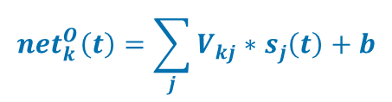
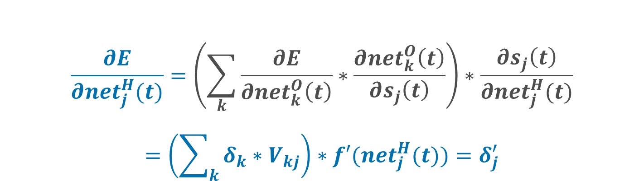


$$\frac{∂E}{∂{net}_{j}^{H}(t)}=\left(\sum_{k}{\frac{∂E}{∂{net}_{k}^{O}\left(t\right)}}∗\frac{∂{net}_{k}^{O}\left(t\right)}{∂s_{j}\left(t\right)}\right)∗\frac{∂s_{j}\left(t\right)}{∂{net}_{j}^{H}(t)}$$
$$=\left(\sum_{k}{δ_{k}∗V_{kj}}\right)∗f′({net}_{j}^{H}(t))=δ_{j}^{′}$$
$$y_{k}\left(t\right)=g\left({net}_{k}^{o}\left(t\right)\right)$$
k
m
$${net}_{k}^{O}\left(t\right)=\sum_{j}{V_{kj}∗s_{j}\left(t\right)+b}$$
$$s_{j}\left(t\right)=f\left({net}_{j}^{H}\left(t\right)\right)$$

Slide 24

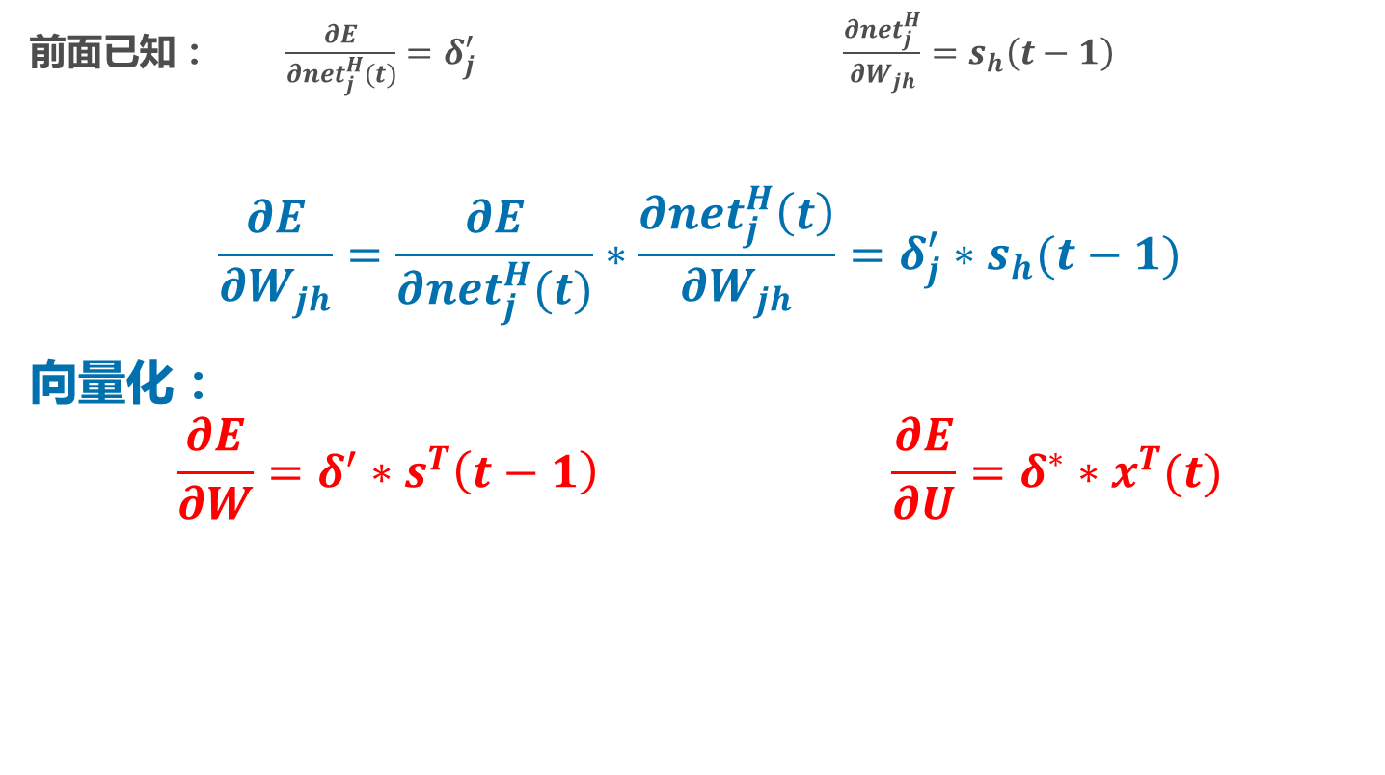
$\frac{∂E}{∂W_{jh}}$
前面已知： $\frac{∂E}{∂{net}_{j}^{H}(t)}=δ_{j}^{′} \frac{∂{net}_{j}^{H}}{∂W_{jh}}=s_{h}\left(t−1\right)$
$$\frac{∂E}{∂W_{jh}}=\frac{∂E}{∂{net}_{j}^{H}(t)}∗\frac{∂{net}_{j}^{H}\left(t\right)}{∂W_{jh}}=δ_{j}^{′}∗s_{h}(t−1)$$
向量化：
$$\frac{∂E}{∂W}=δ^{′}∗s^{T}\left(t−1\right) \frac{∂E}{∂U}=δ^{∗}∗x^{T}(t)$$

Slide 25


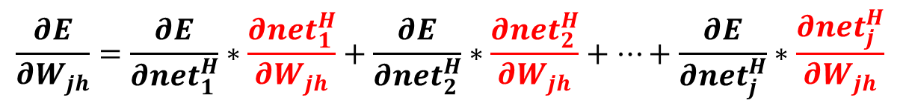
T=2
$$\frac{∂E}{∂W_{jh}}=\frac{∂E}{∂{net}_{1}^{H}}∗\frac{∂{net}_{1}^{H}}{∂W_{jh}}+\frac{∂E}{∂{net}_{2}^{H}}∗\frac{∂{net}_{2}^{H}}{∂W_{jh}}+…+\frac{∂E}{∂{net}_{j}^{H}}∗\frac{∂{net}_{j}^{H}}{∂W_{jh}}$$
$$s_{j}\left(t\right)=f\left({net}_{j}^{H}\left(t\right)\right)$$
s(t)
j
h
$${net}_{j}^{H}\left(t\right)=\sum_{i}{U_{ji}∗x_{i}\left(t\right)+\sum_{h}{W_{jh}∗s_{h}\left(t−1\right)+b}}$$
x(t)
j
h
s(t-1)
x(t-1)
j
h
s(t-2)

Slide 26
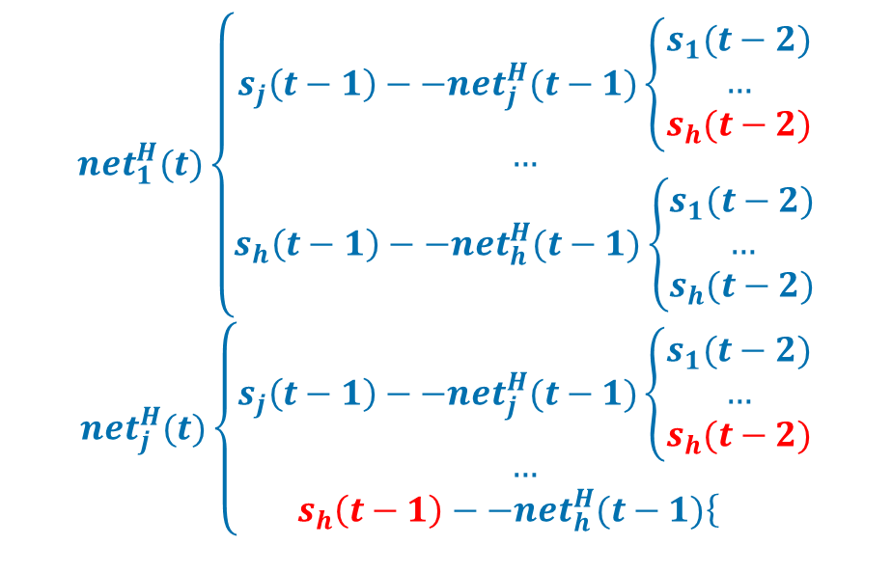


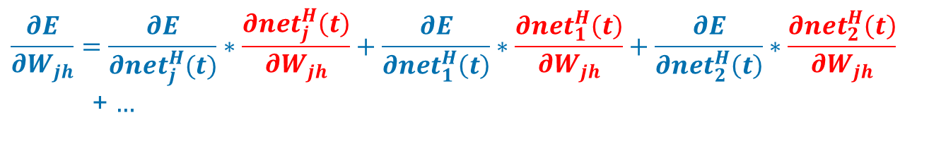

$\frac{∂{net}_{j}^{H}\left(t\right)}{∂W_{jh}}$
$$s_{j}\left(t\right)$$
j
h
$${net}_{1}^{H}(t)\left\{\begin{aligned}s_{j}\left(t−1\right)−−{net}_{j}^{H}(t−1)\left\{\begin{aligned}s_{1}(t−2) \\ … \\ s_{h}(t−2)\end{aligned}\right. \\ … \\ s_{h}\left(t−1\right)−−{net}_{h}^{H}(t−1)\left\{\begin{aligned}s_{1}(t−2) \\ … \\ s_{h}(t−2)\end{aligned}\right.\end{aligned}\right.$$
$${net}_{j}^{H}(t)\left\{\begin{aligned}s_{j}\left(t−1\right)−−{net}_{j}^{H}(t−1)\left\{\begin{aligned}s_{1}(t−2) \\ … \\ s_{h}(t−2)\end{aligned}\right. \\ … \\ s_{h}\left(t−1\right)−−{net}_{h}^{H}(t−1)\left\{\right.\end{aligned}\right.$$
$${net}_{j}^{H}\left(t\right)$$
s(t)
j
h
s(t-1)
x(t)
j
h
s(t-2)
x(t-1)
$$\frac{∂E}{∂W_{jh}}=\frac{∂E}{∂{net}_{j}^{H}(t)}∗\frac{∂{net}_{j}^{H}\left(t\right)}{∂W_{jh}}+\frac{∂E}{∂{net}_{1}^{H}\left(t\right)}∗\frac{∂{net}_{1}^{H}\left(t\right)}{∂W_{jh}}+\frac{∂E}{∂{net}_{2}^{H}\left(t\right)}∗\frac{∂{net}_{2}^{H}\left(t\right)}{∂W_{jh}}$$
+ $…$
Notes:
E对nethj的偏导数在前面已经求出，现在开始求netHj对Wjh的偏导数
注意：上面最后的一个公式中，后面的从1,2…中并没有j，由于j比较特殊，所以将j提出来了

Slide 27
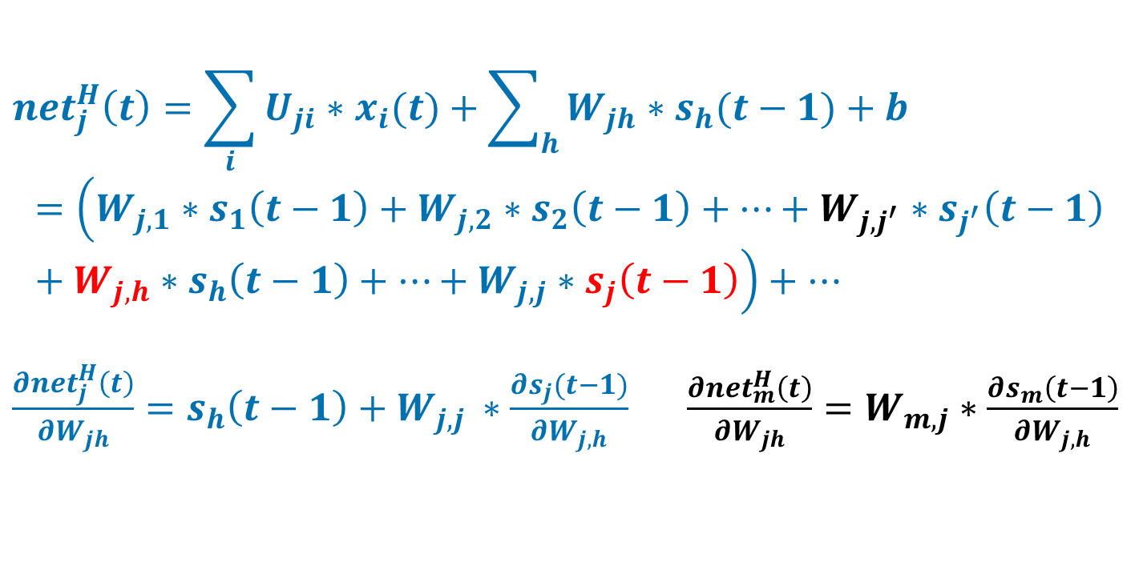
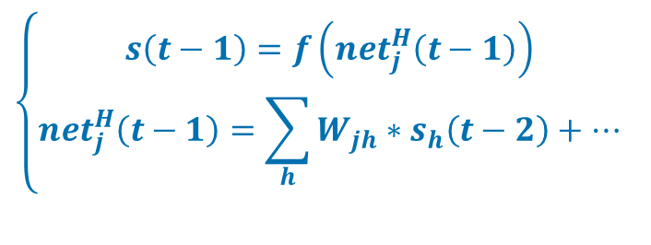
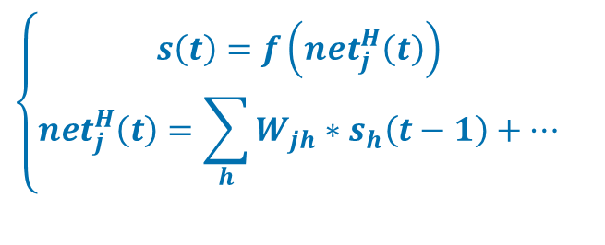
$\frac{∂{net}_{j}^{H}\left(t\right)}{∂W_{jh}}$
$$\left\{\begin{aligned}s\left(t\right)=f\left({net}_{j}^{H}\left(t\right)\right) \\ {net}_{j}^{H}\left(t\right)=\sum_{h}{W_{jh}∗s_{h}\left(t−1\right)+…}\end{aligned}\right.$$
$$\left\{\begin{aligned}s\left(t−1\right)=f\left({net}_{j}^{H}\left(t−1\right)\right) \\ {net}_{j}^{H}\left(t−1\right)=\sum_{h}{W_{jh}∗s_{h}\left(t−2\right)+…}\end{aligned}\right.$$
$${net}_{j}^{H}\left(t\right)=\sum_{i}{U_{ji}∗x_{i}(t)}+\sum_{h}{W_{jh}∗s_{h}(t−1)}+b$$
$$=\left(W_{j,1}∗s_{1}\left(t−1\right)+W_{j,2}∗s_{2}\left(t−1\right)+…+W_{j,j^{′}}∗s_{j^{′}}\left(t−1\right)+W_{j,h}∗s_{h}\left(t−1\right)+…+W_{j,j}∗s_{j}\left(t−1\right)\right)+…$$
$\frac{∂{net}_{j}^{H}\left(t\right)}{∂W_{jh}}=s_{h}\left(t−1\right)+W_{j,j }∗\frac{∂s_{j}(t−1)}{∂W_{j,h}}$ $\frac{∂{net}_{m}^{H}\left(t\right)}{∂W_{jh}}=W_{m,j}∗\frac{∂s_{m}\left(t−1\right)}{∂W_{j,h}}$

Slide 28
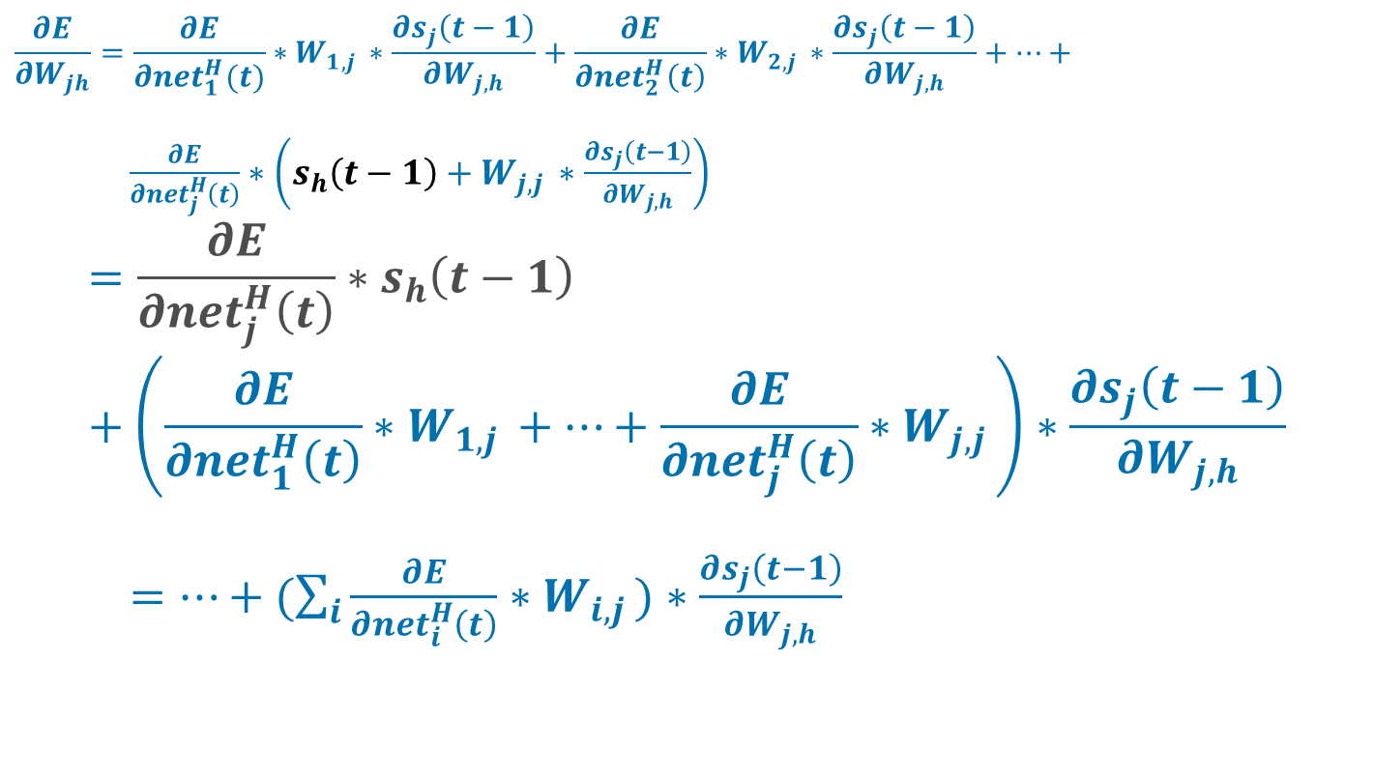
$\frac{∂{net}_{j}^{H}\left(t\right)}{∂W_{jh}}$
$$\frac{∂E}{∂W_{jh}}=\frac{∂E}{∂{net}_{1}^{H}(t)}∗W_{1,j }∗\frac{∂s_{j}\left(t−1\right)}{∂W_{j,h}}+\frac{∂E}{∂{net}_{2}^{H}\left(t\right)}∗W_{2,j }∗\frac{∂s_{j}\left(t−1\right)}{∂W_{j,h}}+…+$$
$\frac{∂E}{∂{net}_{j}^{H}\left(t\right)}∗\left(s_{h}\left(t−1\right)+W_{j,j }∗\frac{∂s_{j}\left(t−1\right)}{∂W_{j,h}}\right)$
$$=\frac{∂E}{∂{net}_{j}^{H}\left(t\right)}∗s_{h}\left(t−1\right)+\left(\frac{∂E}{∂{net}_{1}^{H}\left(t\right)}∗W_{1,j }+…+\frac{∂E}{∂{net}_{j}^{H}\left(t\right)}∗W_{j,j }\right)∗\frac{∂s_{j}\left(t−1\right)}{∂W_{j,h}}$$
$=…+(\sum_{i}{\frac{∂E}{∂{net}_{i}^{H}\left(t\right)}∗W_{i,j })∗\frac{∂s_{j}\left(t−1\right)}{∂W_{j,h}}}$

Slide 29
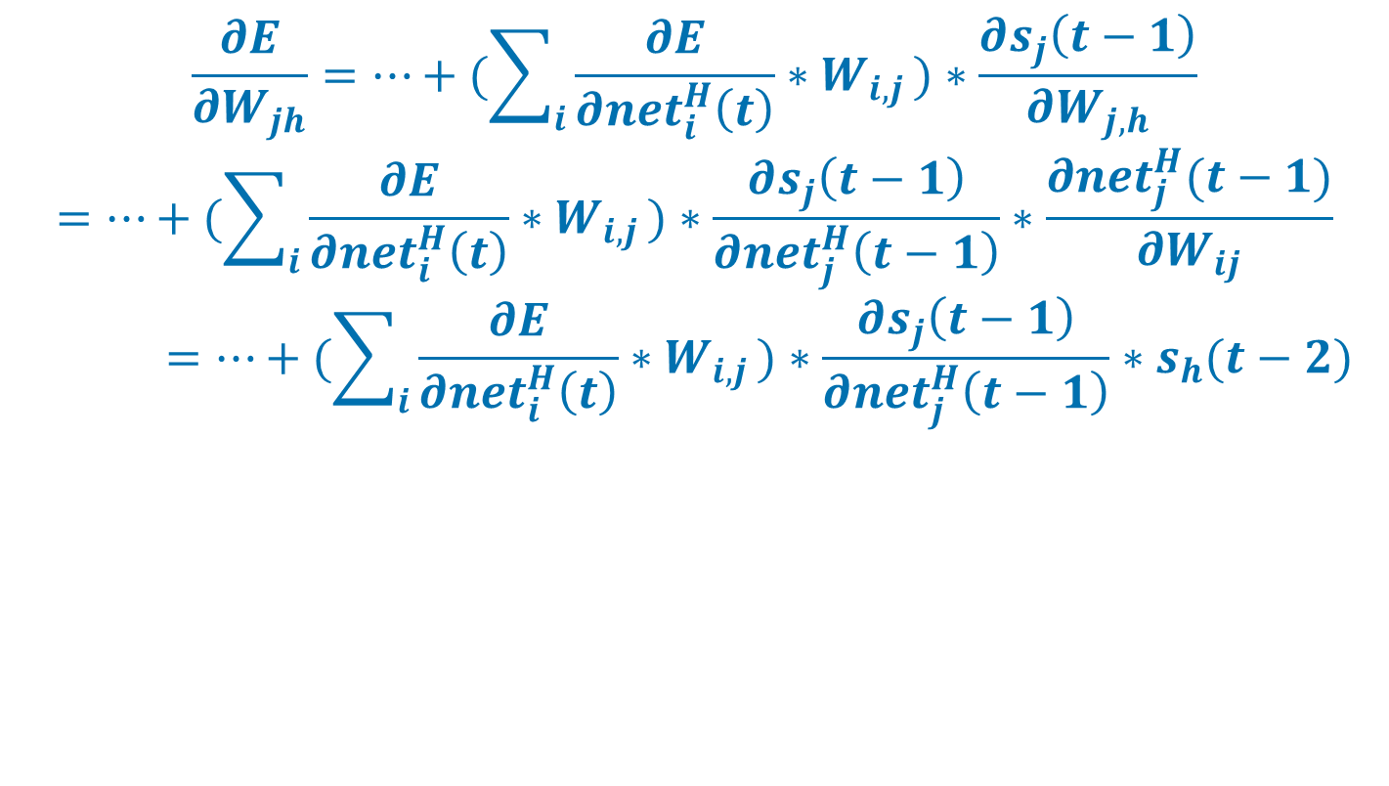
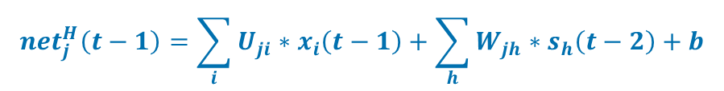
$\frac{∂E}{∂W_{jh}}$
s(t-1)
j
h
$${net}_{j}^{H}\left(t−1\right)=\sum_{i}{U_{ji}∗x_{i}\left(t−1\right)+\sum_{h}{W_{jh}∗s_{h}\left(t−2\right)+b}}$$
s(t-2)
j
h
$$\frac{∂E}{∂W_{jh}}=…+(\sum_{i}{\frac{∂E}{∂{net}_{i}^{H}\left(t\right)}∗W_{i,j })∗\frac{∂s_{j}\left(t−1\right)}{∂W_{j,h}}}$$
$$=…+(\sum_{i}{\frac{∂E}{∂{net}_{i}^{H}\left(t\right)}∗W_{i,j })∗\frac{∂s_{j}\left(t−1\right)}{∂{net}_{j}^{H}\left(t−1\right)}∗\frac{∂{net}_{j}^{H}(t−1)}{∂W_{ij}}}$$
$$=…+(\sum_{i}{\frac{∂E}{∂{net}_{i}^{H}\left(t\right)}∗W_{i,j })∗\frac{∂s_{j}\left(t−1\right)}{∂{net}_{j}^{H}\left(t−1\right)}∗s_{h}(t−2)}$$

Slide 30
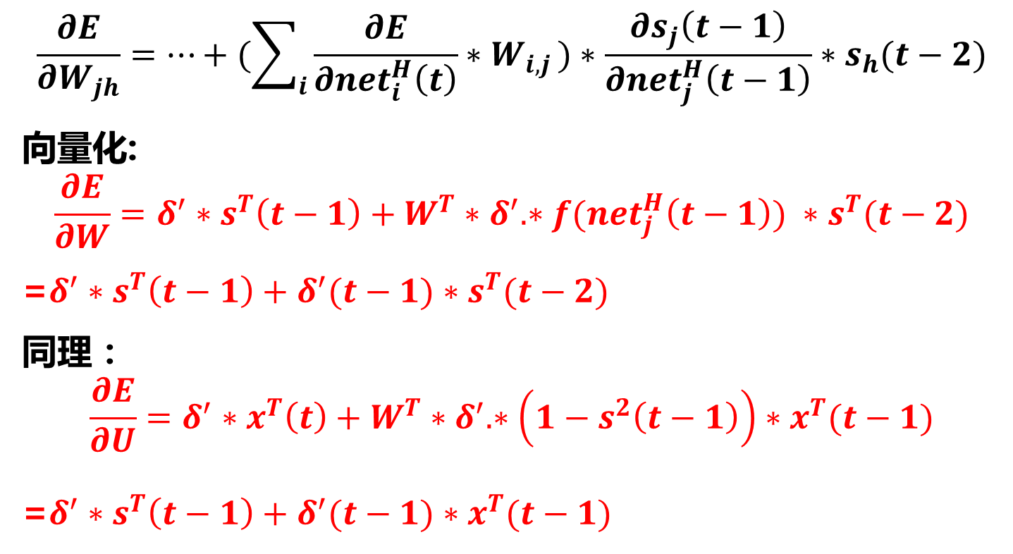
Vectorized
$$\frac{∂E}{∂W_{jh}}=…+(\sum_{i}{\frac{∂E}{∂{net}_{i}^{H}\left(t\right)}∗W_{i,j })∗\frac{∂s_{j}\left(t−1\right)}{∂{net}_{j}^{H}\left(t−1\right)}∗s_{h}(t−2)}$$
向量化:
$$\frac{∂E}{∂W}=δ^{′}∗s^{T}\left(t−1\right)+W^{T}∗δ^{′}.∗f({net}_{j}^{H}\left(t−1\right)) ∗s^{T}(t−2)$$
=$δ^{′}∗s^{T}\left(t−1\right)+δ^{′}(t−1)∗s^{T}(t−2)$
同理：
$$\frac{∂E}{∂U}=δ^{′}∗x^{T}\left(t\right)+W^{T}∗δ^{′}.∗\left(1−s^{2}\left(t−1\right)\right)∗x^{T}(t−1)$$
=$δ^{′}∗s^{T}\left(t−1\right)+δ^{′}(t−1)∗{x^{T}(t−1) }^{}$
Notes:
注意：E对W的偏导中，第一部分是t=1时候的等式，也就是说t=2是在t=1的基础上增加一部分得到的

Slide 31
当t=3时
s(t)
j
h
x(t)
j
h
s(t-1)
x(t-1)
j
h
s(t-2)
x(t-1)
j
h
s(t-3)

Slide 32


${net}_{j}^{H}\left(t\right)对W_{jh}$的偏导数
当t=1时：
$$\frac{∂E}{∂W}=δ^{′}∗s^{T}(t−1)$$
当t=2时：
$$\frac{∂E}{∂W}=δ^{′}∗s^{T}\left(t−1\right)+δ^{′}(t−1) ∗s^{T}(t−2)$$
当t=3时：
$$\frac{∂E}{∂W}=δ^{′}∗s^{T}\left(t−1\right)+δ^{′}(t−1)∗s^{T}\left(t−2\right)+$$
$$δ^{′}(t−2)∗s^{T}(t−3)$$
当t=4时：
…

