Slide 1
RNN & BPTT
林广和

Slide 2
RNN
Traditional Neural Network
Shortcoming: all inputs (and outputs) are independent of each other
Example: predict the next word in a sentence without context
（缺少前馈神经网络的图）

Slide 3
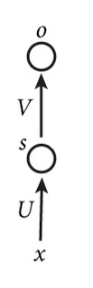
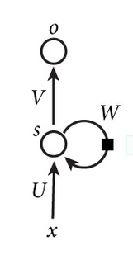
RNN和NN
NN
RNN

Slide 4
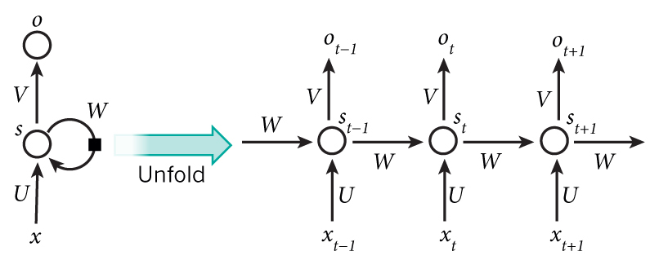
RNN(Recurrent Neural Network)
Recurrent:
perform the same task for every element of a sequence, with the output being depended on the previous computations.
RNNs have a “memory” which captures information about what has been calculated so far.

Slide 5
RNN(Recurrent Neural Network)
Note that:
a RNN shares the same parameters (W,U ,V)
(skip) Output may not be necessary.

Slide 6
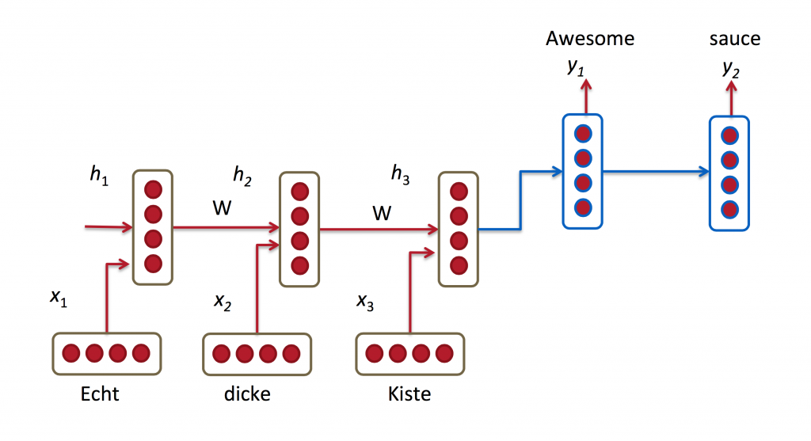
Applications
Language Modeling and Generating Text
Example: Given a sequence of words we want to predict the probability of each word given the previous words.
Machine Translation
Example : German -> English
Speech Recognition

Slide 7
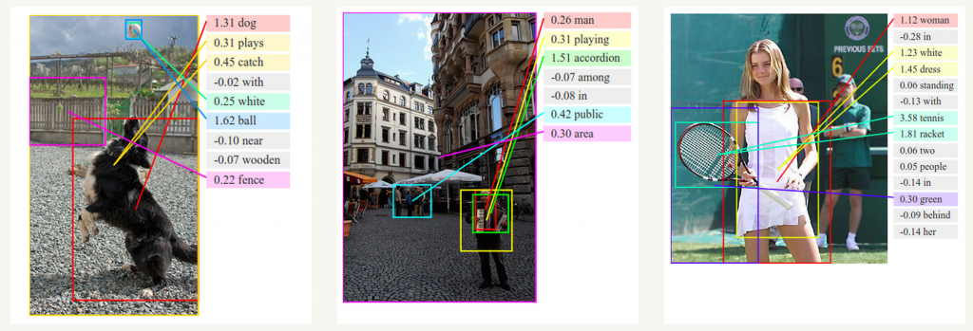
Generating Image Descriptions

Slide 8
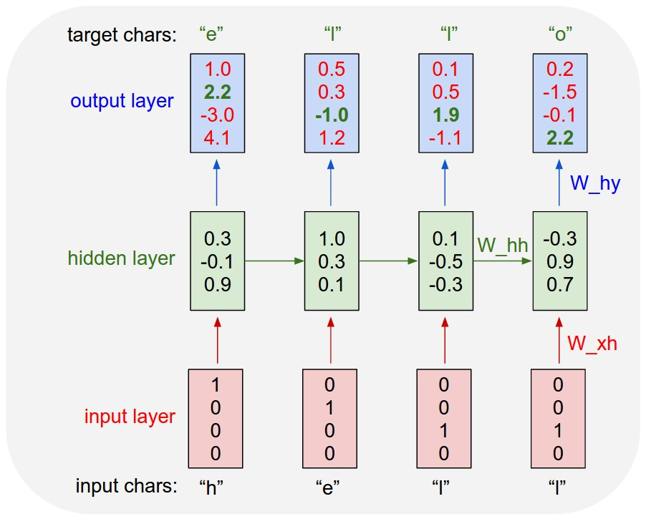
Applications
vocabulary =｛h，e，l，o｝
the training sequence “hello”
1-of-k encoding
t=1
t=2
t=3
t=4

Slide 9
Training RNN
Cost Function
Gradient Descent
NN
BP Algorithm
RNN
Backpropagation Through Time (BPTT)

Slide 10
Training RNN
Chain Rule
Backpropagation
BPTT(Backpropagation Through Time)

Slide 11
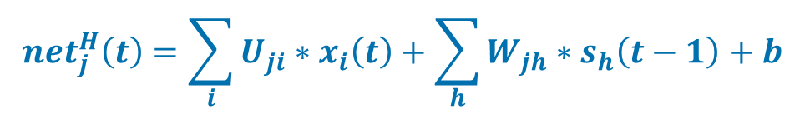

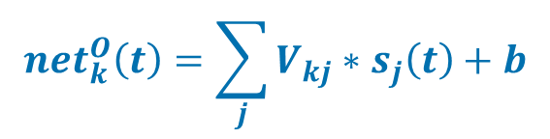

Formulas
$$y_{k}\left(t\right)=g\left({net}_{k}^{o}\left(t\right)\right)$$
k
$${net}_{k}^{O}\left(t\right)=\sum_{j}{V_{kj}∗s_{j}\left(t\right)+b}$$
V
$$s_{j}\left(t\right)=f\left({net}_{j}^{H}\left(t\right)\right)$$
S(t)
j
$${net}_{j}^{H}\left(t\right)=\sum_{i}{U_{ji}∗x_{i}\left(t\right)+\sum_{h}{W_{jh}∗s_{h}\left(t−1\right)+b}}$$
U
W
i
X(t)
S(t-1)
Notes:
如果元素标号没有与求和符号连用，
表示具体的标号，如1,2…，反之，是一个变量

Slide 12
Cross Entropy Loss
One-hot
if

Slide 13
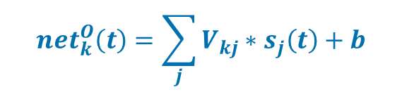
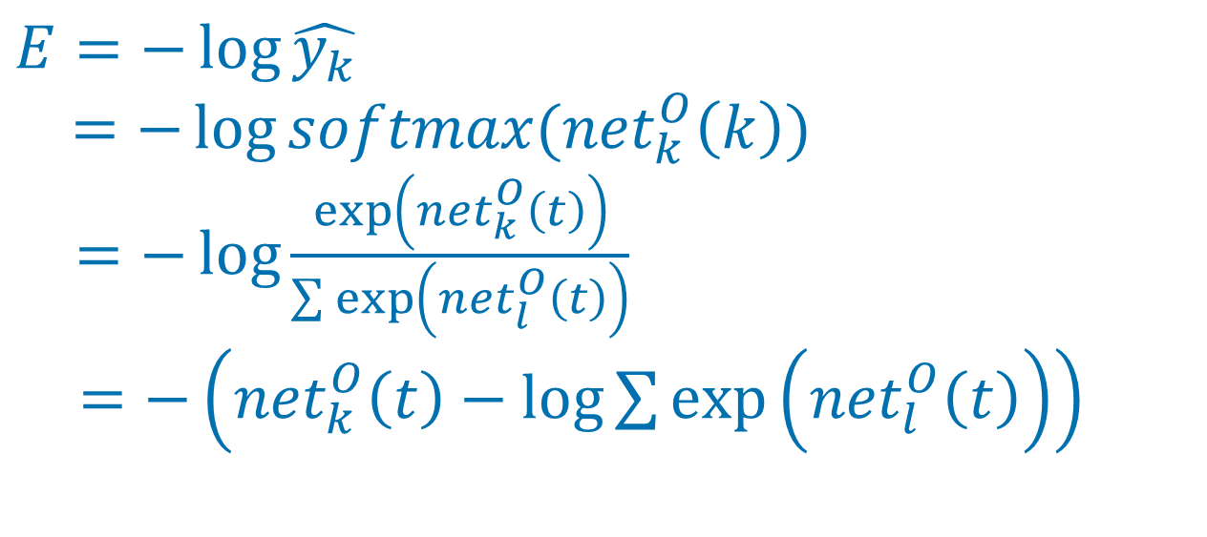

$$y_{k}\left(t\right)=g\left({net}_{k}^{o}\left(t\right)\right)$$
输出层
k
$${net}_{k}^{O}\left(t\right)=\sum_{j}{V_{kj}∗s_{j}\left(t\right)+b}$$
$$E=−\log{\hat{y_{k}}}$$
$$=−\log{softmax({net}_{k}^{O}\left(k\right))}$$
$=−\log{\frac{\exp\left({net}_{k}^{O}\left(t\right)\right)}{\sum{\exp\left({net}_{l}^{O}\left(t\right)\right)}}}$
$=−\left({net}_{k}^{O}\left(t\right)−\log{\sum{\exp\left({net}_{l}^{O}\left(t\right)\right)}}\right)$
Notes:
LGH:提醒杨培将softmax（netok(k)）调整一下

Slide 14
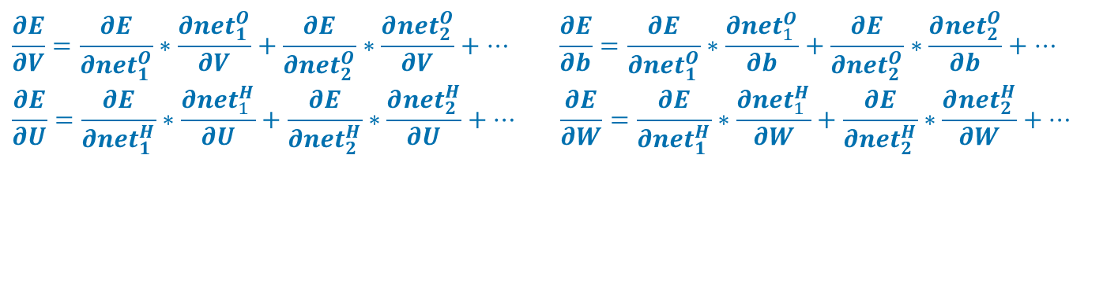

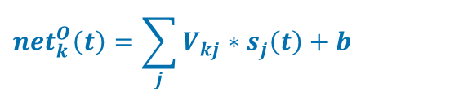

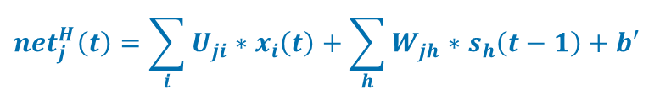
V,W,U的梯度
$$E=−\left({net}_{k}^{O}\left(t\right)−\log{\sum{\exp\left({net}_{l}^{O}\left(t\right)\right)}}\right)$$
$$y_{k}\left(t\right)=g\left({net}_{k}^{o}\left(t\right)\right)$$
$${net}_{k}^{O}\left(t\right)=\sum_{j}{V_{kj}∗s_{j}\left(t\right)+b}$$
$$s_{j}\left(t\right)=f\left({net}_{j}^{H}\left(t\right)\right)$$
+1
$${net}_{j}^{H}\left(t\right)=\sum_{i}{U_{ji}∗x_{i}\left(t\right)+\sum_{h}{W_{jh}∗s_{h}\left(t−1\right)+b′}}$$
$$\frac{∂E}{∂V}=\frac{∂E}{∂{net}_{1}^{O}}∗\frac{∂{net}_{1}^{O}}{∂V}+\frac{∂E}{∂{net}_{2}^{O}}∗\frac{∂{net}_{2}^{O}}{∂V}+… \frac{∂E}{∂b}=\frac{∂E}{∂{net}_{1}^{O}}∗\frac{∂{net}_{1}^{O}}{∂b}+\frac{∂E}{∂{net}_{2}^{O}}∗\frac{∂{net}_{2}^{O}}{∂b}+…$$
$$\frac{∂E}{∂U}=\frac{∂E}{∂{net}_{1}^{H}}∗\frac{∂{net}_{1}^{H}}{∂U}+\frac{∂E}{∂{net}_{2}^{H}}∗\frac{∂{net}_{2}^{H}}{∂U}+… \frac{∂E}{∂W}=\frac{∂E}{∂{net}_{1}^{H}}∗\frac{∂{net}_{1}^{H}}{∂W}+\frac{∂E}{∂{net}_{2}^{H}}∗\frac{∂{net}_{2}^{H}}{∂W}+…$$

Slide 15

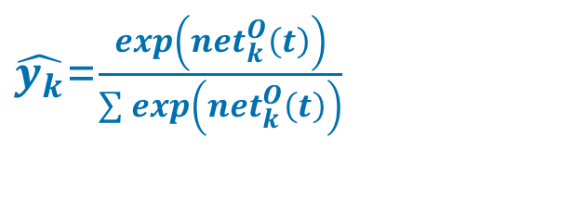
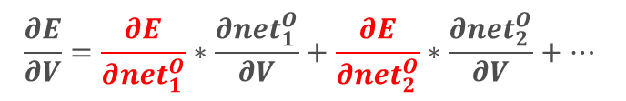
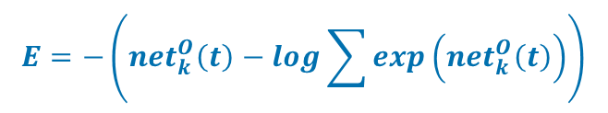
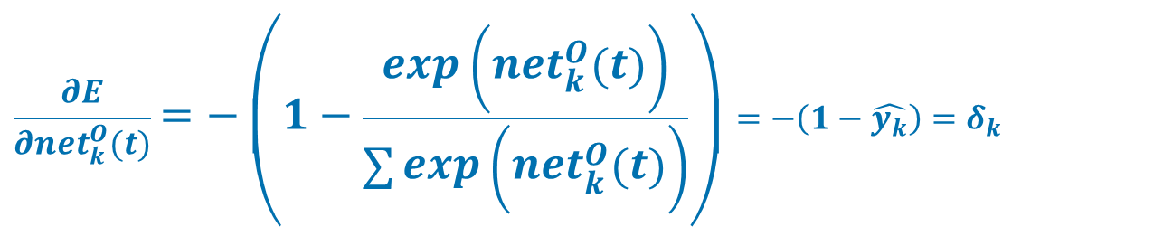
E对${net}_{k}^{O}(t)$求偏导(待修改)
$$\frac{∂E}{∂V}=\frac{∂E}{∂{net}_{1}^{O}}∗\frac{∂{net}_{1}^{O}}{∂V}+\frac{∂E}{∂{net}_{2}^{O}}∗\frac{∂{net}_{2}^{O}}{∂V}+…$$
$$E=−\left({net}_{k}^{O}\left(t\right)−\log{\sum{\exp\left({net}_{k}^{O}\left(t\right)\right)}}\right)$$
Output Layer
k
m
$\hat{y_{k}}$=$\frac{exp\left({net}_{k}^{O}\left(t\right)\right)}{\sum{exp\left({net}_{k}^{O}\left(t\right)\right)}}$
$$\frac{∂E}{∂{net}_{k}^{O}(t)}=−\left(1−\frac{exp\left({net}_{k}^{O}\left(t\right)\right)}{\sum{exp\left({net}_{k}^{O}\left(t\right)\right)}}\right)=−\left(1−\hat{y_{k}}\right)=δ_{k}$$
Notes:
此时，为E有贡献的，不仅有netk （此处，k是具体的标号，不是变量），还有不是k的net，这里，为了不缺乏一般性，定义一个m，还有netm等等，为此需要分别求导

Slide 16
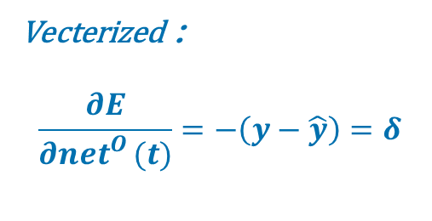
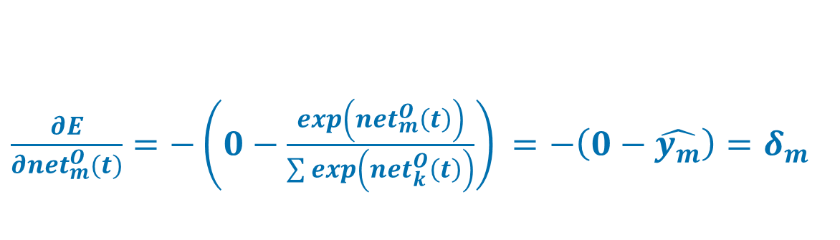
E对${net}_{k}^{O}(t)$求偏导(待修改)
$$\frac{∂E}{∂V}=\frac{∂E}{∂{net}_{1}^{O}}∗\frac{∂{net}_{1}^{O}}{∂V}+\frac{∂E}{∂{net}_{2}^{O}}∗\frac{∂{net}_{2}^{O}}{∂V}+…$$
$$E=−\left({net}_{k}^{O}\left(t\right)−\log{\sum{\exp\left({net}_{k}^{O}\left(t\right)\right)}}\right)$$
Output Layer
k
m
$\frac{∂E}{∂{net}_{m}^{O}(t)}=−\left(0−\frac{exp\left({net}_{m}^{O}\left(t\right)\right)}{\sum{exp\left({net}_{k}^{O}\left(t\right)\right)}}\right)$ $=−\left(0−\hat{y_{m}}\right)=δ_{m}$
Vecterized：
$$\frac{∂E}{∂{net}_{}^{O}(t)}=−\left(y−\hat{y}\right)=δ$$
Notes:
此时，为E有贡献的，不仅有netk （此处，k是具体的标号，不是变量），还有不是k的net，这里，为了不缺乏一般性，定义一个m，还有netm等等，为此需要分别求导

Slide 17
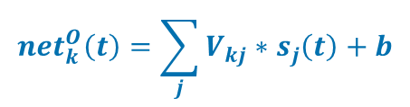
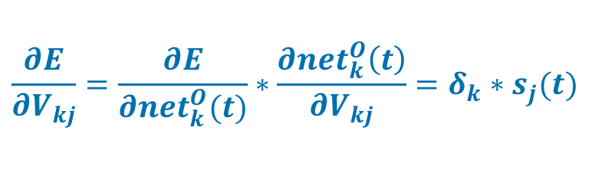

E对V的偏导数
$$\frac{∂E}{∂VV_{}}=\frac{∂E}{∂{net}_{1}^{O}}∗\frac{∂{net}_{2}^{O}}{∂V}+\frac{∂E}{∂{net}_{2}^{O}}∗\frac{∂{net}_{2}^{O}}{∂V}+… V﷯+…$$
$$\frac{∂E}{∂V_{kj}}=\frac{∂E}{∂{net}_{1}^{O}}∗\frac{∂{net}_{1}^{O}}{∂V_{kj}}+\frac{∂E}{∂{net}_{2}^{O}}∗\frac{∂{net}_{2}^{O}}{∂V_{kj}}+…$$
$$y_{k}\left(t\right)=g\left({net}_{k}^{o}\left(t\right)\right)$$
k
m
$${net}_{k}^{O}\left(t\right)=\sum_{j}{V_{kj}∗s_{j}\left(t\right)+b}$$
j
$\frac{∂{net}_{k}^{O}\left(t\right)}{∂V_{kj}}=s_{j}(t)$ $\frac{∂{net}_{m}^{O}\left(t\right)}{∂V_{kj}}=0$
$$\frac{∂E}{∂V_{kj}}=\frac{∂E}{∂{net}_{k}^{O}(t)}∗\frac{∂{net}_{k}^{O}\left(t\right)}{∂V_{kj}}=δ_{k}∗s_{j}(t)$$
$$\frac{∂E}{∂V}=\left(\hat{y}−y\right)∗s^{T}(t)$$
Notes:
E是有多个neto组成的，而每个neto都含有多个不同的Vkj，而且，每个neto之间的Vkj都是不同的。
所以在求E对Vkj的偏导数时，只需要考虑一个netk，然后对netk求Vkj的偏导数
注意：此时，x是常数，s(t)也是常数，V是变量

Slide 18
E对W求偏导

