Slide 1



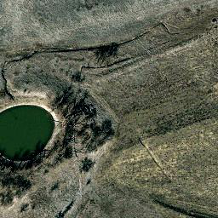



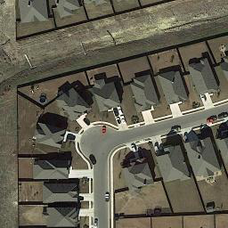
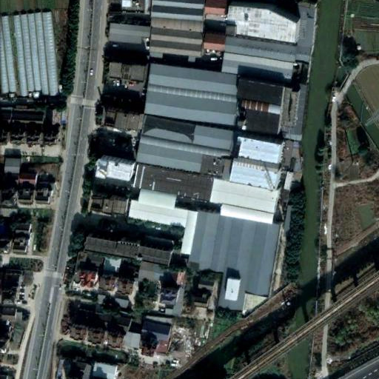
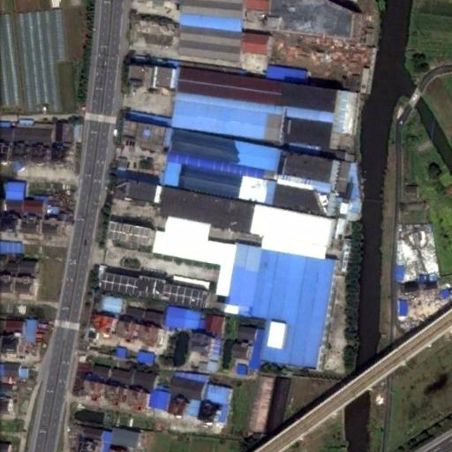
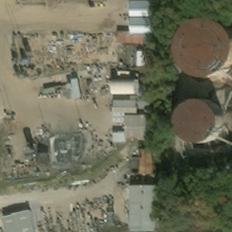
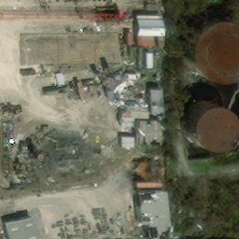
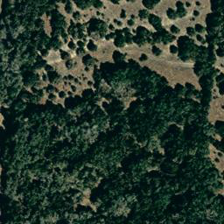
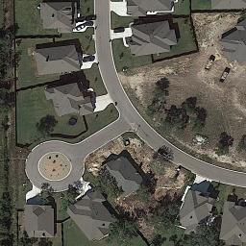
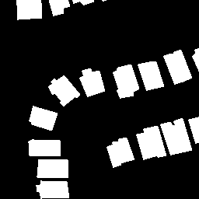


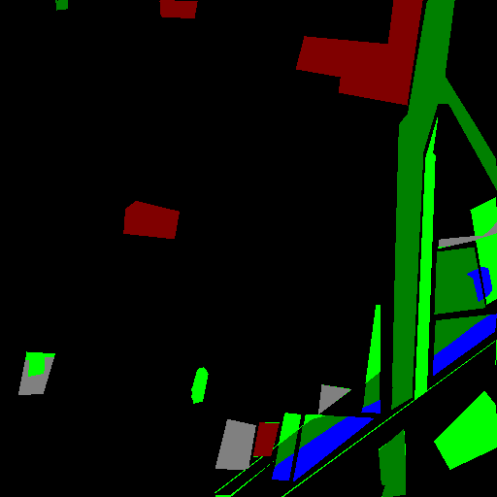
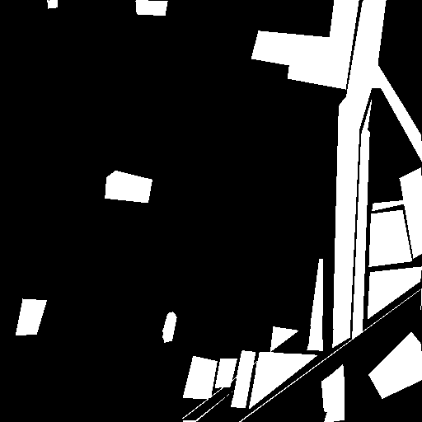
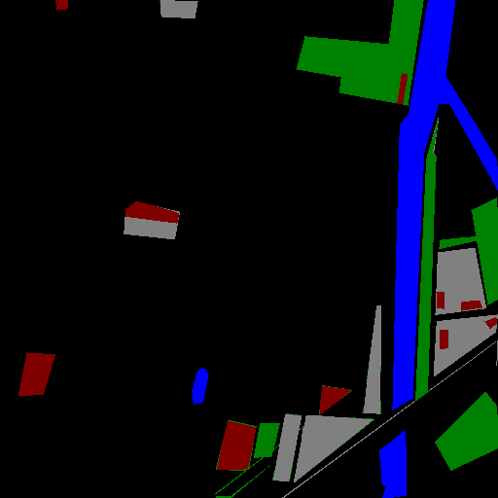
(a) Spatiotemporal Feature Extraction
Five-frame input
Video encoder
Multi-scale features
16 × 16 learnable grids
State-guided difference modulation
F_{pre}
Upsampling
Pre-change
Stem
Stage 1
Stage 2
Stage 3
F_{chg}
Perception Frames
C = 24
C = 24
C = 48
C = 96
Change
Feature update
Feature update
Feature update
Feature update
F_{post}
Post-change
I₁
P_{pre}
P_{chg}
P_{post}
I₂
Four-scale outputs
4 scales per role
(b) Task-Specific Decoders
Binary Change Detection
Semantic Change Detection
Building Damage Assessment
Change Captioning
I₁
I₂
I₁
I₂
I₁
I₂
I₁
I₂
F_{chg} + final-scale fusion
F_{pre}
F_{chg}
F_{post}
F_{pre}
Fusion
Final-scale F_{pre}, F_{chg}, F_{post}
of F_{pre}, F_{chg}, F_{post}
F_{pre}, F_{chg}, F_{post}
Pooling + 128-d projection
Change Decoder
Semantic
Decoder
Change
Decoder
Semantic
Decoder
Localization
Decoder
Damage
Decoder
Caption Decoder
Mask
Mask
Trees are removed and an arc
road is built with some
buildings around.
Binary change map
Semantic (T₁)
Change
Semantic (T₂)
Localization
Damage classes
Change caption
Notes:
Overall architecture. Sources: LEVIR-CD test_120, SECOND 00343, xBD hurricane-michael_00000113, LEVIR-CC test_000004. Image and label assets are from the corresponding datasets. Three learnable 16×16 grids are upsampled to input resolution. The core consists of a stem and three X3D stages, each followed by feature updates. Four task configurations are trained separately. BCD uses final-scale three-role fusion. SCD uses three decoders and change masking. BDA uses pre-change features for localization and four-scale fusion for damage. CC uses highest-scale features, average pooling, 128-dimensional projection and a one-layer caption decoder. Full source information is retained in the adjacent assets manifest. Perception-frame textures visualize the actual learned perception_grids of the SECOND conditional_multiplicative checkpoint at epoch 59. A common min-max transform over all three roles and all RGB channels is used. The small grids use nearest-neighbor display and the larger frames use model-matching bilinear interpolation. Native PowerPoint shapes provide thickness, outlines and editable geometry. Matching role names and colors identify the feature connections between panels (a) and (b). Long inter-panel wiring is omitted for clarity. All four encoder scales are collected before the three role-feature groups.

