Slide 1
Chapter 9 Relations 关系
9.1 Relations and Their Properties 关系及其性质
9.2 n-ary Relations and Their Application n元关系及其应用
9.3 Representing Relations关系的表示
9.4 Closures of Relations 关系的闭包
9.5 Equivalence Relations 等价关系
9.6 Partial Orderings 偏序

Slide 2





9.1 Relations and Their Properties关系及其性质
【Definition】A binary relation R from a set A to a set B is a subset of A×B. 设A、B为任意两个集合，称笛卡儿积A×B的子集R为集合A到B的一个二元关系。若(x,y)∈R，则称x与y有关系R，记为 xRy
Note:
  A binary relation R is a set. 关系R是一个集合
  R ⊆ A×B 关系R的范围
〖Example 1〗
(1) Let A and B be sets,
(2)
(3) Let R be the set of real numbers,

Slide 3



9.1 Relations and Their Properties
Function As Relation 函数作为关系
A function f from a set A to a set B is a relation form A to B.
〖Example 2〗
Suppose that .
f: A→B, f(1)=f(3)=1, f(2)=f(4)=0
Conversely, if R is a relation from A to B, is it a function?
〖Example 3〗

Slide 4
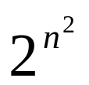
9.1 Relations and Their Properties
Relations On A Set 集合A上的关系
【Definition】A relation on the set A is a relation form A to A.
定义：集合A的关系是从A到A的关系
  Note: 特别，若关系定义中的A=B，则称R为集合A上的二元关系
  R ⊆ A×A
〖Example 4〗
Let
(2) Suppose that S is a set.
Question:
How many binary relations are there on a set A with n elements? n元素集合有多少个关系？

Slide 5
9.1 Relations and Their Properties
Representing Relations关系的表示
The methods of representing relation:
    list its all ordered pairs
    using a set build notation/specification by predicates
    2D table二维表格
    Connection matrix /zero-one matrix
    Directed graph/Digraph

Slide 6

9.1 Relations and Their Properties
〖Example 5〗
 | 2 | 3 | 4 | 5 | 6
2 | × |  | × |  | ×
3 |  | × |  |  | ×
4 |  |  | ×

Slide 7


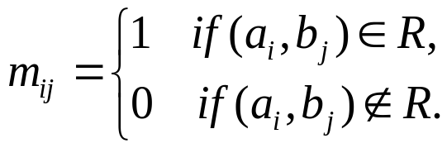
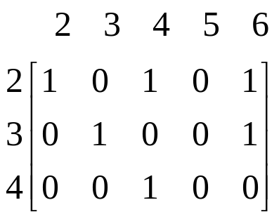
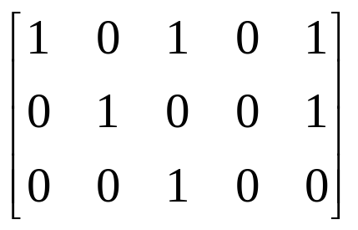
9.1 Relations and Their Properties
Connection Matrices 关系矩阵
【Definition】Let R be a relation from
An connection matrix for R is defined by
For example,

Slide 8
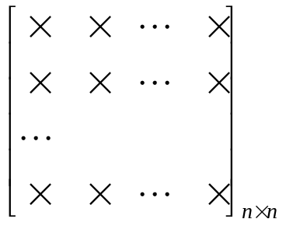
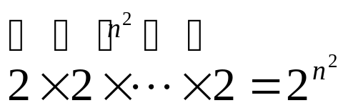
9.1 Relations and Their Properties
Question:
How many binary relations are there on a set A with n elements?
0,1
By the product rule,

Slide 9
9.1 Relations and Their Properties
Directed graph/Digraph 有向图
【Definition】A directed graph or a digraph, consists of a set V of vertices together with a set E of ordered pairs of elements of V called edges(or arcs)。 The vertices a,b is called the initial and terminal vertices of the edge (a,b).
定义：一个有向图由顶点（或结点）集V和边（或弧）集E组成，其中边集是V中元素的有序对的集合。顶点a叫做边（a,b)的始点，而顶点b叫做这条边的终点
2
For example,
2
3
4
3
5
4
6

Slide 10
9.1 Relations and Their Properties
〖Example 6〗A = {0, 1, 2,3}
0
1
3
2
R = {(0,0), (0,3), (2,0),(2,1),(2,3),(3,2)}.

Slide 11
9.1 Relations and Their Properties
Properties of Relations 关系的性质
    Reflexive 自反的
    Irreflexive 反自反的
    Symmetric 对称的
    Antisymmetric 反对称的
    Transitive 传递的

Slide 12
9.1 Relations and Their Properties
Properties of Relations
    Reflexive自反的
    Irreflexive
    Symmetric
    Antisymmetric
    Transitive

Slide 13


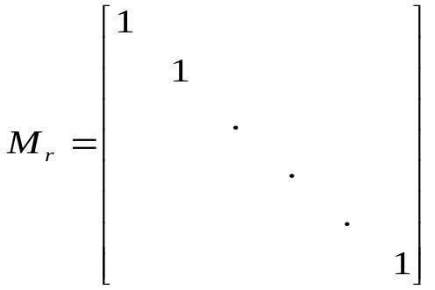
9.1 Relations and Their Properties
【Definition】A relation R on a set A is reflexive if
  若对每个x∈A，均有xRx,则称R为自反的
  Questions:
  (1) What do we know about matrices representing reflexive relations?
All the elements on the main diagonal of must
be 1s. 关系矩阵主对角线的所有元素都等于1

Slide 14
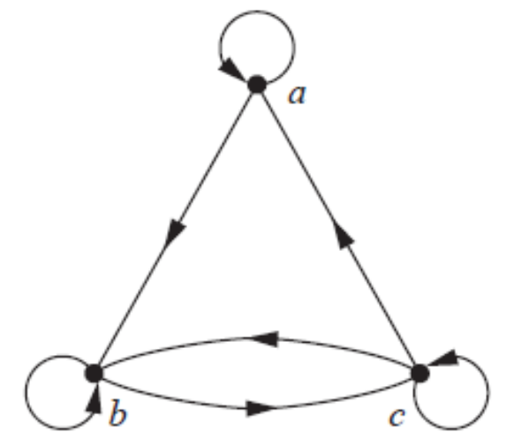
9.1 Relations and Their Properties
  (2) What do we know about digraphs representing reflexive relations?
  There is a loop at every vertex of the directed graph.对于有向图上的每个顶点都有个环

Slide 15
9.1 Relations and Their Properties
Properties of Relations
    Reflexive
    Irreflexive 反自反的
    Symmetric
    Antisymmetric
    Transitive

Slide 16


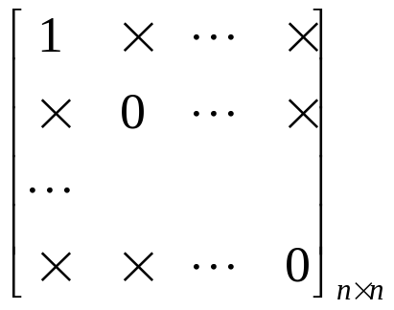
9.1 Relations and Their Properties
【Definition】A relation R on a set A is irreflexive if
  若对每个x∈A，均有x x,则称R为反自反的
  Questions:
  The connection matrix of a irreflexive relations?
  Digraph?
  Can a relation on a set be neither reflexive nor irreflexive? 有没有既不是自反的也不是反自反的关系？
  Yes.

Slide 17
9.1 Relations and Their Properties
Properties of Relations
    Reflexive
    Irreflexive
    Symmetric 对称的
    Antisymmetric
    Transitive

Slide 18

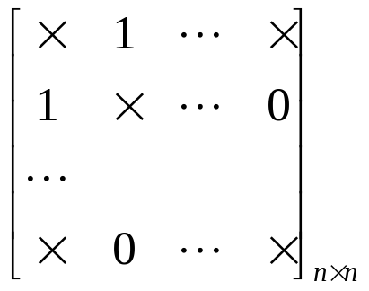
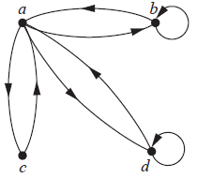
9.1 Relations and Their Properties
【Definition】A relation R on a set A is symmetric if
  对任意x,y∈A，若xRy,则yRx,就称R是对称的
  Questions:
  The connection matrix of a symmetric relations?
  Digraph?
  If there is an arc (x, y) there must be an arc (y, x).

Slide 19
9.1 Relations and Their Properties
Properties of Relations
    Reflexive
    Irreflexive
    Symmetric
    Antisymmetric 反对称的
    Transitive

Slide 20
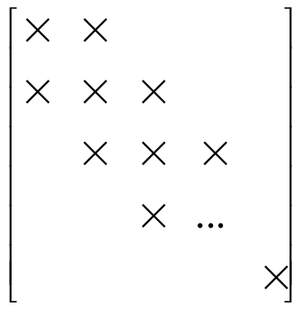
9.1 Relations and Their Properties
【Definition】A relation R on a set A is antisymmetric if
  对任意x,y∈A，若xRy且yRx，则x=y，就称R是反对称的
  Note:
  (1)
  (2) 当 i≠j 时，m_{ij}=0 或 m_{ji}=0
1
0
0
1

Slide 21
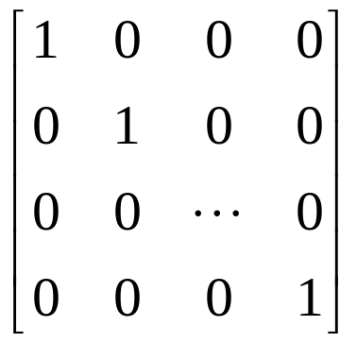
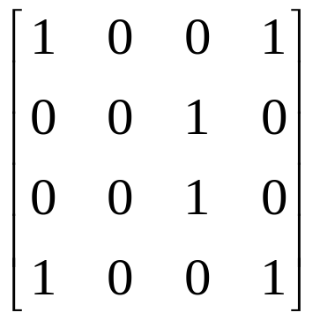
9.1 Relations and Their Properties
  (3) If there is an arc from x to y there cannot be one from y to x if x≠ y. 如果x≠ y，若有一条从x到y的弧，那么不存在从y到x的弧。
  (4) The symmetric and antisymmetric relations are not opposites, because a relation can have both of these properties or may lack both of them (see Exercise 10). 对称的与反对称的关系不是对立的，可以同时具有两种性质或同时不具有两种性质，或只具有其中一种性质。
  For example,

Slide 22
9.1 Relations and Their Properties
Properties of Relations
    Reflexive
    Irreflexive
    Symmetric
    Antisymmetric
    Transitive 传递的

Slide 23
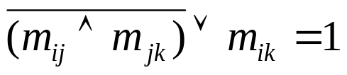
9.1 Relations and Their Properties
【Definition】A relation R on a set A is transitive if whenever
  定义：如果对于x,y,z ∈A （x,y) ∈R并且(y,z) ∈R则(x,z) ∈R,那么集合A上的关系R叫做传递的
  Note:
  (1)
  Why?
  (2) If there is an arc from x to y and one from y to z then there must be one from x to z. (completing a triangle where each side is a directed edge with the correct direction)

Slide 24
9.1 Relations and Their Properties
〖Example 7〗Determine whether the following relations are reflexive, irreflexive, symmetric, antisymmetric and/or transitive.
判断下列关系是否是 自反的，反自反的，对称的，反对称的，或是传递的？
  (1)
reflexive, symmetric, antisymmetric, transitive
自反的，对称的，反对称的，传递的

Slide 25
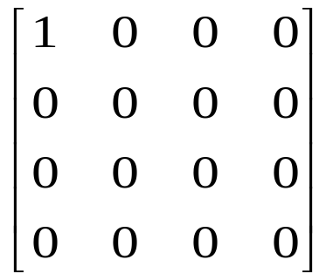
a
  (2)
b
d
c
not reflexive, symmetric, antisymmetric, transitive
不是自反的、对称的、反对称的、传递的

Slide 26

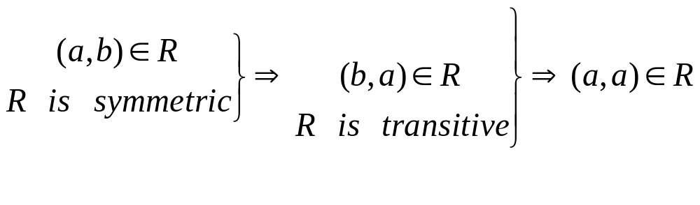
9.1 Relations and Their Properties
  (3)
reflexive, antisymmetric, transitive
自反的、反对称的、传递的
  (4)
reflexive, symmetric, transitive
自反的、对称的、传递的
  Question:
  Symmetric, transitive ⇒ reflexive ?

Slide 27
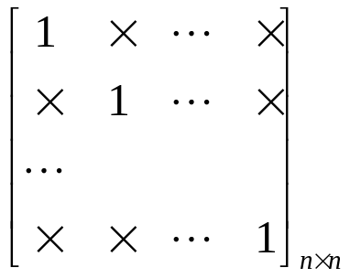
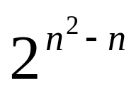
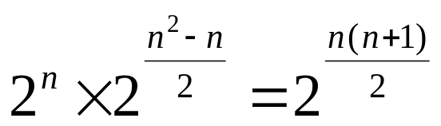
9.1 Relations and Their Properties
〖Example 8〗How many relations are there on a set with n
elements that are
(1) reflexive ? 自反的？
  (2) symmetric ? 对称的？
  (3) antisymmetric ? 反对称的？
Solution:
(1)
0,1
(2)

Slide 28
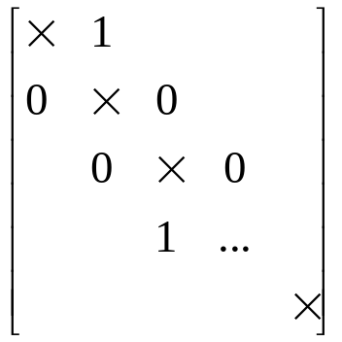
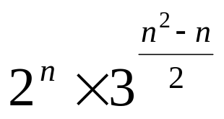
9.1 Relations and Their Properties
Solution:
(3)
Questions:
  reflexive and symmetric?自反的和对称的？
  transitive?传递的？

Slide 29
9.1 Relations and Their Properties
Combining Relations 关系组合
Since relations form A to B are subsets of A×B, two relations form A to B can be combined in any way two sets can be combined. 因为从A到B的关系是A×B的子集，可以按照两个集合组合的任何方式来组合两个从A到B的关系。
    Set operation 集合运算
    Composition 合成
    Inverse relation 关系的逆

Slide 30
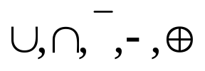




9.1 Relations and Their Properties
1
〖Example 9〗 Let is the set of integers,
what are the relations ?
Solution:
(1) Set operations
Boolean operations/logical operations 布尔运算/逻辑运算
The Boolean Sum
The Boolean product
The complement

Slide 31




9.1 Relations and Their Properties
The logical operations of matrices： 关系矩阵的逻辑运算
Let , the set
operations of two relations are defined by

Slide 32

9.1 Relations and Their Properties
2 Composition 关系的合成
The composite of R and S:
Question:
How to compute SoR?
    (1) Using the definition directly 用定义
    (2) Using the connection matrix 用关系矩阵

Slide 33
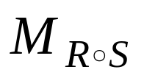
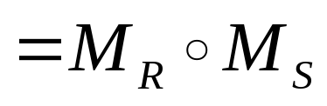
有限集之间的关系，可利用关系矩阵计算复合关系

Slide 34




9.1 Relations and Their Properties
〖Example 10〗
Solution:
(1) Using the definition directly
Note:

Slide 35

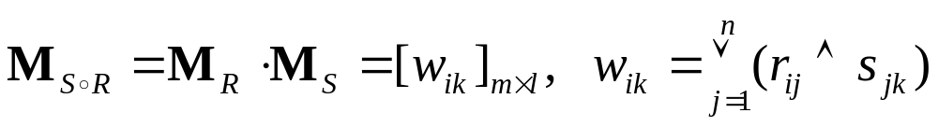
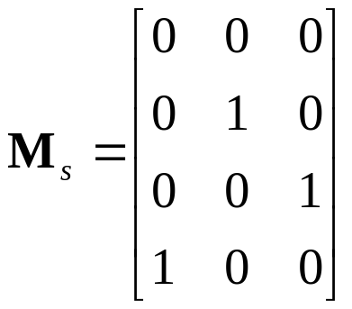
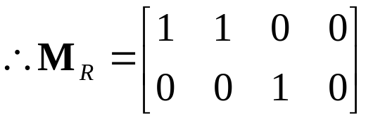
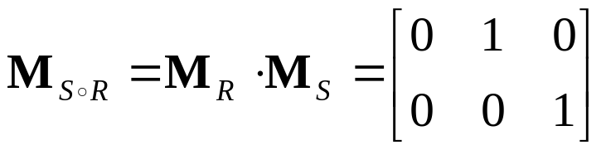

9.1 Relations and Their Properties
Solution:
(2) Using the connection matrix 使用关系矩阵

Slide 36




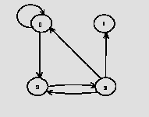
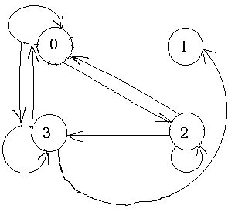
9.1 Relations and Their Properties
【Definition】Let R be a relation on the set A. The powers
,are defined inductively by
设R是集合A上的关系。幂 递归地定义为
〖Example 11〗Let A={0,1,2,3}. R is the relation on the set A.
R ={(0,0),(0,3),(2,3),(3,2),(2,1),(2,0)}. R²=?
Solution:
  Using the definition
    R²={(0,0),(0,3),(0,2),(2,2),(3,3),(2,3),(2,0),(3,1),(3,0)}
  Using the digraph

Slide 37

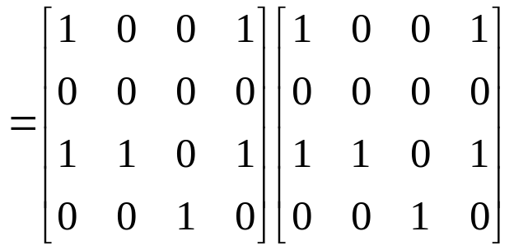
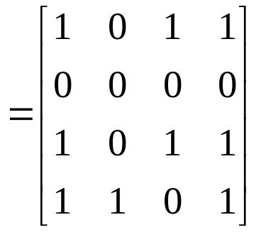
9.1 Relations and Their Properties
Using the matrix

Slide 38











9.1 Relations and Their Properties
【 Theorem 】 The relation R on a set A is transitive if and
only if 集合A上的关系R是传递的，当
且仅当对n=1，2，3…有
Proof:
(1)
⇒ R is transitive
(2) R is transitive ⇒
Inductive base
Inductive step
R is transitive

Slide 39






9.1 Relations and Their Properties
〖Example 12〗 Let R be a symmetric relation on the set A.
Show that R^{n} is symmetric for all positive integers n. 假设集
合A上的关系R是对称的，证明对于所有正整数n对于 都
是对称的
Proof:
Inductive base
n=1, R be a symmetric 对称的
Inductive step
R^{n} is symmetric ⇒ R^{n+1} is symmetric

Slide 40






9.1 Relations and Their Properties
3 Inverse relation 关系的逆
The inverse relation form B to A:
Question:
How to get ?
  Using the definition directly
  For example,
(2) Reverse all the arcs in the digraph representation of R
(3) Take the transpose M_{R} ^{T} of the connection matrix M_{R} of R.

Slide 41






9.1 Relations and Their Properties
4 The properties of relation operations 关系运算的性质
Suppose that R, S are the relations from A to B, T is the relation from B to C, P is the relation from C to D, then
(1)
Proof:

Slide 42







9.1 Relations and Their Properties
4 The properties of relation operations
Suppose that R, S are the relations from A to B, T is the relation from B to C, P is the relation from C to D, then
(1)
Proof:
(2)
(3)
(4)
(5)

Slide 43




9.1 Relations and Their Properties
4 The properties of relation operations
Suppose that R, S are the relations from A to B, T is the relation from B to C, P is the relation from C to D, then
(1)
(2)
(3)
(4)
(5)
关系的复合运算不满足交换律
(6)
(7)
(8)
(9)

Slide 44

定理２ 设R是A上的关系，
（１） R^{m} ◦ R^{n}= R^{m+n}
（２） ( R^{m} )^{n} = R^{mn}, m，n∈N
（３） <x，y>∈R^{m}（m≥２）当且仅当存在 使
<x，x₁>∈R，< x₁，x₂>∈R，…，< x_{m-1}，y>∈R

Slide 45
Homework
9.1节作业： 3(a,b,c)，32, 55
9.3节作业： 14 (a,b,c)，32

Slide 46
Chapter 9 Relations 关系
9.1 Relations and Their Properties 关系及其性质
9.2 n-ary Relations and Their Application n元关系及其应用
9.3 Representing Relations关系的表示
9.4 Closures of Relations 关系的闭包
9.5 Equivalence Relations 等价关系
9.6 Partial Orderings 偏序

Slide 47


9.2 n-ary Relations and Their Application n元关系及其应用
【Definition】 Let be sets. An n-ary Relation on
these sets is a subset of
The domains of relation
degree

Slide 48
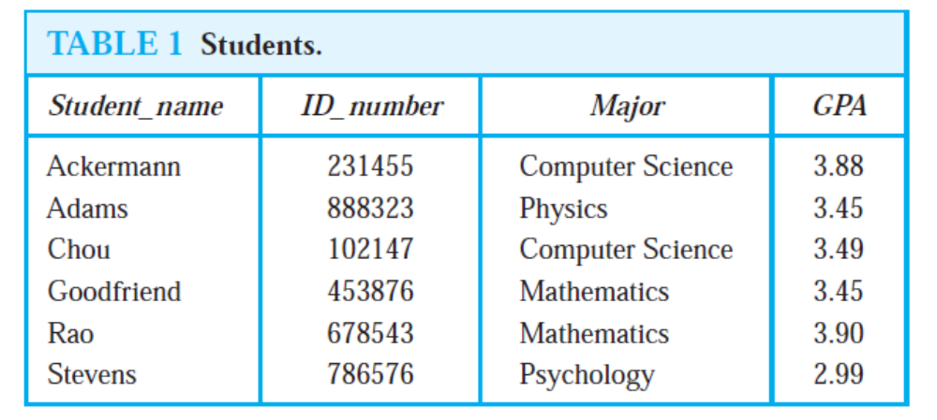

Slide 49
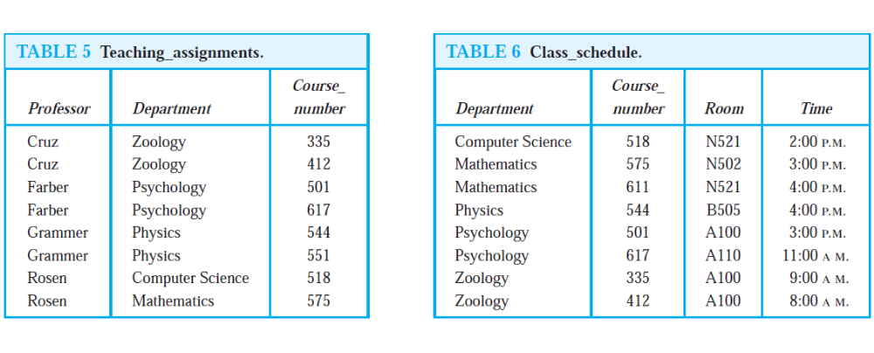

Slide 50
Chapter 9 Relations 关系
9.1 Relations and Their Properties 关系及其性质
9.2 n-ary Relations and Their Application n元关系及其应用
9.3 Representing Relations关系的表示
9.4 Closures of Relations 关系的闭包
9.5 Equivalence Relations 等价关系
9.6 Partial Orderings 偏序

Slide 51
9.4 Closures of Relations 关系的闭包
Reflexive Closure 自反闭包
Symmetric Closure 对称闭包
Transitive Closure 传递闭包
【Definition】The closure of a relation R with respect to
property P is the relation S with property P containing R
such that S is a subset of every relation with property P
containing R. R关于性质P的闭包，是包含R的具有性质P的关系S ，并且S是每个包含R的具有性质P的关系的子集。
The smallest relation with property P containing R

Slide 52



关系的闭包
定义１ 设R是A上的关系，如果A上的关系R′满足如下条件：
（１） R′是传递的（或自反的、对称的）
（２）
（３） 若S是传递的（或自反的、对称的）且 ，则必有 ．
则称R′是R的传递闭包（自反闭包、对称闭包）记为t(R)（或r(R)，s (R)）．

Slide 53



9.4 Closures of Relations
Reflexive Closure自反闭包
【 Theorem 】 Let R be a relation on A. The reflexive closure
of R, denoted by r(R), is
The diagonal relation（对角关系） on A
Proof:
① containing R 包含R
② is a reflexive relation 是自反关系
③ is the smallest reflexive relation which contains R
Suppose that R’ is a reflexive relation containing R, then

Slide 54



9.4 Closures of Relations
【 Corollary 】 ⇔ R is a reflexive relation
R是自反关系.
Proof:
① The reflexive closure is a reflexive relation 自反闭包是自反关系
② Since R is a reflexive relation,

Slide 55

9.4 Closures of Relations
Question:
Given R, how to obtain its reflexive closure?
给定关系R，怎样获得自反闭包？
  Add to R all ordered pairs of the form (a,a) with a∈A, not already in R 在关系R中添加未在R中的形如 (a,a) 的有序偶，a∈A
  Add loops to all vertices on the digraph representation of R.在表示关系R的图中的每个顶点加上环路
  Put 1’s on the diagonal of the connection matrix of R.将1添加到关系矩阵中的 主对角线上

Slide 56



9.4 Closures of Relations
〖Example 1〗 , What is r(R)?
  Solution:

Slide 57

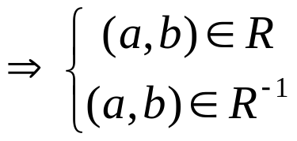




9.4 Closures of Relations
Symmetric Closure 对称闭包
【 Theorem 】 Let R be a relation on A. The symmetric closure
of R, denoted by s(R ), is
Proof:
① containing R
② is a symmetric relation 对称关系

Slide 58

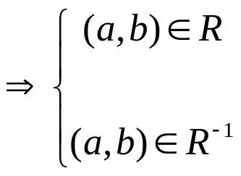
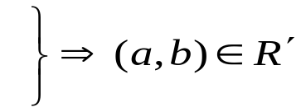








9.4 Closures of Relations
③ is the smallest symmetric relation which containing R
Suppose that R’ is a symmetric relation containing R, then

Slide 59

9.4 Closures of Relations
〖Example 2〗 What is s(R) of the following relation?
a
b
d
c
  Note:
  Add an edge from x to y whenever this edge is not already in directed graph but the edge from y to x is.
  Add all ordered pairs of the form (b,a) where (a,b) is in the relation, that are not already in R.

Slide 60




9.4 Closures of Relations
【Corollary】 ⇔ R is a symmetric relation .
R是对称关系
Proof:
① The symmetric closure is a symmetric relation
② Since R is a symmetric relation, it follows that

Slide 61



9.4 Closures of Relations
Transitive Closure传递闭包
Recall:
  The transitive closure of a relation R, t(R), is the smallest transitive relation containing R（R的传递闭包是包含R的最小的具有传递性的关系）.
  How can we construct t(R)?
    Can t(R) be produced by adding all the pairs of the form (a, c) where (a, b) and (b, c) are already in the relation?
〖Example 3〗 Suppose that be a relation on the set
    t(R)=?
  How to compute?

Slide 62
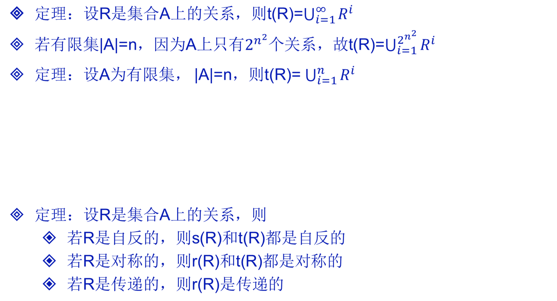
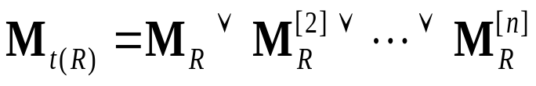
【Corollary】 Let be the zero-one matrix of the
relation R on a set with n elements. The zero-one matrix
of the transitive closure is 设 是n元素集合上的关系R
的0-1矩阵，那么传递闭包的0-1矩阵是

Slide 63
9.4 Closures of Relations
Terminology:术语
A path of length n （长为n的路径）in a digraph G :
A sequence of edges (x₀, x₁),(x₁, x₂),. . . ,(x_{n-1}, x_{n})
Notation: x₀, x₁, x₂,. . . , x_{n-1}, x_{n}.
Cycle or circuit （回路或圈）: If x₀ = x_{n}
For example,
a
b
d
c

Slide 64
9.4 Closures of Relations
The term path also applies to relation.
Why?
  Relation ↔ digraph
How?
  There is a path of length n from a to b in R
a, x₁, x₂,. . . , x_{n-1}, b such that (a, x₁)∈ R, (x₁, x₂)∈ R, …,( x_{n-1}, b)∈ R
如果存在一个元素序列
那么在R中存在一条从a到b的路径

Slide 65





9.4 Closures of Relations
【 Theorem 1 】 Let R be a relation on A. There is a path of
length n from a to b if and only if . 设R是集合A上
的关系，从a到b存在一条长为n的路径，当且仅当 .
Proof:
① Inductive basis 基础步骤
An edge from a to b is a path of length 1 which is in R¹ = R. Hence the assertion is true for n = 1.
Inductive step 归纳步骤
There is a path of length n+1 from a to b if and only if there is an x in A such that there is a path of length 1 from a to x and a path of length n from x to b.
From the Induction Hypothesis,

Slide 66
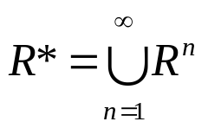
9.4 Closures of Relations
【Definition】 The connectivity relation（连通关系） denoted by R*, is the set of ordered pairs (a, b) such that there is a path (in R) of length at least one from a to b:
设R是集合A上的关系。连通性关系R*, 由对(a,b)构成，使得在R中从顶点a到b之间存在一条至少长为1的路径。
〖Example 3〗 Let A = the set of people, R = {(x, y) | person x
is a parent of person y}. R* = ?

Slide 67


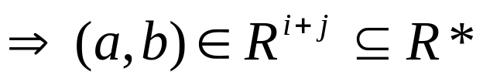
9.4 Closures of Relations
【 Theorem 2】 t(R) = R*. 关系R的传递闭包等于连通性关系R*.
Proof:
① R* contains R
is a transitive relation 证明具有传递性
Suppose (a, c) and (c, b) are in R*. Show that (a, b) is in R*.
By the definition of R*,

Slide 68


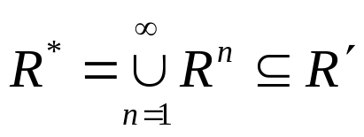
9.4 Closures of Relations
③ is the smallest transitive relation which contains R
Now suppose that R’ is any transitive relation which contains R.
We must show R′ contains R* to show R* is the smallest relation.
In fact, we need only consider paths of length n or less.

Slide 69
9.4 Closures of Relations
【 Theorem 】 If |A | = n, then any path of length > n must
contain a cycle. 对于有n个顶点的路径，如果存在一个
长度大于n的路径，那么该路径必存在环。
Proof:
If we write down a list of more than n vertices representing a path in R, some vertex must appear at least twice in the list (by the Pigeon Hole Principle).

Slide 70
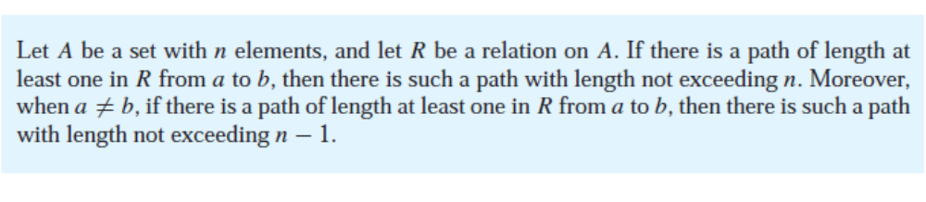
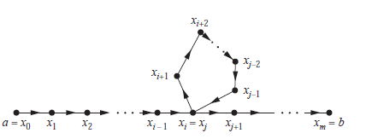
9.4 Closures of Relations

Slide 71




9.4 Closures of Relations
【Theorem】 If , R is a relation on A, then
【Corollary】 If , then
【Corollary】 Let be the zero-one matrix of the
relation R on a set with n elements. The zero-one matrix
of the transitive closure is 设 是n元素集合上的关系R
的0-1矩阵，那么传递闭包的0-1矩阵是

Slide 72
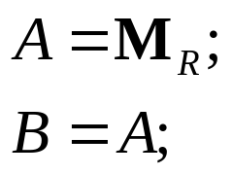
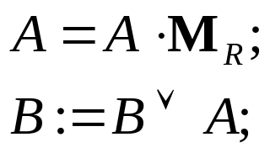
9.4 Closures of Relations
A Procedure for computing t(R)
for (i=2; i<=n; i++)
{
}
The complexity of algorithm:

Slide 73



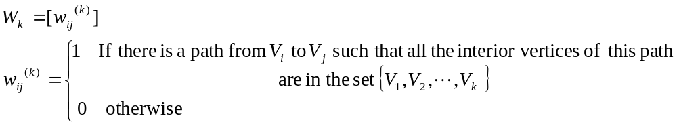

9.4 Closures of Relations
Warshall’s Algorithm 沃舍尔算法
The interior vertices of a path:
Warshall’s algorithm is based on the construction of a sequence of zero-one matrices, such as 沃舍尔算法
的基础是构造一系列0-1矩阵

Slide 74
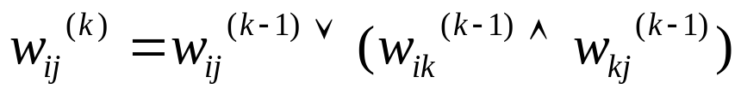
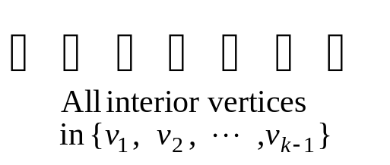

9.4 Closures of Relations
Case 1
V_{i}
V_{j}
V_{k}
Case 2
V_{i}
V_{j}

Slide 75





9.4 Closures of Relations
Warshall’s Algorithm
for (k=1; k <=n; k ++)
{
for (i=1; i <=n; i ++)
{
for (j=1; j <=n; j ++)
}
}
if ( )
{
for (j=1; j <=n; j ++)
}
The complexity of algorithm:

Slide 76






9.4 Closures of Relations
〖Example 3〗 Let
Solution:

Slide 77
Homework
9.4节作业： 2, 3, 29

