Slide 1
Chapter 9 Relations
9.1 Relations and Their Properties
9.2 n-ary Relations and Their Application
9.3 Representing Relations
9.4 Closures of Relations
9.5 Equivalence Relations 等价关系
9.6 Partial Orderings

Slide 2
9.5 Equivalence Relations
Equivalence relations (等价关系)and equivalence classes （等价类）
【Definition】A relation R on a set A is an equivalence relation if R is（等价关系满足三个条件）
        Reflexive自反的
        Symmetric对称的
        transitive 传递的
For example,
(2) The similarity relation between two triangles
(3) The equivalent relation between two formulas in proposition logic

Slide 3


9.5 Equivalence Relations
Terminologies:术语
a and b are equivalent a和b是等价的，记为 a⁓b
R is an equivalence relation, and (a , b)∈ R
the equivalence class of x, x的等价类
The set of all elements that are related to an element x of A
或者：设R为集合A上的等价关系，对每个x∈A，作集合
Notation:
a representative of the equivalence class 等价类的表示

Slide 4
定义2 设R是A上的等价关系，a∈A. 一切与a等价的元素构成的A的子集，叫做a的R-等价类，记为[a]_{R}，或［a］，
[a]_{R}＝｛x | x∈A，xRa｝
a称为[a]_{R}的代表元．

Slide 5
定义3 设R是A上的等价关系，R的所有等价类构成的集合，称为A对R的商集，记为A/R，即
A / R＝｛［a］ | a∈A｝．

Slide 6









9.5 Equivalence Relations
〖Example 1〗 Congruence Modulo 3 模3同余
Show that R is an equivalence relation. And find its equivalence
class. 证明它R是等价关系并且找出他的等价类
Solution:
reflexive 自反的
R is reflexive, since
 symmetric 对称的
 transitive 传递的

Slide 7
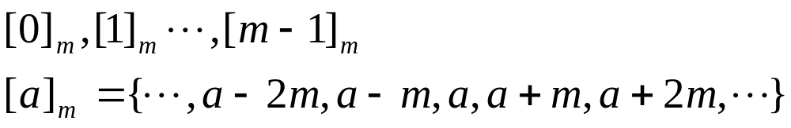
9.5 Equivalence Relations
[0]={…, -6, -3, 0, 3, 6, …}={ 3k | k ∈ Z }
[1]={…, -5, -2, 1, 4, 7, …}={ 3k+1 | k ∈ Z }
[2]={…, -4, -1, 2, 5, 8, …}={ 3k+2 | k ∈ Z }
Congruence Modulo m : 即 m|(a‒b)，a和b模m同余
Congruence class Modulo m :

Slide 8






9.5 Equivalence Relations
The operations of equivalence relations
【 Theorem 】 If are equivalence relations on A, then
is equivalence relations on A.如果 是A上的等价
关系，那么 也是A上的等价关系
Proof:
It suffices to show that the intersection of
  reflexive relations is reflexive,自反证明
  symmetric relations is symmetric,
and
  transitive relations is transitive.

Slide 9




9.5 Equivalence Relations
The operations of equivalence relations
【 Theorem 】 If are equivalence relations on A, then
is equivalence relations on A.
Proof:
It suffices to show that the intersection of
  reflexive relations is reflexive,
  symmetric relations is symmetric,对称证明
and
  transitive relations is transitive.

Slide 10




9.5 Equivalence Relations
The operations of equivalence relations
【 Theorem 】 If are equivalence relations on A, then
is equivalence relations on A.
Proof:
It suffices to show that the intersection of
  reflexive relations is reflexive,
  symmetric relations is symmetric,
and
  transitive relations is transitive. 传递证明

Slide 11






9.5 Equivalence Relations
【 Theorem 】 If are equivalence relations on A, then
is reflexive and symmetric relation on A. 如果 是A
上的等价关系，那么 在A上具有自反的和对称的关系
Proof:
(1) reflexive 证明自反的
(2) Symmetric证明对称的
Question: transitive?

Slide 12
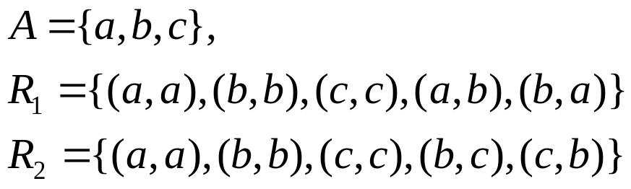

9.5 Equivalence Relations
〖Example 4〗
Is a transitive relation ?
Solution:

Slide 13


9.5 Equivalence Relations
【 Theorem 】 If are equivalence relations on A, then
is an equivalence relation on A. 如果 是A的等价
关系，那么 是A上的等价关系
Proof:
(1) reflexive自反的
(2) symmetric对称的
(3) transitive传递的

Slide 14
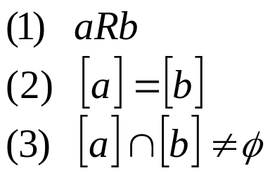




9.5 Equivalence Relations
【 Theorem 】 Let R be an equivalence relation on a set A.
The following statements are equivalent：设R是集合A上
的等价关系，下面
命题是等价的
Proof:
Show that (1) implies (2)

Slide 15






9.5 Equivalence Relations
Show that (2) implies (3)
R is reflexive ⇒ [a] is nonempty
Show that (3) implies (1)

Slide 16

定义２ 设A是一个集合，C＝｛C_{i} | i∈J｝是一个集合族，C_{i}≠∅（i∈J）．如果
＝A，
则称C是A的一个覆盖;
若还有C_{i}∩C_{j}＝∅ （i≠j），则称C是A的一个划分，C_{i}称为划分块．

Slide 17






9.5 Equivalence Relations
Equivalence relations and partitions（划分）
【Definition】Let be a collection of subsets of A. Then the collection forms a partition of A if and only if
集合 构成
集合A的划分
当且仅当
Notation:
A₂
A₁
A₄
A₃
A₅

Slide 18






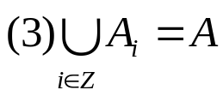

9.5 Equivalence Relations
【 Theorem 】 Let R be an equivalence relation on a set A.
Then the equivalence classes of R form a partition of A.
Conversely, given a partition of the set A, there is
an equivalence relation R that has the sets ,
as its equivalence classes. 设R是集合A上的等价关系。那么R
的等价类构成S的划分。相反，给定集合S的划分
，存在着等价关系R，它以集合 作为它的等价类。
an equivalence relation on a set A ↔ a partition of A
the equivalence class of R :
Proof:

Slide 19


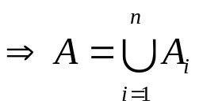










9.5 Equivalence Relations

Slide 20
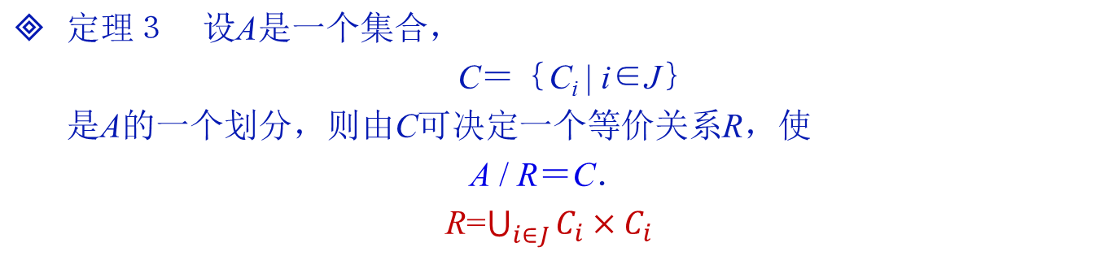
定理２ 设R是集合A的等价关系，则
A / R＝｛［a］| a∈A｝
是A的一个划分．
定理４ 设R₁，R₂为A上的等价关系，则
R₁＝R₂ ⇔ A / R₁＝A / R₂．

Slide 21
9.5 Equivalence Relations
〖Example 3〗 Find the partition of the set A from R.
Solution:
4
[0]={0}
[1]={1,2,3}
[4]={4,5}
pr(A)={ [0], [1], [4]}
1
0
3
2
5

Slide 22
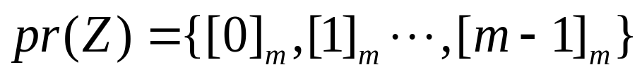
9.5 Equivalence Relations
Question:
Congruence Modulo m 模 m的同余类
Question:
|A|=3. How many different equivalence relations on the set A are there?
Solution:
an equivalence relation on a set A ↔ a partition of A

Slide 23


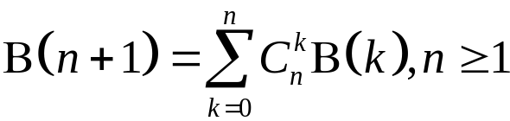

设A＝｛１，２，３，4，5｝，A上共有多少个等价关系？
注 如果用 表示一个具有n个元素的集合上的不同等价关系的个数, 则有下列的递推公式:
其中, 为二项式系数
Notes:
这个数叫Bell数.
可以这样来想，B_{n+1}是含有n+1个元素集合的划分的个数，考虑元素b_{n+1}
假设他被单独划分到一类，那么还剩下n个元素，这种情况下划分个数为C(n,n)B_n；
假设他和某一个元素被划分为一类，那么还剩下n-1个元素，这种情况下划分个数为C(n-1,n)B_{n-1} ；
假设他和某两个元素被划分为一类，那么还剩下n-2个元素，这种情况下划分个数为C(n-2,n)B_{n-2} ；
依次类推，得到了上述组合公式

Slide 24
Homework
P615：1, 15, 48(a,b), 56

Slide 25
Chapter 9 Relations
9.1 Relations and Their Properties
9.2 n-ary Relations and Their Application
9.3 Representing Relations
9.4 Closures of Relations
9.5 Equivalence Relations
9.6 Partial Orderings 偏序关系

Slide 26
9.6 Partial Orderings 偏序
Partial Orderings
【Definition】Let R be a relation on S. Then R is a partial ordering or partial order if R is
        Reflexive自反的
        antisymmetric 反对称的
        transitive 传递的
Notation: (S, R) ---- partially ordered set or a poset 偏序集
〖Example 1〗

Slide 27




9.6 Partial Orderings
Notation:
【Definition】comparable/ incomparable 可比/不可比
The elements a and b of a poset are called comparable if
either . When a and b are elements of S such
that neither , a and b are called incomparable.
偏序集（S，≦）的元素a和b叫做可比的。如果a≦b或b≦a。当a和b是S的元素并且既没有a≦b，也没有b≦a，则称a和b是不可比的
For example,

Slide 28




9.6 Partial Orderings
【Definition】If is a poset and every two elements of S are comparable, S is called a totally ordered（全序） or linearly ordered set, ≤ is called a total order or linear order. In this case is called a chain（链）.
如果 是偏序集，且S的每对元素都是可比的，则S叫作全序集或线序集，且≤叫做全序或线序。一个全序也叫做链。
如果 是全序集，当S的每个非空子集都有一个最小元素时，称为良序集（well-ordered）。
〖Example 2〗
(1) is a poset. In this case either . Hence, ≤ is a total order and is a chain.
(2) is a poset, not a totally ordered set.
(3) is a poset, not a totally ordered set.

Slide 29


9.6 Partial Orderings
Well-ordered Sets 良序集
【Definition】A poset (A, R) is well-ordered set if every nonempty subset of A has a least element.
（偏序集(A, R)，若A的非空子集均有最小元，则称其为良序集 ）
For example,
Note:
A well-ordered set is a totally ordered set.良序集一定是全序集，反之不然。

Slide 30






9.6 Partial Orderings
Lexicographic Order （字典顺序）
The lexicographic order is a special case of an ordering of strings on a set constructed from a partial ordering on the set.
字典顺序是从一个集合上的偏序构造一个集合上的串的序的特殊的情况
Given two posets and , we construct an induced
partial order R on : if
or
This definition of lexicographic order extends naturally to multiple Cartesian products of partially ordered sets.

Slide 31


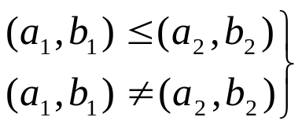
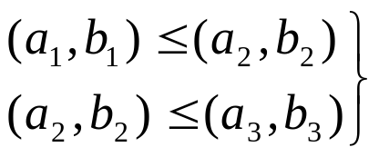

9.6 Partial Orderings
A lexicographic ordering is a partial ordering defined on a
Cartesian product of two posets.
Proof:
reflexive
 antisymmetric
 transitive

Slide 32






9.6 Partial Orderings
〖Example 3〗Let . Then
(2, 4) < (2, 8) since
(2, 4) is not related under R to (2, 6) since
but 4 does not divide 6.
(2, 4) < (4, 5) since
〖Example 4〗 Using the same definitions of as above,
( 2, 3, 4, 5) < ( 2, 3, 8, 2) since and 4 divides 8.
(2, 3, 4, 5) is not related to (3, 6, 8, 10) since 2 does not divide 3.

Slide 33


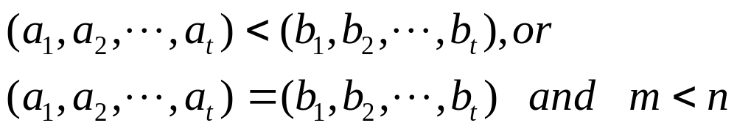

9.6 Partial Orderings
lexicographic order of string
The string is less then if and only if
Where
For example,
Find the lexicographic ordering of the following strings.
discrete discredit discreet discreteness discretion
discredit < discreet < discrete < discreteness < discretion

Slide 34
9.6 Partial Orderings
Hasse Diagrams 哈塞图
Hasse Diagrams
---- A method used to represent a partial ordering
（用来描述偏序关系）
To construct a Hasse diagram（哈塞图的构造）:
1) Construct a digraph representation of the poset (A, R) so that all arcs point up (except the loops). 构造代表偏序关系的有向图
2) Eliminate all loops 去掉所有环
3) Eliminate all arcs that are redundant because of transitivity 由于传递性，除去冗余的边
Eliminate the arrows at the ends of arcs since everything points up. 移走所有有向边上的箭头。

Slide 35
9.6 Partial Orderings
〖Example 5〗
8
4
6
9
2
3
5
7
1

Slide 36
9.6 Partial Orderings
〖Example 5〗
8
4
6
9
2
3
5
7
1

Slide 37
9.6 Partial Orderings
〖Example 5〗
8
4
6
9
2
3
5
7
1

Slide 38
9.6 Partial Orderings
〖Example 5〗
8
4
6
9
2
3
5
7
1

Slide 39
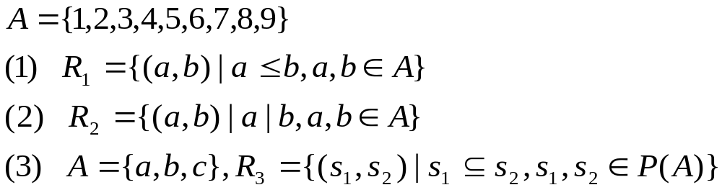
9.6 Partial Orderings
〖Example 6〗
9
8
7
6
5
4
3
2
1

Slide 40
9.6 Partial Orderings
〖Example 6〗
9
8
8
7
6
4
6
9
5
4
2
3
5
7
3
2
1
1

Slide 41
9.6 Partial Orderings
〖Example 6〗
9
8
{a,b,c}
8
7
6
4
6
9
{a,b}
{a,c}
{b,c}
5
4
2
3
5
7
3
{a}
{b}
{c}
2
1
1
φ

Slide 42



9.6 Partial Orderings
chain and antichain
【Definition】 is a poset. ，if is a
totally ordered set，the B is called a chain of .
The length of chain：|B|, B is a definite set，
，if
the B is called a antichain of .

Slide 43
9.6 Partial Orderings
Cover 覆盖
【Definition】 is a poset，如果 x<y，且不存在z使得x<z<y，我们称 y覆盖x（y covers x）.

Slide 44



9.6 Partial Orderings
Maximal and Minimal Elements 极大元和极小元
【Definition】Let be a poset. , then a is a
maximal element if there does not exist an element b in A such
that . a在偏序集 中是极大的，当不存在b∈A使得a＜b。
Similarly for a minimal element.
For example,

Slide 45
9.6 Partial Orderings
9
8
{a,b,c}
8
7
6
4
6
9
{a,b}
{a,c}
{b,c}
Note:
Maximal and minimal elements are the “top” and “bottom” elements in the Hasse diagram.
There can be more than one minimal and maximal element in a poset.
5
4
2
3
5
7
3
{a}
{b}
{c}
2
1
1
φ
(1)
(2)
(3)
      maximal element minimal element
(1) 9 1
(2) 8,6,9,5,7 1
      (3) {a, b, c} φ

Slide 46




9.6 Partial Orderings
Greatest and Least Element 最大元和最小元
【Definition】Let be a poset. Then an element a in A is a greatest element of A if for every b in A, and a is a least element of A if for every b in A. 即a是偏序集 的最大元素，当对所有的b∈A有b≤a。类似，一个元素叫做最小元素，当它小于偏序集的所有其他元素。
For example,

Slide 47
9.6 Partial Orderings
9
8
{a,b,c}
8
7
6
4
6
9
{a,b}
{a,c}
{b,c}
5
4
2
3
5
7
3
{a}
{b}
{c}
2
1
1
φ
(1)
(2)
(3)
      The greatest element The least element
(1) 9 1
(2) / 1
      (3) {a, b, c} φ

Slide 48




9.6 Partial Orderings
【 Theorem 】 The greatest and least element are unique
when they exist. 最大（小）元如果存在，则是唯一的
Proof:
Suppose that a₁ is a greatest element in A. It follows that
for every x in A.
Suppose that a₂ is a greatest element in A. It follows that
for every x in A.
It implies that
That is

Slide 49
定理１ 设〈P，≤〉是一个偏序集，若P中最大（小）元存在，则必唯一．
定理２ 偏序集〈P，≤〉中的最大（小）元，必是唯一极大（小）元．
定理３ 设〈P，≤〉是有限偏序集，若P中存在唯一极大（小）元a，则a必为最大（小）元．

Slide 50

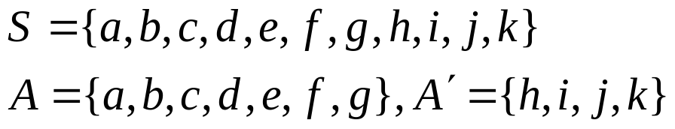
9.6 Partial Orderings
Upper and Lower Bounds 上界和下界
【Definition】Let A be a subset of S in the poset . If
there exists an element a in S such that for all b in A,
then a is called an upper bound of A.
如果a是S的元素使得对所有的元素b∈A，有b≤a,那么a叫做A的一个上界
Similarly for lower bounds.
〖Example 7〗
j
k
the upper bounds of set A：h, i, k, j
the lower bounds of set A：/
the upper bounds of set A’：/
the lower bounds of set A’：f, g, a, b, c, d, e
h
i
g
f
e
b
c
d
a

Slide 51
9.6 Partial Orderings
Least Upper and Greatest Lower Bounds 最小上界与最大下界
【Definition】If a is an upper bound for P which is related to all other upper bounds then it is the least upper bound（最小上界）, denoted by lub(S).
Similarly for the greatest lower bound（最大下界）, glb(S).

Slide 52
定义８ 设〈P，≤〉是偏序集，A ⊆ P，若a是A的上界，且对A的任意上界b，有a≤b，则称a为A的最小上界（上确界），若a是A的下界，且对A的任意下界b，有b≤a，则称a为A的最大下界（下确界）．

Slide 53

9.6 Partial Orderings
〖Example 7〗
Determine the maximal elements, minimal elements, greatest
element, least element of set A, the upper bounds, lower bounds ,
least upper bound , greatest lower bound of set 。
A:
maximal elements: 24,36 minimal elements:2,3
the greatest element: / the least element: /
24
36
12
B₁:
upper bounds: 6,12,24,36 lower bounds: /
The least upper bound: 6 The greatest lower bound:/
6
2
3
B₂:
uper bounds: / lower bounds: 12,6,2,3
The least upper bound: / The greatest lower bound:12

Slide 54
9.6 Partial Orderings
Lattices（格）
【Definition】A poset is called a lattice if every pair of
elements has a lub and a glb. 如果一个偏序集的每对元素都有最小上界和最大下界，就称这个偏序集为格
由定义知，所有的全序都是格，但并非所有的偏序集都是格
〖Example 9〗 Determine whether the following poset is
lattice.
(1)
5
2
4
1
3

Slide 55








9.6 Partial Orderings
(2) ?
lub：the larger of the two elements，
glb：the smaller of the two elements.
Hence, the poset is a lattice.
Note: Every totally ordered set is a lattice.
(3) ?
lub：the least common multiple，
glb：the greatest common divisor
Hence, the poset is a lattice.
(4) ?
, lub： glb：
Hence, the poset is a lattice.

Slide 56

9.6 Partial Orderings
Topological Sorting 拓扑排序
The problem of project schedul:
  Suppose that a project is made up of n different tasks. Some tasks can be completed only after others have been finished. How can an order be found for these tasks? 假设一个项目由20个任务构成。某些任务只能在其他任务结束之后完成。如何找到关于这些任务的顺序？
We impose a total ordering ≤ on a poset compatible with the
partial order if whenever .
如果只要aRb就有a ≤b
(A,R) is a poset. (A,≤) is a total ordering.
If whenever .
The total ordering ≤ is called compatible with the partial ordering R. 则称一个全序≤与偏序R是相容的。

Slide 57
9.6 Partial Orderings
Constructing a compatible total ordering from a partial
ordering is called topological sorting. 从一个偏序构造一个相容的全序叫做拓扑排序
Algorithm: To sort a poset (S, R).
Select a (any) minimal element and put it in the list. Delete it from S.
Continue until all elements appear in the list (and S is void).

Slide 58
9.6 Partial Orderings
〖Example 7〗A project is broken down into seven tasks. A
partial ordering on tasks is set up by considering task x < task y if
task y can’t be started until task x has been completed.
Find an ordered in which these tasks can be carried out to complete
the project.
G
G
G
D
D
F
D
F
F
B
B
B
E
E
A
E
C
C
G
D
F
G
D
F
The order for the task:
A<C<B<E<F<D<G
E
G
G
F

Slide 59
Homework
9.6 Partial Orderings
P630： 5, 12，24，32, 34

