Slide 1
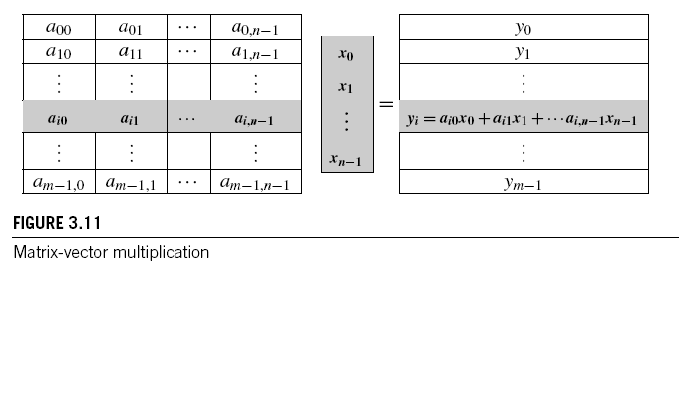
MATRIX-VECTOR MULTIPLICATION IN PTHREADS
Copyright © 2010, Elsevier Inc. All rights Reserved

Slide 2
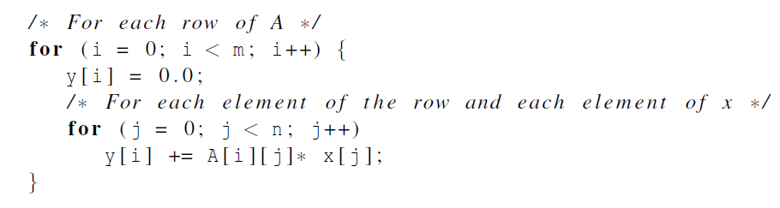
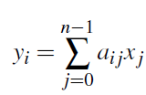
Serial pseudo-code
Copyright © 2010, Elsevier Inc. All rights Reserved

Slide 3
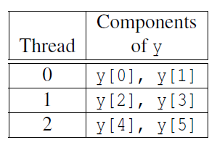
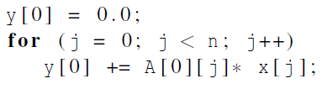
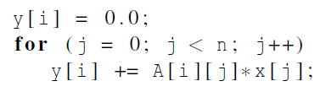
Using 3 Pthreads
thread 0
general case
Copyright © 2010, Elsevier Inc. All rights Reserved

Slide 4
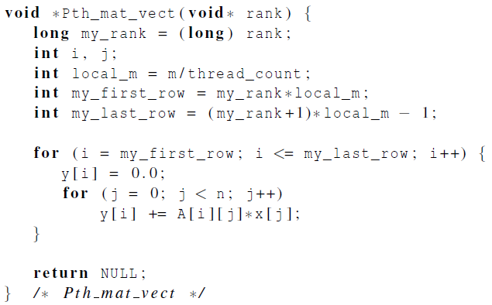
Pthreads matrix-vector multiplication
Copyright © 2010, Elsevier Inc. All rights Reserved

Slide 5
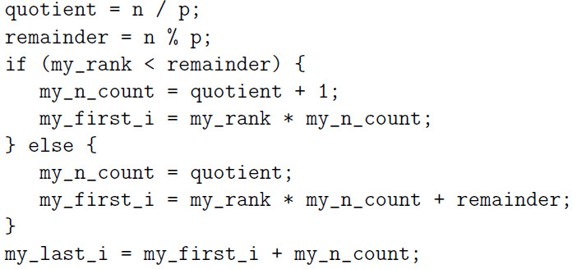
Copyright © 2010, Elsevier Inc. All rights Reserved

Slide 6
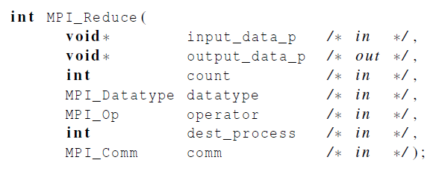
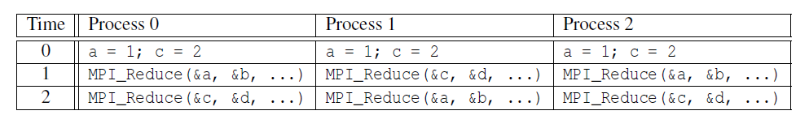
Example (1)
Multiple calls to MPI_Reduce
Copyright © 2010, Elsevier Inc. All rights Reserved

Slide 7
Example (2)
Suppose that each process calls MPI_Reduce with operator MPI_SUM, and destination process 0.
At first glance, it might seem that after the two calls to MPI_Reduce, the value of b will be 3, and the value of d will be 6.
Copyright © 2010, Elsevier Inc. All rights Reserved

Slide 8
Example (3)
However, the names of the memory locations are irrelevant to the matching of the calls to MPI_Reduce.
The order of the calls will determine the matching so the value stored in b will be 1+2+1 = 4, and the value stored in d will be 2+1+2 = 5.
Copyright © 2010, Elsevier Inc. All rights Reserved

Slide 9
Flynn’s Taxonomy
classic von Neumann
SISD
Single instruction stream
Single data stream
(SIMD)
Single instruction stream
Multiple data stream
MISD
Multiple instruction stream
Single data stream
(MIMD)
Multiple instruction stream
Multiple data stream
not covered
Copyright © 2010, Elsevier Inc. All rights Reserved

Slide 10
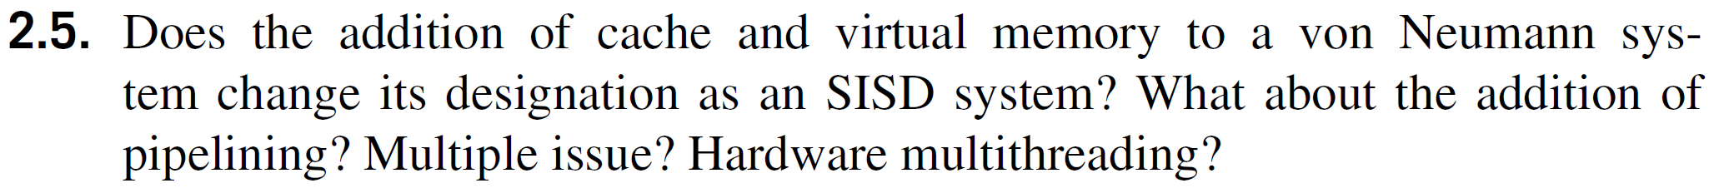
Flynn’s Taxonomy
Copyright © 2010, Elsevier Inc. All rights Reserved

Slide 11

Basics of caching
A collection of memory locations that can be accessed in less time than some other memory locations.
A CPU cache is typically located on the same chip, or one that can be accessed much faster than ordinary memory.
Copyright © 2010, Elsevier Inc. All rights Reserved

Slide 12
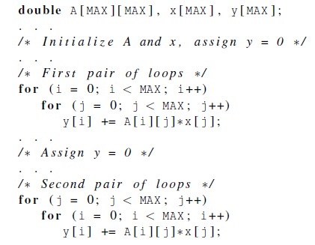
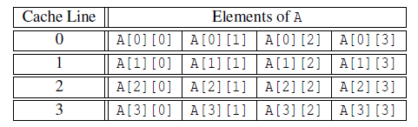
Caches and programs
Copyright © 2010, Elsevier Inc. All rights Reserved

Slide 13
Instruction Level Parallelism
Pipelining - functional units are arranged in stages.
Multiple issue - multiple instructions can be simultaneously initiated.
Copyright © 2010, Elsevier Inc. All rights Reserved

Slide 14
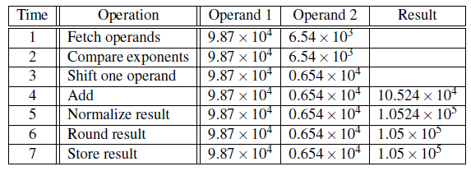
Pipelining example (1)
Add the floating point numbers 9.87×10⁴ and 6.54×10³
Copyright © 2010, Elsevier Inc. All rights Reserved

Slide 15

Pipelining example (2)
Assume each operation takes one nanosecond (10⁻⁹ seconds).
This for loop takes about 7000 nanoseconds.
Copyright © 2010, Elsevier Inc. All rights Reserved

Slide 16
Pipelining (3)
Divide the floating point adder into 7 separate pieces of hardware or functional units.
First unit fetches two operands, second unit compares exponents, etc.
Output of one functional unit is input to the next.
Copyright © 2010, Elsevier Inc. All rights Reserved

Slide 17
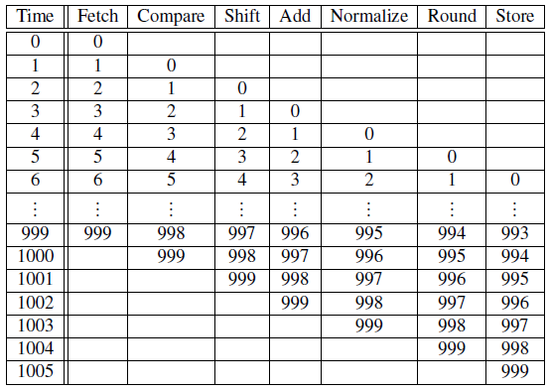
Pipelining (4)
Table 2.3: Pipelined Addition.
Numbers in the table are subscripts of operands/results.
Copyright © 2010, Elsevier Inc. All rights Reserved

Slide 18

Pipelining (5)
One floating point addition still takes
7 nanoseconds.
But 1000 floating point additions
now takes 1006 nanoseconds!
Copyright © 2010, Elsevier Inc. All rights Reserved

Slide 19
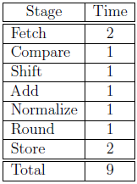
Copyright © 2010, Elsevier Inc. All rights Reserved

Slide 20
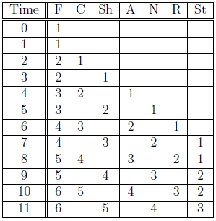
Copyright © 2010, Elsevier Inc. All rights Reserved

Slide 21
Partitioning options
Block partitioning
  Assign blocks of consecutive components to each process.
Cyclic partitioning
  Assign components in a round robin fashion.
Block-cyclic partitioning
  Use a cyclic distribution of blocks of components.
Copyright © 2010, Elsevier Inc. All rights Reserved

Slide 22
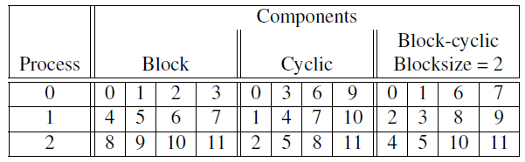
Different partitions of a 12-component vector among 3 processes
Copyright © 2010, Elsevier Inc. All rights Reserved

Slide 23
Collective vs. Point-to-Point Communications
All the processes in the communicator must call the same collective function.
For example, a program that attempts to match a call to MPI_Reduce on one process with a call to MPI_Recv on another process is erroneous, and, in all likelihood, the program will hang or crash.
Copyright © 2010, Elsevier Inc. All rights Reserved

Slide 24
Collective vs. Point-to-Point Communications
The arguments passed by each process to an MPI collective communication must be “compatible.”
For example, if one process passes in 0 as the dest_process and another passes in 1, then the outcome of a call to MPI_Reduce is erroneous, and, once again, the program is likely to hang or crash.
Copyright © 2010, Elsevier Inc. All rights Reserved

Slide 25
Collective vs. Point-to-Point Communications
The output_data_p argument is only used on dest_process.
However, all of the processes still need to pass in an actual argument corresponding to output_data_p, even if it’s just NULL.
Copyright © 2010, Elsevier Inc. All rights Reserved

Slide 26
Collective vs. Point-to-Point Communications
Point-to-point communications are matched on the basis of tags and communicators.
Collective communications don’t use tags.
They’re matched solely on the basis of the communicator and the order in which they’re called.
Copyright © 2010, Elsevier Inc. All rights Reserved

Slide 27
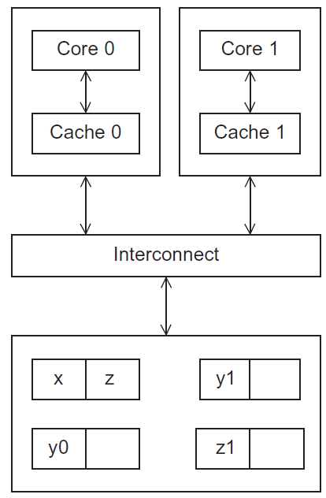
Cache coherence
Programmers have no
control over caches
and when they get updated.
Figure 2.17
A shared memory system with two cores and two caches
Copyright © 2010, Elsevier Inc. All rights Reserved
Notes:
The University of Adelaide, School of Computer Science
Chapter 2 — Instructions: Language of the Computer

Slide 28
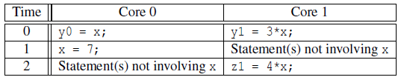
Cache coherence
y0 privately owned by Core 0
y1 and z1 privately owned by Core 1
x = 2; /* shared variable */
y0 eventually ends up = 2
y1 eventually ends up = 6
z1 = ???
Copyright © 2010, Elsevier Inc. All rights Reserved

Slide 29
Snooping Cache Coherence
The cores share a bus .
Any signal transmitted on the bus can be “seen” by all cores connected to the bus.
When core 0 updates the copy of x stored in its cache it also broadcasts this information across the bus.
If core 1 is “snooping” the bus, it will see that x has been updated and it can mark its copy of x as invalid.
Copyright © 2010, Elsevier Inc. All rights Reserved

Slide 30
Directory Based Cache Coherence
Uses a data structure called a directory that stores the status of each cache line.
When a variable is updated, the directory is consulted, and the cache controllers of the cores that have that variable’s cache line in their caches are invalidated.
Copyright © 2010, Elsevier Inc. All rights Reserved

Slide 31

OpenMP
a[0] = 0;
for (i = 1; i < n; i++)
a[i] = a[i - 1] + i;
Copyright © 2010, Elsevier Inc. All rights Reserved

Slide 32

OpenMP
Copyright © 2010, Elsevier Inc. All rights Reserved

