Slide 1
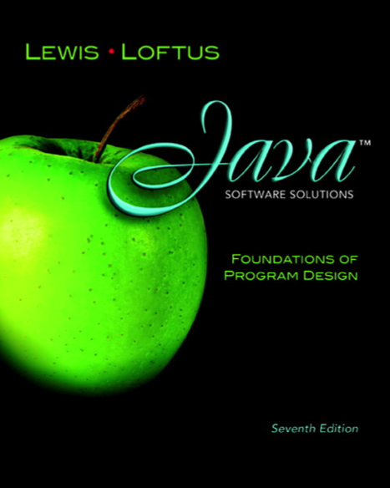

Chapter 1
Introduction
Java Software Solutions
Foundations of Program Design
Seventh Edition
Copyright © 2012 Pearson Education, Inc.

Slide 2
Introduction
We start with the fundamentals of computer processing
Chapter 1 focuses on:
  components of a computer
  how computers store and manipulate information
  computer networks
  the Internet and the World Wide Web
  programming and programming languages
  an introduction to Java
  an overview of object-oriented concepts
Copyright © 2012 Pearson Education, Inc.

Slide 3
Outline
Computer Processing
Hardware Components
Networks
The Java Programming Language
Program Development
Object-Oriented Programming
Copyright © 2012 Pearson Education, Inc.

Slide 4
Hardware and Software
Hardware
  the physical, tangible parts of a computer
  keyboard, monitor, disks, wires, chips, etc.
Software
  programs and data
  a program is a series of instructions
A computer requires both hardware and software
Each is essentially useless without the other
Copyright © 2012 Pearson Education, Inc.

Slide 5
CPU and Main Memory
Central
Processing
Unit
Chip that executes program commands
Primary storage area for programs and data that are in active use
Synonymous with RAM
Main
Memory
Copyright © 2012 Pearson Education, Inc.

Slide 6


Input / Output Devices
Monitor screen
Keyboard
Mouse
Touch screen
Central
Processing
Unit
I/O devices facilitate
user interaction
Main
Memory
Copyright © 2012 Pearson Education, Inc.

Slide 7


Secondary Memory Devices
Information is moved
between main and
secondary memory
as needed
Central
Processing
Unit
Hard Disk
Main
Memory
Secondary memory
devices provide
long-term storage
USB Flash Drive
Copyright © 2012 Pearson Education, Inc.

Slide 8
辅助存储器
程序
原始数据
输入设备
内存储器
输出设备
运算
结果
运 算 器
控制 器
数据
控制信息
Copyright © 2012 Pearson Education, Inc.

Slide 9
Software Categories
Operating System
  controls all machine activities
  provides the user interface to the computer
  manages resources such as the CPU and memory
  Windows, Mac OS, Unix, Linux,IOS,Android
Application program
  generic term for any other kind of software
  word processors, missile control systems, games
Most operating systems and application programs have a graphical user interface (GUI)
Copyright © 2012 Pearson Education, Inc.

Slide 10
Analog vs. Digital
There are two basic ways to store and manage data:
Analog
  continuous, in direct proportion to the data represented
  music on a record album - a needle rides on ridges in the grooves that are directly proportional to the voltages sent to the speaker
Digital
  the information is broken down into pieces, and each piece is represented separately
  sampling – record discrete values of the analog representation
  music on a compact disc - the disc stores numbers representing specific voltage levels sampled at specific times
Copyright © 2012 Pearson Education, Inc.

Slide 11
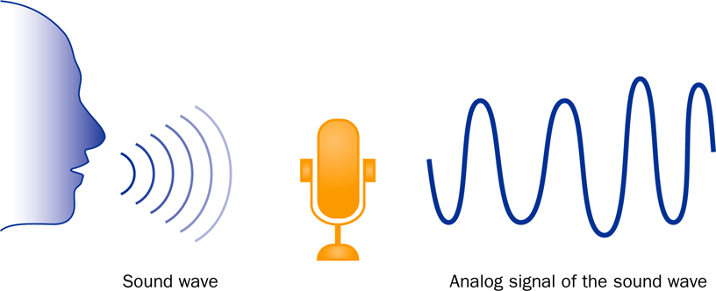
Analog Information
Copyright © 2012 Pearson Education, Inc.

Slide 12
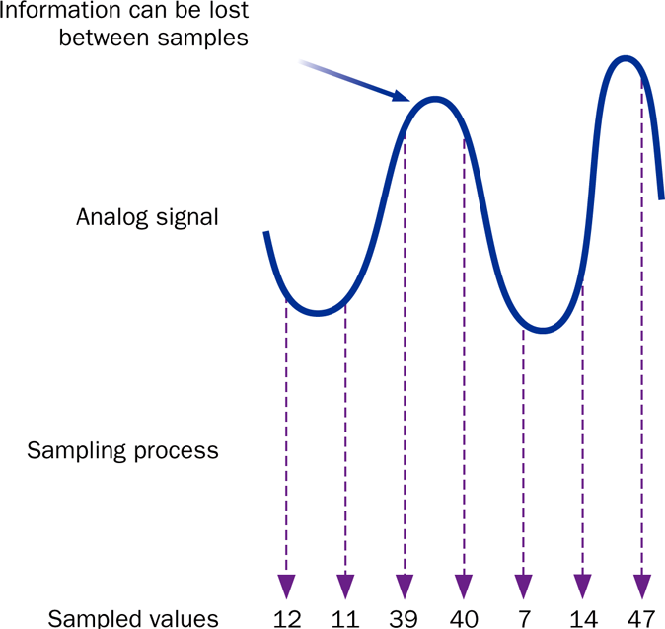
Sampling
Copyright © 2012 Pearson Education, Inc.

Slide 13
Digital Information
Computers store all information digitally:
  numbers
  text
  graphics and images
  audio
  video
  program instructions
In some way, all information is digitized - broken down into pieces and represented as numbers
Copyright © 2012 Pearson Education, Inc.

Slide 14
Representing Text Digitally
For example, every character is stored as a number, including spaces, digits, and punctuation
Corresponding upper and lower case letters are separate characters(appendix C)
H i , H e a t h e r .
72 105 44 32 72 101 97 116 104 101 114 46
Copyright © 2012 Pearson Education, Inc.

Slide 15
Binary Numbers
Once information has been digitized, it is represented and stored in memory using the binary number system
A single binary digit (0 or 1) is called a bit
Devices that store and move information are cheaper and more reliable if they have to represent only two states
A single bit can represent two possible states, like a light bulb that is either on (1) or off (0)
Permutations of bits are used to store values
Copyright © 2012 Pearson Education, Inc.

Slide 16
Bit Permutations
1 bit
2 bits
3 bits
4 bits
0
1
00
01
10
11
000
001
010
011
100
101
110
111
0000
0001
0010
0011
0100
0101
0110
0111
1000
1001
1010
1011
1100
1101
1110
1111
每个附加位使可能的排列数翻倍
Copyright © 2012 Pearson Education, Inc.

Slide 17
位排列
每个置换可以表示特定项
有 2N 排列 N 位
因此，需要 N 位来表示 2N 唯一项
1 bit ?
2 bits ?
3 bits ?
4 bits ?
5 bits ?
2¹ = 2 items
How many
items can be
represented by
2² = 4 items
2³ = 8 items
2⁴ = 16 items
2⁵ = 32 items
Copyright © 2012 Pearson Education, Inc.

Slide 18
Quick Check
使用唯一的位排列来表示 50 个美国中每个位有多少位？
Copyright © 2012 Pearson Education, Inc.

Slide 19
Quick Check
How many bits would you need to represent each of the 50 United States using a unique permutation of bits?
000000 Alabama
000001 Alaska
000010 Arizona
000011 Arkansas
000100 California
000101 Colorado
etc.
Five bits wouldn't be enough, because 2⁵ is 32.
Six bits would give us 64 permutations, and some wouldn't be used.
Copyright © 2012 Pearson Education, Inc.

Slide 20
Outline
计算机处理
硬件组件
网络
Java编程语言
计划开发
面向对象的编程
Copyright © 2012 Pearson Education, Inc.

Slide 21
A Computer Specification
请考虑以下个人计算机规范：
3.07 GHz 英特尔酷睿 i7 处理器
4 GB 内存
750 GB 硬盘
16x 蓝光 / 高清 DVD-ROM + 16x DVD+R DVD 刻录机
17 英寸平板视频显示，分辨率为 1280 x 1024
网卡
Copyright © 2012 Pearson Education, Inc.

Slide 22
Memory
9278
9279
9280
9281
9282
9283
9284
9285
9286
主内存分为多个内存位置（或单元格）
每个内存单元都有一个数字地址，该地址唯一标识它
Copyright © 2012 Pearson Education, Inc.

Slide 23
Storing Information
9278
9279
9280
9281
9282
9283
9284
9285
9286
每个内存单元存储一组位数（通常为 8 位或一个字节）
10011010
大值是
连续存储
内存位置
Copyright © 2012 Pearson Education, Inc.

Slide 24
存储容量
每个内存设备都有存储容量，指示它可以容纳的字节数
容量以各种单位表示：
Unit | Symbol | Number of Bytes
kilobyte | KB | 2¹⁰ = 1024
megabyte | MB | 2²⁰ (over one million)
gigabyte | GB | 2³⁰ (over one billion)
terabyte | TB | 2⁴⁰ (over one trillion)
petabyte | PB | 2⁵⁰ (a whole bunch)
Copyright © 2012 Pearson Education, Inc.

Slide 25
Memory
主内存是易失性 - 如果断电，存储的信息将丢失
辅助内存设备是非易失性
主内存和磁盘是直接访问设备 - 可以直接访问信息
直接访问和随机访问这两个术语经常互换使用
磁带是一种顺序访问设备，因为它的数据按线性顺序排列 - 您必须通过中间数据获取才能访问其他信息
Copyright © 2012 Pearson Education, Inc.

Slide 26
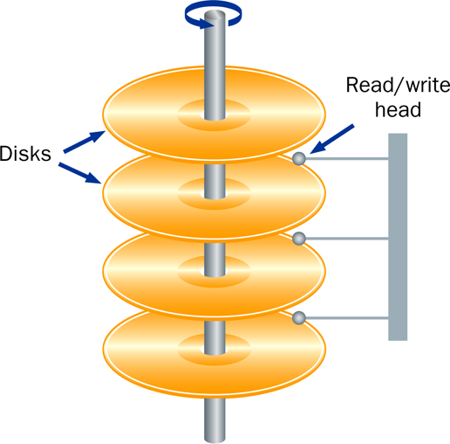
Hard Disk Drive
Copyright © 2012 Pearson Education, Inc.

Slide 27
RAM vs. ROM
RAM - 随机访问内存（直接访问）
ROM - 只读内存
术语 RAM 和主内存基本上可互换
ROM 可以是一组内存芯片，也可以是单独的设备，如 CD ROM
RAM 和 ROM 都是随机（直接）访问设备！
RAM 可能应该称为读写内存
Copyright © 2012 Pearson Education, Inc.

Slide 28
Compact Discs
CD-ROM 是便携式只读存储器
CD 上的微观坑表示二进制 1，平滑区域表示二进制 0
低强度激光从平滑区域强烈反射，从坑中反射微弱
CD 可录制 （CD-R） 驱动器可用于将信息写入 CD 一次
可擦除和重复使用 CD-可重写 （CD-RW）
CD 驱动器的速度指示它读写信息到 CD 的速度（最大）
Copyright © 2012 Pearson Education, Inc.

Slide 29
DVDs
DVD 的物理大小与 CD 相同，但可以存储更多信息
DVD 的格式每平方英寸存储更多位
CD 可以存储 650 MB，而标准 DVD 可以存储 4.7 GB
双面 DVD 可以存储 9.4 GB
其他高级技术可使容量达到 17.0 GB
与 CD 一样，还有 DVD-R 和 DVD-RW 光盘
Copyright © 2012 Pearson Education, Inc.

Slide 30
The Central Processing Unit
CPU 在称为微处理器的芯片上
它持续遵循提取-解码-执行周期：
Retrieve an instruction from main memory
fetch
execute
decode
Carry out the
instruction
Determine what the
instruction is
Copyright © 2012 Pearson Education, Inc.

Slide 31
The Central Processing Unit
Arithmetic / Logic Unit
Performs calculations and makes decisions
Coordinates processing steps
Control Unit
Small storage areas
Registers
Copyright © 2012 Pearson Education, Inc.

Slide 32
中央处理单元(CPU)
CPU 的速度由系统时钟控制
系统时钟定期生成电子脉冲
脉冲协调 CPU 的活动
速度通常以千兆赫 （GHz） 为单位进行测量
Copyright © 2012 Pearson Education, Inc.

Slide 33
Monitor
显示器的大小（17"）以对角线方式测量，就像电视屏幕一样
监视器具有一定的最大分辨率，指示它可以显示的图片元素数（称为像素数）（例如 1280 x 1024）
高分辨率（更多像素）可生成更清晰的图片
Copyright © 2012 Pearson Education, Inc.

Slide 34
Outline
计算机处理
硬件组件
网络
Java编程语言
计划开发
面向对象的编程
Copyright © 2012 Pearson Education, Inc.

Slide 35
Networks
网络是连接的两台或两台多台计算机，以便共享数据和资源
大多数计算机都连接到某种网络
每台计算机都有自己的网络地址，该地址在其他计算机中唯一标识它
文件服务器是专用于存储网络用户之间共享的程序和数据的网络计算机
Copyright © 2012 Pearson Education, Inc.

Slide 36
网络连接
网络中的每台计算机可以直接连接到网络中的其他计算机
这些称为点对点连接
添加计算机需要
新的通信线路
对于每台计算机已经
在网络中
这种技术不实用
不止几台关闭的机器
Copyright © 2012 Pearson Education, Inc.

Slide 37
Network Connections
大多数网络共享一条通信线路
将新计算机添加到网络相对容易
网络流量必须
转向使用线，这
引入延迟
通常信息被破坏
在部分，称为数据包，
发送到接收
机器， 然后重新组装
Copyright © 2012 Pearson Education, Inc.

Slide 38
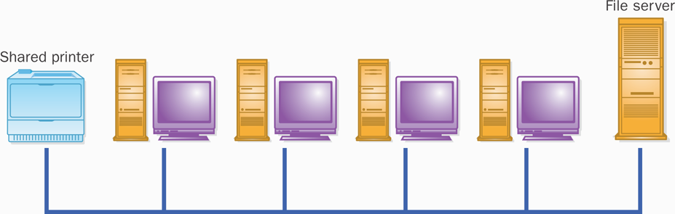
A Computer Network
Copyright © 2012 Pearson Education, Inc.

Slide 39
Local-Area Networks
A Local-Area Network
(LAN) covers a small
distance and a small
number of computers
LAN
A LAN often connects the machines
in a single room or building
Copyright © 2012 Pearson Education, Inc.

Slide 40
Wide-Area Networks
A Wide-Area Network (WAN)
connects two or more LANs,
often over long distances
LAN
LAN
Copyright © 2012 Pearson Education, Inc.

Slide 41
The Internet
The Internet is a WAN which spans the planet
The word Internet comes from the term internetworking
It started as a United States government project, sponsored by the Advanced Research Projects Agency (ARPA)
  originally it was called the ARPANET
The Internet grew quickly throughout the 1980s and 90s
Copyright © 2012 Pearson Education, Inc.

Slide 42
TCP/IP
协议是一组规则，用于确定事物如何相互通信
管理互联网通信的软件遵循一套称为 TCP/IP 的协议
互联网协议 （IP） 确定信息传输的格式
传输控制协议 （TCP） 规定如何重新组合消息和处理丢失的信息
Copyright © 2012 Pearson Education, Inc.

Slide 43
IP and Internet Addresses
Internet 上的每台计算机都有一个唯一的 IP 地址，例如：
204.192.116.2
大多数计算机还具有唯一的 Internet 名称，也称为 Internet 地址：
hector.vt.edu
kant.gestalt-llc.com
第一部分指示特定计算机（赫克托）
其余的是域名，指示组织（vt.edu）
Copyright © 2012 Pearson Education, Inc.

Slide 44
Domain Names
域名的最后一部分（称为顶级域 （TLD）））据说指示组织的类型：
edu educational institution
com commercial entity
org non-profit organization
net network-based organization
Sometimes the suffix
indicates the country:
uk United Kingdom
au Australia
ca Canada
se Sweden
Additional TLDs have
been added:
biz, info, tv, name
Copyright © 2012 Pearson Education, Inc.

Slide 45
Domain Names
域名可以有几个部分
唯一的域名意味着多个站点可以具有具有相同本地名称的单个计算机
使用时，互联网地址通过称为域名系统 （DNS） 的软件转换为 IP 地址
IP 地址的各个部分与 Internet 地址各部分之间没有一对一的通信
Copyright © 2012 Pearson Education, Inc.

Slide 46
The World Wide Web
万维网允许使用公共界面访问许多不同类型的信息
浏览器是访问网络资源并呈现网络资源的程序
热门浏览器： 互联网浏览器， Safari， 火狐
提供的资源包括：
文本、图形、视频、声音、音频、可执行程序
Web 文档通常包含指向其他 Web 文档的链接，从而创建超媒体环境
"Web"一词源于这样一个事实，即信息不是以线性方式组织的
Copyright © 2012 Pearson Education, Inc.

Slide 47
The World Wide Web
Web documents are often defined using the HyperText Markup Language (HTML)
Information on the Web is found using a Uniform Resource Locator (URL):
http://www.cnn.com
http://www.vt.edu/student_life/index.html
ftp://java.sun.com/applets/animation.zip
A URL specifies a protocol (http), a domain, and possibly specific documents
Copyright © 2012 Pearson Education, Inc.

Slide 48
Outline
Computer Processing
Hardware Components
Networks
The Java Programming Language
Program Development
Object-Oriented Programming
Copyright © 2012 Pearson Education, Inc.

Slide 49
Java
Java编程语言是由Sun Microsystems, Inc公司创建的。
它于1995年推出，其受欢迎程度增长迅速，因为
编程语言指定可用于编写程序的单词和符号
编程语言使用一组规则，这些规则要求如何将单词和符号放在一起形成有效的程序语句
Copyright © 2012 Pearson Education, Inc.

Slide 50
Java Program Structure
在 Java 编程语言中：
程序由一个或多个类
类包含一个或多个方法
方法包含程序语句
在整个课程中将详细探讨这些术语
Java 应用程序始终包含一种称为 main 的方法
见林肯.贾瓦
Copyright © 2012 Pearson Education, Inc.

Slide 51
//********************************************************************
// Lincoln.java Author: Lewis/Loftus
//
// Demonstrates the basic structure of a Java application.
//********************************************************************
public class Lincoln
{
//-----------------------------------------------------------------
// Prints a presidential quote.
//-----------------------------------------------------------------
public static void main (String[] args)
{
System.out.println ("A quote by Abraham Lincoln:");
System.out.println ("Whatever you are, be a good one.");
}
}
Copyright © 2012 Pearson Education, Inc.

Slide 52
Output
A quote by Abraham Lincoln:
Whatever you are, be a good one.
//********************************************************************
// Lincoln.java Author: Lewis/Loftus
//
// Demonstrates the basic structure of a Java application.
//********************************************************************
public class Lincoln
{
//-----------------------------------------------------------------
// Prints a presidential quote.
//-----------------------------------------------------------------
public static void main (String[] args)
{
System.out.println ("A quote by Abraham Lincoln:");
System.out.println ("Whatever you are, be a good one.");
}
}
Copyright © 2012 Pearson Education, Inc.

Slide 53
Java Program Structure
// comments about the class
public class MyProgram
{
}
class header
class body
Comments can be placed almost anywhere
Copyright © 2012 Pearson Education, Inc.

Slide 54
Java Program Structure
// comments about the class
public class MyProgram
{
}
// comments about the method
public static void main (String[] args)
{
}
method header
method body
Copyright © 2012 Pearson Education, Inc.

Slide 55
Comments
应包括注释来解释程序的目的并描述处理步骤
它们不会影响程序的工作方式
Java 注释可以有三种形式：
// this comment runs to the end of the line
/* this comment runs to the terminating
symbol, even across line breaks */
/** this is a javadoc comment */
Copyright © 2012 Pearson Education, Inc.

Slide 56
Identifiers（标示符）
标识符是程序中的"单词"
Java 标识符可以由字母、数字、下划线字符 （ * ） 和美元符号） 和
标识符不能以数字为对象
Java 是大小写相关的： Total, total, and TOTAL是不同的标识符
按照惯例，程序员对不同类型的标识符使用不同的大小写样式，例如
类名的标题大小 - 林肯
常数的大写 - 最大值
Copyright © 2012 Pearson Education, Inc.

Slide 57
Identifiers
有时程序员会选择识别器（如林肯）
有时我们使用另一个程序员的代码，所以我们使用他或她选择的标识符（如 println）
我们通常使用特殊标识符，称为保留词，已在语言中具有预定义的含义
保留字不能以任何其他方式使用
Copyright © 2012 Pearson Education, Inc.

Slide 58
Reserved Words
The Java reserved words:
abstract
assert
boolean
break
byte
case
catch
char
class
const
continue
default
do
double
else
enum
extends
false
final
finally
float
for
goto
if
implements
import
instanceof
int
interface
long
native
new
null
package
private
protected
public
return
short
static
strictfp
super
switch
synchronized
this
throw
throws
transient
true
try
void
volatile
while
Copyright © 2012 Pearson Education, Inc.

Slide 59
Quick Check
Which of the following are valid Java identifiers?
grade
quizGrade
NetworkConnection
frame2
3rdTestScore
MAXIMUM
MIN_CAPACITY
student#
Shelves1&2
Copyright © 2012 Pearson Education, Inc.

Slide 60
Quick Check
Which of the following are valid Java identifiers?
grade
quizGrade
NetworkConnection
frame2
3rdTestScore
MAXIMUM
MIN_CAPACITY
student#
Shelves1&2
Valid
Valid
Valid
Valid
Invalid – cannot begin with a digit
Valid
Valid
Invalid – cannot contain the '#' character
Invalid – cannot contain the '&' character
Copyright © 2012 Pearson Education, Inc.

Slide 61
White Space
空格、空白行和制表符称为White Space
空白用于分隔程序中的单词和符号
额外的空白将被忽略
有效的Java程序可以通过多种方式格式化
应设置程序的格式，以提高可读性，使用一致的缩进
见林肯2.java和林肯3.java
Copyright © 2012 Pearson Education, Inc.

Slide 62
Outline
Computer Processing
Hardware Components
Networks
The Java Programming Language
Program Development
Object-Oriented Programming
Copyright © 2012 Pearson Education, Inc.

Slide 63
Program Development
开发程序的机制包括以下几个活动：
用特定的编程语言（如 Java）编写程序
将程序转换为计算机可以执行的窗体
调查和修复可能发生的各种类型的错误
软件工具可用于帮助完成此过程的所有部分
Copyright © 2012 Pearson Education, Inc.

Slide 64
Language Levels
有四种编程语言级别：
机器语言
assembly language（汇编语言）
高级语言
第四代语言
每种类型的 CPU 都有其自己的特定计算机语言
创建其他级别是为了使人类更容易读写程序
Copyright © 2012 Pearson Education, Inc.

Slide 65
Programming Languages
每种类型的 CPU 仅执行特定的计算机语言
程序必须先翻译成机器语言，然后才能执行
编译器 （+） 是一种软件工具，可将源代码转换为特定的目标语言
通常，该目标语言是特定 CPU 类型的计算机语言
Java 方法有些不同
Copyright © 2012 Pearson Education, Inc.

Slide 66
编程语言
翻译的方式有两种，一个是编译，一个是解释。两种方式只是翻译的时间不同。
编程语言分两种:编译型的语言和解释型语言
  编译型语言代表：C, C++
    先将源代码一次性全部翻译成机器指令，运行时直接执行机器指令。
  解释型语言：python, JavaScript等等
    边翻译、边执行
JAVA属于什么类型的语言？
Copyright © 2012 Pearson Education, Inc.

Slide 67
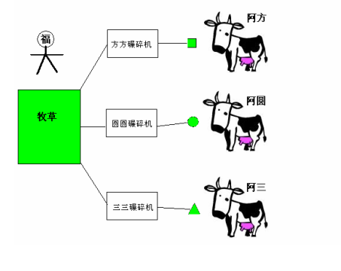
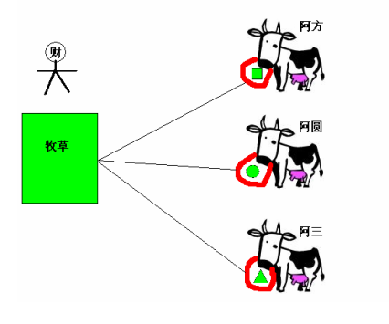
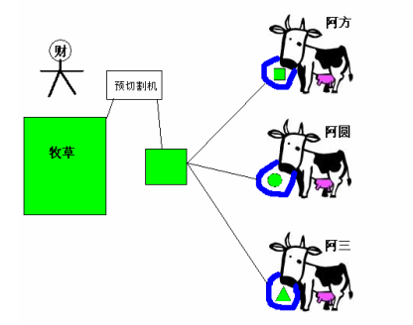
旺财方案
来福方案
旺财改进方案
Copyright © 2012 Pearson Education, Inc.

Slide 68
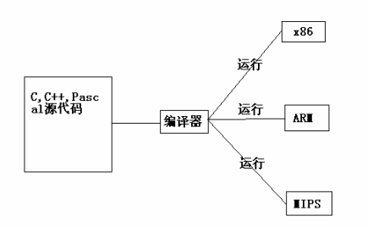
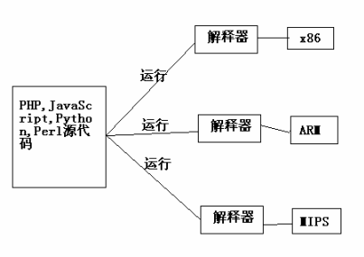
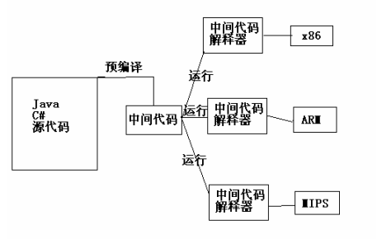
牧草 ＝ 我们的各种编程语言，C/C++/C#, Java, Pascal, PHP, Python, Perl, Java Script等等
切割机 ＝ 各种编译器
奶牛 ＝ 各种CPU（不要告诉我Intel和AMD哦），比如x86，ARM，MIPS等等
Copyright © 2012 Pearson Education, Inc.

Slide 69
Java Translation
Java 编译器将 Java 源代码转换为称为字节代码的特殊表示形式
Java 字节码不是任何传统 CPU 的机器语言
另一个软件工具，称为解释器，将字节码转换为机器语言并执行它
因此，Java编译器不绑定到任何特定计算机
Java 被认为是与体系结构无关的
Copyright © 2012 Pearson Education, Inc.

Slide 70
Java Translation
Java source
code
Java
bytecode
Java
compiler
Bytecode
interpreter
Bytecode
compiler
Machine
code
Copyright © 2012 Pearson Education, Inc.

Slide 71
Development Environments
有许多程序支持开发Java软件，包括：
Java 开发工具包 （JDK）
Eclipse（日食）
网豆
蓝 J
IntelliJ IDEA
........
虽然这些环境的细节不同，但基本的编译和执行过程基本相同
Copyright © 2012 Pearson Education, Inc.

Slide 72
Syntax and Semantics
语言的语法规则定义了我们如何将符号、保留单词和标识符放在一起以创建有效的程序
程序语句的语义定义该语句的含义（它在程序中的目的或角色）
语法正确的程序不一定在逻辑上（语义上）正确
程序总是做我们告诉它做什么， 而不是我们的意思告诉它做什么
Copyright © 2012 Pearson Education, Inc.

Slide 73
Errors
程序可以有三种类型的错误
编译器将查找语法错误和其他基本问题（编译时错误）
如果存在编译时错误，则不会创建程序的可执行版本
在程序执行过程中可能会出现问题，例如尝试除以零，这会导致程序异常终止（运行时错误）
程序可能会运行，但会产生不正确的结果，可能使用不正确的公式（逻辑错误）
Copyright © 2012 Pearson Education, Inc.

Slide 74
Basic Program Development
Edit and
save program
errors?
Compile program
errors?
Execute program and
evaluate results
Copyright © 2012 Pearson Education, Inc.

Slide 75
Test
1. 拼错 Java 保留字
2. 计算空数字列表的平均值，方法是将列表数的总和（即零）除以列表的大小（也是零）
3. 在应输出学生的平均考试成绩时，打印学生的高考试成绩。
Copyright © 2012 Pearson Education, Inc.

Slide 76
测试
下面哪些是Java中合法的标识符。
A. MAX_SIZE B. 2ndLevel C. coin#value D. hook&ladder
A
下列选项中符合Java命名规则的标识符是（）
2japro B. &Class C. const D. _123
D
编译Java 源程序文件产生的字节码文件的扩展名为
A. java B. class C. html D. Exe
B
Copyright © 2012 Pearson Education, Inc.

Slide 77
测试
下列关于Java程序设计语言的说法，正确的是：
  A. Java程序具有严格的语法，这保证了程序不会产生运行时错误（Runtime Error）。
  B.JDK是Java程序运行的必需环境，如果一个系统想运行Java程序，必需安装JDK。
  C.Java程序的字节码文件（Byte Code）是由机器语言（即汇编语言）组成的可执行程序文件。
  D. Java是大小写敏感的，需要区分大小写字母。
  D
选出合法的Java标识符：
A. my-apple B. 123Sample C. eclipse D. &abc
C
Copyright © 2012 Pearson Education, Inc.

Slide 78
测试
程序执行结束后，正确输出结果应为200，实际输出结果为100，则程序错误的类型为
    A.语法错误
    B. 编译错误
    C. 运行错误
    D. 逻辑错误
  D
Copyright © 2012 Pearson Education, Inc.

Slide 79
Outline
Computer Processing
Hardware Components
Networks
The Java Programming Language
Program Development
Object-Oriented Programming
Copyright © 2012 Pearson Education, Inc.

Slide 80
Problem Solving
编写程序的目的是解决问题
解决问题包括多种活动：
了解问题
设计解决方案
考虑替代方案并优化解决方案
实施解决方案
测试解决方案
这些活动不是纯粹的线性活动， 它们重叠和相互作用
Copyright © 2012 Pearson Education, Inc.

Slide 81
Problem Solving
The key to designing a solution is break设计解决方案的关键就是将解决方案分解为可管理的部分
When writing software, we design separate pieces that are responsible for certain parts of the solution
An object-oriented approach lends itself to this kind of solution decomposition
We will dissect our solutions into pieces called objects and classes
在编写软件时，我们设计单独的部分，负责解决方案的某些部分
面向对象的方法适合这种解决方案分解
我们将将解决方案分解为称为对象和类的片段
ing it down into manageable pieces
Copyright © 2012 Pearson Education, Inc.

Slide 82
Object-Oriented Programming
Java is an object-oriented programming language
As the term implies, an object is a fundamental entity in a Java program
Objects can be used effectively to represent real-world entities
For instance, an object might represent a particular employee in a company
Each employee object handles the processing and data management related to that employee
Copyright © 2012 Pearson Education, Inc.

Slide 83
Objects
An object has:
  state - descriptive characteristics
  behaviors - what it can do (or what can be done to it)
The state of a bank account includes its account number and its current balance
The behaviors associated with a bank account include the ability to make deposits and withdrawals
Note that the behavior of an object might change its state
Copyright © 2012 Pearson Education, Inc.

Slide 84
Classes
对象由类定义
类是对象的蓝图
类使用方法来定义对象的行为
包含 Java 程序的主要方法的类表示整个程序
类表示概念，对象表示该概念的体现
可以从同一类创建多个对象
Copyright © 2012 Pearson Education, Inc.

Slide 85
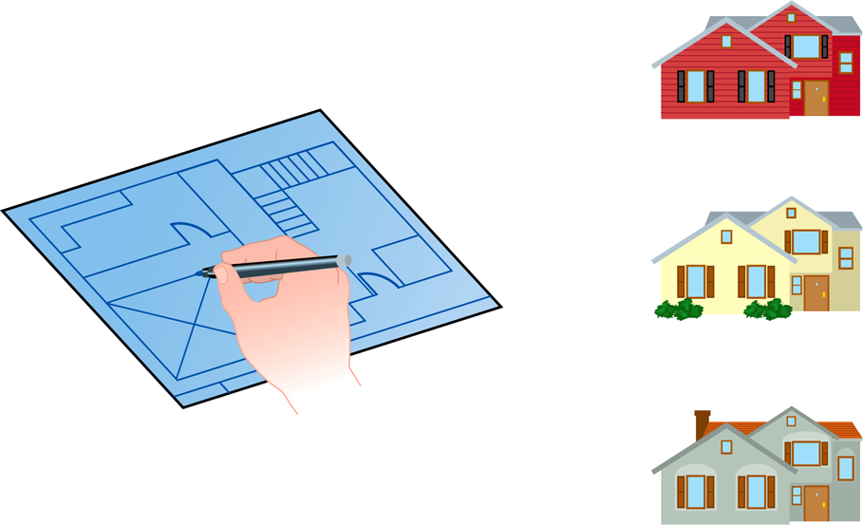
Class = Blueprint
One blueprint to create several similar, but different, houses:
Copyright © 2012 Pearson Education, Inc.

Slide 86
Objects and Classes
An object
(the realization)
A class
(the concept)
John’s Bank Account
Balance: $5,257
Bank Account
Bill’s Bank Account
Balance: $1,245,069
Multiple objects
from the same class
Mary’s Bank Account
Balance: $16,833
Copyright © 2012 Pearson Education, Inc.

Slide 87
Inheritance(继承)
One class can be used to derive another via inheritance
Classes can be organized into hierarchies
Account
Charge Account
Bank Account
Savings Account
Checking Account
Copyright © 2012 Pearson Education, Inc.

Slide 88
Summary
第 1 章侧重于：
计算机的组件
这些组件如何交互
计算机如何存储和操作信息
计算机网络
互联网和万维网
编程和编程语言
Java 简介
面向对象概念概述
Copyright © 2012 Pearson Education, Inc.

