Slide 1


Chapter 3
Using Classes and Objects
Java Software Solutions
Foundations of Program Design
Seventh Edition
John Lewis
William Loftus
Copyright © 2012 Pearson Education, Inc.

Slide 2
Using Classes and Objects
We can create more interesting programs using predefined classes and related objects
Chapter 3 focuses on:
  object creation and object references
  the String class and its methods
  the Java API class library
  the Random and Math classes
  formatting output
  enumerated types
  wrapper classes
Copyright © 2012 Pearson Education, Inc.

Slide 3
Outline
Creating Objects
The String Class
The Random and Math Classes
Formatting Output
Enumerated Types
Wrapper Classes
Copyright © 2012 Pearson Education, Inc.

Slide 4
Creating Objects
变量包含基元值或对对象的引用
类名称可用作声明对象引用变量的类型
字符串标题;
未创建此声明的对象
对象引用变量保存对象的地址
必须单独创建对象本身
Copyright © 2012 Pearson Education, Inc.

Slide 5
Creating Objects
通常，我们使用 new 运算符创建对象
创建对象称为实例化
对象是特定类的实例
title = new String ("Java Software Solutions");
这调用字符串构造函数 （3），这是
设置对象的特殊方法
Copyright © 2012 Pearson Education, Inc.

Slide 6
调用方法
我们看到，一旦对象被实例化，我们可以使用点运算符来调用其方法
numChars = 标题. 长度 （）
方法可以返回一个值，该值可用于赋值或表达式
方法调用可视为请求对象执行服务
Copyright © 2012 Pearson Education, Inc.

Slide 7
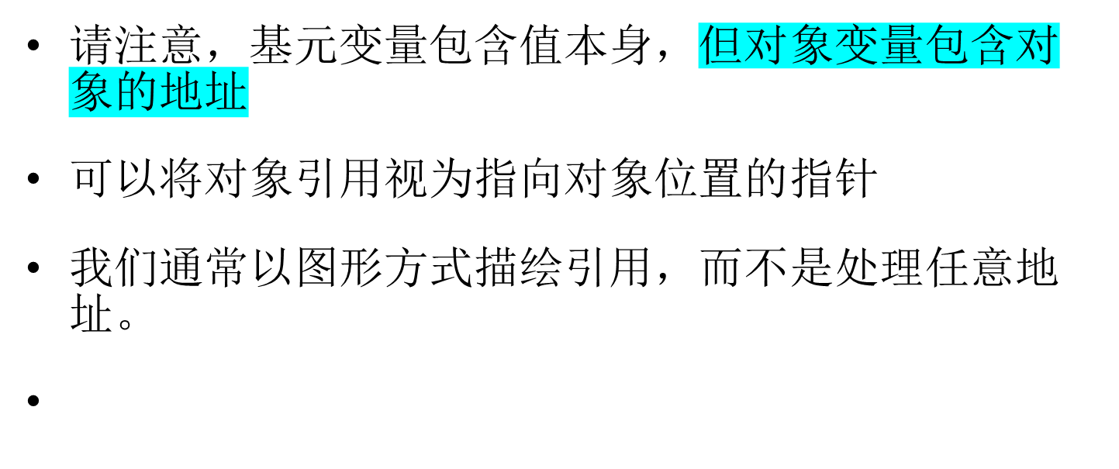
References
num1
38
name1
"Steve Jobs"
Copyright © 2012 Pearson Education, Inc.

Slide 8
Assignment Revisited
赋值行为需要一个值的副本，并将其存储到变量中
对于基元类型：
num1
38
Before:
num2
96
num2 = num1;
num1
38
After:
num2
38
Copyright © 2012 Pearson Education, Inc.

Slide 9
Reference Assignment
对于对象引用，赋值复制地址：
name1
"Steve Jobs"
Before:
name2
"Steve Wozniak"
name2 = name1;
name1
"Steve Jobs"
After:
name2
Copyright © 2012 Pearson Education, Inc.

Slide 10
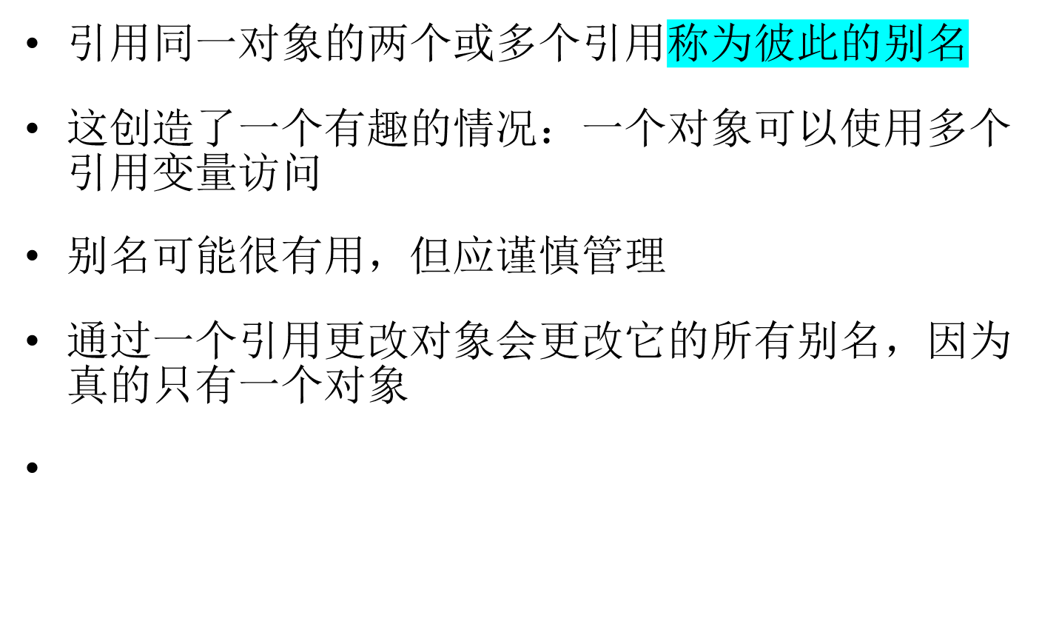
Aliases(别名)
Copyright © 2012 Pearson Education, Inc.

Slide 11
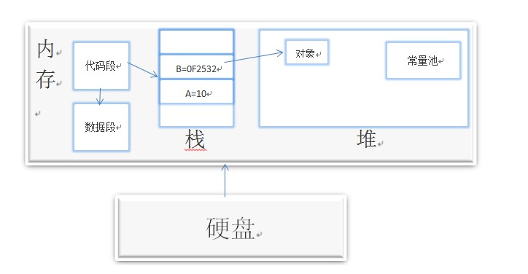
Java内存机制
Copyright © 2012 Pearson Education, Inc.

Slide 12
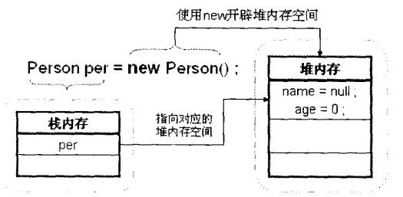
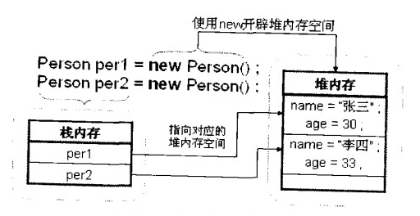
Copyright © 2012 Pearson Education, Inc.

Slide 13
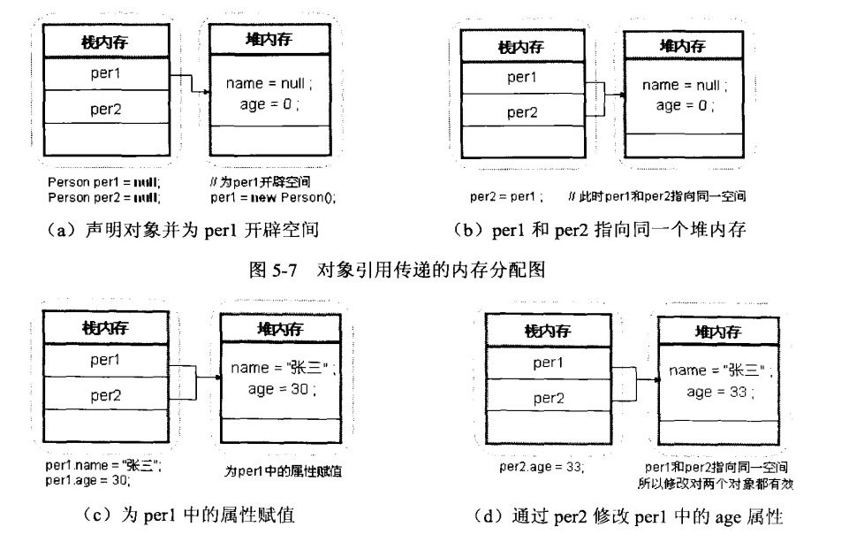
对象引用传递
Copyright © 2012 Pearson Education, Inc.

Slide 14
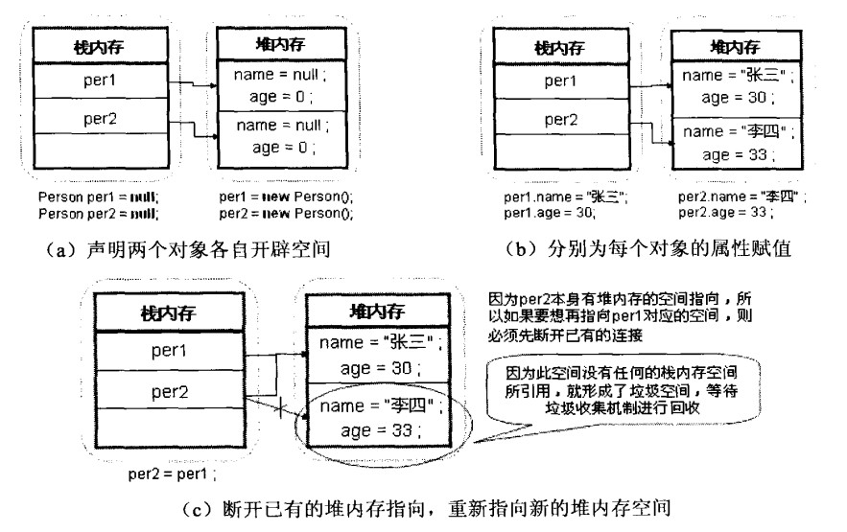
垃圾对象的产生
Copyright © 2012 Pearson Education, Inc.

Slide 15
垃圾收集
当对象不再具有对它的任何有效引用时，程序无法再访问它
对象是无用的，因此被称为垃圾
Java 定期执行自动垃圾回收，将对象的内存返回到系统供将来使用
在其他语言中，程序员负责执行垃圾回收
Copyright © 2012 Pearson Education, Inc.

Slide 16
Outline
Creating Objects
The String Class
The Random and Math Classes
Formatting Output
Enumerated Types
Wrapper Classes
Copyright © 2012 Pearson Education, Inc.

Slide 17
The String Class
因为字符串非常常见，因此我们不必使用 new 运算符来创建 String 对象
标题 = "Java 软件解决方案";
这是仅适用于字符串的特殊语法
每个字符串文本（以双引号括起来）表示字符串对象
Copyright © 2012 Pearson Education, Inc.

Slide 18
String Methods
创建 String 对象后，既不能更改其值，也不能更改其长度
因此，我们说 String 类的对象是不可变的
但是，String 类的几种方法返回新的 String 对象，这些对象是原始
Copyright © 2012 Pearson Education, Inc.

Slide 19
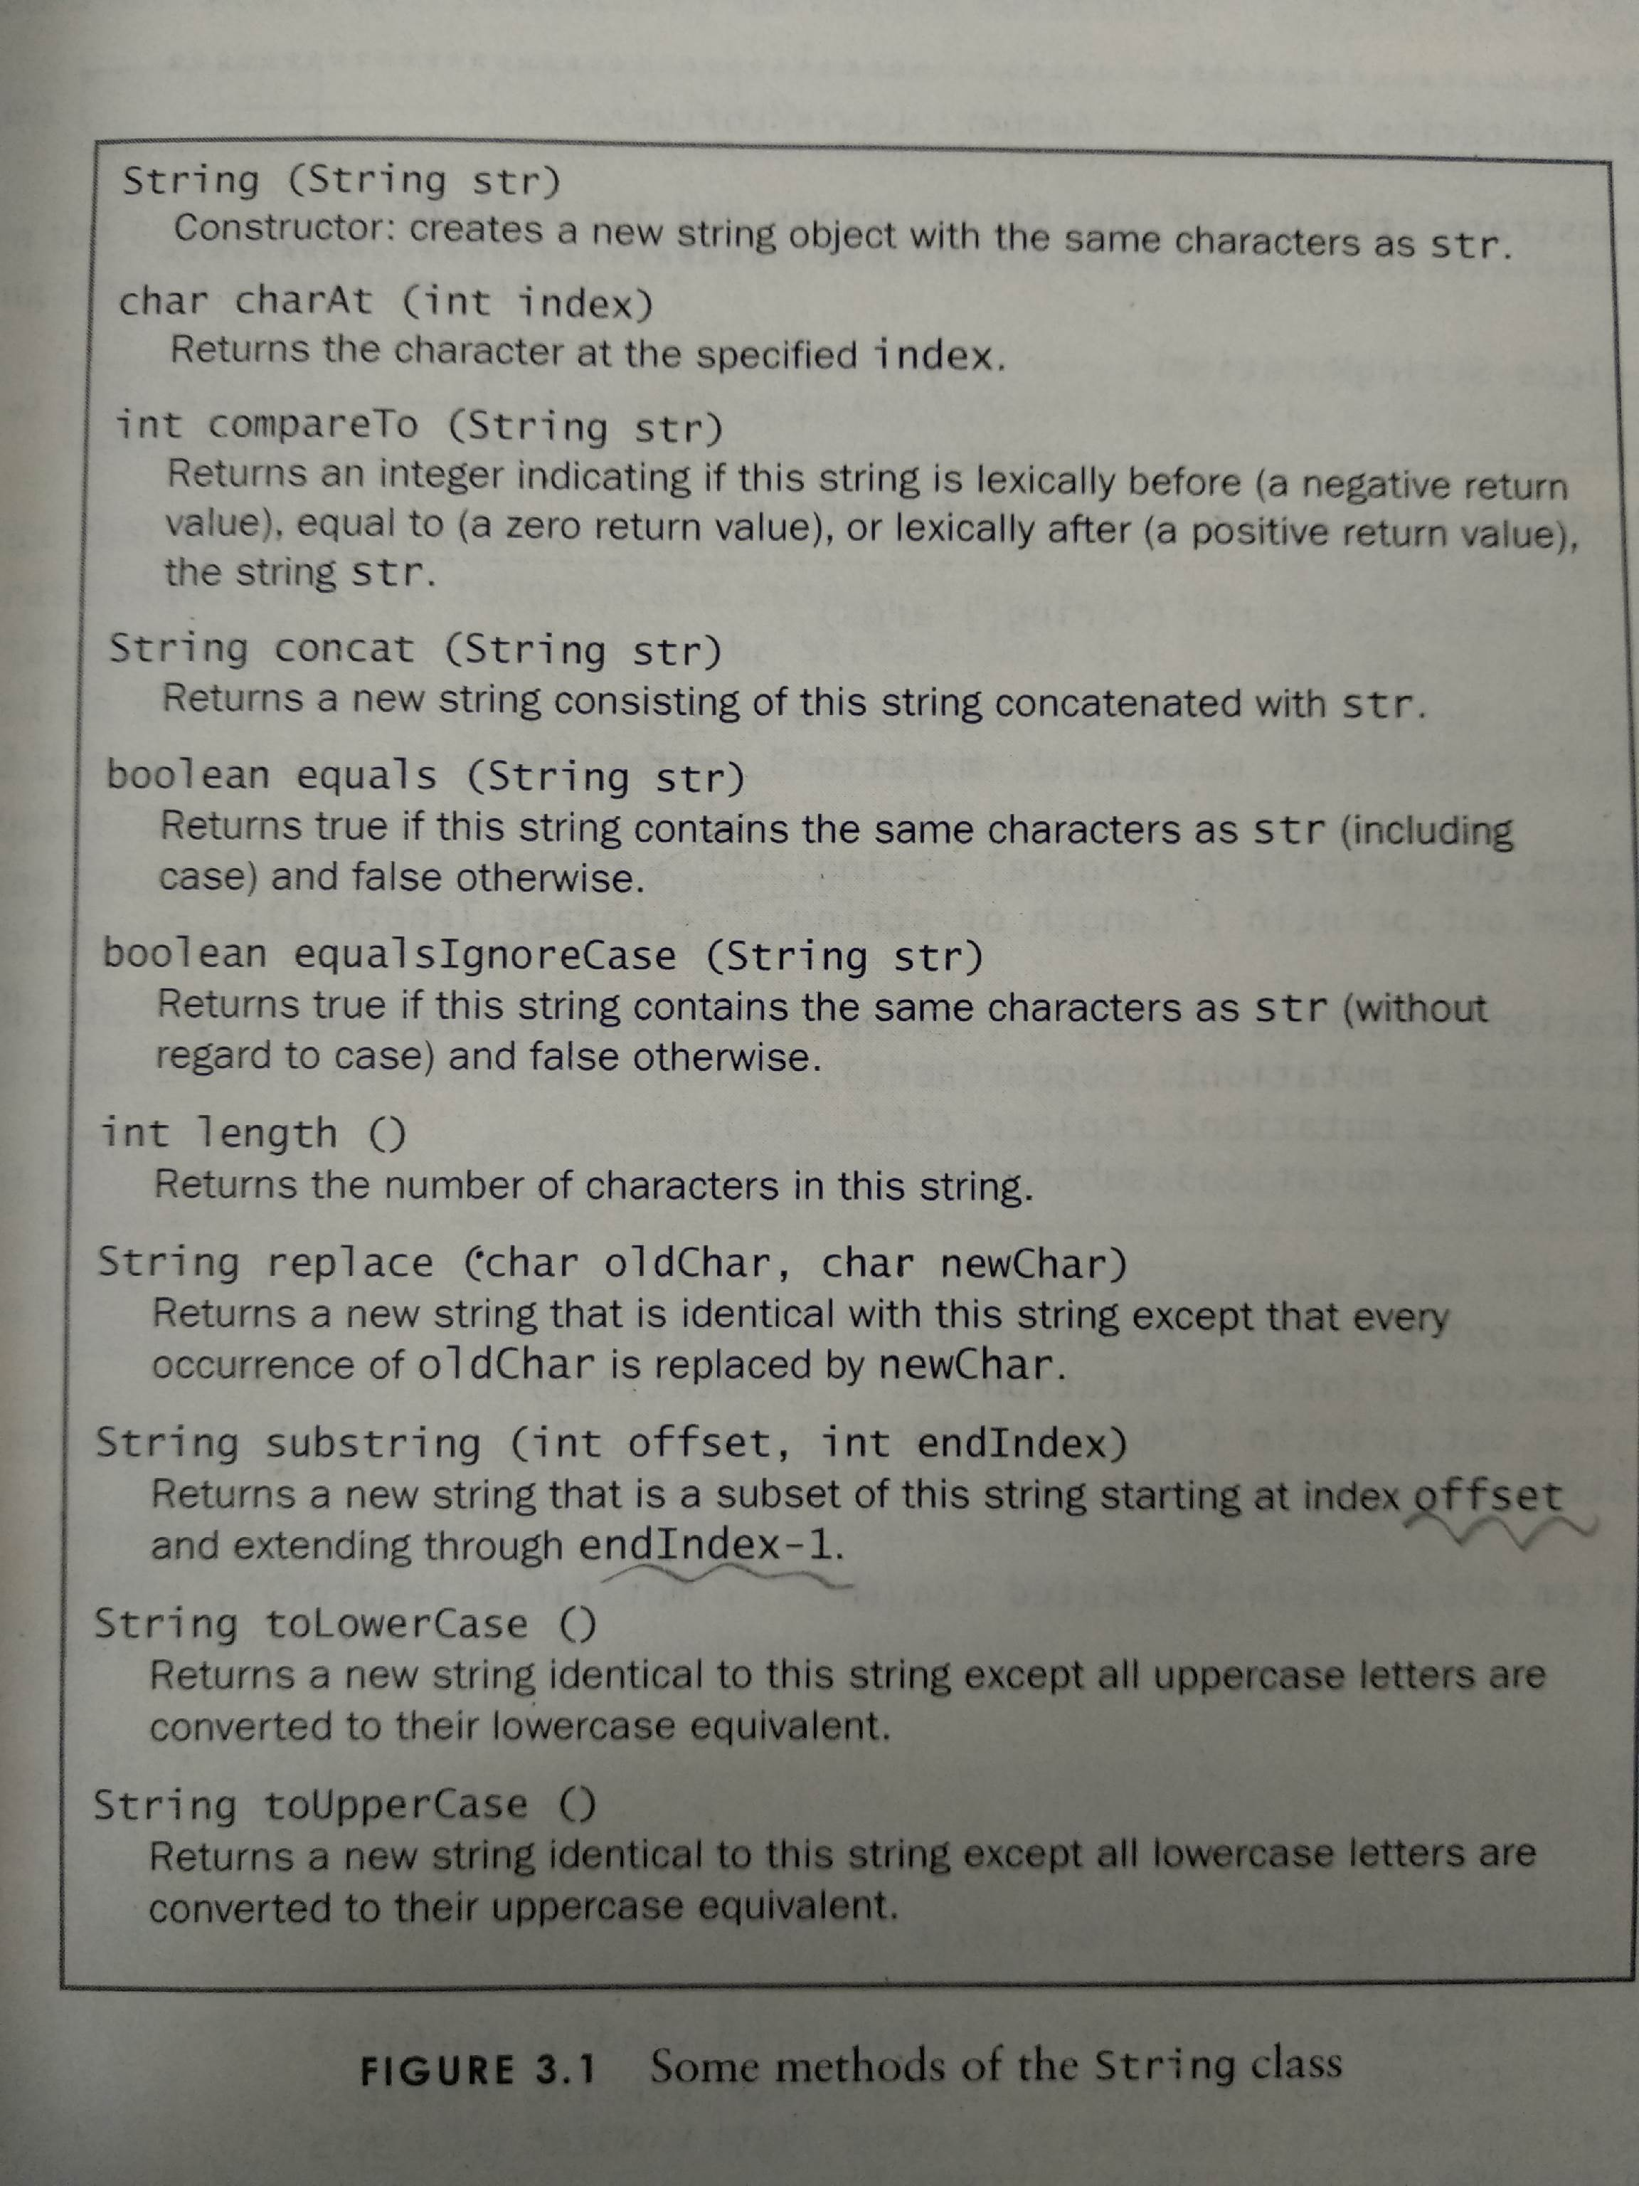
Copyright © 2012 Pearson Education, Inc.

Slide 20
int compareTo(String anotherString)
this.compareTo(anotherString)
按字典顺序比较两个字符串。该比较基于字符串中各个字符的 Unicode 值。
按字典顺序将此 String 对象表示的字符序列与参数字符串所表示的字符序列进行比较。
  如果按字典顺序此 String 对象位于参数字符串之前，则比较结果为一个负整数。
  如果按字典顺序此 String 对象位于参数字符串之后，则比较结果为一个正整数。
  如果这两个字符串相等，则结果为 0；
Copyright © 2012 Pearson Education, Inc.

Slide 21
两个字符串不同
在某个索引处的字符不同（该索引对二者均为有效索引）
字符串长度不同
或者同时具备这两种情况。
如果它们在一个或多个索引位置上的字符不同：
假设 k 是这类索引的最小值；则在位置 k 上具有较小值的那个字符串（使用 < 运算符确定），其字典顺序在其他字符串之前。 在这种情况下，compareTo 返回这两个字符串在位置 k 处两个char 值的差，
*： 这个. charat （k） - 另一个字符串. charat （k）
如果没有字符不同的索引位置，则较短字符串的字典顺序在较长字符串之前
在这种情况下，compareTo 返回这两个字符串长度的差，即值： this.length()-anotherString.length()
Copyright © 2012 Pearson Education, Inc.

Slide 22
String Indexes
引用字符串中的特定字符有时很有帮助
这可以通过指定字符的数字索引来完成
索引在每个字符串中从零开始
在字符串"Hello"中，字符"H"位于索引 0，"o"位于索引 4
请参阅字符串突变.java
Copyright © 2012 Pearson Education, Inc.

Slide 23
//********************************************************************
// StringMutation.java Author: Lewis/Loftus
//
// Demonstrates the use of the String class and its methods.
//********************************************************************
public class StringMutation
{
//-----------------------------------------------------------------
// Prints a string and various mutations of it.
//-----------------------------------------------------------------
public static void main (String[] args)
{
String phrase = "Change is inevitable";
String mutation1, mutation2, mutation3, mutation4;
System.out.println ("Original string: \"" + phrase + "\"");
System.out.println ("Length of string: " + phrase.length());
mutation1 = phrase.concat (", except from vending machines.");
mutation2 = mutation1.toUpperCase();
mutation3 = mutation2.replace ('E', 'X');
mutation4 = mutation3.substring (3, 30);
continued
Copyright © 2012 Pearson Education, Inc.

Slide 24
continued
// Print each mutated string
System.out.println ("Mutation #1: " + mutation1);
System.out.println ("Mutation #2: " + mutation2);
System.out.println ("Mutation #3: " + mutation3);
System.out.println ("Mutation #4: " + mutation4);
System.out.println ("Mutated length: " + mutation4.length());
}
}
Copyright © 2012 Pearson Education, Inc.

Slide 25
Output
Original string: "Change is inevitable"
Length of string: 20
Mutation #1: Change is inevitable, except from vending machines.
Mutation #2: CHANGE IS INEVITABLE, EXCEPT FROM VENDING MACHINES.
Mutation #3: CHANGX IS INXVITABLX, XXCXPT FROM VXNDING MACHINXS.
Mutation #4: NGX IS INXVITABLX, XXCXPT F
Mutated length: 27
continued
// Print each mutated string
System.out.println ("Mutation #1: " + mutation1);
System.out.println ("Mutation #2: " + mutation2);
System.out.println ("Mutation #3: " + mutation3);
System.out.println ("Mutation #4: " + mutation4);
System.out.println ("Mutated length: " + mutation4.length());
}
}
Copyright © 2012 Pearson Education, Inc.

Slide 26
Quick Check
What output is produced by the following?
字符串 str = "空间，最终边界";
系统.out.println （长度））;
系统.out.println （str.子字符串（7））;
System.out.println （str.toUpperCase（））;
系统.out.println （长度））;
Copyright © 2012 Pearson Education, Inc.

Slide 27
Quick Check
What output is produced by the following?
String str = "Space, the final frontier.";
System.out.println (str.length());
System.out.println (str.substring(7));
System.out.println (str.toUpperCase());
System.out.println (str.length());
26
the final frontier.
SPACE, THE FINAL FRONTIER.
26
Copyright © 2012 Pearson Education, Inc.

Slide 28
Outline
Creating Objects
The String Class
The Random and Math Classes
Formatting Output
Enumerated Types
Wrapper Classes
Copyright © 2012 Pearson Education, Inc.

Slide 29
Class Libraries
类库是我们在开发程序时可以使用的类的集合
Java 标准类库是任何 Java 开发环境的一部分
它的类不是Java语言的一部分，但我们严重依赖它们
我们已经使用的各种类（系统、扫描仪、字符串）是 Java 标准类库的一部分
Copyright © 2012 Pearson Education, Inc.

Slide 30
The Java API
Java 类库有时称为 Java API
API 代表应用程序编程接口
相关类的群集有时称为特定 API：
摆动 API
数据库 API
Copyright © 2012 Pearson Education, Inc.

Slide 31
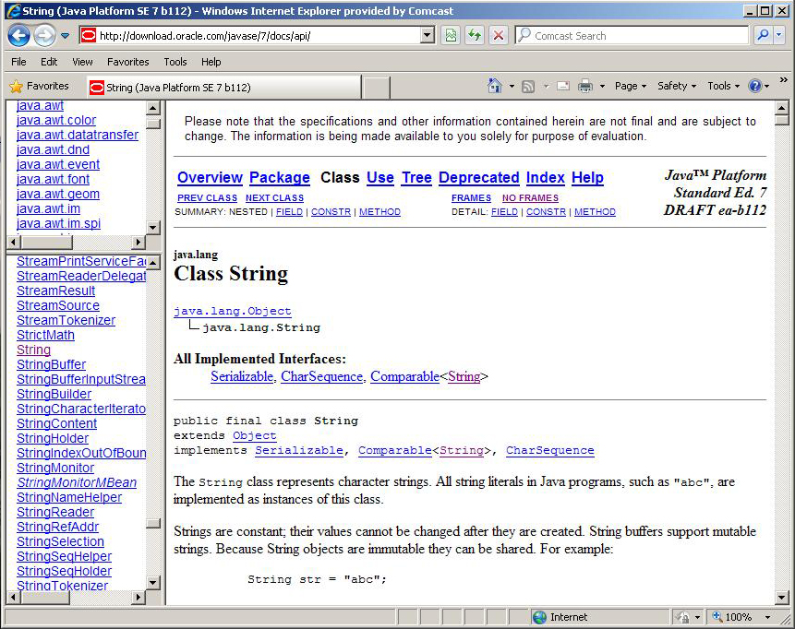
The Java API
Get comfortable navigating the online Java API documentation
Copyright © 2012 Pearson Education, Inc.

Slide 32
Packages
为了访问它们，Java API 中的类被组织成包
这些通常与特定的 API 重叠
例子：
包
java. lang
java. applet
java. awt
javax. 摆动
java.net
java. util
javax. xml. 解析器
目的
一般支持
为 Web 创建小应用程序
图形和图形用户界面
其他图形功能
网络通信
公用事业
XML 文档处理
Copyright © 2012 Pearson Education, Inc.

Slide 33
The import Declaration
当您想要使用包的类时，可以使用其完全限定的名称
java. util. 扫描仪
或者您可以导入类，然后仅使用类名
导入 java. util. 扫描仪;
若要导入特定包中的所有类，可以使用 * 通配符
导入 java.util.*;
Copyright © 2012 Pearson Education, Inc.

Slide 34
The import Declaration
java.lang 包的所有类都自动导入到所有程序中
好像所有程序都包含以下行：
导入 java.lang.*;
这就是为什么我们不必在较早的程序中显式导入系统或字符串类
另一方面，Scanner 类是 java.util 包的一部分，因此必须导入
Copyright © 2012 Pearson Education, Inc.

Slide 35
The Random Class
随机类是 java.util 包的一部分
它提供了生成伪随机数的方法
随机对象根据种子值执行复杂的计算，以生成看似随机的值流
请参阅随机数字.java
Copyright © 2012 Pearson Education, Inc.

Slide 36
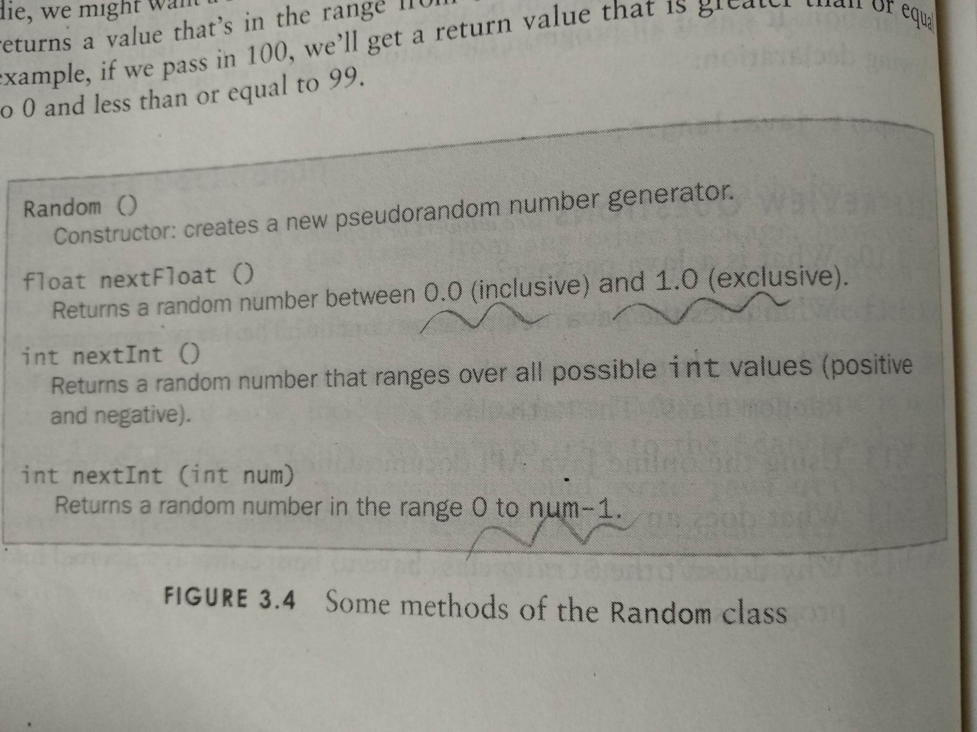
Copyright © 2012 Pearson Education, Inc.

Slide 37
//********************************************************************
// RandomNumbers.java Author: Lewis/Loftus
//
// Demonstrates the creation of pseudo-random numbers using the
// Random class.
//********************************************************************
import java.util.Random;
public class RandomNumbers
{
//-----------------------------------------------------------------
// Generates random numbers in various ranges.
//-----------------------------------------------------------------
public static void main (String[] args)
{
Random generator = new Random();
int num1;
float num2;
num1 = generator.nextInt();
System.out.println ("A random integer: " + num1);
num1 = generator.nextInt(10);
System.out.println ("From 0 to 9: " + num1);
continued
Copyright © 2012 Pearson Education, Inc.

Slide 38
continued
num1 = generator.nextInt(10) + 1;
System.out.println ("From 1 to 10: " + num1);
num1 = generator.nextInt(15) + 20;
System.out.println ("From 20 to 34: " + num1);
num1 = generator.nextInt(20) - 10;
System.out.println ("From -10 to 9: " + num1);
num2 = generator.nextFloat();
System.out.println ("A random float (between 0-1): " + num2);
num2 = generator.nextFloat() * 6; // 0.0 to 5.999999
num1 = (int)num2 + 1;
System.out.println ("From 1 to 6: " + num1);
}
}
Copyright © 2012 Pearson Education, Inc.

Slide 39
Sample Run
A random integer: 672981683
From 0 to 9: 0
From 1 to 10: 3
From 20 to 34: 30
From -10 to 9: -4
A random float (between 0-1): 0.18538326
From 1 to 6: 3
continued
num1 = generator.nextInt(10) + 1;
System.out.println ("From 1 to 10: " + num1);
num1 = generator.nextInt(15) + 20;
System.out.println ("From 20 to 34: " + num1);
num1 = generator.nextInt(20) - 10;
System.out.println ("From -10 to 9: " + num1);
num2 = generator.nextFloat();
System.out.println ("A random float (between 0-1): " + num2);
num2 = generator.nextFloat() * 6; // 0.0 to 5.999999
num1 = (int)num2 + 1;
System.out.println ("From 1 to 6: " + num1);
}
}
Copyright © 2012 Pearson Education, Inc.

Slide 40
Quick Check
Given a Random object named gen, what range of values are produced by the following expressions?
gen.nextInt(25)
gen.nextInt(6) + 1
gen.nextInt(100) + 10
gen.nextInt(50) + 100
gen.nextInt(10) – 5
gen.nextInt(22) + 12
Copyright © 2012 Pearson Education, Inc.

Slide 41
Quick Check
Given a Random object named gen, what range of values are produced by the following expressions?
Range
0 to 24
1 to 6
10 to 109
100 to 149
-5 to 4
12 to 33
gen.nextInt(25)
gen.nextInt(6) + 1
gen.nextInt(100) + 10
gen.nextInt(50) + 100
gen.nextInt(10) – 5
gen.nextInt(22) + 12
Copyright © 2012 Pearson Education, Inc.

Slide 42
Quick Check
Write an expression that produces a random integer in the following ranges:
Range
0 to 12
1 to 20
15 to 20
-10 to 0
Copyright © 2012 Pearson Education, Inc.

Slide 43
Quick Check
Write an expression that produces a random integer in the following ranges:
Range
0 to 12
1 to 20
15 to 20
-10 to 0
gen.nextInt(13)
gen.nextInt(20) + 1
gen.nextInt(6) + 15
gen.nextInt(11) – 10
Copyright © 2012 Pearson Education, Inc.

Slide 44
The Math Class
The Math class is part of the java.lang package
The Math class contains methods that perform various mathematical functions
These include:
  absolute value
  square root
  exponentiation
  trigonometric functions
Copyright © 2012 Pearson Education, Inc.

Slide 45
The Math Class
The methods of the Math class are static methods (also called class methods)
Static methods are invoked through the class name – no object of the Math class is needed
value = Math.cos(90) + Math.sqrt(delta);
We discuss static methods further in Chapter 7
See Quadratic.java
Copyright © 2012 Pearson Education, Inc.

Slide 46
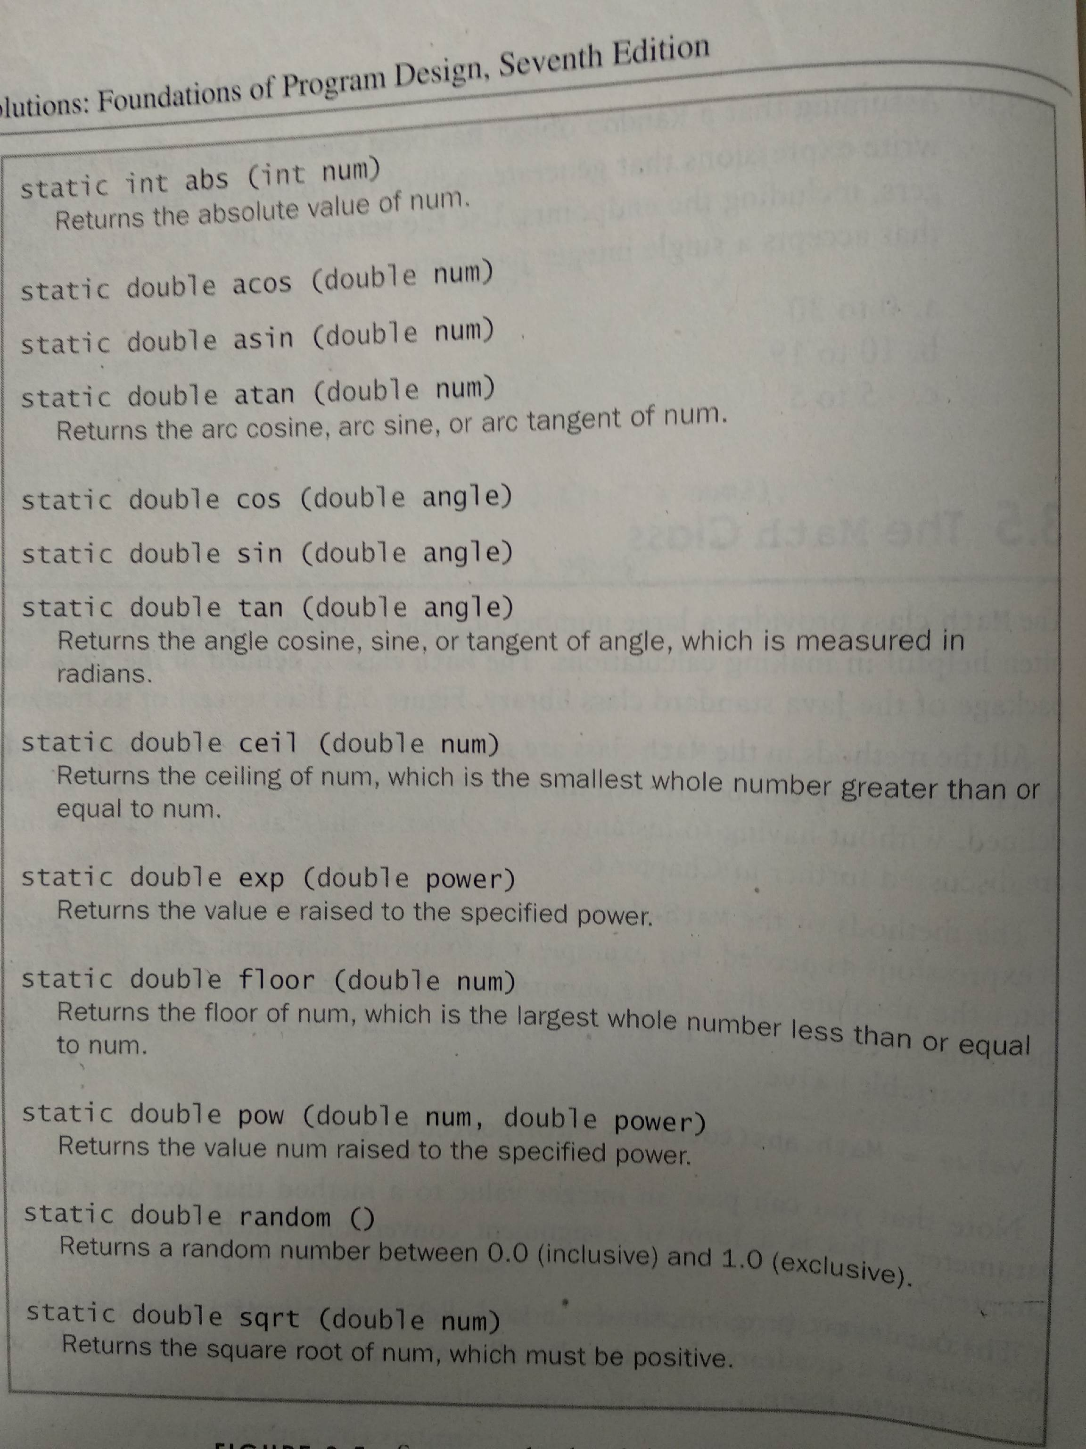
Copyright © 2012 Pearson Education, Inc.

Slide 47
//********************************************************************
// Quadratic.java Author: Lewis/Loftus
//
// Demonstrates the use of the Math class to perform a calculation
// based on user input.
//********************************************************************
import java.util.Scanner;
public class Quadratic
{
//-----------------------------------------------------------------
// Determines the roots of a quadratic equation.
//-----------------------------------------------------------------
public static void main (String[] args)
{
int a, b, c; // ax^2 + bx + c
double discriminant, root1, root2;
Scanner scan = new Scanner (System.in);
System.out.print ("Enter the coefficient of x squared: ");
a = scan.nextInt();
continued
Copyright © 2012 Pearson Education, Inc.

Slide 48
continued
System.out.print ("Enter the coefficient of x: ");
b = scan.nextInt();
System.out.print ("Enter the constant: ");
c = scan.nextInt();
// Use the quadratic formula to compute the roots.
// Assumes a positive discriminant.
discriminant = Math.pow(b, 2) - (4 * a * c);
root1 = ((-1 * b) + Math.sqrt(discriminant)) / (2 * a);
root2 = ((-1 * b) - Math.sqrt(discriminant)) / (2 * a);
System.out.println ("Root #1: " + root1);
System.out.println ("Root #2: " + root2);
}
}
Copyright © 2012 Pearson Education, Inc.

Slide 49
Sample Run
Enter the coefficient of x squared: 3
Enter the coefficient of x: 8
Enter the constant: 4
Root #1: -0.6666666666666666
Root #2: -2.0
continued
System.out.print ("Enter the coefficient of x: ");
b = scan.nextInt();
System.out.print ("Enter the constant: ");
c = scan.nextInt();
// Use the quadratic formula to compute the roots.
// Assumes a positive discriminant.
discriminant = Math.pow(b, 2) - (4 * a * c);
root1 = ((-1 * b) + Math.sqrt(discriminant)) / (2 * a);
root2 = ((-1 * b) - Math.sqrt(discriminant)) / (2 * a);
System.out.println ("Root #1: " + root1);
System.out.println ("Root #2: " + root2);
}
}
Copyright © 2012 Pearson Education, Inc.

Slide 50
Outline
Creating Objects
The String Class
The Random and Math Classes
Formatting Output
Enumerated Types
Wrapper Classes
Copyright © 2012 Pearson Education, Inc.

Slide 51
Formatting Output
通常需要以某些方式格式化输出值，以便正确显示它们
Java 标准类库包含提供格式设置功能的类
NumberFormat 类允许您将值格式化为货币或百分比
十进制格式类允许您基于模式设置值的格式
两者都是 java.文本包的一部分
Copyright © 2012 Pearson Education, Inc.

Slide 52
Formatting Output
NumberFormat 类具有返回格式化对象的静态方法
获取货币（）
get 百分位 （）
每个 formatter 对象都有一种称为格式的方法，该方法返回一个字符串，该字符串具有适当的格式中指定的信息
请参阅购买.java
Copyright © 2012 Pearson Education, Inc.

Slide 53
//********************************************************************
// Purchase.java Author: Lewis/Loftus
//
// Demonstrates the use of the NumberFormat class to format output.
//********************************************************************
import java.util.Scanner;
import java.text.NumberFormat;
public class Purchase
{
//-----------------------------------------------------------------
// Calculates the final price of a purchased item using values
// entered by the user.
//-----------------------------------------------------------------
public static void main (String[] args)
{
final double TAX_RATE = 0.06; // 6% sales tax
int quantity;
double subtotal, tax, totalCost, unitPrice;
Scanner scan = new Scanner (System.in);
continued
Copyright © 2012 Pearson Education, Inc.

Slide 54
continued
NumberFormat fmt1 = NumberFormat.getCurrencyInstance();
NumberFormat fmt2 = NumberFormat.getPercentInstance();
System.out.print ("Enter the quantity: ");
quantity = scan.nextInt();
System.out.print ("Enter the unit price: ");
unitPrice = scan.nextDouble();
subtotal = quantity * unitPrice;
tax = subtotal * TAX_RATE;
totalCost = subtotal + tax;
// Print output with appropriate formatting
System.out.println ("Subtotal: " + fmt1.format(subtotal));
System.out.println ("Tax: " + fmt1.format(tax) + " at "
+ fmt2.format(TAX_RATE));
System.out.println ("Total: " + fmt1.format(totalCost));
}
}
Copyright © 2012 Pearson Education, Inc.

Slide 55
Sample Run
Enter the quantity: 5
Enter the unit price: 3.87
Subtotal: $19.35
Tax: $1.16 at 6%
Total: $20.51
continued
NumberFormat fmt1 = NumberFormat.getCurrencyInstance();
NumberFormat fmt2 = NumberFormat.getPercentInstance();
System.out.print ("Enter the quantity: ");
quantity = scan.nextInt();
System.out.print ("Enter the unit price: ");
unitPrice = scan.nextDouble();
subtotal = quantity * unitPrice;
tax = subtotal * TAX_RATE;
totalCost = subtotal + tax;
// Print output with appropriate formatting
System.out.println ("Subtotal: " + fmt1.format(subtotal));
System.out.println ("Tax: " + fmt1.format(tax) + " at "
+ fmt2.format(TAX_RATE));
System.out.println ("Total: " + fmt1.format(totalCost));
}
}
Copyright © 2012 Pearson Education, Inc.

Slide 56
Formatting Output
DecimalFormat 类可用于以各种方式设置浮点值的格式
例如，您可以指定将数字截断为小数位三位
DecimalFormat 类的构造函数采用一个字符串，该字符串表示格式化数字的模式
请参阅 CircleStats. java
Copyright © 2012 Pearson Education, Inc.

Slide 57
//********************************************************************
// CircleStats.java Author: Lewis/Loftus
//
// Demonstrates the formatting of decimal values using the
// DecimalFormat class.
//********************************************************************
import java.util.Scanner;
import java.text.DecimalFormat;
public class CircleStats
{
//-----------------------------------------------------------------
// Calculates the area and circumference of a circle given its
// radius.
//-----------------------------------------------------------------
public static void main (String[] args)
{
int radius;
double area, circumference;
Scanner scan = new Scanner (System.in);
continued
Copyright © 2012 Pearson Education, Inc.

Slide 58
continued
System.out.print ("Enter the circle's radius: ");
radius = scan.nextInt();
area = Math.PI * Math.pow(radius, 2);
circumference = 2 * Math.PI * radius;
// Round the output to three decimal places
DecimalFormat fmt = new DecimalFormat ("0.###");
System.out.println ("The circle's area: " + fmt.format(area));
System.out.println ("The circle's circumference: "
+ fmt.format(circumference));
}
}
Copyright © 2012 Pearson Education, Inc.

Slide 59
Sample Run
Enter the circle's radius: 5
The circle's area: 78.54
The circle's circumference: 31.416
continued
System.out.print ("Enter the circle's radius: ");
radius = scan.nextInt();
area = Math.PI * Math.pow(radius, 2);
circumference = 2 * Math.PI * radius;
// Round the output to three decimal places
DecimalFormat fmt = new DecimalFormat ("0.###");
System.out.println ("The circle's area: " + fmt.format(area));
System.out.println ("The circle's circumference: "
+ fmt.format(circumference));
}
}
Copyright © 2012 Pearson Education, Inc.

Slide 60
Outline
Creating Objects
The String Class
The Random and Math Classes
Formatting Output
Enumerated Types
Wrapper Classes
Copyright © 2012 Pearson Education, Inc.

Slide 61
Enumerated(枚举) Types
Java 允许您定义枚举类型，然后可用于声明变量
枚举类型声明列出该类型的变量的所有可能值
这些值是您自己选择的标识符
以下声明创建名为"季节"的枚举类型
冬名季节 [冬天，春天，夏天，秋天];
可以列出任何数量的值
Copyright © 2012 Pearson Education, Inc.

Slide 62
Enumerated Types
定义类型后，可以声明该类型的变量：
季节时间;
可以分配一个值：
时间 = 季节. 秋天;
这些值通过类型的名称引用
枚举类型是类型安全的 - 除列出的值外，您不能分配任何值
Copyright © 2012 Pearson Education, Inc.

Slide 63
Ordinal Values
在内部，枚举类型的每个值都存储为整数，称为其序号值
枚举类型中的第一个值的序号值为零，第二个值，等等。
但是，您不能将数值分配给枚举类型，即使它对应于有效的序号值
Copyright © 2012 Pearson Education, Inc.

Slide 64
Enumerated Types
枚举类型的声明是一种特殊类型的类，该类型的每个变量都是一个对象
序号方法返回对象的序号值
name 方法返回与对象值对应的标识符的名称
请参阅冰淇淋. java
Copyright © 2012 Pearson Education, Inc.

Slide 65
//********************************************************************
// IceCream.java Author: Lewis/Loftus
//
// Demonstrates the use of enumerated types.
//********************************************************************
public class IceCream
{
enum Flavor {vanilla, chocolate, strawberry, fudgeRipple, coffee,
rockyRoad, mintChocolateChip, cookieDough}
//-----------------------------------------------------------------
// Creates and uses variables of the Flavor type.
//-----------------------------------------------------------------
public static void main (String[] args)
{
Flavor cone1, cone2, cone3;
cone1 = Flavor.rockyRoad;
cone2 = Flavor.chocolate;
System.out.println ("cone1 value: " + cone1);
System.out.println ("cone1 ordinal: " + cone1.ordinal());
System.out.println ("cone1 name: " + cone1.name());
continued
Copyright © 2012 Pearson Education, Inc.

Slide 66
continued
System.out.println ();
System.out.println ("cone2 value: " + cone2);
System.out.println ("cone2 ordinal: " + cone2.ordinal());
System.out.println ("cone2 name: " + cone2.name());
cone3 = cone1;
System.out.println ();
System.out.println ("cone3 value: " + cone3);
System.out.println ("cone3 ordinal: " + cone3.ordinal());
System.out.println ("cone3 name: " + cone3.name());
}
}
Copyright © 2012 Pearson Education, Inc.

Slide 67
Output
cone1 value: rockyRoad
cone1 ordinal: 5
cone1 name: rockyRoad
cone2 value: chocolate
cone2 ordinal: 1
cone2 name: chocolate
cone3 value: rockyRoad
cone3 ordinal: 5
cone3 name: rockyRoad
continued
System.out.println ();
System.out.println ("cone2 value: " + cone2);
System.out.println ("cone2 ordinal: " + cone2.ordinal());
System.out.println ("cone2 name: " + cone2.name());
cone3 = cone1;
System.out.println ();
System.out.println ("cone3 value: " + cone3);
System.out.println ("cone3 ordinal: " + cone3.ordinal());
System.out.println ("cone3 name: " + cone3.name());
}
}
Copyright © 2012 Pearson Education, Inc.

Slide 68
public class Enumtest {
public enum Color {
RED("红色", 1), GREEN("绿色", 2), BLANK("白色", 3), YELLO("黄色", 4);
// 成员变量
private String name;
private int index;
// 构造方法
private Color(String name, int index) {
this.name = name;
this.index = index;
}
// 覆盖方法
@Override
public String toString() {
return this.index + "_" + this.name;
}
}
Copyright © 2012 Pearson Education, Inc.

Slide 69
Output
co1 value: 1_红色
co1 ordinal: 0
co1 name: RED
co2 value: 2_绿色
co2 ordinal: 1
co2 name: GREEN
public static void main(String[] args) {
Color co1, co2;
co1 = Color.RED;
co2 = Color.GREEN;
System.out.println("co1 value: " + co1);
System.out.println("co1 ordinal: " + co1.ordinal());
System.out.println("co1 name: " + co1.name());
System.out.println();
System.out.println("co2 value: " + co2);
System.out.println("co2 ordinal: " + co2.ordinal());
System.out.println("co2 name: " + co2.name());
}
}
Copyright © 2012 Pearson Education, Inc.

Slide 70
Outline
Creating Objects
The String Class
The Random and Math Classes
Formatting Output
Enumerated Types
Wrapper Classes
Copyright © 2012 Pearson Education, Inc.

Slide 71
Wrapper Classes
java.lang 包包含对应于每个基元类型的包装类：
Primitive Type | Wrapper Class
byte | Byte
short | Short
int | Integer
long | Long
float | Float
double | Double
char | Character
boolean | Boolean

Slide 72
Wrapper Classes
以下声明创建一个将整数 40 表示为对象的整数对象
整数年龄 = 新整数（40）;
包装类的对象可用于基元值不足的任何情况
例如，某些对象充当其他对象的容器
原始值不能存储在此类容器中，但包装对象可以
Copyright © 2012 Pearson Education, Inc.

Slide 73
Wrapper Classes
包装器类还包含有助于管理关联类型的静态方法
例如，Integer 类包含一个将存储在 String 中的整数转换为 int 值的方法：
num = 整数.解析（str）;
它们通常也包含有用的常量
例如，Integer 类包含MIN_VALUE和MAX_VALUE包含最小和最大的 int 值
Copyright © 2012 Pearson Education, Inc.

Slide 74
Wrapper Classes
Public static toString(int i)；
int i=100;
String s= Integer.toString(i);
Copyright © 2012 Pearson Education, Inc.

Slide 75
Autoboxing
自动装箱是基元值自动转换为相应的包装对象：
整数 obj;
int num = 42;
obj = num;
赋值创建相应的整数对象
反向转换（称为取消装箱）也会根据需要自动发生
Copyright © 2012 Pearson Education, Inc.

Slide 76
Quick Check
Are the following assignments valid? Explain.
Double value = 15.75;
Character ch = new Character('T');
char myChar = ch;
Copyright © 2012 Pearson Education, Inc.

Slide 77
Quick Check
Are the following assignments valid? Explain.
Double value = 15.75;
Character ch = new Character('T');
char myChar = ch;
Yes. The double literal is autoboxed into a Double object.
Yes, the char in the object is unboxed before the assignment.
Copyright © 2012 Pearson Education, Inc.

Slide 78
Summary
第 3 章侧重于：
对象创建和对象引用
字符串类及其方法
Java 标准类库
随机和数学类
格式化输出
枚举类型
包装器类
Copyright © 2012 Pearson Education, Inc.

