Slide 1
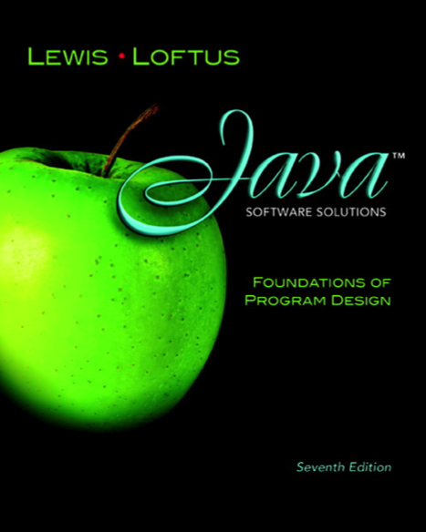

Chapter 4
Writing Classes
Java Software Solutions
Foundations of Program Design
Seventh Edition
John Lewis
William Loftus
Copyright © 2012 Pearson Education, Inc.

Slide 2
Writing Classes
We've been using predefined classes from the Java API. Now we will learn to write our own classes.
Chapter 4 focuses on:
  class definitions
  instance data
  encapsulation and Java modifiers
  method declaration and parameter passing
  Constructors(构造函数)
Copyright © 2012 Pearson Education, Inc.

Slide 3
Outline
Anatomy of a Class
Encapsulation
Anatomy of a Method
Copyright © 2012 Pearson Education, Inc.

Slide 4
Writing Classes
The programs we’ve written in previous examples have used classes defined in the Java standard class library
Now we will begin to design programs that rely on classes that we write ourselves
The class that contains the main method is just the starting point of a program
True object-oriented programming is based on defining classes that represent objects with well-defined characteristics and functionality
Copyright © 2012 Pearson Education, Inc.

Slide 5
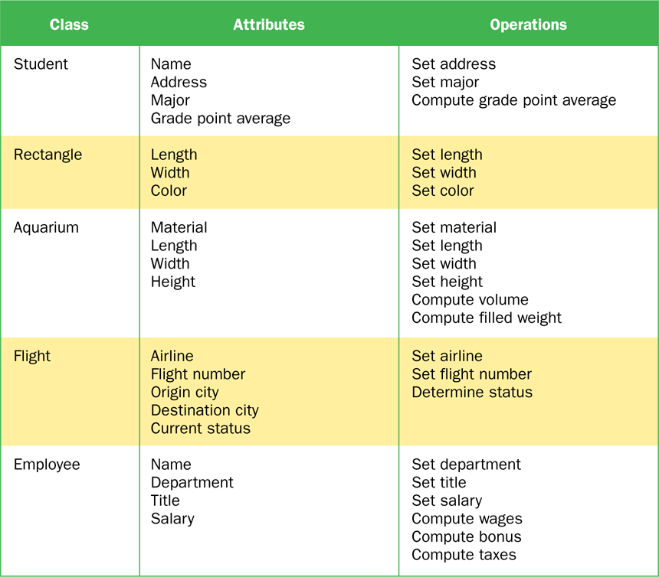
Examples of Classes
Copyright © 2012 Pearson Education, Inc.

Slide 6
Classes and Objects
Recall from our overview of objects in Chapter 1 that an object has state and behavior
Consider a six-sided die (singular of dice)
  It’s state can be defined as which face is showing
  It’s primary behavior is that it can be rolled
We represent a die by designing a class called Die that models this state and behavior
  The class serves as the blueprint for a die object
We can then instantiate as many die objects as we need for any particular program
Copyright © 2012 Pearson Education, Inc.

Slide 7
Classes
A class can contain data declarations and method declarations
int size, weight;
char category;
Data declarations
Method declarations
Copyright © 2012 Pearson Education, Inc.

Slide 8
Classes
The values of the data define the state of an object created from the class
The functionality of the methods define the behaviors of the object
For our Die class, we might declare an integer called faceValue that represents the current value showing on the face
One of the methods would “roll” the die by setting faceValue to a random number between one and six
Copyright © 2012 Pearson Education, Inc.

Slide 9
Classes
We’ll want to design the Die class so that it is a versatile and reusable resource
Any given program will probably not use all operations of a given class
See RollingDice.java
See Die.java
Copyright © 2012 Pearson Education, Inc.

Slide 10
//********************************************************************
// RollingDice.java Author: Lewis/Loftus
//
// Demonstrates the creation and use of a user-defined class.
//********************************************************************
public class RollingDice
{
//-----------------------------------------------------------------
// Creates two Die objects and rolls them several times.
//-----------------------------------------------------------------
public static void main (String[] args)
{
Die die1, die2;
int sum;
die1 = new Die();
die2 = new Die();
die1.roll();
die2.roll();
System.out.println ("Die One: " + die1 + ", Die Two: " + die2);
continue
Copyright © 2012 Pearson Education, Inc.

Slide 11
continue
die1.roll();
die2.setFaceValue(4);
System.out.println ("Die One: " + die1 + ", Die Two: " + die2);
sum = die1.getFaceValue() + die2.getFaceValue();
System.out.println ("Sum: " + sum);
sum = die1.roll() + die2.roll();
System.out.println ("Die One: " + die1 + ", Die Two: " + die2);
System.out.println ("New sum: " + sum);
}
}
Copyright © 2012 Pearson Education, Inc.

Slide 12
Sample Run
Die One: 5, Die Two: 2
Die One: 1, Die Two: 4
Sum: 5
Die One: 4, Die Two: 2
New sum: 6
continue
die1.roll();
die2.setFaceValue(4);
System.out.println ("Die One: " + die1 + ", Die Two: " + die2);
sum = die1.getFaceValue() + die2.getFaceValue();
System.out.println ("Sum: " + sum);
sum = die1.roll() + die2.roll();
System.out.println ("Die One: " + die1 + ", Die Two: " + die2);
System.out.println ("New sum: " + sum);
}
}
Copyright © 2012 Pearson Education, Inc.

Slide 13
//********************************************************************
// Die.java Author: Lewis/Loftus
//
// Represents one die (singular of dice) with faces showing values
// between 1 and 6.
//********************************************************************
public class Die
{
private final int MAX = 6; // maximum face value
private int faceValue; // current value showing on the die
//-----------------------------------------------------------------
// Constructor: Sets the initial face value.
//-----------------------------------------------------------------
public Die()
{
faceValue = 1;
}
continue
Copyright © 2012 Pearson Education, Inc.

Slide 14
continue
//-----------------------------------------------------------------
// Rolls the die and returns the result.
//-----------------------------------------------------------------
public int roll()
{
faceValue = (int)(Math.random() * MAX) + 1;
return faceValue;
}
//-----------------------------------------------------------------
// Face value mutator.
//-----------------------------------------------------------------
public void setFaceValue (int value)
{
faceValue = value;
}
//-----------------------------------------------------------------
// Face value accessor.
//-----------------------------------------------------------------
public int getFaceValue()
{
return faceValue;
}
continue
Copyright © 2012 Pearson Education, Inc.

Slide 15
continue
//-----------------------------------------------------------------
// Returns a string representation of this die.
//-----------------------------------------------------------------
public String toString()
{
String result = Integer.toString(faceValue);
return result;
}
}
Copyright © 2012 Pearson Education, Inc.

Slide 16
The Die Class
The Die class contains two data values
  a constant MAX that represents the maximum face value
  an integer faceValue that represents the current face value
The roll method uses the random method of the Math class to determine a new face value
There are also methods to explicitly set and retrieve the current face value at any time
Copyright © 2012 Pearson Education, Inc.

Slide 17
The toString Method
It's good practice to define a toString method for a class
The toString method returns a character string that represents the object in some way
It is called automatically when an object is concatenated to a string or when it is passed to the println method
It's also convenient for debugging problems
Copyright © 2012 Pearson Education, Inc.

Slide 18
Constructors(构造函数)
As mentioned previously, a constructor is used to set up an object when it is initially created
A constructor has the same name as the class
The Die constructor is used to set the initial face value of each new die object to one
We examine constructors in more detail later in this chapter
Copyright © 2012 Pearson Education, Inc.

Slide 19
Data Scope
The scope of data is the area in a program in which that data can be referenced (used)
Data declared at the class level can be referenced by all methods in that class
Data declared within a method can be used only in that method
Data declared within a method is called local data
In the Die class, the variable result is declared inside the toString method -- it is local to that method and cannot be referenced anywhere else
Copyright © 2012 Pearson Education, Inc.

Slide 20
Instance Data
A variable declared at the class level (such as faceValue) is called instance data
Each instance (object) has its own instance variable
A class declares the type of the data, but it does not reserve memory space for it
Each time a Die object is created, a new faceValue variable is created as well
The objects of a class share the method definitions, but each object has its own data space
That's the only way two objects can have different states
Copyright © 2012 Pearson Education, Inc.

Slide 21
Instance Data
We can depict the two Die objects from the RollingDice program as follows:
die1
faceValue
5
die2
faceValue
2
Each object maintains its own faceValue variable, and thus its own state
Copyright © 2012 Pearson Education, Inc.

Slide 22
UML Diagrams
UML stands for the Unified Modeling Language
UML diagrams show relationships among classes and objects
A UML class diagram consists of one or more classes, each with sections for the class name, attributes (data), and operations (methods)
Lines between classes represent associations
A dotted arrow shows that one class uses the other (calls its methods)
Copyright © 2012 Pearson Education, Inc.

Slide 23
UML Class Diagrams
A UML class diagram for the RollingDice program:
RollingDice
Die
faceValue : int
main (args : String[]) : void
roll() : int
setFaceValue (int value) : void
getFaceValue() : int
toString() : String

Slide 24
Quick Check
What is the relationship between a class and an object?
Copyright © 2012 Pearson Education, Inc.

Slide 25

主观题
答案解析
10分
答案解析
What is the relationship between a class and an object?
A class is the definition/pattern/blueprint of an object. It defines the data that will be managed by an object but doesn't reserve memory space for it. Multiple objects can be created from a class, and each object has its own copy of the instance data.
正常使用主观题需2.0以上版本雨课堂
作答
可为此题添加文本、图片、公式等解析，且需将内容全部放在本区域内。正常使用需3.0以上版本
Copyright © 2012 Pearson Education, Inc.

Slide 26
Quick Check
What is the relationship between a class and an object?
A class is the definition/pattern/blueprint of an object. It defines the data that will be managed by an object but doesn't reserve memory space for it. Multiple objects can be created from a class, and each object has its own copy of the instance data.
Copyright © 2012 Pearson Education, Inc.

Slide 27
Quick Check
Where is instance data declared?
What is the scope of instance data?
What is local data?
Copyright © 2012 Pearson Education, Inc.

Slide 28
主观题
答案解析
10分
答案解析
At the class level
2.It can be referenced in any method of the class.
3. Local data is declared within a method, and is only accessible in that method.
1.Where is instance data declared?
2. What is the scope of instance data?
3. What is local data?
正常使用主观题需2.0以上版本雨课堂
作答
可为此题添加文本、图片、公式等解析，且需将内容全部放在本区域内。正常使用需3.0以上版本
Copyright © 2012 Pearson Education, Inc.

Slide 29
Quick Check
Where is instance data declared?
What is the scope of instance data?
What is local data?
At the class level.
It can be referenced in any method of the class.
Local data is declared within a method, and is only accessible in that method.
Copyright © 2012 Pearson Education, Inc.

Slide 30
Outline
Anatomy of a Class
Encapsulation
Anatomy of a Method
Copyright © 2012 Pearson Education, Inc.

Slide 31
Encapsulation(封装)
We can take one of two views of an object:
  internal - the details of the variables and methods of the class that defines it
  external - the services that an object provides and how the object interacts with the rest of the system
From the external view, an object is an encapsulated entity, providing a set of specific services
These services define the interface to the object
Copyright © 2012 Pearson Education, Inc.

Slide 32
Encapsulation
One object (called the client) may use another object for the services it provides
The client of an object may request its services (call its methods), but it should not have to be aware of how those services are accomplished
Any changes to the object's state (its variables) should be made by that object's methods
We should make it difficult, if not impossible, for a client to access an object’s variables directly
That is, an object should be self-governing
Copyright © 2012 Pearson Education, Inc.

Slide 33
Encapsulation
An encapsulated object can be thought of as a black box -- its inner workings are hidden from the client
The client invokes the interface methods and they manage the instance data
Client
Methods
Data
Copyright © 2012 Pearson Education, Inc.

Slide 34
Visibility Modifiers
In Java, we accomplish encapsulation through the appropriate use of visibility modifiers
A modifier is a Java reserved word that specifies particular characteristics of a method or data
We've used the final modifier to define constants
Java has three visibility modifiers: public, protected, and private
The protected modifier involves inheritance, which we will discuss later
Copyright © 2012 Pearson Education, Inc.

Slide 35
Visibility Modifiers
Members of a class that are declared with public visibility can be referenced anywhere
Members of a class that are declared with private visibility can be referenced only within that class
Members declared without a visibility modifier have default visibility and can be referenced by any class in the same package
An overview of all Java modifiers is presented in Appendix E
Copyright © 2012 Pearson Education, Inc.

Slide 36
Visibility Modifiers
Public variables violate encapsulation because they allow the client to modify the values directly
Therefore instance variables should not be declared with public visibility
It is acceptable to give a constant public visibility, which allows it to be used outside of the class
Public constants do not violate encapsulation because, although the client can access it, its value cannot be changed
Copyright © 2012 Pearson Education, Inc.

Slide 37
Visibility Modifiers
Methods that provide the object's services are declared with public visibility so that they can be invoked by clients
Public methods are also called service methods
A method created simply to assist a service method is called a support method
Since a support method is not intended to be called by a client, it should not be declared with public visibility
Copyright © 2012 Pearson Education, Inc.

Slide 38
Visibility Modifiers
public
private
Violate
encapsulation
Enforce
encapsulation
Variables
Support other
methods in the
class
Provide services
to clients
Methods
Copyright © 2012 Pearson Education, Inc.

Slide 39
Accessors and Mutators
Because instance data is private, a class usually provides services to access and modify data values
An accessor method returns the current value of a variable
A mutator method changes the value of a variable
The names of accessor and mutator methods take the form getX and setX, respectively, where X is the name of the value
They are sometimes called “getters” and “setters”
Copyright © 2012 Pearson Education, Inc.

Slide 40
Mutator Restrictions
The use of mutators gives the class designer the ability to restrict a client’s options to modify an object’s state
A mutator is often designed so that the values of variables can be set only within particular limits
For example, the setFaceValue mutator of the Die class should restrict the value to the valid range (1 to MAX)
We’ll see in Chapter 5 how such restrictions can be implemented
Copyright © 2012 Pearson Education, Inc.

Slide 41
Quick Check
Why was the faceValue variable declared as private in the Die class?
Why is it ok to declare MAX as public in the Die class?
Copyright © 2012 Pearson Education, Inc.

Slide 42
Quick Check
Why was the faceValue variable declared as private in the Die class?
Why is it ok to declare MAX as public in the Die class?
By making it private, each Die object controls its own data and allows it to be modified only by the well-defined operations it provides.
MAX is a constant. Its value cannot be changed. Therefore, there is no violation of encapsulation.
Copyright © 2012 Pearson Education, Inc.

Slide 43
Outline
Anatomy of a Class
Encapsulation
Anatomy of a Method
Copyright © 2012 Pearson Education, Inc.

Slide 44
Method Declarations
Let’s now examine methods in more detail
A method declaration specifies the code that will be executed when the method is invoked (called)
When a method is invoked, the flow of control jumps to the method and executes its code
When complete, the flow returns to the place where the method was called and continues
The invocation may or may not return a value, depending on how the method is defined
Copyright © 2012 Pearson Education, Inc.

Slide 45
Method Control Flow
If the called method is in the same class, only the method name is needed
compute
myMethod
myMethod();
Copyright © 2012 Pearson Education, Inc.

Slide 46
Method Control Flow
The called method is often part of another class or object
main
doIt
helpMe
obj.doIt();
helpMe();
Copyright © 2012 Pearson Education, Inc.

Slide 47
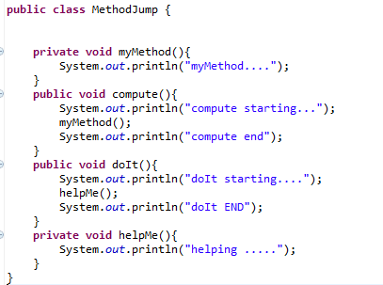
MethodJump.java
Copyright © 2012 Pearson Education, Inc.

Slide 48
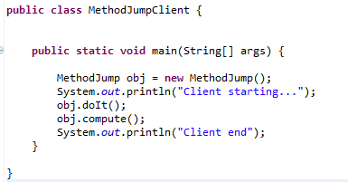
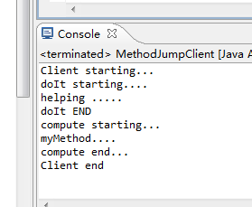
MethodJumpClient.java
Copyright © 2012 Pearson Education, Inc.

Slide 49
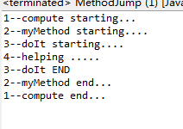
public class MethodJump {
public void myMethod(){
System.out.println("2--myMethod starting....");
doIt();
System.out.println("2--myMethod end...");
}
public void compute(){
System.out.println("1--compute starting...");
myMethod();
System.out.println("1--compute end...");
}
public void doIt(){
System.out.println("3--doIt starting....");
helpMe();
System.out.println("3--doIt END");
}
public void helpMe(){
System.out.println("4--helping .....");
}
public static void main(String[] args) {
MethodJump m=new MethodJump();
m.compute();
}
}
Copyright © 2012 Pearson Education, Inc.

Slide 50
Method Header
A method declaration begins with a method header
char calc (int num1, int num2, String message)
method
name
parameter list
return
type
The parameter list specifies the type
and name of each parameter
The name of a parameter in the method
declaration is called a formal parameter
Copyright © 2012 Pearson Education, Inc.

Slide 51
Method Body
The method header is followed by the method body
char calc (int num1, int num2, String message)
{
int sum = num1 + num2;
char result = message.charAt (sum);
return result;
}
sum and result
are local data
They are created each time the method is called, and are destroyed when it finishes executing
The return expression
must be consistent with
the return type
Copyright © 2012 Pearson Education, Inc.

Slide 52
The return Statement
The return type of a method indicates the type of value that the method sends back to the calling location
A method that does not return a value has a void return type
A return statement specifies the value that will be returned
return expression;
Its expression must conform to the return type
Copyright © 2012 Pearson Education, Inc.

Slide 53
Parameters
When a method is called, the actual parameters in the invocation are copied into the formal parameters in the method header
ch = obj.calc (25, count, "Hello");
char calc (int num1, int num2, String message)
{
int sum = num1 + num2;
char result = message.charAt (sum);
return result;
}
Copyright © 2012 Pearson Education, Inc.

Slide 54
Local Data
As we’ve seen, local variables can be declared inside a method
The formal parameters of a method create automatic local variables when the method is invoked
When the method finishes, all local variables are destroyed (including the formal parameters)
Keep in mind that instance variables, declared at the class level, exists as long as the object exists
Copyright © 2012 Pearson Education, Inc.

Slide 55
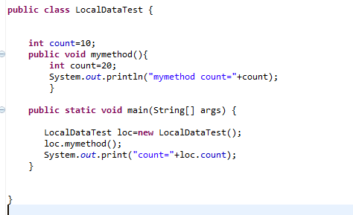
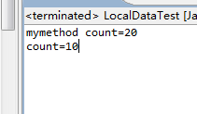
实例数据和局部数据重名
Copyright © 2012 Pearson Education, Inc.

Slide 56
Bank Account Example
Let’s look at another example that demonstrates the implementation details of classes and methods
We’ll represent a bank account by a class named Account
It’s state can include the account number, the current balance, and the name of the owner
An account’s behaviors (or services) include deposits and withdrawals, and adding interest
Copyright © 2012 Pearson Education, Inc.

Slide 57
Driver Programs
A driver program drives the use of other, more interesting parts of a program
Driver programs are often used to test other parts of the software
The Transactions class contains a main method that drives the use of the Account class, exercising its services
See Transactions.java
See Account.java
Copyright © 2012 Pearson Education, Inc.

Slide 58
//********************************************************************
// Transactions.java Author: Lewis/Loftus
//
// Demonstrates the creation and use of multiple Account objects.
//********************************************************************
public class Transactions
{
//-----------------------------------------------------------------
// Creates some bank accounts and requests various services.
//-----------------------------------------------------------------
public static void main (String[] args)
{
Account acct1 = new Account ("Ted Murphy", 72354, 102.56);
Account acct2 = new Account ("Jane Smith", 69713, 40.00);
Account acct3 = new Account ("Edward Demsey", 93757, 759.32);
acct1.deposit (25.85);
double smithBalance = acct2.deposit (500.00);
System.out.println ("Smith balance after deposit: " +
smithBalance);
continue
Copyright © 2012 Pearson Education, Inc.

Slide 59
continue
System.out.println ("Smith balance after withdrawal: " +
acct2.withdraw (430.75, 1.50));
acct1.addInterest();
acct2.addInterest();
acct3.addInterest();
System.out.println ();
System.out.println (acct1);
System.out.println (acct2);
System.out.println (acct3);
}
}
Copyright © 2012 Pearson Education, Inc.

Slide 60
Output
Smith balance after deposit: 540.0
Smith balance after withdrawal: 107.55
72354 Ted Murphy $132.90
69713 Jane Smith $111.52
93757 Edward Demsey $785.90
continue
System.out.println ("Smith balance after withdrawal: " +
acct2.withdraw (430.75, 1.50));
acct1.addInterest();
acct2.addInterest();
acct3.addInterest();
System.out.println ();
System.out.println (acct1);
System.out.println (acct2);
System.out.println (acct3);
}
}
Copyright © 2012 Pearson Education, Inc.

Slide 61
//********************************************************************
// Account.java Author: Lewis/Loftus
//
// Represents a bank account with basic services such as deposit
// and withdraw.
//********************************************************************
import java.text.NumberFormat;
public class Account
{
private final double RATE = 0.035; // interest rate of 3.5%
private long acctNumber;
private double balance;
private String name;
//-----------------------------------------------------------------
// Sets up the account by defining its owner, account number,
// and initial balance.
//-----------------------------------------------------------------
public Account (String owner, long account, double initial)
{
name = owner;
acctNumber = account;
balance = initial;
}
continue
Copyright © 2012 Pearson Education, Inc.

Slide 62
continue
//-----------------------------------------------------------------
// Deposits the specified amount into the account. Returns the
// new balance.
//-----------------------------------------------------------------
public double deposit (double amount)
{
balance = balance + amount;
return balance;
}
//-----------------------------------------------------------------
// Withdraws the specified amount from the account and applies
// the fee. Returns the new balance.
//-----------------------------------------------------------------
public double withdraw (double amount, double fee)
{
balance = balance - amount - fee;
return balance;
}
continue
Copyright © 2012 Pearson Education, Inc.

Slide 63
continue
//-----------------------------------------------------------------
// Adds interest to the account and returns the new balance.
//-----------------------------------------------------------------
public double addInterest ()
{
balance += (balance * RATE);
return balance;
}
//-----------------------------------------------------------------
// Returns the current balance of the account.
//-----------------------------------------------------------------
public double getBalance ()
{
return balance;
}
//-----------------------------------------------------------------
// Returns a one-line description of the account as a string.
//-----------------------------------------------------------------
public String toString ()
{
NumberFormat fmt = NumberFormat.getCurrencyInstance();
return (acctNumber + "\t" + name + "\t" + fmt.format(balance));
}
}
Copyright © 2012 Pearson Education, Inc.

Slide 64
Bank Account Example
acct1
acctNumber
72354
balance
102.56
name
"Ted Murphy"
acct2
acctNumber
69713
balance
40.00
name
"Jane Smith"
Copyright © 2012 Pearson Education, Inc.

Slide 65
Bank Account Example
There are some improvements that can be made to the Account class
Formal getters and setters could have been defined for all data
The design of some methods could also be more robust, such as verifying that the amount parameter to the withdraw method is positive
Copyright © 2012 Pearson Education, Inc.

Slide 66
Constructors Revisited
Note that a constructor has no return type specified in the method header, not even void
A common error is to put a return type on a constructor, which makes it a “regular” method that happens to have the same name as the class
The programmer does not have to define a constructor for a class
Each class has a default constructor that accepts no parameters
Copyright © 2012 Pearson Education, Inc.

Slide 67
Quick Check
How do we express which Account object's balance is updated when a deposit is made?
Copyright © 2012 Pearson Education, Inc.

Slide 68
Quick Check
How do we express which Account object's balance is updated when a deposit is made?
Each account is referenced by an object reference variable:
Account myAcct = new Account(…);
and when a method is called, you call it through a particular object:
myAcct.deposit(50);
Copyright © 2012 Pearson Education, Inc.

Slide 69
Summary
Chapter 4 focused on:
  class definitions
  instance data
  encapsulation and Java modifiers
  method declaration and parameter passing
  constructors
Copyright © 2012 Pearson Education, Inc.

