Slide 1
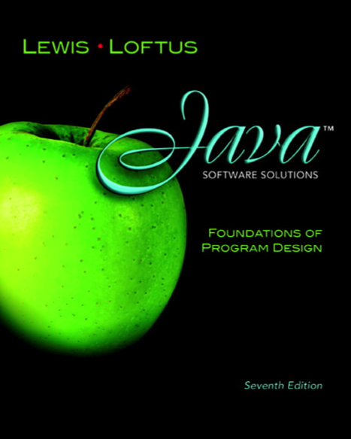

Chapter 5
Conditionals and Loops
Java Software Solutions
Foundations of Program Design
Seventh Edition
John Lewis
William Loftus
Copyright © 2012 Pearson Education, Inc.

Slide 2
Conditionals and Loops
Now we will examine programming statements that allow us to:
  make decisions
  repeat processing steps in a loop
Chapter 5 focuses on:
  boolean expressions
  the if and if-else statements
  comparing data
  while loops
  iterators
Copyright © 2012 Pearson Education, Inc.

Slide 3
Outline
Boolean Expressions
The if Statement
Comparing Data
The while Statement
Iterators
The ArrayList Class
Copyright © 2012 Pearson Education, Inc.

Slide 4
Flow of Control
Unless specified otherwise, the order of statement execution through a method is linear: one after another
Some programming statements allow us to make decisions and perform repetitions
These decisions are based on boolean expressions (also called conditions) that evaluate to true or false
The order of statement execution is called the flow of control
Copyright © 2012 Pearson Education, Inc.

Slide 5
Conditional Statements
A conditional statement lets us choose which statement will be executed next
They are sometimes called selection statements
Conditional statements give us the power to make basic decisions
The Java conditional statements are the:
  if and if-else statement
  switch statement
We'll explore the switch statement in Chapter 6
Copyright © 2012 Pearson Education, Inc.

Slide 6
Boolean Expressions
A condition often uses one of Java's equality operators or relational operators, which all return boolean results:
      == equal to
      != not equal to
      < less than
      > greater than
      <= less than or equal to
      >= greater than or equal to
Note the difference between the equality operator (==) and the assignment operator (=)
Copyright © 2012 Pearson Education, Inc.

Slide 7
Boolean Expressions
An if statement with its boolean condition:
if (sum > MAX)
delta = sum – MAX;
First, the condition is evaluated: the value of sum is either greater than the value of MAX, or it is not
If the condition is true, the assignment statement is executed; if it isn't, it is skipped
See Age.java
Copyright © 2012 Pearson Education, Inc.

Slide 8
//********************************************************************
// Age.java Author: Lewis/Loftus
//
// Demonstrates the use of an if statement.
//********************************************************************
import java.util.Scanner;
public class Age
{
//-----------------------------------------------------------------
// Reads the user's age and prints comments accordingly.
//-----------------------------------------------------------------
public static void main (String[] args)
{
final int MINOR = 21;
Scanner scan = new Scanner (System.in);
System.out.print ("Enter your age: ");
int age = scan.nextInt();
continue
Copyright © 2012 Pearson Education, Inc.

Slide 9
continue
System.out.println ("You entered: " + age);
if (age < MINOR)
System.out.println ("Youth is a wonderful thing. Enjoy.");
System.out.println ("Age is a state of mind.");
}
}
Copyright © 2012 Pearson Education, Inc.

Slide 10
Sample Run
Enter your age: 47
You entered: 47
Age is a state of mind.
continue
System.out.println ("You entered: " + age);
if (age < MINOR)
System.out.println ("Youth is a wonderful thing. Enjoy.");
System.out.println ("Age is a state of mind.");
}
}
Another Sample Run
Enter your age: 12
You entered: 12
Youth is a wonderful thing. Enjoy.
Age is a state of mind.
Copyright © 2012 Pearson Education, Inc.

Slide 11
Logical Operators
Boolean expressions can also use the following logical operators:
  ! Logical NOT
  && Logical AND
  || Logical OR
They all take boolean operands and produce boolean results
Logical NOT is a unary operator (it operates on one operand)
Logical AND and logical OR are binary operators (each operates on two operands)
Copyright © 2012 Pearson Education, Inc.

Slide 12
Logical NOT
The logical NOT operation is also called logical negation or logical complement
If some boolean condition a is true, then !a is false; if a is false, then !a is true
Logical expressions can be shown using a truth table:
a | !a
true | false
false | true
Copyright © 2012 Pearson Education, Inc.

Slide 13
Logical AND and Logical OR
The logical AND expression
a && b
is true if both a and b are true, and false otherwise
The logical OR expression
a || b
is true if a or b or both are true, and false otherwise
Copyright © 2012 Pearson Education, Inc.

Slide 14
Logical AND and Logical OR
A truth table shows all possible true-false combinations of the terms
Since && and || each have two operands, there are four possible combinations of conditions a and b
a | b | a && b | a || b
true | true | true | true
true | false | false | true
false | true | false | true
false | false | false | false
Copyright © 2012 Pearson Education, Inc.

Slide 15
Logical Operators
Expressions that use logical operators can form complex conditions
if (total < MAX && !found)
System.out.println ("Processing…");
All logical operators have lower precedence than the relational operators
The ! operator has higher precedence than && and ||
Copyright © 2012 Pearson Education, Inc.

Slide 16
Boolean Expressions
Specific expressions can be evaluated using truth tables
total < MAX | found | !found | total < MAX && !found
false | false | true | false
false | true | false | false
true | false | true | true
true | true | false | false
Copyright © 2012 Pearson Education, Inc.

Slide 17
Short-Circuited Operators
The processing of && and || is “short-circuited”
If the left operand is sufficient to determine the result, the right operand is not evaluated
if (count != 0 && total/count > MAX)
System.out.println ("Testing.");
This type of processing should be used carefully
Copyright © 2012 Pearson Education, Inc.

Slide 18
Outline
Boolean Expressions
The if Statement
Comparing Data
The while Statement
Iterators
The ArrayList Class
Determining Event Sources
Check Boxes and Radio Buttons
Copyright © 2012 Pearson Education, Inc.

Slide 19
The if Statement
Let's now look at the if statement in more detail
The if statement has the following syntax:
The condition must be a
boolean expression. It must
evaluate to either true or false.
if is a Java
reserved word
if ( condition )
statement;
If the condition is true, the statement is executed.
If it is false, the statement is skipped.
Copyright © 2012 Pearson Education, Inc.

Slide 20
Logic of an if statement
condition
evaluated
true
false
statement
Copyright © 2012 Pearson Education, Inc.

Slide 21
Indentation
The statement controlled by the if statement is indented to indicate that relationship
The use of a consistent indentation style makes a program easier to read and understand
The compiler ignores indentation, which can lead to errors if the indentation is not correct
"Always code as if the person who ends up maintaining your code will be a violent psychopath who knows where you live."
-- Martin Golding
Copyright © 2012 Pearson Education, Inc.

Slide 22
Quick Check
What do the following statements do?
if (total != stock + warehouse)
inventoryError = true;
if (found || !done)
System.out.println("Ok");
Copyright © 2012 Pearson Education, Inc.

Slide 23
Quick Check
What do the following statements do?
if (total != stock + warehouse)
inventoryError = true;
Sets the boolean variable to true if the value of total
is not equal to the sum of stock and warehouse
if (found || !done)
System.out.println("Ok");
Prints "Ok" if found is true or done is false
Copyright © 2012 Pearson Education, Inc.

Slide 24

主观题
10分
int a = 5;
int b = -5;
int c = 20;
int d = -20;
if ((b-- < -5) && (a++ < 5) || (c < 30)) {
System.out.println("HERE FIRST");
}
System.out.println("FIRST a is " + a);
System.out.println("FIRST b is " + b);
正常使用主观题需2.0以上版本雨课堂
作答
Copyright © 2012 Pearson Education, Inc.

Slide 25
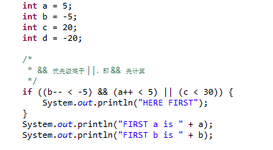
HERE FIRST
FIRST a is 5
FIRST b is -6
Copyright © 2012 Pearson Education, Inc.

Slide 26
主观题
10分
a = 5;
b = -5;
c=20;
if ((c < 30) || (b-- < -5) && (a++ < 5)) {
System.out.println("HERE Second");
}
System.out.println("Second a is " + a);
System.out.println("Second b is " + b);
a = 5;
b = -5;
c=20; d=-20;
if ((c < 20) || (a++ < 5) && (b-- < -5) || (d++ < -10)) {
System.out.println("HERE Third");
}
System.out.println("Third a is " + a);
System.out.println("Third b is " + b);
System.out.println("Third d is " + d);
正常使用主观题需2.0以上版本雨课堂
作答
Copyright © 2012 Pearson Education, Inc.

Slide 27
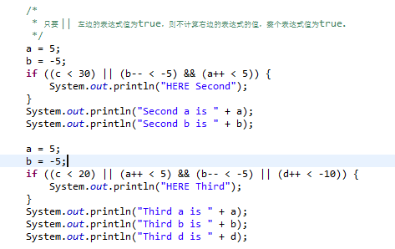
HERE Second
Second a is 5
Second b is -5
HERE Third
Third a is 6
Third b is -5
Third d is -19
Copyright © 2012 Pearson Education, Inc.

Slide 28
主观题
10分
/*
* 运算符 && 左边的表达式值若为 false，则不用计算 && 右边的表达式的值，整个 && 表达式值为 false。
*/
a = 5;
b = -5;
C=20;
if ((c < 20) && (b-- < -5) || (a++ < 15)) {
System.out.println("HERE Fourth");
}
System.out.println("Fourth a is " + a);
System.out.println("Fourth b is " + b);
正常使用主观题需2.0以上版本雨课堂
作答
Copyright © 2012 Pearson Education, Inc.

Slide 29
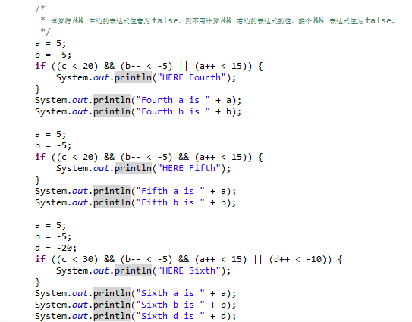
HERE Fourth
Fourth a is 6
Fourth b is -5
Fifth a is 5
Fifth b is -5
HERE Sixth
Sixth a is 5
Sixth b is -6
Sixth d is -19
Copyright © 2012 Pearson Education, Inc.

Slide 30
The if-else Statement
An else clause can be added to an if statement to make an if-else statement
if ( condition )
statement1;
else
statement2;
If the condition is true, statement1 is executed; if the condition is false, statement2 is executed
One or the other will be executed, but not both
See Wages.java
Copyright © 2012 Pearson Education, Inc.

Slide 31
//********************************************************************
// Wages.java Author: Lewis/Loftus
//
// Demonstrates the use of an if-else statement.
//********************************************************************
import java.text.NumberFormat;
import java.util.Scanner;
public class Wages
{
//-----------------------------------------------------------------
// Reads the number of hours worked and calculates wages.
//-----------------------------------------------------------------
public static void main (String[] args)
{
final double RATE = 8.25; // regular pay rate
final int STANDARD = 40; // standard hours in a work week
Scanner scan = new Scanner (System.in);
double pay = 0.0;
continue
Copyright © 2012 Pearson Education, Inc.

Slide 32
continue
System.out.print ("Enter the number of hours worked: ");
int hours = scan.nextInt();
System.out.println ();
// Pay overtime at "time and a half"
if (hours > STANDARD)
pay = STANDARD * RATE + (hours-STANDARD) * (RATE * 1.5);
else
pay = hours * RATE;
NumberFormat fmt = NumberFormat.getCurrencyInstance();
System.out.println ("Gross earnings: " + fmt.format(pay));
}
}
Copyright © 2012 Pearson Education, Inc.

Slide 33
Sample Run
Enter the number of hours worked: 46
Gross earnings: $404.25
continue
System.out.print ("Enter the number of hours worked: ");
int hours = scan.nextInt();
System.out.println ();
// Pay overtime at "time and a half"
if (hours > STANDARD)
pay = STANDARD * RATE + (hours-STANDARD) * (RATE * 1.5);
else
pay = hours * RATE;
NumberFormat fmt = NumberFormat.getCurrencyInstance();
System.out.println ("Gross earnings: " + fmt.format(pay));
}
}
Copyright © 2012 Pearson Education, Inc.

Slide 34
Logic of an if-else statement
condition
evaluated
true
false
statement1
statement2
Copyright © 2012 Pearson Education, Inc.

Slide 35
The Coin Class
Let's look at an example that uses a class that represents a coin that can be flipped
Instance data is used to indicate which face (heads or tails) is currently showing
See CoinFlip.java
See Coin.java
Copyright © 2012 Pearson Education, Inc.

Slide 36
//********************************************************************
// CoinFlip.java Author: Lewis/Loftus
//
// Demonstrates the use of an if-else statement.
//********************************************************************
public class CoinFlip
{
//-----------------------------------------------------------------
// Creates a Coin object, flips it, and prints the results.
//-----------------------------------------------------------------
public static void main (String[] args)
{
Coin myCoin = new Coin();
myCoin.flip();
System.out.println (myCoin);
if (myCoin.isHeads())
System.out.println ("You win.");
else
System.out.println ("Better luck next time.");
}
}
Copyright © 2012 Pearson Education, Inc.

Slide 37
Sample Run
Tails
Better luck next time.
//********************************************************************
// CoinFlip.java Author: Lewis/Loftus
//
// Demonstrates the use of an if-else statement.
//********************************************************************
public class CoinFlip
{
//-----------------------------------------------------------------
// Creates a Coin object, flips it, and prints the results.
//-----------------------------------------------------------------
public static void main (String[] args)
{
Coin myCoin = new Coin();
myCoin.flip();
System.out.println (myCoin);
if (myCoin.isHeads())
System.out.println ("You win.");
else
System.out.println ("Better luck next time.");
}
}
Copyright © 2012 Pearson Education, Inc.

Slide 38
//********************************************************************
// Coin.java Author: Lewis/Loftus
//
// Represents a coin with two sides that can be flipped.
//********************************************************************
public class Coin
{
private final int HEADS = 0;
private final int TAILS = 1;
private int face;
//-----------------------------------------------------------------
// Sets up the coin by flipping it initially.
//-----------------------------------------------------------------
public Coin ()
{
flip();
}
continue
Copyright © 2012 Pearson Education, Inc.

Slide 39
continue
//-----------------------------------------------------------------
// Flips the coin by randomly choosing a face value.
//-----------------------------------------------------------------
public void flip ()
{
face = (int) (Math.random() * 2);
}
//-----------------------------------------------------------------
// Returns true if the current face of the coin is heads.
//-----------------------------------------------------------------
public boolean isHeads ()
{
return (face == HEADS);
}
continue
Copyright © 2012 Pearson Education, Inc.

Slide 40
continue
//-----------------------------------------------------------------
// Returns the current face of the coin as a string.
//-----------------------------------------------------------------
public String toString()
{
String faceName;
if (face == HEADS)
faceName = "Heads";
else
faceName = "Tails";
return faceName;
}
}
Copyright © 2012 Pearson Education, Inc.

Slide 41
Indentation Revisited
Remember that indentation is for the human reader, and is ignored by the compiler
if (depth >= UPPER_LIMIT)
delta = 100;
else
System.out.println("Reseting Delta");
delta = 0;
Despite what the indentation implies, delta will be set to 0 no matter what
Copyright © 2012 Pearson Education, Inc.

Slide 42
Block Statements
Several statements can be grouped together into a block statement delimited by braces
A block statement can be used wherever a statement is called for in the Java syntax rules
if (total > MAX)
System.out.println ("Error!!");
errorCount++;
Copyright © 2012 Pearson Education, Inc.

Slide 43
Block Statements
The if clause, or the else clause, or both, could govern block statements
See Guessing.java
if (total > MAX)
{
System.out.println ("Error!!");
errorCount++;
}
else
{
System.out.println ("Total: " + total);
current = total*2;
}
Copyright © 2012 Pearson Education, Inc.

Slide 44
//********************************************************************
// Guessing.java Author: Lewis/Loftus
//
// Demonstrates the use of a block statement in an if-else.
//********************************************************************
import java.util.*;
public class Guessing
{
//-----------------------------------------------------------------
// Plays a simple guessing game with the user.
//-----------------------------------------------------------------
public static void main (String[] args)
{
final int MAX = 10;
int answer, guess;
Scanner scan = new Scanner (System.in);
Random generator = new Random();
answer = generator.nextInt(MAX) + 1;
continue
Copyright © 2012 Pearson Education, Inc.

Slide 45
continue
System.out.print ("I'm thinking of a number between 1 and "
+ MAX + ". Guess what it is: ");
guess = scan.nextInt();
if (guess == answer)
System.out.println ("You got it! Good guessing!");
else
{
System.out.println ("That is not correct, sorry.");
System.out.println ("The number was " + answer);
}
}
}
Copyright © 2012 Pearson Education, Inc.

Slide 46
Sample Run
I'm thinking of a number between 1 and 10. Guess what it is: 6
That is not correct, sorry.
The number was 9
continue
System.out.print ("I'm thinking of a number between 1 and "
+ MAX + ". Guess what it is: ");
guess = scan.nextInt();
if (guess == answer)
System.out.println ("You got it! Good guessing!");
else
{
System.out.println ("That is not correct, sorry.");
System.out.println ("The number was " + answer);
}
}
}
Copyright © 2012 Pearson Education, Inc.

Slide 47
Nested if Statements
The statement executed as a result of an if or else clause could be another if statement
These are called nested if statements
An else clause is matched to the last unmatched if (no matter what the indentation implies)
Braces can be used to specify the if statement to which an else clause belongs
See MinOfThree.java
Copyright © 2012 Pearson Education, Inc.

Slide 48
//********************************************************************
// MinOfThree.java Author: Lewis/Loftus
//
// Demonstrates the use of nested if statements.
//********************************************************************
import java.util.Scanner;
public class MinOfThree
{
//-----------------------------------------------------------------
// Reads three integers from the user and determines the smallest
// value.
//-----------------------------------------------------------------
public static void main (String[] args)
{
int num1, num2, num3, min = 0;
Scanner scan = new Scanner (System.in);
System.out.println ("Enter three integers: ");
num1 = scan.nextInt();
num2 = scan.nextInt();
num3 = scan.nextInt();
continue
Copyright © 2012 Pearson Education, Inc.

Slide 49
continue
if (num1 < num2)
if (num1 < num3)
min = num1;
else
min = num3;
else
if (num2 < num3)
min = num2;
else
min = num3;
System.out.println ("Minimum value: " + min);
}
}
Copyright © 2012 Pearson Education, Inc.

Slide 50
Sample Run
Enter three integers:
84 69 90
Minimum value: 69
continue
if (num1 < num2)
if (num1 < num3)
min = num1;
else
min = num3;
else
if (num2 < num3)
min = num2;
else
min = num3;
System.out.println ("Minimum value: " + min);
}
}
Copyright © 2012 Pearson Education, Inc.

Slide 51
public class NestIf {
/**
* @param args
*/
public static void main(String[] args) {
int i = 10, j = 10, k = 200;
  if (i == 10) {
  if (j < 20)
  System.out.println("i==10,j<20");
  if (k > 100)
  System.out.println("i==10,k>100");
  } else
  System.out.println(“i!=10");
}
}
Copyright © 2012 Pearson Education, Inc.
Notes:
Else和同一程序块中最近的没有匹配的IF 配对

Slide 52
If-else-if
public class NestIf {
/**
* @param args
*/
public static void main(String[] args) {
int a = 100;
  if (a > 1000) {
  System.out.println("太好了，我可以买奥迪Q7啦");
  } else if (a > 500) {
  System.out.println("oh，我可以买沃尔沃cx90");
  } else if (a > 30) {
  System.out.println("也不错，别克我也很喜欢");
  } else if (a > 10) {
  System.out.println("捷达有新款哦");
  } else {
  System.out.println(“还是算了吧");
  }
}
}
Copyright © 2012 Pearson Education, Inc.

Slide 53
Outline
Boolean Expressions
The if Statement
Comparing Data
The while Statement
Iterators
The ArrayList Class
Copyright © 2012 Pearson Education, Inc.

Slide 54
Comparing Data
When comparing data using boolean expressions, it's important to understand the nuances of certain data types
Let's examine some key situations:
  Comparing floating point values for equality
  Comparing characters
  Comparing strings (alphabetical order)
  Comparing object vs. comparing object references
Copyright © 2012 Pearson Education, Inc.

Slide 55
Comparing Float Values
You should rarely use the equality operator (==) when comparing two floating point values (float or double)
Two floating point values are equal only if their underlying binary representations match exactly
Computations often result in slight differences that may be irrelevant
In many situations, you might consider two floating point numbers to be "close enough" even if they aren't exactly equal
Copyright © 2012 Pearson Education, Inc.

Slide 56
Comparing Float Values
To determine the equality of two floats, use the following technique:
if (Math.abs(f1 - f2) < TOLERANCE)
System.out.println ("Essentially equal");
If the difference between the two floating point values is less than the tolerance, they are considered to be equal
The tolerance could be set to any appropriate level, such as 0.000001
Copyright © 2012 Pearson Education, Inc.

Slide 57
Comparing Characters
As we've discussed, Java character data is based on the Unicode character set
Unicode establishes a particular numeric value for each character, and therefore an ordering
We can use relational operators on character data based on this ordering
For example, the character '+' is less than the character 'J' because it comes before it in the Unicode character set
Appendix C provides an overview of Unicode
Copyright © 2012 Pearson Education, Inc.

Slide 58
Comparing Characters
In Unicode, the digit characters (0-9) are contiguous and in order
Likewise, the uppercase letters (A-Z) and lowercase letters (a-z) are contiguous and in order
Characters | Unicode Values
0 – 9 | 48 through 57
A – Z | 65 through 90
a – z | 97 through 122
Copyright © 2012 Pearson Education, Inc.

Slide 59
Comparing Strings
Remember that in Java a character string is an object
The equals method can be called with strings to determine if two strings contain exactly the same characters in the same order
The equals method returns a boolean result
if (name1.equals(name2))
System.out.println ("Same name");
Copyright © 2012 Pearson Education, Inc.

Slide 60
Comparing Strings
We cannot use the relational operators to compare strings
The String class contains the compareTo method for determining if one string comes before another
A call to name1.compareTo(name2)
  returns zero if name1 and name2 are equal (contain the same characters)
  returns a negative value if name1 is less than name2
  returns a positive value if name1 is greater than name2
Copyright © 2012 Pearson Education, Inc.

Slide 61
Comparing Strings
Because comparing characters and strings is based on a character set, it is called a lexicographic ordering
int result = name1.comareTo(name2);
if (result < 0)
System.out.println (name1 + "comes first");
else
if (result == 0)
System.out.println ("Same name");
else
System.out.println (name2 + "comes first");
Copyright © 2012 Pearson Education, Inc.

Slide 62
Lexicographic Ordering
Lexicographic ordering is not strictly alphabetical when uppercase and lowercase characters are mixed
For example, the string "Great" comes before the string "fantastic" because all of the uppercase letters come before all of the lowercase letters in Unicode
Also, short strings come before longer strings with the same prefix (lexicographically)
Therefore "book" comes before "bookcase"
Copyright © 2012 Pearson Education, Inc.

Slide 63
Comparing Objects
The == operator can be applied to objects – it returns true if the two references are aliases of each other
The equals method is defined for all objects, but unless we redefine it when we write a class, it has the same semantics as the == operator
It has been redefined in the String class to compare the characters in the two strings
When you write a class, you can redefine the equals method to return true under whatever conditions are appropriate
For Student.java Employee.java
Copyright © 2012 Pearson Education, Inc.

Slide 64
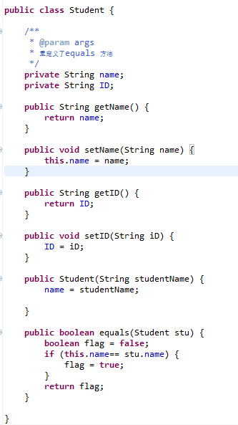
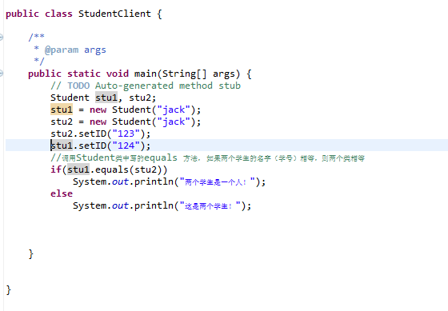
Student.java studentClient.java
Copyright © 2012 Pearson Education, Inc.

Slide 65
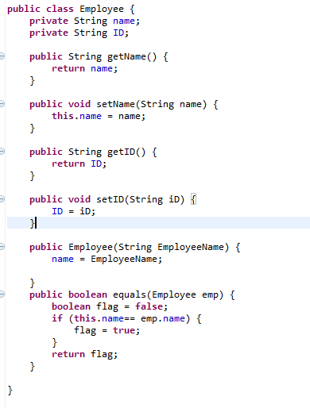
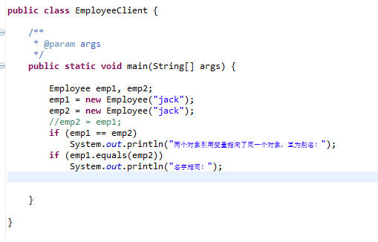
Employee.java EmployeeClient.java
Copyright © 2012 Pearson Education, Inc.

Slide 66
Outline
Boolean Expressions
The if Statement
Comparing Data
The while Statement
Iterators
The ArrayList Class
Copyright © 2012 Pearson Education, Inc.

Slide 67
Repetition Statements
Repetition statements allow us to execute a statement multiple times
Often they are referred to as loops
Like conditional statements, they are controlled by boolean expressions
Java has three kinds of repetition statements: while, do, and for loops
The do and for loops are discussed in Chapter 6
Copyright © 2012 Pearson Education, Inc.

Slide 68
The while Statement
A while statement has the following syntax:
while ( condition )
statement;
If the condition is true, the statement is executed
Then the condition is evaluated again, and if it is still true, the statement is executed again
The statement is executed repeatedly until the condition becomes false
Copyright © 2012 Pearson Education, Inc.

Slide 69
Logic of a while Loop
condition
evaluated
false
true
statement
Copyright © 2012 Pearson Education, Inc.

Slide 70
The while Statement
An example of a while statement:
If the condition of a while loop is false initially, the statement is never executed
Therefore, the body of a while loop will execute zero or more times
int count = 1;
while (count <= 5)
{
System.out.println (count);
count++;
}
Copyright © 2012 Pearson Education, Inc.

Slide 71
Sentinel Values
Let's look at some examples of loop processing
A loop can be used to maintain a running sum
A sentinel value is a special input value that represents the end of input
See Average.java
Copyright © 2012 Pearson Education, Inc.

Slide 72
//********************************************************************
// Average.java Author: Lewis/Loftus
//
// Demonstrates the use of a while loop, a sentinel value, and a
// running sum.
//********************************************************************
import java.text.DecimalFormat;
import java.util.Scanner;
public class Average
{
//-----------------------------------------------------------------
// Computes the average of a set of values entered by the user.
// The running sum is printed as the numbers are entered.
//-----------------------------------------------------------------
public static void main (String[] args)
{
int sum = 0, value, count = 0;
double average;
Scanner scan = new Scanner (System.in);
System.out.print ("Enter an integer (0 to quit): ");
value = scan.nextInt();
continue
Copyright © 2012 Pearson Education, Inc.

Slide 73
continue
while (value != 0) // sentinel value of 0 to terminate loop
{
count++;
sum += value;
System.out.println ("The sum so far is " + sum);
System.out.print ("Enter an integer (0 to quit): ");
value = scan.nextInt();
}
continue
Copyright © 2012 Pearson Education, Inc.

Slide 74
continue
System.out.println ();
if (count == 0)
System.out.println ("No values were entered.");
else
{
average = (double)sum / count;
DecimalFormat fmt = new DecimalFormat ("0.###");
System.out.println ("The average is " + fmt.format(average));
}
}
}
Copyright © 2012 Pearson Education, Inc.

Slide 75
Sample Run
Enter an integer (0 to quit): 25
The sum so far is 25
Enter an integer (0 to quit): 164
The sum so far is 189
Enter an integer (0 to quit): -14
The sum so far is 175
Enter an integer (0 to quit): 84
The sum so far is 259
Enter an integer (0 to quit): 12
The sum so far is 271
Enter an integer (0 to quit): -35
The sum so far is 236
Enter an integer (0 to quit): 0
The average is 39.333
continue
System.out.println ();
if (count == 0)
System.out.println ("No values were entered.");
else
{
average = (double)sum / count;
DecimalFormat fmt = new DecimalFormat ("0.###");
System.out.println ("The average is " + fmt.format(average));
}
}
}
Copyright © 2012 Pearson Education, Inc.

Slide 76
Input Validation
A loop can also be used for input validation, making a program more robust
It's generally a good idea to verify that input is valid (in whatever sense) when possible
See WinPercentage.java
Copyright © 2012 Pearson Education, Inc.

Slide 77
//********************************************************************
// WinPercentage.java Author: Lewis/Loftus
//
// Demonstrates the use of a while loop for input validation.
//********************************************************************
import java.text.NumberFormat;
import java.util.Scanner;
public class WinPercentage
{
//-----------------------------------------------------------------
// Computes the percentage of games won by a team.
//-----------------------------------------------------------------
public static void main (String[] args)
{
final int NUM_GAMES = 12;
int won;
double ratio;
Scanner scan = new Scanner (System.in);
System.out.print ("Enter the number of games won (0 to "
+ NUM_GAMES + "): ");
won = scan.nextInt();
continue
Copyright © 2012 Pearson Education, Inc.

Slide 78
continue
while (won < 0 || won > NUM_GAMES)
{
System.out.print ("Invalid input. Please reenter: ");
won = scan.nextInt();
}
ratio = (double)won / NUM_GAMES;
NumberFormat fmt = NumberFormat.getPercentInstance();
System.out.println ();
System.out.println ("Winning percentage: " + fmt.format(ratio));
}
}
Copyright © 2012 Pearson Education, Inc.

Slide 79
Sample Run
Enter the number of games won (0 to 12): -5
Invalid input. Please reenter: 13
Invalid input. Please reenter: 7
Winning percentage: 58%
continue
while (won < 0 || won > NUM_GAMES)
{
System.out.print ("Invalid input. Please reenter: ");
won = scan.nextInt();
}
ratio = (double)won / NUM_GAMES;
NumberFormat fmt = NumberFormat.getPercentInstance();
System.out.println ();
System.out.println ("Winning percentage: " + fmt.format(ratio));
}
}
Copyright © 2012 Pearson Education, Inc.

Slide 80
Infinite Loops
The body of a while loop eventually must make the condition false
If not, it is called an infinite loop, which will execute until the user interrupts the program
This is a common logical error
You should always double check the logic of a program to ensure that your loops will terminate normally
Copyright © 2012 Pearson Education, Inc.

Slide 81
Infinite Loops
An example of an infinite loop:
This loop will continue executing until interrupted (Control-C) or until an underflow error occurs
int count = 1;
while (count <= 25)
{
System.out.println (count);
count = count - 1;
}
Copyright © 2012 Pearson Education, Inc.

Slide 82
Nested Loops
Similar to nested if statements, loops can be nested as well
That is, the body of a loop can contain another loop
For each iteration of the outer loop, the inner loop iterates completely
See PalindromeTester.java
Copyright © 2012 Pearson Education, Inc.

Slide 83
//********************************************************************
// PalindromeTester.java Author: Lewis/Loftus
//
// Demonstrates the use of nested while loops.
//********************************************************************
import java.util.Scanner;
public class PalindromeTester
{
//-----------------------------------------------------------------
// Tests strings to see if they are palindromes.
//-----------------------------------------------------------------
public static void main (String[] args)
{
String str, another = "y";
int left, right;
Scanner scan = new Scanner (System.in);
while (another.equalsIgnoreCase("y")) // allows y or Y
{
System.out.println ("Enter a potential palindrome:");
str = scan.nextLine();
left = 0;
right = str.length() - 1;
continue
Copyright © 2012 Pearson Education, Inc.

Slide 84
continue
while (str.charAt(left) == str.charAt(right) && left < right)
{
left++;
right--;
}
System.out.println();
if (left < right)
System.out.println ("That string is NOT a palindrome.");
else
System.out.println ("That string IS a palindrome.");
System.out.println();
System.out.print ("Test another palindrome (y/n)? ");
another = scan.nextLine();
}
}
}
Copyright © 2012 Pearson Education, Inc.

Slide 85
Sample Run
Enter a potential palindrome:
radar
That string IS a palindrome.
Test another palindrome (y/n)? y
Enter a potential palindrome:
able was I ere I saw elba
That string IS a palindrome.
Test another palindrome (y/n)? y
Enter a potential palindrome:
abracadabra
That string is NOT a palindrome.
Test another palindrome (y/n)? n
continue
while (str.charAt(left) == str.charAt(right) && left < right)
{
left++;
right--;
}
System.out.println();
if (left < right)
System.out.println ("That string is NOT a palindrome.");
else
System.out.println ("That string IS a palindrome.");
System.out.println();
System.out.print ("Test another palindrome (y/n)? ");
another = scan.nextLine();
}
}
}
Copyright © 2012 Pearson Education, Inc.

Slide 86
Quick Check
How many times will the string "Here" be printed?
count1 = 1;
while (count1 <= 10)
{
count2 = 1;
while (count2 < 20)
{
System.out.println ("Here");
count2++;
}
count1++;
}
Copyright © 2012 Pearson Education, Inc.

Slide 87
Quick Check
How many times will the string "Here" be printed?
count1 = 1;
while (count1 <= 10)
{
count2 = 1;
while (count2 < 20)
{
System.out.println ("Here");
count2++;
}
count1++;
}
10 * 19 = 190
Copyright © 2012 Pearson Education, Inc.

Slide 88
Outline
Boolean Expressions
The if Statement
Comparing Data
The while Statement
Iterators
The ArrayList Class
Copyright © 2012 Pearson Education, Inc.

Slide 89
Iterators(迭代器)
An iterator is an object that allows you to process a collection of items one at a time
It lets you step through each item in turn and process it as needed
An iterator has a hasNext method that returns true if there is at least one more item to process
The next method returns the next item
Iterator objects are defined using the Iterator interface, which is discussed further in Chapter 7
Copyright © 2012 Pearson Education, Inc.

Slide 90
Iterators
Several classes in the Java standard class library are iterators
The Scanner class is an iterator
  the hasNext method returns true if there is more data to be scanned
  the next method returns the next scanned token as a string
The Scanner class also has variations on the hasNext method for specific data types (such as hasNextInt)
Copyright © 2012 Pearson Education, Inc.

Slide 91
Iterators
The fact that a Scanner is an iterator is particularly helpful when reading input from a file
Suppose we wanted to read and process a list of URLs stored in a file
One scanner can be set up to read each line of the input until the end of the file is encountered
Another scanner can be set up for each URL to process each part of the path
See URLDissector.java
Copyright © 2012 Pearson Education, Inc.

Slide 92
//********************************************************************
// URLDissector.java Author: Lewis/Loftus
//
// Demonstrates the use of Scanner to read file input and parse it
// using alternative delimiters.
//********************************************************************
import java.util.Scanner;
import java.io.*;
public class URLDissector
{
//-----------------------------------------------------------------
// Reads urls from a file and prints their path components.
//-----------------------------------------------------------------
public static void main (String[] args) throws IOException
{
String url;
Scanner fileScan, urlScan;
fileScan = new Scanner (new File("urls.inp"));
continue
Copyright © 2012 Pearson Education, Inc.

Slide 93
continue
// Read and process each line of the file
while (fileScan.hasNext())
{
url = fileScan.nextLine();
System.out.println ("URL: " + url);
urlScan = new Scanner (url);
urlScan.useDelimiter("/");
// Print each part of the url
while (urlScan.hasNext())
System.out.println (" " + urlScan.next());
System.out.println();
}
}
}
Copyright © 2012 Pearson Education, Inc.

Slide 94
Sample Run
URL: www.google.com
www.google.com
URL: www.linux.org/info/gnu.html
www.linux.org
info
gnu.html
URL: thelyric.com/calendar/
thelyric.com
calendar
URL: www.cs.vt.edu/undergraduate/about
www.cs.vt.edu
undergraduate
about
URL: youtube.com/watch?v=EHCRimwRGLs
youtube.com
watch?v=EHCRimwRGLs
continue
// Read and process each line of the file
while (fileScan.hasNext())
{
url = fileScan.nextLine();
System.out.println ("URL: " + url);
urlScan = new Scanner (url);
urlScan.useDelimiter("/");
// Print each part of the url
while (urlScan.hasNext())
System.out.println (" " + urlScan.next());
System.out.println();
}
}
}
Copyright © 2012 Pearson Education, Inc.

Slide 95
Outline
Boolean Expressions
The if Statement
Comparing Data
The while Statement
Iterators
The ArrayList Class
Copyright © 2012 Pearson Education, Inc.

Slide 96
The ArrayList Class
An ArrayList object stores a list of objects, and is often processed using a loop
The ArrayList class is part of the java.util package
You can reference each object in the list using a numeric index
An ArrayList object grows and shrinks as needed, adjusting its capacity as necessary
Copyright © 2012 Pearson Education, Inc.

Slide 97
The ArrayList Class
Index values of an ArrayList begin at 0 (not 1):
0 "Bashful"
1 "Sleepy"
2 "Happy"
3 "Dopey"
4 "Doc"
Elements can be inserted and removed
The indexes of the elements adjust accordingly
Copyright © 2012 Pearson Education, Inc.

Slide 98
ArrayList Methods
Some ArrayList methods:
boolean add (E obj)
void add (int index, E obj)
Object remove (int index)
Object get (int index)
boolean isEmpty()
int size()
Copyright © 2012 Pearson Education, Inc.

Slide 99
The ArrayList Class
The type of object stored in the list is established when the ArrayList object is created:
ArrayList<String> names = new ArrayList<String>();
ArrayList<Book> list = new ArrayList<Book>();
An ArrayList object cannot store primitive types, but that's what wrapper classes are for
See Beatles.java
Copyright © 2012 Pearson Education, Inc.

Slide 100
//********************************************************************
// Beatles.java Author: Lewis/Loftus
//
// Demonstrates the use of a ArrayList object.
//********************************************************************
import java.util.ArrayList;
public class Beatles
{
//-----------------------------------------------------------------
// Stores and modifies a list of band members.
//-----------------------------------------------------------------
public static void main (String[] args)
{
ArrayList<String> band = new ArrayList<String>();
band.add ("Paul");
band.add ("Pete");
band.add ("John");
band.add ("George");
continue
Copyright © 2012 Pearson Education, Inc.

Slide 101
continue
System.out.println (band);
int location = band.indexOf ("Pete");
band.remove (location);
System.out.println (band);
System.out.println ("At index 1: " + band.get(1));
band.add (2, "Ringo");
System.out.println ("Size of the band: " + band.size());
int index = 0;
while (index < band.size())
{
System.out.println (band.get(index));
index++;
}
}
}
Copyright © 2012 Pearson Education, Inc.

Slide 102
Output
[Paul, Pete, John, George]
[Paul, John, George]
At index 1: John
Size of the band: 4
Paul
John
Ringo
George
continue
System.out.println (band);
int location = band.indexOf ("Pete");
band.remove (location);
System.out.println (band);
System.out.println ("At index 1: " + band.get(1));
band.add (2, "Ringo");
System.out.println ("Size of the band: " + band.size());
int index = 0;
while (index < band.size())
{
System.out.println (band.get(index));
index++;
}
}
}
Copyright © 2012 Pearson Education, Inc.

Slide 103
Summary
Chapter 5 focused on:
  boolean expressions
  the if and if-else statements
  comparing data
  while loops
  iterators
Copyright © 2012 Pearson Education, Inc.

Slide 104
单选题
1分
int a=3, b=4, x=5;
if( ++a==b )
x=++a*x;
A
5
B
20
C
25
D
35
提交
Copyright © 2012 Pearson Education, Inc.

Slide 105
主观题
10分
public class TwoOne {
public static void main(String[] args) {
int number = 21;
while(number>0)
{
System.out.print(number++%3+"\t");
number/=3;
}
}
}
正常使用主观题需2.0以上版本雨课堂
作答
Copyright © 2012 Pearson Education, Inc.

