Slide 1


Chapter 10
Polymorphism—多态
Java Software Solutions
Foundations of Program Design
Seventh Edition
John Lewis
William Loftus
Copyright © 2012 Pearson Education, Inc.

Slide 2
Polymorphism
Polymorphism is an object-oriented concept that allows us to create versatile software designs
Chapter 10 focuses on:
  defining polymorphism and its benefits
  using inheritance to create polymorphic references
  using interfaces to create polymorphic references
  using polymorphism to implement sorting and searching algorithms
Copyright © 2012 Pearson Education, Inc.

Slide 3
多态性是对象多种表现形式的体现
现实中，比如我们按下 F1 键这个动作：
  如果当前在 Flash 界面下弹出的就是 AS 3 的帮助文档；
  如果当前在 Word 下弹出的就是 Word 帮助；
  在 Windows 下弹出的就是 Windows 帮助和支持。
  同一个事件发生在不同的对象上会产生不同的结果
Copyright © 2012 Pearson Education, Inc.

Slide 4
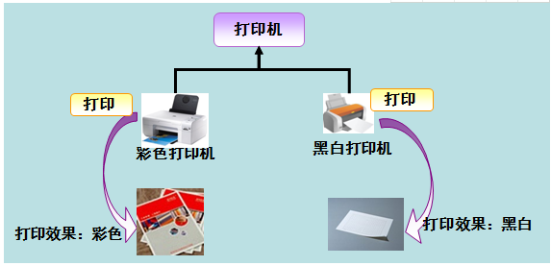
多态是同一个行为具有多个不同表现形式或形态的能力。
多态就是同一个接口，使用不同的实例而执行不同操作，
Copyright © 2012 Pearson Education, Inc.

Slide 5
Outline
Late Binding
Polymorphism via Inheritance
Polymorphism via Interfaces
Sorting
Searching
Copyright © 2012 Pearson Education, Inc.

Slide 6
Binding
Consider the following method invocation:
obj.doIt();
At some point, this invocation is bound to the definition of the method that it invokes
If this binding occurred at compile time, then that line of code would call the same method every time
However, Java defers method binding until run time -- this is called dynamic binding or late binding
Copyright © 2012 Pearson Education, Inc.

Slide 7
Polymorphism
The term polymorphism literally means "having many forms"
A polymorphic reference is a variable that can refer to different types of objects at different points in time
The method called through a polymorphic reference can change from one invocation to the next
All object references in Java are potentially polymorphic
Copyright © 2012 Pearson Education, Inc.

Slide 8
Polymorphism
Suppose we create the following reference variable:
Occupation job;
This reference can point to an Occupation object, or to any object of any compatible type
This compatibility can be established using inheritance or using interfaces
Careful use of polymorphic references can lead to elegant, robust software designs
Copyright © 2012 Pearson Education, Inc.

Slide 9
Outline
Late Binding
Polymorphism via Inheritance
Polymorphism via Interfaces
Sorting
Searching
Copyright © 2012 Pearson Education, Inc.

Slide 10
References and Inheritance
An object reference can refer to an object of any class related to it by inheritance
For example, if Holiday is the superclass of Christmas, then a Holiday reference could be used to refer to a Christmas object
Holiday
Holiday day;
day=new Holiday();
day = new Christmas();
Christmas
Copyright © 2012 Pearson Education, Inc.

Slide 11
References and Inheritance
These type compatibility rules are just an extension of the is-a relationship established by inheritance
Assigning a Christmas object to a Holiday reference is fine because Christmas is-a holiday
Assigning a child object to a parent reference can be performed by simple assignment
Assigning an parent object to a child reference can be done also, but must be done with a cast
After all, Christmas is a holiday but not all holidays are Christmas
Copyright © 2012 Pearson Education, Inc.

Slide 12
Polymorphism via Inheritance
Now suppose the Holiday class has a method called celebrate, and Christmas overrides it
What method is invoked by the following?
day.celebrate();
The type of the object being referenced, not the reference type, determines which method is invoked
If day refers to a Holiday object, it invokes the Holiday version of celebrate; if it refers to a Christmas object, it invokes that version
Copyright © 2012 Pearson Education, Inc.

Slide 13
Polymorphism via Inheritance
Holiday day;
day = new Christmas();
Note that the compiler restricts invocations based on the type of the reference
So if Christmas had a method called getTree that Holiday didn't have, the following would cause a compiler error:
day.getTree(); // compiler error
Remember, the compiler doesn't "know" which type of holiday is being referenced
A cast can be used to allow the call:
((Christmas)day).getTree();
Copyright © 2012 Pearson Education, Inc.
Notes:
Holiday day;
day = new Christmas();

Slide 14
Quick Check
If MusicPlayer is the parent of CDPlayer, are the following assignments valid?
MusicPlayer mplayer = new CDPlayer();
CDPlayer cdplayer = new MusicPlayer();
Copyright © 2012 Pearson Education, Inc.

Slide 15
Quick Check
If MusicPlayer is the parent of CDPlayer, are the following assignments valid?
MusicPlayer mplayer = new CDPlayer();
CDPlayer cdplayer = new MusicPlayer();
Yes, because a CDPlayer is-a MusicPlayer
No, you'd have to use a cast (and you shouldn't
knowingly assign a super class object to a
subclass reference)
Copyright © 2012 Pearson Education, Inc.

Slide 16
Polymorphism via Inheritance
Consider the following class hierarchy:
StaffMember
Volunteer
Employee
Executive
Hourly
Copyright © 2012 Pearson Education, Inc.

Slide 17
Polymorphism via Inheritance
Let's look at an example that pays a set of diverse employees using a polymorphic method
See Firm.java
See Staff.java
See StaffMember.java
See Volunteer.java
See Employee.java
See Executive.java
See Hourly.java
Copyright © 2012 Pearson Education, Inc.

Slide 18
//********************************************************************
// Firm.java Author: Lewis/Loftus
//
// Demonstrates polymorphism via inheritance.
//********************************************************************
public class Firm
{
//-----------------------------------------------------------------
// Creates a staff of employees for a firm and pays them.
//-----------------------------------------------------------------
public static void main (String[] args)
{
Staff personnel = new Staff();
personnel.payday();
}
}
Copyright © 2012 Pearson Education, Inc.

Slide 19
Output
Name: Sam
Address: 123 Main Line
Phone: 555-0469
Social Security Number: 123-45-6789
Paid: 2923.07
-----------------------------------
Name: Carla
Address: 456 Off Line
Phone: 555-0101
Social Security Number: 987-65-4321
Paid: 1246.15
-----------------------------------
Name: Woody
Address: 789 Off Rocker
Phone: 555-0000
Social Security Number: 010-20-3040
Paid: 1169.23
-----------------------------------
Output (continued)
Name: Diane
Address: 678 Fifth Ave.
Phone: 555-0690
Social Security Number: 958-47-3625
Current hours: 40
Paid: 422.0
-----------------------------------
Name: Norm
Address: 987 Suds Blvd.
Phone: 555-8374
Thanks!
-----------------------------------
Name: Cliff
Address: 321 Duds Lane
Phone: 555-7282
Thanks!
-----------------------------------
//********************************************************************
// Firm.java Author: Lewis/Loftus
//
// Demonstrates polymorphism via inheritance.
//********************************************************************
public class Firm
{
//-----------------------------------------------------------------
// Creates a staff of employees for a firm and pays them.
//-----------------------------------------------------------------
public static void main (String[] args)
{
Staff personnel = new Staff();
personnel.payday();
}
}
Copyright © 2012 Pearson Education, Inc.

Slide 20
//********************************************************************
// Staff.java Author: Lewis/Loftus
//
// Represents the personnel staff of a particular business.
//********************************************************************
public class Staff
{
private StaffMember[] staffList;
//-----------------------------------------------------------------
// Constructor: Sets up the list of staff members.
//-----------------------------------------------------------------
public Staff ()
{
staffList = new StaffMember[6];
continue
Copyright © 2012 Pearson Education, Inc.

Slide 21
continue
staffList[0] = new Executive ("Sam", "123 Main Line",
"555-0469", "123-45-6789", 2423.07);
staffList[1] = new Employee ("Carla", "456 Off Line",
"555-0101", "987-65-4321", 1246.15);
staffList[2] = new Employee ("Woody", "789 Off Rocker",
"555-0000", "010-20-3040", 1169.23);
staffList[3] = new Hourly ("Diane", "678 Fifth Ave.",
"555-0690", "958-47-3625", 10.55);
staffList[4] = new Volunteer ("Norm", "987 Suds Blvd.",
"555-8374");
staffList[5] = new Volunteer ("Cliff", "321 Duds Lane",
"555-7282");
((Executive)staffList[0]).awardBonus (500.00);
((Hourly)staffList[3]).addHours (40);
}
continue
Copyright © 2012 Pearson Education, Inc.

Slide 22
continue
//-----------------------------------------------------------------
// Pays all staff members.
//-----------------------------------------------------------------
public void payday ()
{
double amount;
for (int count=0; count < staffList.length; count++)
{
System.out.println (staffList[count]);
amount = staffList[count].pay(); // polymorphic
if (amount == 0.0)
System.out.println ("Thanks!");
else
System.out.println ("Paid: " + amount);
System.out.println ("-----------------------------------");
}
}
}
Copyright © 2012 Pearson Education, Inc.

Slide 23
//********************************************************************
// StaffMember.java Author: Lewis/Loftus
//
// Represents a generic staff member.
//********************************************************************
abstract public class StaffMember
{
protected String name;
protected String address;
protected String phone;
//-----------------------------------------------------------------
// Constructor: Sets up this staff member using the specified
// information.
//-----------------------------------------------------------------
public StaffMember (String eName, String eAddress, String ePhone)
{
name = eName;
address = eAddress;
phone = ePhone;
}
continue
Copyright © 2012 Pearson Education, Inc.

Slide 24
continue
//-----------------------------------------------------------------
// Returns a string including the basic employee information.
//-----------------------------------------------------------------
public String toString()
{
String result = "Name: " + name + "\n";
result += "Address: " + address + "\n";
result += "Phone: " + phone;
return result;
}
//-----------------------------------------------------------------
// Derived classes must define the pay method for each type of
// employee.
//-----------------------------------------------------------------
public abstract double pay();
}
Copyright © 2012 Pearson Education, Inc.

Slide 25
//********************************************************************
// Volunteer.java Author: Lewis/Loftus
//
// Represents a staff member that works as a volunteer.
//********************************************************************
public class Volunteer extends StaffMember
{
//-----------------------------------------------------------------
// Constructor: Sets up this volunteer using the specified
// information.
//-----------------------------------------------------------------
public Volunteer (String eName, String eAddress, String ePhone)
{
super (eName, eAddress, ePhone);
}
//-----------------------------------------------------------------
// Returns a zero pay value for this volunteer.
//-----------------------------------------------------------------
public double pay()
{
return 0.0;
}
}
Copyright © 2012 Pearson Education, Inc.

Slide 26
//********************************************************************
// Employee.java Author: Lewis/Loftus
//
// Represents a general paid employee.
//********************************************************************
public class Employee extends StaffMember
{
protected String socialSecurityNumber;
protected double payRate;
//-----------------------------------------------------------------
// Constructor: Sets up this employee with the specified
// information.
//-----------------------------------------------------------------
public Employee (String eName, String eAddress, String ePhone,
String socSecNumber, double rate)
{
super (eName, eAddress, ePhone);
socialSecurityNumber = socSecNumber;
payRate = rate;
}
continue
Copyright © 2012 Pearson Education, Inc.

Slide 27
continue
//-----------------------------------------------------------------
// Returns information about an employee as a string.
//-----------------------------------------------------------------
public String toString()
{
String result = super.toString();
result += "\nSocial Security Number: " + socialSecurityNumber;
return result;
}
//-----------------------------------------------------------------
// Returns the pay rate for this employee.
//-----------------------------------------------------------------
public double pay()
{
return payRate;
}
}
Copyright © 2012 Pearson Education, Inc.

Slide 28
//********************************************************************
// Executive.java Author: Lewis/Loftus
//
// Represents an executive staff member, who can earn a bonus.
//********************************************************************
public class Executive extends Employee
{
private double bonus;
//-----------------------------------------------------------------
// Constructor: Sets up this executive with the specified
// information.
//-----------------------------------------------------------------
public Executive (String eName, String eAddress, String ePhone,
String socSecNumber, double rate)
{
super (eName, eAddress, ePhone, socSecNumber, rate);
bonus = 0; // bonus has yet to be awarded
}
continue
Copyright © 2012 Pearson Education, Inc.

Slide 29
continue
//-----------------------------------------------------------------
// Awards the specified bonus to this executive.
//-----------------------------------------------------------------
public void awardBonus (double execBonus)
{
bonus = execBonus;
}
//-----------------------------------------------------------------
// Computes and returns the pay for an executive, which is the
// regular employee payment plus a one-time bonus.
//-----------------------------------------------------------------
public double pay()
{
double payment = super.pay() + bonus;
bonus = 0;
return payment;
}
}
Copyright © 2012 Pearson Education, Inc.

Slide 30
//********************************************************************
// Hourly.java Author: Lewis/Loftus
//
// Represents an employee that gets paid by the hour.
//********************************************************************
public class Hourly extends Employee
{
private int hoursWorked;
//-----------------------------------------------------------------
// Constructor: Sets up this hourly employee using the specified
// information.
//-----------------------------------------------------------------
public Hourly (String eName, String eAddress, String ePhone,
String socSecNumber, double rate)
{
super (eName, eAddress, ePhone, socSecNumber, rate);
hoursWorked = 0;
}
continue
Copyright © 2012 Pearson Education, Inc.

Slide 31
continue
//-----------------------------------------------------------------
// Adds the specified number of hours to this employee's
// accumulated hours.
//-----------------------------------------------------------------
public void addHours (int moreHours)
{
hoursWorked += moreHours;
}
//-----------------------------------------------------------------
// Computes and returns the pay for this hourly employee.
//-----------------------------------------------------------------
public double pay()
{
double payment = payRate * hoursWorked;
hoursWorked = 0;
return payment;
}
continue
Copyright © 2012 Pearson Education, Inc.

Slide 32
continue
//-----------------------------------------------------------------
// Returns information about this hourly employee as a string.
//-----------------------------------------------------------------
public String toString()
{
String result = super.toString();
result += "\nCurrent hours: " + hoursWorked;
return result;
}
}
Copyright © 2012 Pearson Education, Inc.

Slide 33
class Person
{
private String name; //人的姓名
public Person(String initialName) {
name = initialName;
System.out.println("In Constructor Person");
}
public void outputClassName() {
System.out.println("Person");
}
public void writeOutput() {
outputClassName();
//子类来到了父类，因为重写的概念，会去调子类的方法
System.out.println("Name: " + name);
}
}
Copyright © 2012 Pearson Education, Inc.
Notes:
增加的例子

Slide 34
class Student extends Person
{
private int studentNumber;//学生学号
public Student(String initialName, int initialStudentNumber) {
super(initialName);
studentNumber = initialStudentNumber;
System.out.println("In Constructor Student");
}
public void writeOutput()
{
super.writeOutput();//指向父类的方法
System.out.println("Student Number: " + studentNumber);
}
public void outputClassName() {
System.out.println("Student");
}
}
Copyright © 2012 Pearson Education, Inc.
Notes:
增加的例子

Slide 35
public class PolymorphismTest {
public static void main(String[] args) {
Person[] personlist=new Person[2];
personlist[0]=new Person("LiPing");
//In Constructor Person
personlist[1]=new Student(“SunMing”,2008001);
//有super，所以先打印In Constructor Person，然后再打印In Constructor Student
for(int i=0;i<2;i++)
personlist[i].writeOutput();
}
}
In Constructor Person
In Constructor Person
In Constructor Student
Person
Name: LiPing
Student
Name: SunMing
Student Number: 2008001
Copyright © 2012 Pearson Education, Inc.
Notes:
增加的例子

Slide 36
//定义超类superA
class superA {
void fun(int j) {
System.out.println("This is superA");
}
}
// 定义superA的子类subB
class subB extends superA {
void fun(int aa) {
System.out.println("This is subB");
}
}
// 定义superA的子类subC
class subC extends superA {
void fun(int cc) {
System.out.println("This is subC");
}
void fun2(int i) {
System.out.println("This is subC fun2");
}
}
Copyright © 2012 Pearson Education, Inc.
Notes:
增加的例子

Slide 37
continue
public class SuperTest2 {
public static void main(String[] args) {
superA a = new superA();
subB b = new subB();
subC c = new subC();
a = b;
a.fun(100);
a = c;
a.fun(100);
// a.fun2(200); 报错，因为SuperA类中没有fun2方法
((subC) a).fun2(100);
}
}
This is subB
This is subC
This is subC fun2
Copyright © 2012 Pearson Education, Inc.

Slide 38
Outline
Late Binding
Polymorphism via Inheritance
Polymorphism via Interfaces
Sorting
Searching
Event Processing Revisited
File Choosers and Color Choosers
Sliders
Copyright © 2012 Pearson Education, Inc.

Slide 39
Polymorphism via Interfaces
Interfaces can be used to set up polymorphic references as well
Suppose we declare an interface called Speaker as follows:
public interface Speaker
{
public void speak();
public void announce (String str);
}
Copyright © 2012 Pearson Education, Inc.

Slide 40
Polymorphism via Interfaces
An interface name can be used as the type of an object reference variable:
Speaker current;
The current reference can be used to point to any object of any class that implements the Speaker interface
The version of speak invoked by the following line depends on the type of object that current is referencing:
current.speak();
Copyright © 2012 Pearson Education, Inc.

Slide 41
Polymorphism via Interfaces
Now suppose two classes, Philosopher and Dog, both implement the Speaker interface, providing distinct versions of the speak method
In the following code, the first call to speak invokes one version and the second invokes another:
Speaker guest = new Philospher();
guest.speak();
guest = new Dog();
guest.speak();
Copyright © 2012 Pearson Education, Inc.

Slide 42
Polymorphism via Interfaces
As with class reference types, the compiler will restrict invocations to methods in the interface
For example, even if Philosopher also had a method called pontificate, the following would still cause a compiler error:
Speaker special = new Philospher();
special.pontificate(); // compiler error
Remember, the compiler bases its rulings on the type of the reference
Copyright © 2012 Pearson Education, Inc.

Slide 43
Quick Check
Would the following statements be valid?
Speaker first = new Dog();
Philosopher second = new Philosopher();
second.pontificate();
first = second;
Copyright © 2012 Pearson Education, Inc.

Slide 44
Quick Check
Would the following statements be valid?
Speaker first = new Dog();
Philosopher second = new Philosopher();
second.pontificate();
first = second;
Yes, all assignments and method calls are
valid as written
Copyright © 2012 Pearson Education, Inc.

Slide 45
Outline
Late Binding
Polymorphism via Inheritance
Polymorphism via Interfaces
Sorting
Searching
Copyright © 2012 Pearson Education, Inc.

Slide 46
Sorting
Sorting is the process of arranging a list of items in a particular order
The sorting process is based on specific criteria:
  sort test scores in ascending numeric order
  sort a list of people alphabetically by last name
There are many algorithms, which vary in efficiency, for sorting a list of items
We will examine two specific algorithms:
  Selection Sort
  Insertion Sort
Copyright © 2012 Pearson Education, Inc.

Slide 47
Selection Sort
The strategy of Selection Sort:
  select a value and put it in its final place in the list
  repeat for all other values
In more detail:
  find the smallest value in the list
  switch it with the value in the first position
  find the next smallest value in the list
  switch it with the value in the second position
  repeat until all values are in their proper places
Copyright © 2012 Pearson Education, Inc.

Slide 48
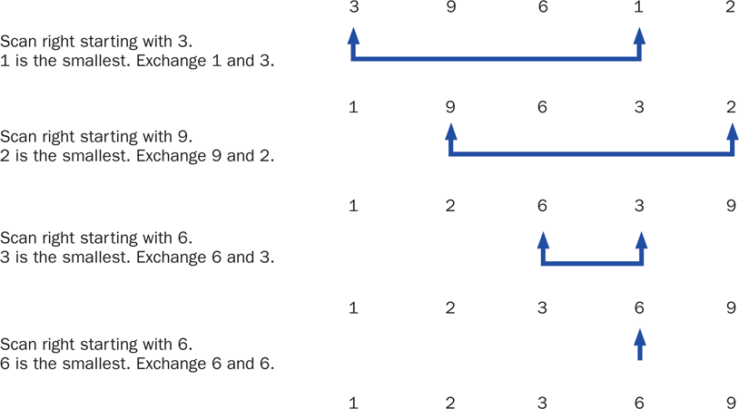
Selection Sort
Copyright © 2012 Pearson Education, Inc.

Slide 49
Swapping
The processing of the selection sort algorithm includes the swapping of two values
Swapping requires three assignment statements and a temporary storage location
To swap the values of first and second:
temp = first;
first = second;
second = temp;
Copyright © 2012 Pearson Education, Inc.

Slide 50
Polymorphism in Sorting
Recall that a class that implements the Comparable interface defines a compareTo method to determine the relative order of its objects
We can use polymorphism to develop a generic sort for any set of Comparable objects
The sorting method accepts as a parameter an array of Comparable objects
That way, one method can be used to sort an array of People, or Books, or whatever
Copyright © 2012 Pearson Education, Inc.

Slide 51
Selection Sort
This technique allows each class to decide for itself what it means for one object to be less than another
Let's look at an example that sorts an array of Contact objects
The selectionSort method is a static method in the Sorting class
See PhoneList.java
See Sorting.java
See Contact.java
Copyright © 2012 Pearson Education, Inc.

Slide 52
//********************************************************************
// PhoneList.java Author: Lewis/Loftus
//
// Driver for testing a sorting algorithm.
//********************************************************************
public class PhoneList
{
//-----------------------------------------------------------------
// Creates an array of Contact objects, sorts them, then prints
// them.
//-----------------------------------------------------------------
public static void main (String[] args)
{
Contact[] friends = new Contact[8];
friends[0] = new Contact ("John", "Smith", "610-555-7384");
friends[1] = new Contact ("Sarah", "Barnes", "215-555-3827");
friends[2] = new Contact ("Mark", "Riley", "733-555-2969");
friends[3] = new Contact ("Laura", "Getz", "663-555-3984");
friends[4] = new Contact ("Larry", "Smith", "464-555-3489");
friends[5] = new Contact ("Frank", "Phelps", "322-555-2284");
friends[6] = new Contact ("Mario", "Guzman", "804-555-9066");
friends[7] = new Contact ("Marsha", "Grant", "243-555-2837");
continue
Copyright © 2012 Pearson Education, Inc.

Slide 53
continue
Sorting.selectionSort(friends);
for (Contact friend : friends)
System.out.println (friend);
}
}
Copyright © 2012 Pearson Education, Inc.

Slide 54
Output
Barnes, Sarah 215-555-3827
Getz, Laura 663-555-3984
Grant, Marsha 243-555-2837
Guzman, Mario 804-555-9066
Phelps, Frank 322-555-2284
Riley, Mark 733-555-2969
Smith, John 610-555-7384
Smith, Larry 464-555-3489
continue
Sorting.selectionSort(friends);
for (Contact friend : friends)
System.out.println (friend);
}
}
Copyright © 2012 Pearson Education, Inc.

Slide 55
The static selectionSort method in the Sorting class:
//-----------------------------------------------------------------
// Sorts the specified array of objects using the selection
// sort algorithm.
//-----------------------------------------------------------------
public static void selectionSort (Comparable[] list)
{
int min;
Comparable temp;
for (int index = 0; index < list.length-1; index++)
{
min = index;
for (int scan = index+1; scan < list.length; scan++)
if (list[scan].compareTo(list[min]) < 0)
min = scan;
// Swap the values
temp = list[min];
list[min] = list[index];
list[index] = temp;
}
}
Copyright © 2012 Pearson Education, Inc.

Slide 56
//********************************************************************
// Contact.java Author: Lewis/Loftus
//
// Represents a phone contact.
//********************************************************************
public class Contact implements Comparable
{
private String firstName, lastName, phone;
//-----------------------------------------------------------------
// Constructor: Sets up this contact with the specified data.
//-----------------------------------------------------------------
public Contact (String first, String last, String telephone)
{
firstName = first;
lastName = last;
phone = telephone;
}
continue
Copyright © 2012 Pearson Education, Inc.

Slide 57
continue
//-----------------------------------------------------------------
// Returns a description of this contact as a string.
//-----------------------------------------------------------------
public String toString ()
{
return lastName + ", " + firstName + "\t" + phone;
}
//-----------------------------------------------------------------
// Returns a description of this contact as a string.
//-----------------------------------------------------------------
public boolean equals (Object other)
{
return (lastName.equals(((Contact)other).getLastName()) &&
firstName.equals(((Contact)other).getFirstName()));
}
continue
Copyright © 2012 Pearson Education, Inc.

Slide 58
continue
//-----------------------------------------------------------------
// Uses both last and first names to determine ordering.
//-----------------------------------------------------------------
public int compareTo (Object other)
{
int result;
String otherFirst = ((Contact)other).getFirstName();
String otherLast = ((Contact)other).getLastName();
if (lastName.equals(otherLast))
result = firstName.compareTo(otherFirst);
else
result = lastName.compareTo(otherLast);
return result;
}
continue
Copyright © 2012 Pearson Education, Inc.

Slide 59
continue
//-----------------------------------------------------------------
// First name accessor.
//-----------------------------------------------------------------
public String getFirstName ()
{
return firstName;
}
//-----------------------------------------------------------------
// Last name accessor.
//-----------------------------------------------------------------
public String getLastName ()
{
return lastName;
}
}
Copyright © 2012 Pearson Education, Inc.

Slide 60
Insertion Sort
The strategy of Insertion Sort:
  pick any item and insert it into its proper place in a sorted sublist
  repeat until all items have been inserted
In more detail:
  consider the first item to be a sorted sublist (of one item)
  insert the second item into the sorted sublist, shifting the first item as needed to make room to insert the new one
  insert the third item into the sorted sublist (of two items), shifting items as necessary
  repeat until all values are inserted into their proper positions
Copyright © 2012 Pearson Education, Inc.

Slide 61
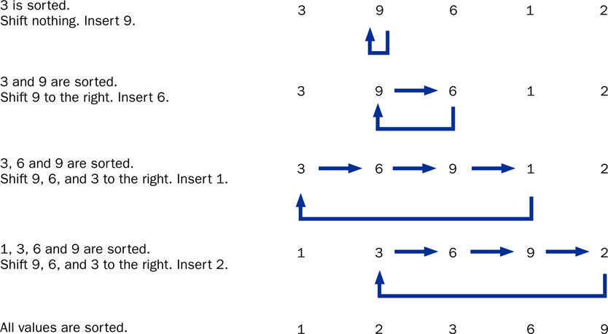
Insertion Sort
Copyright © 2012 Pearson Education, Inc.

Slide 62
The static insertionSort method in the Sorting class:
//-----------------------------------------------------------------
// Sorts the specified array of objects using the insertion
// sort algorithm.
//-----------------------------------------------------------------
public static void insertionSort (Comparable[] list)
{
for (int index = 1; index < list.length; index++)
{
Comparable key = list[index];
int position = index;
// Shift larger values to the right
while (position > 0 && key.compareTo(list[position-1]) < 0)
{
list[position] = list[position-1];
position--;
}
list[position] = key;
}
}
Copyright © 2012 Pearson Education, Inc.

Slide 63
Comparing Sorts
The Selection and Insertion sort algorithms are similar in efficiency
They both have outer loops that scan all elements, and inner loops that compare the value of the outer loop with almost all values in the list
Approximately n² number of comparisons are made to sort a list of size n
We therefore say that these sorts are of order n²
Other sorts are more efficient: order n log₂ n
Copyright © 2012 Pearson Education, Inc.

Slide 64
Outline
Late Binding
Polymorphism via Inheritance
Polymorphism via Interfaces
Sorting
Searching
Copyright © 2012 Pearson Education, Inc.

Slide 65
Searching
Searching is the process of finding a target element within a group of items called the search pool
The target may or may not be in the search pool
We want to perform the search efficiently, minimizing the number of comparisons
Let's look at two classic searching approaches: linear search and binary search
As we did with sorting, we'll implement the searches with polymorphic Comparable parameters
Copyright © 2012 Pearson Education, Inc.

Slide 66
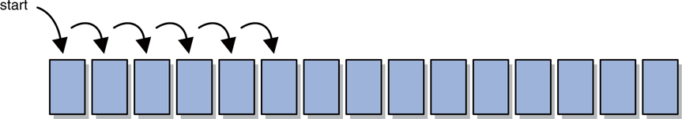
Linear Search
A linear search begins at one end of a list and examines each element in turn
Eventually, either the item is found or the end of the list is encountered
Copyright © 2012 Pearson Education, Inc.

Slide 67
Binary Search
A binary search assumes the list of items in the search pool is sorted
It eliminates a large part of the search pool with a single comparison
A binary search first examines the middle element of the list -- if it matches the target, the search is over
If it doesn't, only one half of the remaining elements need be searched
Since they are sorted, the target can only be in one half of the other
Copyright © 2012 Pearson Education, Inc.

Slide 68
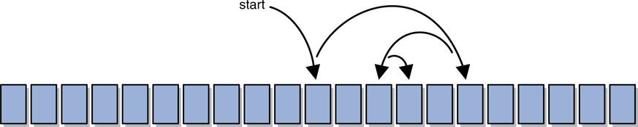
Binary Search
The process continues by comparing the middle element of the remaining viable candidates
Each comparison eliminates approximately half of the remaining data
Eventually, the target is found or the data is exhausted
Copyright © 2012 Pearson Education, Inc.

Slide 69
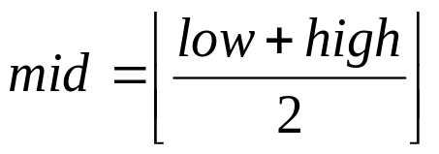
Sequence of Successful Search - 1
low high mid
search( 44 )
#1
0 8
4
0
1
2
3
4
5
6
7
8
5
12
17
23
38
44
77
84
90
low
mid
high
38 < 44
low = mid+1 = 5

Slide 70
Sequence of Successful Search - 2
low high mid
search( 44 )
#1
0 8
4
#2
5 8
6
0
1
2
3
4
5
6
7
8
5
12
17
23
38
44
77
84
90
low
mid
high
high = mid-1=5
44 < 77

Slide 71
Sequence of Successful Search - 3
low high mid
search( 44 )
#1
0 8
4
#2
5 8
6
#3
5 5
5
0
1
2
3
4
5
6
7
8
5
12
17
23
38
44
77
84
90
low
high
mid
Successful Search!!
44 == 44

Slide 72
Sequence of Unsuccessful Search - 1
low high mid
search( 45 )
#1
0 8
4
0
1
2
3
4
5
6
7
8
5
12
17
23
38
44
77
84
90
low
mid
high
38 < 45
low = mid+1 = 5

Slide 73
Sequence of Unsuccessful Search - 2
low high mid
search( 45 )
#1
0 8
4
#2
5 8
6
0
1
2
3
4
5
6
7
8
5
12
17
23
38
44
77
84
90
low
mid
high
high = mid-1=5
45 < 77

Slide 74
Sequence of Unsuccessful Search - 3
low high mid
search( 45 )
#1
0 8
4
#2
5 8
6
#3
5 5
5
0
1
2
3
4
5
6
7
8
5
12
17
23
38
44
77
84
90
low
high
mid
44 < 45
low = mid+1 = 6

Slide 75
Sequence of Unsuccessful Search - 4
low high mid
search( 45 )
#1
0 8
4
#2
5 8
6
#3
5 5
5
#4
6 5
0
1
2
3
4
5
6
7
8
5
12
17
23
38
44
77
84
90
high
low
Unsuccessful Search
no more elements to search
low > high

Slide 76
Searching
The search methods are implemented as static methods in the Searching class
See PhoneList2.java
See Searching.java
Copyright © 2012 Pearson Education, Inc.

Slide 77
//********************************************************************
// PhoneList2.java Author: Lewis/Loftus
//
// Driver for testing searching algorithms.
//********************************************************************
public class PhoneList2
{
//-----------------------------------------------------------------
// Creates an array of Contact objects, sorts them, then prints
// them.
//-----------------------------------------------------------------
public static void main (String[] args)
{
Contact test, found;
Contact[] friends = new Contact[8];
friends[0] = new Contact ("John", "Smith", "610-555-7384");
friends[1] = new Contact ("Sarah", "Barnes", "215-555-3827");
friends[2] = new Contact ("Mark", "Riley", "733-555-2969");
friends[3] = new Contact ("Laura", "Getz", "663-555-3984");
friends[4] = new Contact ("Larry", "Smith", "464-555-3489");
friends[5] = new Contact ("Frank", "Phelps", "322-555-2284");
friends[6] = new Contact ("Mario", "Guzman", "804-555-9066");
friends[7] = new Contact ("Marsha", "Grant", "243-555-2837");
continue
Copyright © 2012 Pearson Education, Inc.

Slide 78
continue
test = new Contact ("Frank", "Phelps", "");
found = (Contact) Searching.linearSearch(friends, test);
if (found != null)
System.out.println ("Found: " + found);
else
System.out.println ("The contact was not found.");
System.out.println ();
Sorting.selectionSort(friends);
test = new Contact ("Mario", "Guzman", "");
found = (Contact) Searching.binarySearch(friends, test);
if (found != null)
System.out.println ("Found: " + found);
else
System.out.println ("The contact was not found.");
}
}
Copyright © 2012 Pearson Education, Inc.

Slide 79
Output
Found: Phelps, Frank 322-555-2284
Found: Guzman, Mario 804-555-9066
continue
test = new Contact ("Frank", "Phelps", "");
found = (Contact) Searching.linearSearch(friends, test);
if (found != null)
System.out.println ("Found: " + found);
else
System.out.println ("The contact was not found.");
System.out.println ();
Sorting.selectionSort(friends);
test = new Contact ("Mario", "Guzman", "");
found = (Contact) Searching.binarySearch(friends, test);
if (found != null)
System.out.println ("Found: " + found);
else
System.out.println ("The contact was not found.");
}
}
Copyright © 2012 Pearson Education, Inc.

Slide 80
The linearSearch method in the Searching class:
//-----------------------------------------------------------------
// Searches the specified array of objects for the target using
// a linear search. Returns a reference to the target object from
// the array if found, and null otherwise.
//-----------------------------------------------------------------
public static Comparable linearSearch (Comparable[] list,
Comparable target)
{
int index = 0;
boolean found = false;
while (!found && index < list.length)
{
if (list[index].equals(target))
found = true;
else
index++;
}
if (found)
return list[index];
else
return null;
}
Copyright © 2012 Pearson Education, Inc.

Slide 81
The binarySearch method in the Searching class:
//-----------------------------------------------------------------
// Searches the specified array of objects for the target using
// a binary search. Assumes the array is already sorted in
// ascending order when it is passed in. Returns a reference to
// the target object from the array if found, and null otherwise.
//-----------------------------------------------------------------
public static Comparable binarySearch (Comparable[] list,
Comparable target)
{
int min=0, max=list.length, mid=0;
boolean found = false;
while (!found && min <= max)
{
mid = (min+max) / 2;
if (list[mid].equals(target))
found = true;
else
if (target.compareTo(list[mid]) < 0)
max = mid-1;
else
min = mid+1;
}
continue
Copyright © 2012 Pearson Education, Inc.

Slide 82
continue
if (found)
return list[mid];
else
return null;
}
Copyright © 2012 Pearson Education, Inc.

Slide 83
面向对象编程有三大特性：封装、继承、多态
  封装隐藏了类的内部实现机制，可以在不影响使用的情况下改变类的内部结构，同时也保护了数据。对外界而已它的内部细节是隐藏的，暴露给外界的只是它的访问方法。
  继承是为了重用父类代码。两个类若存在IS-A的关系就可以使用继承。
Copyright © 2012 Pearson Education, Inc.

Slide 84
多态是指程序中定义的引用变量所指向的具体类型和通过该引用变量发出的方法调用在编程时并不确定，而是在程序运行期间才确定，即一个引用变量到底会指向哪个类的实例对象，该引用变量发出的方法调用到底是哪个类中实现的方法，必须在由程序运行期间才能决定。
因为在程序运行时才确定具体的类，这样，不用修改源程序代码，就可以让引用变量绑定到各种不同的类实现上，从而导致该引用调用的具体方法随之改变，即不修改程序代码就可以改变程序运行时所绑定的具体代码，让程序可以选择多个运行状态，这就是多态性。
Copyright © 2012 Pearson Education, Inc.

Slide 85
Summary
Chapter 10 has focused on:
  defining polymorphism and its benefits
  using inheritance to create polymorphic references
  using interfaces to create polymorphic references
  using polymorphism to implement sorting and searching algorithms
Copyright © 2012 Pearson Education, Inc.

Slide 86
class TwoThree {
void g(int x) {
f(x);
}
void g(double x) {
f(x);
}
void g(long x) {
f(x);
}
void f(int x) {
System.out.println("int in T: " + x);
}
void f(long x) {
System.out.println("double in T: " + x);
}
void f(double x) {
System.out.println("double in T: " + x);
}
}
continue
Copyright © 2012 Pearson Education, Inc.

Slide 87
continue
public class SubTwoThree extends TwoThree {
void f(int x) {
System.out.println("int in S: " + x);
}
void f(long x) {
System.out.println("long in S: " + x);
}
public static void main(String[] args) {
TwoThree t = new SubTwoThree();
t.g(20);
t.g(20L); // !! t is a TwoTree type
t.g(3.5f);
t.g(3.5);
}
}
Output
int in S: 20
double in T: 20.0
double in T: 3.5
double in T: 3.5
Copyright © 2012 Pearson Education, Inc.
Notes:
首先要看参数的类型。父类里面假如没有double，编译时直接就报错了，因为它现它根本就没有相配的方法，不可能去子类找，只是在运行时刻才看，有相同的方法到底该用哪个，到底是new 的什么对象来决定。
静态情况下编译时首先要决定这个程序有没有问题，g这边要去调用f，f要求long类型，父类没有，再看能不能转换，如果不能转换，就直接就编译报错了。在运行时才去看是否能去调用，子类父类里面都有相同的方法，到底用哪个，这时才做决定
g调用f，不能说是不遵循延迟绑定。首先，要根据类型判定能不能调用方法，如果能调用，则看动态绑定结果。第二个g里调用f时，在父类中没有long参数的f，所以只能看有没有能进行转换的，找到double参数的，再看是否动态约束，子类中没有相应的覆盖方法，就只能用父类的了

