Slide 1


Chapter 12
Recursion
Java Software Solutions
Foundations of Program Design
Seventh Edition
John Lewis
William Loftus
Copyright © 2012 Pearson Education, Inc.

Slide 2
Recursion
Recursion is a fundamental programming technique that can provide an elegant solution certain kinds of problems
Chapter 12 focuses on:
  thinking in a recursive manner
  programming in a recursive manner
  the correct use of recursion
  recursion examples
Copyright © 2012 Pearson Education, Inc.

Slide 3
Outline
Recursive Thinking
Recursive Programming
Using Recursion
Copyright © 2012 Pearson Education, Inc.

Slide 4
Recursive Thinking
A recursive definition is one which uses the word or concept being defined in the definition itself
When defining an English word, a recursive definition is often not helpful
But in other situations, a recursive definition can be an appropriate way to express a concept
Before applying recursion to programming, it is best to practice thinking recursively
Copyright © 2012 Pearson Education, Inc.

Slide 5
Recursive Definitions
Consider the following list of numbers:
24, 88, 40, 37
Such a list can be defined as follows:
A List is a: number
or a: number comma List
That is, a List is defined to be a single number, or a number followed by a comma followed by a List
The concept of a List is used to define itself
Copyright © 2012 Pearson Education, Inc.

Slide 6
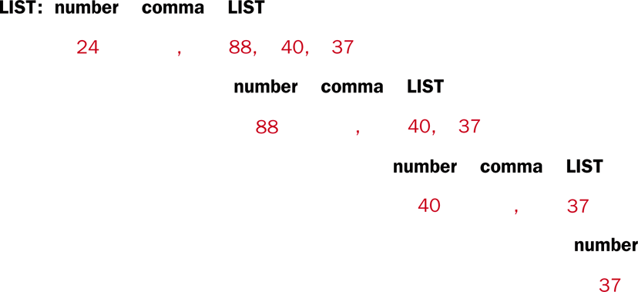
Recursive Definitions
The recursive part of the LIST definition is used several times, terminating with the non-recursive part:
Copyright © 2012 Pearson Education, Inc.

Slide 7
Infinite Recursion
All recursive definitions have to have a non-recursive part called the base case
If they didn't, there would be no way to terminate the recursive path
Such a definition would cause infinite recursion
This problem is similar to an infinite loop, but the non-terminating "loop" is part of the definition itself
Copyright © 2012 Pearson Education, Inc.

Slide 8
Recursive Factorial
N!, for any positive integer N, is defined to be the product of all integers between 1 and N inclusive
This definition can be expressed recursively as:
1! = 1
N! = N * (N-1)!
A factorial is defined in terms of another factorial
Eventually, the base case of 1! is reached
Copyright © 2012 Pearson Education, Inc.

Slide 9
Recursive Factorial
5!
5 * 4!
4 * 3!
3 * 2!
2 * 1!
1
120
24
6
2
Copyright © 2012 Pearson Education, Inc.

Slide 10
Quick Check
Write a recursive definition of 5 * n, where n > 0.
Copyright © 2012 Pearson Education, Inc.

Slide 11
Quick Check
Write a recursive definition of 5 * n, where n > 0.
5 * 1 = 5
5 * n = 5 + (5 * (n-1))
Copyright © 2012 Pearson Education, Inc.

Slide 12
Outline
Recursive Thinking
Recursive Programming
Using Recursion
Recursion in Graphics
Copyright © 2012 Pearson Education, Inc.

Slide 13
Recursive Programming
A recursive method is a method that invokes itself
A recursive method must be structured to handle both the base case and the recursive case
Each call to the method sets up a new execution environment, with new parameters and local variables（探索）
As with any method call, when the method completes, control returns to the method that invoked it (which may be an earlier invocation of itself)（回溯）
Copyright © 2012 Pearson Education, Inc.

Slide 14
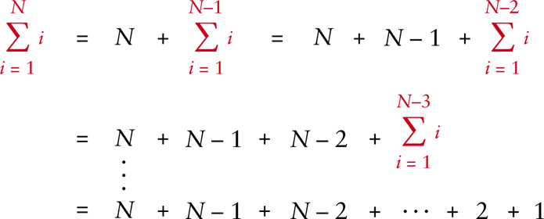
Sum of 1 to N
Consider the problem of computing the sum of all the numbers between 1 and any positive integer N
This problem can be recursively defined as:
Copyright © 2012 Pearson Education, Inc.

Slide 15
Sum of 1 to N
The summation could be implemented recursively as follows:
// This method returns the sum of 1 to num
public int sum (int num)
{
int result;
if (num == 1)
result = 1;
else
result = num + sum (num-1);
return result;
}
Copyright © 2012 Pearson Education, Inc.

Slide 16
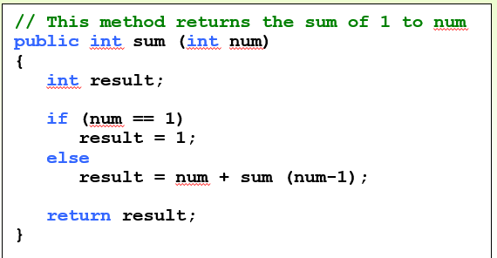
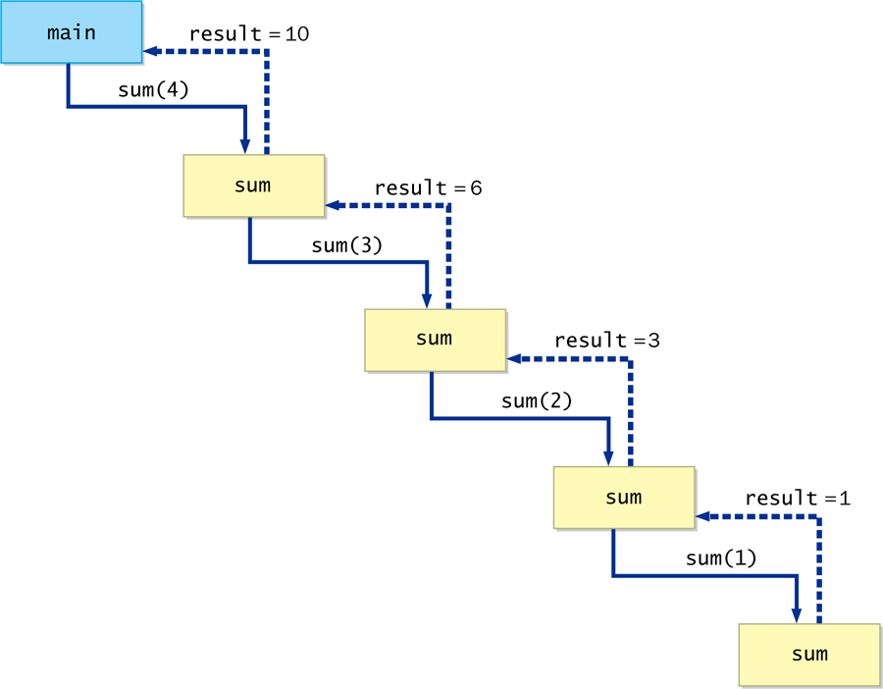
Sum of 1 to N
Copyright © 2012 Pearson Education, Inc.

Slide 17
Recursive Programming
Note that just because we can use recursion to solve a problem, doesn't mean we should
We usually would not use recursion to solve the summation problem, because the iterative version is easier to understand
However, for some problems, recursion provides an elegant solution, often cleaner than an iterative version
You must carefully decide whether recursion is the correct technique for any problem
Copyright © 2012 Pearson Education, Inc.

Slide 18
Indirect Recursion
A method invoking itself is considered to be direct recursion
A method could invoke another method, which invokes another, etc., until eventually the original method is invoked again
For example, method m1 could invoke m2, which invokes m3, which in turn invokes m1 again
This is called indirect recursion, and requires all the same care as direct recursion
It is often more difficult to trace and debug
Copyright © 2012 Pearson Education, Inc.

Slide 19
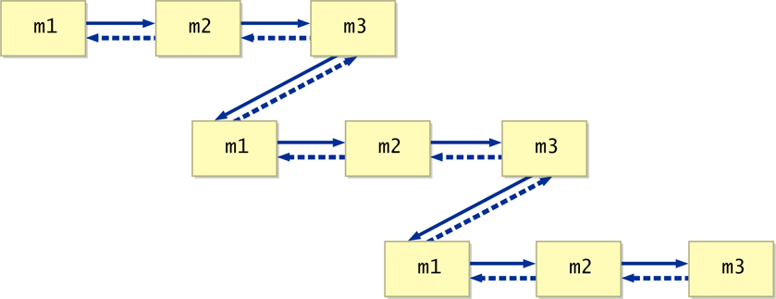
Indirect Recursion
Copyright © 2012 Pearson Education, Inc.

Slide 20
Outline
Recursive Thinking
Recursive Programming
Using Recursion
Recursion in Graphics
Copyright © 2012 Pearson Education, Inc.

Slide 21
Maze Traversal
We can use recursion to find a path through a maze
From each location, we can search in each direction
The recursive calls keep track of the path through the maze
The base case is an invalid move or reaching the final destination
See MazeSearch.java
See Maze.java
Copyright © 2012 Pearson Education, Inc.

Slide 22
//********************************************************************
// MazeSearch.java Author: Lewis/Loftus
//
// Demonstrates recursion.
//********************************************************************
public class MazeSearch
{
//-----------------------------------------------------------------
// Creates a new maze, prints its original form, attempts to
// solve it, and prints out its final form.
//-----------------------------------------------------------------
public static void main (String[] args)
{
Maze labyrinth = new Maze();
System.out.println (labyrinth);
if (labyrinth.traverse (0, 0))
System.out.println ("The maze was successfully traversed!");
else
System.out.println ("There is no possible path.");
System.out.println (labyrinth);
}
}
Copyright © 2012 Pearson Education, Inc.

Slide 23
Output
1110110001111
1011101111001
0000101010100
1110111010111
1010000111001
1011111101111
1000000000000
1111111111111
The maze was successfully traversed!
7770110001111
3077707771001
0000707070300
7770777070333
7070000773003
7077777703333
7000000000000
7777777777777
//********************************************************************
// MazeSearch.java Author: Lewis/Loftus
//
// Demonstrates recursion.
//********************************************************************
public class MazeSearch
{
//-----------------------------------------------------------------
// Creates a new maze, prints its original form, attempts to
// solve it, and prints out its final form.
//-----------------------------------------------------------------
public static void main (String[] args)
{
Maze labyrinth = new Maze();
System.out.println (labyrinth);
if (labyrinth.traverse (0, 0))
System.out.println ("The maze was successfully traversed!");
else
System.out.println ("There is no possible path.");
System.out.println (labyrinth);
}
}
Copyright © 2012 Pearson Education, Inc.

Slide 24
//********************************************************************
// Maze.java Author: Lewis/Loftus
//
// Represents a maze of characters. The goal is to get from the
// top left corner to the bottom right, following a path of 1s.
//********************************************************************
public class Maze
{
private final int TRIED = 3;
private final int PATH = 7;
private int[][] grid = { {1,1,1,0,1,1,0,0,0,1,1,1,1},
{1,0,1,1,1,0,1,1,1,1,0,0,1},
{0,0,0,0,1,0,1,0,1,0,1,0,0},
{1,1,1,0,1,1,1,0,1,0,1,1,1},
{1,0,1,0,0,0,0,1,1,1,0,0,1},
{1,0,1,1,1,1,1,1,0,1,1,1,1},
{1,0,0,0,0,0,0,0,0,0,0,0,0},
{1,1,1,1,1,1,1,1,1,1,1,1,1} };
continued
Copyright © 2012 Pearson Education, Inc.

Slide 25
continued
public boolean traverse(int row, int column) {
boolean done = false;
if (valid(row, column))
{
grid[row][column] = TRIED; //this cell has been tried
if (row == grid.length - 1 && column == grid[0].length - 1) {
done = true; // the maze is solved
} else {
done = traverse(row + 1, column); //down
  if (!done)
  done = traverse(row, column + 1); //right
  if (!done)
  done = traverse(row - 1, column); //up
  if (!done)
  done = traverse(row, column - 1); //left
}
if (done) // this location is part of the final path
grid[row][column] = PATH;
}
return done;
}
continued
Copyright © 2012 Pearson Education, Inc.

Slide 26
continued
//-----------------------------------------------------------------
// Determines if a specific location is valid.
//-----------------------------------------------------------------
private boolean valid (int row, int column)
{
boolean result = false;
// check if cell is in the bounds of the matrix
if (row >= 0 && row < grid.length &&
column >= 0 && column < grid[row].length)
// check if cell is not blocked and not previously tried
if (grid[row][column] == 1)
result = true;
return result;
}
continued
Copyright © 2012 Pearson Education, Inc.

Slide 27
continued
//-----------------------------------------------------------------
// Returns the maze as a string.
//-----------------------------------------------------------------
public String toString ()
{
String result = "\n";
for (int row=0; row < grid.length; row++)
{
for (int column=0; column < grid[row].length; column++)
result += grid[row][column] + "";
result += "\n";
}
return result;
}
}
Copyright © 2012 Pearson Education, Inc.

Slide 28
1 1 0 0
1 1 1 1
0 1 0 1
0 0 1 1
3 1 0 0
3 3 3 3
0 3 0 3
0 0 1 3
7 1 0 0
7 7 7 7
0 3 0 7
0 0 1 7
Copyright © 2012 Pearson Education, Inc.
Notes:
3 1 0 0
3 3 3 3
0 3 0 3
0 0 1 3
7 1 0 0
7 7 7 7
0 3 0 7
0 0 1 7

Slide 29
t(0,0)
t(1,0)
t(2,0)
t(1,1)
t(2,1)
t(3,1)
t(2,2)
t(1,1)
t(2,0)
t(1,2)
t(2,2)
t(1,3)
t(2,3)
t(3,3)
Copyright © 2012 Pearson Education, Inc.
Notes:
traverse(1,0)
traverse(2,0)
traverse(1,1)
traverse(2,1)
traverse(3,1)
traverse(2,2)
traverse(1,1)
traverse(2,0)
traverse(1,2)
traverse(2,2)
traverse(1,3)
traverse(2,3)
traverse(3,3)

Slide 30
Towers of Hanoi
The Towers of Hanoi is a puzzle made up of three vertical pegs and several disks that slide onto the pegs
The disks are of varying size, initially placed on one peg with the largest disk on the bottom with increasingly smaller ones on top
The goal is to move all of the disks from one peg to another under the following rules:
  Move only one disk at a time
  A larger disk cannot be put on top of a smaller one
Copyright © 2012 Pearson Education, Inc.

Slide 31
A
B
C
A
B
C
Original Configuration
Move1 done

Slide 32
A
B
C
A
B
C
Original Configuration
Move1
A
B
C
A
B
C
Move2
Move3 done
可以借助B将2个盘子从A移动到C，当然，也可以借助C将2个盘子从A移动到B。
Notes:
可以借助B将2个盘子从A移动到C，当然，也可以借助C将2个盘子从A移动到B。

Slide 33
A
B
C
A
B
C
Original Configuration
Move 1
A
B
C
A
B
C
Move 2
Move 3
1-3步，借助C 把盘子1之上的2个盘子从A移到B
Notes:
1-3步，借助C 把盘子1之上的2个盘子从A移到B

Slide 34
A
B
C
A
B
C
Move 4
Move 5
A
B
C
A
B
C
Move 6
Move 7 (done)
第4步：将盘子1从A移动到C，A变成空座；
第5-7步：借助A座，将B上的两个盘子移动到C。
这说明：可以借助一个空座，将3个盘子从一个座移动到另一个。
Notes:
第4步：将盘子1从A移动到C，A变成空座；
第5-7步：借助A座，将B上的两个盘子移动到C。
这说明：可以借助一个空座，将3个盘子从一个座移动到另一个。
如果有4个盘子，那么首先借助空座C，将盘子1上的三个盘子从A移动到B；将盘子1移动到C，A变成空座；借助空座A，将B座上的三个盘子移动到C。
上述的思路可以一直扩展到64个盘子的情况：可以借助空座C将盘子1上的63个盘子从A移动到B；将盘子1移动到C，A变成空座；借助空座A，将B座上的63个盘子移动到C。

Slide 35
如果有4个盘子，那么首先借助空座C，将盘子1上的三个盘子从A移动到B；将盘子1移动到C，A变成空座；借助空座A，将B座上的三个盘子移动到C。
上述的思路可以一直扩展到64个盘子的情况：可以借助空座C将盘子1上的63个盘子从A移动到B；将盘子1移动到C，A变成空座；借助空座A，将B座上的63个盘子移动到C。

Slide 36
Towers of Hanoi
An iterative solution to the Towers of Hanoi is quite complex
A recursive solution is much shorter and more elegant
See SolveTowers.java
See TowersOfHanoi.java
Copyright © 2012 Pearson Education, Inc.

Slide 37
//********************************************************************
// SolveTowers.java Author: Lewis/Loftus
//
// Demonstrates recursion.
//********************************************************************
public class SolveTowers
{
//-----------------------------------------------------------------
// Creates a TowersOfHanoi puzzle and solves it.
//-----------------------------------------------------------------
public static void main (String[] args)
{
TowersOfHanoi towers = new TowersOfHanoi (4);
towers.solve();
}
}
Copyright © 2012 Pearson Education, Inc.

Slide 38
Output
Move one disk from 1 to 2
Move one disk from 1 to 3
Move one disk from 2 to 3
Move one disk from 1 to 2
Move one disk from 3 to 1
Move one disk from 3 to 2
Move one disk from 1 to 2
Move one disk from 1 to 3
Move one disk from 2 to 3
Move one disk from 2 to 1
Move one disk from 3 to 1
Move one disk from 2 to 3
Move one disk from 1 to 2
Move one disk from 1 to 3
Move one disk from 2 to 3
//********************************************************************
// SolveTowers.java Author: Lewis/Loftus
//
// Demonstrates recursion.
//********************************************************************
public class SolveTowers
{
//-----------------------------------------------------------------
// Creates a TowersOfHanoi puzzle and solves it.
//-----------------------------------------------------------------
public static void main (String[] args)
{
TowersOfHanoi towers = new TowersOfHanoi (4);
towers.solve();
}
}
Copyright © 2012 Pearson Education, Inc.

Slide 39
//********************************************************************
// TowersOfHanoi.java Author: Lewis/Loftus
//
// Represents the classic Towers of Hanoi puzzle.
//********************************************************************
public class TowersOfHanoi
{
private int totalDisks;
//-----------------------------------------------------------------
// Sets up the puzzle with the specified number of disks.
//-----------------------------------------------------------------
public TowersOfHanoi (int disks)
{
totalDisks = disks;
}
//-----------------------------------------------------------------
// Performs the initial call to moveTower to solve the puzzle.
// Moves the disks from tower 1 to tower 3 using tower 2.
//-----------------------------------------------------------------
public void solve ()
{
moveTower (totalDisks, 1, 3, 2);
}
continued
Copyright © 2012 Pearson Education, Inc.

Slide 40
continued
//-----------------------------------------------------------------
// Moves the specified number of disks from one tower to another
// by moving a subtower of n-1 disks out of the way, moving one
// disk, then moving the subtower back. Base case of 1 disk.
//-----------------------------------------------------------------
private void moveTower (int numDisks, int start, int end, int temp)
{
if (numDisks == 1)
moveOneDisk (start, end);
else
{
moveTower (numDisks-1, start, temp, end);
moveOneDisk (start, end);
moveTower (numDisks-1, temp, end, start);
}
}
//-----------------------------------------------------------------
// Prints instructions to move one disk from the specified start
// tower to the specified end tower.
//-----------------------------------------------------------------
private void moveOneDisk (int start, int end)
{
System.out.println ("Move one disk from " + start + " to " +
end);
}
}
Copyright © 2012 Pearson Education, Inc.

Slide 41
EX:
public class TwoFour {
public static void main(String[] args) {
for (int i = 0; i < 5; i++) {
for (int j = 0; j <= i; j++)
System.out.print(func(i, j) + "\t");
System.out.println();
}
}
static int func(int n, int k) {
if (k <= 0 || k >= n)
return 1;
return func(n - 1, k) + func(n - 1, k - 1);
}
}
Copyright © 2012 Pearson Education, Inc.
Notes:
1
1 1
1 2 1
1 3 3 1
1 4 6 4 1

Slide 42
1
1 1
1 2 1
1 3 3 1
1 4 6 4 1
Copyright © 2012 Pearson Education, Inc.

Slide 43
Outline
Recursive Thinking
Recursive Programming
Using Recursion
Recursion in Graphics
Copyright © 2012 Pearson Education, Inc.

Slide 44
Tiled Pictures
Consider the task of repeatedly displaying a set of images in a mosaic
  Three quadrants contain individual images
  Upper-left quadrant repeats pattern
The base case is reached when the area for the images shrinks to a certain size
See TiledPictures.java
Copyright © 2012 Pearson Education, Inc.

Slide 45
//********************************************************************
// TiledPictures.java Author: Lewis/Loftus
//
// Demonstrates the use of recursion.
//********************************************************************
import java.awt.*;
import javax.swing.JApplet;
public class TiledPictures extends JApplet
{
private final int APPLET_WIDTH = 320;
private final int APPLET_HEIGHT = 320;
private final int MIN = 20; // smallest picture size
private Image world, everest, goat;
continue
Copyright © 2012 Pearson Education, Inc.

Slide 46
continue
//-----------------------------------------------------------------
// Loads the images.
//-----------------------------------------------------------------
public void init()
{
world = getImage (getDocumentBase(), "world.gif");
everest = getImage (getDocumentBase(), "everest.gif");
goat = getImage (getDocumentBase(), "goat.gif");
setSize (APPLET_WIDTH, APPLET_HEIGHT);
}
//-----------------------------------------------------------------
// Draws the three images, then calls itself recursively.
//-----------------------------------------------------------------
public void drawPictures (int size, Graphics page)
{
page.drawImage (everest, 0, size/2, size/2, size/2, this);
page.drawImage (goat, size/2, 0, size/2, size/2, this);
page.drawImage (world, size/2, size/2, size/2, size/2, this);
if (size > MIN)
drawPictures (size/2, page);
}
continue
Copyright © 2012 Pearson Education, Inc.

Slide 47
continue
//-----------------------------------------------------------------
// Performs the initial call to the drawPictures method.
//-----------------------------------------------------------------
public void paint (Graphics page)
{
drawPictures (APPLET_WIDTH, page);
}
}
Copyright © 2012 Pearson Education, Inc.

Slide 48
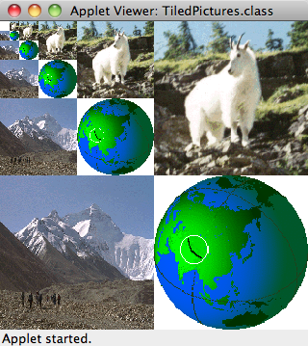
continue
//-----------------------------------------------------------------
// Performs the initial call to the drawPictures method.
//-----------------------------------------------------------------
public void paint (Graphics page)
{
drawPictures (APPLET_WIDTH, page);
}
}
Copyright © 2012 Pearson Education, Inc.

Slide 49
Fractals
A fractal is a geometric shape made up of the same pattern repeated in different sizes and orientations
The Koch Snowflake is a particular fractal that begins with an equilateral triangle
To get a higher order of the fractal, the sides of the triangle are replaced with angled line segments
See KochSnowflake.java
See KochPanel.java
Copyright © 2012 Pearson Education, Inc.

Slide 50
//********************************************************************
// KochSnowflake.java Author: Lewis/Loftus
//
// Demonstrates the use of recursion in graphics.
//********************************************************************
import java.awt.*;
import java.awt.event.*;
import javax.swing.*;
public class KochSnowflake extends JApplet implements ActionListener
{
private final int APPLET_WIDTH = 400;
private final int APPLET_HEIGHT = 440;
private final int MIN = 1, MAX = 9;
private JButton increase, decrease;
private JLabel titleLabel, orderLabel;
private KochPanel drawing;
private JPanel appletPanel, tools;
continue
Copyright © 2012 Pearson Education, Inc.

Slide 51
continue
//-----------------------------------------------------------------
// Sets up the components for the applet.
//-----------------------------------------------------------------
public void init()
{
tools = new JPanel ();
tools.setLayout (new BoxLayout(tools, BoxLayout.X_AXIS));
tools.setPreferredSize (new Dimension (APPLET_WIDTH, 40));
tools.setBackground (Color.yellow);
tools.setOpaque (true);
titleLabel = new JLabel ("The Koch Snowflake");
titleLabel.setForeground (Color.black);
increase = new JButton (new ImageIcon ("increase.gif"));
increase.setPressedIcon (new ImageIcon ("increasePressed.gif"));
increase.setMargin (new Insets (0, 0, 0, 0));
increase.addActionListener (this);
decrease = new JButton (new ImageIcon ("decrease.gif"));
decrease.setPressedIcon (new ImageIcon ("decreasePressed.gif"));
decrease.setMargin (new Insets (0, 0, 0, 0));
decrease.addActionListener (this);
continue
Copyright © 2012 Pearson Education, Inc.

Slide 52
continue
orderLabel = new JLabel ("Order: 1");
orderLabel.setForeground (Color.black);
tools.add (titleLabel);
tools.add (Box.createHorizontalStrut (40));
tools.add (decrease);
tools.add (increase);
tools.add (Box.createHorizontalStrut (20));
tools.add (orderLabel);
drawing = new KochPanel (1);
appletPanel = new JPanel();
appletPanel.add (tools);
appletPanel.add (drawing);
getContentPane().add (appletPanel);
setSize (APPLET_WIDTH, APPLET_HEIGHT);
}
continue
Copyright © 2012 Pearson Education, Inc.

Slide 53
continue
//-----------------------------------------------------------------
// Determines which button was pushed, and sets the new order
// if it is in range.
//-----------------------------------------------------------------
public void actionPerformed (ActionEvent event)
{
int order = drawing.getOrder();
if (event.getSource() == increase)
order++;
else
order--;
if (order >= MIN && order <= MAX)
{
orderLabel.setText ("Order: " + order);
drawing.setOrder (order);
repaint();
}
}
}
Copyright © 2012 Pearson Education, Inc.

Slide 54
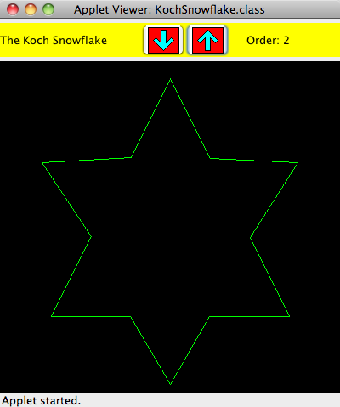
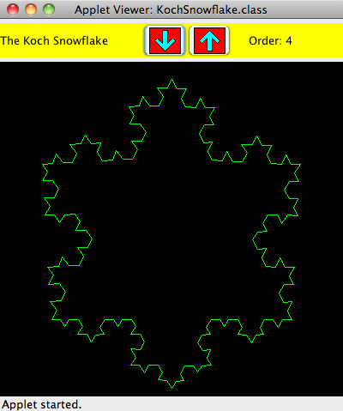
continue
//-----------------------------------------------------------------
// Determines which button was pushed, and sets the new order
// if it is in range.
//-----------------------------------------------------------------
public void actionPerformed (ActionEvent event)
{
int order = drawing.getOrder();
if (event.getSource() == increase)
order++;
else
order--;
if (order >= MIN && order <= MAX)
{
orderLabel.setText ("Order: " + order);
drawing.setOrder (order);
repaint();
}
}
}
Copyright © 2012 Pearson Education, Inc.

Slide 55
Koch Snowflakes
< x₅, y₅>
< x₅, y₅>
< x₄, y₄>
Becomes
< x₃, y₃>
< x₂, y₂>
< x₁, y₁>
< x₁, y₁>
Copyright © 2012 Pearson Education, Inc.

Slide 56
//********************************************************************
// KochPanel.java Author: Lewis/Loftus
//
// Represents a drawing surface on which to paint a Koch Snowflake.
//********************************************************************
import java.awt.*;
import javax.swing.JPanel;
public class KochPanel extends JPanel
{
private final int PANEL_WIDTH = 400;
private final int PANEL_HEIGHT = 400;
private final double SQ = Math.sqrt(3.0) / 6;
private final int TOPX = 200, TOPY = 20;
private final int LEFTX = 60, LEFTY = 300;
private final int RIGHTX = 340, RIGHTY = 300;
private int current; // current order
continue
Copyright © 2012 Pearson Education, Inc.

Slide 57
continue
//-----------------------------------------------------------------
// Draws the fractal recursively. The base case is order 1 for
// which a simple straight line is drawn. Otherwise three
// intermediate points are computed, and each line segment is
// drawn as a fractal.
//-----------------------------------------------------------------
public void drawFractal (int order, int x1, int y1, int x5, int y5,
Graphics page)
{
int deltaX, deltaY, x2, y2, x3, y3, x4, y4;
if (order == 1)
page.drawLine (x1, y1, x5, y5);
else
{
deltaX = x5 - x1; // distance between end points
deltaY = y5 - y1;
x2 = x1 + deltaX / 3; // one third
y2 = y1 + deltaY / 3;
x3 = (int) ((x1+x5)/2 + SQ * (y1-y5)); // tip of projection
y3 = (int) ((y1+y5)/2 + SQ * (x5-x1));
continue
Copyright © 2012 Pearson Education, Inc.

Slide 58
continue
x4 = x1 + deltaX * 2/3; // two thirds
y4 = y1 + deltaY * 2/3;
drawFractal (order-1, x1, y1, x2, y2, page);
drawFractal (order-1, x2, y2, x3, y3, page);
drawFractal (order-1, x3, y3, x4, y4, page);
drawFractal (order-1, x4, y4, x5, y5, page);
}
}
//-----------------------------------------------------------------
// Performs the initial calls to the drawFractal method.
//-----------------------------------------------------------------
public void paintComponent (Graphics page)
{
super.paintComponent (page);
page.setColor (Color.green);
drawFractal (current, TOPX, TOPY, LEFTX, LEFTY, page);
drawFractal (current, LEFTX, LEFTY, RIGHTX, RIGHTY, page);
drawFractal (current, RIGHTX, RIGHTY, TOPX, TOPY, page);
}
continue
Copyright © 2012 Pearson Education, Inc.

Slide 59
continue
//-----------------------------------------------------------------
// Sets the fractal order to the value specified.
//-----------------------------------------------------------------
public void setOrder (int order)
{
current = order;
}
//-----------------------------------------------------------------
// Returns the current order.
//-----------------------------------------------------------------
public int getOrder ()
{
return current;
}
}
Copyright © 2012 Pearson Education, Inc.

Slide 60
Summary
Chapter 12 has focused on:
  thinking in a recursive manner
  programming in a recursive manner
  the correct use of recursion
  recursion examples
Copyright © 2012 Pearson Education, Inc.

