Slide 1
Chapter 14 Streams and File I/O

Slide 2
Outline
Overview of Streams and File I/O
Text File I/O
Binary File I/O
File Objects and File Names

Slide 3
I/O Overview
I/O = Input/Output
In this context it is input to and output from programs
Input can be from keyboard or a file
Output can be to display (screen) or a file
Advantages of file I/O
  permanent copy
  output from one program can be input to another
  input can be automated (rather than entered manually)
Note: Since the sections on text file I/O and binary file I/O have some similar information, and can be covered with either one first, some duplicate (or nearly duplicate) slides are included.

Slide 4
Streams
Stream: an object that either delivers data to its destination (screen, file, etc.) or that takes data from a source (keyboard, file, etc.)
  it acts as a buffer between the data source and destination
Input stream: a stream that provides input to a program
Output stream: a stream that accepts output from a program
  System.out is an output stream
A stream connects a program to an I/O object
  System.out connects a program to the screen

Slide 5
Binary Versus Text Files
All data and programs are ultimately just zeros and ones
  each digit can have one of two values, hence binary
  bit is one binary digit
  byte is a group of eight bits
Text files: the bits represent printable characters
  one byte per character for ASCII, the most common code
  for example, Java source files are text files
  so is any file created with a "text editor"
Binary files: the bits represent other types of encoded information, such as executable instructions or numeric data
  these files are easily read by the computer but not humans
  they are not "printable" files
    actually, you can print them, but they will be unintelligible
    "printable" means "easily readable by humans when printed"

Slide 6
Java: Text Versus Binary Files
Text files are more readable by humans
Binary files are more efficient
  computers read and write binary files more easily than text
Java binary files are portable
  they can be used by Java on different machines
  Reading and writing binary files is normally done by a program
  text files are used only to communicate with humans
Java Text Files
Source files
Occasionally input files
Occasionally output files
Java Binary Files
Executable files (created by compiling source files)
Usually input files
Usually output files

Slide 7
Text File I/O
Important classes for text file output (to the file)
  PrintWriter
  FileOutputStream
Important classes for text file input (from the file):
  BufferedReader
  FileReader
Note that FileOutputStream and FileReader are used only for their（PrintWriter and BufferedReader ） constructors, which can take file names as arguments.
  PrintWriter and BufferedReader cannot take file names as arguments for their constructors.
To use these classes your program needs a line like the following:
  import java.io.*;

Slide 8
Text File Output
To open a text file for output: connect a text file to a stream for writing
  create a stream of the class PrintWriter and connect it to a text file
For example:
PrintWriter outputStream =
new PrintWriter(new FileOutputStream("out.txt"));
Then you can use print and println to write to the file
  The text lists some other useful PrintWriter methods

Slide 9
TextFileOutputDemo
Part 1
outputStream would not be accessible to the rest of the program if it were declared inside the try-block
public static void main(String[] args)
{
PrintWriter outputStream = null;
try
{
outputStream =
new PrintWriter(new FileOutputStream("out.txt"));
}
catch(FileNotFoundException e)
{
System.out.println("Error opening the file out.txt.");
System.exit(0);
}
Opening the file
Creating a file can cause the FileNotFound-Exception if the new file cannot be made.

Slide 10
TextFileOutputDemo
Part 2
System.out.println("Enter three lines of text:");
String line = null;
int count;
for (count = 1; count <= 3; count++)
{
line = scan.nextLine();
outputStream.println(count + " " + line);
}
outputStream.close();
System.out.println("... written to out.txt.");
}
Writing to the file
Closing the file
The println method is used with two different streams: outputStream and System.out

Slide 11
Closing a File
An output file should be closed when you are done writing to it (and an input file should be closed when you are done reading from it).
Use the close method of the class PrintWriter (BufferedReader also has a close method).
For example, to close the file opened in the previous example:
  outputStream.close();
If a program ends normally it will close any files that are open

Slide 12
If It Is Done Automatically,
Why Explicitly Close Files?
If a program automatically closes files when it ends normally, why close them with explicit calls to close?
Two reasons:
  1. To make sure it is closed if a program ends abnormally (it could get damaged if it is left open).
  2. A file open for writing must be closed before it can be opened for reading.

Slide 13
Text File Input
To open a text file for input: connect a text file to a stream for reading
  use a stream of the class BufferedReader and connect it to a text file
  use the FileReader class to connect the BufferedReader object to the text file
For example:
  BufferedReader inputStream =
  new BufferedReader(new FileReader("data.txt"));
Then:
  read lines (Strings) with readLine
  BufferedReader has no methods to read numbers directly, so read numbers as Strings and then convert them
  read a char with read

Slide 14
Testing for End of File in a Text File
There are several ways to test for end of file. For reading text files in Java you can use this one:
  Test for a special character that signals the end of the file
When readLine tries to read beyond the end of a text file it returns the special value null
  so you can test for null to stop processing a text file
read returns -1 when it tries to read beyond the end of a text file
  the int value of all ordinary characters is nonnegative
Neither of these two methods (read and readLine) will throw an EOFException.

Slide 15
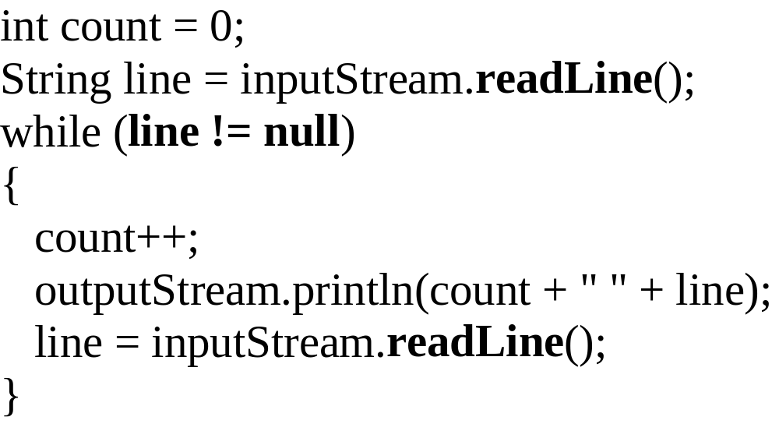
Example: Using Null to
Test for End-of-File in a Text File
When using readLine
test for null
Excerpt from TextEOFDemo
When using read test for -1

Slide 16
Reading Words in a String: Using
StringTokenizer Class
There are BufferedReader methods to read a line and a character, but not just a single word
StringTokenizer can be used to parse a line into words
  it is in the util library so you need to import java.util.*
  some of its useful methods are shown in the text
    e.g. test if there are more tokens
  you can specify delimiters (the character or characters that separate words)
    the default delimiters are "white space" (space, tab, and newline)

Slide 17
Example: StringTokenizer
Display the words separated by any of the following characters: space, new line (\n), period (.) or comma (,).
String inputLine = scan.nextLine();
StringTokenizer wordFinder =
new StringTokenizer(inputLine, " \n.,");
//the second argument is a string of the 4 delimiters
while(wordFinder.hasMoreTokens())
{
System.out.println(wordFinder.nextToken());
}
Question
2b
or
!tooBee
Entering "Question,2b.or !tooBee." gives this output:

Slide 18
Binary File I/O
Important classes for binary file output (to the file)
  ObjectOutputStream
  FileOutputStream
Important classes for binary file input (from the file):
  ObjectInputStream
  FileInputStream
Note that FileOutputStream and FileInputStream are used only for their constructors, which can take file names as arguments.
  ObjectOutputStream and ObjectInputStream cannot take file names as arguments for their constructors.
To use these classes your program needs a line like the following:
  import java.io.*;

Slide 19
When Using ObjectOutputStream to Output Data to Files:
The output files are binary and can store any of the primitive data types (int, char, double, etc.) and the String type
The files created can be read by other Java programs but are not printable
The Java I/O library must be imported by including the line:
import java.io.*;
  it contains ObjectOutputStream and other useful class definitions
An IOException might be thrown

Slide 20
Opening an Output File
To open a file named numbers.dat:
  ObjectOutputStream outputStream =
  new ObjectOutputStream(new FileOutputStream("numbers.dat"));
The following two statements are equivalent to the single statement above:
  FileOutputStream middleman =
  new FileOutputStream("numbers.dat");
  ObjectOutputStream outputStream =
  new ObjectOutputStream(middleman);

Slide 21
Some ObjectOutputStream Methods
You can write data to an output file after it is connected to a stream class
  Use methods defined in ObjectOutputStream
    writeInt(int n)
    writeDouble(double x)
    writeBoolean(boolean b)
    etc.
    See the text for more
Note that each write method throws IOException
  eventually we will have to write a catch block for it
Also note that each write method includes the modifier final
  final methods cannot be redefined in derived classes

Slide 22
Closing a File
An Output file should be closed when you are done writing to it
Use the close method
  For example, to close the file opened in the previous example:
  outputStream.close();
If a program ends normally it will close any files that are open

Slide 23
Writing a Character to a File: an Unexpected Little Complexity
The method writeChar has an annoying property:
  it takes an int, not a char, argument
But it is easy to fix:
  just cast the character to an int
For example, to write the character 'A' to the file opened previously:
  outputStream.writeChar((int) 'A');

Slide 24
Writing a boolean Value to a File
boolean values can be either of two values, true or false
true and false are not just names for the values, they actually are of type boolean
For example, to write the boolean value false to the output file:
  outputStream.writeBoolean(false);

Slide 25
Writing Strings to a File:
Another Little Unexpected Complexity
Use the writeUTF method to output a value of type String
  there is no writeString method
UTF stands for Unicode Text Format
  a special version of Unicode
Unicode: a text (printable) code that uses 2 bytes per character
  designed to accommodate languages with a different alphabet or no alphabet (such as Chinese and Japanese)
ASCII: also a text (printable) code, but it uses just 1 byte per character
  the most common code for English and languages with a similar alphabet
UTF is a modification of Unicode that uses just one byte for ASCII characters
  allows other languages without sacrificing（牺牲） efficiency for ASCII files

Slide 26
Warning: Overwriting a File
Opening a file creates a new file if it does not already exist
Opening a file that already exists eliminates the old file and creates a new, empty one
  data in the original file is lost
FileOutputStream(String name, boolean append)
  new FileOutputStream("numbers.dat“,true)
How to test for the existence of a file and avoid overwriting it will be covered later

Slide 27
When Using ObjectInputStream to Read Data from Files:
Input files are binary and contain any of the primitive data types (int, char, double, etc.) and the String type
The files can be read by Java programs but are not printable
The Java I/O library must be imported including the line:
import java.io.*;
  it contains ObjectInputStream and other useful class definitions
An IOException might be thrown

Slide 28
Opening a New Input File
Similar to opening an output file, but replace "output" with "input"
The file name is given as a String
  file name rules are determined by your operating system
Opening a file takes two steps
  1. Creating a FileInputStream object associated with the file name String
  2. Connecting the FileInputStream to a ObjectInputStream object
This can be done in one line of code

Slide 29
Example: Opening an Input File
To open a file named numbers.dat:
  ObjectInputStream inStream =
  new ObjectInputStream (new FileInputStream("numbers.dat"));
The following two statements are equivalent:
  FileInputStream middleman =
  new FileInputStream("numbers.dat");
  ObjectInputStream inputStream =
  new ObjectInputStream (middleman);

Slide 30
Some ObjectInputStream Methods
For every output file method there is a corresponding input file method
You can read data from an input file after it is connected to a stream class
  Use methods defined in DataInputStream
    readInt()
    readDouble()
    readBoolean()
    etc.
    See the text for more
Note that each write method throws IOException
Also note that each write method includes the modifier final

Slide 31
Input File Exceptions
A FileNotFoundException is thrown if the file is not found when an attempt is made to open a file
Each read method throws IOException
  we still have to write a catch block for it
If a read goes beyond the end of the file an EOFException is thrown

Slide 32
Avoiding Common ObjectInputStream File Errors
There is no error message (or exception)
if you read the wrong data type!
Input files can contain a mix of data types
  it is up to the programmer to know their order and use the correct read method
DataInputStream works with binary, not text files
As with an output file, close the input file when you are done with it

Slide 33
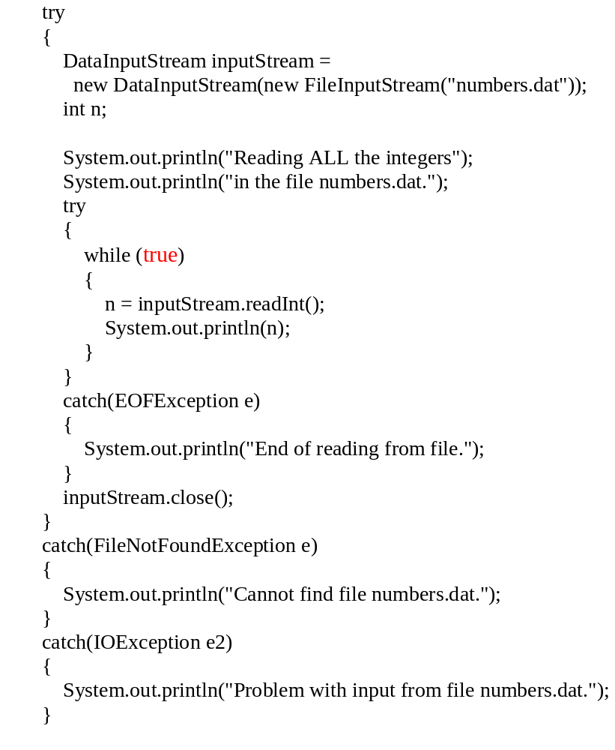
Using EOFException
main method from
EOFExceptionDemo
Intentional "infinite" loop to process data from input file
Loop exits when end-of-file exception is thrown
Processing continues after EOFException: the input file is closed
Note order of catch blocks:
the most specific is first
and the most general last

Slide 34
Exception Handling with File I/O
Catching IOExceptions
IOException is a predefined class
File I/O done as described here might throw an IOException
You should catch the exception in a catch block that at least prints an error message and ends the program
FileNotFoundException is derived from IOException
  therefore any catch block that catches IOExceptions also catches FileNotFoundExceptions
  errors can be isolated better if they have different messages
  so create different catch blocks for each exception type
  put the more specific one first (the derived one) so it catches specifically file-not-found exceptions
  then you will know that an I/O error is something other than file-not-found

Slide 35
The EOFException Class
A common programming situation is to read data from an input file but not know how much data the file contains
In these situations you need to check for the end of the file
Many (but not all) methods that read from a file throw an end-of-file exception (EOFException) when they try to read beyond the file
  all the DataInputStream methods in Display 9.3 do throw it
The end-of-file exception can be used in an "infinite" (while(true)) loop that reads and processes data from the file
  the loop terminates when an EOFException is thrown
The program is written to continue normally after the EOFException has been caught

Slide 36
Object File I/O
It is possible to store objects just as easily as you store primitive data values.
To save objects from a given class, the class declaration must include the phrase implements Serializable. For example,
      class Person implements Serializable
      {
      . . .
      }
Transient Keywords
  用transient修饰的属性不会保存和恢复(实现Serializable)
  transient String b;

Slide 37
Saving Objects
FileOutputStream outFileStream
= new FileOutputStream(“objects.data”);
ObjectOutputStream outObjectStream
= new ObjectOutputStream(outFileStream);
Person person = new Person("Mr. Espresso", 20, 'M');
outObjectStream.writeObject( person );
account1 = new Account();
bank1 = new Bank();
outObjectStream.writeObject( account1 );
outObjectStream.writeObject( bank1 );
Could save objects from the different classes.
Notes:
You can even mix objects and primitive data type values. For example,
outObjectStream.writeInt ( 15 );
outObjectStream.writeObject( account1 );
outObjectStream.writeChar ( 'X' );

Slide 38
Loading Objects
FileInputStream inFileStream
= new FileInputStream(“objects.data”);
ObjectInputStream inObjectStream
= new ObjectInputStream(inFileStream);
Person person
= (Person) inObjectStream.readObject( );
Must type cast to the correct object type.
Account account1
= (Account) inObjectStream.readObject( );
Bank bank1
= (Bank) inObjectStream.readObject( );
Must read in the correct order.
Notes:
You can even mix objects and primitive data type values. For example,
outObjectStream.writeInt ( 15 );
outObjectStream.writeObject( account1 );
outObjectStream.writeChar ( 'X' );

Slide 39
Saving and Loading Arrays
Instead of processing array elements individually, it is possible to save and load the whole array at once.
Person[] people = new Person[ N ]; //assume N already has a value
//build the people array
. . .
//save the array
outObjectStream.writeObject ( people );
//load the array
Person[ ] people = (Person[ ]) inObjectStream.readObject ( );
Notes:
class FindSum
{
private int sum;
private boolean success;
public int getSum()
{
return sum;
}
public boolean isSuccess()
{
return success;
}
void computeSum (String fileName )
{
success = true;
try {
File inFile = new File(fileName);
FileInputStream inFileStream
= new FileInputStream(inFile);
DataInputStream inDataStream
= new DataInputStream(inFileStream);
//read three integers
int i = inDataStream.readInt();
int j = inDataStream.readInt();
int k = inDataStream.readInt();
sum = i + j + k;
inDataStream.close();
}
catch (IOException e) {
success = false;
}
}
}

Slide 40
RandomAccessFile(Optional)
Not stream based I/O
Permit Assessed Randomly
Permit R/W Simutaneously

Slide 41
RandomAccessFile rf =
new RandomAccessFile("rtest.dat", "rw");
for(int i = 0; i < 10; i++)
rf.writeDouble(i*1.414);
rf.close();
rf = new RandomAccessFile("rtest.dat", "rw");
rf.seek(5*8);
rf.writeDouble(47.0001);
rf.close();
rf = new RandomAccessFile("rtest.dat", "r");
for(int i = 0; i < 10; i++)
System.out.println(
"Value " + i + ": " +
rf.readDouble());
rf.close();

Slide 42
Timing Data for File Operations
computing the checksum of the 37-Mbyte file
Method Time
Buffered Input Stream 9.9 s
Random Access File 162 s

Slide 43
The File Class
Acts like a wrapper class for file names
A file name like "numbers.dat" has only String properties
But a file name of type File has some very useful methods
  exists: tests to see if a file already exists
  canRead: tests to see if the operating system will let you read a file
FileInputStream and FileOutputStream have constructors that take a File argument as well as constructors that take a String argument
Note: file names alone are presumed in the same directory/folder as the program，you can also use a full or relative path name if the file is in a different directory/folder

Slide 44
The File Class
    isFile(); isDirectory();
    getName();getPath();
    length();
    renameTo(File new File)
    delete();
    mkdirs();

Slide 45
Using Path Names
Path name—gives name of file and tells which directory the file is in
Relative path name—gives the path starting with the directory that the program is in
Typical UNIX path name:
/user/smith/home.work/java/FileClassDemo.java
Typical Windows path name:
D:\Work\Java\Programs\FileClassDemo.java
When a backslash is used in a quoted string it must be written as two backslashes since backslash is the escape character:
"D:\\Work\\Java\\Programs\\FileClassDemo.java"
Java will accept path names in UNIX or Windows format, regardless of which operating system it is actually running on.

Slide 46
//: c11:DirList.java Displays directory listing.
import java.io.*;
import java.util.*;
import com.bruceeckel.util.*;
public class DirList {
public static void main(String[] args) {
File path = new File(".");
String[] list;
if(args.length == 0)
list = path.list();
else
list = path.list(new DirFilter(args[0]));
Arrays.sort(list,
new AlphabeticComparator());
for(int i = 0; i < list.length; i++)
System.out.println(list[i]);
}
}

Slide 47
class DirFilter implements FilenameFilter {
String afn;
DirFilter(String afn) { this.afn = afn; }
public boolean accept(File dir, String name) {
// Strip path information:
String f = new File(name).getName();
return f.indexOf(afn) != -1;
}
}

Slide 48
Summary
Part 1
Text files contain strings of printable characters; they look intelligible to humans when opened in a text editor.
Binary files contain numbers or data in non-printable codes; they look unintelligible to humans when opened in a text editor.
Java can process both binary and text files, but binary files are more common when doing file I/O.
The class ObjectOutputStream is used to write output to a binary file.
The class ObjectInputStream is used to read input from a binary file.

Slide 49
Summary
Part 2
Always check for the end of the file when reading from a file. The way you check for end-of-file depends on the method you use to read from the file.
A file name can be read from the keyboard into a String variable and the variable used in place of a file name.
The class File has methods to test if a file exists and if it is read- and/or write-enabled.

Slide 50
Zip stream (Optional)
ClassName
Description
CheckedInputStream
GetCheckSum( ) produces checksum for any InputStream (not just decompression).
CheckedOutputStream
GetCheckSum( ) produces checksum for any OutputStream (not just compression).
ZipOutputStream
A DeflaterOutputStream that compresses data into the Zip file format.
GZIPOutputStream
A DeflaterOutputStream that compresses data into the GZIP file format.
ZipInputStream
An InflaterInputStream that decompresses data that has been stored in the Zip file format.
GZIPInputStream
An InflaterInputStream that decompresses data that has been stored in the GZIP file format.

Slide 51
//: c11:GZIPcompress.java
// Uses GZIP compression to compress a file
// whose name is passed on the command line.
import java.io.*;
import java.util.zip.*;
public class GZIPcompress {
// Throw exceptions to console:
public static void main(String[] args)
throws IOException {
BufferedReader in =
new BufferedReader(
new FileReader(args[0]));
BufferedOutputStream out =
new BufferedOutputStream(
new GZIPOutputStream(
new FileOutputStream("test.gz")));
System.out.println("Writing file");

Slide 52
int c;
while((c = in.read()) != -1)
out.write(c);
in.close();
out.close();
System.out.println("Reading file");
BufferedReader in2 =
new BufferedReader(
new InputStreamReader(
new GZIPInputStream(
new FileInputStream("test.gz"))));
String s;
while((s = in2.readLine()) != null)
System.out.println(s);
}
} //writing your own winzip。

Slide 53
Java ARchives (JARs)
The Zip format
cross-platform
manifest file(describes the collection if zipped files);
jar [options] destination [manifest] inputfile(s)
  jar cf myJarFile.jar *.class
Usage：Compress & Package

Slide 54
-- test
`-- Test.class
test.zip
`-- test
`-- Test.class
test.jar
|-- META-INF
| `-- MANIFEST.MF
`-- test
`--Test.class
manifest.mf
  Main-Class: test.Test <回车>
  jar cvfm test.jar manifest.mf test

