Slide 1
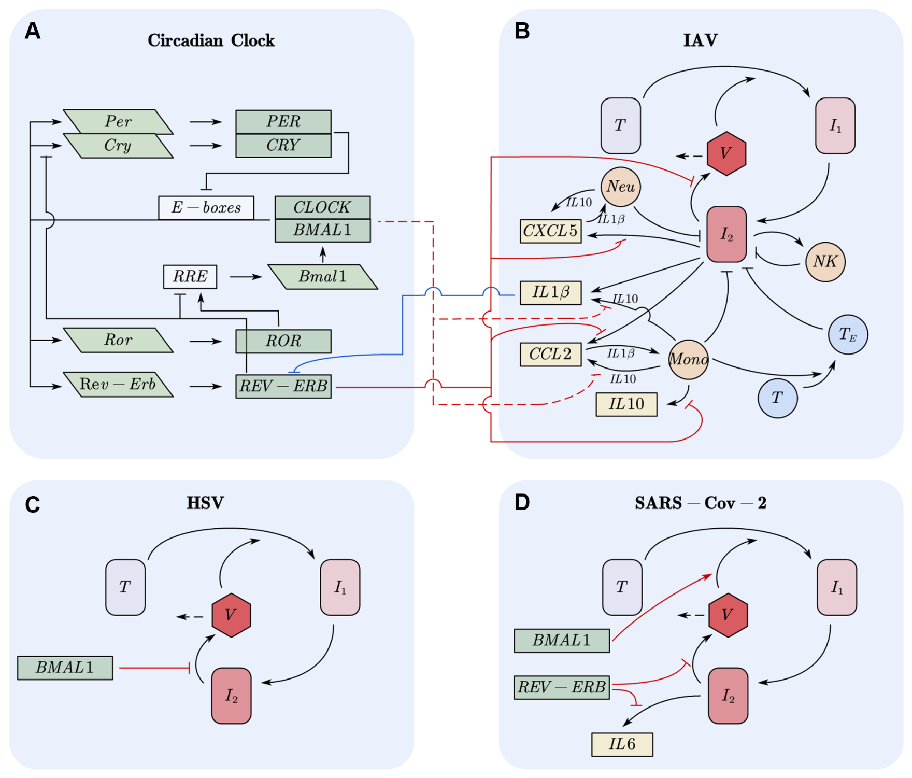
Figure 1. Models

Slide 2
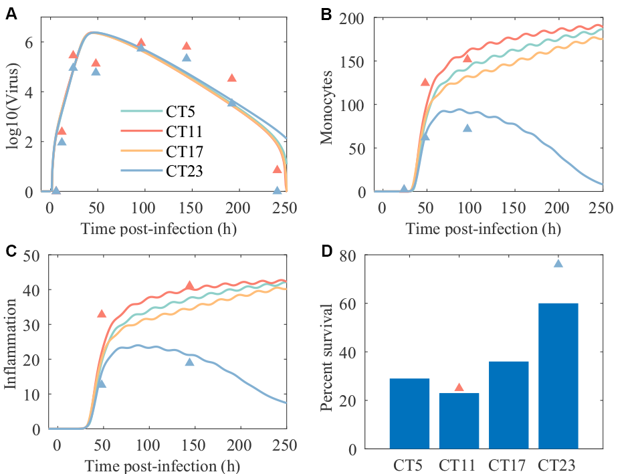
Figure 2. Infection time determines the inflammatory response and outcomes.

Slide 3
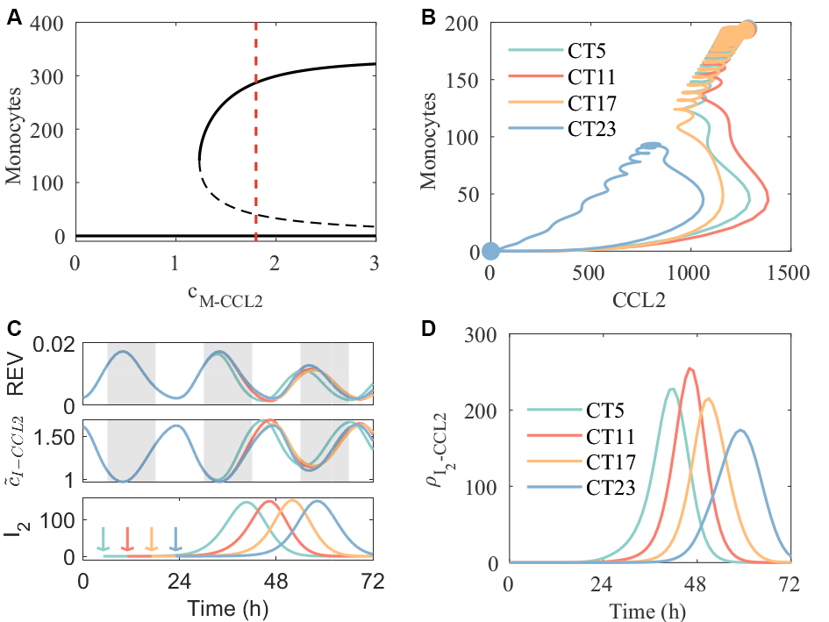
Figure 3. Mechanisms of time dependent immune response and outcomes.

Slide 4
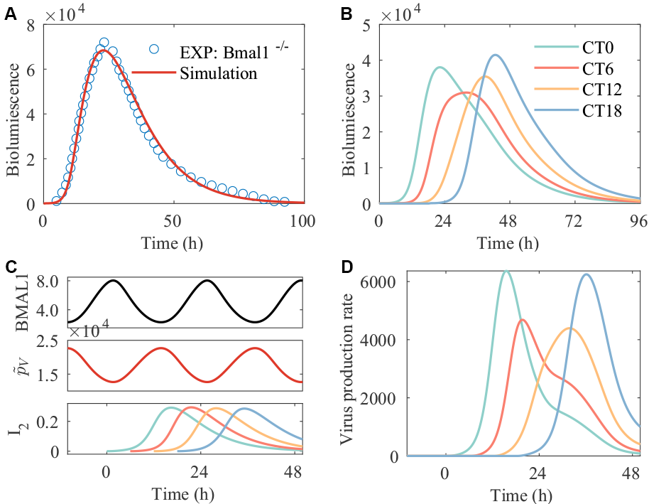
Figure 4. Time of infection peak determines viral replication in HSV cell infection model.

Slide 5
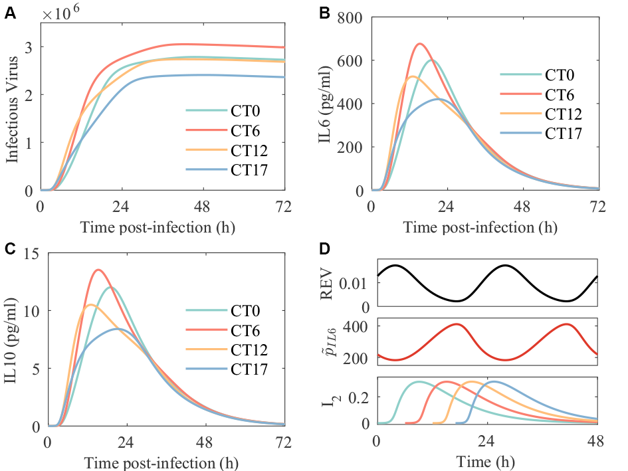
Figure 5. Time of infection peak determines viral replication and cytokines in SARS-Cov-2 cell infection model.

Slide 6
Figure 6. Disturbances in the circadian clock lead to worse infection outcomes. - IAV

Slide 7
Figure 6. Disturbances in the circadian clock lead to worse infection outcomes. - HSV

Slide 8
Figure 6. Disturbances in the circadian clock lead to worse infection outcomes. – SARS-Cov-2

