Slide 1
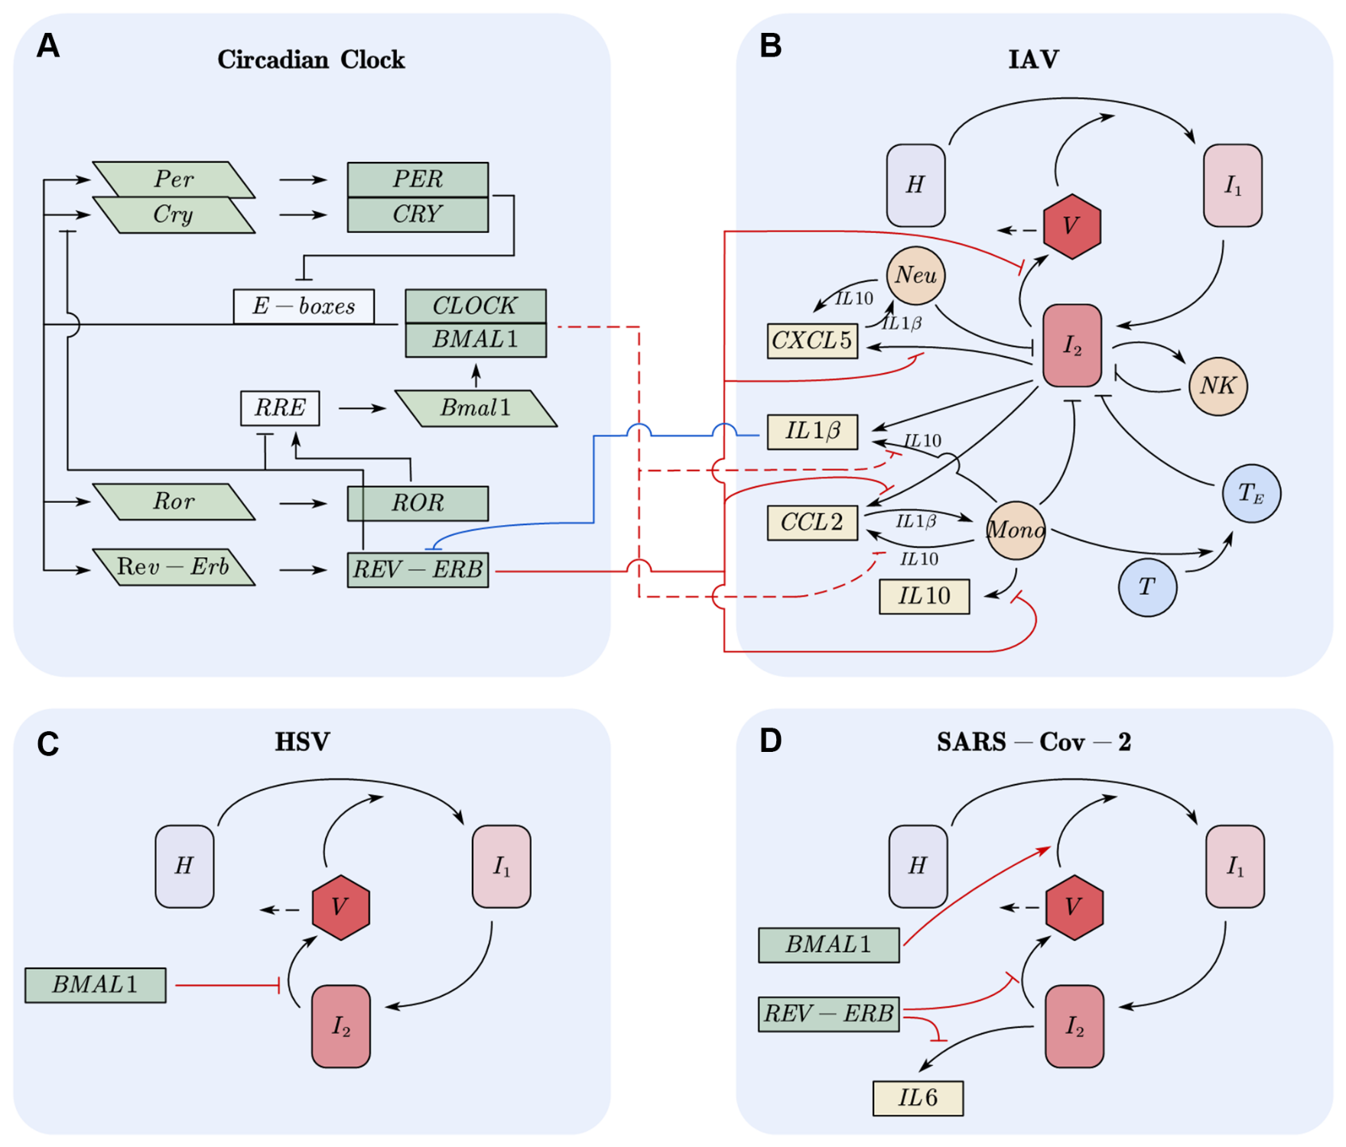
Figure 1. Models

Slide 2
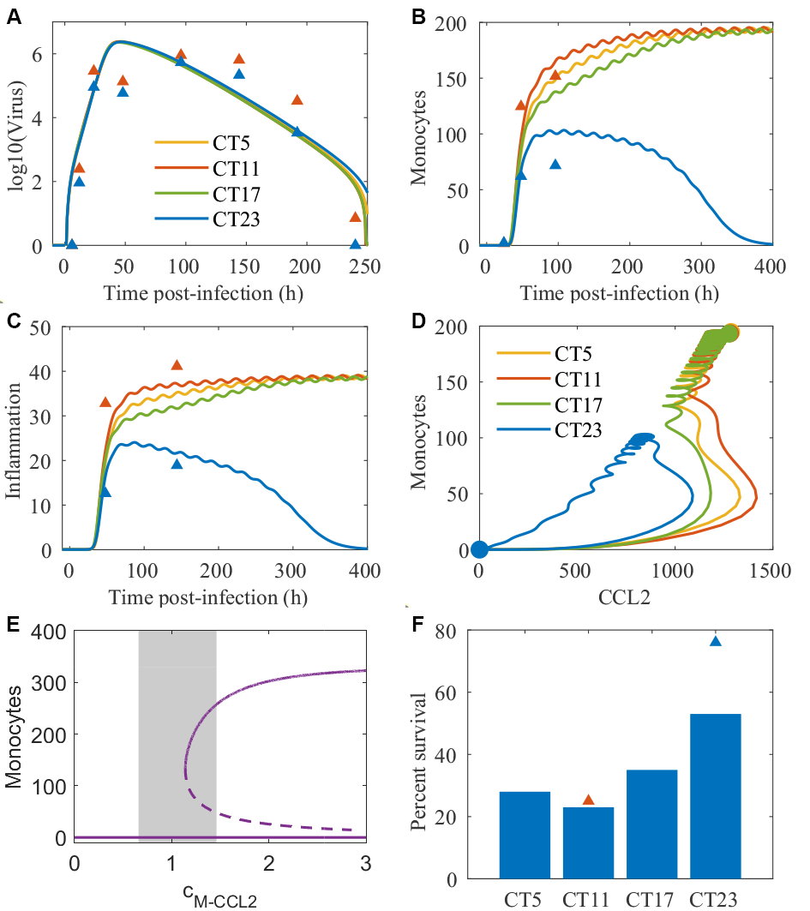
Figure 2. Infection time determines the inflammatory response and outcomes.

Slide 3
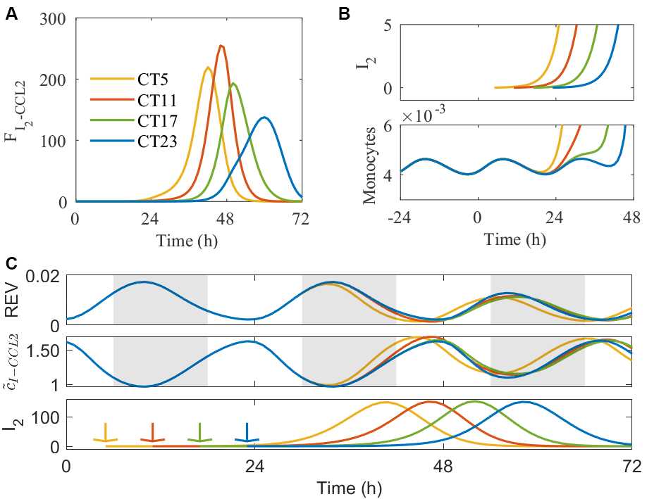
Figure 3. Mechanisms of time dependent immune response and outcomes.

Slide 4
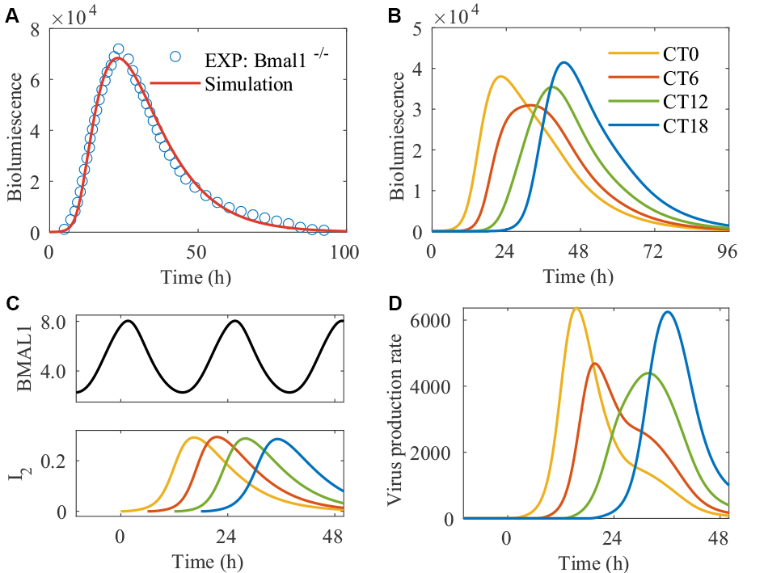
Figure 4. Time of infection peak determines viral replication in HSV cell infection model.

Slide 5
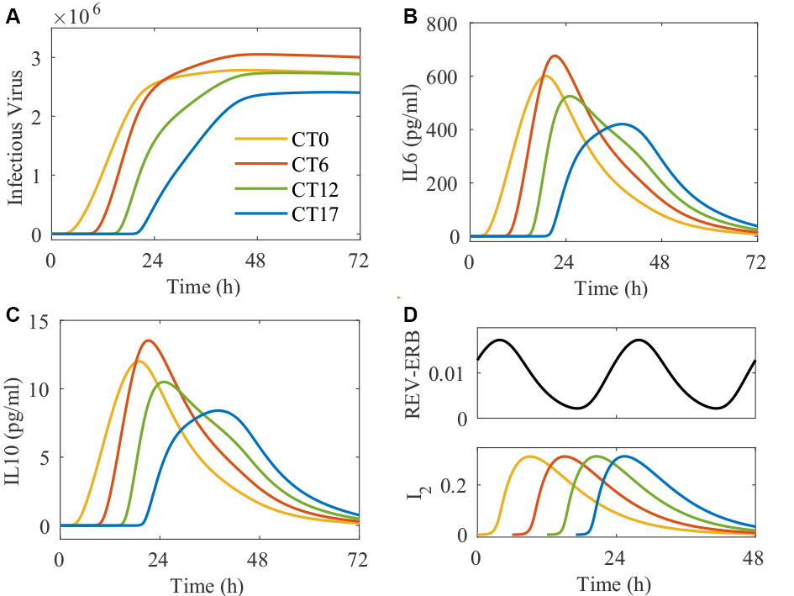
Figure 5. Time of infection peak determines viral replication and cytokines in SARS-Cov-2 cell infection model.

Slide 6
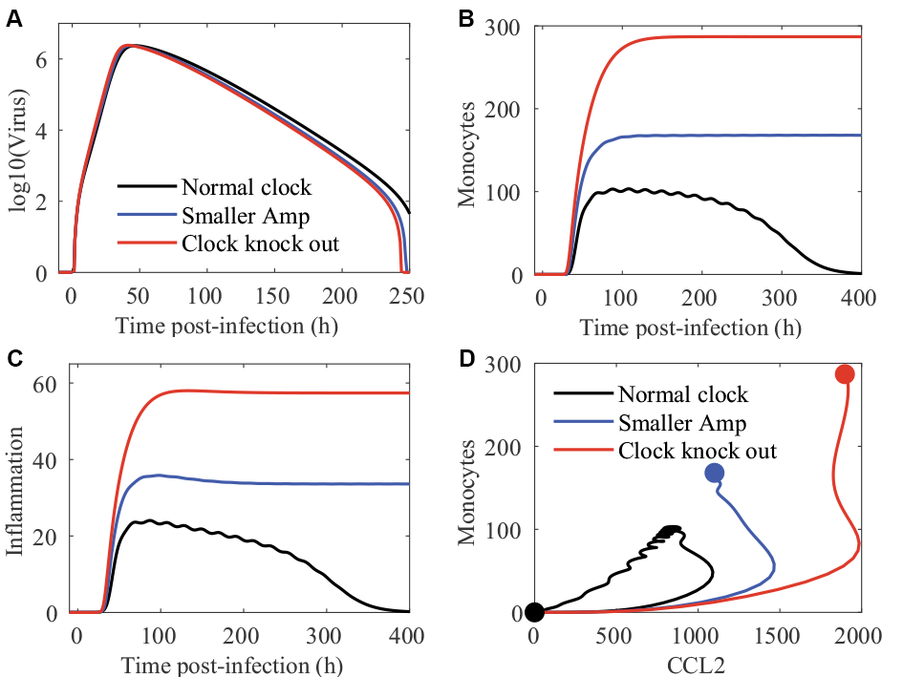
Figure 6. Disturbances in the circadian clock lead to worse IAV infection outcomes.

Slide 7
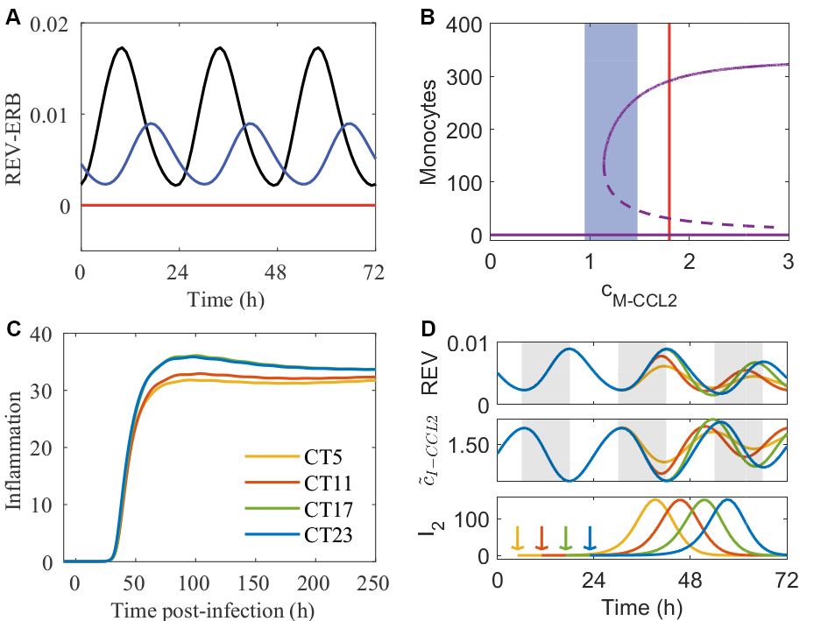
Figure 7. Mechanisms of clock disruption’s effect on IAV infection outcomes.

Slide 8
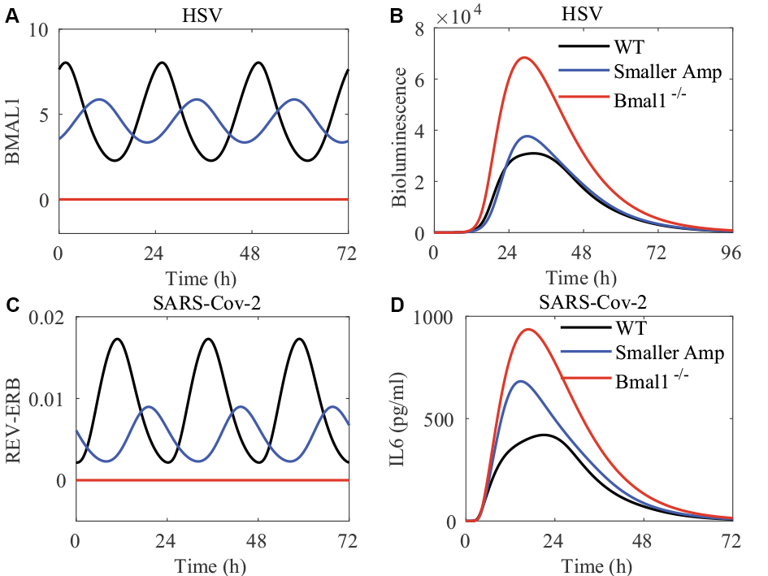
Figure 8. Disturbances in the circadian clock lead to worse HSV and SARS-Cov-2 infection outcomes.

