Slide 1
Guide of Daily Report System
2014/03/24

Slide 2
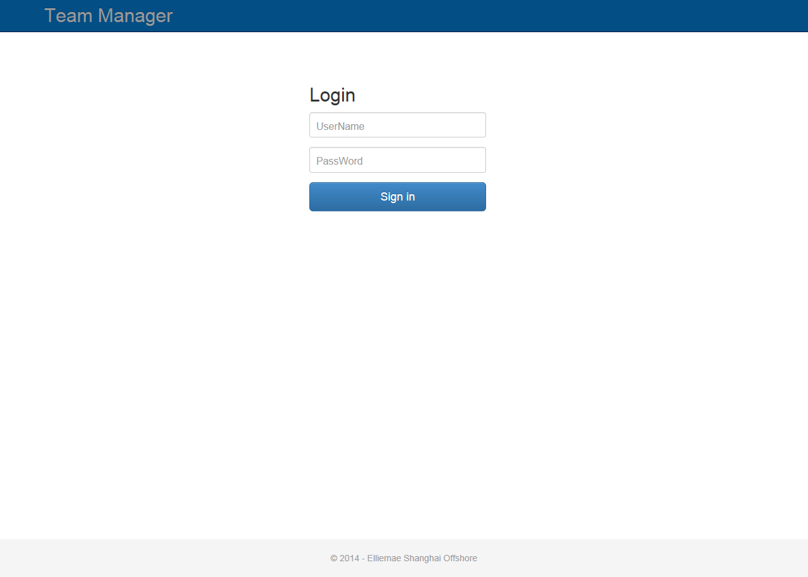
Input your UserName.
Input your Password.

Slide 3
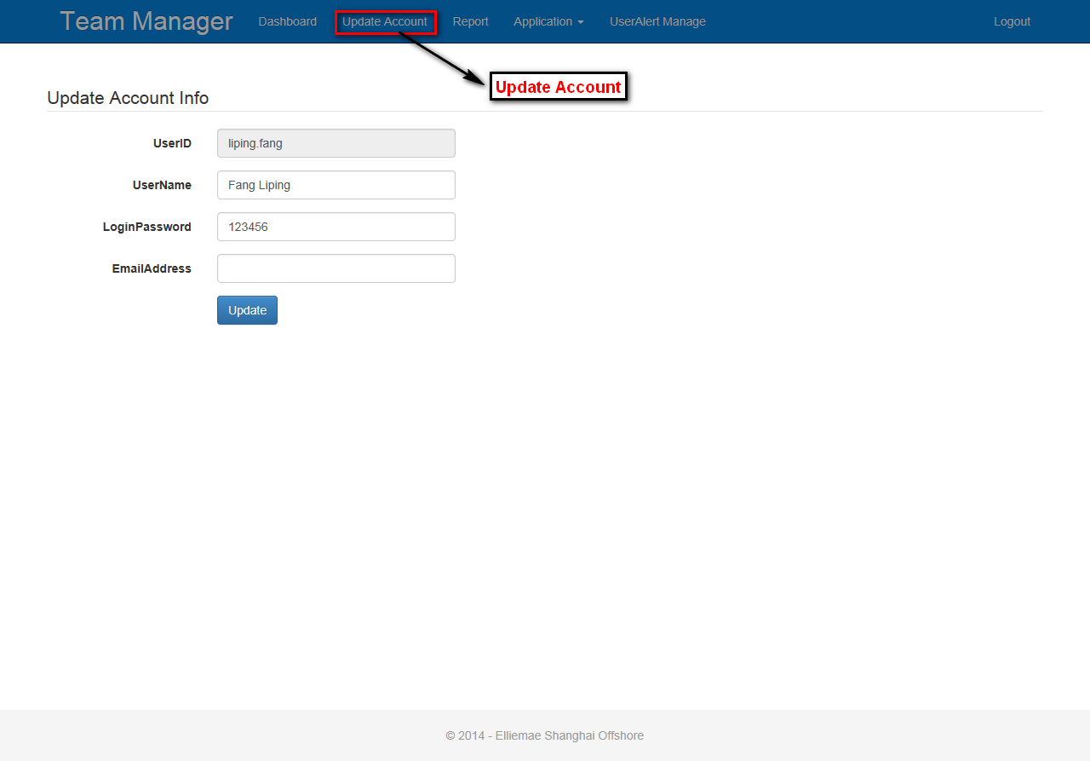
Your can update your information like UserName,LoginPassword and EmailAddress at here.

Slide 4
First part:
Staff Articles

Slide 5
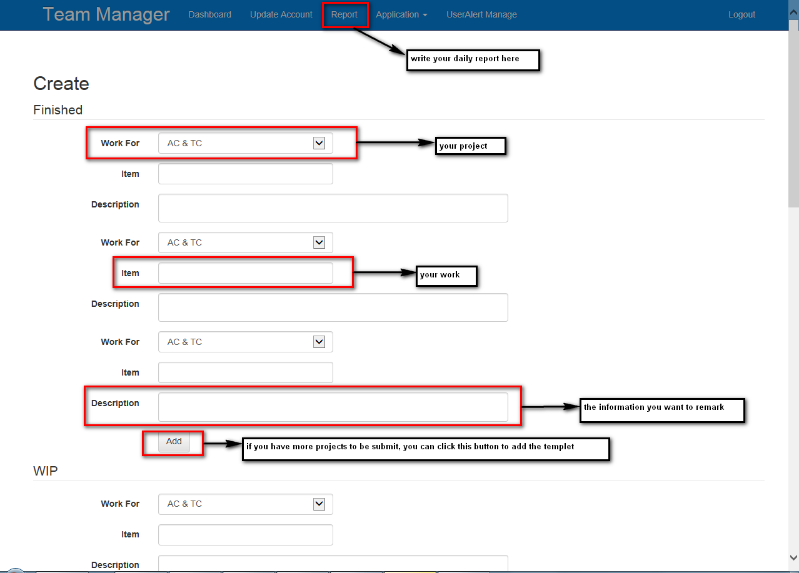

Slide 6
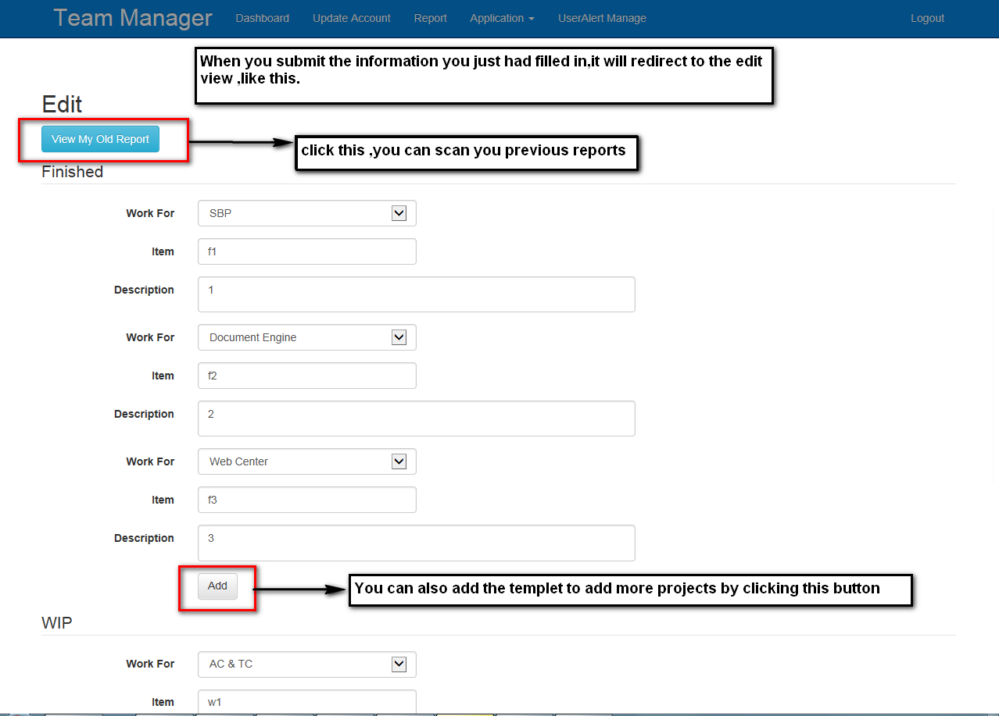

Slide 7
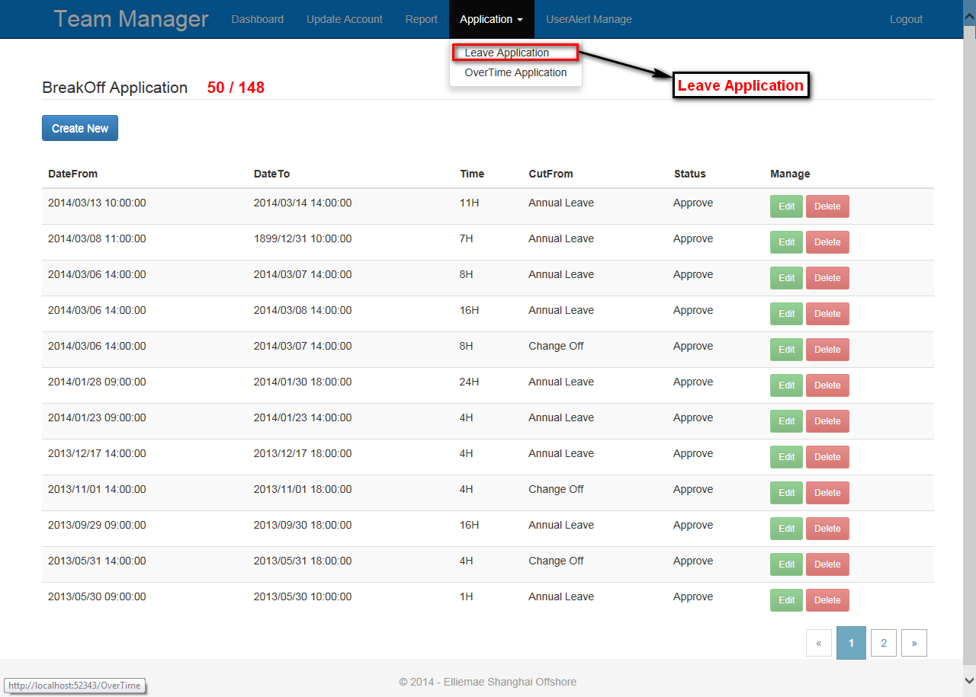
Your time.
When we want to create an new BreakOff Application,click this button.
Edit
Delete

Slide 8
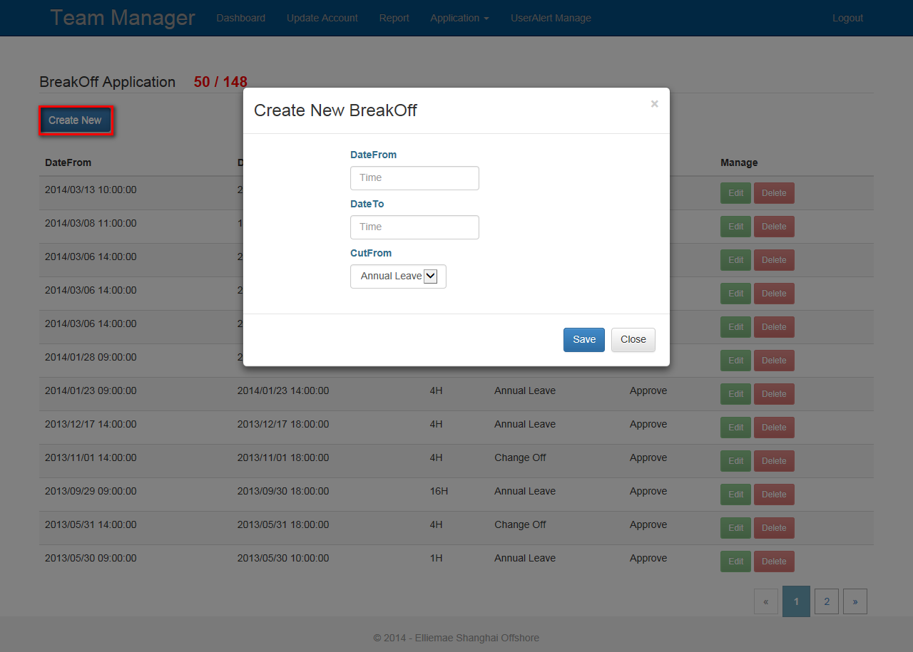
From Time
To Time
CutFrom
After click the CreateNew button, the page pops up a modal dialog for us inputing our BreakOff Information.

Slide 9
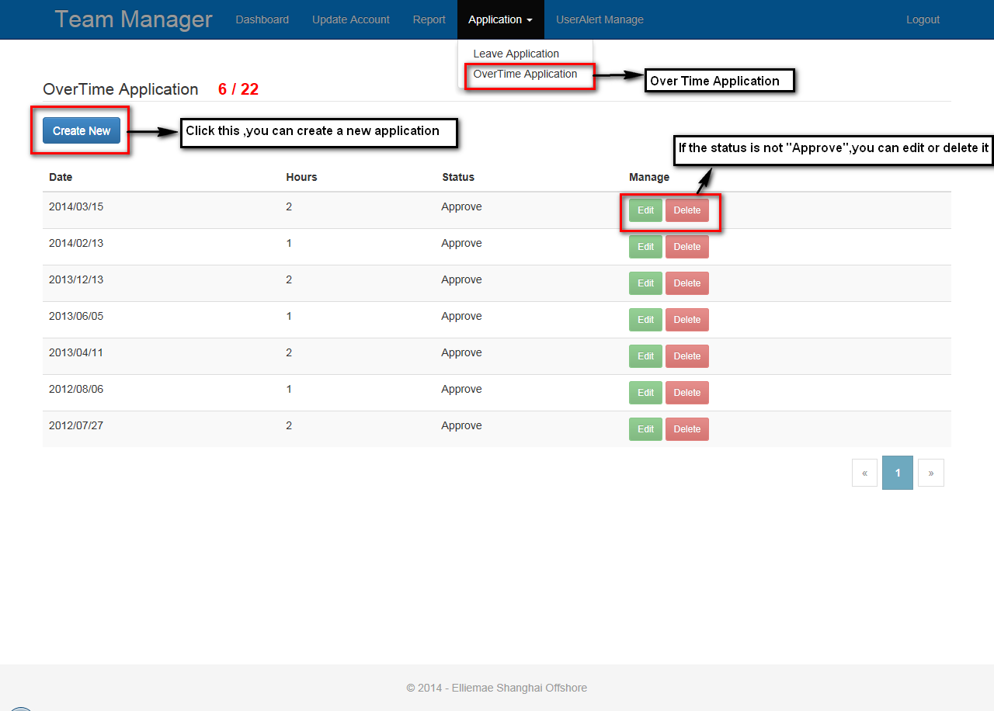

Slide 10
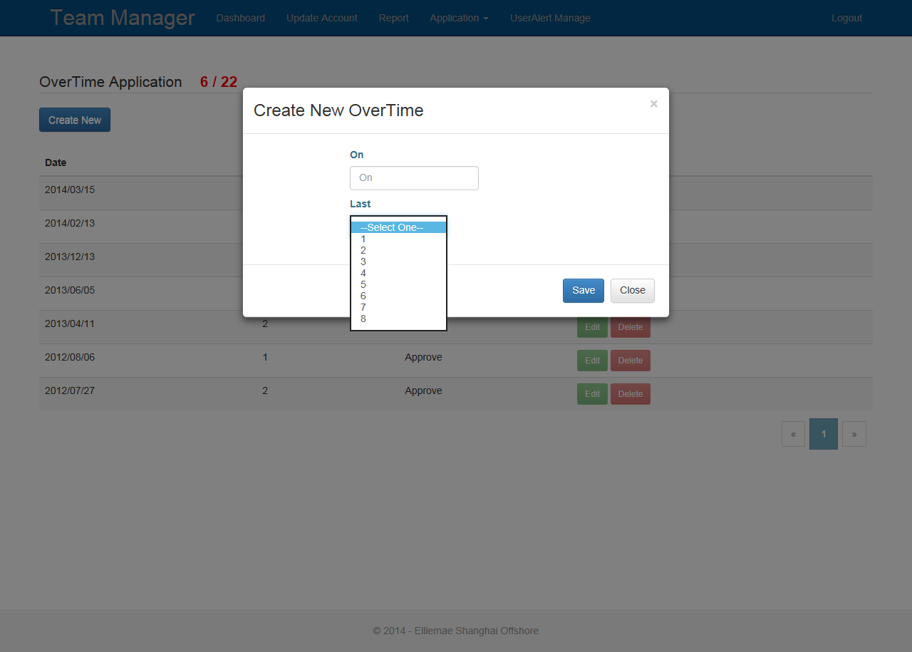
The date
How long did you work overtime?
After click the CreateNew button, the page pops up a modal dialog for us inputing our OverTime Information.
The OverTime Application page almost the same as the page of BreakOff Applcation.

Slide 11
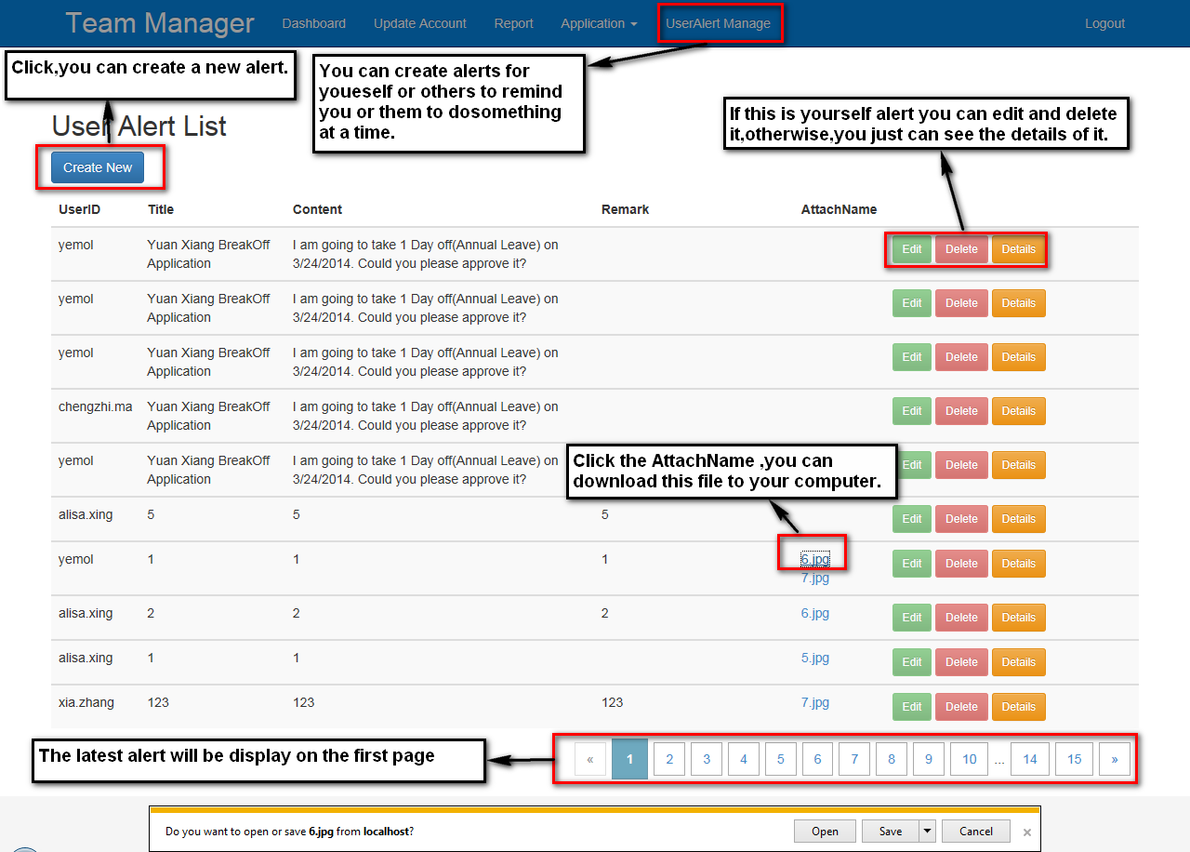

Slide 12
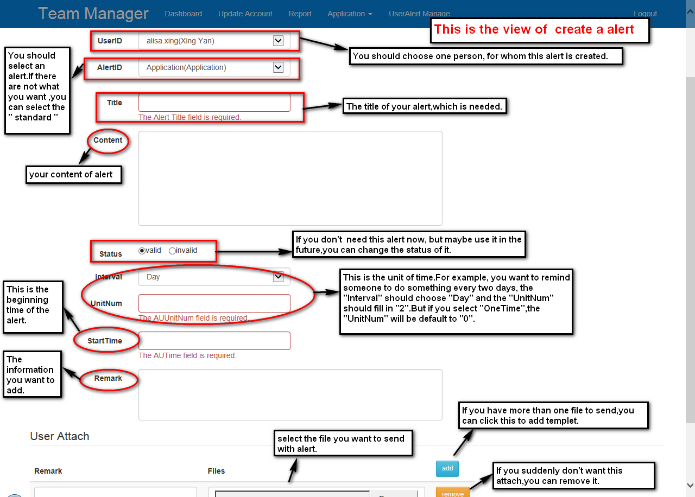

Slide 13
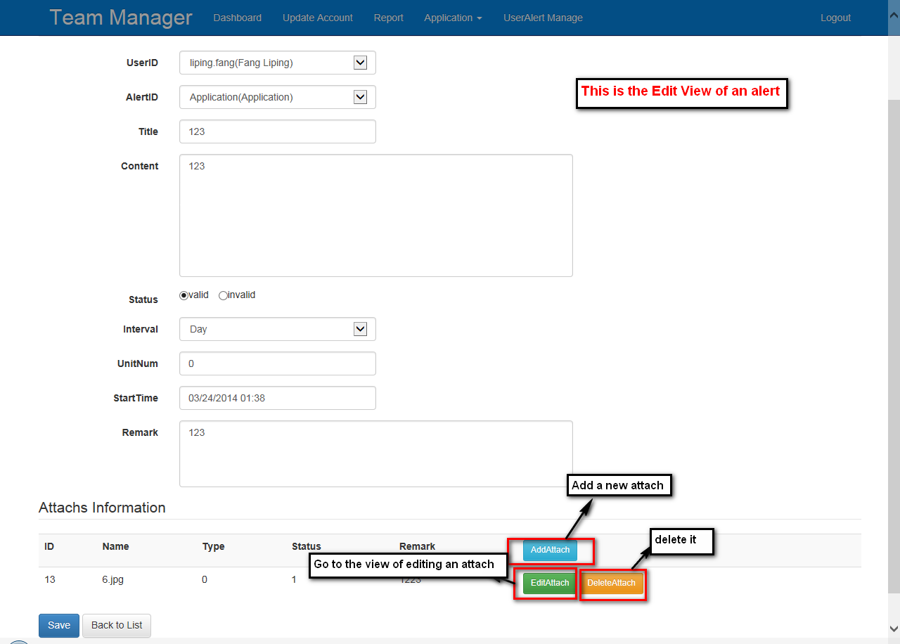

Slide 14
Second part:
Trainee Articles

Slide 15
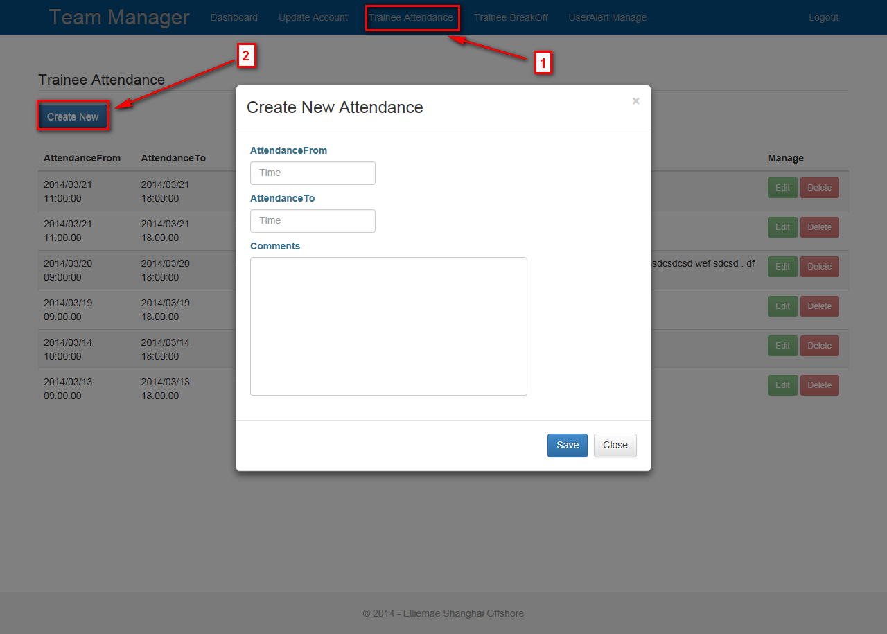
From Time
To Time
Attendance Comments

Slide 16
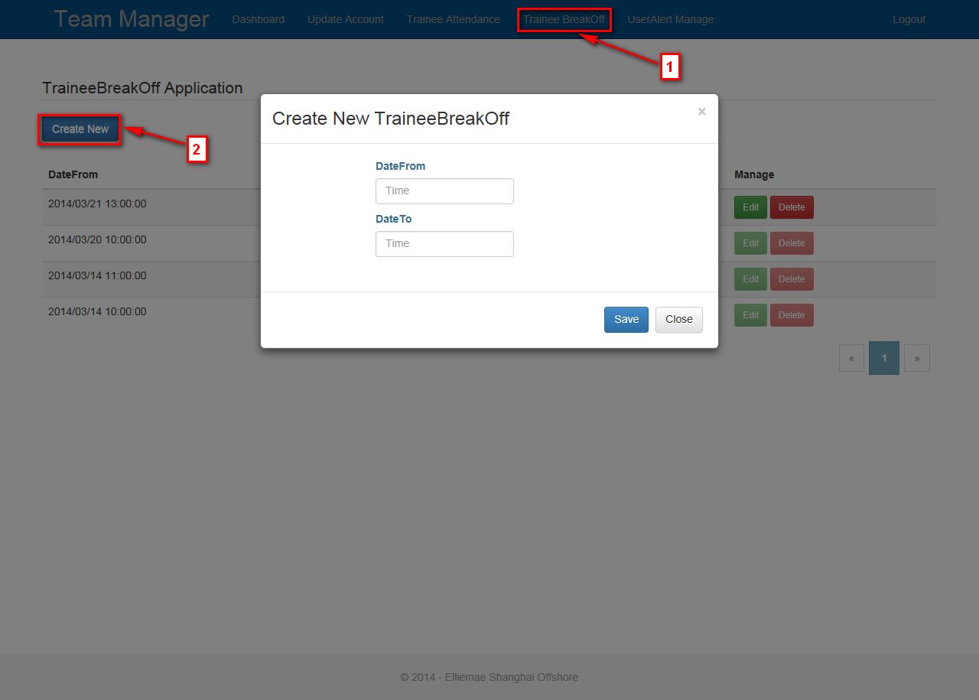
Form Time
To Time

Slide 17
Third part:
Manager Articles

Slide 18
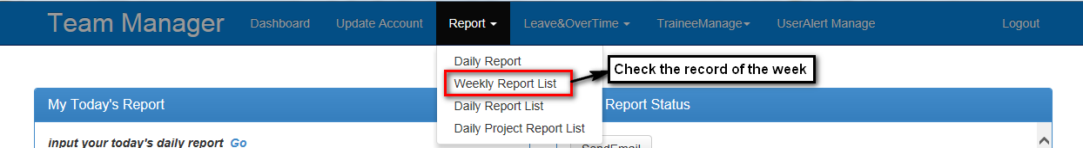
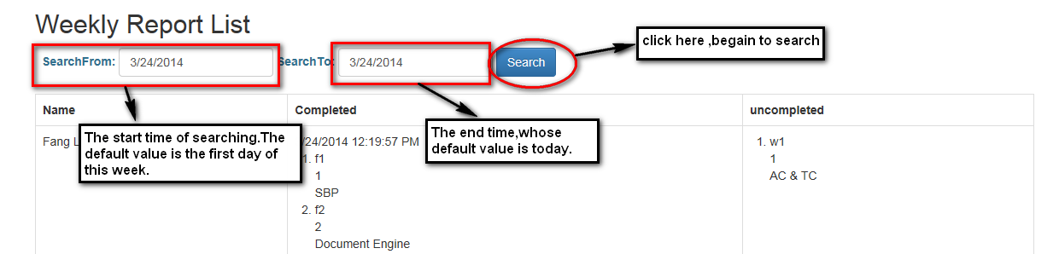

Slide 19
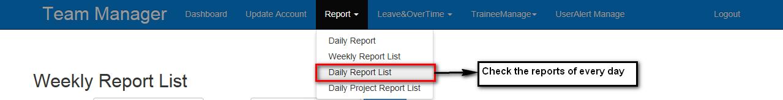
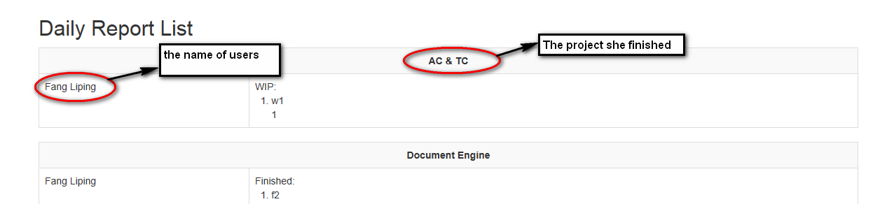

Slide 20
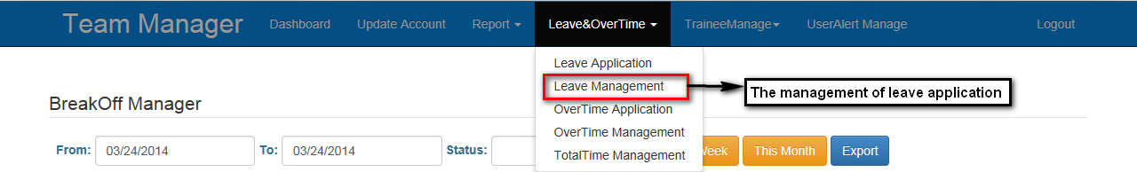
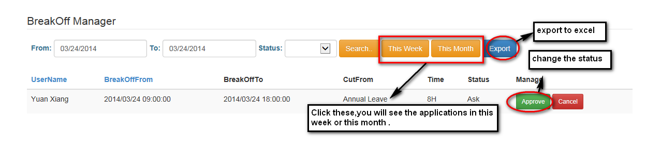

Slide 21
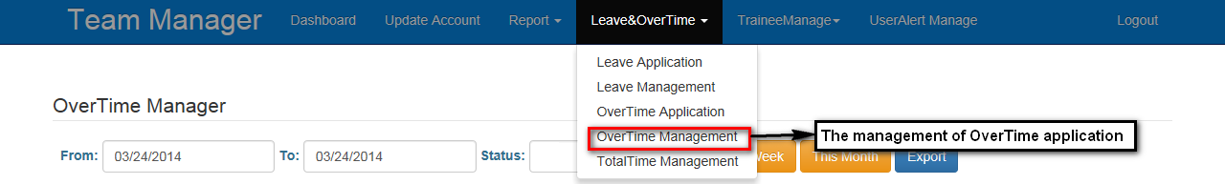
This part is same to the last one

Slide 22
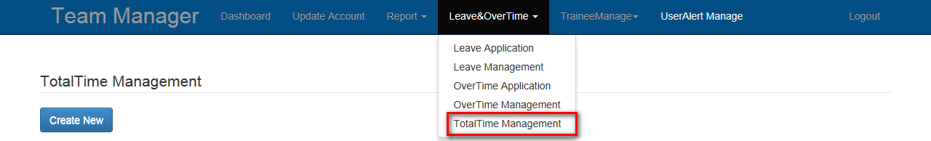
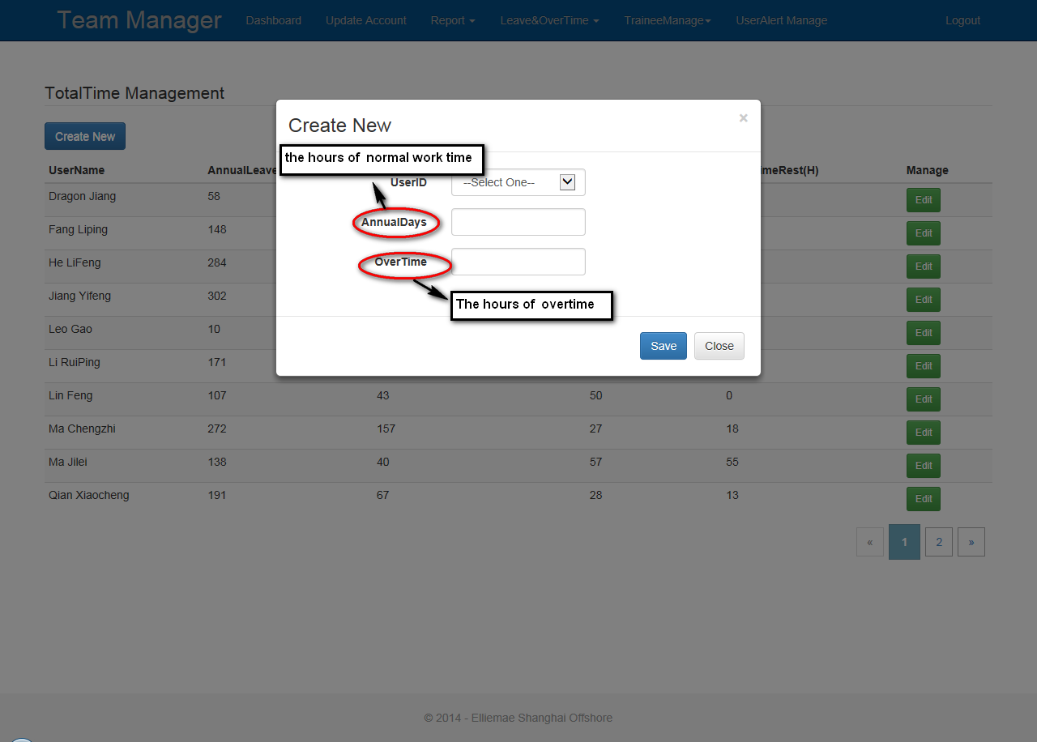

Slide 23
