Slide 1
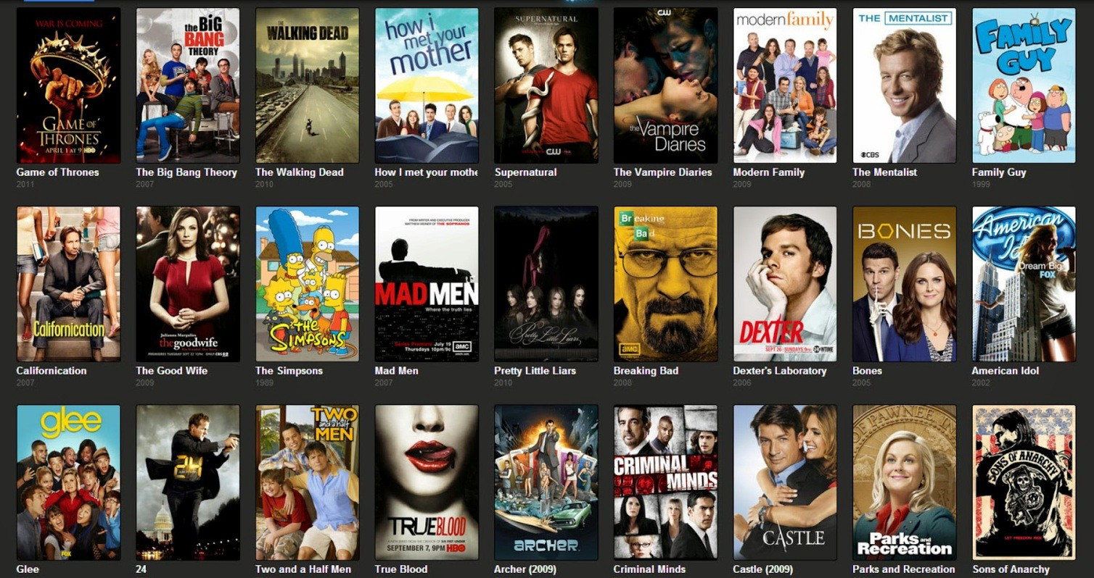
US TV Series Renewal
JY Xu
IDS 702 Final Project Presentation – JY (Jiayue) Xu

Slide 2

Key Research Questions
Motivation:
No more next season? Why ??
What factors affect the odds of renewal of tv shows?
01
Does shows of different genres have different odds of renewal?
02
Does the impact of ratings on odds of renewal differs across network?
03
Notes:
Scope: 2013 to 2018 TV Seasons
600+ Shows

Slide 3


Background & Scope
01
TV Seasons: 2013/14 to 2018/19
609 Show across 295 Series
02
5 Major Networks
03
Key Demographic Ratings: Adults Age 18 to 49
Rating = % of Total TV Households
04
Train (80%) vs Test (20%) Spilt
Random Sample
Notes:
Adults ages 18-49 are known as the key demographic because advertisers believe they have the most disposable income and least brand loyalty, which may make them more susceptible to advertising.
Rating is the percentage of total TV households tuned into a program at a given time. So if a show has a 1.0 rating, it means that 1% of those 120.6 million households watched that program. This number is always out of the total estimated TV households and does not factor how many of those total households actually had their TVs on.
Share is the percentage of households that watched a program out of all the households that were actively watching TV at a specific time.

Slide 4




Data
Show Data
Series Data
Feature
Engineering
Genre Dummy
15 Features:
5 Features:
4 Features
12 Features:
TV Season
Network
Season No.
Number of Episode
Air Day
Air Time
Premiere Date
18-49 Demo Rating Per Episode
Genre (1 to 3 genre combos)
Release Year
Certificate
Runtime
IMDB Rating
First Season
Change in Air Day/Time
Debut on Different Day
Debut days after TV Season Premiere
18-49 Season Min
18-49 % Change from Prev Season
18-49 Season Min % Drop from Premiere
Genre Count
89 combinations of genres
↓
23 unique genres
↓
Top 12 genres by number of shows
Notes:
TVSeason2013 + Network + Season1 + FirstSeason + Episode1 + AirDayInitial + AirTimeInitial + AirDayTimeInitial +
ChangeAirDayTime + Debut.on.Different.Day + DaysfromTVSeasonPremiere +
X18to49_Min + X18to49_YrtoYrChange + X18to49_MinDropPremiere + Network:X18to49_Min
Runtime + Certificate + ReleaseYr1967 + IMDBrating

Slide 5
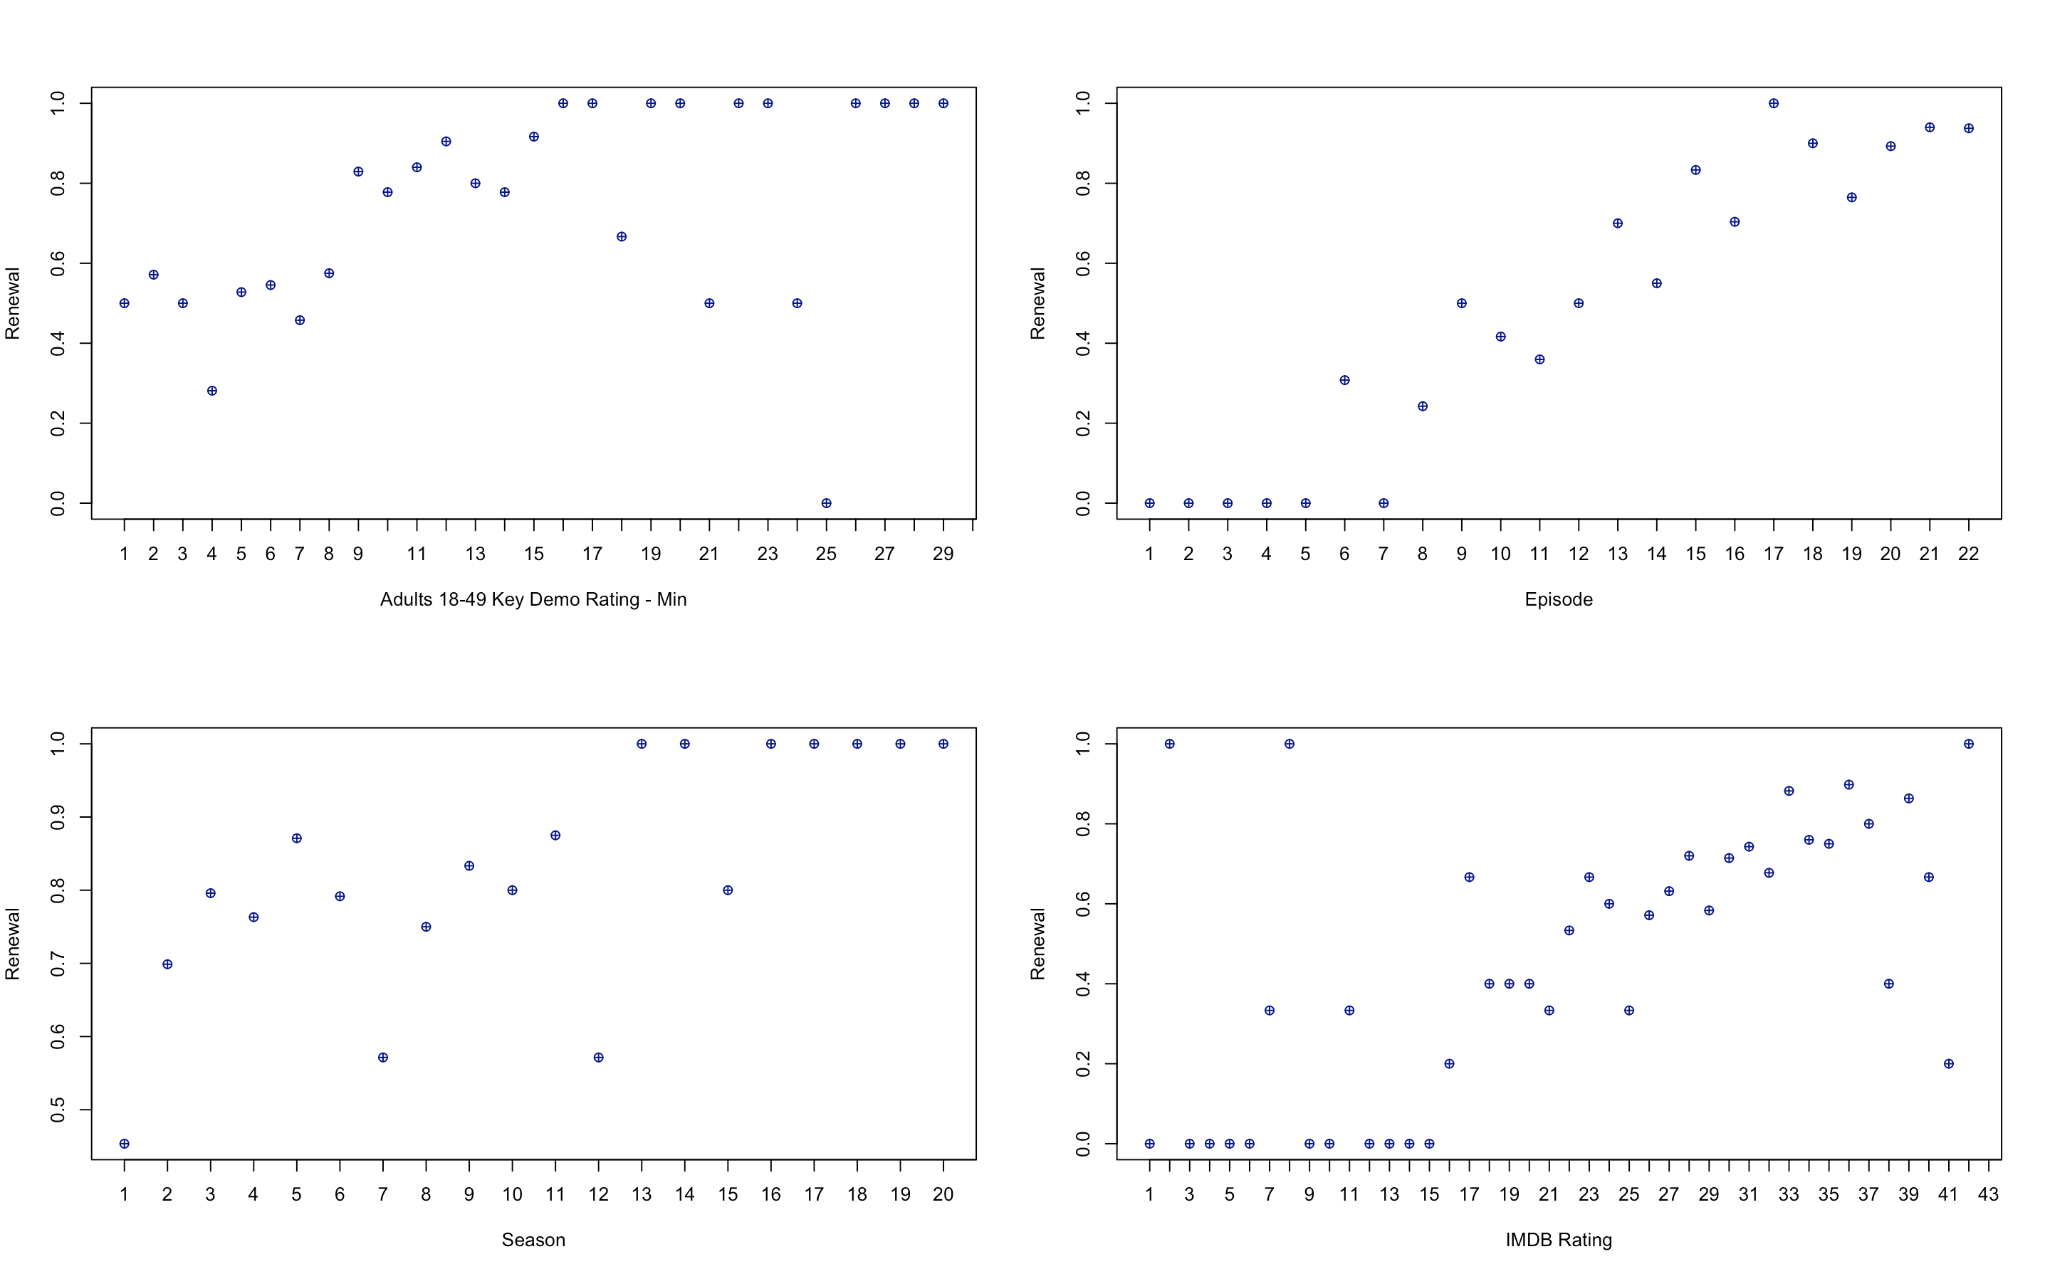
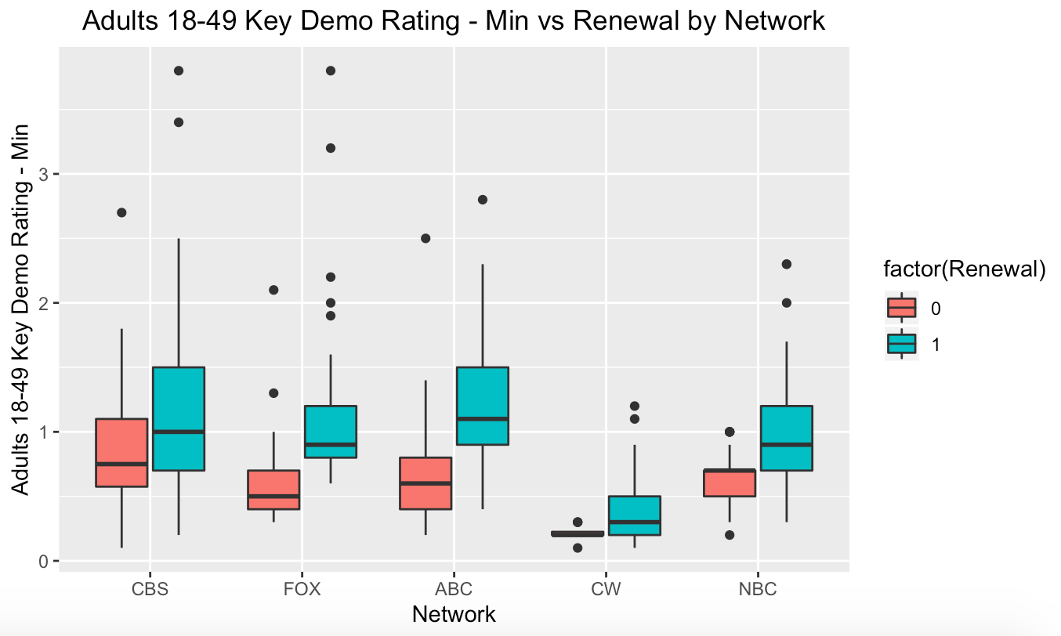
EDA
Numerical Variables
Categorical Variables – Chisq
Significant: Network, Genre_Count, Debut.on.Different.Day
All Genre Dummy Variables – No Significant Association
Text
Interaction
Text
Text

Slide 6
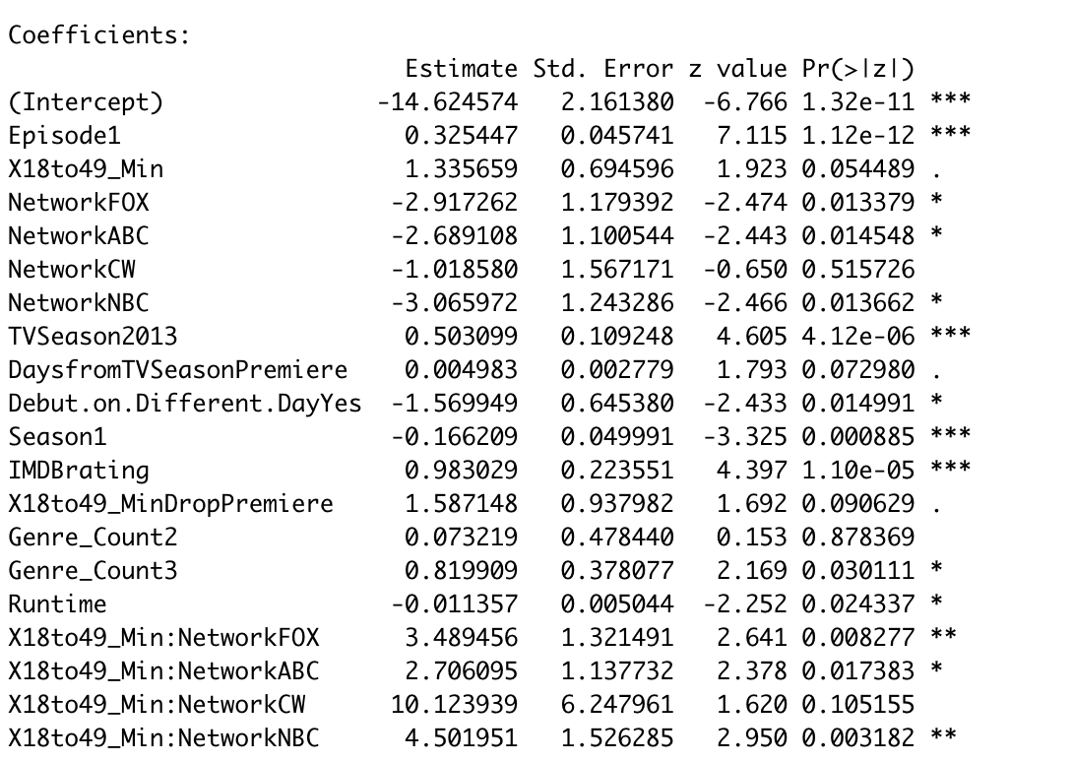
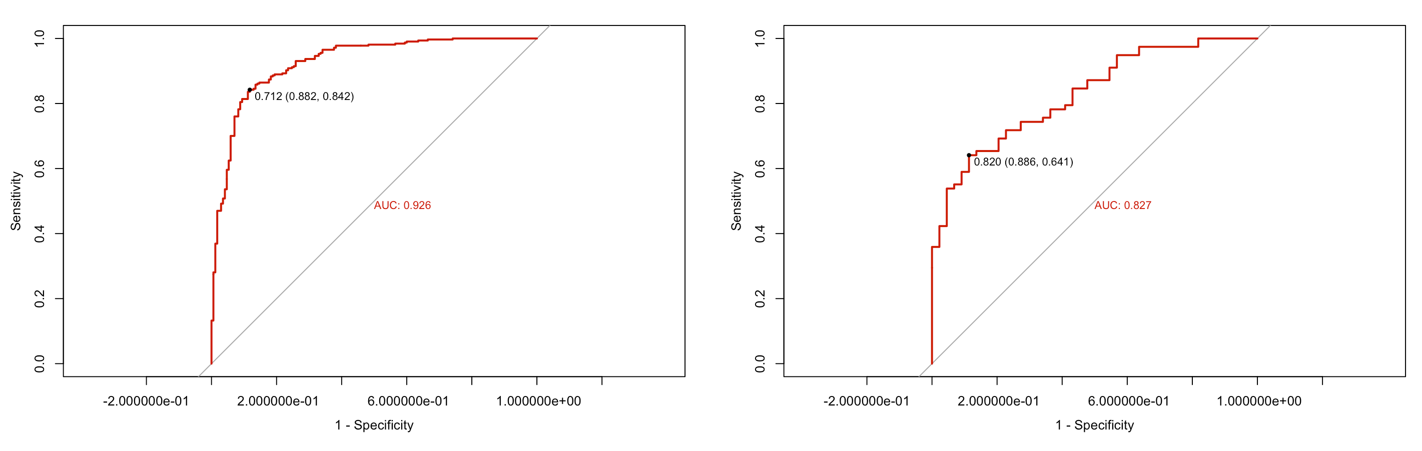
Final Model
Logistic Regression
Model Coefficients
Model Selection: AIC Stepwise
Text
Model Performance Metrics
Training Data Accuracy: 85.63%
Test Data Accuracy: 72.95%
Text

Slide 7
Key Findings
Episode
Season
18-49 Rating – Min
38% increase in odds per increase in episode
15% decrease in odds per increase in number of season
~4X in odds per % increase in rating
Network: CBS (Base)
Debut Days from TV Season Premiere
18to49_Min:Network
ABC: 93% decrease
NBC: 95% decrease
FOX: 95% decrease
ABC: 33X increase
NBC: 15X increase
FOX: 90X increase
0.5% increase in odds per days delay in release after season start
IMDB Rating
Runtime
Genre Count: 1 (Base)
>2X in odds per increase in IMDB rating
1% decrease in odds per min decrease in runtime
>2X odds for series with 3 genre combo compared to single genre series

Slide 8
Limitations & Future Works
Inaccurate data
Availability on streaming services
Cancellation affects number of episodes,
air day/time
Other Classification Models:
Decision Tree/Random Forest

Slide 9
Thank you!
Happy Binge-Watching :)

