Slide 1
PageRank in practice
Topics in Large Dimensional Data Processing
Peter Barabas, Sungjun Han, Jeongin Yang, Yi Xia

Slide 2
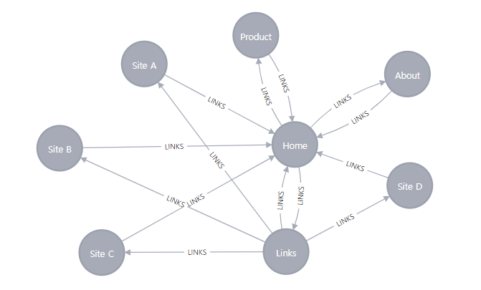
What is PageRank?
A system that measures and scores a webpage’s importance.
Initially, used by Google to determine in which order engine results should be presented.
Uses the directed links between webpages.

Slide 3
PageRank implementation
Power Method
Finding the eigenvector corresponding to the largest eigenvalue of the transition matrix.
Initialize the score vector ‘r’ by setting all the values to 1 / the number of nodes in the graph.
Iterate over to calculate r = M*r
‘r’ will converge eventually.

Slide 4

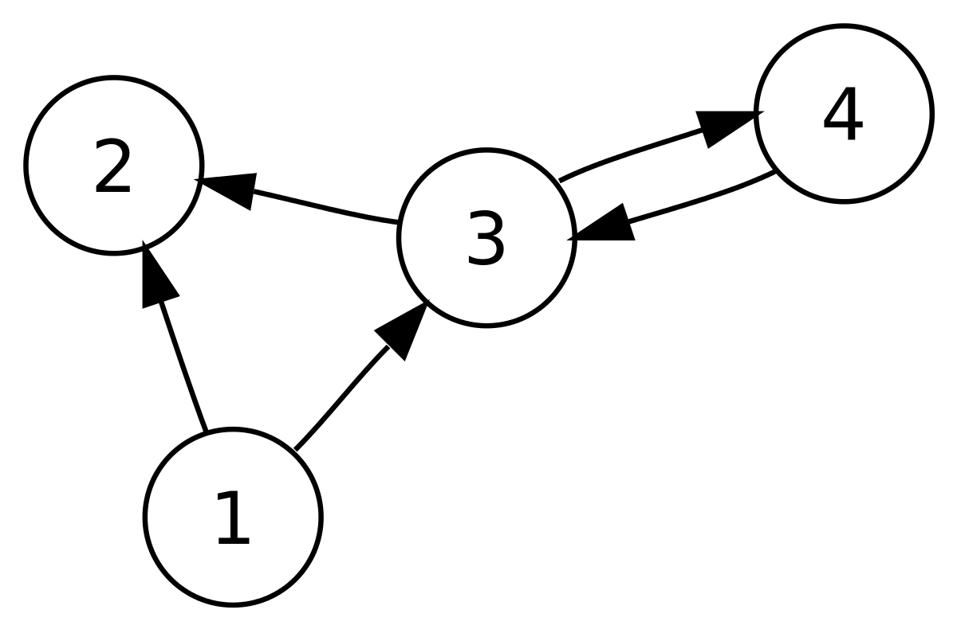




1
Red: Chosen edge for this iteration.
Nodes: Webpages
Edges: Directed links between webpages (if A has a link for B then A-->B)

Slide 5




1
Red: Chosen edge for this iteration.
1
Nodes: Webpages
Edges: Directed links between webpages (if A has a link for B then A-->B)

Slide 6




1
Red: Chosen edge for this iteration.
1
1
Nodes: Webpages
Edges: Directed links between webpages (if A has a link for B then A-->B)

Slide 7




1
Red: Chosen edge for this iteration.
1
1
Nodes: Webpages
Edges: Directed links between webpages (if A has a link for B then A-->B)
1

Slide 8



1
Red: Chosen edge for this iteration.
1
2
Nodes: Webpages
Edges: Directed links between webpages (if A has a link for B then A-->B)
1

Slide 9




2
Red: Chosen edge for this iteration.
1
2
Nodes: Webpages
Edges: Directed links between webpages (if A has a link for B then A-->B)
1

Slide 10
Limitations of PageRank in practice
Does not reflect current events – the scoring system favours older links
Even if the new link is very good / important, it does not have many links and hence does not reflect the importance accurately
Open to manipulation
Link selling

Slide 11
Various applications
Chemistry
Application of PageRank algorithm to hydrogen bonds in water
Biology
GeneRank, Protein Distance calculation, ProteinRank, IsoRank
Neuroscience
Evaluate the importance of brain regions given observed correlations of brain activity

Slide 12
Graph Neural Network meets Personalized PageRank
Improved propagation scheme, PPNP (Personalized Propagation of Neural Predictions) based on Personalized PageRank

Slide 13
Existing problems with Message passing with traditional Graph Convolutional Network (GCN)
A popular way of leveraging deep learning algorithms on graphs is neighborhood aggregation (sometimes referred to as message passing)
Xu et al. (2018) shows a relationship between the message passing algorithm termed "Graph Convolutional Network" and a random walk.
The GCN converges to the random walk's limit distribution as the number of layers increases which is a property of the graph as a whole and does not take into account the starting node of the random walk.

Slide 14
Existing problems with Message passing with traditional Graph Convolutional Network (GCN)
Neighborhood aggregation does not scale well on large graphs.
Existing neighborhood aggregation schemes only use information of a very limited neighborhood for each node.
Using a larger neighborhood increases the depth and number of learnable parameters of the neural network, hence increasing computational difficulty.

Slide 15
Proposed solution
Use an additional propagation step after training which incorporates nodes further away from the root node. While having a tunable parameter that allows us to stay local but reach information further away from the root node.
This also allows us to separate the model from the propagation step which gives us greater freedom on model choice.

Slide 16


Personalized PageRank
The traditional PageRank algorithm does not take into account the root node's preferences which means locality is not preserved after a lot of iterations.
We can set a parameter α between 0 and 1 which corresponds to a chance of the propagation to "teleport" back to the root node, hence preserving locality^{[2]}.

Slide 17
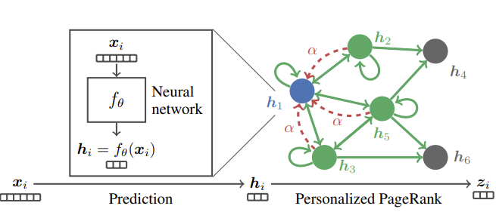

Personalized propagation of neural predictions (PPNP)
Putting the two together results in the following model equation
The model is trained end-to-end so the gradient flows through the propagation scheme during backpropagation same as the model weights.

Slide 18
Pros of Personalized Propagation of Neural Predictions (PPNP)
Separation of the neural network and the propagation scheme, this means that the depth is independent of the propagation algorithm.
Incorporates information from nodes that are far from the root node, this was not the case with the basic message passing algorithm.
With proper tuning to α it does not over-smooth.

Slide 19
Limitations of Personalized Propagation of Neural Predictions (PPNP)
It is computationally inefficient to the fully personalized PageRank since it results in a dense N x N matrix, leading to a computational complexity and memory requirement of O(n^2) for training and inference.

Slide 20


Approximate Personalized Propagation of Neural Predictions (APPNP)
Approximating topic-sensitive PageRank via power iteration
We can look at the equation of PPNP as a variant of topic-sensitive PageRank^{[3]}.
Every column of H defines an unnormalized distribution over nodes that act as a teleport set.

Slide 21
Approximate Personalized Propagation of Neural Predictions (APPNP)
APPNP is linear in complexity since the power iteration has linear complexity
The propagation scheme of this model does not require any additional parameters to train as opposed to GCN, so we can propagate very far without having more parameters to train
Both with APPNP and PPNP the neighborhood influencing each node can be tuned with the α parameter

Slide 22
Experimental Setup
4 Text-Classification Datasets: CITESEER, CORA-ML, PUBMED, MICROSOFT ACADEMIC
Baseline Models (five SOTA models): GCN, network of GCNs (N-GCN), graph attention networks (GAT), bootstrapped feature propagation (Bt. FP), jumping knowledge networks with concatenation (JK)
Model Hyperparameters: hidden units h = 64, L2 regularization with λ = 0.005, dropout rate d = 0.5, teleport probability α = 0.1, power iteration steps K = 10

Slide 23
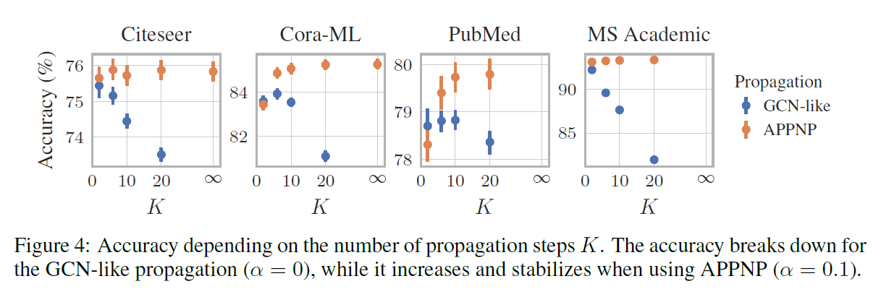
Evaluation of Result: Power Iteration
GCN-like: performance breaks down with increase in the number of power iterations, K
Personalized propagation: accuracy increases and converges to exact PPNP with infinitely many propagation steps
Notes:
thus demonstrating the personalized propagation principle is indeed beneficial. As also shown in the figure, it is enough to use a moderate number of power iterations (e.g. K = 10) to effectively approximate exact PPNP

Slide 24
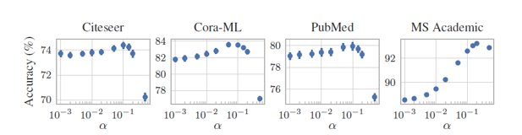
Evaluation of Result: Teleport Probability
Effect of the hyperparameter α on the accuracy on the validation set
Optimal lies between 0.05 and 0.2
Higher α improves convergence speed

Slide 25
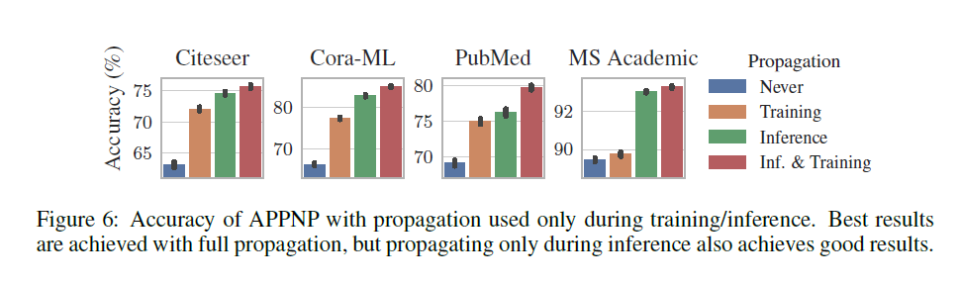
Evaluation of Result: Propagation
Data on how propagation affects both training and inference
Inference vs inference & training give similar results
Suggests APPNP can combine well with pre-trained models
Notes:
”Never” denotes the case where no propagation is used; essentially we train and apply a standard multilayer perceptron (MLP) fθ using the features only. ”Training” denotes the case where we use APPNP during training to learn fθ; at inference time, however, only fθ is used to predict the class labels. ”Inference”, in contrast, denotes the case where fθ is trained without APPNP (i.e. standard MLP on features). This pretrained network with fixed weights is then used with APPNP’s propagation for inference. Finally, ”Inf. & Training” denotes the regular APPNP, which always uses propagation

Slide 26
Sources
[1]: Qimai Li, Zhichao Han, and Xiao-Ming Wu. Deeper Insights Into Graph Convolutional Networks for Semi-Supervised Learning. In AAAI, 2018.
[2]: Johannes Klicpera, Aleksandar Bojchevski, and Stephan Günnemann. 2018. Predict then Propagate: Graph Neural Networks meet Personalized PageRank. In ICLR.
[3]: Taher H. Haveliwala. Topic-sensitive PageRank. In WWW, 2002.

