Slide 1

Geodatabase Programming with Python
John Yaist
DevSummit DC
February 26, 2016 | Washington, DC

Slide 2



Target Audience: Assumptions
Basic knowledge of Python
Basic knowledge of Enterprise Geodatabase and workflows
Demos of How more than the Why
Code
Please silence cell phones

Slide 3

Session Roadmap
Part 1: What is the geodatabase
Part 2: Geodatabase Creation
Part 3: Version Management
Demos throughout

Slide 4

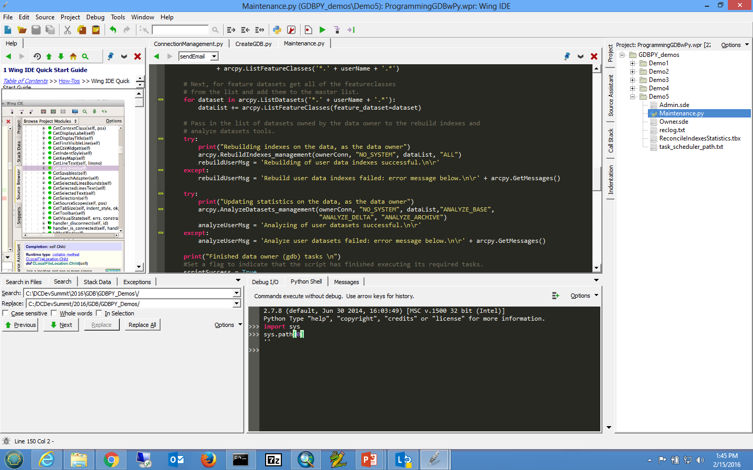
Why Python
Free
Simple and easy to learn
Easy to maintain
Wide-acceptance
Modular
Cross platform
Scheduling

Slide 5
What is the Geodatabase
A physical store of geographic data
Scalable storage model supported on different platforms
Core ArcGIS Information Model
Comprehensive GIS Data model for real-world features
Implemented as a series of simple tables
Transactional model for managing GIS workflows
Set of components for accessing data

Slide 6
Geodatabase System Tables
Store:
Definitions, rules, behaviors for datasets
Some database level metadata
Versions, domains, etc.
Track:
Geodatabase contents
Administer:
Version management
Connection management
Geodatabase upgrade
XML
System Tables
SQL Type
User Data

Slide 7
User-defined Tables
Store:
Content of each dataset in one or more tables
Administer:
Grant/revoke privileges
Update statistics/indexes
Register as versioned
Add global ids
Enable editor tracking
XML
System Tables
SQL Type
User Data

Slide 8

Types of Administrators
Database Administrator
Geodatabase Administrator
Data owner (dataset administrator)
Depends on your organization as to whether
They are all different people

Slide 9
Types of Administrators Database
Database Administrator (DBA)
Instance level administration

Slide 10
Types of Administrators Geodatabase
Geodatabase Administrator
Owns the geodatabase repository

Slide 11
Types of Administrators Data owner
Dataset administrator
Granting privileges to data
Modifying schema of data
Database statistics and index maintenance

Slide 12
Connections
Connection file necessary to access enterprise geodatabase
Control of how you connect to geodatabase
What user is connected
Creating Data
Schema changes
Administering the geodatabase
Instance/Database you connect to
Version, historical archive, or moment in time
Changing properties requires new connection files

Slide 13
Connection Tools
Create Database Connection: arcpy.CreateDatabaseConnection_management
Output an .sde file
Connect to databases and geodatabases
NOTE:
Create ArcSDE Connection File: deprecated at 10.3
arcpy.CreateArcSDEConnectionFile_management

Slide 14
DEMO: Creating Connections

Slide 15

Geodatabase Creation with Python

Slide 16
Two Tools for Geodatabases:
Enabling A Geodatabase:
arcpy.EnableEnterpriseGeodatabase_management
Creating A Geodatabase
arcpy.CreateEnterpriseGeodatabase_management

Slide 17
Enabling A Geodatabase:
arcpy.EnableEnterpriseGeodatabase_management
You already have an existing database
Lays down Geodatabase Repository
GDB Tables and Stored Procedures
Must connect as appropriate user

Slide 18
Creating Enterprise Geodatabases:
arcpy.CreateEnterpriseGeodatabase_management
Create Enterprise Geodatabase tool
When you have a need for:
Creating testing or development environments
Database does not already exist
Run as DBA

Slide 19
Creating Users:
arcpy.CreateDatabaseUser_management
Creates a user in enterprise geodatabase or database
Cannot create geodatabase administrative user
Run as DBA not GDB Administrator

Slide 20
Creating Roles:
arcpy.CreateRole_management
Makes it easier to assign/revoke privileges to multiple users
Prior to creating users in the geodatabase
Assign users to roles
DBA not the GDB administrator
Editing
Reporting

Slide 21
Demo
How to Create a Geodatabase

Slide 22
Creating and Loading Data
Numerous tools for creating any type of data:
Create table, Create feature class, Create Raster Dataset, etc.
Create Geometric Network, Create Topology, Create Domain, etc.
•Also tools for loading data:
Feature class to feature class (single)
Feature class to geodatabase (multiple)
Import XML workspace
•Write a custom script

Slide 23

Configuration Keywords

Slide 24
Managing privileges
Allow other users of the geodatabase to view or edit data that you own
Change privileges tool
Allows multiple input datasets to be passed in
Grant view only or view and edit
View = select
Edit = insert, update, delete
Must be connected as data owner

Slide 25
Demo:
Putting it all together

Slide 26
Version administration

Slide 27
Parts of the version administration workflow
Reconciling/posting/compressing
Updating statistics and indexes on system tables
Updating statistics and indexes on user data tables
Managing user connections

Slide 28
Managing user connections
Block/allow connections
arcpy.AcceptConnections
Provide boolean
Finding connected users
arcpy.ListUsers
Returns a tuple of properties for each connected user
ID, name, machine name, connection time, connection type
Disconnecting users
arcpy.DisconnectUser
Use ids provided from listusers function or use ‘ALL’ keyword

Slide 29
Disconnecting user connections
A user who is connected but has gone home
Create a cold backup of the database
Running large queries that are using up resources
Reconcile/post/compress process (optional)

Slide 30




Reconciling and Posting Versions
Reconcile = pulling changes from a parent to child version
Post = pushing reconciled changes to parent version from child
Reconcile versions tool
Recommended to run as geodatabase administrator
- Can ‘see’ and reconcile all versions in the geodatabase

Slide 31
Indexes and Statistics
Update after major ‘data change’ events
Reconcile
Compress
Appending data
Typically not necessary after loading new data
Can be done by both:
Geodatabase Admin (system tables)
Data owner (data tables)
We suggest to run regularly.

Slide 32
Demo:
Version
Maintenance

Slide 33
Summary

Slide 34
Scripts to illustrate tools used in these slides: http://bit.ly/2lJvj4W

Slide 35


