Slide 1
ArcGIS Pro: Scripting with Python
John Yaist: jyaist@esri.com

Slide 2
Target Audience
Curious about or New to ArcGIS Pro and Anaconda
Familiar with Python Scripting
Experienced ArcGIS Desktop Users

Slide 3


Python
Scripting language of choice introduced at
ArcGIS 9.0 as the arcgisscripting module
Since 10.0 – the ArcPy site-package
Esri fully embraces it for:
Data Analysis
Data Conversion
Data Management
Map Automation

Slide 4
Why Python?
Accessible: Most Taught first programming language (US universities)
Huge user base with extensive package collection (56,000 on PyPI)
Strong glue language used to bind together many environments, both open source and commercial
Open source with liberal license — do what you want

Slide 5
ArcGIS Pro 1.4
ArcGIS Desktop and ArcGIS Pro 1.0 – 1.2
Installed Python core libraries at root of System
Accessed ArcPy as a site-package in separate location
As of ArcGIS Pro 1.3 (July ‘16):
Installs Python Package manager - conda

Slide 6
Conda

Slide 7

Package Management for Python
Why not pip, wheels, virtualenvs?
Don’t handle system dependencies, seen as out of scope by Python packagers — does it end up in site-packages?
Package devs:
OSX and Linux, ‘easy’ to get the deps! Use a system package manager (e.g. apt, brew, yum) and the included compiler (e.g. clang, gcc).
Windows – What about Windows?

Slide 8

Conda
Handles dependencies for many languages (C, C++, R and of course Python)
Built for Python first, but it really solves a much broader infrastructural issue.

Slide 9

How does Conda work?
Environments: isolate Python version without affecting installed software.
Requirements – include package name and versions
Also handles platforms and Jupyter notebooks

Slide 10

Conda packages hosted variety of locations:
On disk (file://)
Public repositories
Anaconda Cloud
self-hosted
Private repositories
Paid private repositories

Slide 11


Conda
Cross-platform: Linux, OS X, Windows.
meta.yaml file + build recipe
Open source (BSD):
Esri projects & your own contexts

Slide 12

What Do I Get Out of the Box?
Conda command and a Conda root Python install
New modules (e.g. requests)
ArcGIS Pro dependencies as Conda packages :
arcgispro-py3 environment

Slide 13
A picture’s worth 1000 words

Slide 14
DEMO ArcGIS Pro – File System

Slide 15
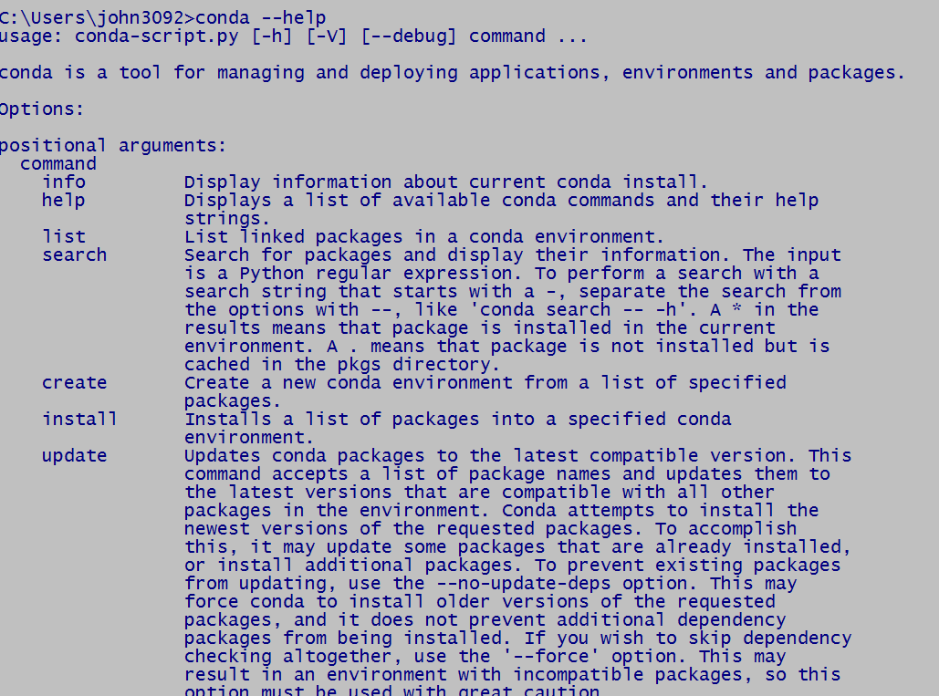
conda --help

Slide 16
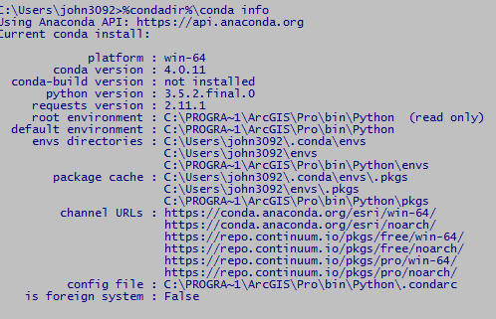
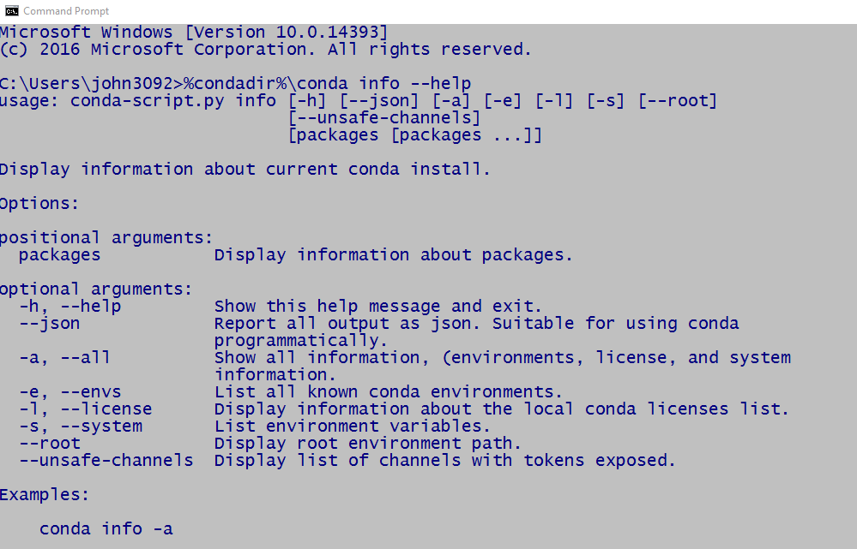
Command Line Options
conda info
conda info --help

Slide 17
Accessing Environments: Command Line
DEMO

Slide 18
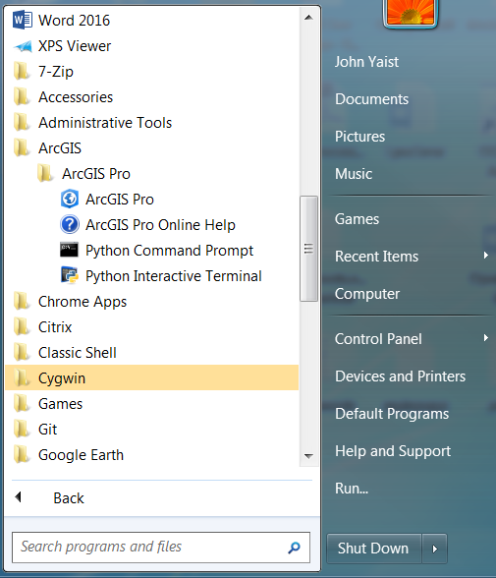
Start Menu Options

Slide 19
DEMO Python Command Prompt

Slide 20
DEMO

Slide 21
Scripts using ArcPy and ArcGIS Pro located at: http://bit.ly/2mjyA7L

