Slide 1


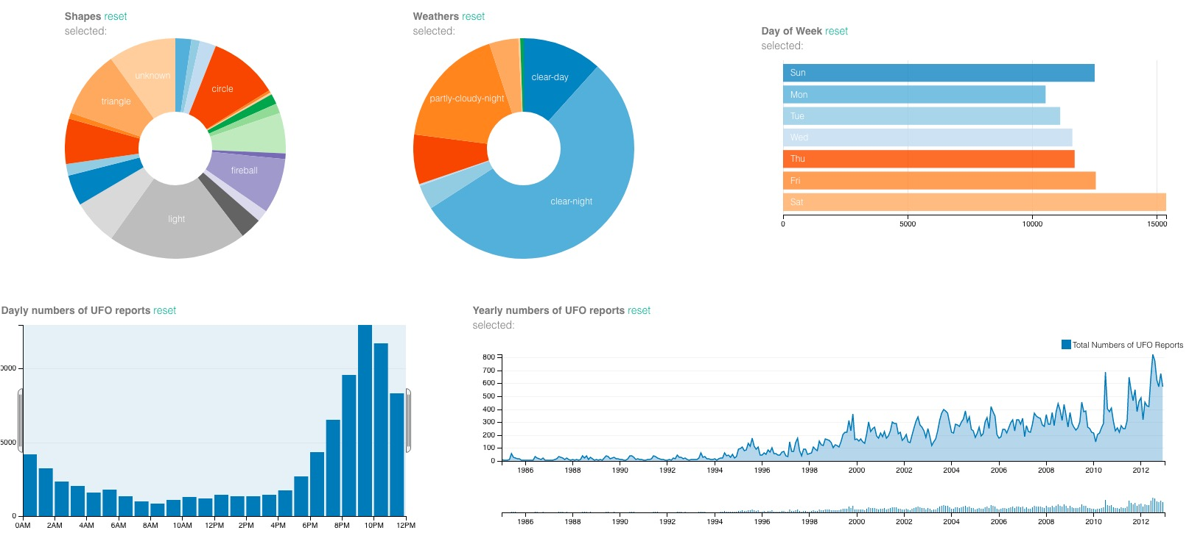
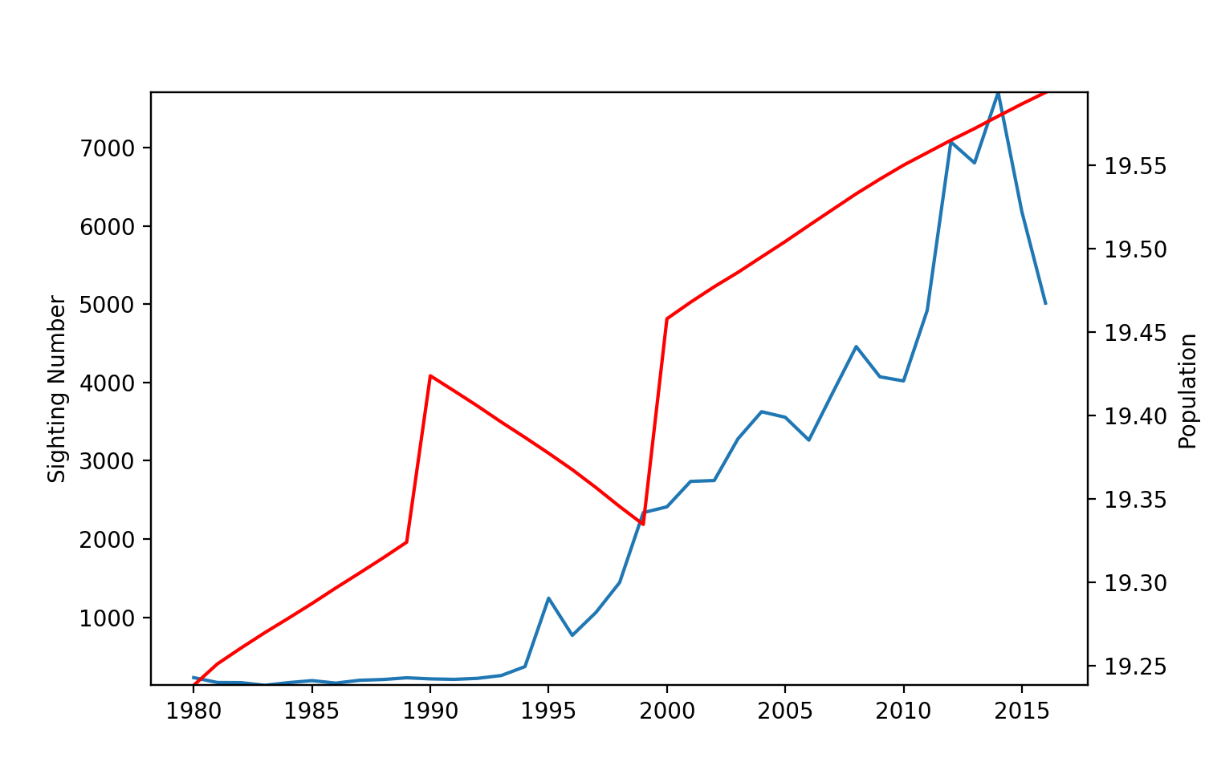
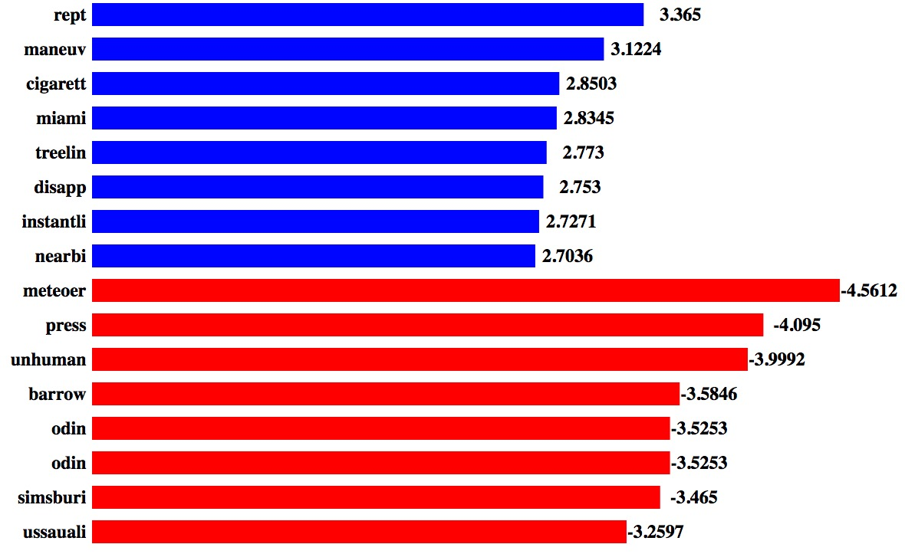
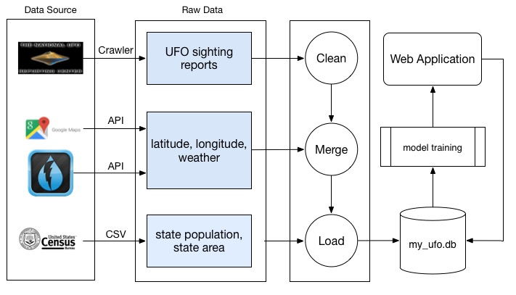
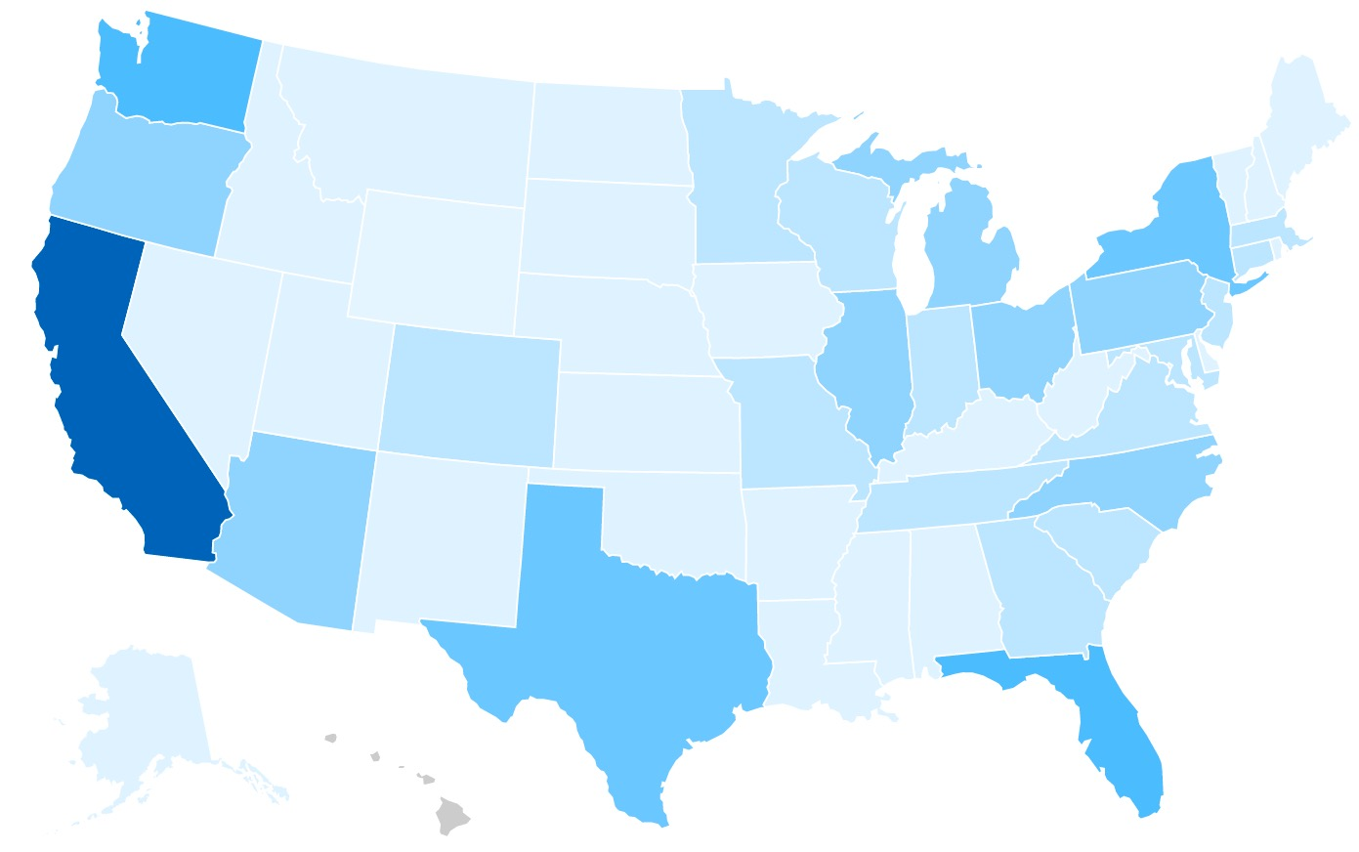
myUFO: A UFO Sighting Checker based on Weather and Geo Information Analysis
Jin Yan (jyan16), Lei Tian(ltian1), Yao Yao, Jing Qian
Carstain Binning, CS1951-A, Spring 2017
Introduction & Hypothesis
Methodology
Machine learning
UFO reports have been around us for decades, and people tell their UFO sightings in different ways. Predicting anything with UFO is intriguing since these tiny fickle light dots leave us little trace behind.
We will try to investigate this topic in three steps. Firstly, we will figure out correlations between UFO sightings and other source of information such as geometry, weather, population and area data. Secondly, based on statistic analysis and machine learning techniques, we will develop models to detect fake UFO reports. Finally, we will build a web application to visualize our analysis results, and enable users to report their own sightings.
Fake detection: We use four models to do fake detection: decision tree and logistic regression to train text features, decision tree and SVM to train numeric features. They vote for the final result in average.
Sighting number Analysis: We draw a heat map to show the distribution of accumulate UFO sightings, and polynomial regression to analyze it. Some statistic methodology are used.
Website building: We build a web application for users to report their UFO sightings, view our checking results of their reports, and the statistic conclusion of this topic. The structure of our web application are shown in figure 1.
Our machine learning work focus on using supervised learning algorithms to detect fake reports, as well as regression method for distribution analysis.
We use logistic regression and decision tree to process summary data, and rbf kernel - SVM and decision tree to check numeric (lat, lng, sighting time, sighting shape, weather-tag and visibility) data. All these classifiers vote in average to give out the final grade of user reports. One possible feedback are shown above.
We use degree 4 polynomial regression to fit UFO sighting number of a state with year and state population. The total number of UFO sightings have higher correlation to year and log(population), while not much with area. Our regression score is 0.96 (which is much close to the best score 1).
Data ETL
Statistic Result
Data source: UFO reports data: NUFORC(National UFO Report Center) GIS data: Google‘s API Weather data: DarkSky U.S. population data: U.S. Census Bureau
Chalenges
Data collection: We write python scripts to scrap UFO reports data from NUFORC online database, use Google’s API to get latitude and longitude data, use Darksky API to get weather data and download CSV files from U.S. Census Bureau to get population data.
Data integration: To clean UFO reports data, we use regular expressions to remove useless HTML tags, remove rows containing columns of “Unknown” or “Unspecified” and transform date format to yyyy, mm, dd, hh:MM:ss. We use UFO reports data’s “event id” as a key to merge UFO data, location data and weather data. Then we create a sqlite3 database with 4 relational tables “events”, “weathers”, “populations” and “areas”, and load data from CSV files into database.
conclusions
Conclusion 1
Conclusion 2
Conclusion 3

