Slide 1

Savvy Care
Jin Yan
Week 2 demo

Slide 2


Problem
Discount
next week?
Brand:
Lancome
Forecast
How long do you willing to wait?:
7
Wait!!!
Gift?
The lowest discount on next Wednesday!
(80 accuracy%)
&
Free gift with purchase!
(90 accuracy%)
Given recent skincare discount information, what is the expected deal for the week ahead?

Slide 3
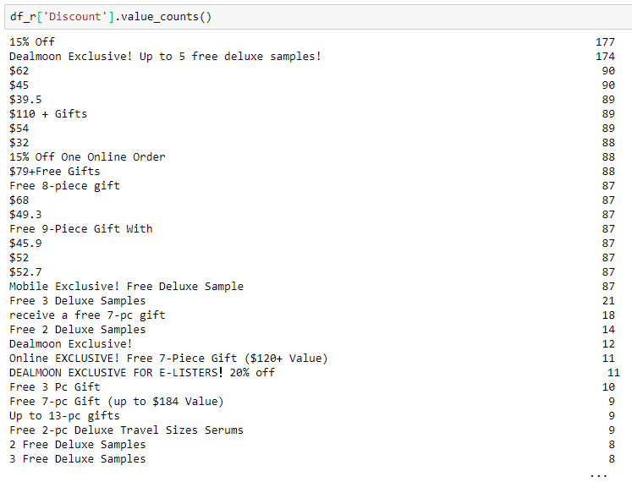
Problem framing
Day | Discount (% off) | GWP
1 | 15 | True
2 | 30 | False
3 | 15 | True
4 | ? | ?
5 | ? | ?
Data source: dealmoon.com + Web scraping: Selenium
Discount type varies, solution:
transfer discount to % off
Label GWP, “True” or False
Regression
Classification
Training: 2010-2019 daily discount information;
Testing: Recent one year’s daily discount information.
Training vs Testing: 0.89 : 0.11
Notes:
Inputs vs. Outputs
Endogenous vs. Exogenous
Unstructured vs. Structured
Regression vs. Classification
Univariate vs. Multivariate
Single-step vs. Multi-step
Contiguous vs. Discontiguous

Slide 4
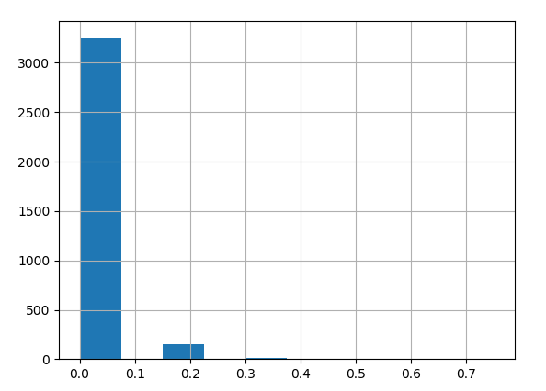
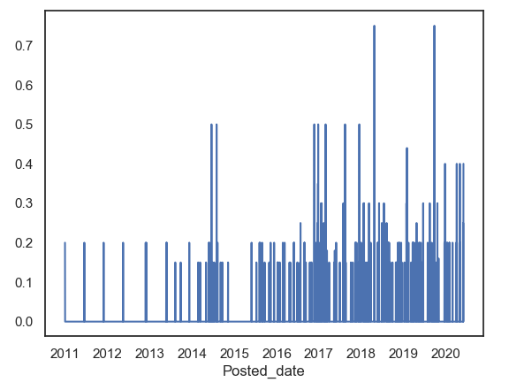
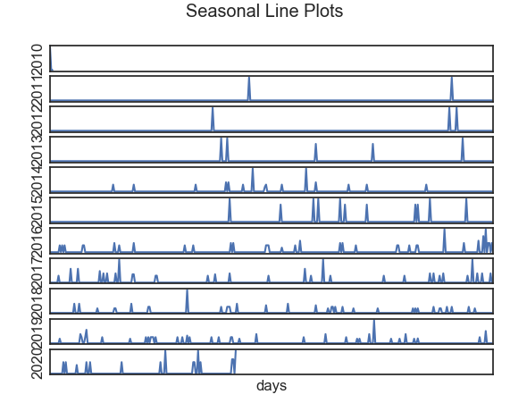
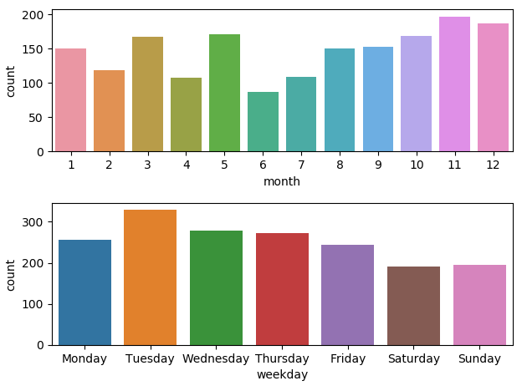
Preliminary Exploratory Analysis
Wavelet denoising
Notes:
count 3444.000000
mean 0.011641
std 0.053520
min 0.000000
25% 0.000000
50% 0.000000
75% 0.000000
max 0.750000

Slide 5
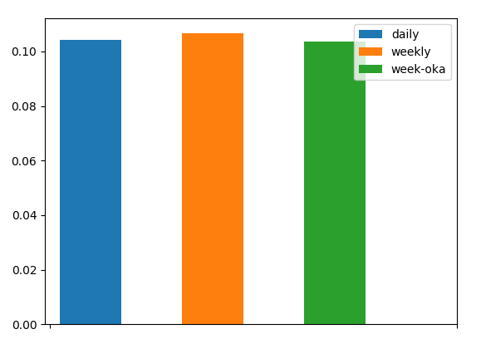
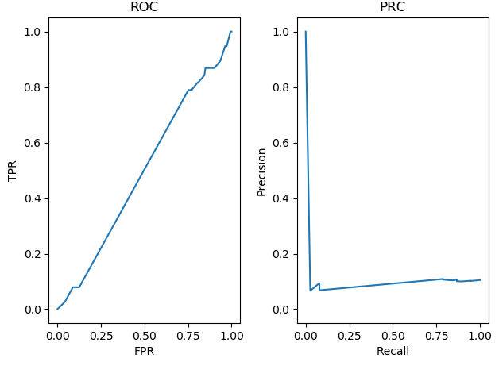
Forecast Performance Baseline
Regression: Naive Forecast | Classification: Logistic Regression
Persistence Forecast: Daily Weekly Weekly One-Year-Ago Evaluation metric: overall RMSE regardless of day Forward-chaining Cross-validation | Extremely imbalanced: 5% Accuracy: 0.89589 F1 score: 0.00000 AUROC: 0.49352 AUPRC: 0.10576
Problem
EDA
Baseline
Feature Engineering
Models
Performance
Notes:
0.1043043412538309
0.10666266018116685
0.10369810366297305

Slide 6
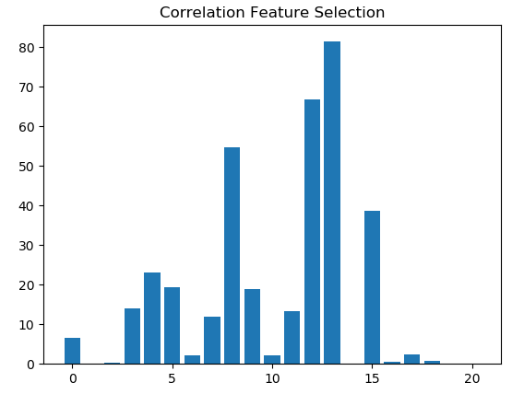
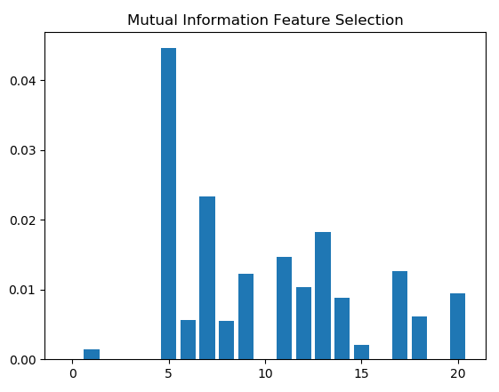
Feature Engineering
Calendar Features:
Year, month, day
Weekend or not.
A week from holiday or not.
Lag Features
Discount past 1 day/1 week/2 weeks/1 month
Rolling Window Statistics
Max, mean, min past 1 day/1 week/2 weeks/1 month
Modeling With Selected Features!

Slide 7
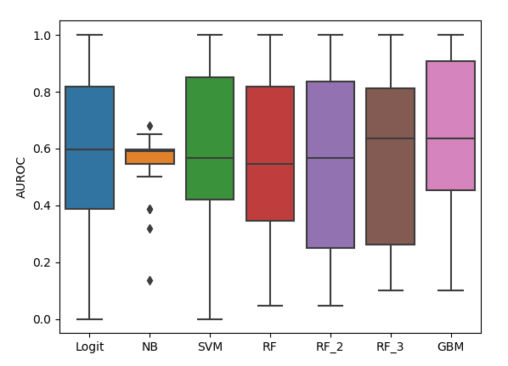
Classification Forecast
Stratify!
Resampling to get more balanced data
GBM: built-in approaches combatting class imbalance

Slide 8
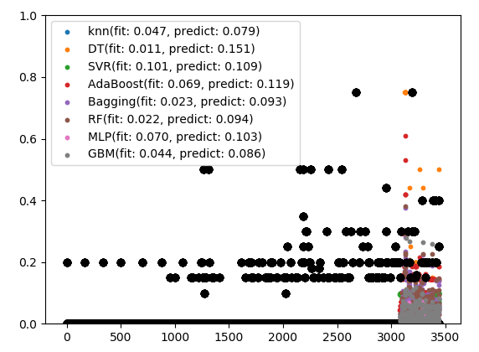
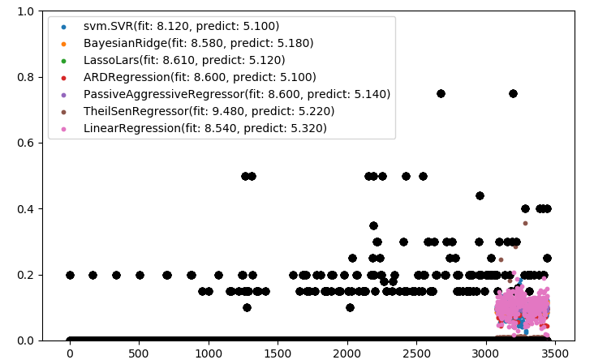
Regression Forecast
23% accuracy improvement

Slide 9
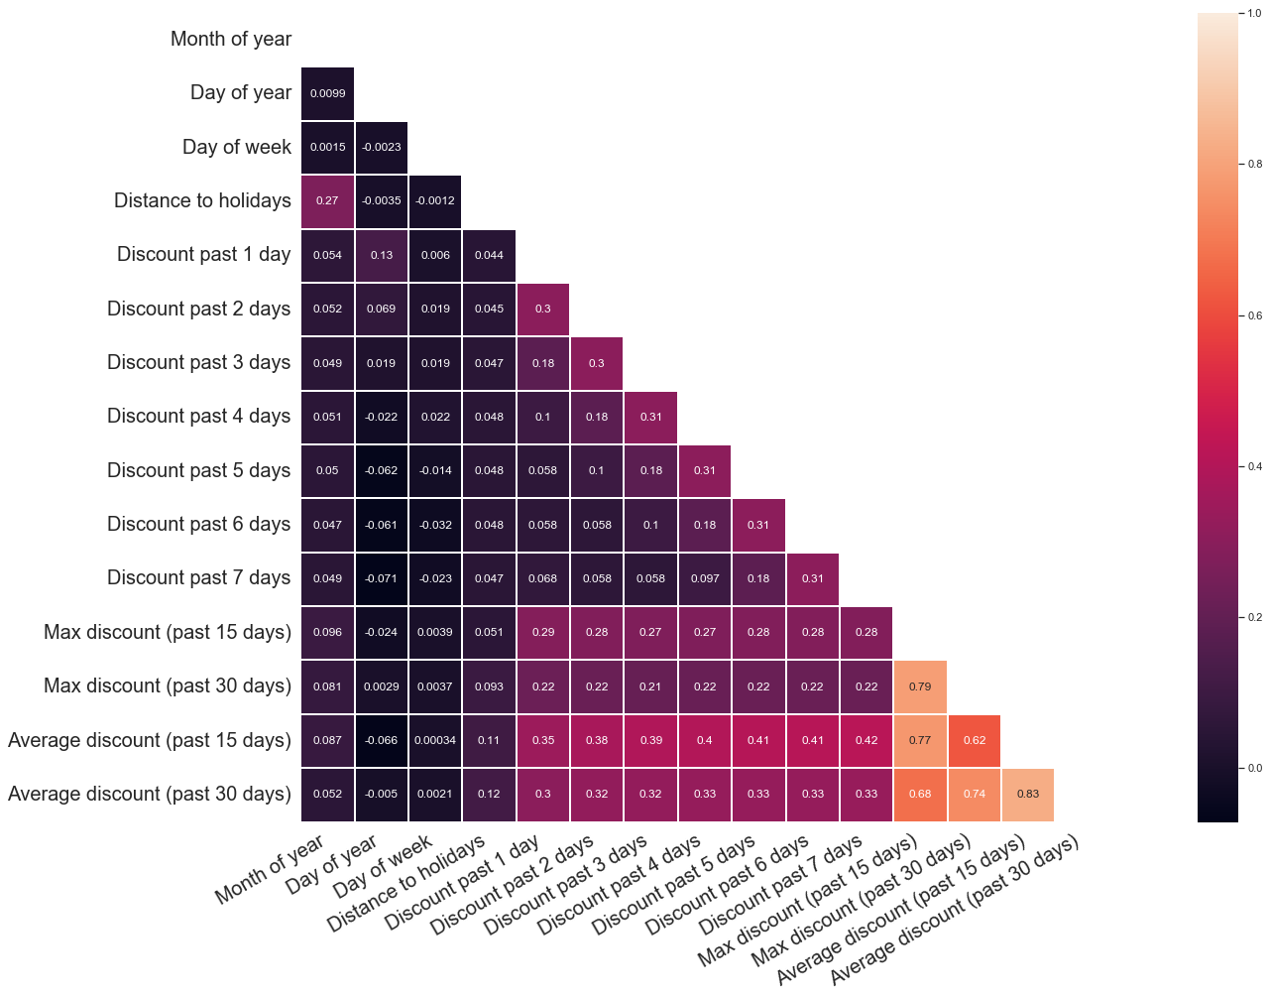
Base model
Given features:
(1). Seasonality features:
Month of year, Day of year, Day of week, Distance to major holidays, etc.
(2). Autocorrelation features:
Discount past 1 day, Discount past 2 days, Discount past 3 days...Discount past 7 days
(3). Other statistical features:
Max discount past 15 days, Average discount past 15 days, Max discount past 30 days, Average discount past 30 days, etc.
Output label: what % off will be in 7 days, …?
0-15%; 16% - 30%; 31% - 50%; 50% - 100 %
Model: Multiclass classification with logistic regression
Front-end: Streamlit, under development….
precision recall f1-score support
0 0.83 0.94 0.88 520
1 0.49 0.25 0.34 130
2 0.00 0.00 0.00 5
3 0.00 0.00 0.00 3

