Slide 1

Savvy Care
Jin Yan
Week 2 demo

Slide 2
Problem
Optimizing the budgets for skincare loyalty customers managing skincare refills.
Last from one to three years
Loyalty!
Deals & promotions coming out “randomly”
Refill every 2~3 months.

Slide 3
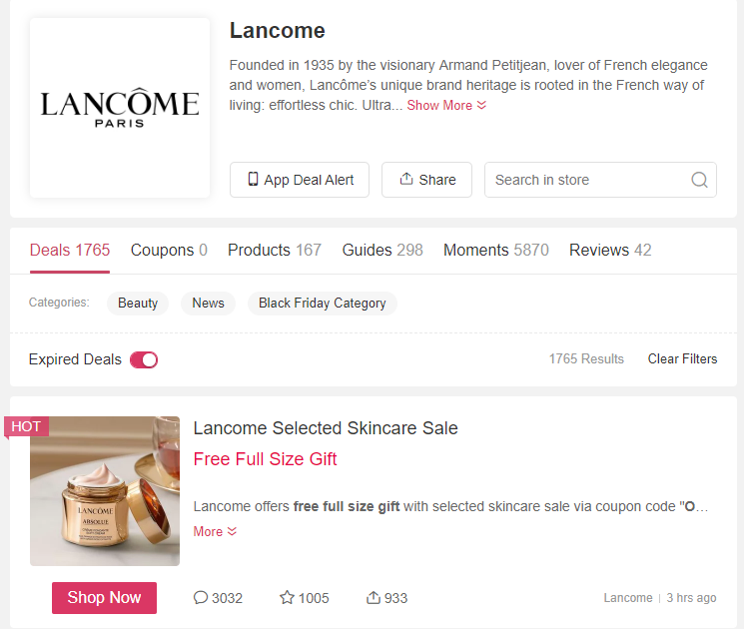
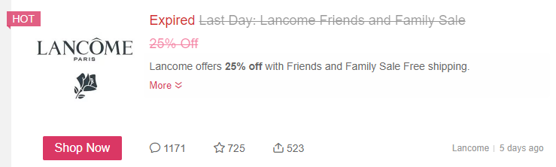
Data Overview
Resource: www.dealmoon.com/en
Web Scraping Tool: Selenium
Data:
Popular brands: 'kiehls', 'lancome’, 'la-mer', 'estee-lauder', 'clinique', 'tatcha', 'fresh’, 'tatcha’
Promotions, posted dates, end dates, popularity (comments, likes, shares)

Slide 4
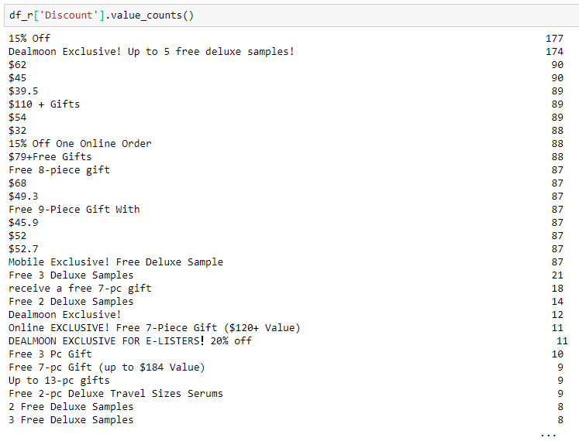
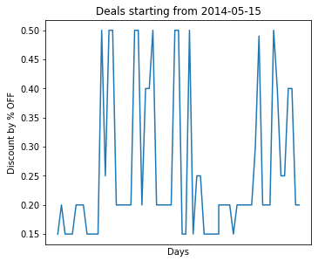
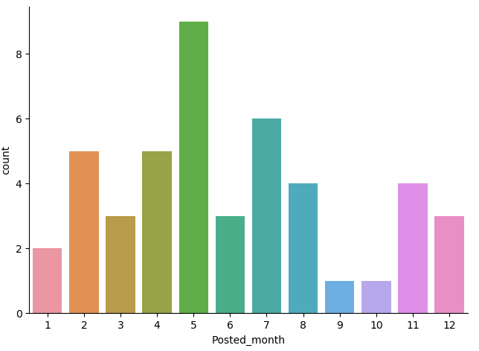
Data EDA
Discount type varies: % off, $ off, gift with purchase (GWP), % off + GWP, buy one get one free….
Simple solution:
transfer to single variable % off
Observations dropped from 2729 to 361.
Is 25% off really better than GWP?
NLP needed?
Adding holidays

Slide 5
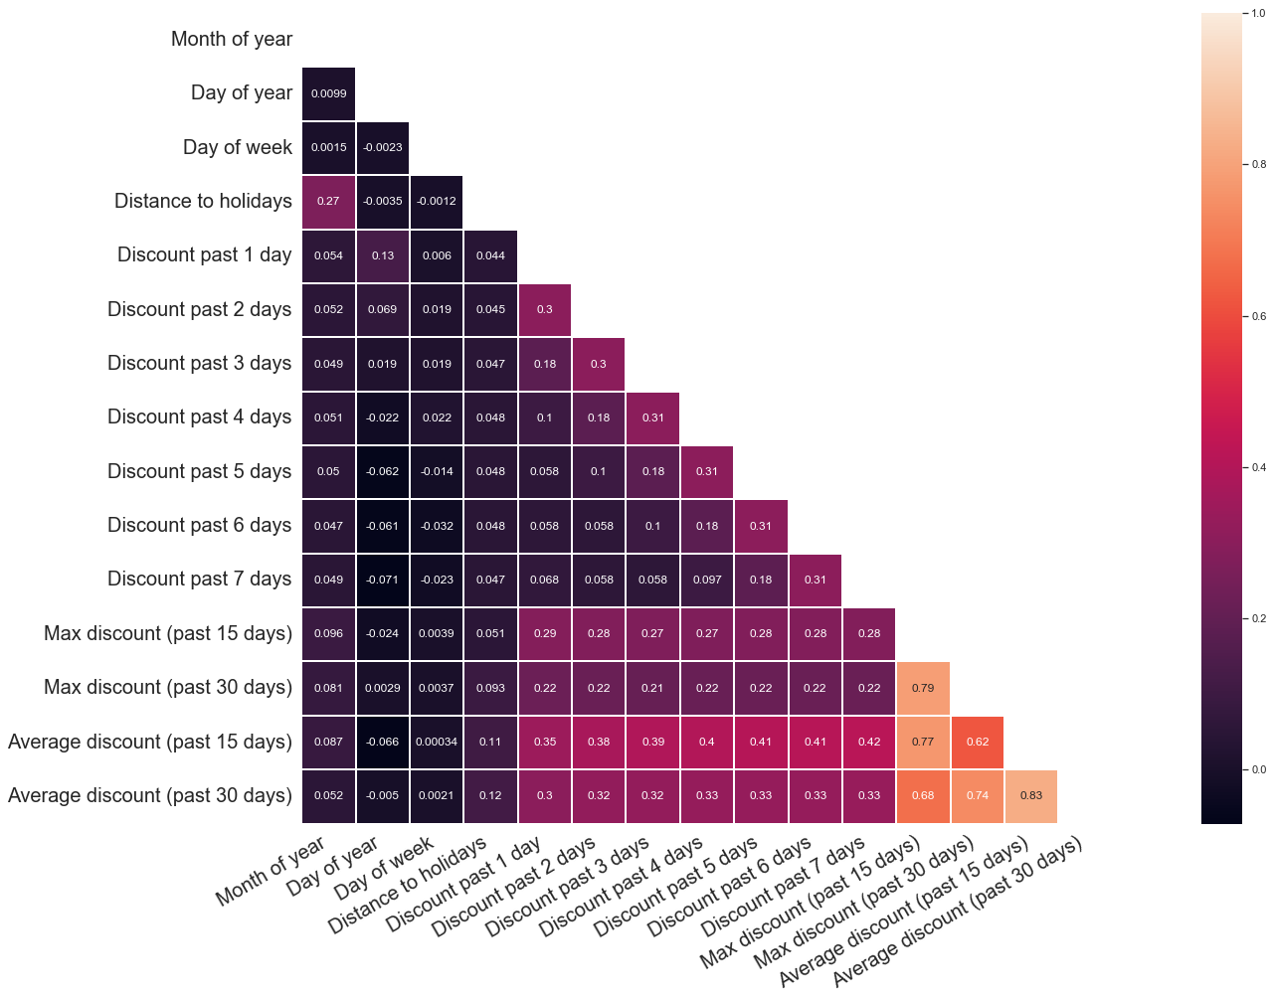
Base model
Given features:
(1). Seasonality features:
Month of year, Day of year, Day of week, Distance to major holidays, etc.
(2). Autocorrelation features:
Discount past 1 day, Discount past 2 days, Discount past 3 days...Discount past 7 days
(3). Other statistical features:
Max discount past 15 days, Average discount past 15 days, Max discount past 30 days, Average discount past 30 days, etc.
Output label: what % off will be in 7 days, …?
0-15%; 16% - 30%; 31% - 50%; 50% - 100 %
Model: Multiclass classification with logistic regression
Front-end: Streamlit, under development….
precision recall f1-score support
0 0.83 0.94 0.88 520
1 0.49 0.25 0.34 130
2 0.00 0.00 0.00 5
3 0.00 0.00 0.00 3

